Slide 1
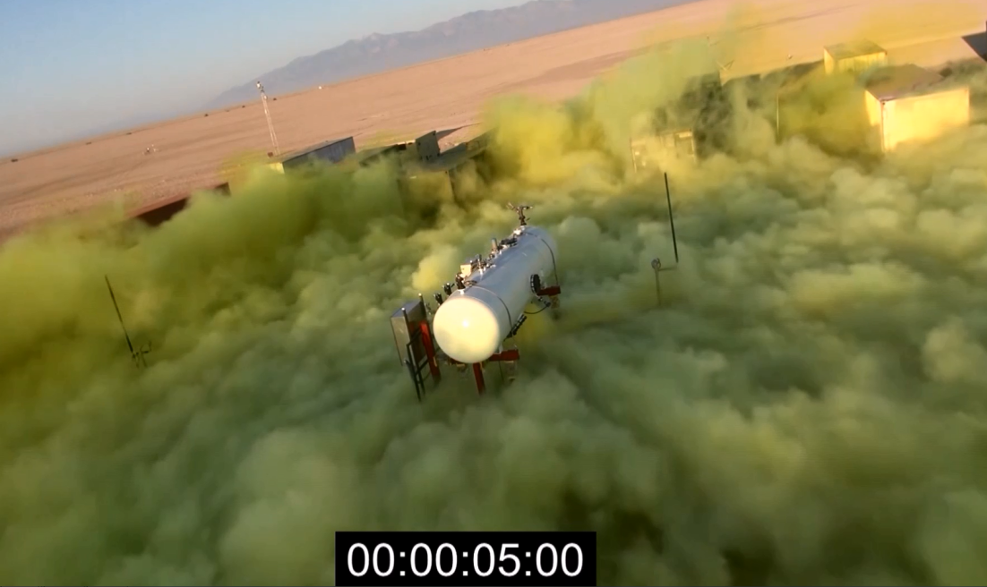
JACK RABBIT II
DTRA Reachback Modeling Progress Using 2015 Data
JUNE2016 – GMU
Dr. Steven Simpson
Mr. Sean Miner
J9 Directorate
Information and Systems Application Dept.
Technical Reachback Division
(703) 767-3445, DSN 427-
DISTRIBUTION STATEMENT A. Approved for public release; distribution is unlimited

Slide 2
Up-Front Notes
Jack Rabbit II (JRII) was a series of 5 trials at Dugway Proving Ground (DPG) in late-August/early-September 2015 where 5 – 10 tons of pressurized chlorine was released in a downward direction per trial.
A ‘conex village’ was built to simulate an urban environment around the chlorine tank. Sensors were placed within the conex village, surrounding the test pad, and in arcs in the historical downwind direction (15 degrees west of north).
Current HPAC JRII model (blowdown model using directed jets) does not allow incorporation of UDM analysis and therefore cannot simulate the urban area.
In HPAC most sensors received chlorine mass close-in, so initial emphasis was to get downwind sensor hits correct spatially and temporally (if possible).
  ToxiRAE (11km and 5km arcs @ 1ft AGL) were mainly used
  MiniRAE (2km and 1km arcs at 1ft AGL) were used sparingly
MiniRAE data subject to calibration drift over time, so actual readings are less reliable, but positioning is still useful for plume analysis (spatial and temporal).
  MiniRAE drift has not been corrected in the final data set but errors can be bounded.

Slide 3
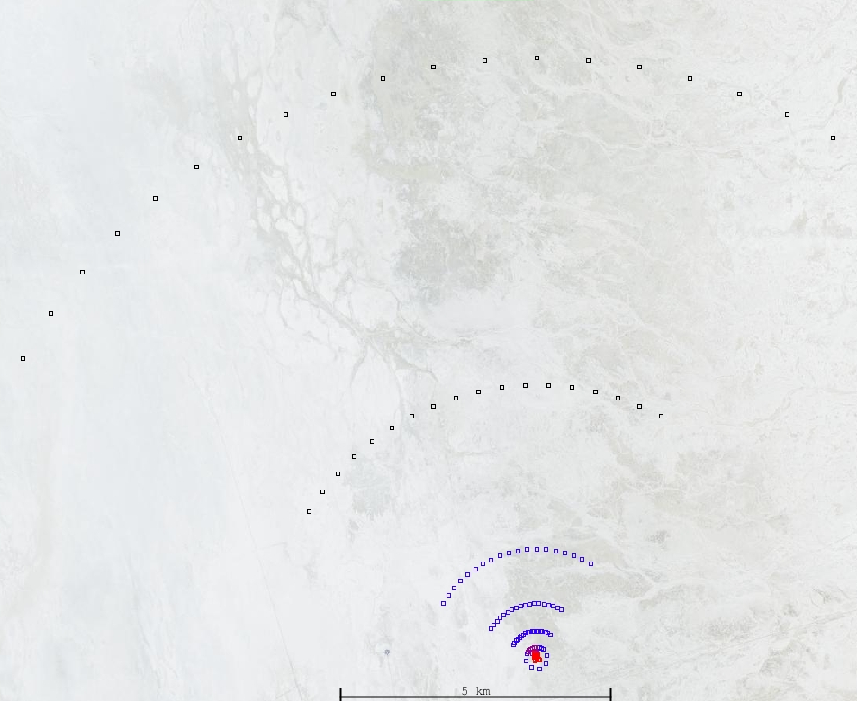
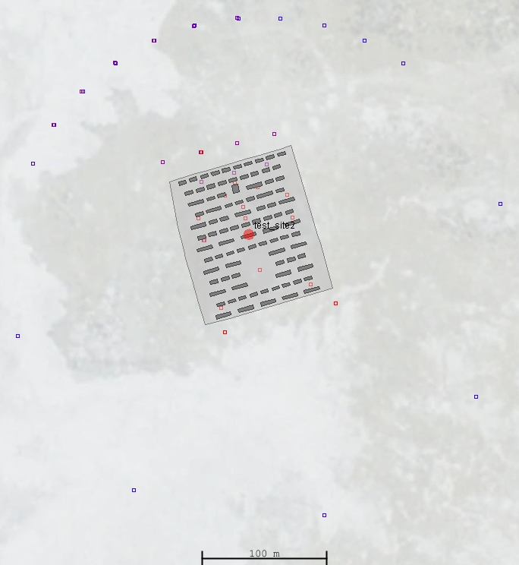
Jack Rabbit II Testbed Layout
N
11 km
ToxiRAE – Black Squares
MiniRAE – Blue Squares
Canary – Purple Squares
JAZ – Red Squares
5 km
2 km
1 km
200 m
500 m

Slide 4
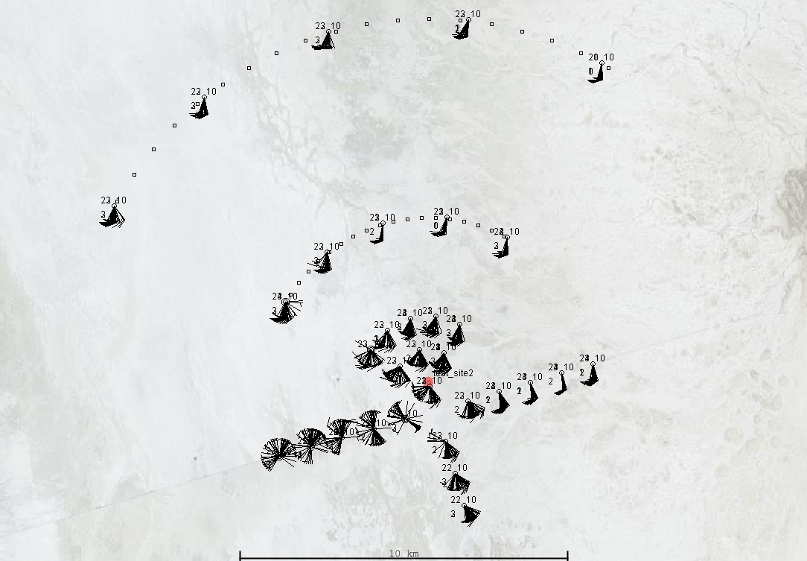
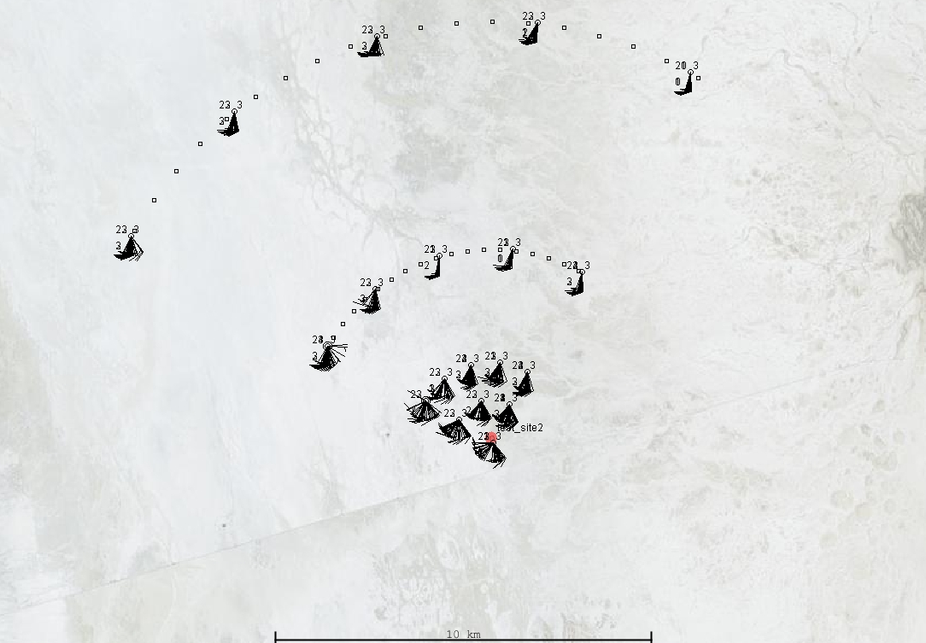
PWIDS Stations for Trial 5 (03SEP2015)
All reporting PWIDS stations at 1300 – 1400Z
(“ALL PWIDS”); 0.3 meters AGL
N
Orange triangles indicate 32m tower stations with sensors at 2, 4, 8, 16, and 32 meters AGL
Removal of PWIDS stations 20 – 34
at 1300 – 1400Z (“Wedge” or “V” PWIDS);
0.3 meters AGL

Slide 5
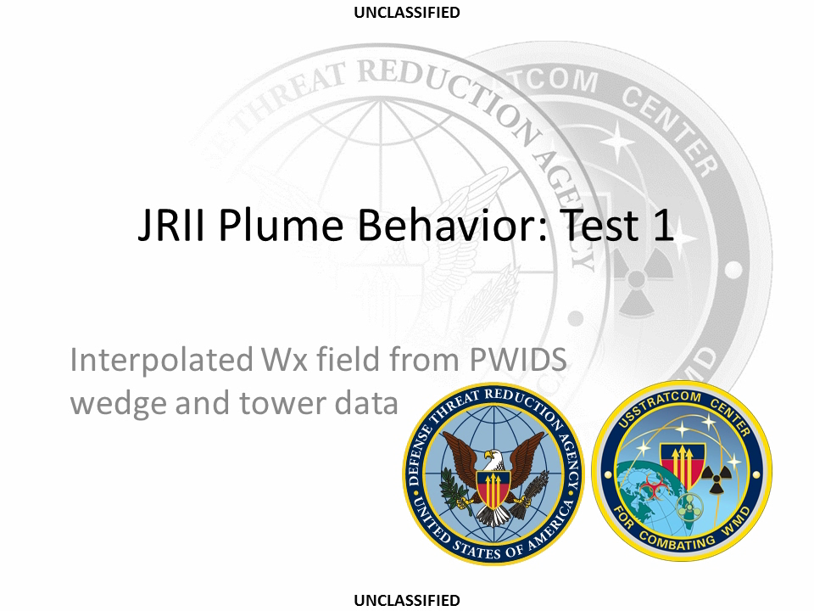

Slide 6


Slide 7


Slide 8


Slide 9


Slide 10
Concentration Data Comparison Between HPAC and Sensors
ToxiRAE at 5km and 11km

Slide 11
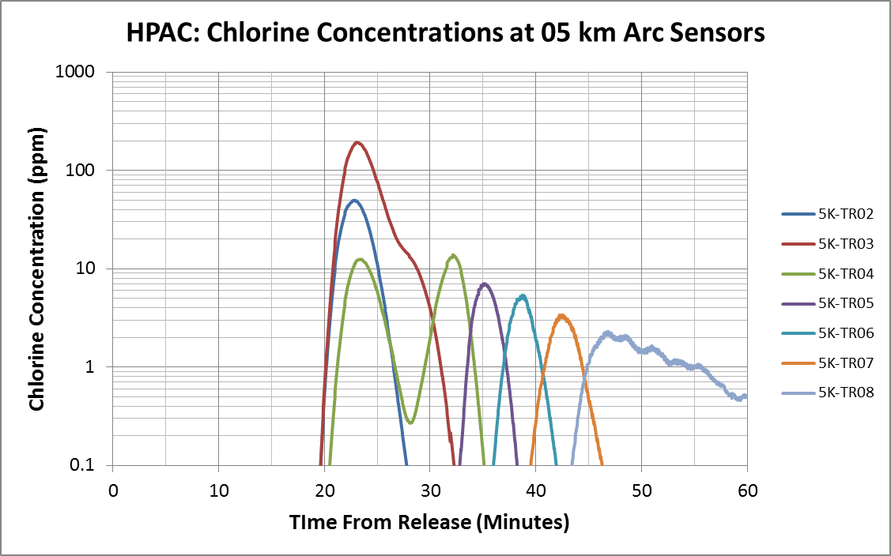
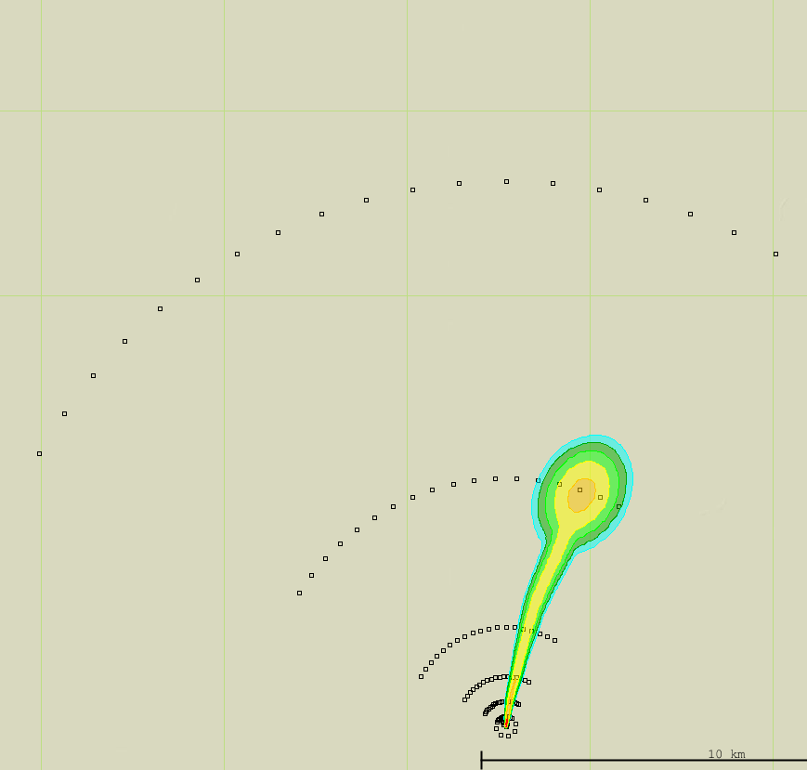
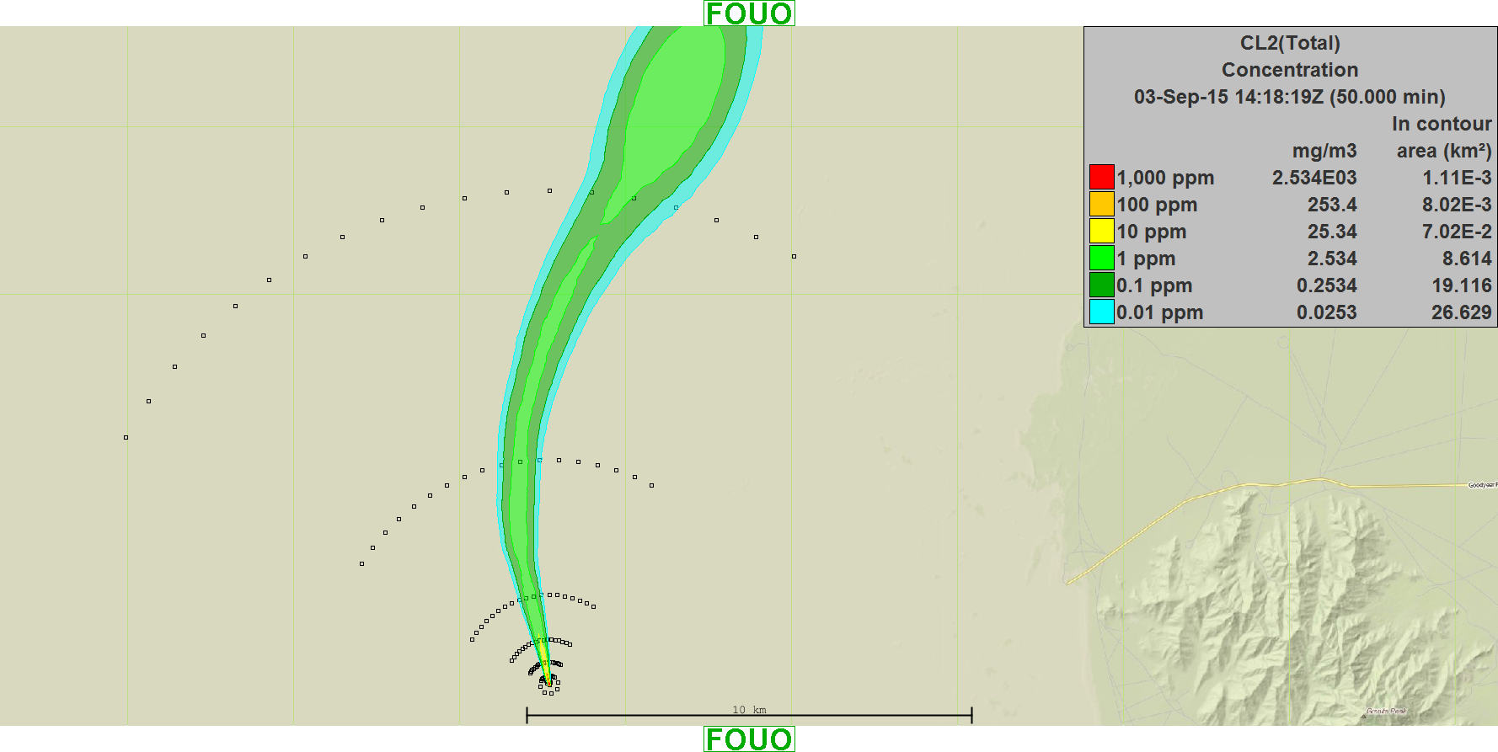
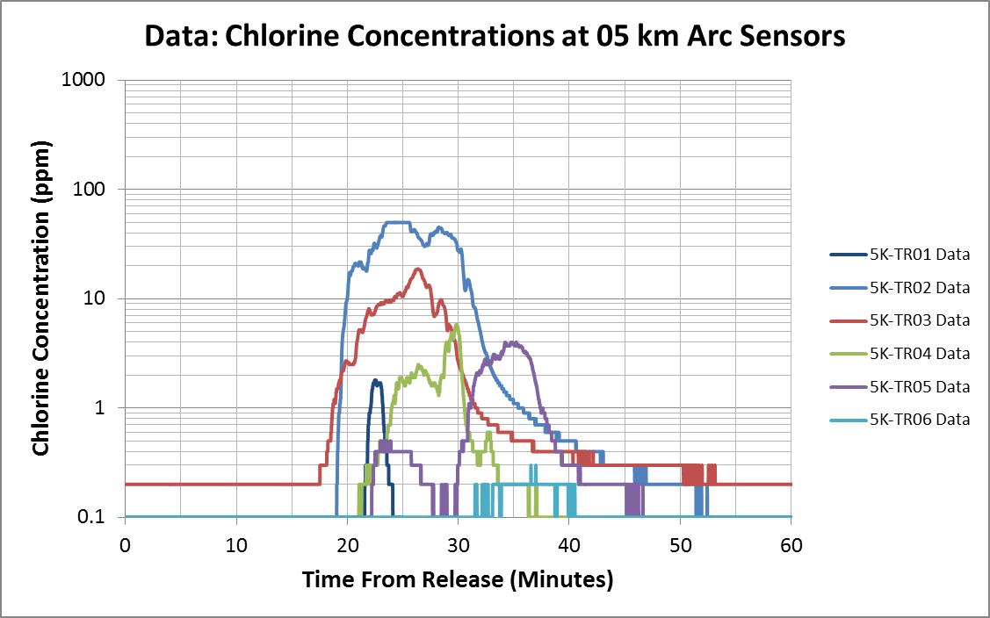
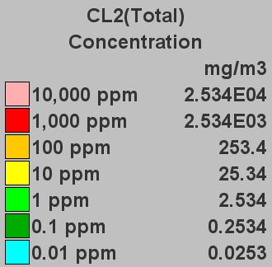
Trial 5: ToxiRAE at 05 km Arc
50min
N
Wind blows plume across sensors
23min
Sensor Max (49.9 ppm)

Slide 12
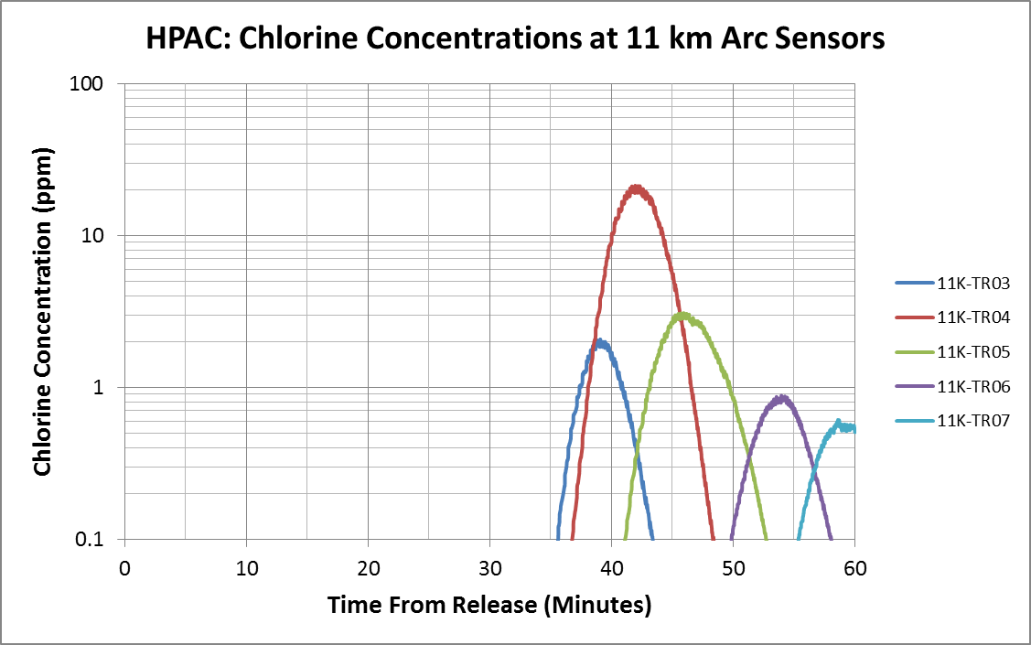
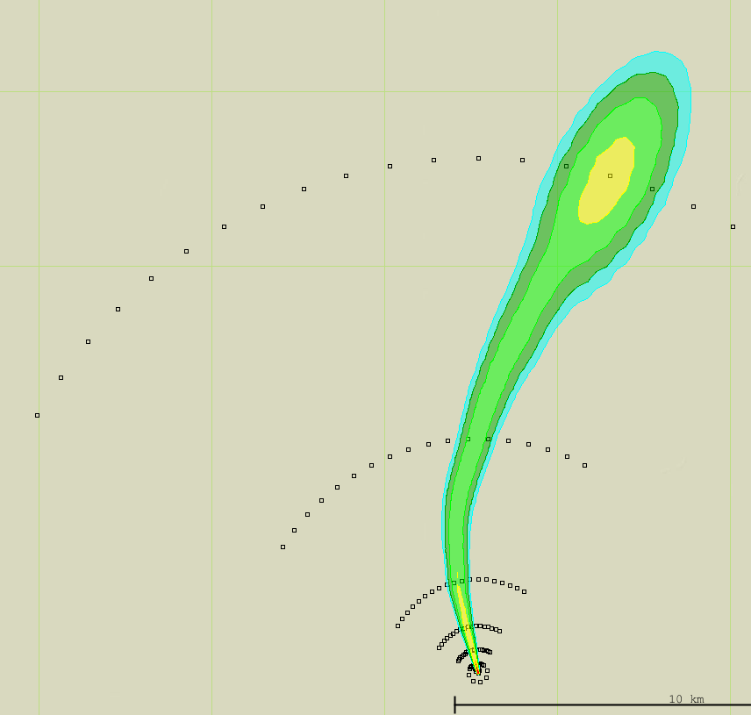
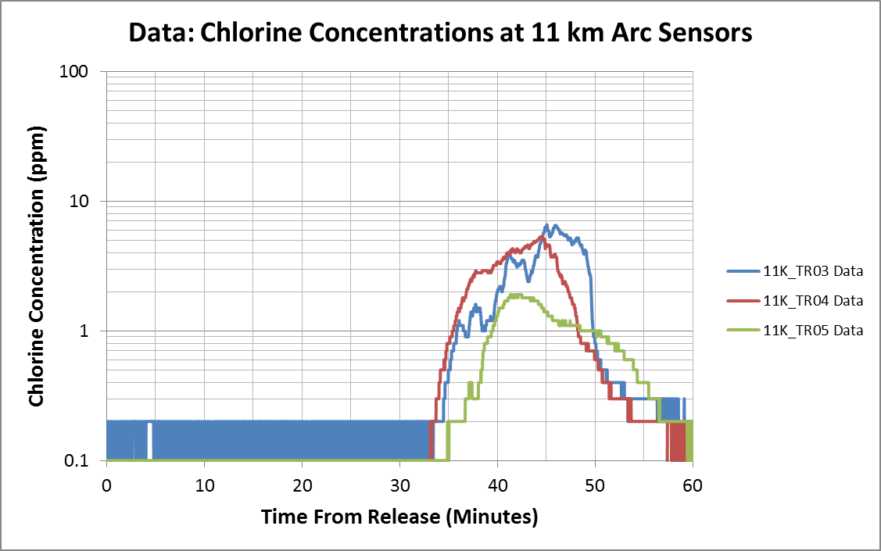
Trial 5: ToxiRAE at 11 km Arc
N
42min

Slide 13
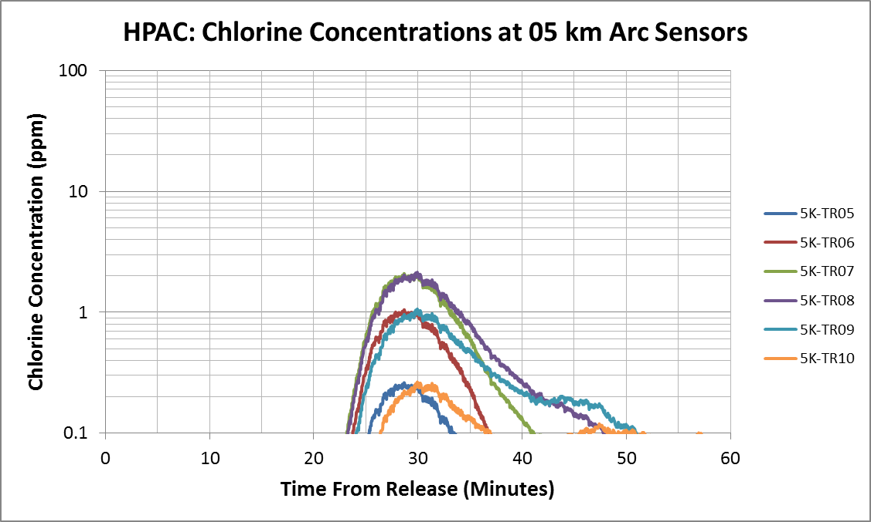
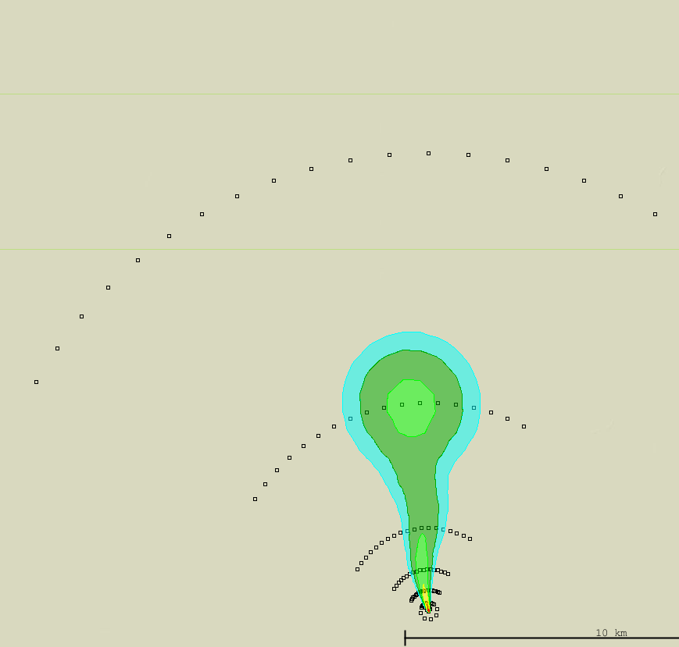
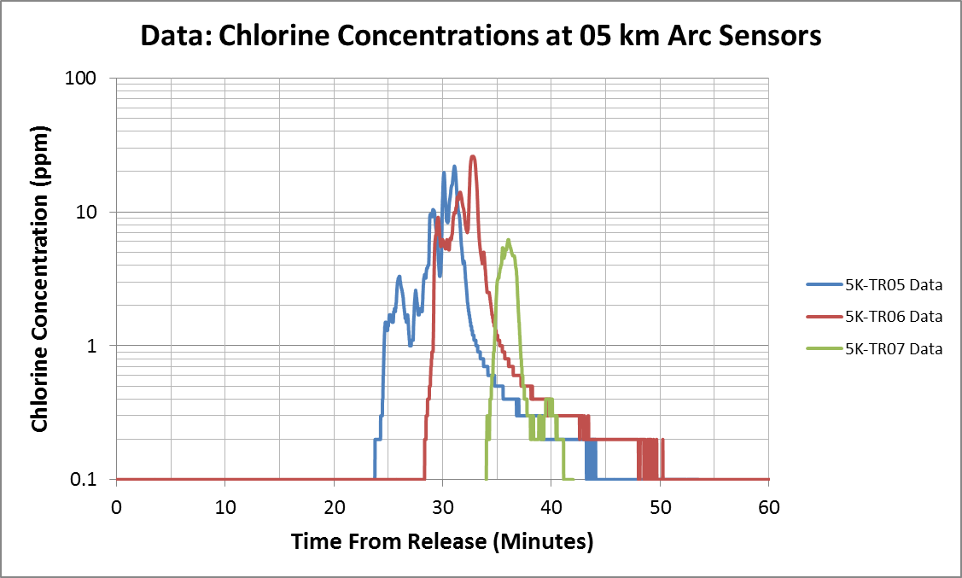
Trial 4: ToxiRAE at 05 km Arc
N
Data shows a much denser and narrower plume
29min

Slide 14
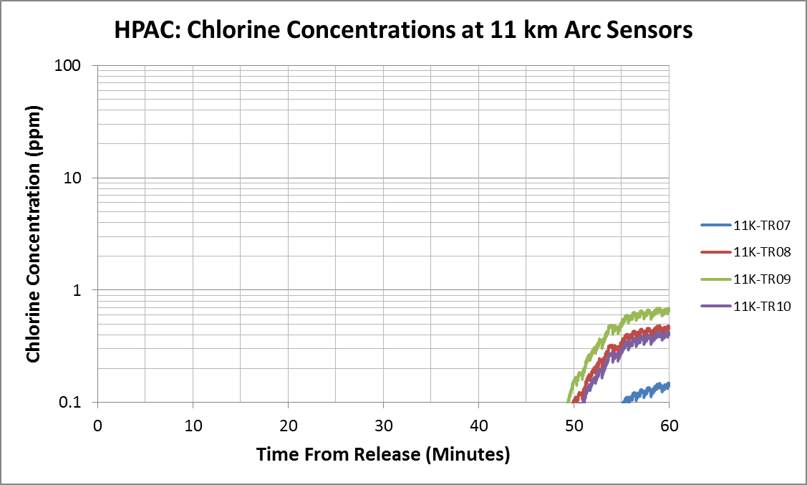
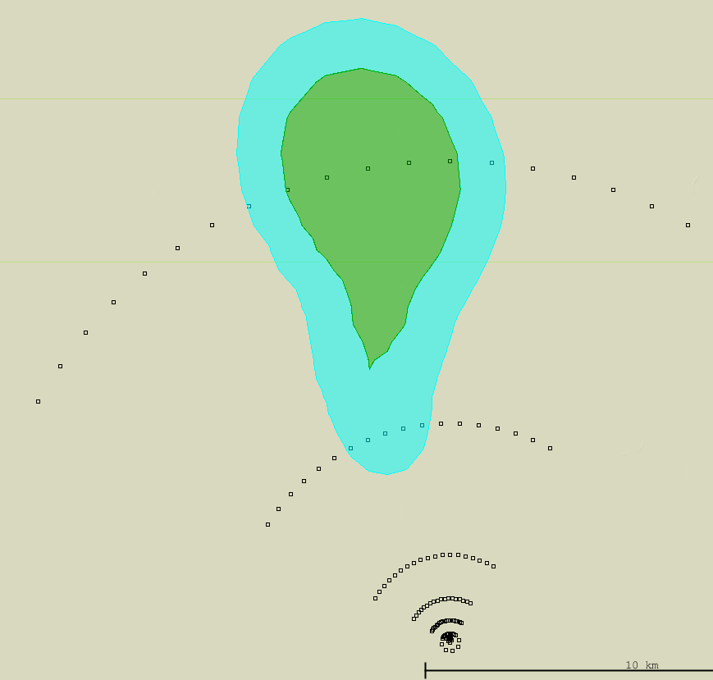
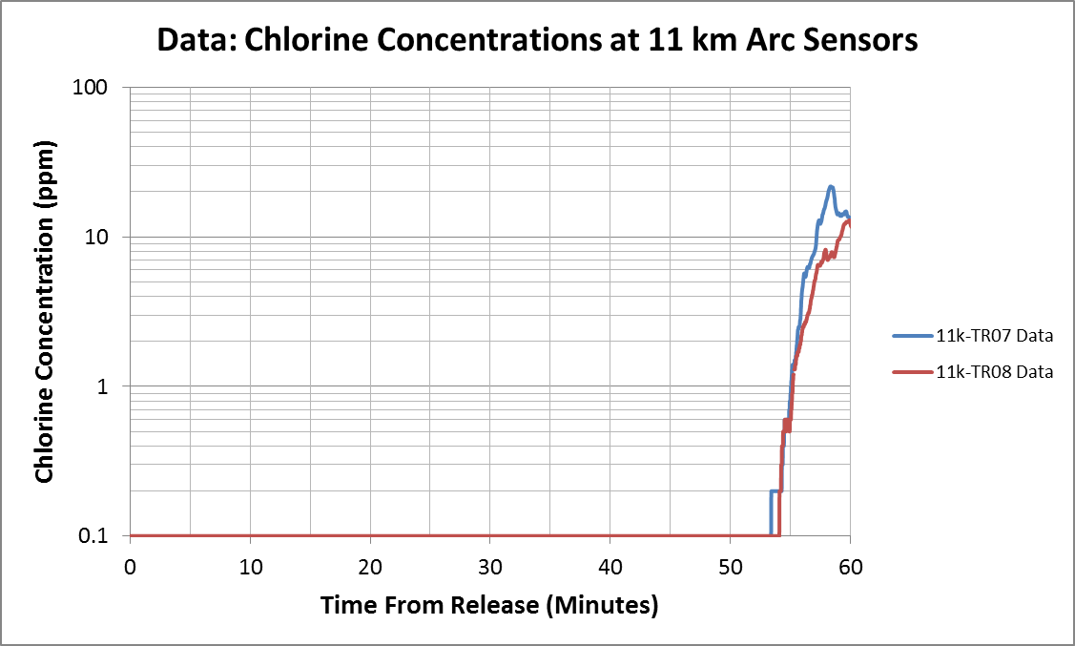
Trial 4: ToxiRAE at 11 km Arc
N
60min
Data shows a much denser and narrower plume

Slide 15
Conclusions
Using high temporal resolution PWIDS coupled with tower data allows us to better represent the test wind field.
Executing model runs with .sfc and .prf Wx data and generating/ingesting .mcw files is useful to capture interpolated wind field for obs files.
MCSCIPUFF may be performing some erroneous calculations when running mass-consistency; need to investigate further!
Current HPAC models of JRII 2015 are progressing, but still need to work with test sensor data to better understand model accuracy.
We can better understand downwind plume geometry from comparing HPAC and sensor data per trial.

Slide 16
Future Work
Investigate MCSCIPUFF behavior.
Look at boundary layer heights for releases more closely.
Process all sensor data for all trials with current HPAC method.
  ToxiRAE, MiniRAE, Canary, JAZ, and UV Sentry Data
Investigate affect of pool size/mass on downfield concentration (less pool mass = more plume mass); impact on Cl₂ concentration readings and spatial/temporal overlap?
Move to UDM enabled model (iTrans or evolution of directed jet usability?) and compare outputs.
Consider operational adjustments to RFIs due to release cooling in area, speed of release, observed liquid/aerosol/vapor ratios, and Wx temporal resolution. This will improve our real-world response capability in DTRA Reachback.

Slide 17
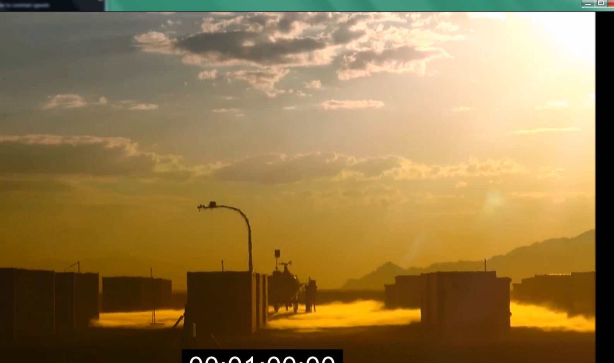
FIN

