Slide 1
Joint Urban 2003
Preliminary Urban Dispersion Model Results
Sean Miner
Thomas Mazzola
John Magerko
DISTRIBUTION STATEMENT A. Approved for public release; distribution is unlimited

Slide 2
Outline
Overview of UDM
Overview of JU2003 release parameters
Description of comparison metrics
Results from Intensive Operation periods (IOP) 3 and 9 at a single sampler
Building wake effects on concentration
Comparison of all IOP releases including max concentration, retention time and cloud speed
Summary and conclusions

Slide 3

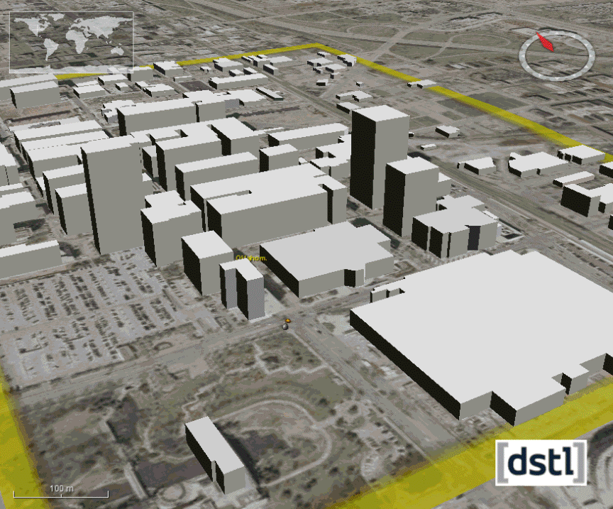
UDM History
Developed to meet UK MOD requirement for rapid urban dispersion modelling capability for:
  Research and planning;
  Integration into operational systems.
  Couples open terrain dispersion model with:
    Relationships derived from wind tunnel array experiments;
    Urban building data provided by the Geographic and Environmental Data Information System (GEDIS) database.
UDM wind tunnel experiment
GEDIS building data
Slide courtesy of Steven Herring

Slide 4
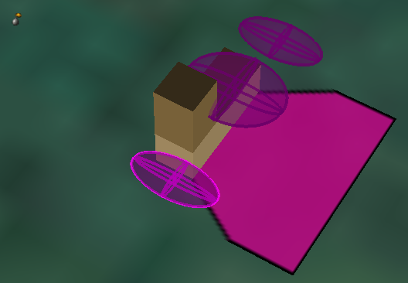
UDM Implementation
Models enhanced urban dispersion when obstacle density >5%.
Models channelling due to street alignment.
Models interaction with single buildings when:
  Obstacle density ≤5%;
  A large building exists within the urban array.
Building interactions result in puff splitting.
Urban dispersion with channelling
Puffs created by splitting around lower structure
Wake
Puff interaction with multi-part building
Slide courtesy of Steven Herring

Slide 5
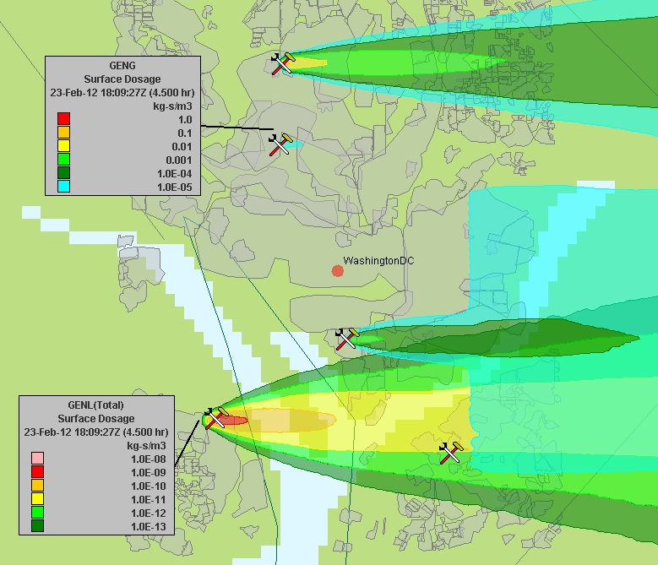
Integration with HPAC/SCIPUFF
Sources always offered to urban first.
UDM allows multiple sources;
continuous, instantaneous, stack, pool and moving are shown.
UDM models dispersion until puffs become large compared to buildings (1-2 km).
UDM returns puffs to SCIPUFF as they become large.
Output for test with 5 different source types
Slide courtesy of Steven Herring
Notes:
Grey patches are the urban area polygons – the polygons are the result of the morphological pre-processing which defines areas of buildings with similar characteristics.
The morphological data associated with these is then used by UDM when it executes.
The five releases shown are:
Continuous (Generic Gas, 30 min duration, 1 kg·s⁻¹)
Instantaneous (Generic Gas, 1 kg)
Stack (Generic Gas, 30 min duration, 0.1 kg·s⁻¹)
Liquid Pool (Generic Liquid, 10 kg), (note change of legend levels)
Moving (Generic Gas, 30 s duration, 10 kg·s⁻¹, 700 km·h⁻¹ in Y-direction), creating apparent line source in light blue

Slide 6
Comparison Metrics
Dt_{a} = time from first recording of 0.1*C_{max} until maximum concentration
Dt_{d} = time from maximum concentration until last recording of 0.1*C_{max}
Retention time = Dt_{a} + Dt_{d}
Cloud speed defined as distance from release location to sensor over time until maximum concentration
Fractional bias and normalized mean square error are computed for maximum concentration values

Slide 7
Comparison Metrics
Retention time = Dt_{a} + Dt_{d}
max_conc
0.1*max_conc
Dt_{a}
Dt_{d}

Slide 8
JU2003 Release Specifications
Releases were modeled as an instantaneous release at 2m
AGL with an initial puff diameter of 2m
PWIDS observations, consisting of wind speed and direction,
temperature and humidity taken at the post office were used
PWIDS data was taken 40m AGL on post office roof,
approximately 1km south of release points
For each release the Urban Dispersion Model (UDM) was
activated to account for building effects on transport and
dispersion

Slide 9
IOP3 and IOP9 Comparison
IOP3 Release 1 and IOP9 Release 1 are compared to observations
IOP3 is a morning release at 0800 local and 50m from
nearest building
IOP9 is an early morning release at 0400 local and
immediately adjacent to the north side of a large building
Winds for IOP3 are from the south at 5-10 kts
Winds for IOP9 are from the southeast at 5-10 kts

Slide 10
Release Points
IOP 9
IOP 3

Slide 11
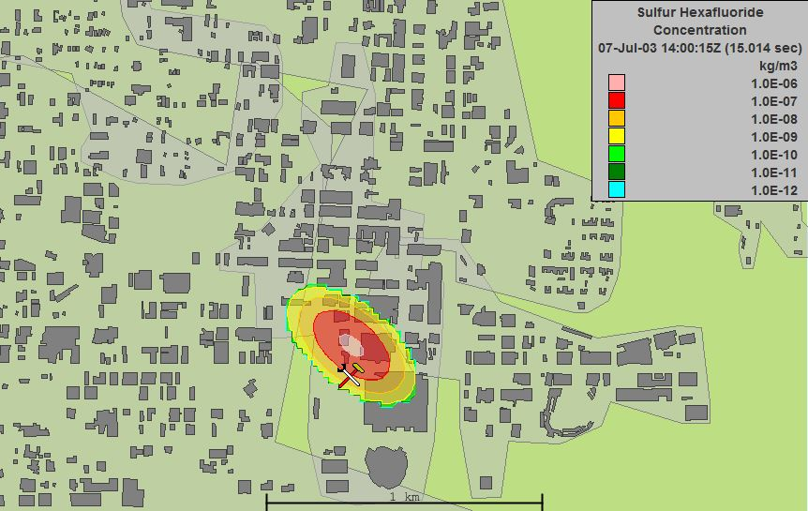
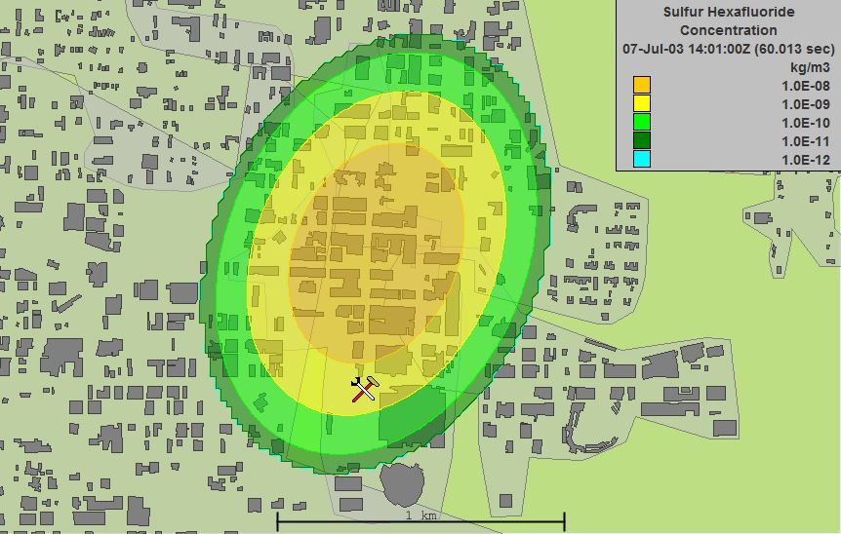
IOP3 Release 1: Surface Concentration
15s
Sampler location
Release is approximately 50m
from the nearest building
Surface concentration at 15 and
60s after release
Concentration values initialize as
an elliptical formation, elongating
in a NE/SW orientation with time
in response to wind field
60s

Slide 12
IOP3 UDM vs Observed Concentration
Predicted SF₆ first detected at
sampler zero 29s after
release, observed SF₆ first
detected 96s after release
Predicted max concentration
occurs 39s after release,
observed max occurs 115s
after release
Predicted retention time is 79s
while observed retention time is
315s

Slide 13
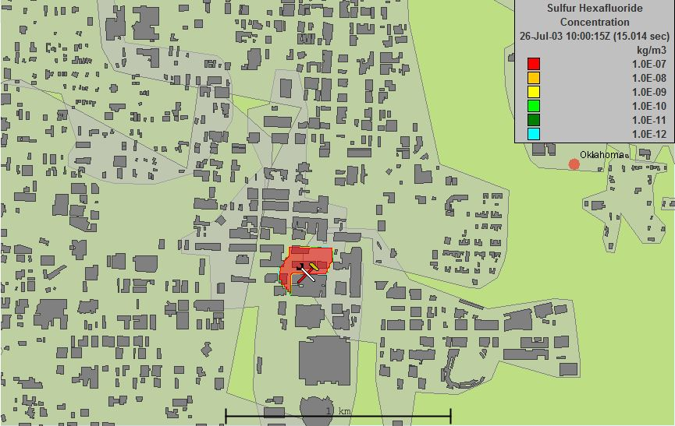
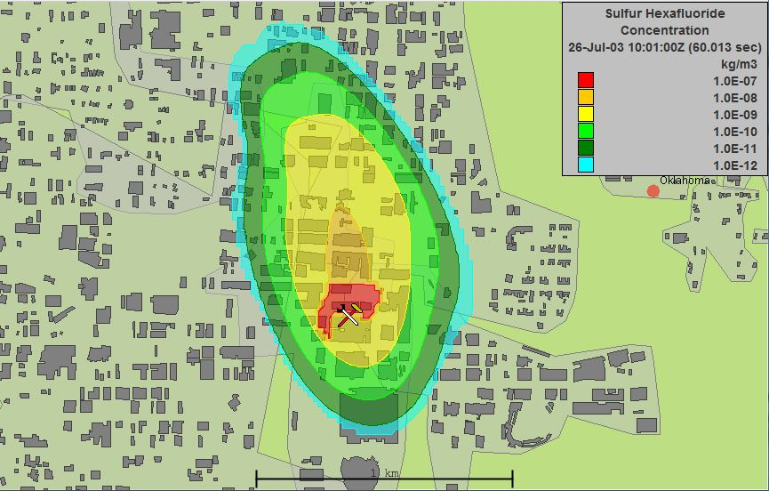
IOP9 Release 1: Surface Concentration
Release is immediately adjacent to a
building
Release immediately fills a static wake
region defined by adjacent building
Detrainment from the wake begins
after 15 sec, with puffs periodically
released until the wake is emptied
after 4min 30s
15s
60s

Slide 14
IOP9 UDM vs Observed Concentration
Predicted SF₆ detected 16s
after release, observed SF₆
detected 126s after release
- Pronounced sawtooth pattern
observed with a 15s period
This pattern corresponds to
release of puffs from wake
region every 15s

Slide 15
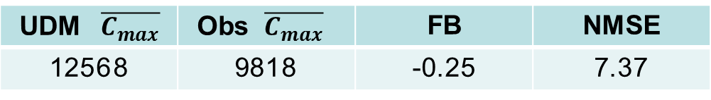
Observed vs UDM Max Concentration
UDM predicted max concentration typically within factor of 2-5 of observed max concentration
Observed max concentration greater than UDM max concentration for 64% of releases
UDM $\overline{C_{max}}$ | Obs $\overline{C_{max}}$ | FB | NMSE
12568 | 9818 | -0.25 | 7.37

Slide 16
Observed vs UDM Cloud Speed
UDM cloud speed consistently higher than observed cloud
speed

Slide 17
UDM/Observed Cloud Speed
The ratio of UDM/Observed cloud speed decreases with distance from release
point.
Observed cloud speed increased with distance from release point while UDM
cloud speed does not

Slide 18
Cloud Speed vs Distance
- Cloud speed increases with distance from release point for
the observed cloud while little pronounced trend is observed
with the predicted cloud speed.
*max y-axis values are different

Slide 19
Observed vs UDM Retention Time
Observed retention time greater than UDM retention time for
63% of releases.

Slide 20
Results Summary
Predicted max concentrations were typically within a factor of 2-5 of observed maximum concentrations
Predicted retention times were 1/2 to 1/3 observed retention times
Computed puff speed for UDM was a factor of 4-6 greater than observed puff speed within 400m of release point decreasing to a factor of 2-4 after 400m
Observed puff speed increased with distance while UDM puff speed shows little trend with distance
Wake effects result in sawtooth concentration plots as material is released from wake at regular intervals.

