Slide 1
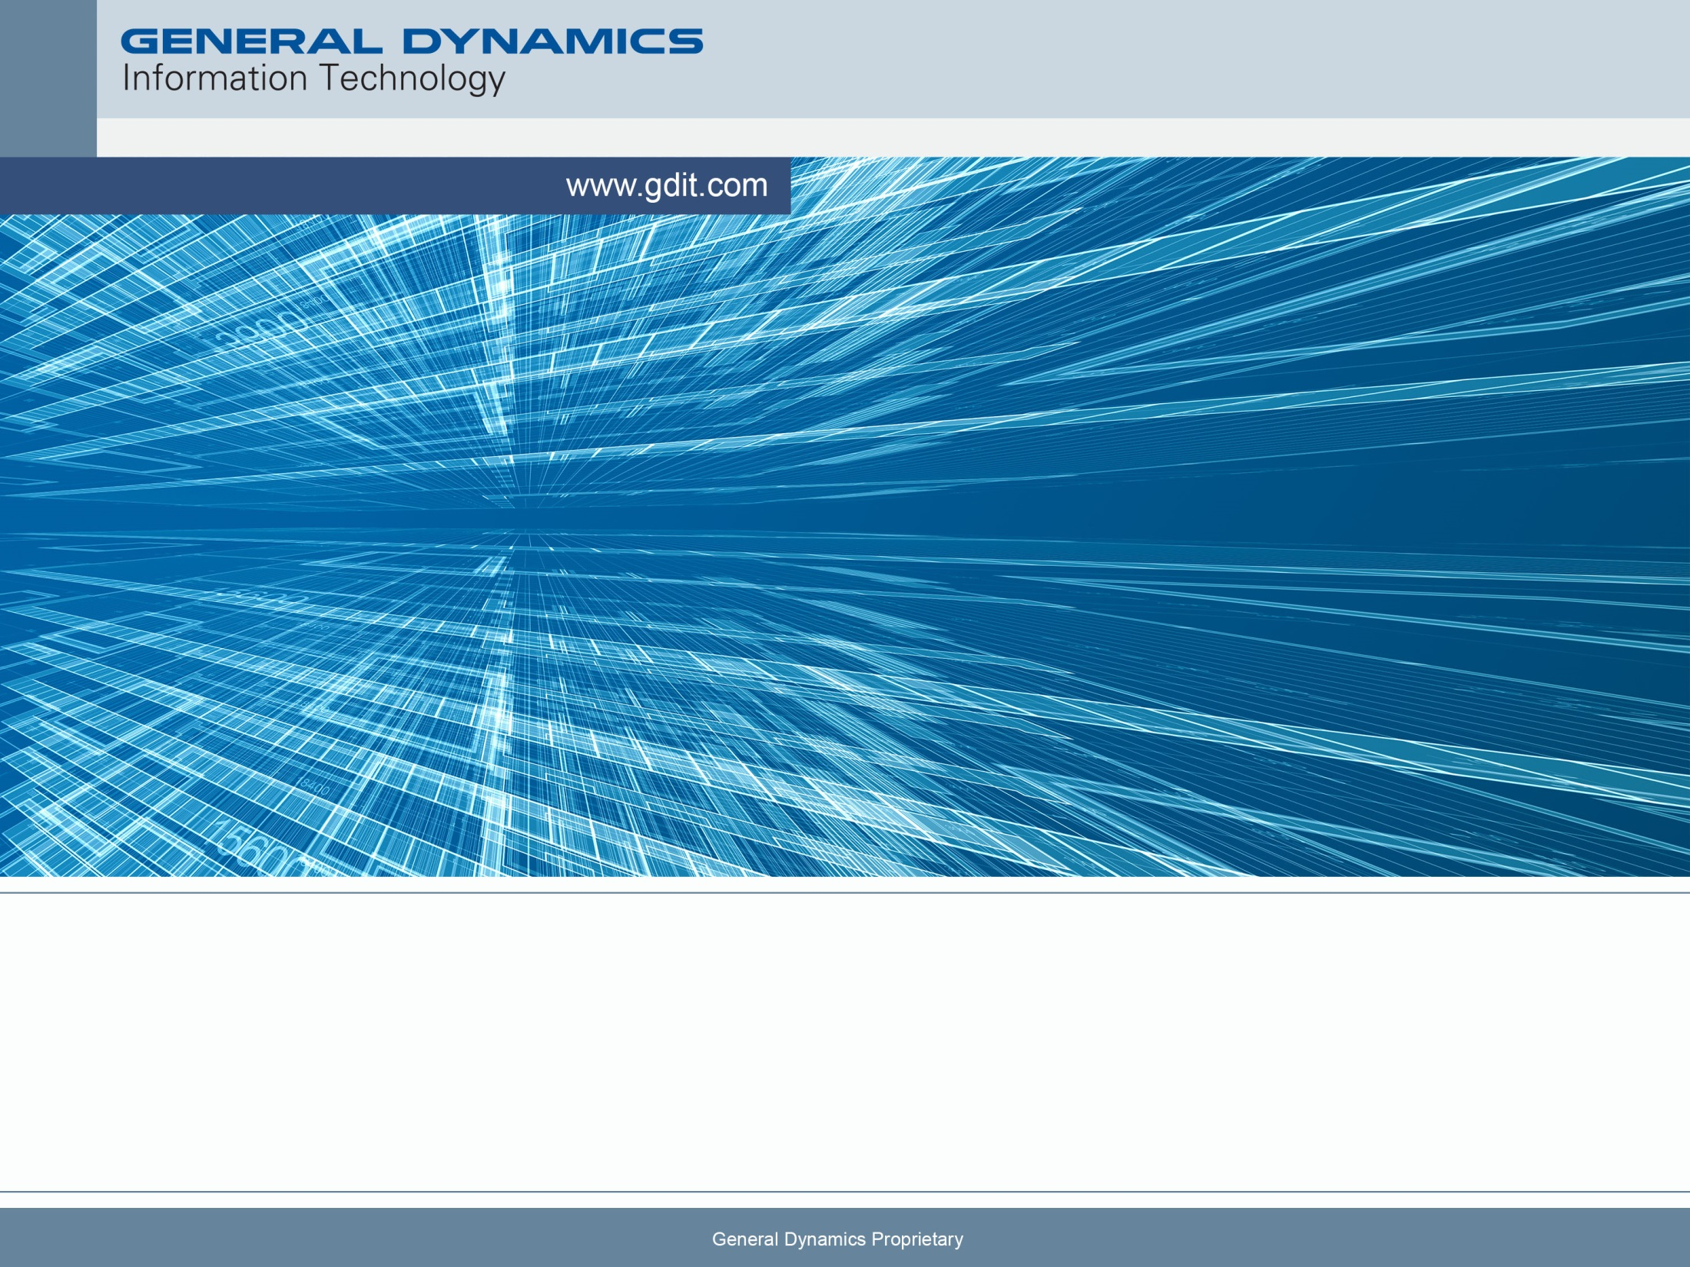
Joint Effects Model (JEM) 2.0 Uses CCMI Standards for Rapid S&T Integration into Operational Environments
Mark Brosnan ¹, Michael Rocheleau¹, George Bieberbach², Jonathan Hurst², Phil Wingfield³, Martyn Bull³, Matthew Ward⁴, Thomas Smith⁵, Eric Rial⁵, Sami Rishmawi⁵, and Russ Brown⁶
June 14-16, 2016

Slide 2
Joint Effects Model Increment 2.0
The Accredited and Operationally Tested Tool to Model The Effects of Chemical, Biological, Radiological, and Nuclear (CBRN) Weapon Strikes and Incidents
  Received Limited Fielding Decision for the National Guard Bureau (NGB) in April 2016, Full fielding: NGB, and Air Force expected Summer 2016.
  Has an Authorization to Operate (ATO)
  Will be the replacement for JEM Increment 1.0
Combines CBRN Science and Technology Models from 4 legacy baselines
Scalable Architecture: Deploy to forward staged DIL Workstations and cloud Servers

Slide 3
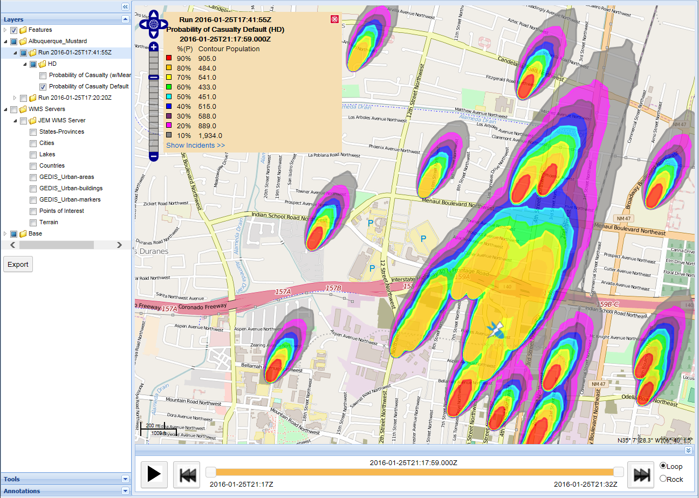
JEM 2.0 Hazard Areas and Human Effects
View and Animate Hazard Area Layers in 4 dimensions; 2D on the map at chosen altitude, vertical slices; animate over time
Select Which Measure(s) to View, e.g. Concentration, Probability of Casualty, etc.
See the Number Of Affected People In Each Level of Hazard

Slide 4
JEM CCMI Components, by referents
Munitions
Explosive Warhead
Agent Material
OG
Key
CATT
Munitions
Explosive Warhead
Agent Material
Output Generator
VLS Drive
HPAC v168
JEM
Incr 1
Incident Source Models
T&D Ctl
Effects Collator
JEM
2.0
NTwpn
Nuclear Weapon
MInt
CBWS (VLS)
CSWI
CBFS
HAR
Nuclear Facility
Rad Weapon
Analytic Incident
SIR
T&D Cntrlr
Eff Coll
Met MC
Met-P
Rad Act
T&D
Effects
Population
SWIFT
SWIM
RTH
SCIPUFF
UDM
FxCODA
GEDIS-P
Met Sources
Land Use
Land Prop
Terrain
Urban
Secondary Evap
Hist
MDS
AFWA
METGM
Land Use
Land Prop
Terrain
Urban
Secondary Evap

Slide 5
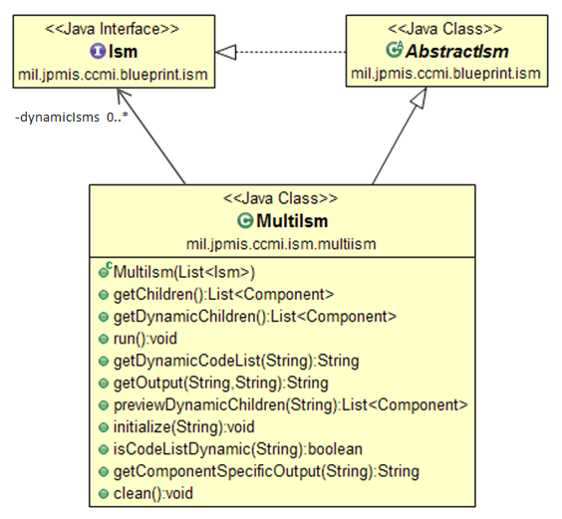
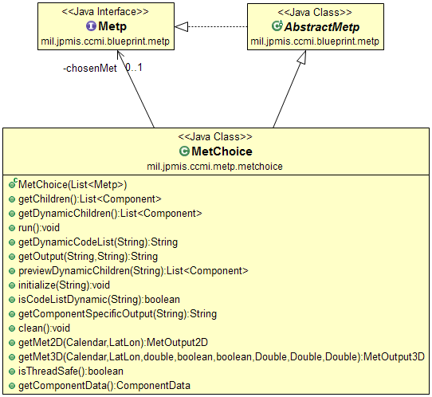
CCMI Updates for a scalable web application
Increase CCMI blueprint flexibility to reduce the risk of insertion of new components into the framework
  Allow users to run multiple components of the same type (multi-ism)
  Allow users to choose between components of the same type at run time (MetChoice)
  Allow JEM 2.0 to run models concurrently to improve runtime performance (CCMI-IsRunConcurrent)
MultiIsm
MetChoice

Slide 6
Example Scenario Wiring
Static Wiring*
Runtime Wiring* showing Dynamic Children
OG
OG
T&D
T&D
ISM A
ISM A
Met A
MultiIsm
ISM B
MetChoice
MultiIsm
ISM A
MetChoice
Met A
Met B
  CCMI-HasDynamicChildren
ISM C
  CCMI-HasDynamicChildren
ISM B
  Run in parallel
  CCMI-IsRunConcurrent
* Not all components shown

Slide 7
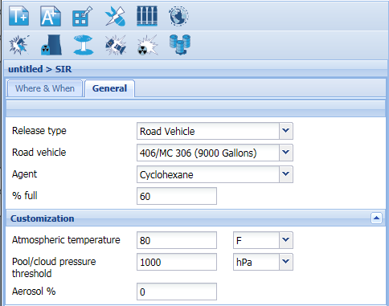
Quick integration of a new ISM
JEM users need an easy way to efficiently model TIC/TIM releases so JPM IS created a new ISM called Simple Incident Release (SIR)
SIR was developed using the CCMI ISM blueprint and delivered with CATT test cases.
This greatly simplified integration and testing within JEM 2.0
The GDIT team was able to fully integrate SIR into JEM 2.0 in < 4 weeks

Slide 8
Future Work; Integrate Updated / New Models
ISMs that have been updated such as MINT, RDWD, NWI, etc.
New Interior Building Hazard (IBH) as an ISM and using a new blueprint for interior T&D models
New Shelter Stay Time component
New Source Term Estimation components and blueprint changes

Slide 9
Testing highlights
Use the CCMI Automated Test Tool (CATT) to run over 800 component tests
  Test components without the entire system
  Provides visibility and logging of all data flows between components
  Helps quickly identify regression test issues
  Helps diagnose component behavior
Run over 3000 regression and V&V tests
Verification Validation and Accreditation is in the final stages with preliminary results looking good. Future work will maintain chain of accreditation.

Slide 10
Authors’ Contact information
¹General Dynamics Information Technology One Corporate Place Middletown, RI 02842 (401) 845-3656 | ²Aeris LLC 1314 Main Street Louisville, CO 80027 (720) 370-9012
³Riskaware Colston Tower, Colston St City of Bristol BS1 5AQ, UK +44 (0) 117 929 1058 | ⁴Maritime Planning Associates (401) 263-7227 12 Sherman Street Newport, RI 02840
⁵Joint Project Manager Information Systems (JPM IS) Joint Program Executive Office for Chemical Biological Defense (JPEO-CBD) | ⁶Naval Surface Warfare Center, Dahlgren Division, Code B24 4045 Higley Rd, Suite 344 Dahlgren, VA 22448

