Slide 1


JECP SPM
SKUI Model Development
20th Annual George Mason University Conference on Atmospheric Transport and Dispersion Modeling
14-16 June 2016
Harold K. Barnette III
Engineer
UNCLASSIFIED – NSWCDD-PN-16-00224 – Approved for Public Release
Distribution Statement A; Distribution is unlimited
Notes:
DISTRIBUTION A: Approved for public release; distribution unlimited.
DISTRIBUTION B: Distribution authorized to U.S. Government agencies; reason (month year). Other requests for this document shall be referred to the name of controlling office.
DISTRIBUTION C: Distribution authorized to U.S. Government agencies and their contractors; reason (month year). Other requests for this document shall be referred to the name of controlling office.
DISTRIBUTION D: Distribution authorized to Department of Defense (DoD) and U.S. DoD contractors only; reason (month year). Other requests for this document shall be referred to the name of controlling office.
DISTRIBUTION E: Distribution authorized to Department of Defense Components only; reason (month year). Other requests for this document shall be referred to the name of controlling office.
DISTRIBUTION F: Further dissemination only as directed by the name of controlling office (month year) or higher DoD authority.
REASONS:
Administrative or operational use (B, C, D, E)
Contractor performance evaluation (B, E)
Critical technology (B, C, D, E)
Direct military support (E)
Export controlled (B, C, D, E)
Foreign government information (B, C, D, E)
Operations security (B, E)
Premature dissemination (B, E)
Proprietary information (B, E)
Test and evaluation (B, E)
Software documentation (B, C, D, E)
Specific authority (B, C, D, E)
Vulnerability information (B, C, D, E)

Slide 2
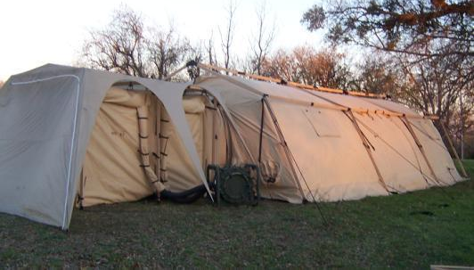
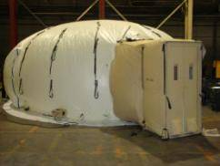
Background
What is JECP?
  JECP = Joint Expeditionary Collective Protection
  A family of shelter systems developed to protect Joint Expeditionary Forces and their assets through a versatile and transportable COLPRO capability
  ACAT III program of record (POR)
JECP Standalone Large Shelter with MPE airlock
JECP Structure Kit Improved (SKI) Shelter with SPE airlock

Slide 3
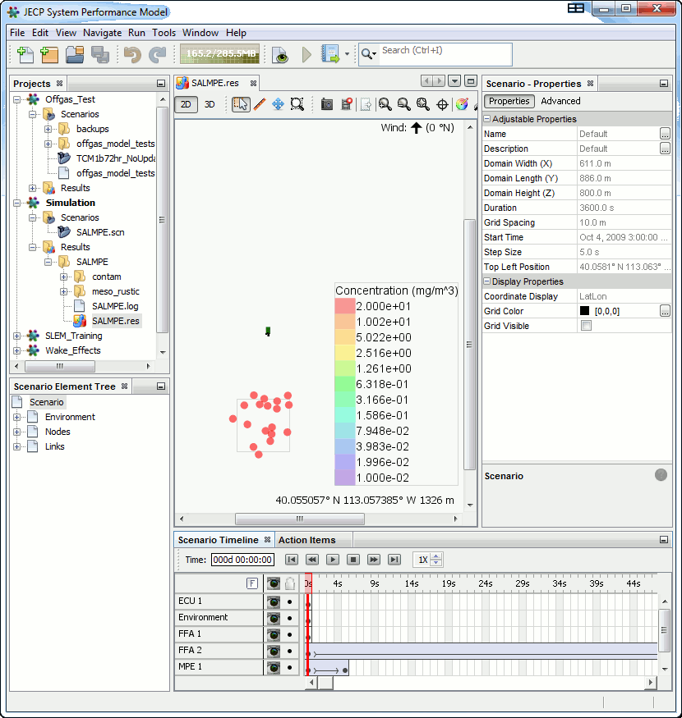
Background
What is the JECP SPM?
  SPM = System Performance Model
  A software product sponsored by DTRA and developed by NSWC Dahlgren and other partners to model the Collective Protection (COLPRO) performance of JECP shelters (JECP KPP-1)
  Designed to supplement JECP testing with simulations
  Accredited by the JECP Product Manager for JECP Phase 1 shelters.
JECP SPM GUI – 2D view
The JECP SPM is a software product designed to model COLPRO performance of the JECP shelters for the purpose of supplementing JECP T&E efforts.

Slide 4
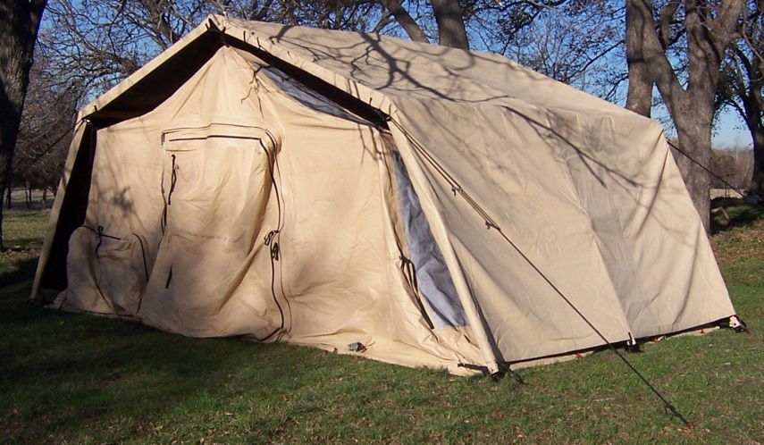
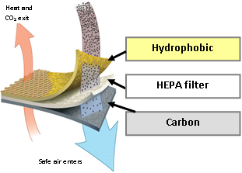
Background
About the JECP SKUI
  JECP Phase 2 shelter
  Utilizes Passive Filtration
    Airflow through filters is dependent on external pressures.
    Passive filters are protected by a rainfly or an unimproved structure (e.g., cave, barn, etc.)
  No Airlock
  No Overpressure
JECP Structure Kit Unimproved (SKUI) with Rainfly
Passive Filter Layers

Slide 5
SKUI Modeling Concept
Lagrangian Particle Model (MESO-RUSTIC)
CFD Model (ADVED_NS)
Unimproved Structure
Contaminant Release
SKUI
Box Model
Filter Model
Concentration and pressure boundary conditions
Concentration and flow boundary conditions
Desire run time to be on the order of hours and not days

Slide 6
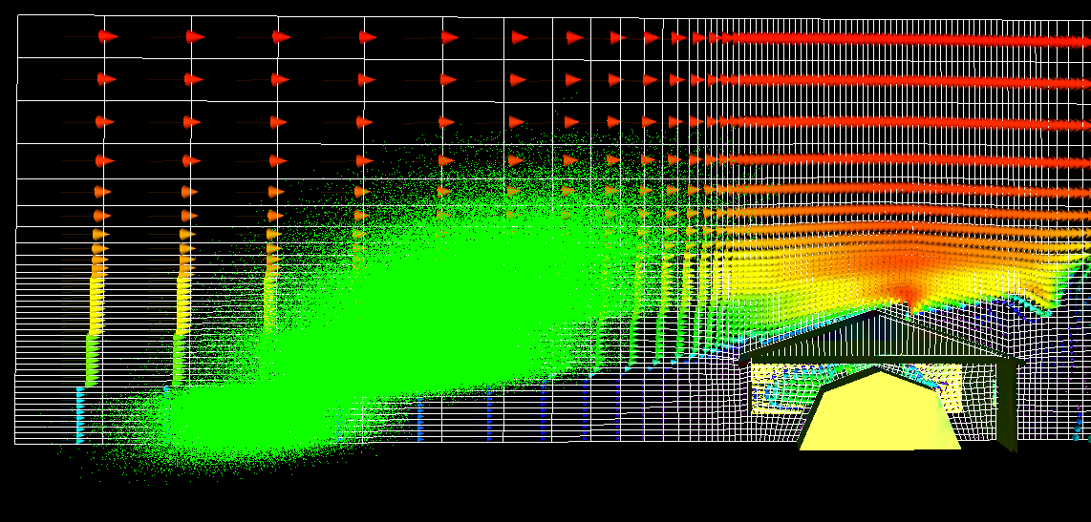
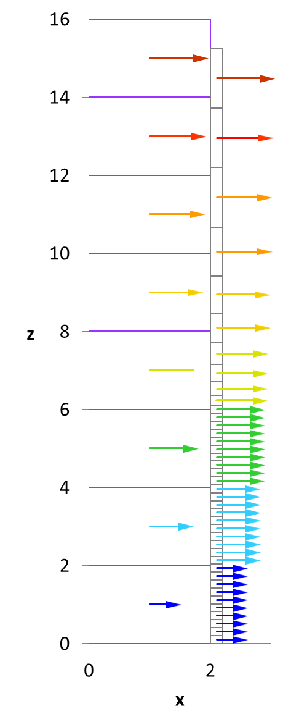
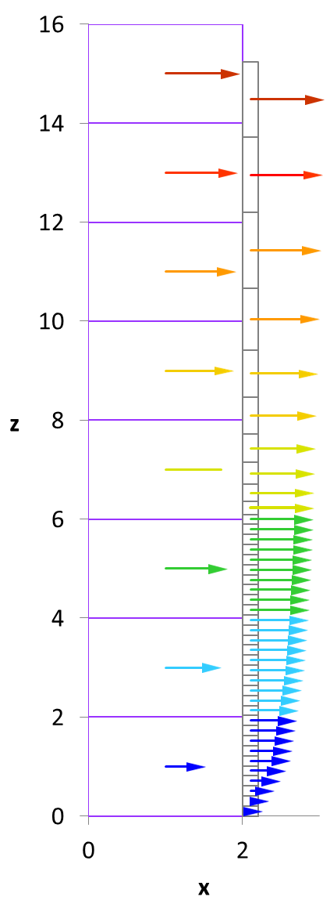
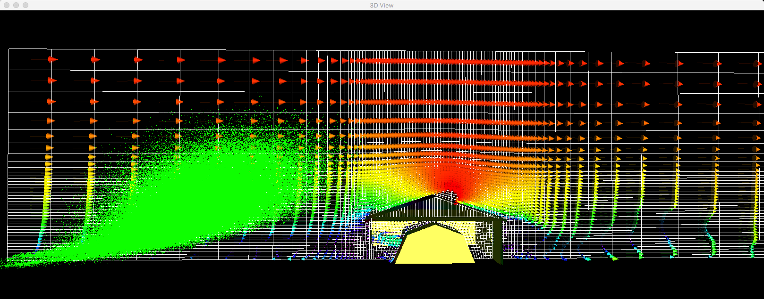
CFD Airflow Boundary Conditions
RUSTIC grid is coarser than ADVED_NS grid.
Direct transition of RUSTIC airflow to ADVED_NS causes “staircase” effect.
Linear interpolation used to eliminate “staircase” effect.
Profile before linear interpolation
Profile after linear interpolation
Example of particle dispersion with staircase inflow
Example of particle dispersion with interpolated inflow
RUSTIC grid
ADVED_NS Grid
Notes:
Harold, I’ll supply the same image using the smoothed flow after it finished running.

Slide 7
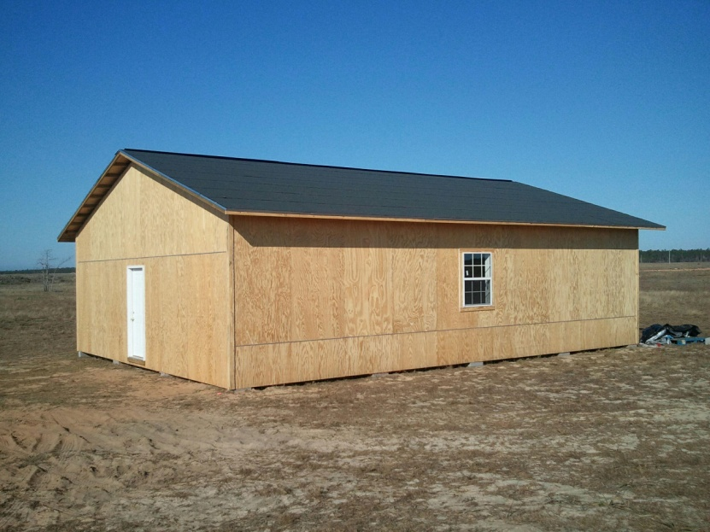
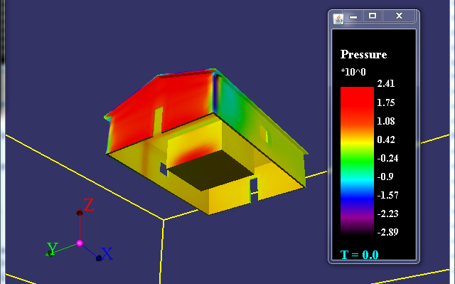
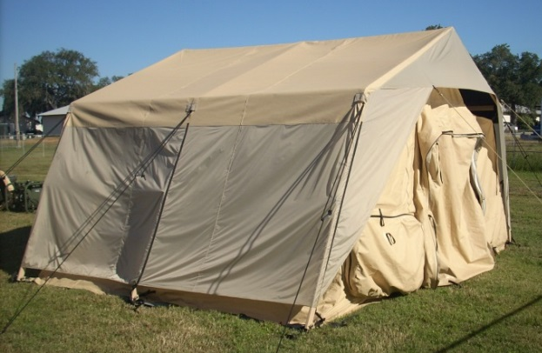
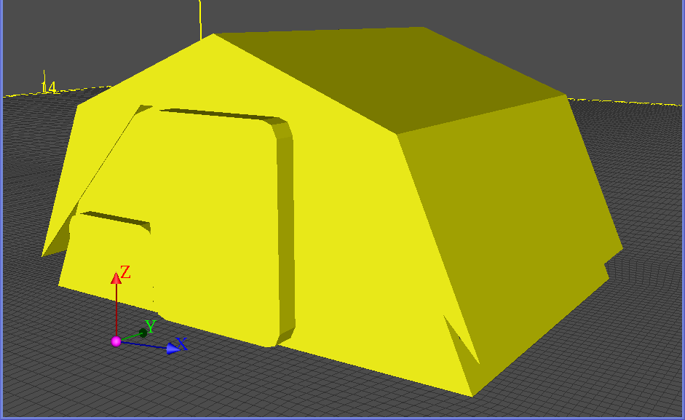
Unimproved Structures
The SKUI is always contained within some type of structure.
Simple House built at EAFB for JECP T&E
ADVED_NS representation Simple House containing SKUI
SKUI covered by Rainfly
ADVED_NS representation of SKUI with Rainfly

Slide 8
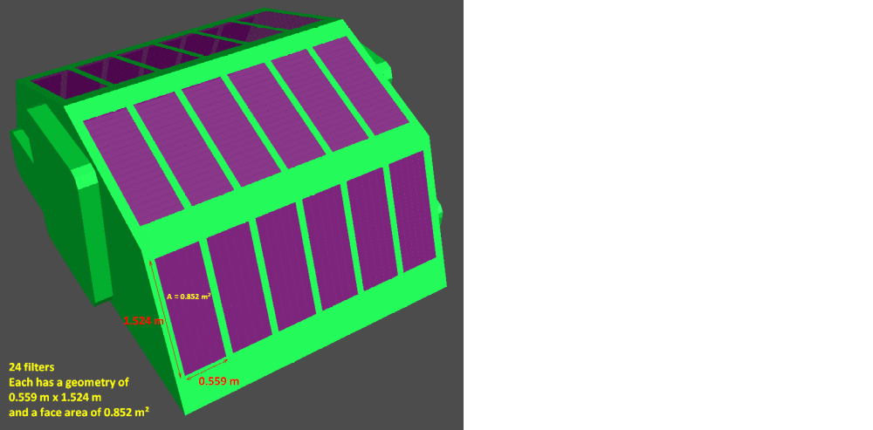
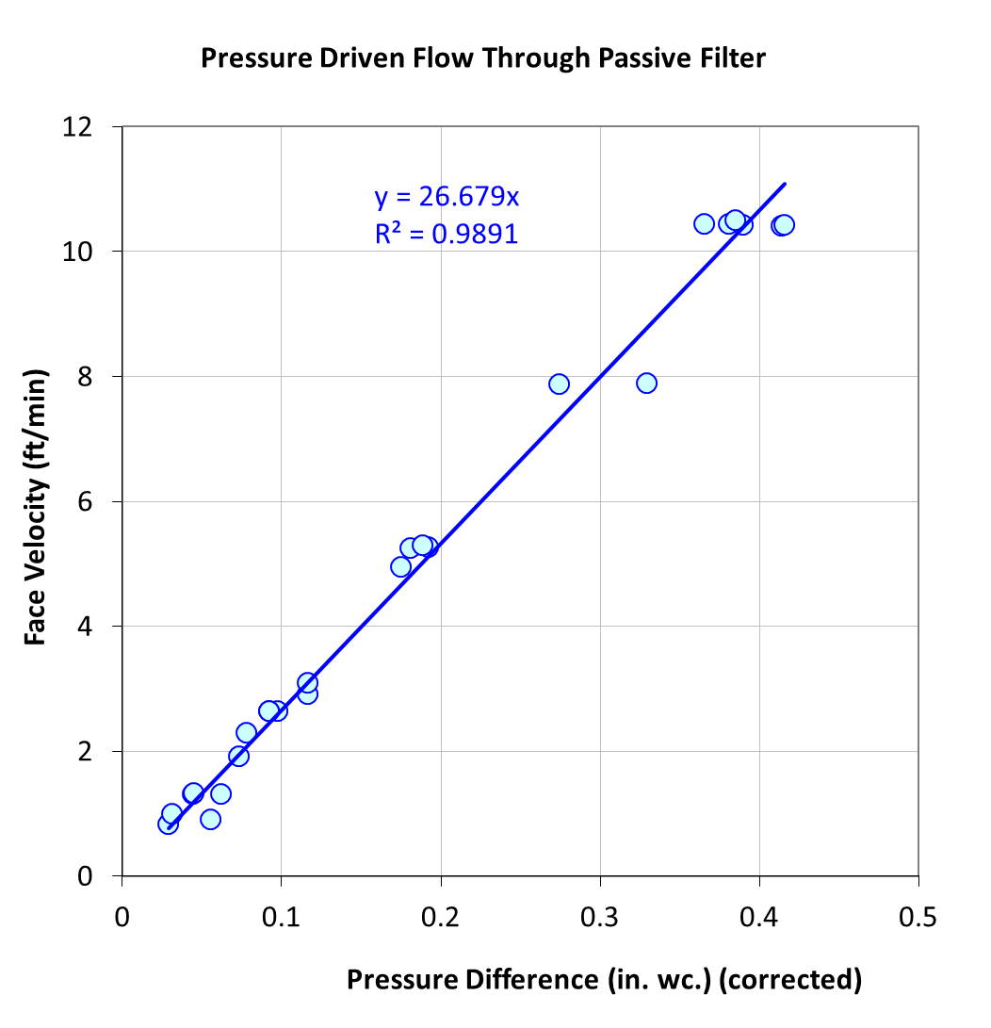
Passive Filter Modeling
Each filter panel will be divided into cells
  Each cell will have a unique concentration and pressure history computed by ADVED_NS
Velocity of air through a filter cell is a function of pressure acting on the cell.
  ADVED_NS approximates passive filters as solid objects for pressure computation to reduce computation time.
  Darcy’s law is used to compute velocity of air (coefficient derived from test data).
  Air velocity is used as an input to the carbon and HEPA filter models.
  Cumulative flow of air used to determine SKUI purge rate.
    Volumetric flow of air through a cell equals area of the cell times air velocity.
Notes:
The Darcy flow drag model is fairly well accepted in the porous media models. It is commonly referred to as “Darcy’s law”. The coefficient is fitted using data, but it is applicable in many forms of porous media.

Slide 9
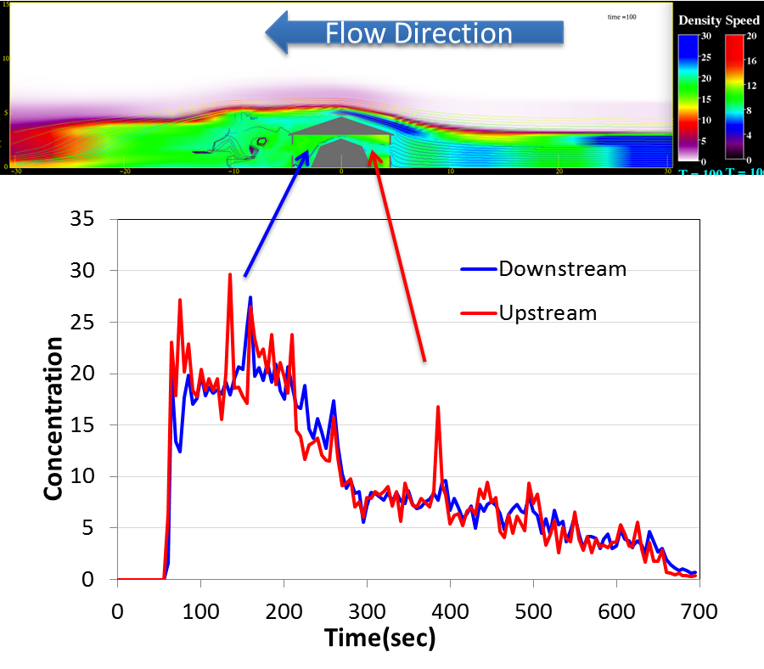
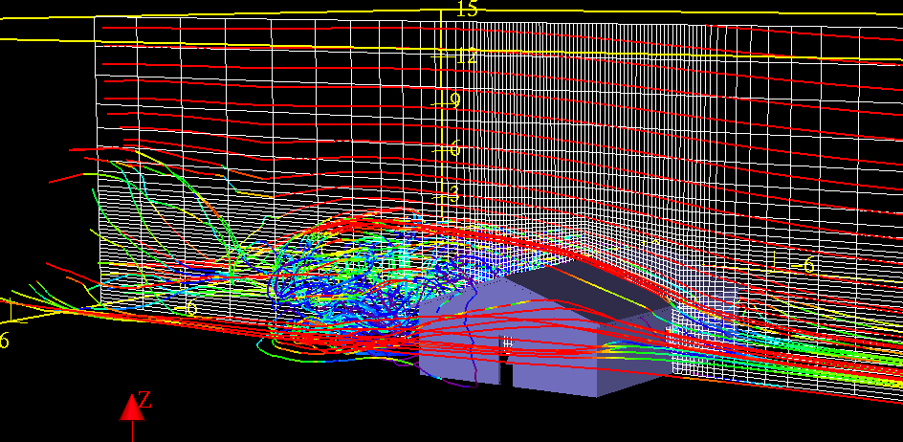
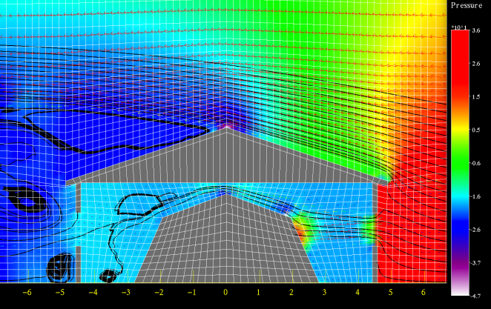
ADVED_NS Snapshots
3D Streamlines flowing over the house structure
Case where concentrations within the house structure remain fairly uniform throughout the interior
2D Streamlines and pressures interacting with the house structure and the SKUI

Slide 10
Forward Path
Model development in progress.
  Finish ADVED_NS modifications required to support model concept.
  Integration of ADVED_NS into the JECP SPM.
Model testing and verification.
Model validation.

Slide 11
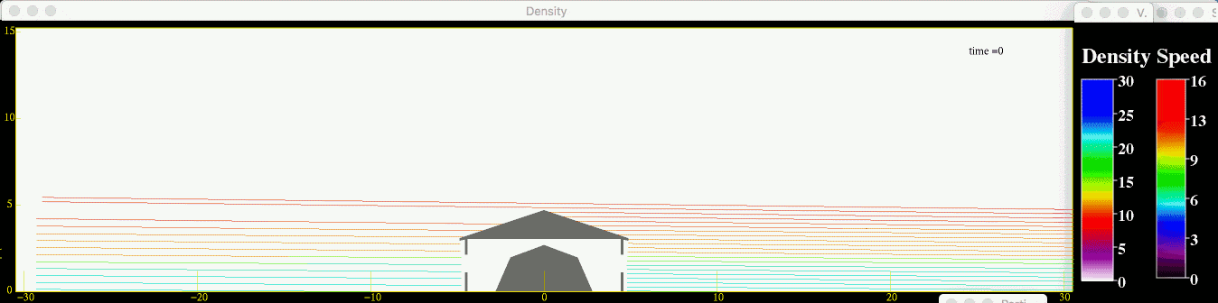
Questions?

