Slide 1
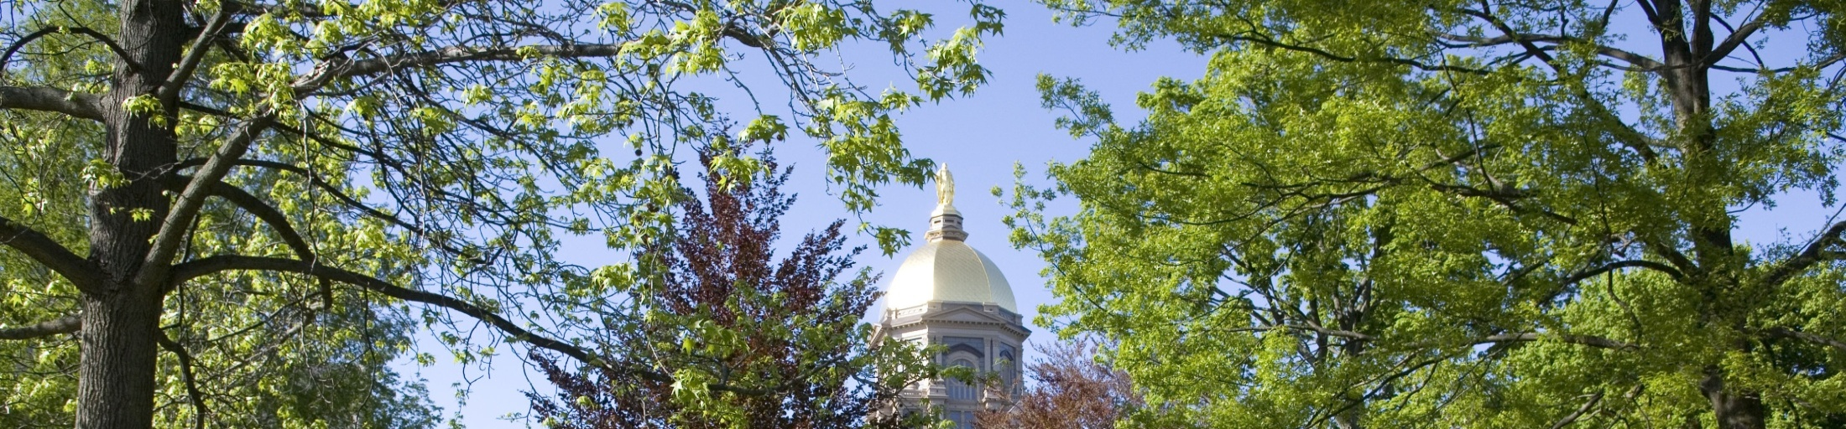


The Mountain Terrain Atmospheric Modeling and Observations (MATERHORN) Program (2011-2016)
By
H.J.S. Fernando, Univ. of Notre Dame
J. P. Hacker, Naval Postgraduate School/NCAR
F. K. Chow, University of California, Berkeley
E. R. Pardyjak, University of Utah
S.F.J. De Wekker, University of Virginia

Slide 2
ONR FY 2011 Multidisciplinary University Research Initiative (MURI)
TOPIC #7:
Improved Meteorological Modeling in Mountain Terrain
Topic Chiefs:
Dr. Ronald J. Ferek and Dr. Daniel Eleuterio (ONR)
Additional support:
Army Research Office
(Dr. Gordon Videen and Dr. Walter Bach)
Air Force Weather Agency
through ARL
www.nd.edu/~dynamics/Materhorn

Slide 3

Principal Investigators:
H.J.S. Fernando
(University of Notre Dame)
Eric Pardyjak
(University of Utah)
Stephan De Wekker
(University of Virginia)
Josh Hacker
(NPS/NCAR)
Tina Katopodes Chow
(Univ. California, Berkeley)
Working Partners:
John Pace, Dragan Zajic (DPG)
Jim Doyle (NRL)
Yansen Wang,
Melvin Fenton &
Ed Creegan (ARL)
Julian Hunt (U. London)
Eliezer Kit (Tel Aviv Univ)
Multidisciplinary University Research Initiative MURI
Collaborators
NCAR
NOAA
Simpson Weather Associates
Oregon State University
University of Colorado
IIBR, Israel
University of Bergen, Norway
University of Vienna, Austria
École Polytechnique De Montreal, Canada
University of Lecce, Italy

Slide 4
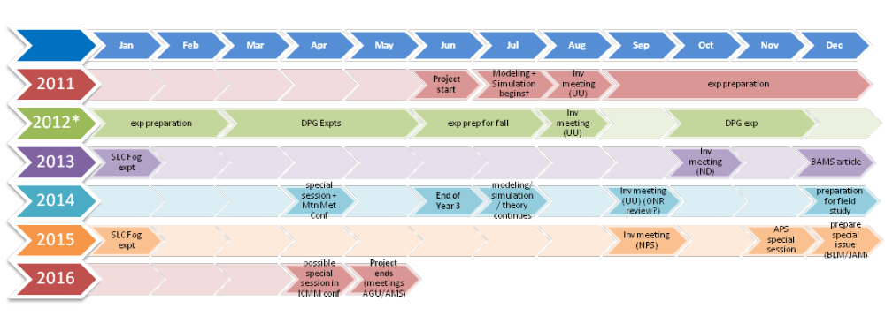
Timeline
Reports available upon request
or
visit www.nd.edu/~dynamics/Materhorn
DRY
exp preparation + modeling
analysis of previous work
DPG exp
25 Aug. - 28 Aug. 2012: MATERHORN-X-DRY
25 Sept. – 25 Oct. 2012: MATERHORN-X-FALL
1 May– 30 May 2013: MATERHORN-X-SPRING
Nov 30 – Feb 15 2015: MATERHORN-Fog
Barriers

Slide 5
Some Scientific Barriers…..
(1) Near-surface atmospheric wind and temperature predictions in complex terrain
– poor
(2) Accurate measurements of model relevant parameters (soil properties, surface energy balance) – lean
(3) Near-surface temperature forecasts - very sensitive to soil moisture
(4) Holistic (multi-scale) observations of large
to small-scale processes – rare
Mat componenta

Slide 6
Barriers .....
Ultra high-resolution (50 m horizontal or finer) simulations have been nearly impossible over complex terrain
Issues remains on turbulence closure modeling, terrain representation and numerical methods (What is the best? – e.g., terrain-following vs. immersed boundary method)
Nocturnal predictions are not satisfactory -- unknown physical processes?
BAMS

Slide 7
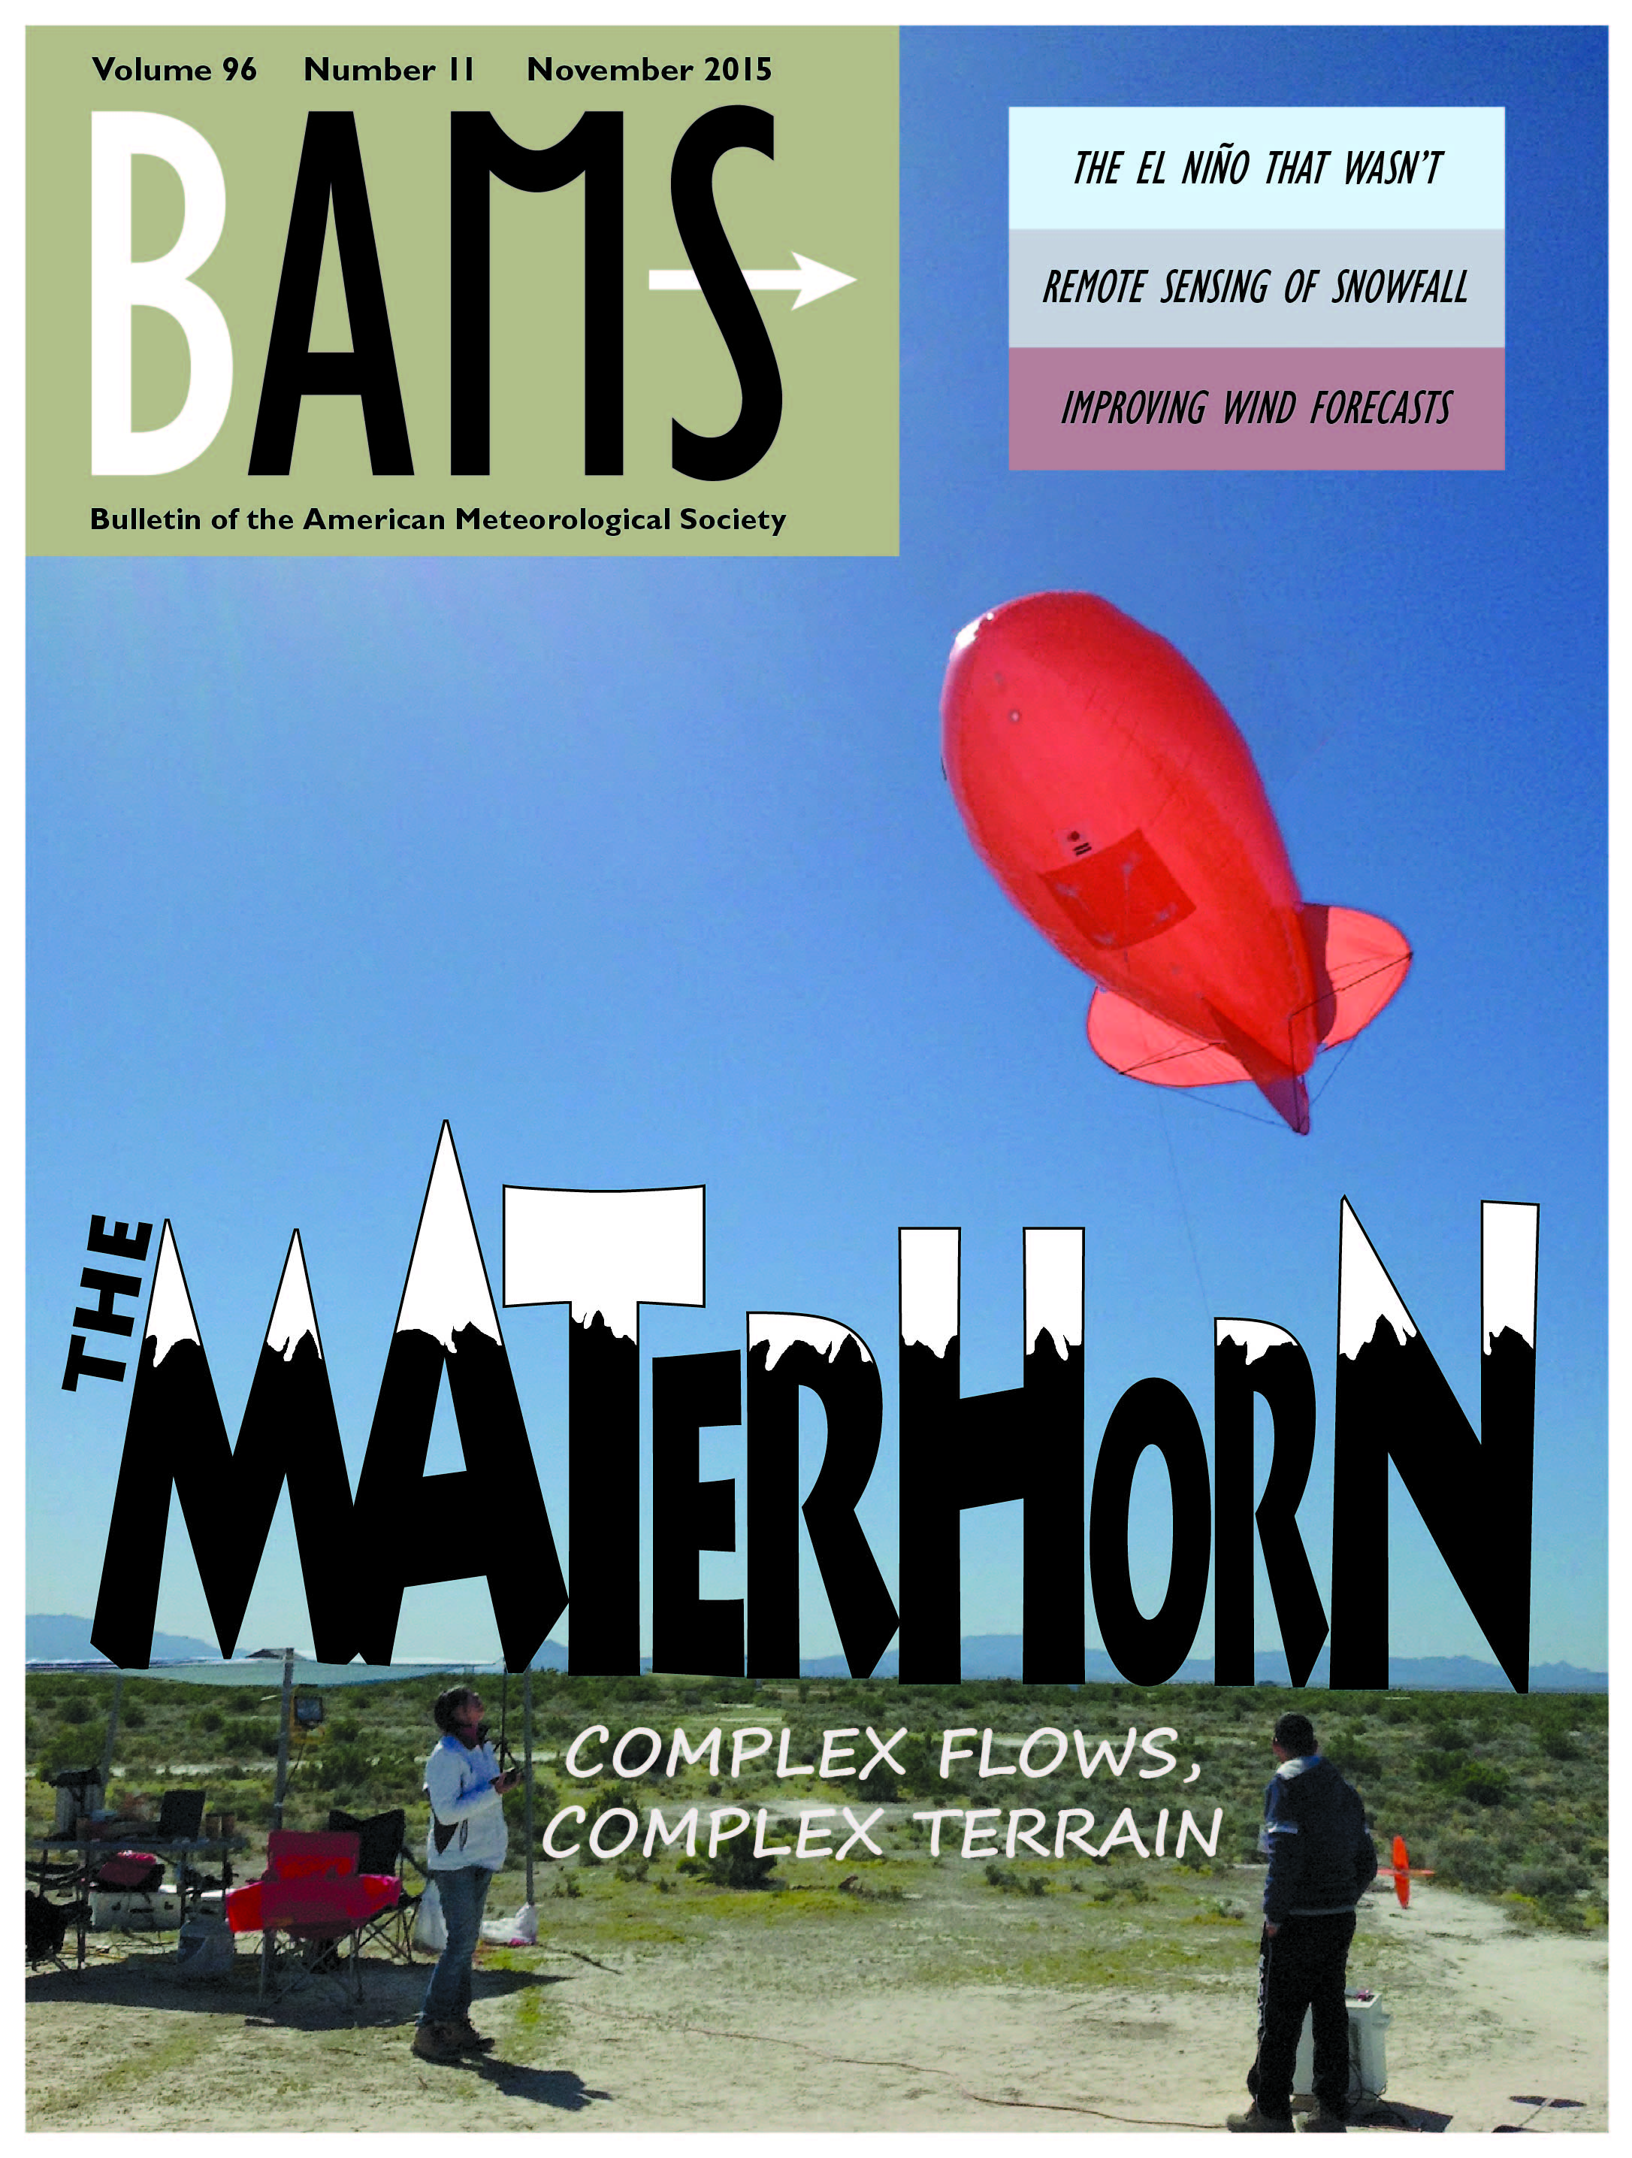
Mountain Terrain
Atmospheric Modeling
and
Observations Program
Bulletin of the American Meteorological Society, 96 (11), 2015. doi: http://dx.doi.org/10.1175/BAMS-D-13-00131.1

Slide 8
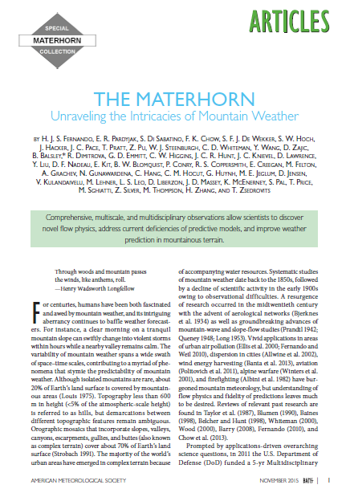
processes

Slide 9
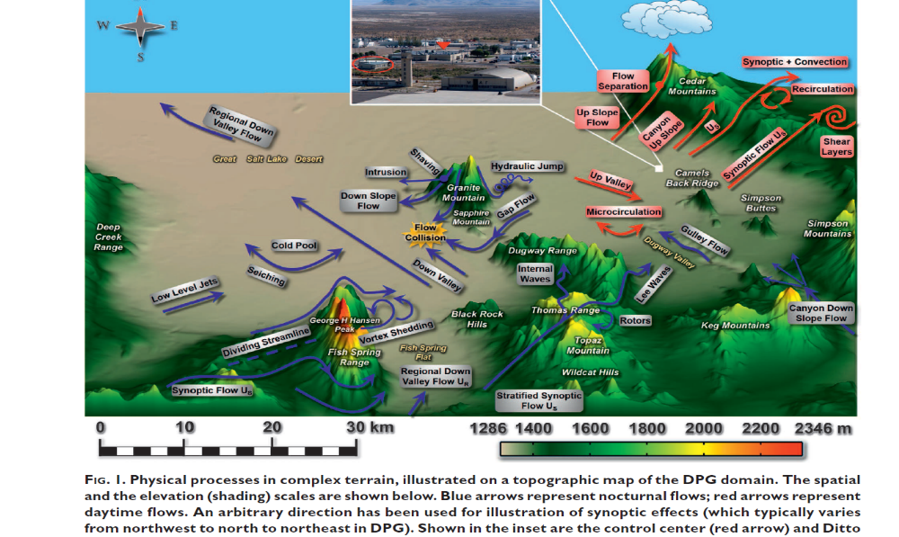
4 components

Slide 10
MATERHORN has four components
working symbiotically
across institutions and disciplines
Experiments (MATERHORN-X)
Modeling (MATERHORN-M)
Technology Development (MATERHORN-T)
Parameterizations (MATERHORN-P)
Mat-X

Slide 11
MATERHORN Fall and Spring
Granite Mountain Atmospheric Science Test bed (GMAST)
US Army Dugway Proving Ground (1252 sq. miles)
Calm Winds (FALL) – October 1 - 31, 2012
Synoptic Winds (SPRING) – May 1-30, 2013
10 Intensive Operational Periods IOPs each (24-36 hrs)
5 Intensive Operational Locations IOLs
~ 50 TB Data from MATERHORN 1 and 2
MATERHORN - Fog
November 30 2014 – January 20, 2015
10 IOPs
2 Locations
Heber Valley and Salt Lake Valley
Canada Environment joined in the effort
Mat x

Slide 12
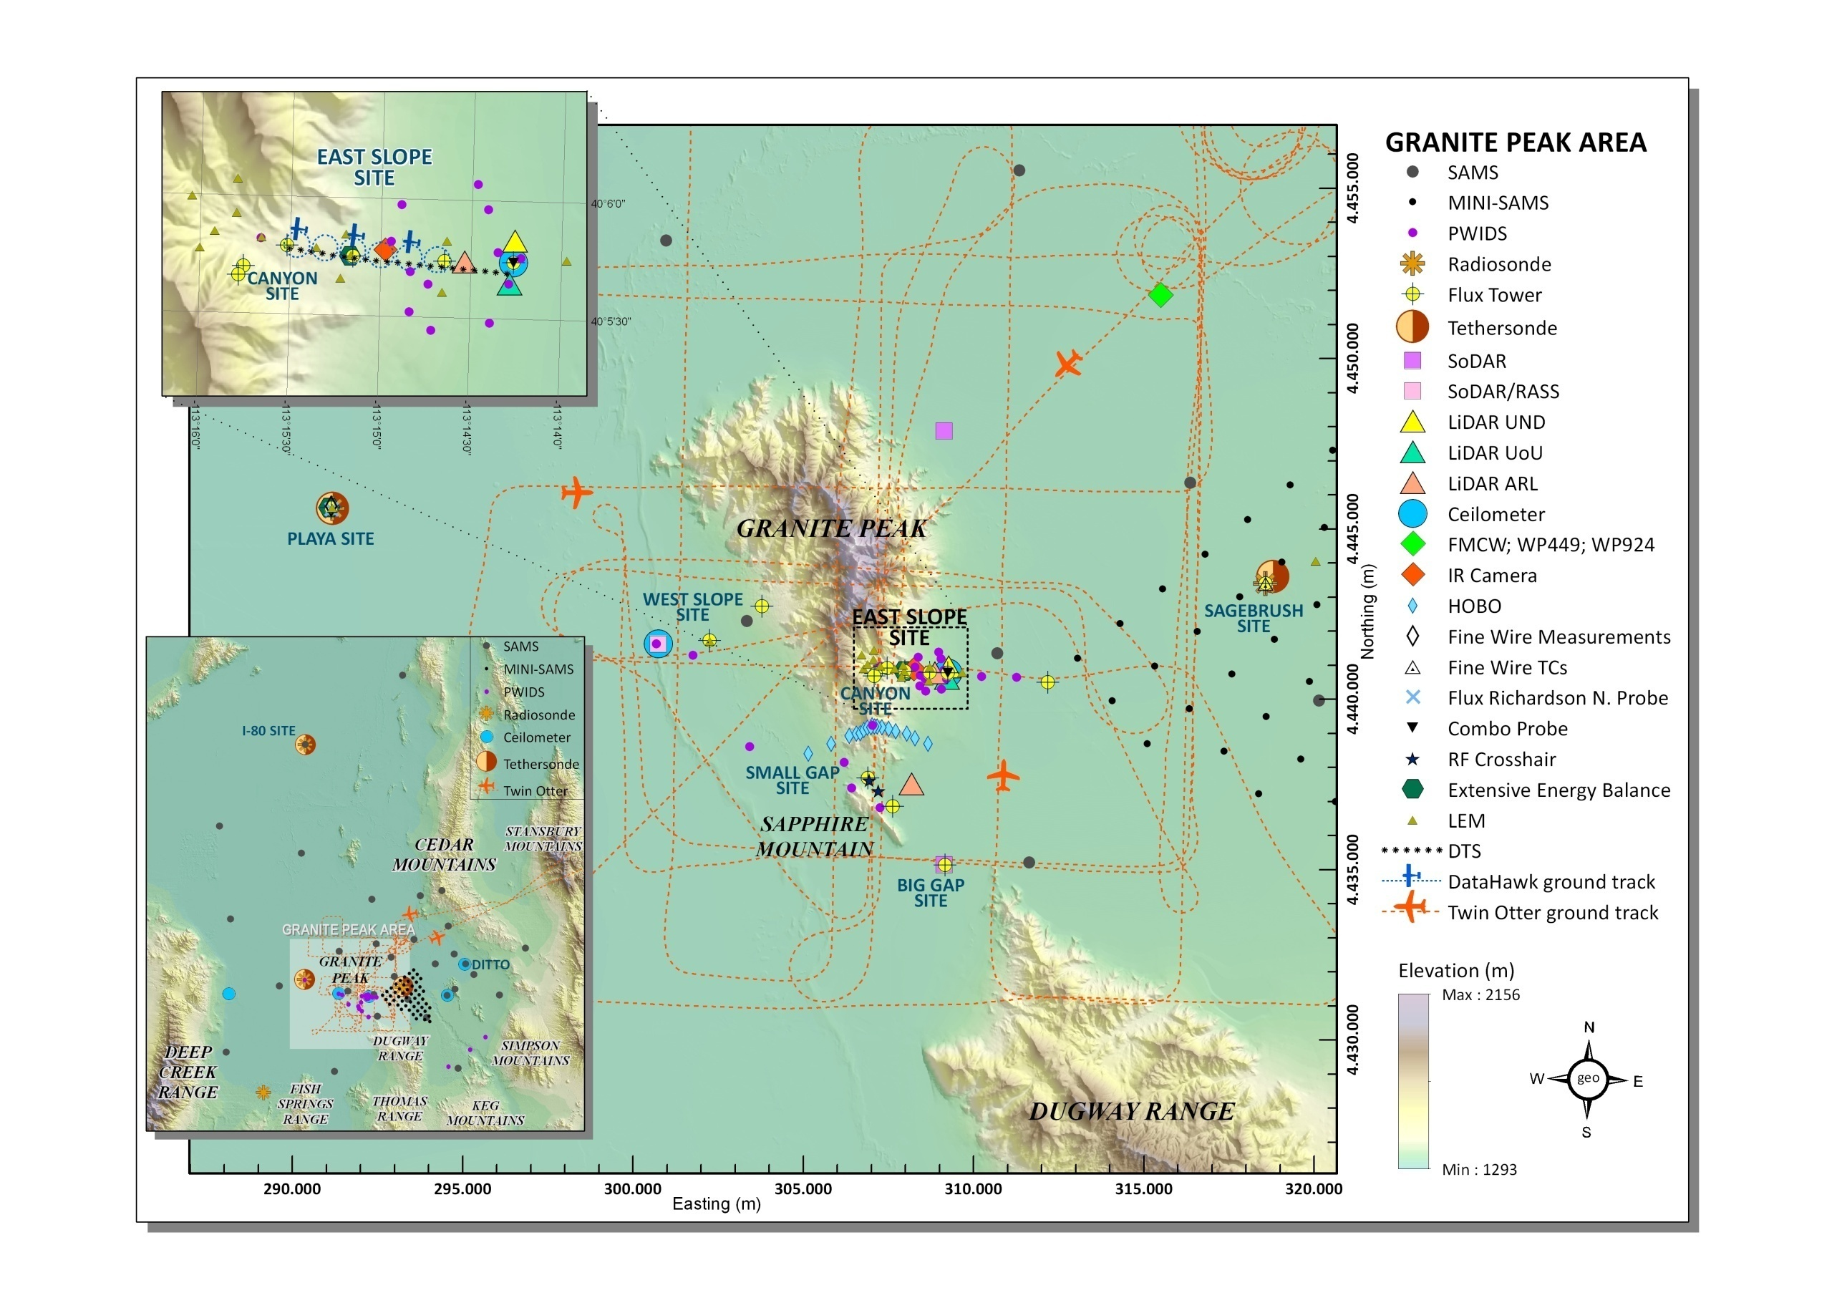


Materhorn - Fall
expt slides
Notes:
This has two aircraft path animations – may want to turn it off

Slide 13
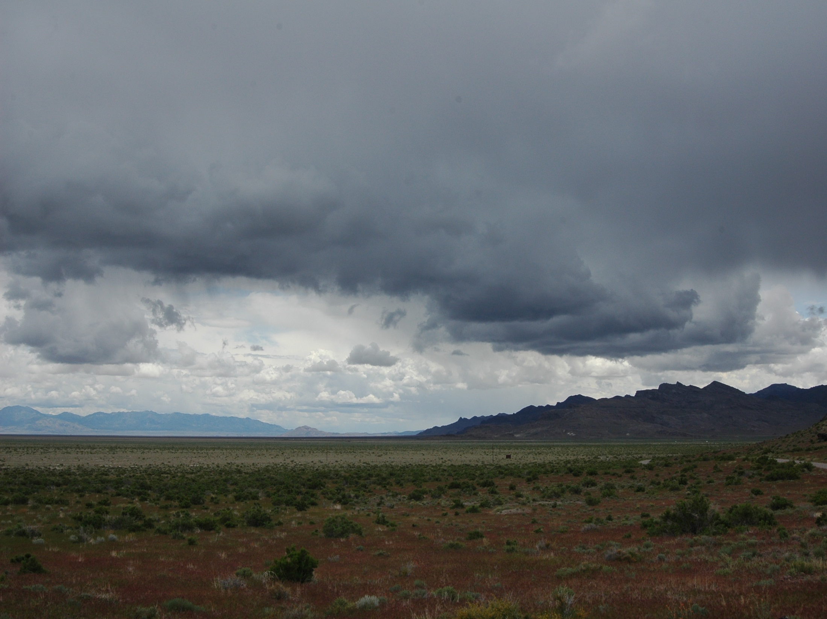
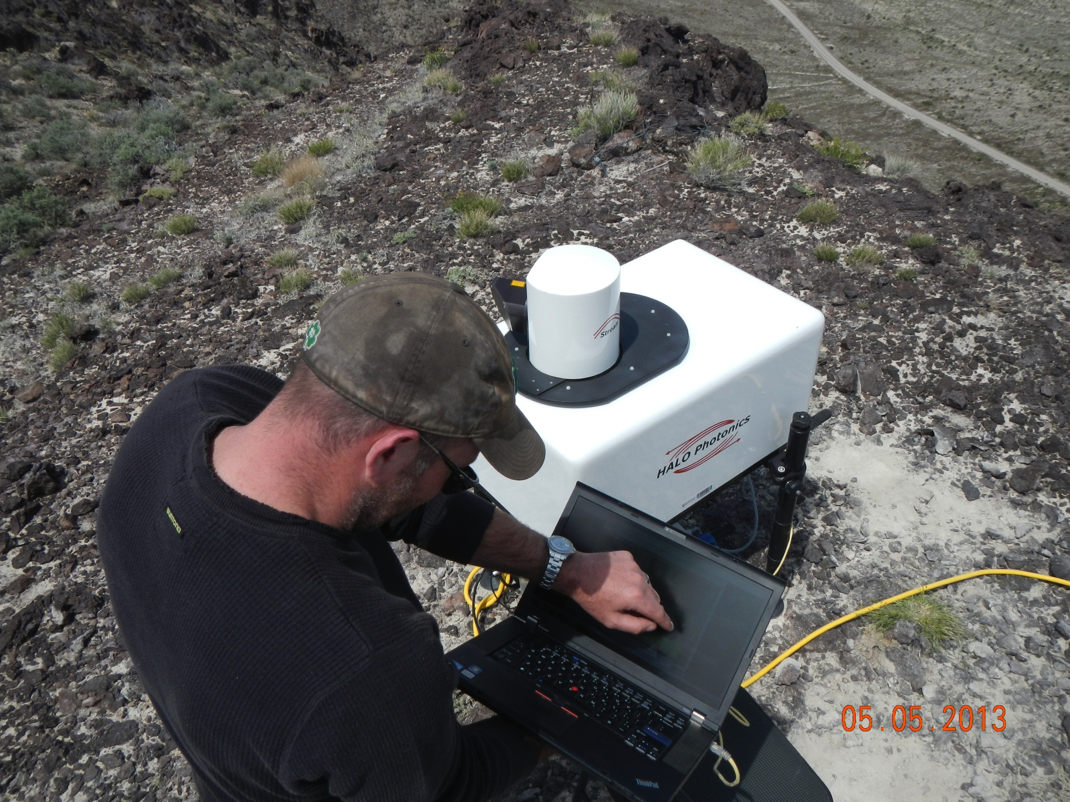
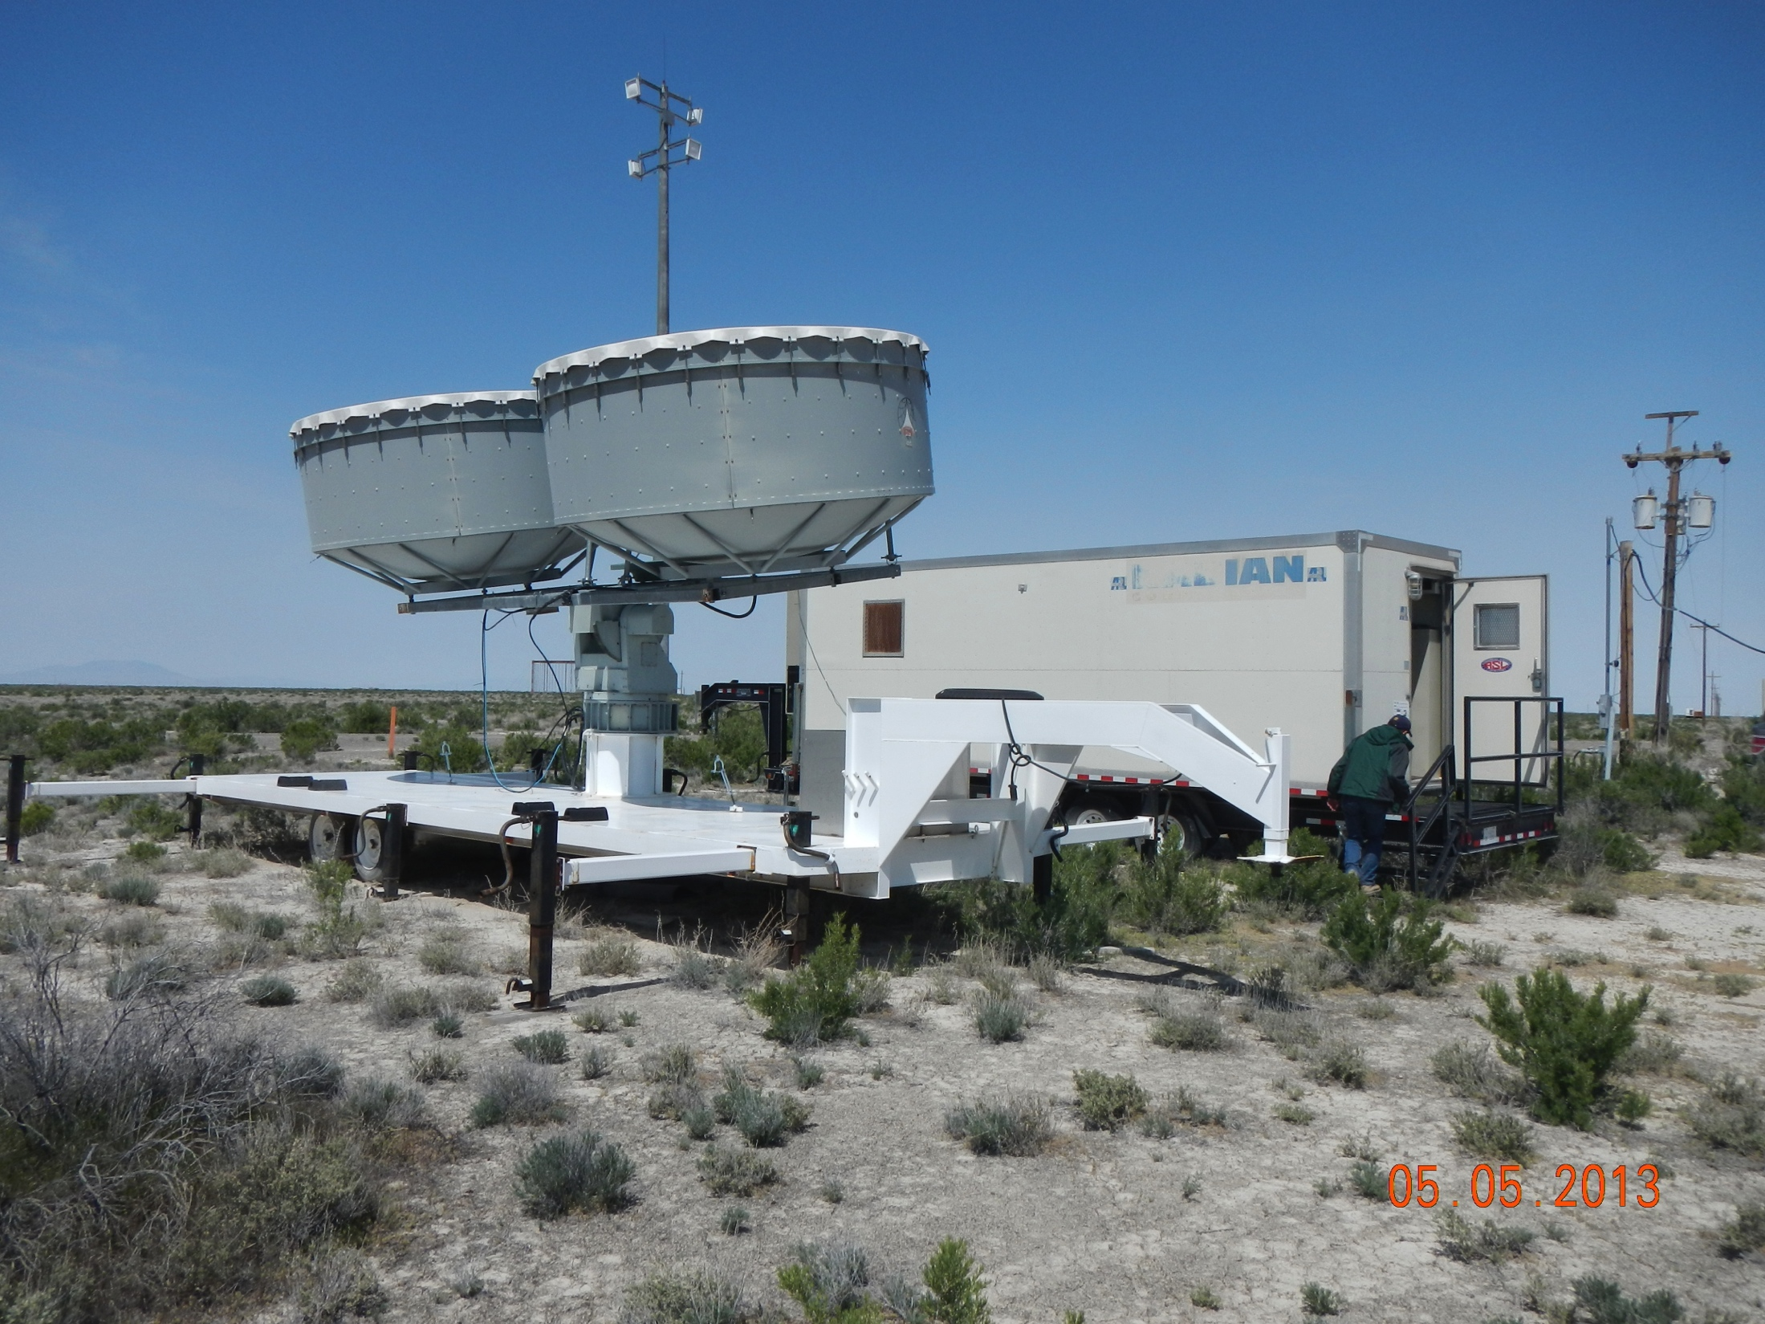
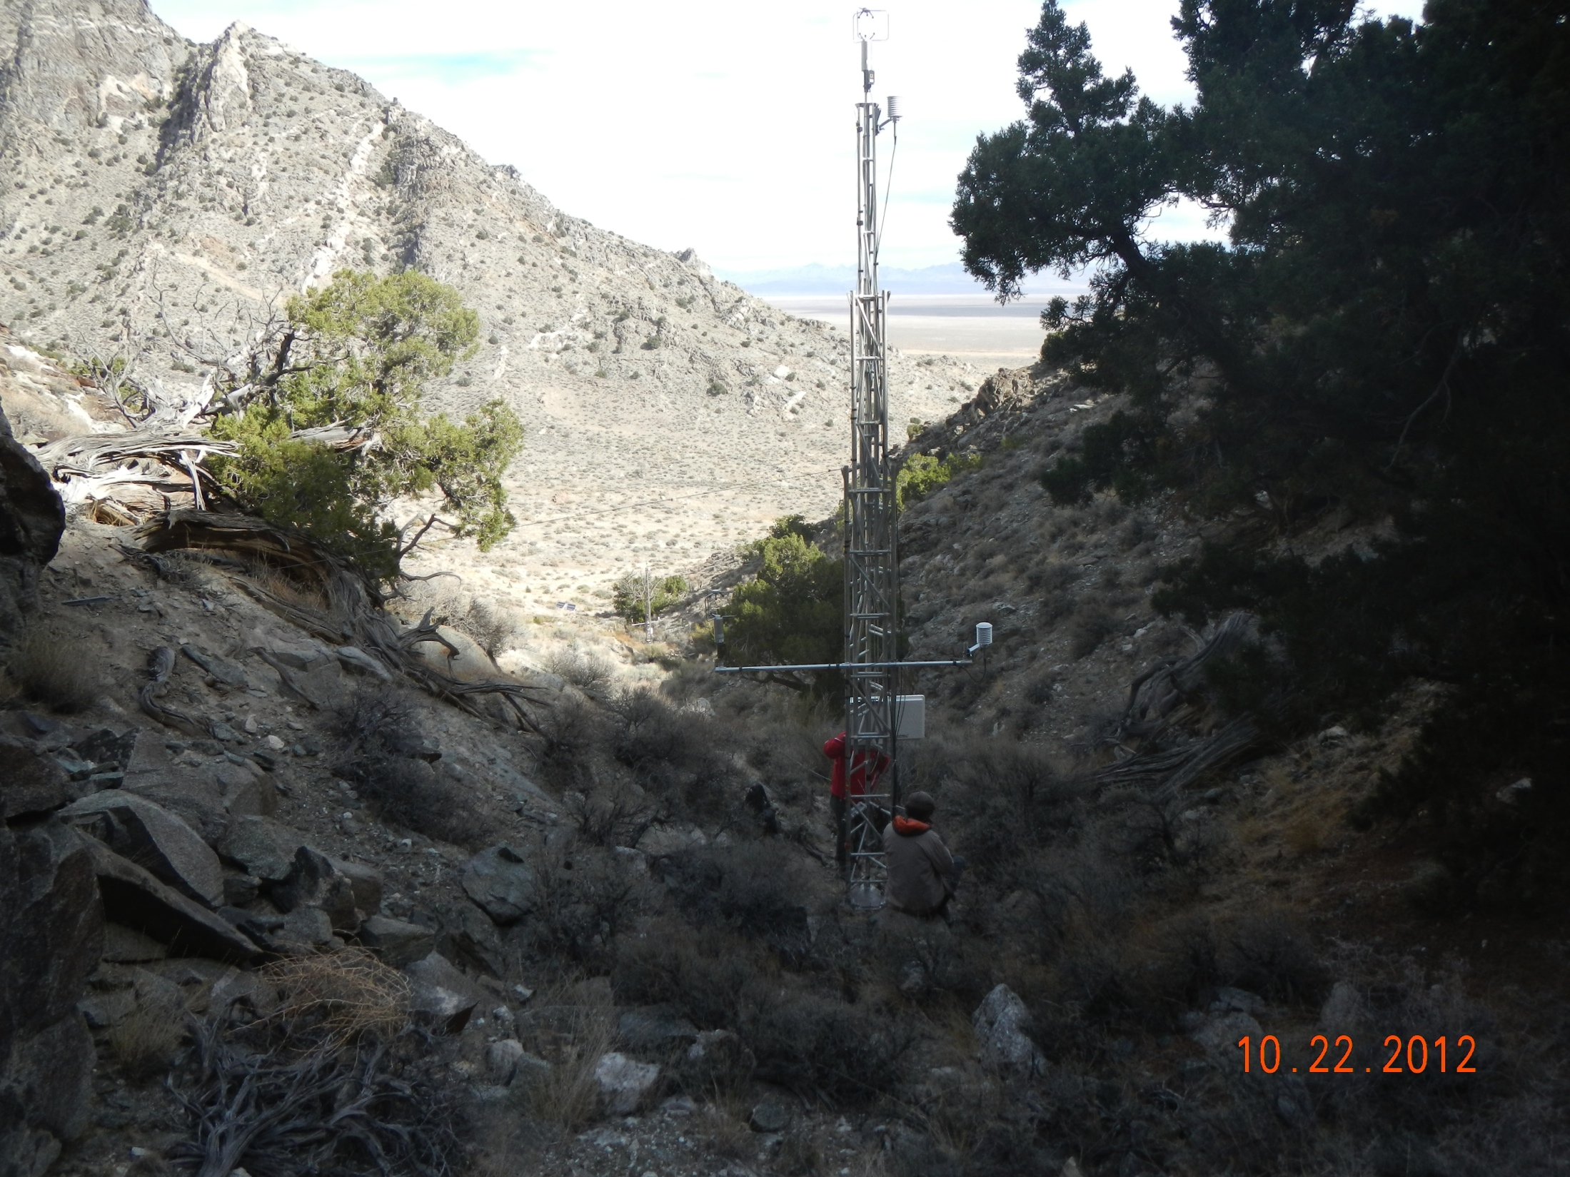
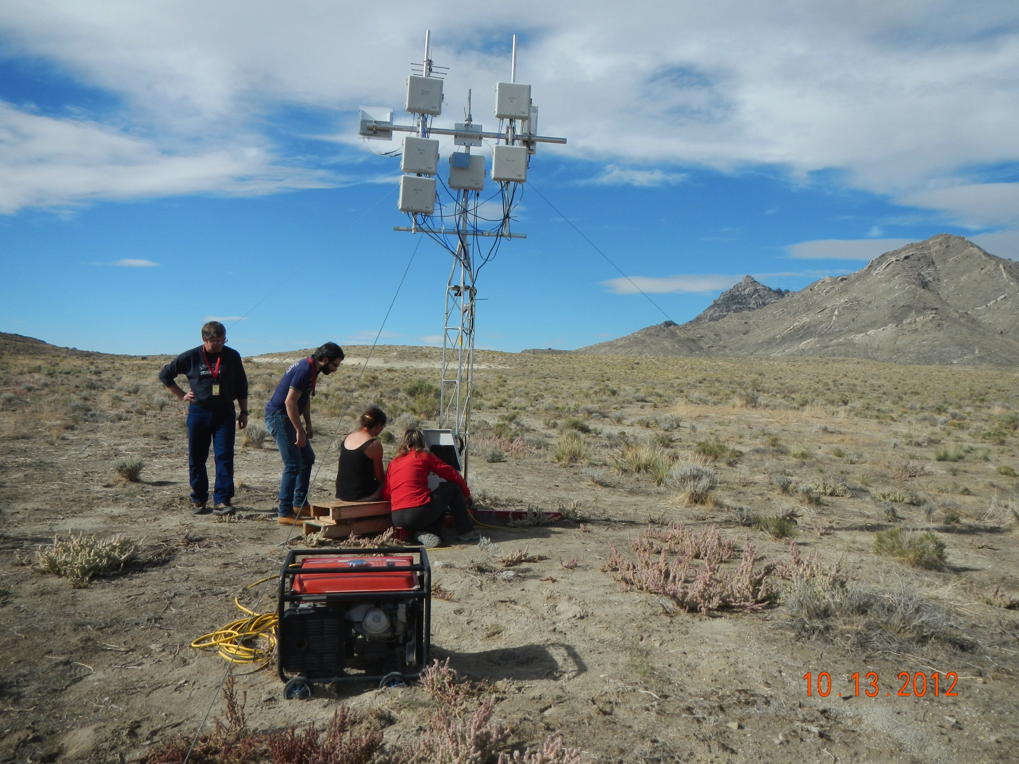
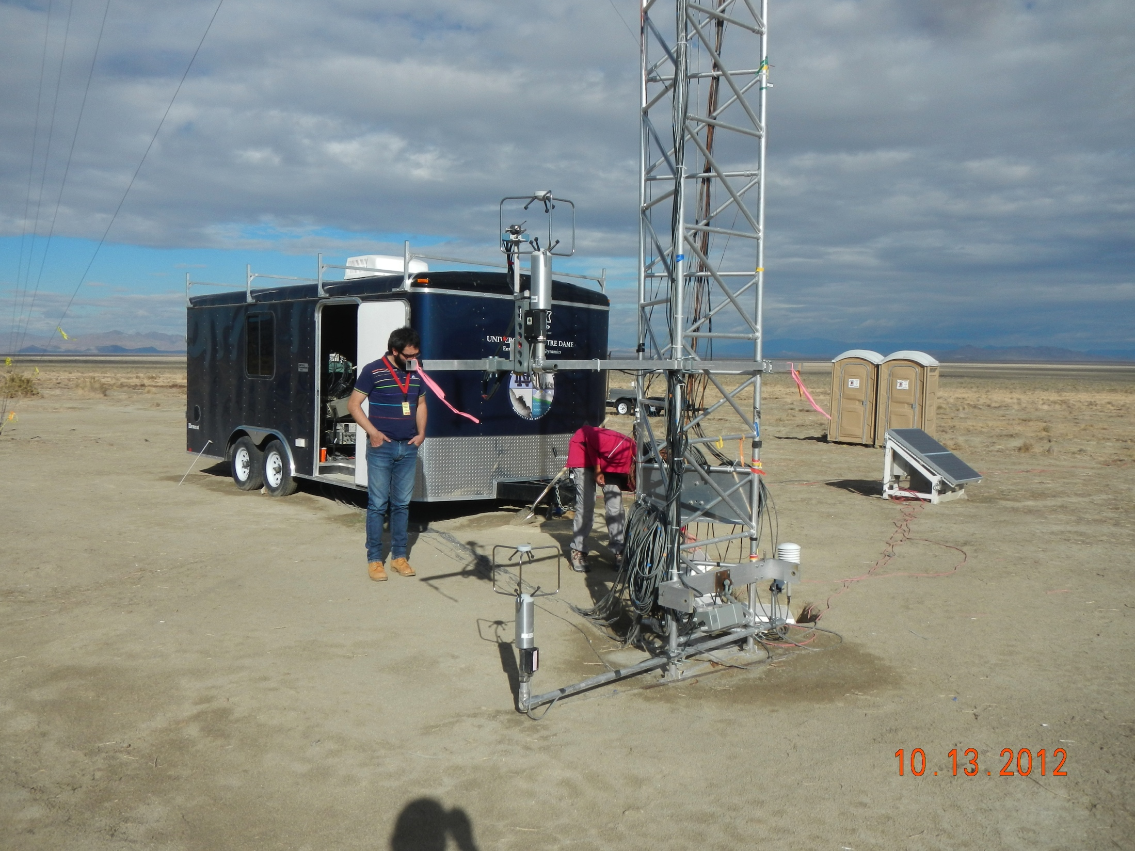
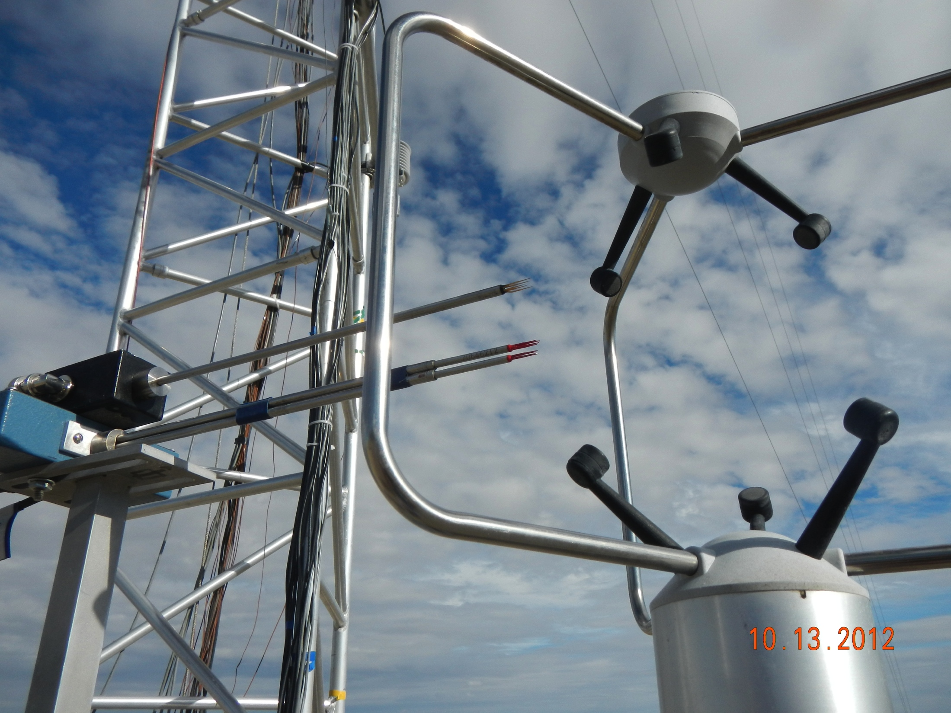
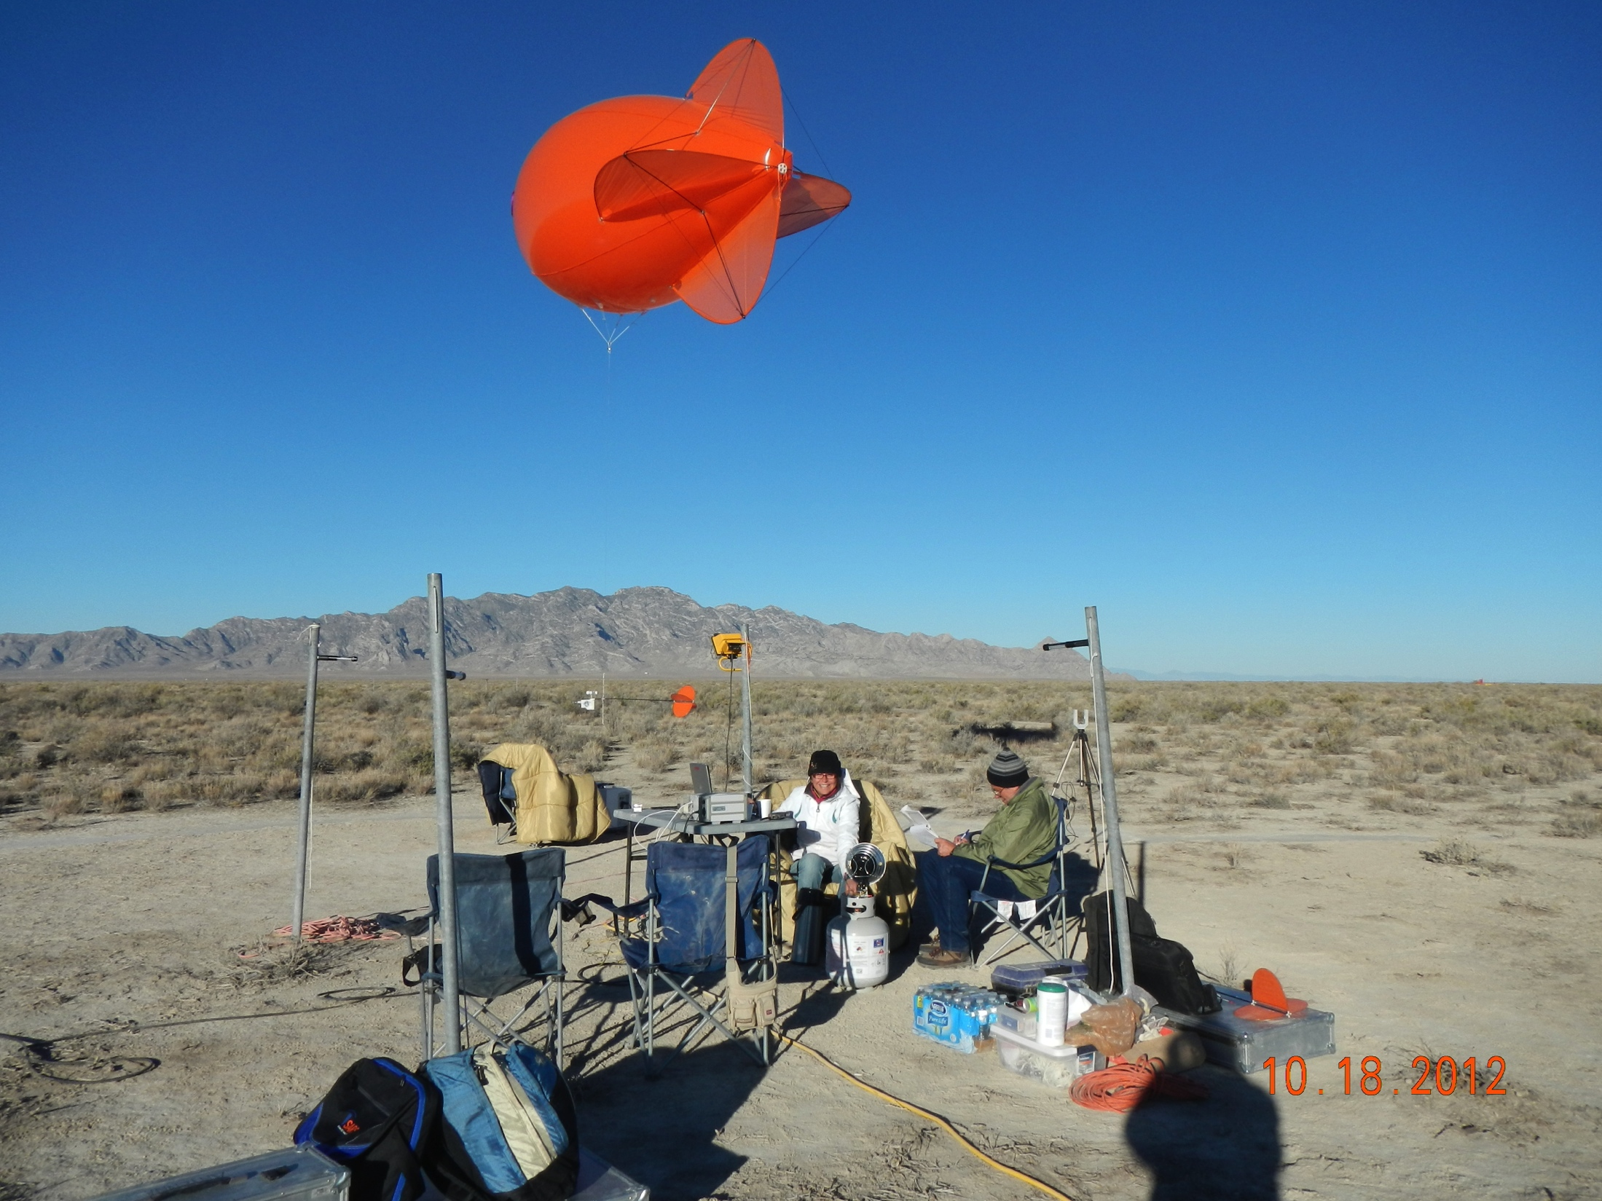
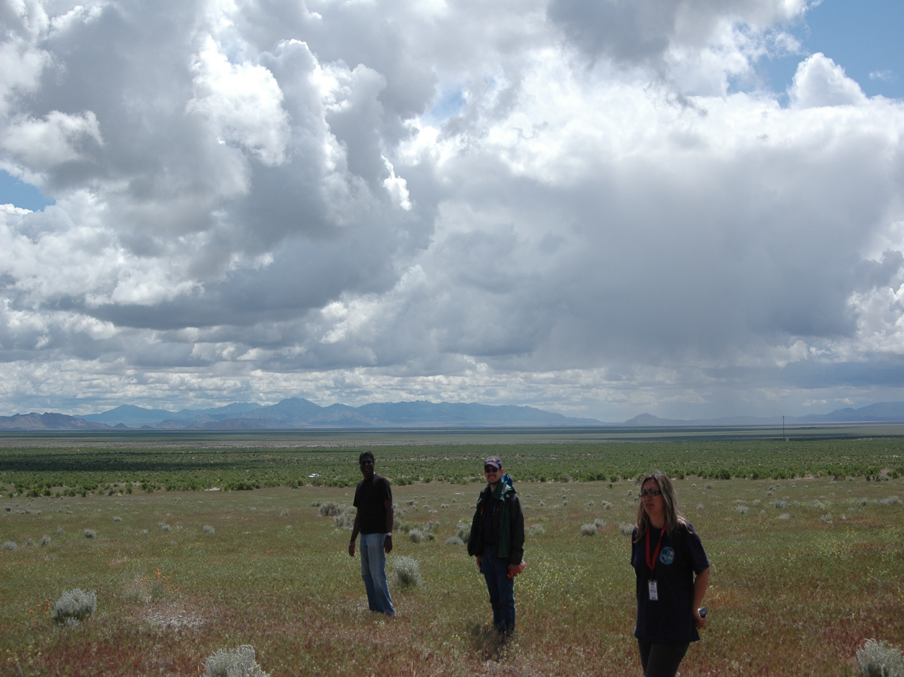
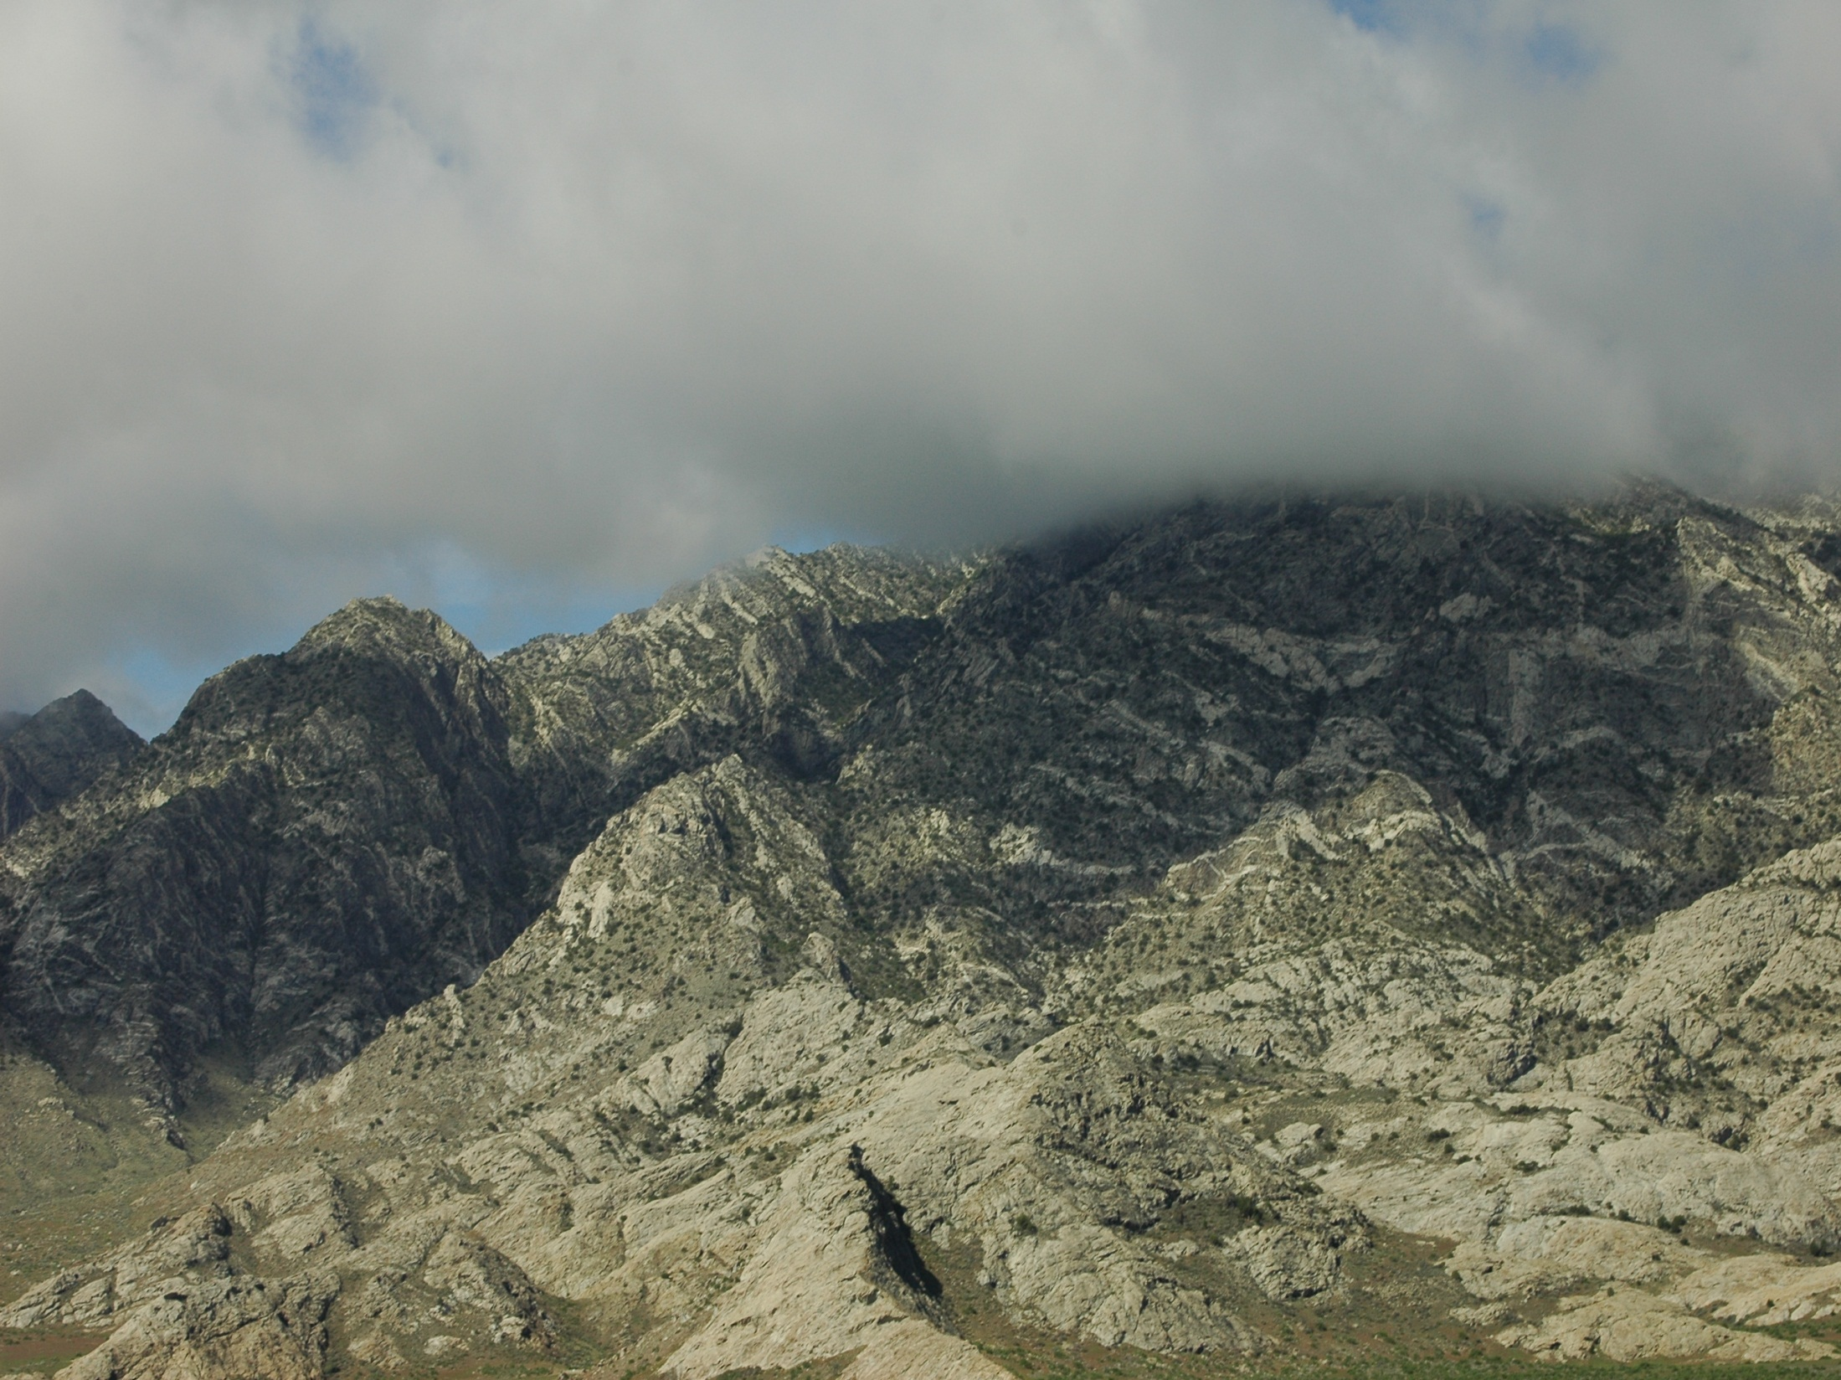
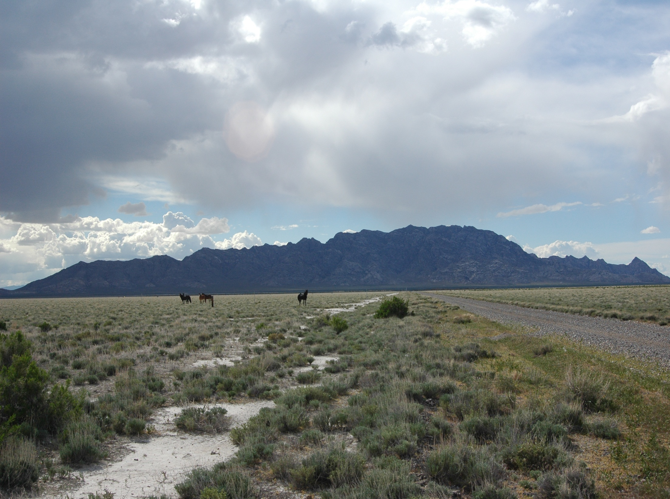
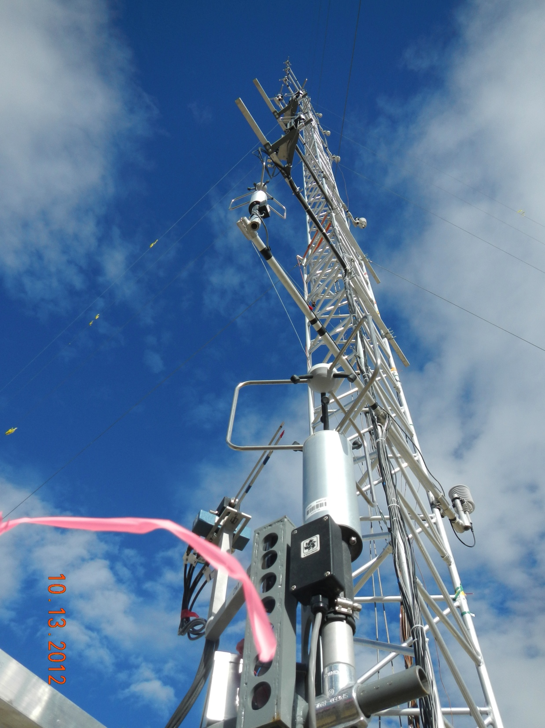
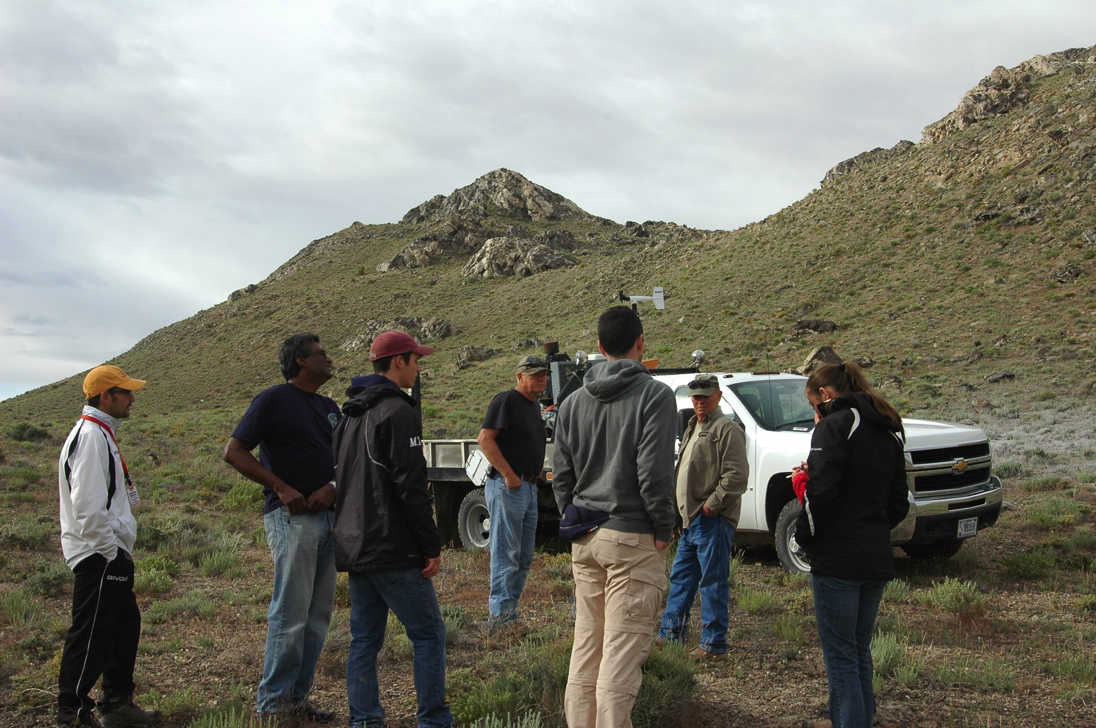
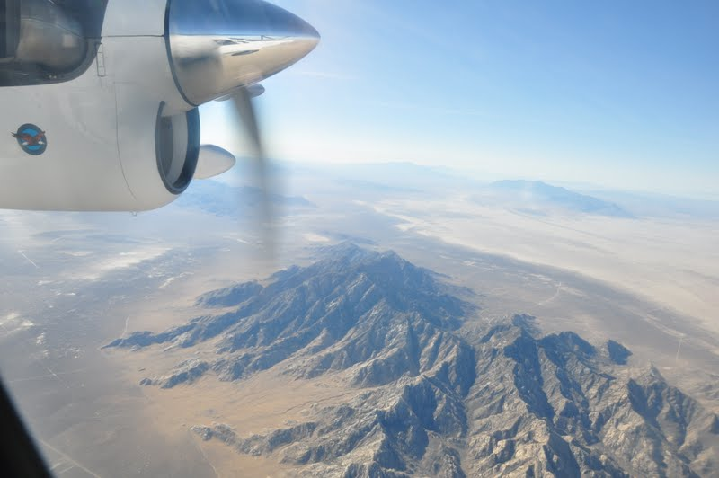
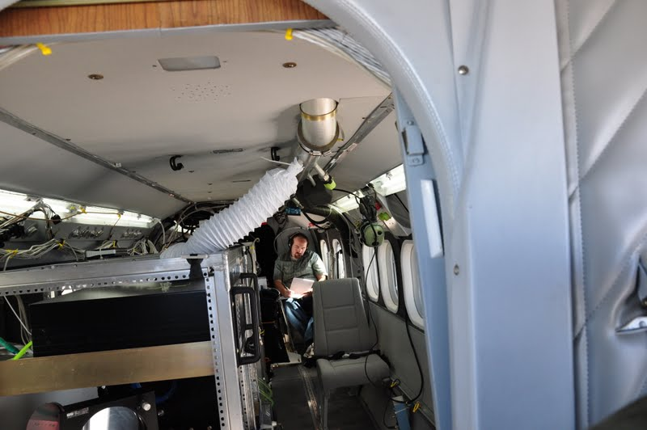
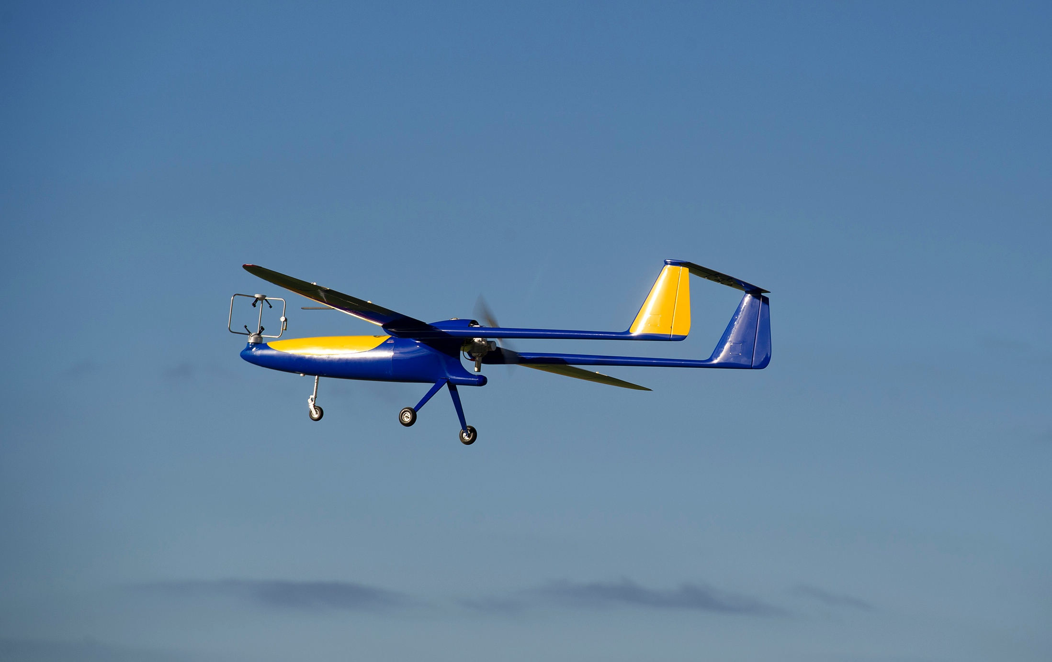
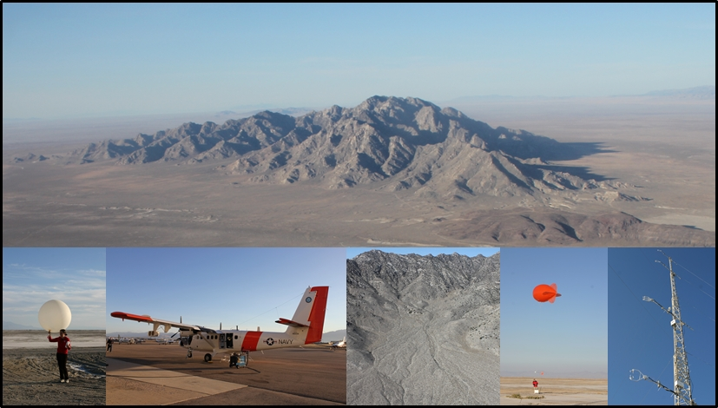
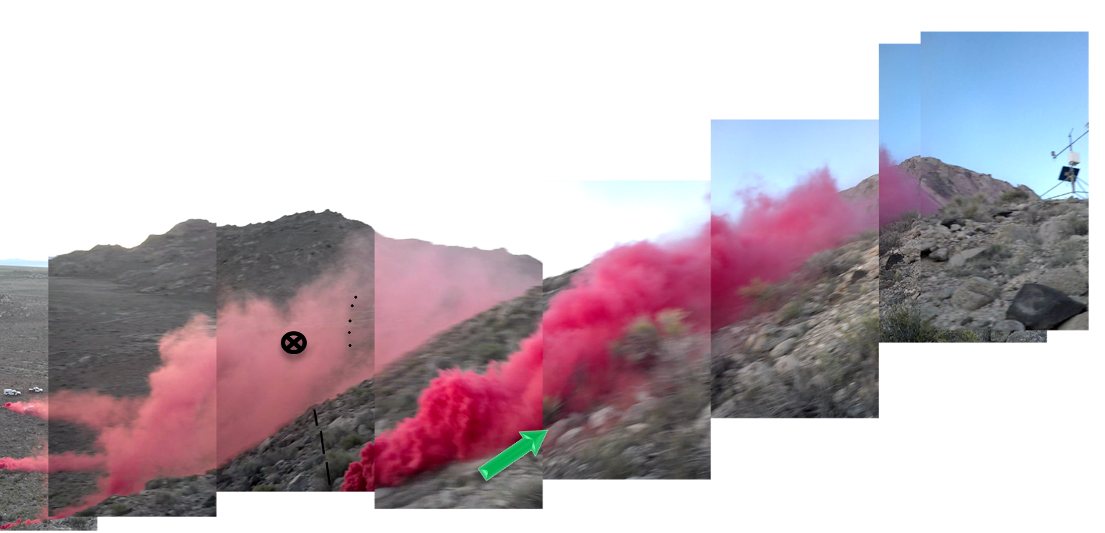
Granite Mountain
Test Bed [GMAST]
US Army Dugway Proving Ground

Slide 14
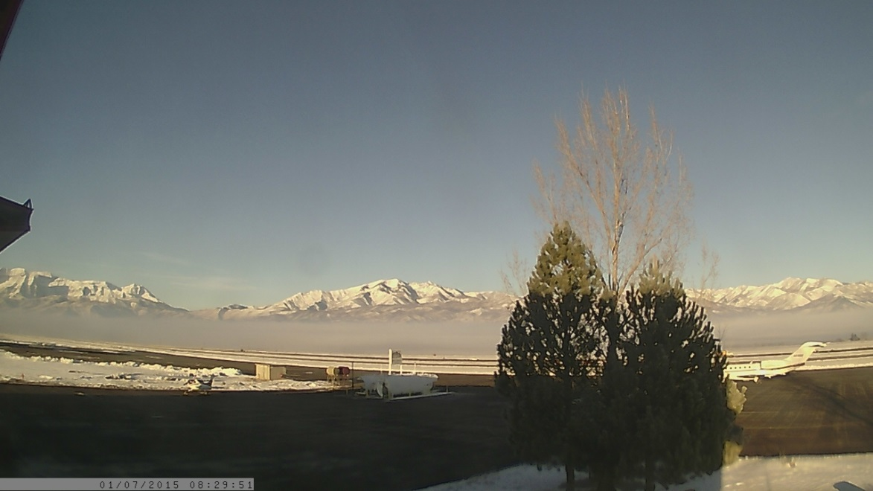
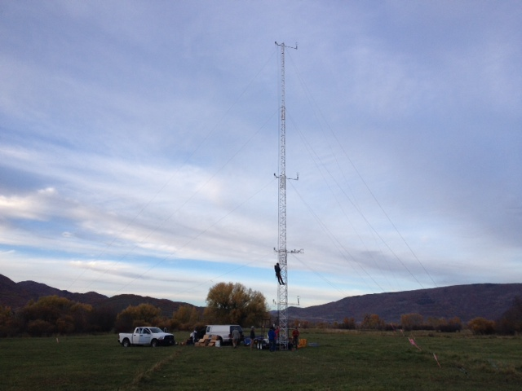
MATERHORN-FOG
Heber Valley
Salt Lake Valley
Nov 30 – Feb 15, 2015

Slide 15
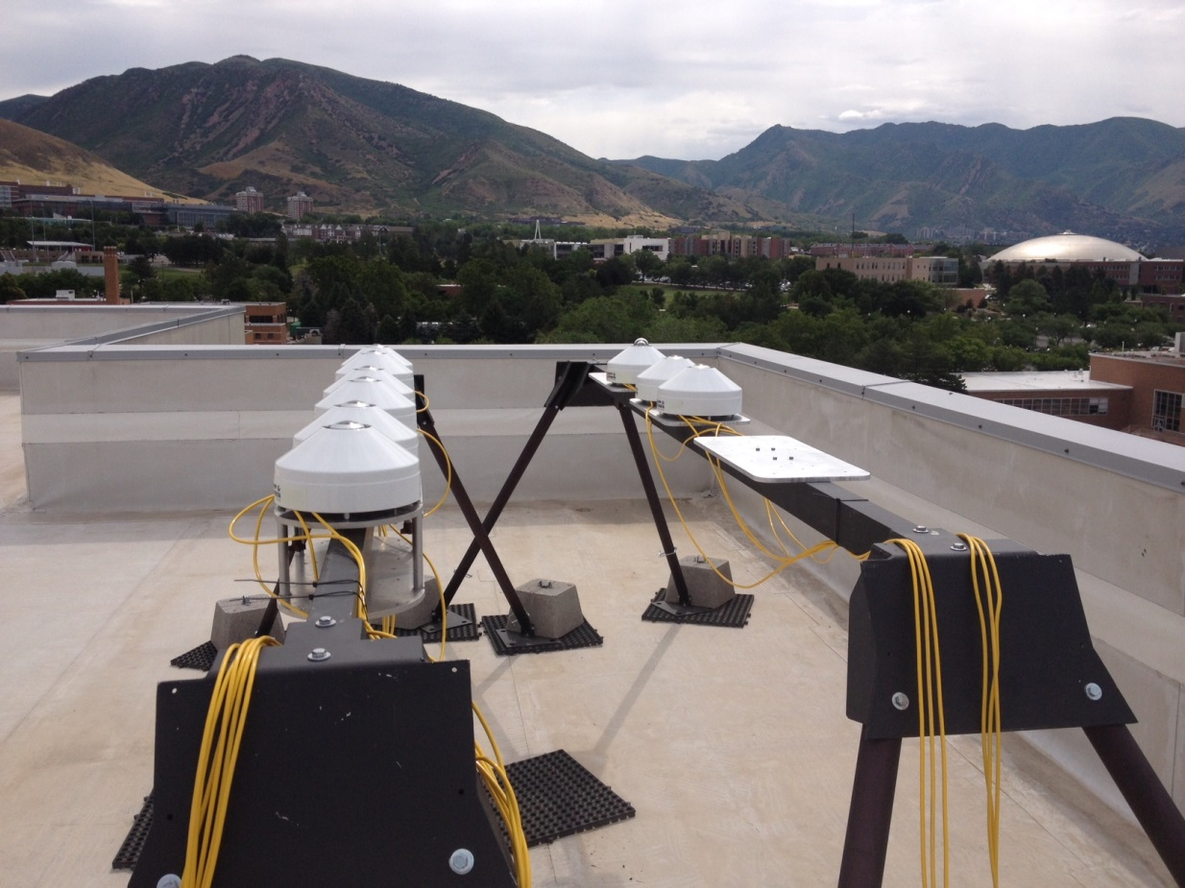
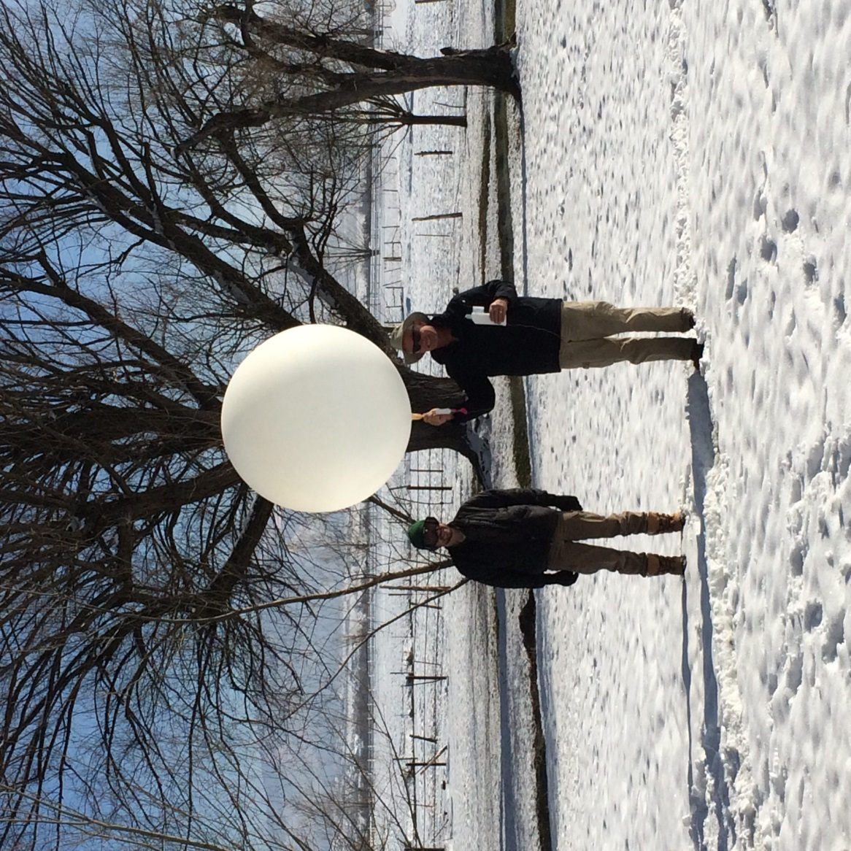
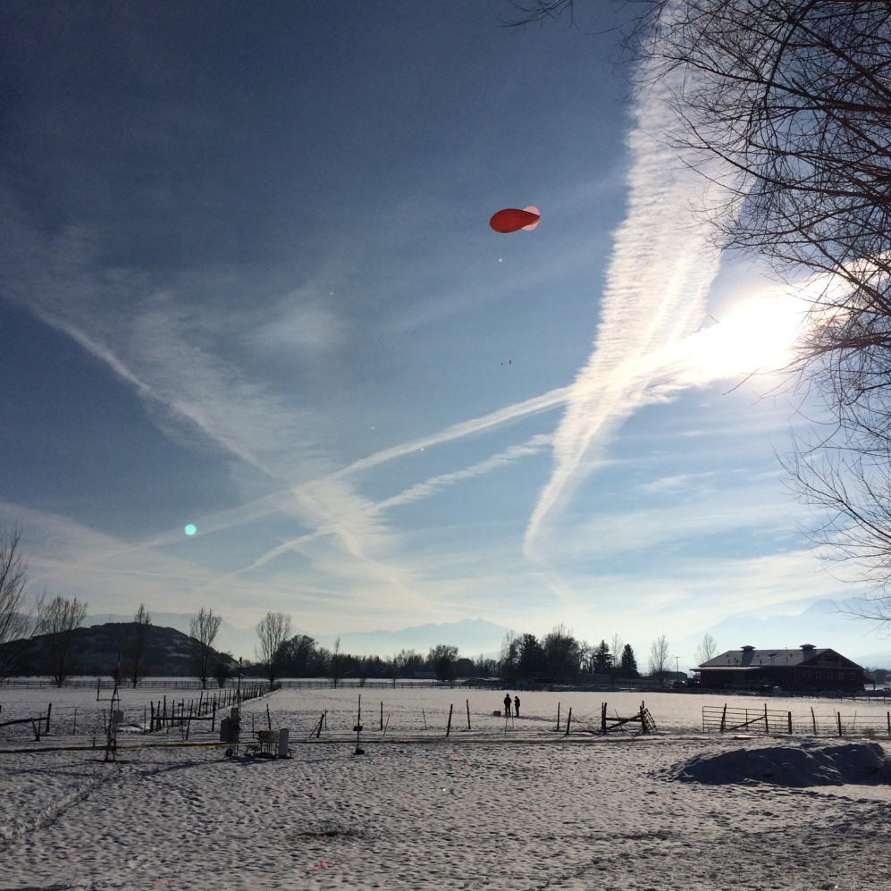
Radiosondes
Full radiation budget
Flow and turbulence
Particle counters
Visibility
Nephelometer
Camera
Temp and RH
Lidars and MWR
Gultepe, I., Fernando, H.J.S., Pardyjak, E., Hoch, S.W., Silver, Z., Creegan, E., Leo, L.S., P, Z., de Wekker S., Hang, C., Mountain Ice Fog: Observations and Predictability" Pure and Applied Geophysics, Revision submitted.

Slide 16
MATERHORN-X Results
- An example

Slide 17
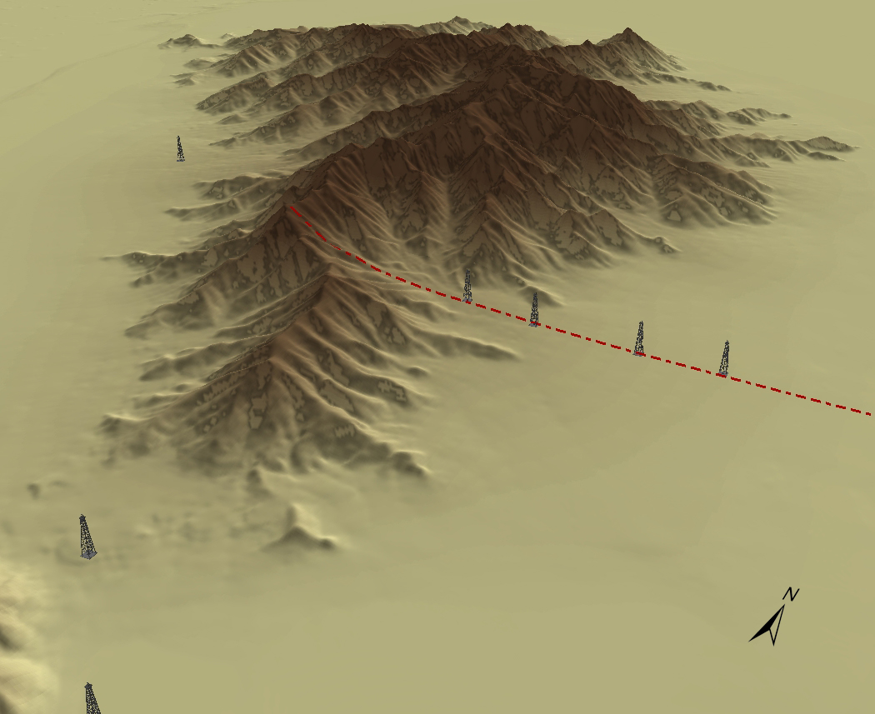




Flow Collisions
ES5
ES4
ES3
ES2
600 m
700 m
600 m
Lidar

Slide 18
East Slope LiDAR - 4:41– 5:11 UTC (22:41 – 23:11 MDT)

Slide 19
Secondary
Collisions
Notes:
Time series of UU LiDAR data located at the EFS-Slope site. This event is a secondary collision between the downslope (red) and valley flow (blue). (A) 5:41 UTC, a very weak thin layer of downslope flow is present . (B) 5:56 UTC, shortly after the moment of the secondary collision and the surge of turbulence observed in Figure 4.11. (C) 6:11 UTC, piled up downslope flow, flows over the undercutting valley current. please use arrows to show these features

Slide 20
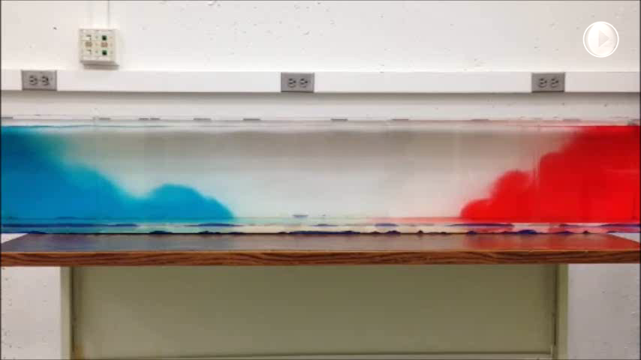
Gravity Currents Collide
4:41 UTC (22:41 MDT)
4:54 UTC (22:54 MDT)
5:11 UTC (23:11 MDT)

Slide 21
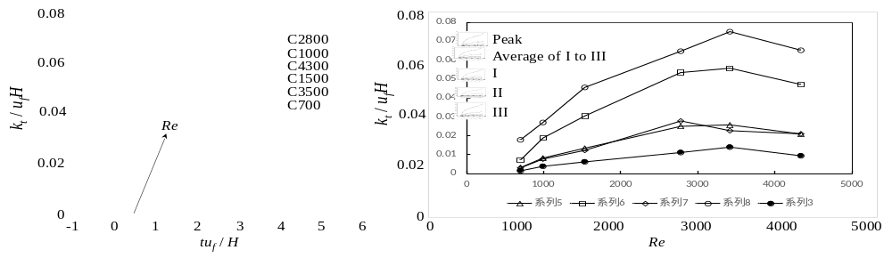
Eddy Diffusion Coefficient
for Modelers

Slide 22
MATERHORN-M
...Improving predictability on mesoscale

Slide 23

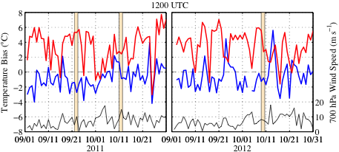
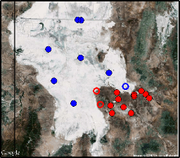
Example - Improving Surface Forecasts
Issue: Atmospheric models (e.g., WRF) are too warm at night over the
sagebrush region at DPG (systemic)
Implications: Poorly simulated NBL -> errors in the prediction of
near-surface winds and turbulence, dust emissions and transport, etc.
Massey, J. D., W. J. Steenburgh, S. W. Hoch, and J. C. Knievel, 2014: J. Appl. Meteor. Clim., 53, 1976–1996.
Notes:
Left: Dugway area, stations in blue are playa stations, red are sagebrush stations
Right: Mean errors for playa (blue) and sagebrush stations (red) showing very large warm biases in the early morning (1200 UTC/0500 MST) over the sagebrush area.
Similar errors have been observed in other regions. There are implications for PBL strength and surface wind and turbulence forecasts as well – as well as issues getting dust emissions and transport right in models that attempt to parameterize this.

Slide 24
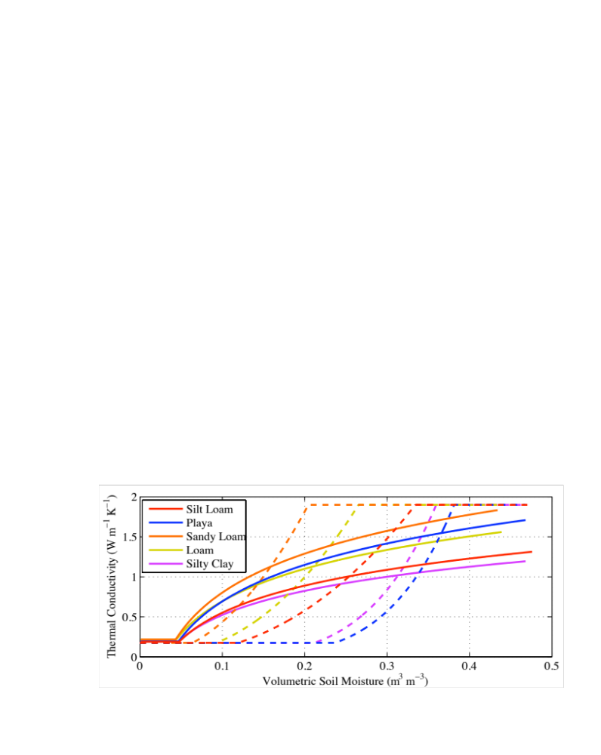
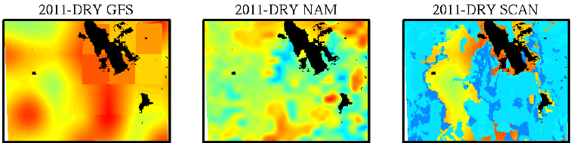

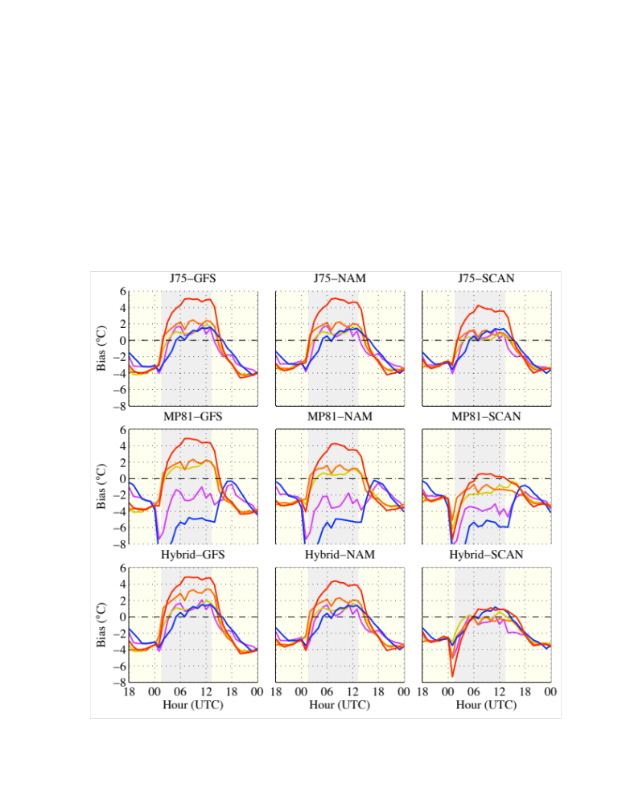


Example - Findings and Advances
Error Sources: Initialization of soil moisture; Parameterization of soil thermal conductivity
Advances: Improved initialization and parameterization of soil characteristics
Remaining Challenge: Improving soil moisture analyses in data sparse regions
Notes:
We have identified the initialized soil moisture and parameterization of soil thermal conductivity to be important sources of error. The top left figure are 3 different 5cm soil moisture analyses for one case. The SCAN soil moisture (right most map) is created from observations and is the driest. Top right are 2 different soil thermal conductivity parameterizations, which are a function of soil moisture and soil type. The solid lines are what’s currently in the WRF, and the dashed lines for silt loam and sandy loam soils are used in our hybrid runs.
Materhorn surface energy balance observations help to confirm this. During materhorn we measured soil thermal conductivity, soil moisture, and surface energy balance components and all observed values matched better with our hybrid-scan wrf run than our control runs.
These changes led to better nighttime 2m temperature forecasts. Bottom left shows model results using the old analysis and parameterization. Note the large nighttime positive bias, especially for silt loam soil textures, which is the soil texture class of the sagebrush region. Bottom right shows the new approach. The forecast is much better at night, but the afternoon cool bias remains. The cool bias at 1Z was unique to this case.

Slide 25
MATERHORN-P
Improve mixing parameterizations
via improved physics
(observations, high resolution simulations, laboratory experiments)
Implement them in models
ND

Slide 26
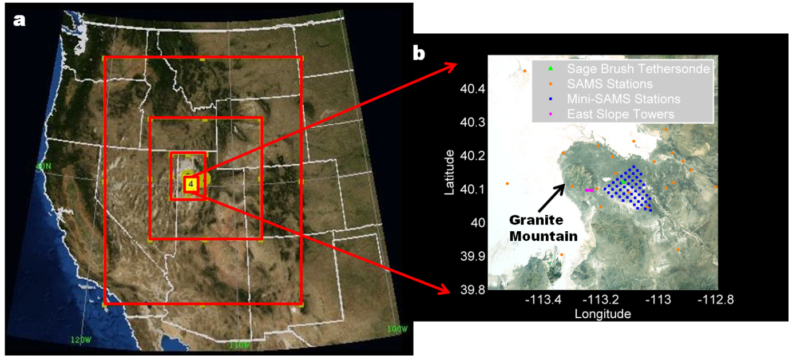
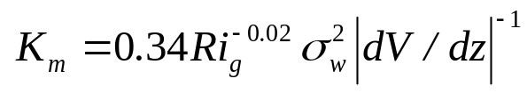

Evaluation of PBL Schemes in WRF using MATERHORN Data
(started with Massey et al. surface properties)
Dimitrova et al.
BLM, 2016
Yonsei University - YSU (Hong et al. 2006)
Asymmetric Convective Model - ACM2 (Pleim, 2007a)
Mellor-Yamada-Janjic - MYJ (Janjic, 1990)
Mellor-Yamada Nakanishi and Niino Level 2.5 – MYNN (Nakanishi and Niino, 2006)
Bougeault and Lacarrere - BouLac (Bougeault and Lacarrere, 1989)
Quasi-Normal Scale Elimination - QNSE (Sukoriansky et al. 2005)
YSU Modified

Slide 27
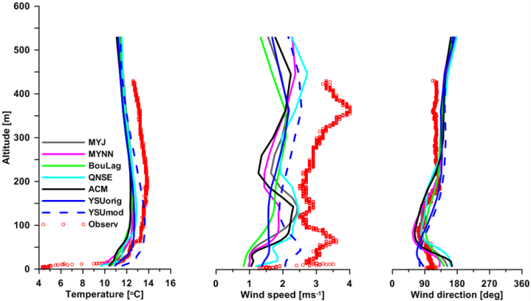
Vertical profile comparison between different PBL schemes and tethered-balloon soundings at SB site, IOP 8
Dimitrova et al. (2016) Boundary Layer Meteorology, 120(10), 6897-6913.
Notes:
for IOP8, October 18, 2012 at 2203-2228 MDT

Slide 28
MATERHORN-T
...pushing technological frontiers

Slide 29
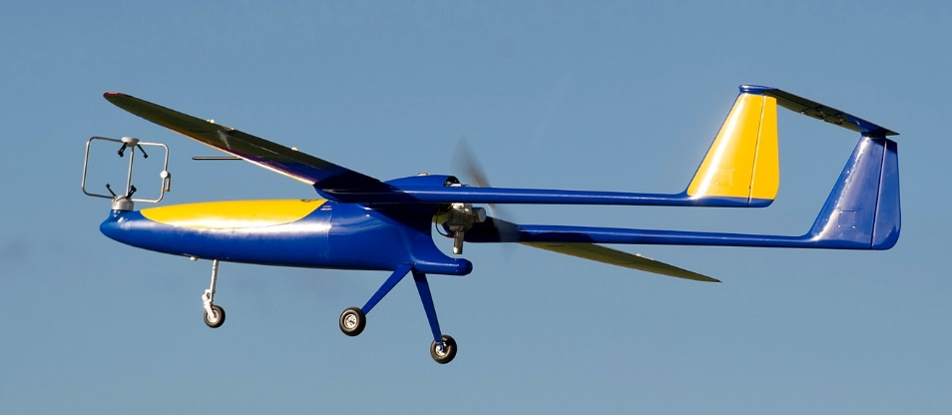
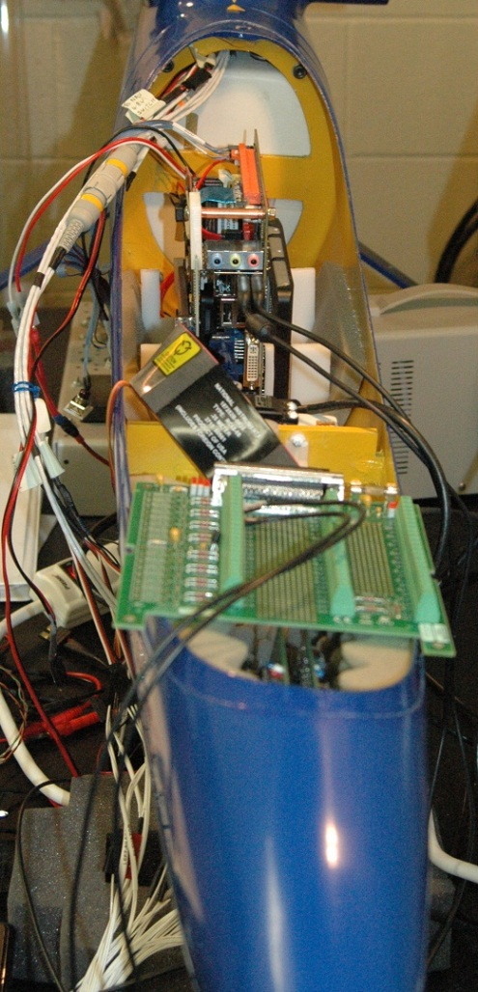
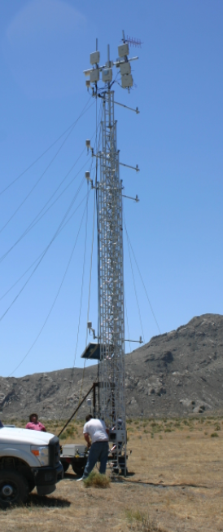
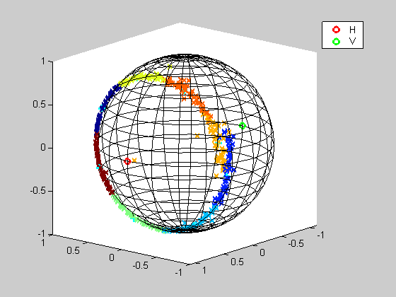
Unmanned Aerial Vehicle
  Temperature, humidity, wind velocity
  Turbulent components (combo probe) up to Kolmogorov
  Onboard data acquisition
  Automated flight tracks
  Fog droplet size distribution (FASS)
Designed, Constructed and Deployed three-frequency sensor systems to collection RF polarimetric data – for moisture (RF Cross-wires)
- Extensive data, two MATERHORN sites, moisture calibration
- Developed theoretical electromagnetic modeling
- Field Research Vehicle (DURIP)
Ground Reflections
System deployed on tower near east slope of Granite Mountain
Polarization Response

Slide 30
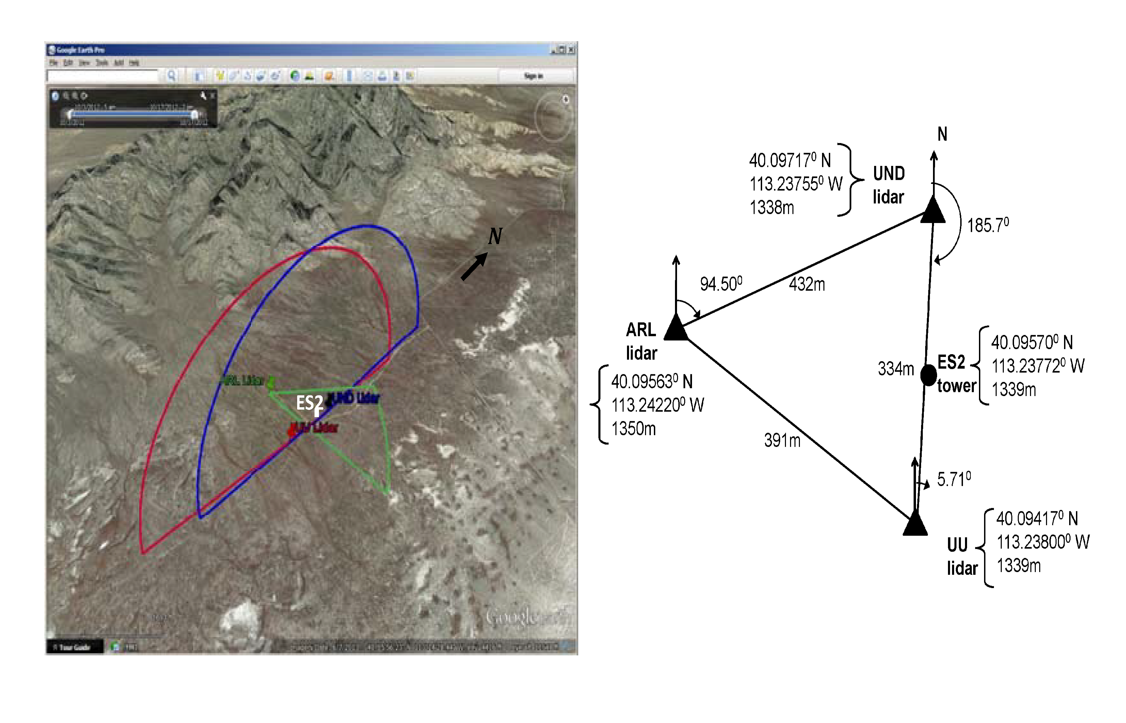
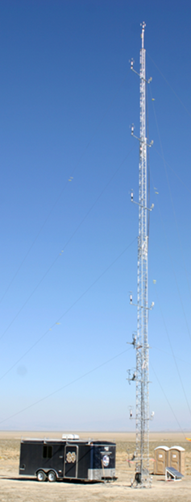
Triple Lidar deployment
MATERHORN FALL 2012
Wang, Y., Creegan, E., Felton M., Huynh, G., Hocut, C., Fernando, H.J.S., Hoch, S., Whiteman, C.D., “Triple Doppler wind lidar observations during the MATERHORN field project" Journal of Applied Remote Sensing, 10(2), 026015 (2016).

Slide 31
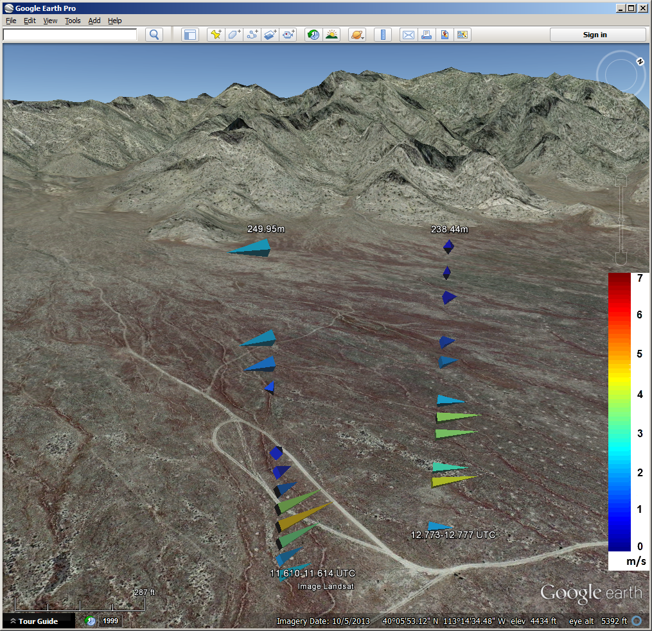
Virtual Tower using Triple Lidar!
Examples of vertical profile (virtual towers) 3D wind vectors retrieved from coordinated triple Doppler wind lidars scanning on 7 October 2012. The down valley low-level jet was evident in these virtual towers at 11.61 to 12.77 UTC (0537 to 0646 MDT). The horizontal distance between two virtual towers is 134 m.
Notre Dame will purchase
a Triple Lidar System
– A DURIP Grant/ONR
– First from Halo Photonics
Streamline®

Slide 32
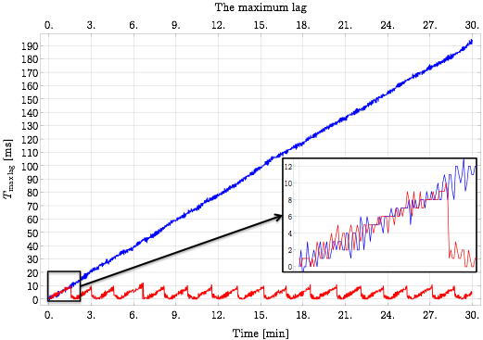
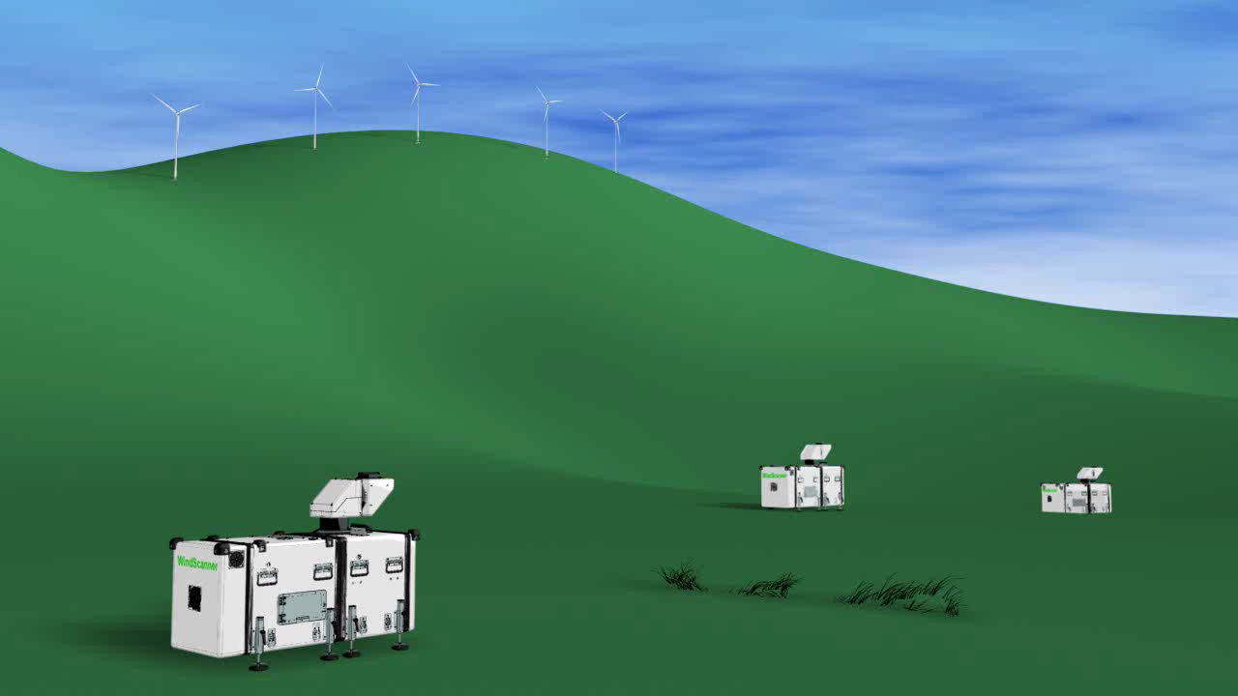

Long-range WindScanner system
Courtesy: Nikola Vasiljević
Without master computer
Threshold 10 ms
Master computer
Threshold 10 ms
With master computer
WindScanners coordinated by a remote master computer
Coordination can be achieved using any type of network
WindScanners are synchronized
Arbitrary scanning trajectories
Measurement rate can be dynamic from one LOS measurement to another
Distances which the LOS measurements are acquired can be dynamic as well
Flexible remote sensing measurement system that can accommodate wide range of atmospheric experiments
Notes:
The Ph.D. project focused on the development of a system of coherent Doppler scanning lidars, known as the long-range WindScanner system, for three-dimensional measurements of wind velocity fields within a large volume of the atmospheric boundary layer.

Slide 33
Special Journal Issues
AMS Journals – special collection (Zhaoxia Pu as the editor) - afoot
Boundary Layer Meteorology (Silvana Di Sabatino as the editor) – completed, 9 papers
Environmental Fluid Mechanics (Eric Pardyjak as the editor)
Bams

Slide 34
Major accomplishments – Year 4
  40 papers published or accepted (21 in 2015);
  09 submitted (many in preparation);
  19 Invited conference presentations (8 in 2015);
  07 conference papers ( 0 in 2015);
  124 conference presentations (43 in 2015)
  9 Awards and 2 recognitions (4 in 2015)
personnel

Slide 35
Summary (End of 4rd year)
Senior PIs: 11
Research faculty: 4 , 5, 5
Technical staff: 8, 8
Post docs: 8 13, 13
Graduate Students : 18, 22, 18 PhD and 9 MS (Total 27)
Undergraduate Students: 13 22, 25
Collaborators (proposal): 5 (supported – 2), 5 (3)
Collaborators : 11, 10
(total supported fully or partially: 67 82, 89 )
timeline

Slide 36
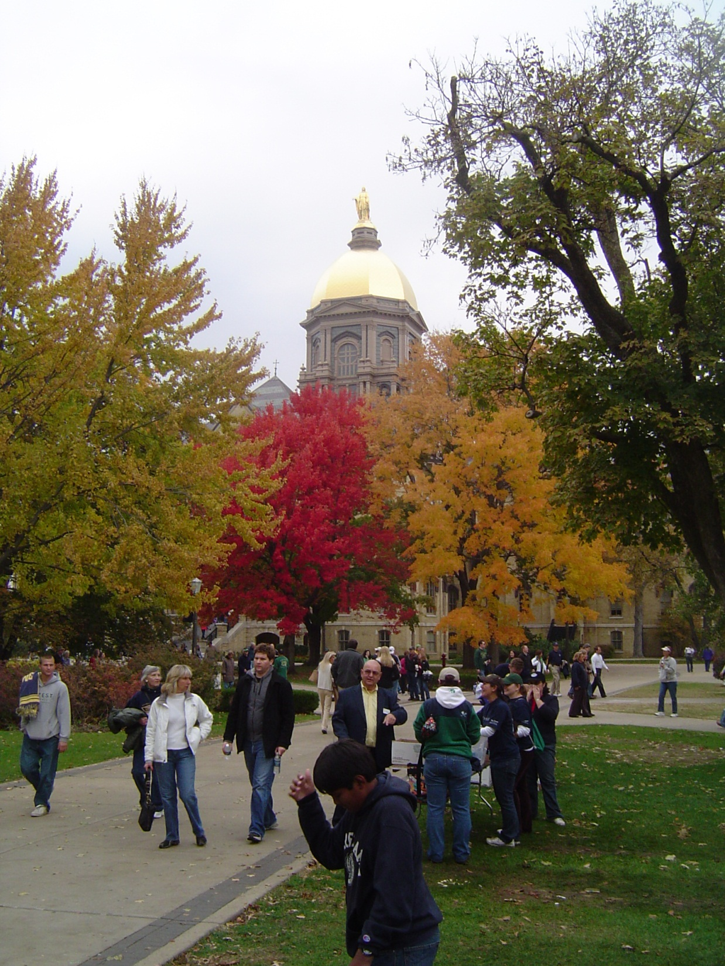


Thank you

Slide 37



Proper Orthogonal Decomposition of Velocity Vectors
Mat M
10/19/2012 21:59 MDT
10/19/2012 03:59 UTC

Slide 38



Ex: Immersed boundary method (IBM) development
Chow - UC Berkeley
Terrain following coordinates
(traditional WRF)
Immersed boundary method
(terrain immersed within Cartesian grid, WRF-IBM)
New algorithm development for surface similarity theory (log law)
Preliminary simulations of drainage flows over Granite Mountain with WRF-IBM

