Slide 1

Dispersion simulations of inline HYSPLIT for Sagebrush tracer experiment
Fong (Fantine) Ngan ^{1,2} and Ariel Stein ¹
¹ NOAA/Air Resource Laboratory, College Park, Maryland
² Cooperative Institute for Climate and Satellites, University of Maryland, College Park, Maryland
20th Annual George Mason University Conference
on Atmospheric Transport and Dispersion Modeling
June 14-16, 2016

Slide 2
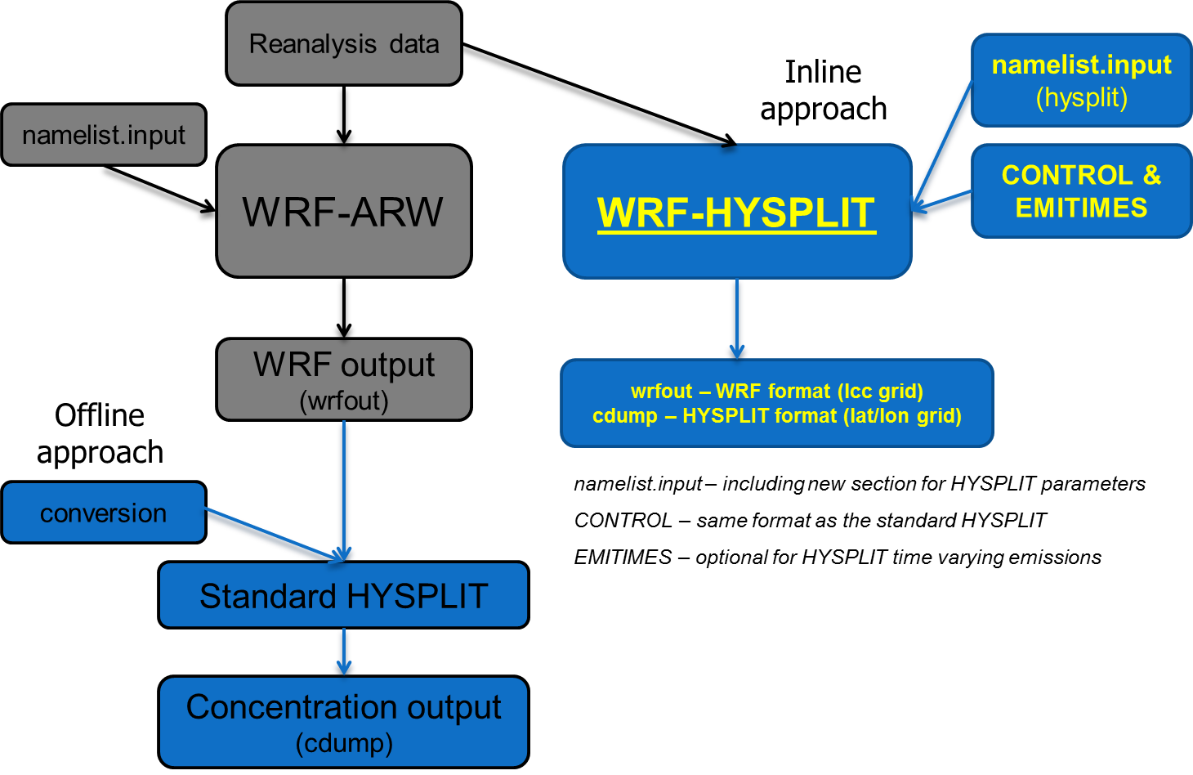
Diagram of inline and offline coupling

Slide 3
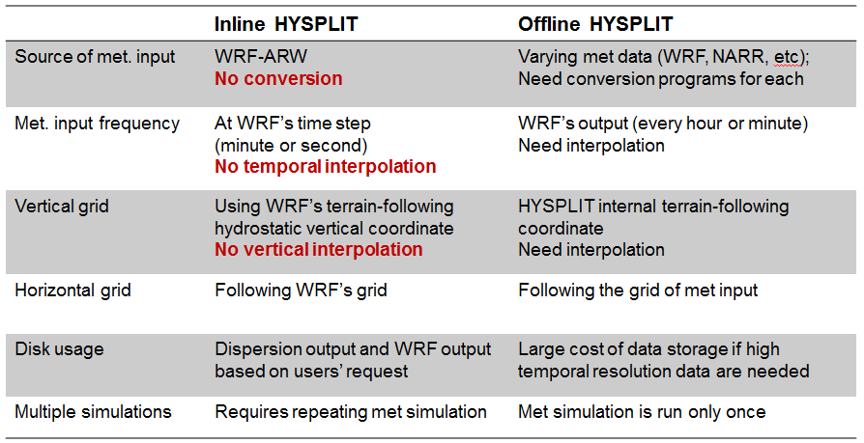
Comparison of inline and offline approaches
Publication: Ngan et al. (2015) http://dx.doi.org/10.1175/JAMC-D-14-0247.1
The inline WRF-HYSPLIT website: http://www.arl.noaa.gov/WRF_inline.php

Slide 4
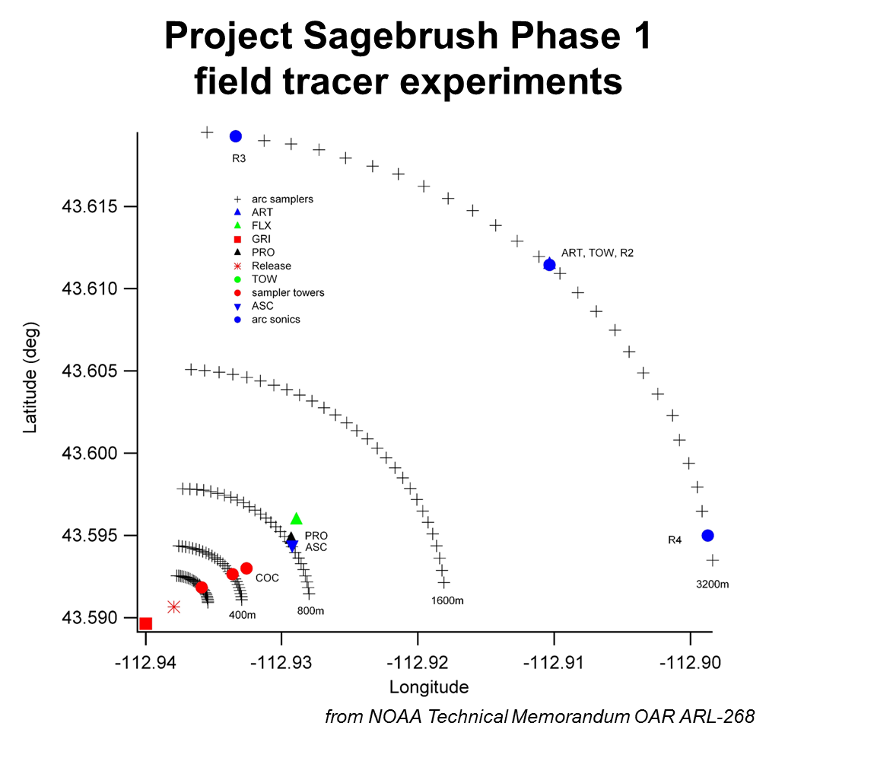
Sagebrush tracer experiment
Conducted by ARL’s Field Research Division

Slide 5
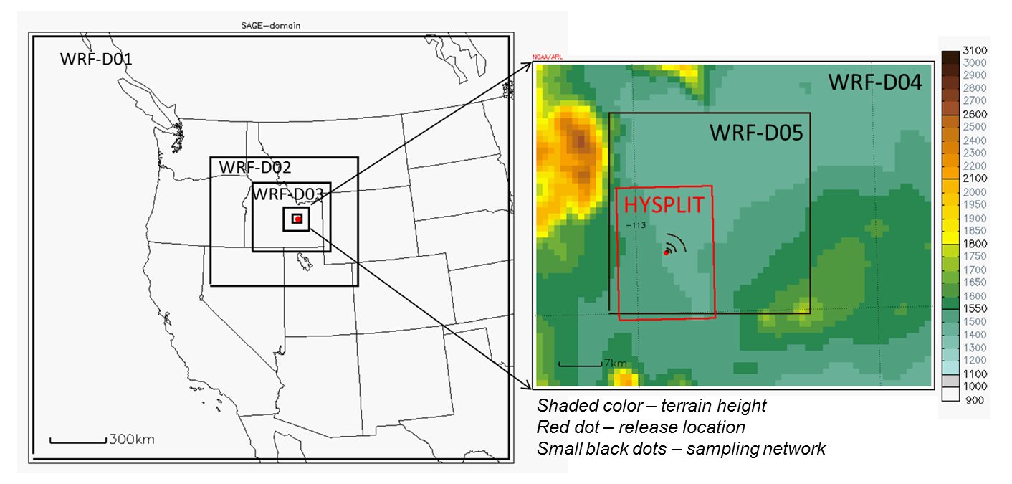
Domain configuration
Horizontal grid: 27km, 9km, 3km, 1km and 333m
Vertical coordinate: 33 layers with the 1st mid-layer at around 8m and 20 layers included below 850 hPa.
Simulation period: 2013/10/07 00UTC – 10/08 00UTC

Slide 6
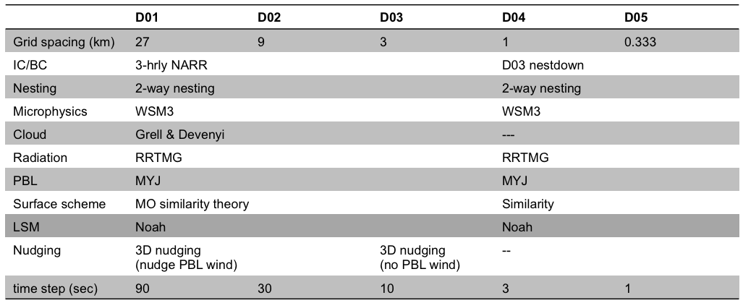
WRF model configuration

Slide 7
HYSPLIT model configuration
Tracer: SF₆
Sampling network: 10-minute interval for 2 hours
Release location: Idaho National Laboratory
Release time: 1930 UTC on 7th October 2013
Release duration: 2.5 hours
Release rate: 35748 g/hr with 250,000 particles
HYSPLIT grid: ~11 m (horizontal)
50 m (vertical)
WRF data frequency: 5-minute for offline
using WRF time-step for inline

Slide 8
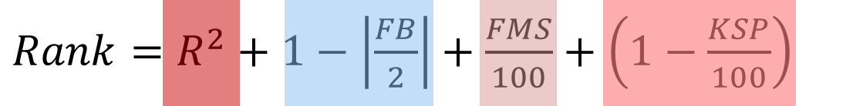

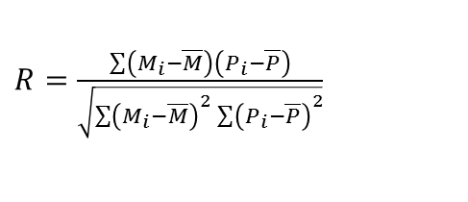


Statistical metrics
(Draxler 2006)
$R=\frac{\sum{\left(M_{i}−\overline{M}\right)\left(P_{i}−\overline{P}\right)}}{\sqrt{\sum{{\left(M_{i}−\overline{M}\right)}^{2}\sum{{\left(P_{i}−\overline{P}\right)}^{2}}}}}$
Correlation coefficient (R)
Fractional bias (FB)
$FB=2\frac{\left(\overline{P}−\overline{M}\right)}{\left(\overline{P}+\overline{M}\right)}$
Figure of merit in space (FMS; %)
$FMS=100\frac{N_{p}∩N_{m}}{N_{p}∪N_{m}}$
Kolmogorov-Smirnov parameter (KSP; %)
$KSP=Max\left|D\left(M_{k}\right)−D\left(P_{k}\right)\right|$
NOTE: “M” – measured tracer concentrations
“P” – predicted tracer concentrations
N is number of samples and “D” is the cumulative distribution

Slide 9
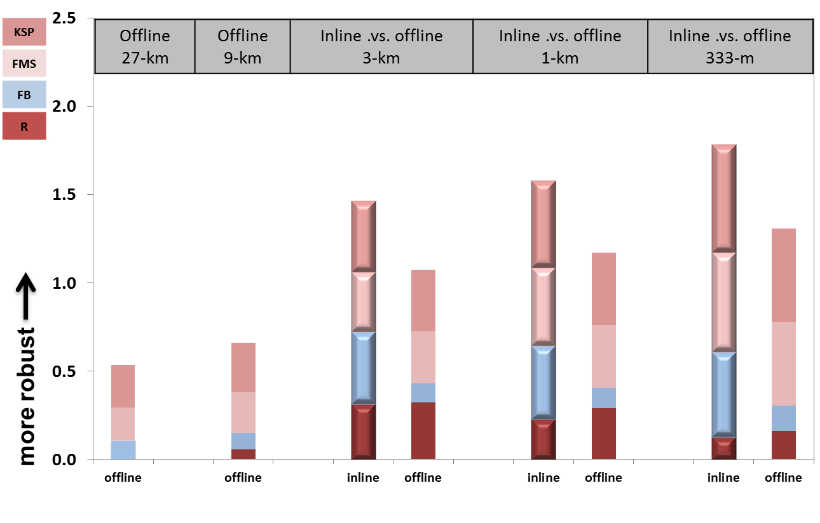
Dispersion results using different grid spacing (3-km, 1-km & 333-m) and coupling approaches (inline and offline)
Inline HYSPLIT showed significant improvement compared to the offline approach for the Sagebrush case. The fractional bias of the inline plume was much lower than that of the offline plume calculated with different meteorological model resolutions.

Slide 10
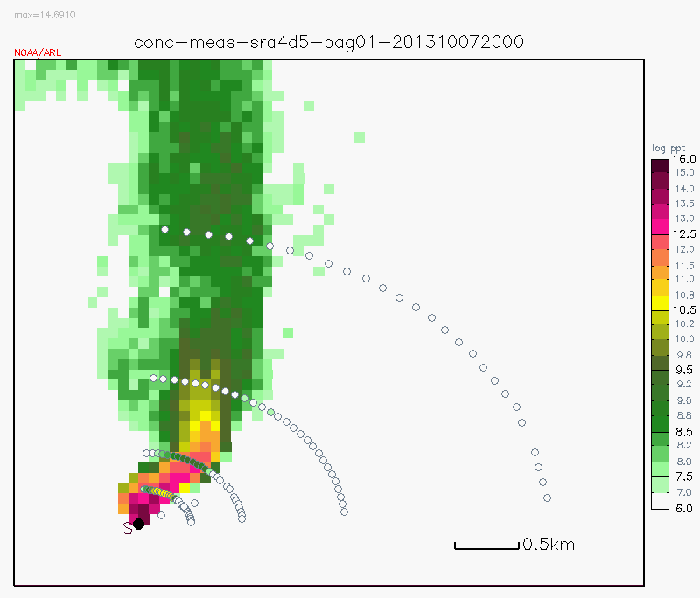
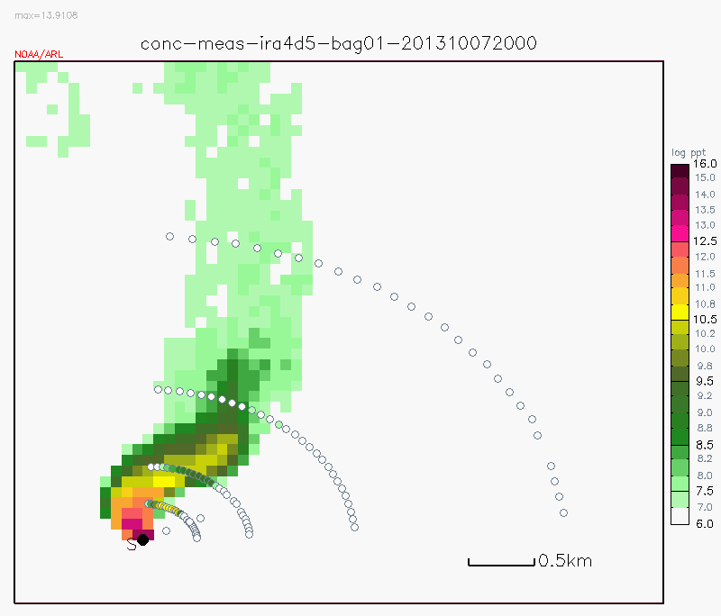

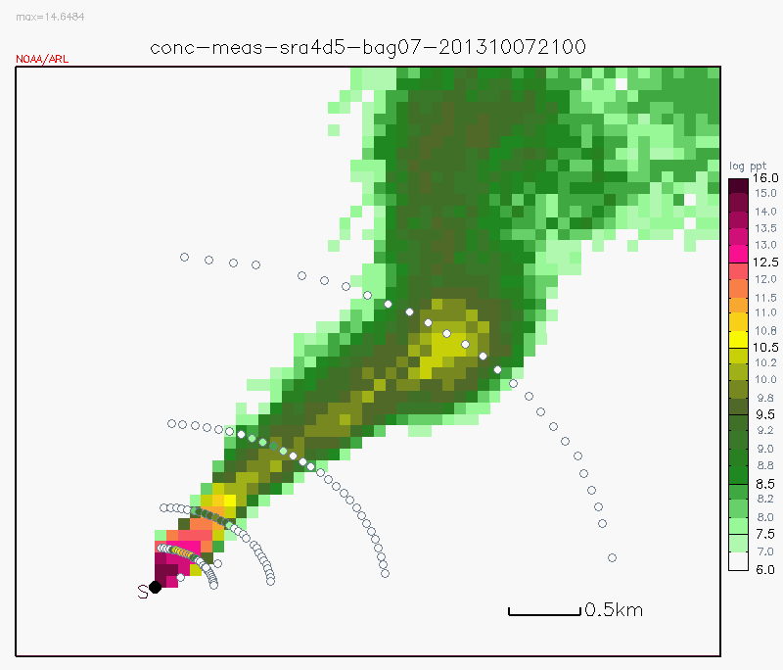
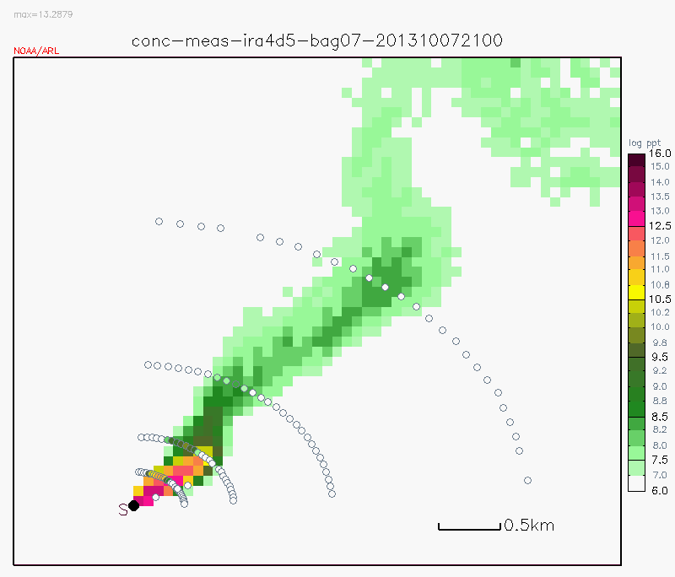
Spatial plots of tracer concentrations, color dots: measured concentrations, unit: log ppt
offline
Sample time #1
inline
Sample time #1
offline
Sample time #7
inline
Sample time #7

Slide 11
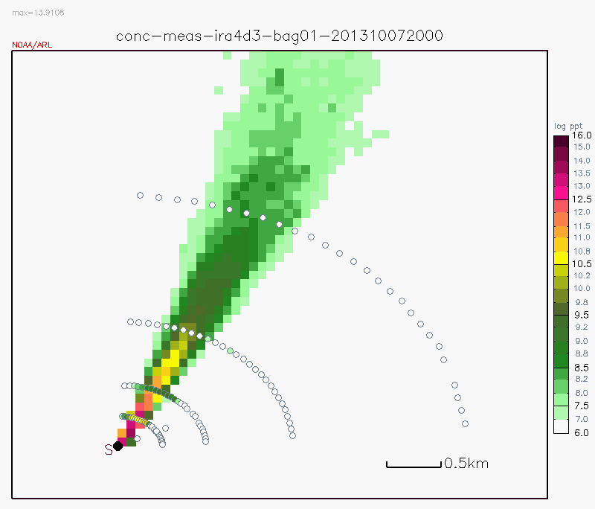
Inline dispersion results using WRF 3-km and 333-m grid spacing
The model plume simulated using the WRF data in 3-km grid spacing was moving toward northeast throughout the sampling period with large overestimation in the downwind area.
Using fine resolution WRF data (333-m grid spacing), the statistic scores got better in both offline and inline simulations.

Slide 12
Impact of vertical layers on dispersion results
“inline”
“offline”
“off-lvl”
Layer | Inline layer height (m) | Offline (default) layer height (m) | Offline (enhanced) layer height (m)
 | Sagebrush
1 | 7.8 | 10 | 5
2 | 23.7 | 30 | 16
3 | 43.4 | 70 | 33
4 | 67.1 | 130 | 56
5 | 98.8 | 210 | 86

Slide 13
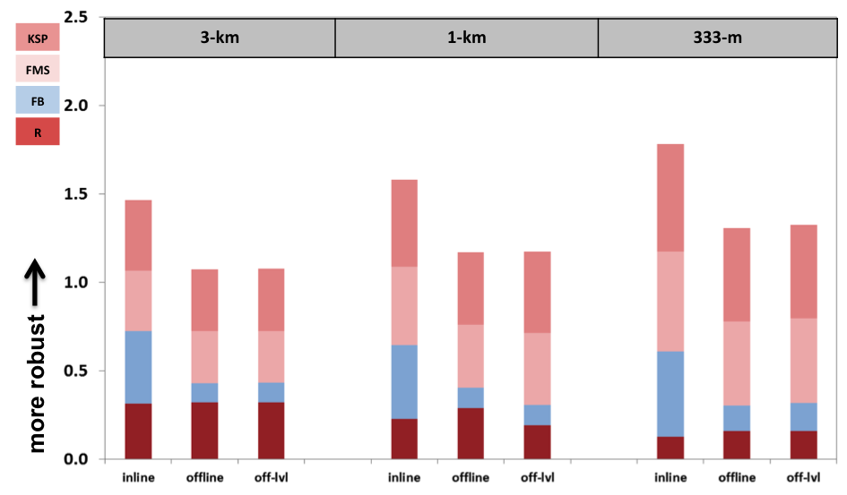
Dispersion results using different grid spacing (3-km, 1-km & 333-m) and coupling approaches (inline, offline and offline with more layers)

Slide 14
Summary
Dispersion simulations for Sagebrush tracer experiment were conducted using the inline coupling of WRF-HYSPLIT and evaluated against measured tracer concentrations.
The inline results outperformed the offline simulations. The inline coupling system is especially beneficial for a scenario that requires the use of fine spatial and temporal resolution to resolve the main dispersion features.
The improvement of the inline over the offline method is attributed to the elimination of temporal and vertical interpolation of the WRF data, as well as using the WRF’s vertical coordinate.

Slide 15
Future Work
Dispersion simulations using the inline approach will be run for other tracer experiments in fine scale for the urban environment and other complex terrain studies.
The inline HYSPLIT will also be tested using different parameters from the WRF model most relevant to plume mixing, stability, and convection.
Website: http://www.arl.noaa.gov/WRF_inline.php
Email: Fantine.Ngan@noaa.gov

