Slide 1

HPAC Analyst
SCIPUFF and Meteorology ANALYSIS Tool
Steven Schneider
Sage, an Xator Company
steven.schneider@xatorcorp.com

Slide 2
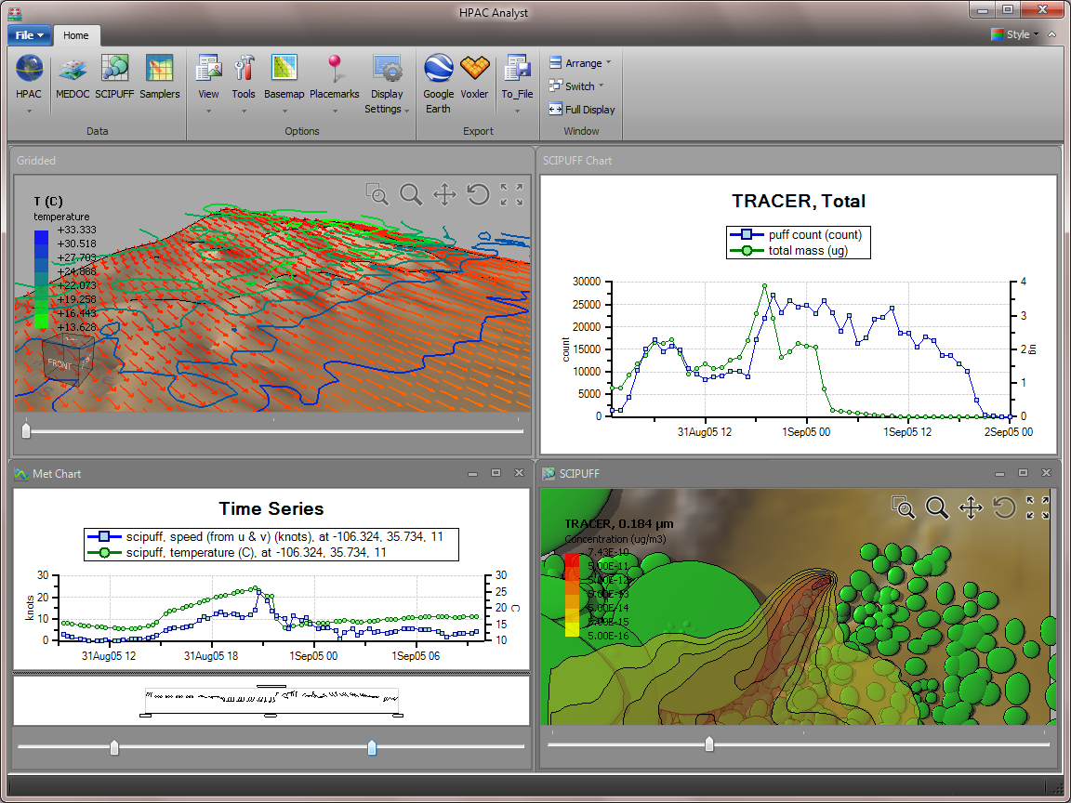
HPAC Analyst
Overview
Data visualization tool for the Hazard Prediction & Assessment Capability (HPAC) program
Supports HPAC projects (*.hzip), MEDOC met (*.mcw, .fmt), and SCIPUFF projects (*.prj)
Unlimited* number of data windows/views of the same or different datasets
* Dependent on memory

Slide 3
Meteorology

Slide 4
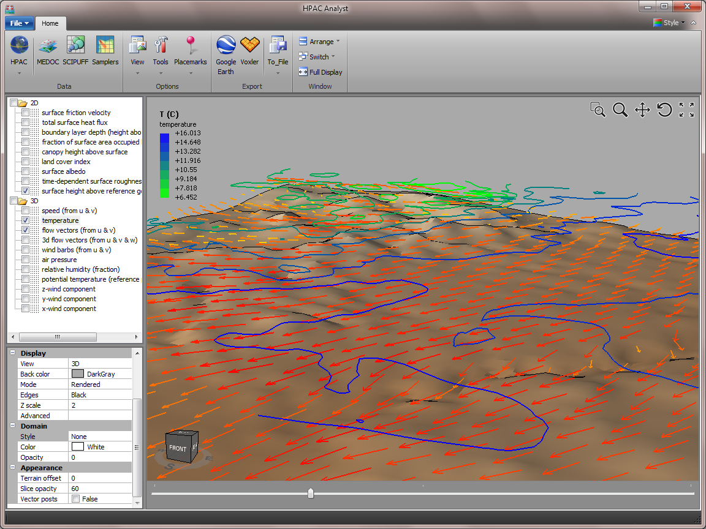
Meteorology
Gridded Met Data
2D and 3D visualization of gridded meteorological data (MEDOC)
Displays terrain, color maps, wind vectors, wind barbs, and contours
Export of full (i.e. time series) datasets to Google Earth or AVI animations

Slide 5
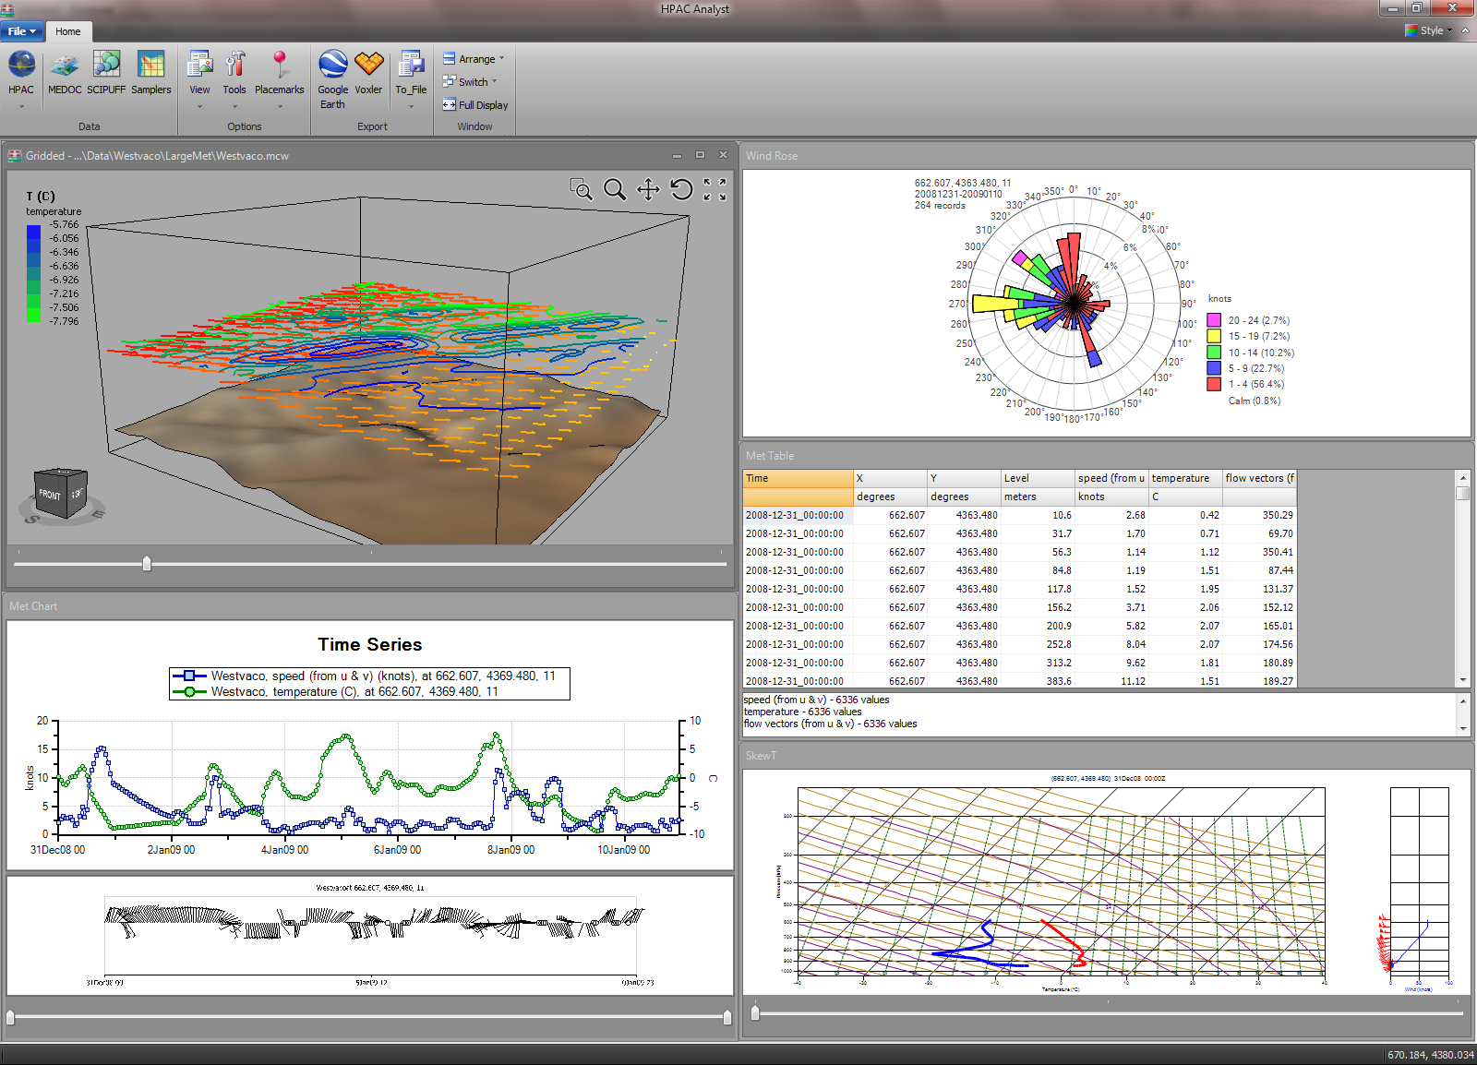
Meteorology
Gridded Met Data
Additional views:
  Time series chart
  Wind rose
  Data table
  Skew-T diagram
Data views can be synchronized to reflect changes in location and time among all displays
Interactive location selection tool in main display to select common met data point for all displays

Slide 6
SCIPUFF

Slide 7
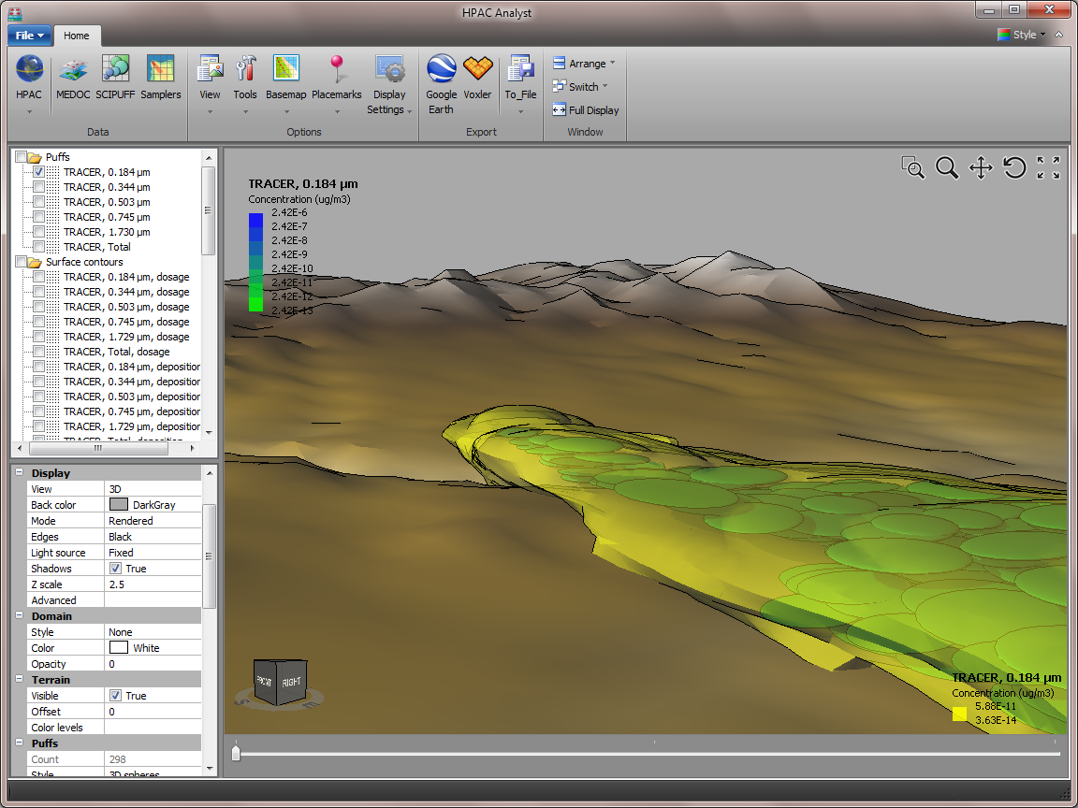
SCIPUFF
Results
2D and 3D visualization of SCIPUFF results
Displays puffs, contours, isosurfaces, surface adaptive grids, and terrain
Puffs can be displayed as points, 2D circles, 3D spheres, vectors, or posts
Export of full (i.e. time series) datasets to Google Earth or AVI animations

Slide 8
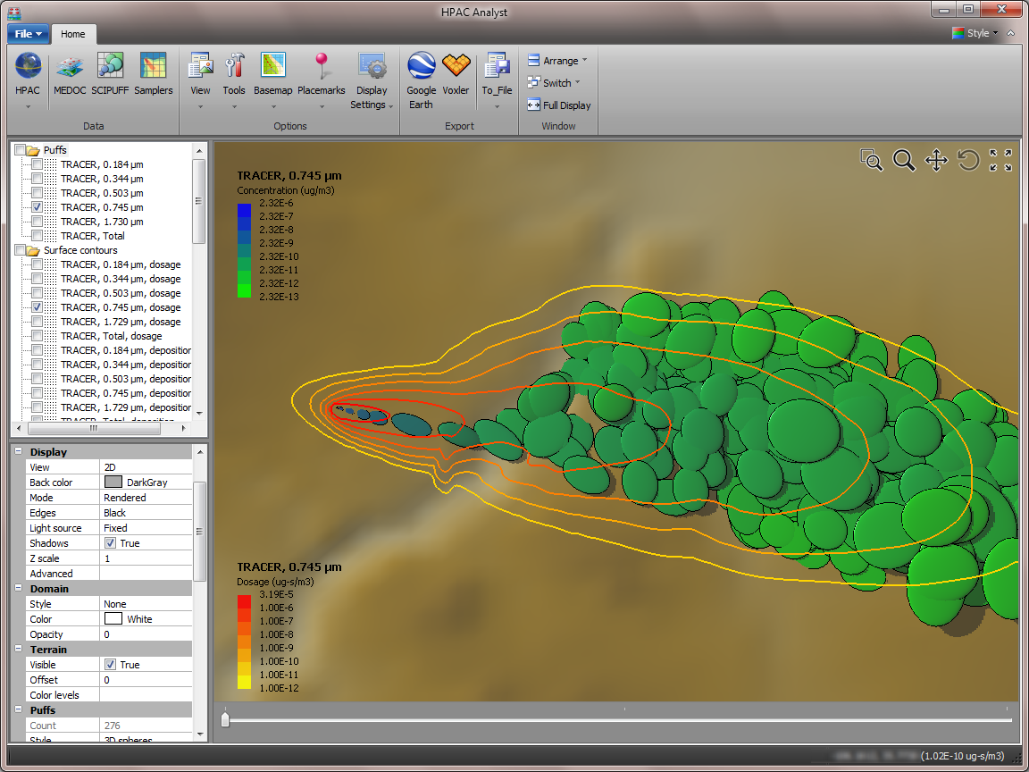
SCIPUFF
Contours
Display of puffs and concentration contours
Interactive sampler tool displays the selected conc/dep/dos value under the cursor

Slide 9
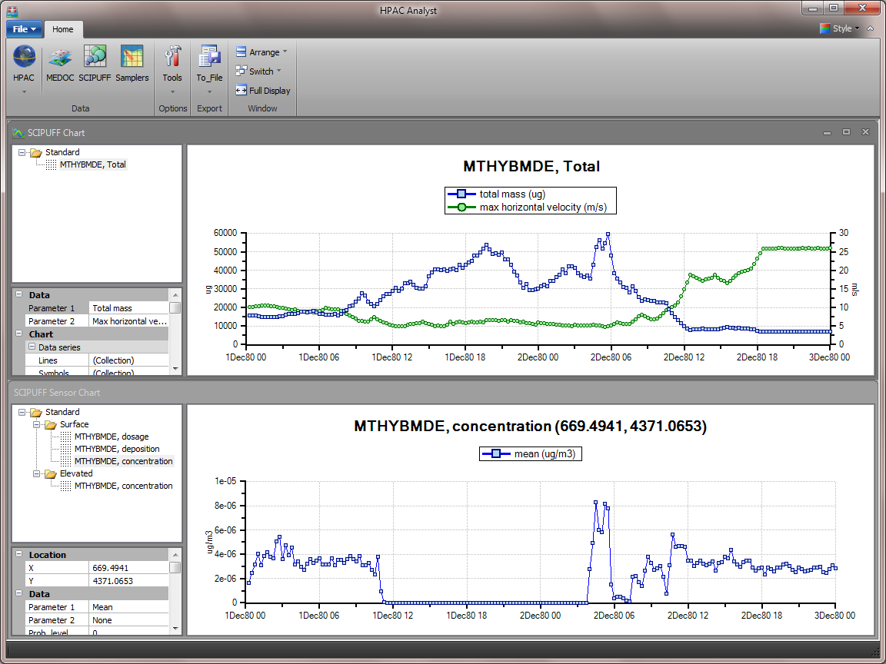
SCIPUFF
Charts
Time series chart of puff statistics with:
  puff count
  total mass
  local mixed layer depth
  puff vert cap height
  horizontal velocity
  vertical velocity
  puff height
  vertical extent
Time series chart of sensor data

Slide 10
Samplers

Slide 11
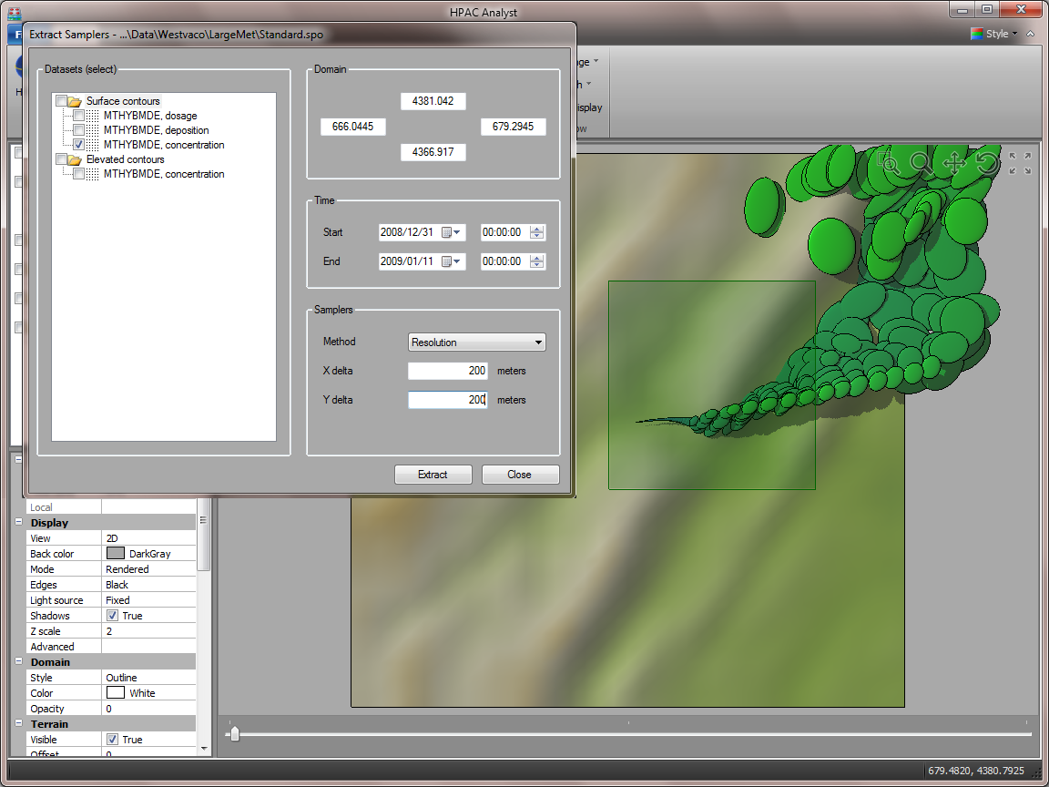
Samplers
Extracting
Extracts samplers of surface concentration, deposition, or dosage, and elevated horizontal slices of concentration
Interactive tool within SCIPUFF display to select region of interest to extract samplers from

Slide 12
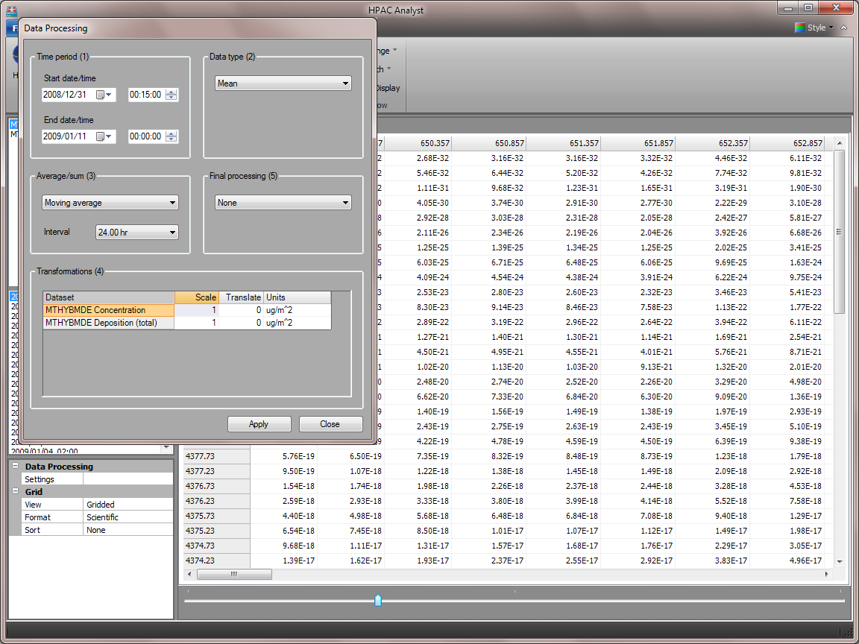
Samplers
Data Processing
Interactive processing with:
  Block, moving, or period average or sum
  Highs, lows, exceedances, thresholds, increases
  Transformation through scaling factors and translations
Processed datasets can be exported to a Sage binary sampler file, Excel spreadsheet, or CSV file

Slide 13
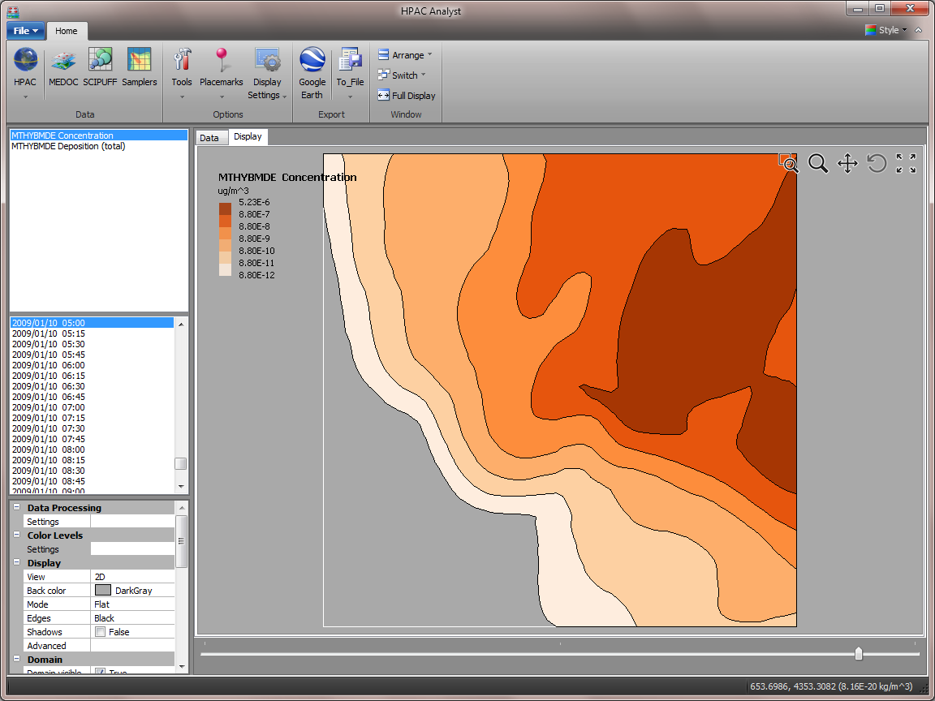
Samplers
Display
Contour plot of 24 hour moving average of concentration
Other displays include:
  spreadsheet
  3D surface plot
  sampler locations with color scale
  Voronoi polygons

Slide 14
Export

Slide 15
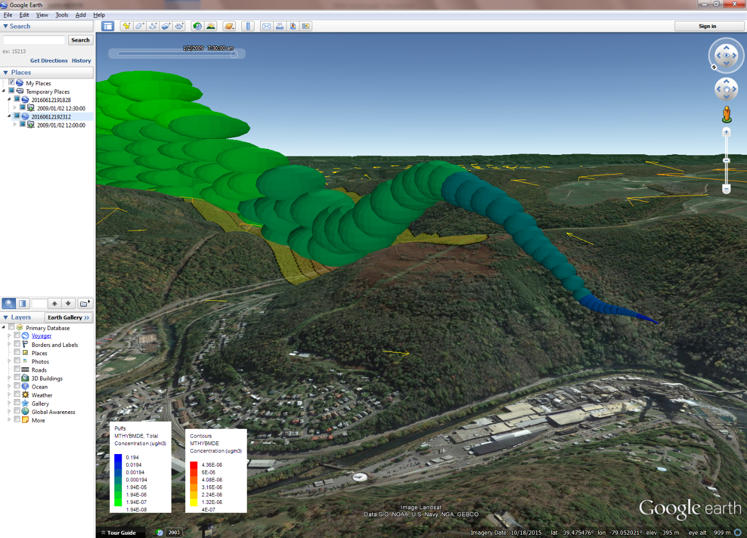
Export
Google Earth
Exports 2D and 3D meteorological data, SCIPUFF results, and sampler data to Google Earth
Supports time series data to perform animations within Google Earth

Slide 16
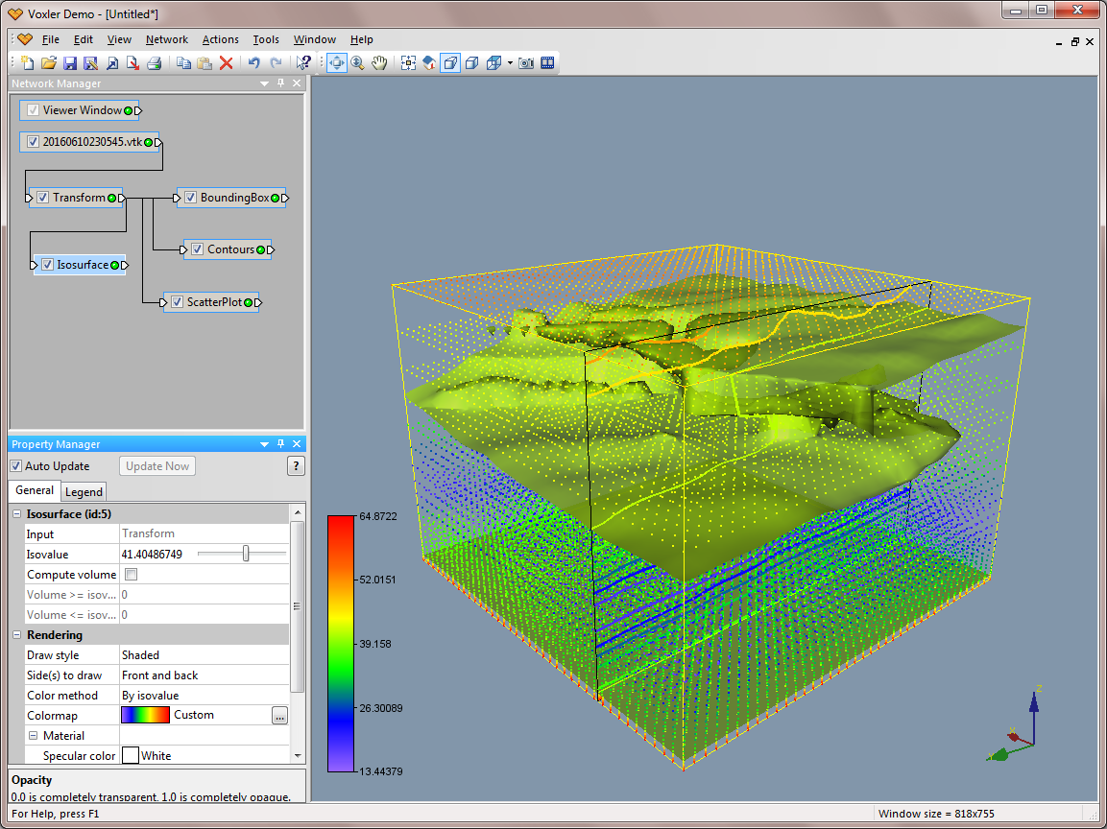
Export
Other
AVI movies
Images (.bmp, .jpg, .png)
Voxler (Golden Software)
VTK (Visualization ToolKit)
Excel
CSV

Slide 17
Examples

Slide 18
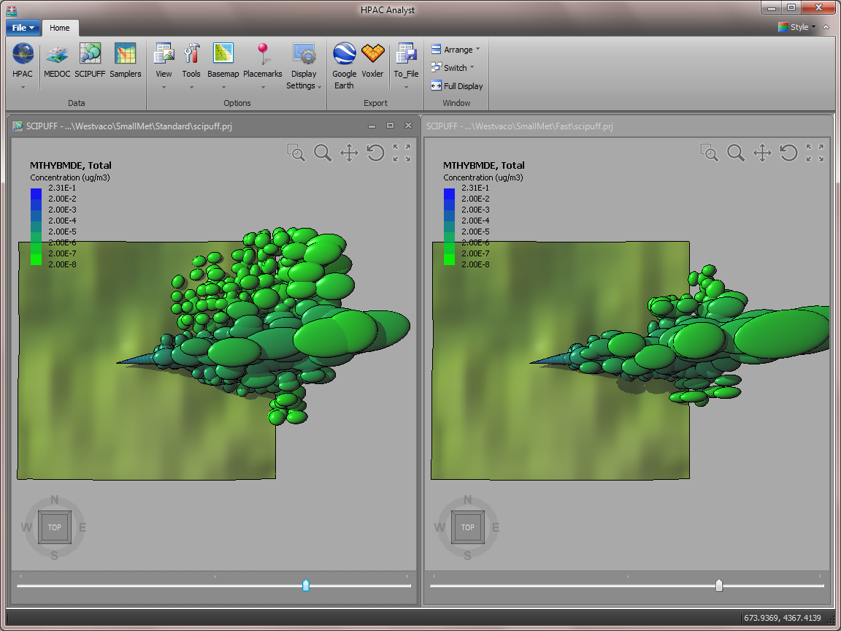
Examples
Fast Mode
Allows puffs to grow larger in the vertical (if the default is selected)
Allows puffs to merge more readily
Restricts the resolution of surface grids (dosage and deposition)
Comparison of puffs between standard and fast modes

Slide 19
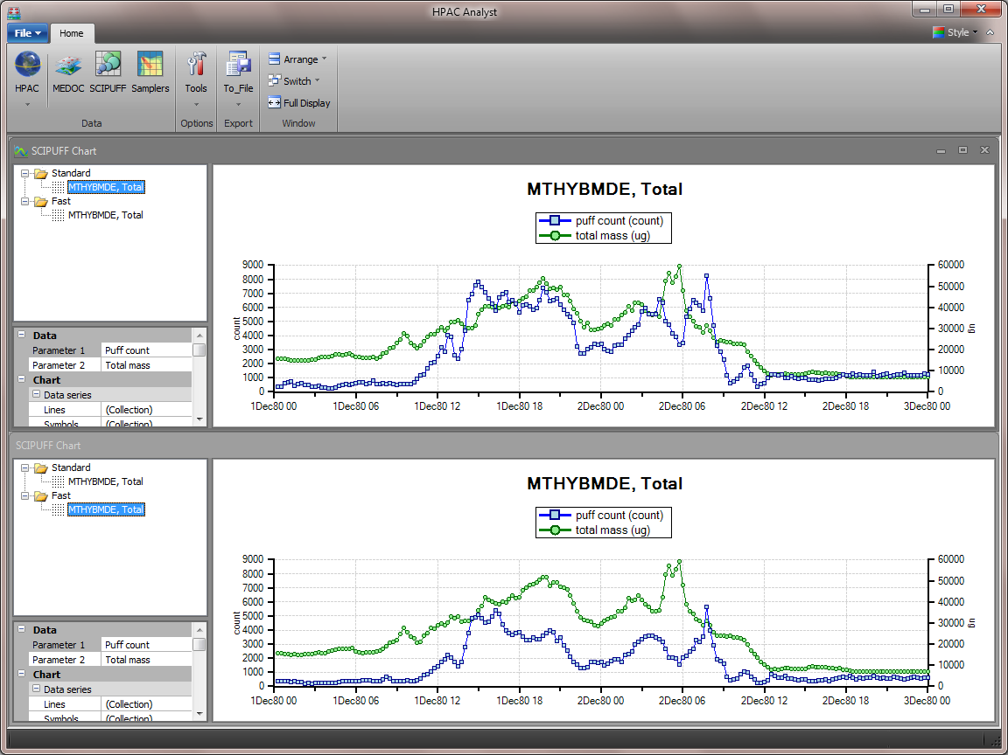
Examples
Fast Mode
Comparison of puff count and total mass between standard and fast mode runs

Slide 20
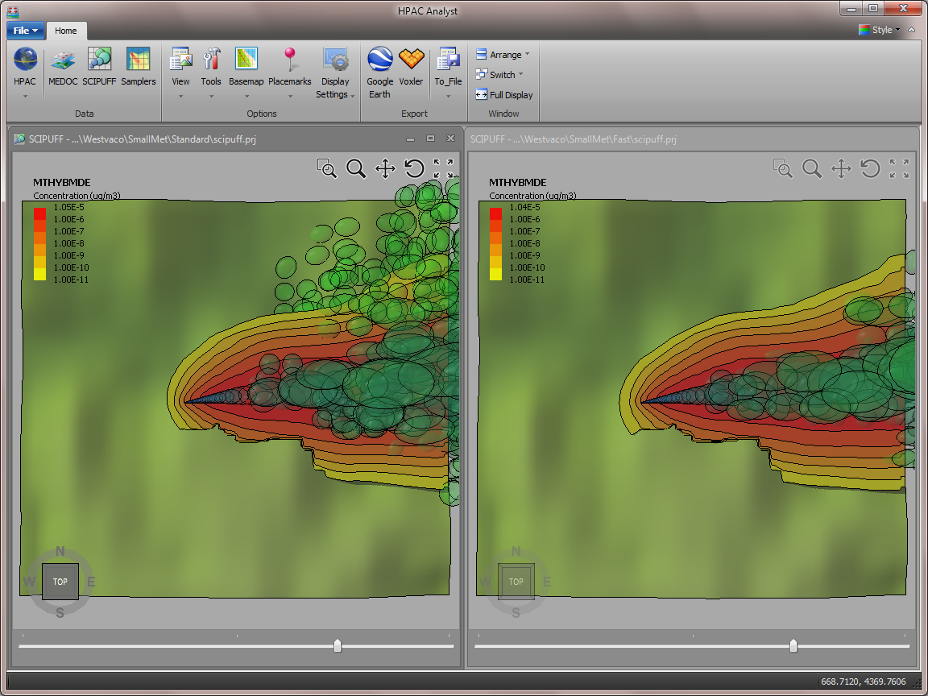
Examples
Fast Mode
Elevated horizontal slice of concentration in standard and fast mode

Slide 21
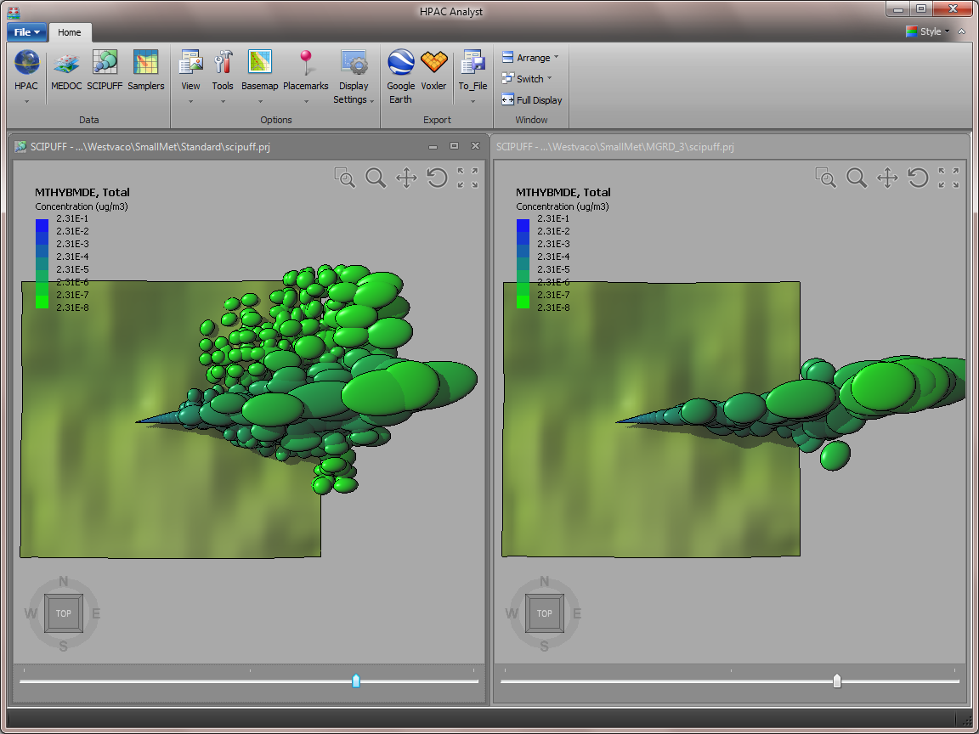
Examples
Grid Resolution Parameter
Controls horizontal puff splitting; critical size is proportional to 2^Value
Reduces the number of puffs in complex situations, but may smooth out small-scale variations
Comparison of puffs between MGRD=2 and MGRD=3 runs

Slide 22
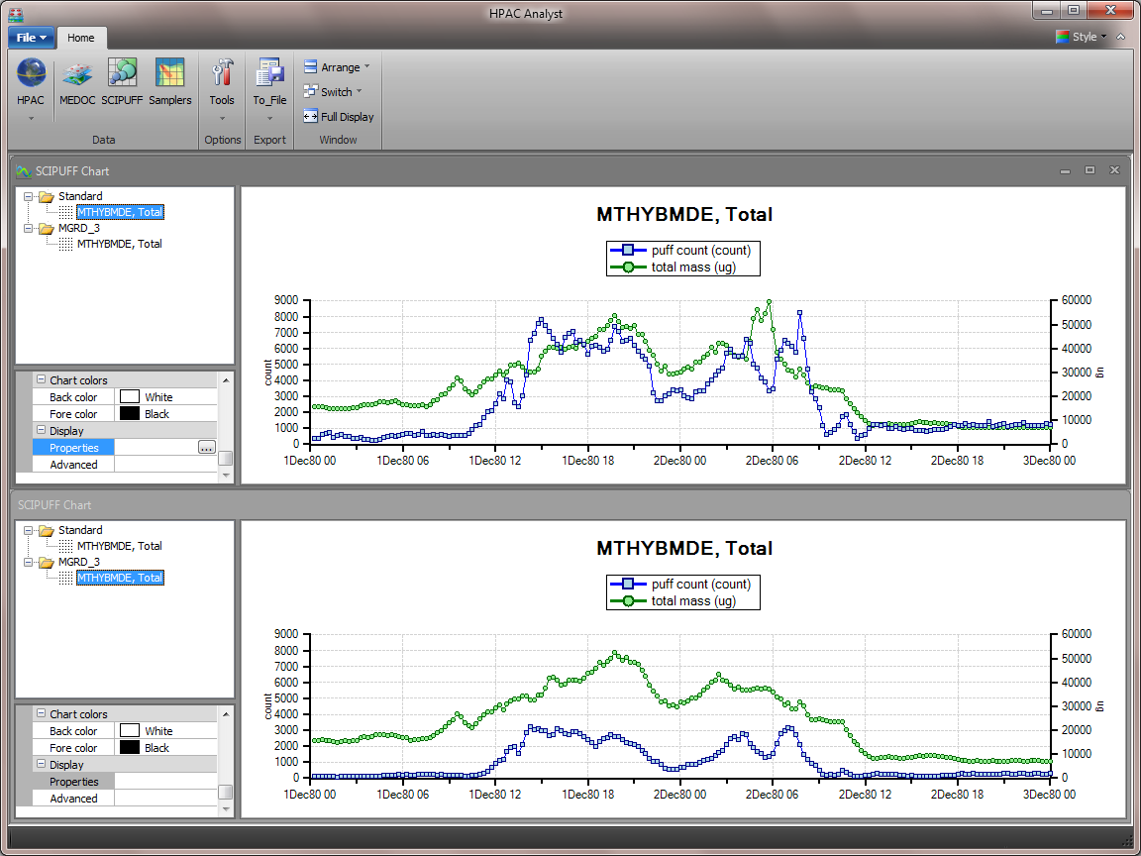
Examples
Grid Resolution Parameter
Comparison of puff count and total mass between MGRD=2 and MGRD=3 runs

Slide 23
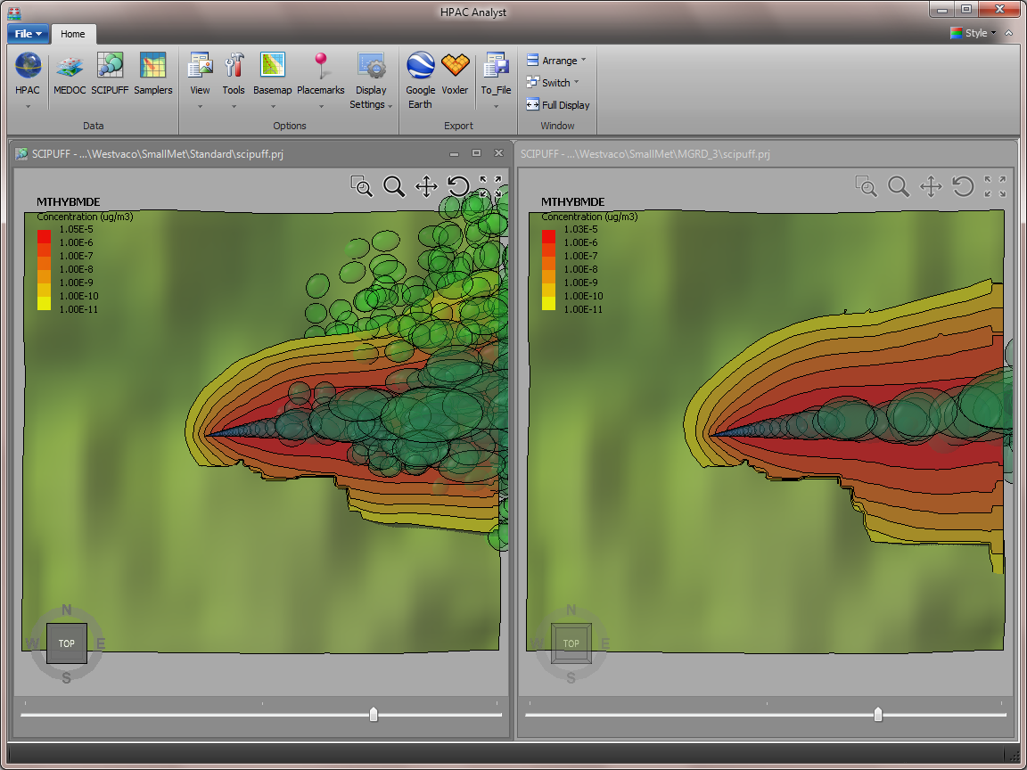
Examples
Grid Resolution Parameter
Elevated horizontal slice of concentration in MGRD=2 and MGRD=3

Slide 24
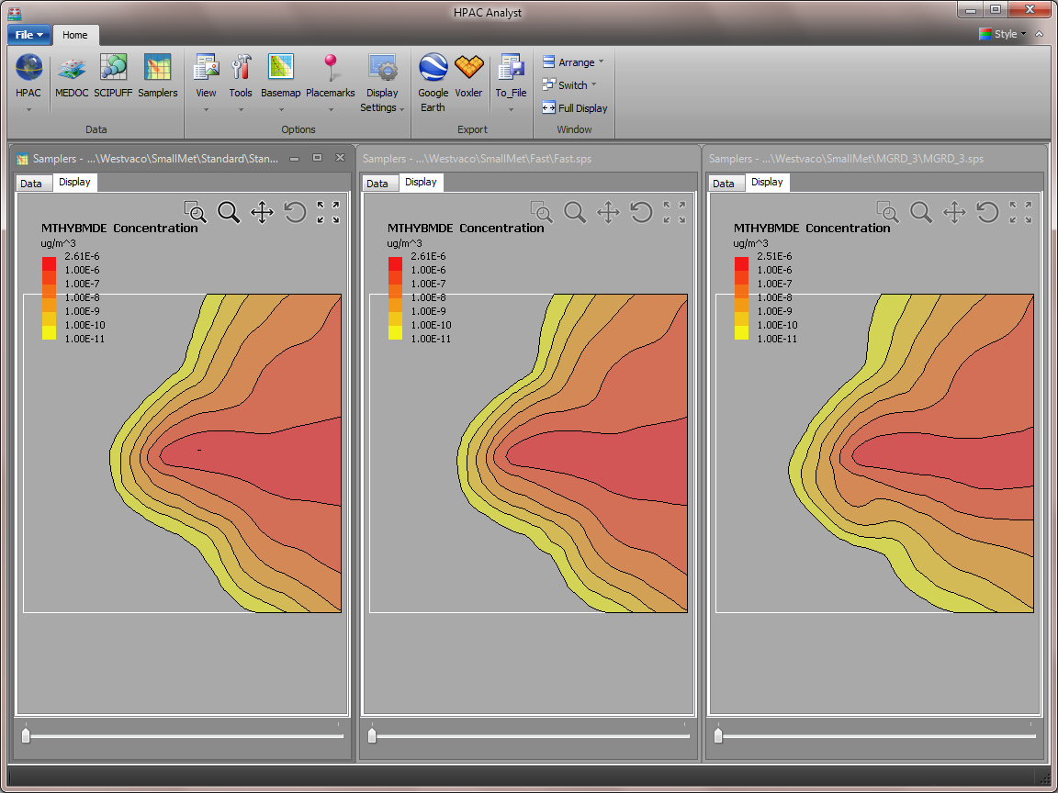
Examples
Overall Comparison
48 hour period average of surface concentration
Run times:
Standard = 20.18 min
Fast = 7.67 min
MGRD of 3 = 3.13 min

Slide 25
Gallery

Slide 26
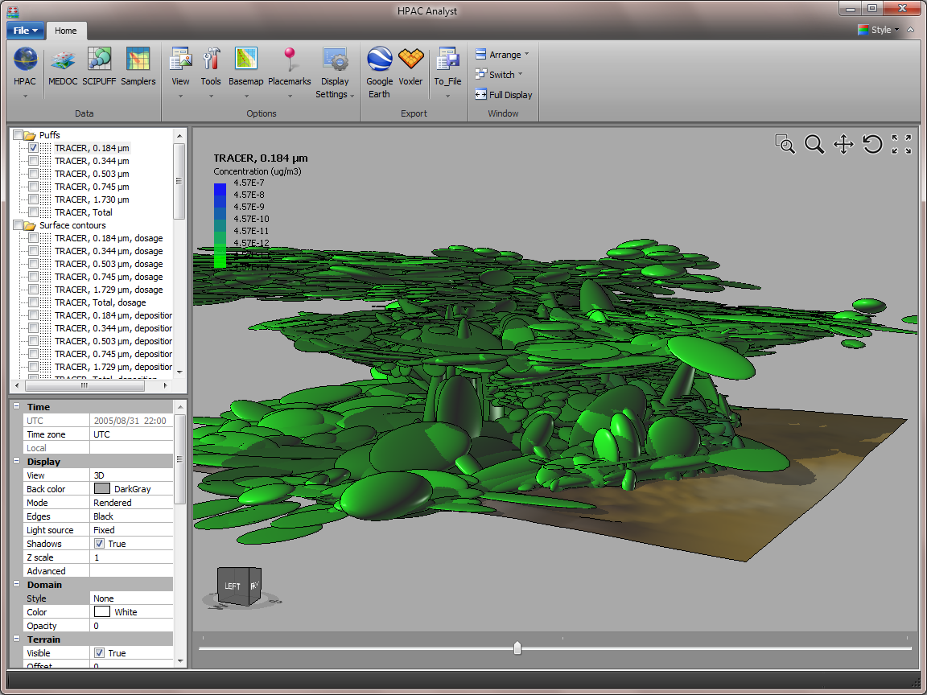
Gallery
Puff transport during thunderstorm

Slide 27
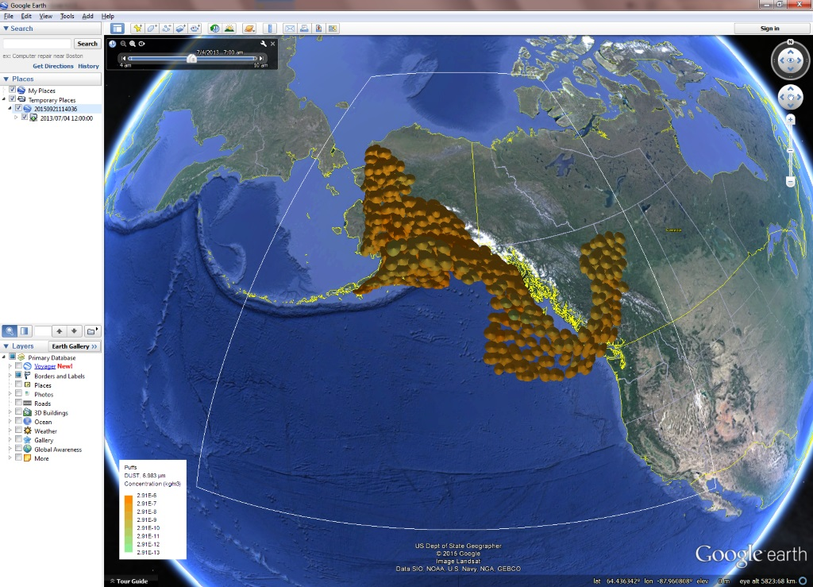
Gallery
Google Earth display of 2013 Mount Pavlof eruption dust cloud

Slide 28
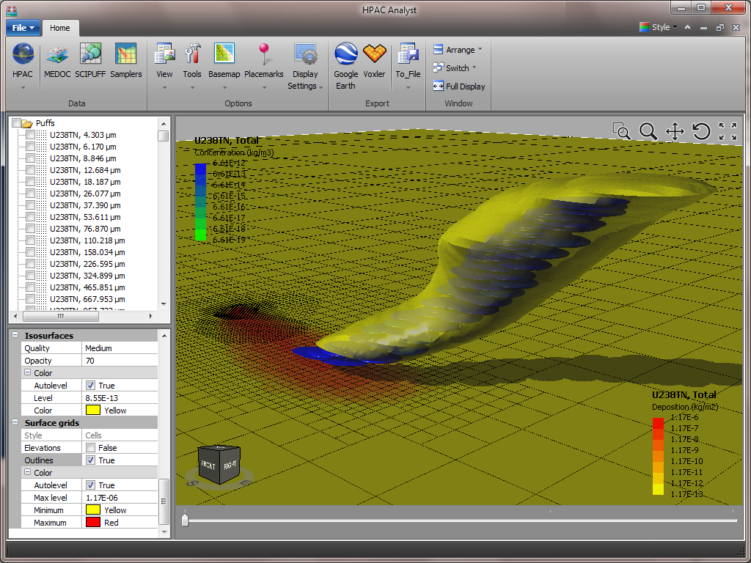
Gallery
Cloud of particulates depositing on surface grid

Slide 29
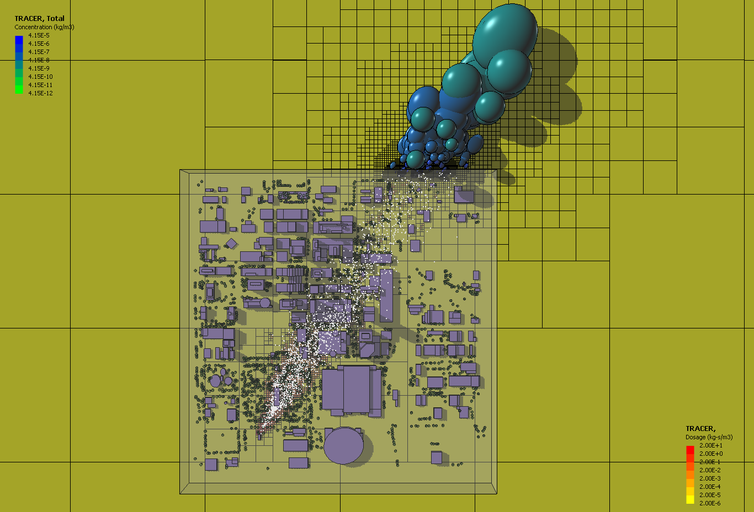
Gallery
SCIPUFF/QUIC simulation in Oklahoma City

Slide 30
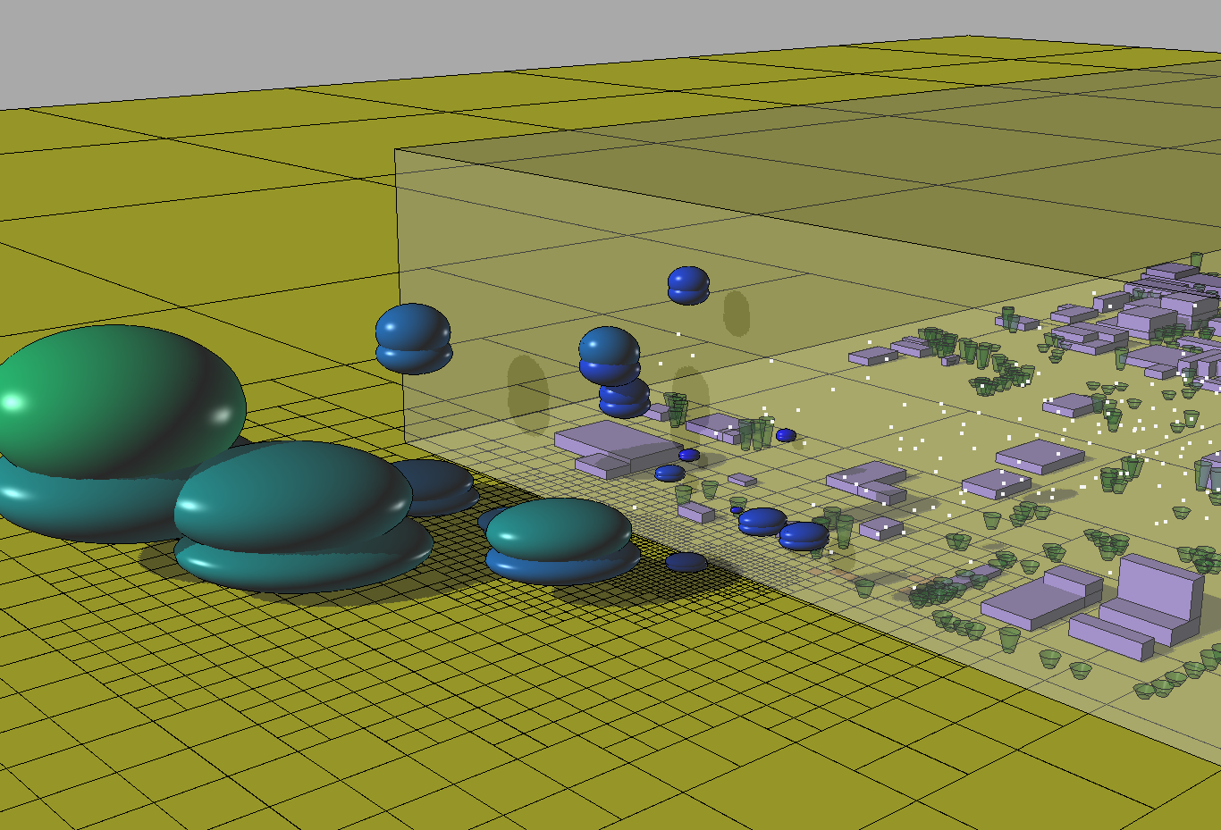
Gallery
SCIPUFF/QUIC simulation in Oklahoma City

Slide 31

Gallery
SCIPUFF animation

Slide 32
Questions

