Slide 1

Aerosol Detection and the
Hilbert Huang Transform in 2D
19th Atmospheric Transport and Dispersion Conference
George Mason University, Fairfax (VA)
June 9-10, 2015
Alex Coletti (*), Semion Kizhner (**), An Nguyen(*), and Meg Vootukuru (*)
(*) Syneren Technologies Corp, Arlington, VA , (**) NASA GSFC, Greenbelt, MD

Slide 2
Outline
Aerosol Observations Over Land
Surface Reflectance and Aerosols Detection
Hilbert Huang Transform in 2 D (HHT2)
Hilbert Huang Transform in 2D – Example
Examples of Hilbert Huang Transform in 2D
Filtering TOA Radiances with HHT2
TOA Radiances of the 2009 Station Fire
Decomposition of Fires, Clouds and Surface Features
Conclusions
A Novel Approach to Multiple Light Scattering

Slide 3
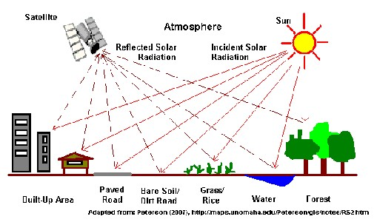


Aerosol Observations Over Land
The Radiative Transfer Problem is Non-linear

Slide 4
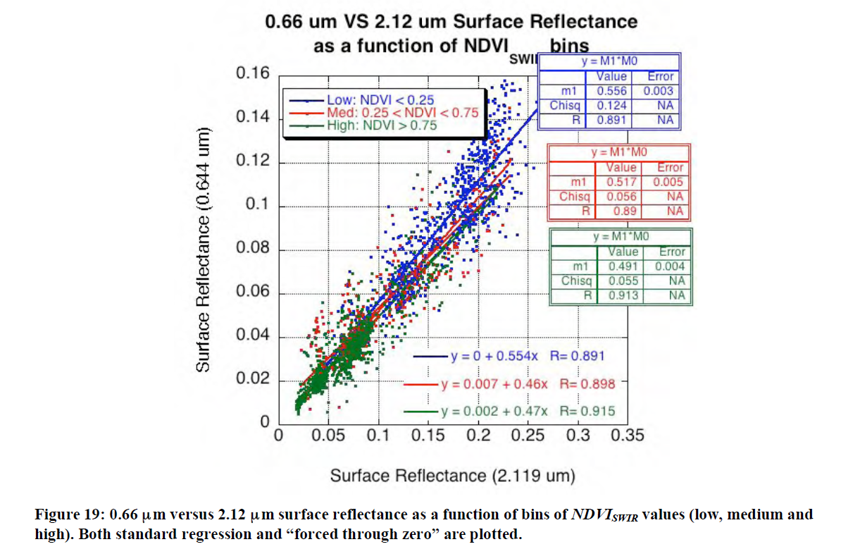
Surface Reflectance and Aerosols Detection
Detection of Aerosols Optical Depth (AOD) and Single Scattering Albedo (SSA) are highly dependent on local reflectance properties of land surfaces
Accuracy and precision of SSA of small and large particle mixtures are very sensitive to different surface types
Averaging pixels over land attenuates the effects of surface inhomogeneity
MODIS C005L over land: channels 0.47, 0.66 and
2.12 µm.
NDVI =
(r_{1.24}-r_{2.12})/(r_{1.24}-r_{2.22})
Surface reflectance is parametrized for NDVI scattering angle
AOD and SSA from different instruments are hard to compare. The algorithms for AOD retrieval over land are empirically tuned for each optical instrument and ground truth measurements are geographically sparse.
AOD and SSA Measurement Accuracy Dependent on Surface Spatial Properties

Slide 5
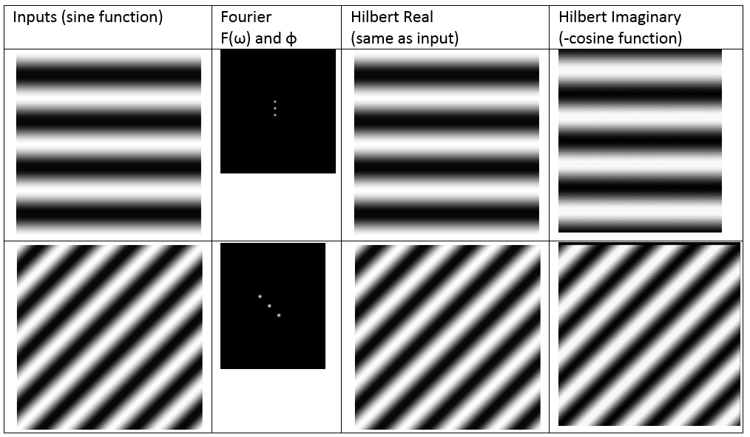
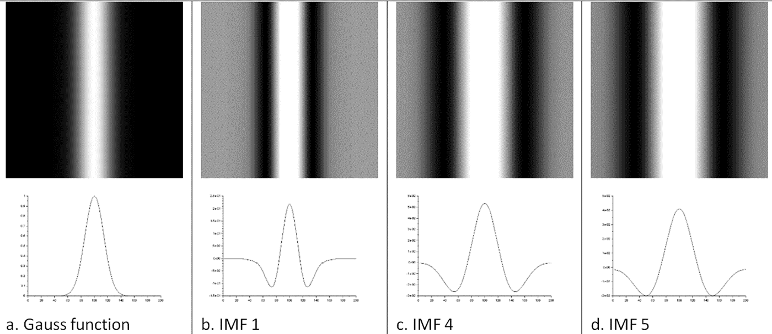
Hilbert Huang Transform in 2 D (HHT2)
The Hilbert transform:
Is a linear operator
Leads to harmonic analysis (HSA) and to ability to identify and select optimal filters
The Hilbert-Huang Transform applies to non-linear and non-stationary problems
HHT2 decomposes images according to a Bi-dimensional Empirical Mode Decomposition (BEMD)
The application of the BEMD breaks down input image into so-called Intrinsic Mode Functions (BIMF)
The set of BIMF’s form a complete, nearly orthogonal basis for the original signal.
Real and Imaginary Part HHT2 Retain Original Pixel Coordinates

Slide 6




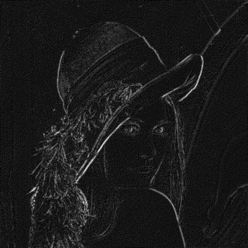

Hilbert Huang Transform in 2D - Example
Picture
Picture + sine
BIMF₁
BIMF₁₀₀
The first BIMF isolates the sharpest edges in the image
The higher the order of BIMF, the greater the contributions from the lowest frequencies
Amplitude and Phase of a BIMF form the HSA of the BIMF ( A*e^{iφ} )
BIMF₁ - Amplitude
BIMF₁ - Phase
HSA Can Be Used on All the BEMDs Components of an Image

Slide 7

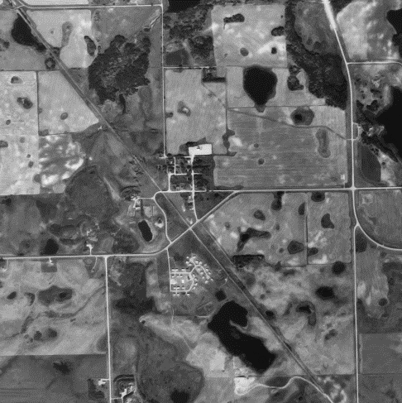
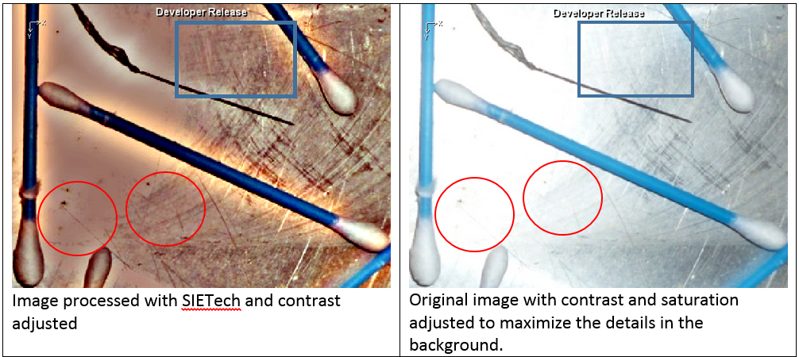
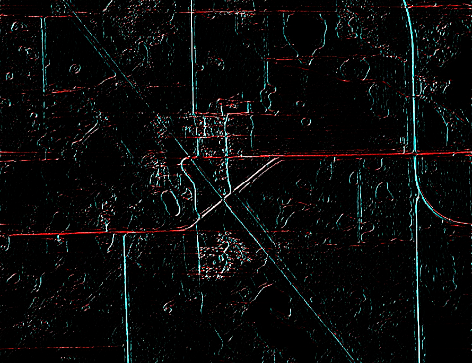
Examples of Hilbert Huang Transform in 2D
Input image
Filtered image output
Input image
Input image
Filtered image output
Phase (color coded) BIMF₁
Non-linear Features Can Be Separated with BIMF Selections

Slide 8
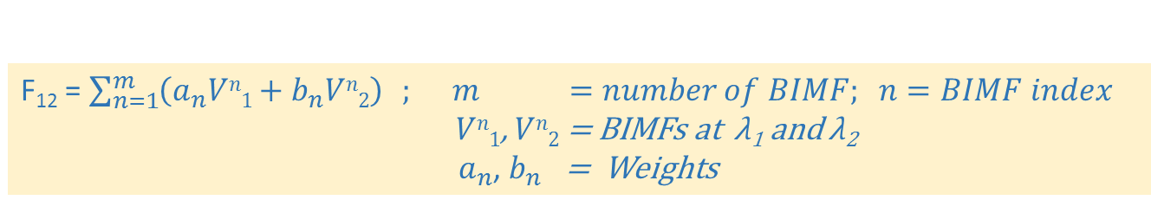
Filtering TOA Radiances with HHT2
HHT2 provides a new method for analyzing non-stationary and nonlinear radiative processes in satellite images
The HHT2 process decomposes TOA radiances into their spatially nearly orthogonal BIMF components
  The BIMF’s form a complete and nearly orthogonal basis of the observed radiances
  The BEMD process decomposes satellite images according to spatial domain textures or frequencies
The HHT2 preserves local spatial features because there is a one-on-one correspondence between pixels in the BIMFs and the original
The BIMF of the radiances observed at different wavelength bands separate aerosols, smoke, dust, and surface features according to spatial frequency distributions
F₁₂ = $\sum_{n=1}^{m}{\left(a_{n}Vn1+b_{n}Vn2\right)} ; m =number of BIMF; n=BIMF index$ $Vn1$, $Vn2$ = BIMFs at λ₁ and λ₂
$a_{n}$, $b_{n}$ = Weights
Aerosols and Surface BIMFs are likely to improve AOD and SSA retrievals

Slide 9
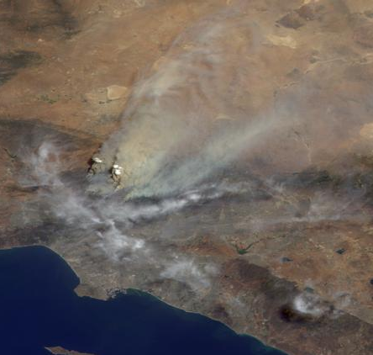
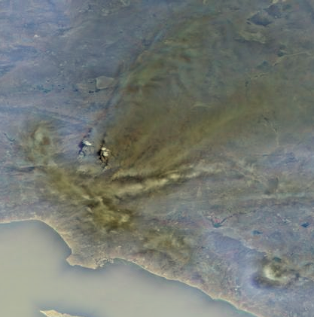
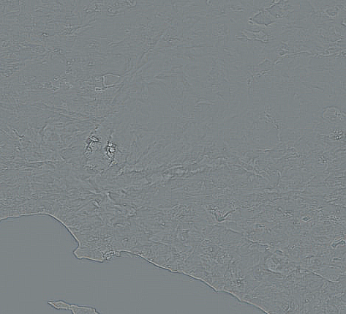

TOA Radiances of the 2009 Station Fire
Station Fire, Southern California
Aug. 30, 2009
Image credit: NASA/GSFC/LaRC/JPL, MISR Team
Image 682x488
SIETech-GPU iterations = 100
Window size = 3x3
Execution time: ~14s/band
RGB (Original – Res₁₀₀)
The details in the image of the Station Fire in 2009 (a) are emphasized in the image (b) obtained subtracting the low resolution background residual at the end of the the decomposition (d)
(a)
(b)
BIMF1
(c)
Res₁₀₀
(d)
HHT2 Separates General TOA Reflectance From the Details

Slide 10
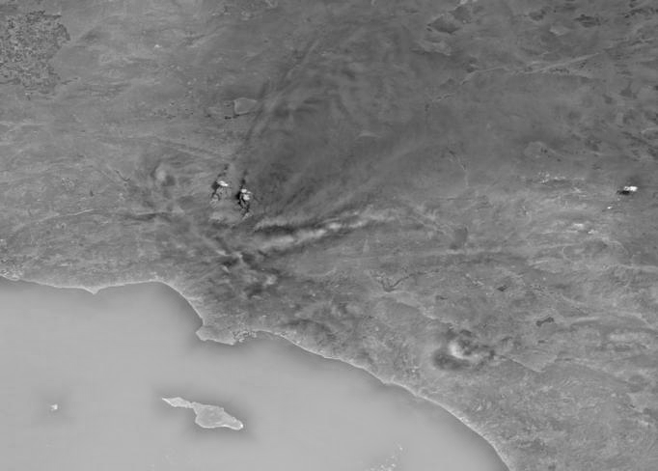
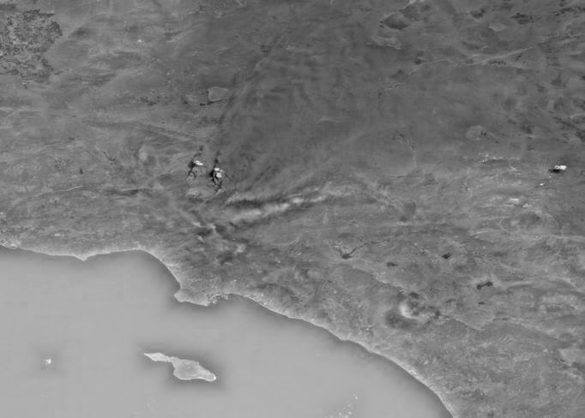
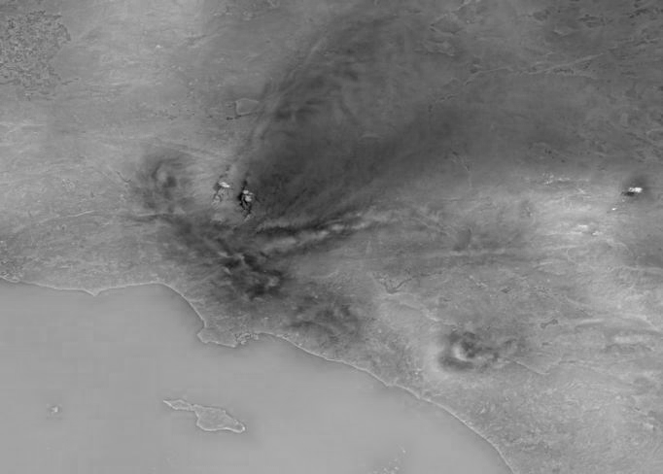
Decomposition of Fires, Clouds and Surface
Individual RGB components of the 2009 Station Fire image with the 100th order residual background removed
Green
SIETech
Image 682x488
Time: 0.140 ms / (BIMF , band)
Red
Blue
Band-wise HHT2 TOA Reflectance Separation for Smoke and Surface

Slide 11
Conclusions
HHT2 analysis promises to enable accurate retrieval of AOD and SSA over complex terrains
Since the HHT2 is scale invariant, radiative transfer properties of terrain can be measured and categorized according to textures independently on linear size
Improved separation of aerosol according to origin (e.g. PBL, source type, distant transport)
TOA observations could forecast radiative field on the ground
Enhanced spatial resolution improves forecast and modelling
Radiative transfer retrieval have lesser dependent on optical resolution and instrumental properties
Accuracy of comparisons of AOD and SSA determined with different instruments can increase
HHT2 Enables to Classify Surface Types by Their Radiative Properties

