Slide 1


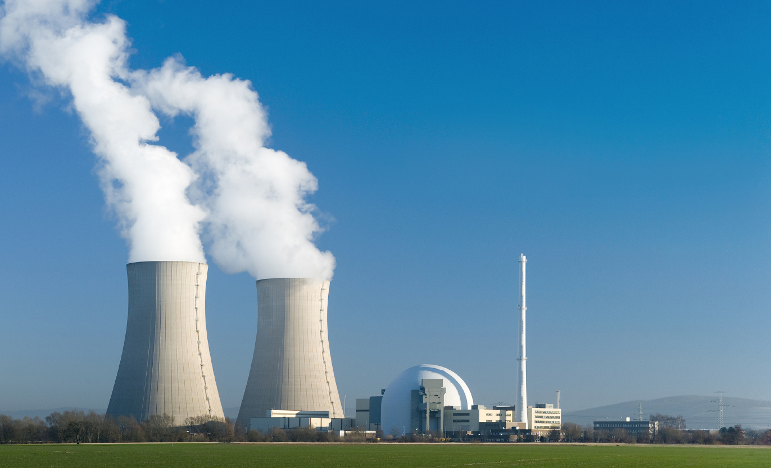
HABIT v1.2
(Control Room Habitability)
Casper Sun, PhD, CHP, FHPS
Syed I. Haider, PhD
Radiation Protection Branch,
Division of System Analysis
Prepared for 2015 Joint Action Group for Atmospheric Transport and Dispersion Modeling meeting, at George Mason University, Fairfax, VA: June 9, 2015
Notes:
Explain information on this cover page
Syed got his PhD major at Penn State, mechanical engineering (thermal sciences, two-phase flow and heat transfer).
He was also a post-doctoral research at the University of Maryland (College Park) for 3.5 year and visiting faculty at Georgia Tech for five years.
Key words are: Habitability and Control Room

Slide 2
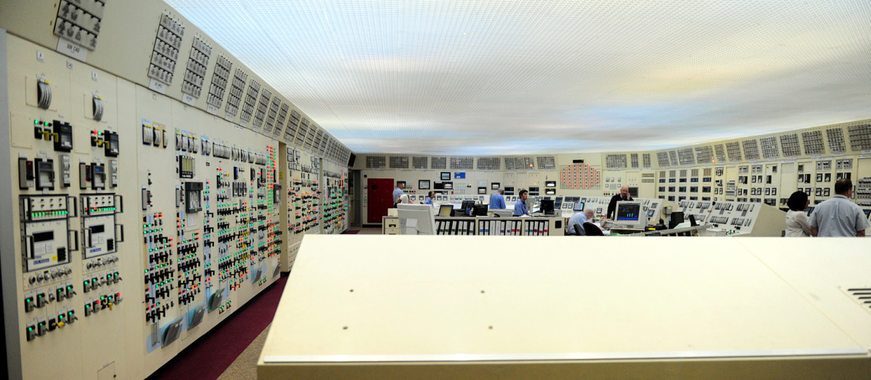
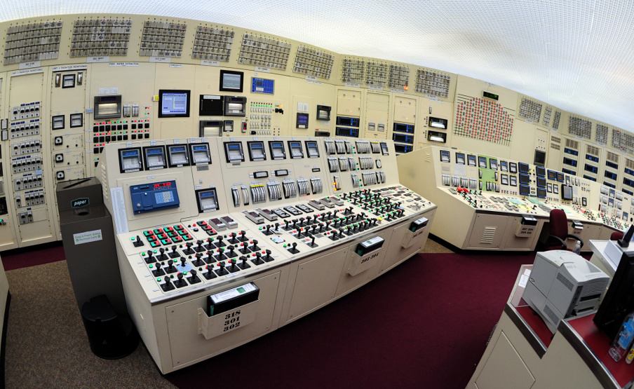
https://carlwillis.wordpress.com/tag/control-room/
Peach Bottom Atomic Power Station
Notes:
https://carlwillis.wordpress.com/tag/control-room/
The two boiling water reactors at Peach Bottom Atomic Power Station are of the BWR/4 product line from General Electric and are housed in Mark I (“lightbulb”) containments. They share a common turbine building and a common control room. Electrical output is about 1200 MW each, leaving the station at a respectable 500 kV to feed the power-hungry metropolitan areas of the northeastern United States. Nuclear power plants have understandably committed unprecedented attention to safety and security in the last decade or so. An unfortunate side effect has been that those of us who don’t work in these facilities have scant resources to help wrap our heads around their scale, layout, equipment, and operations. With that in mind, I’m profoundly grateful to Exelon Corporation’s Peach Bottom staff, and in particular Jim Kovalchick, director of security, for allowing the comprehensive tour on which these photos were taken in April 2012.

Slide 3
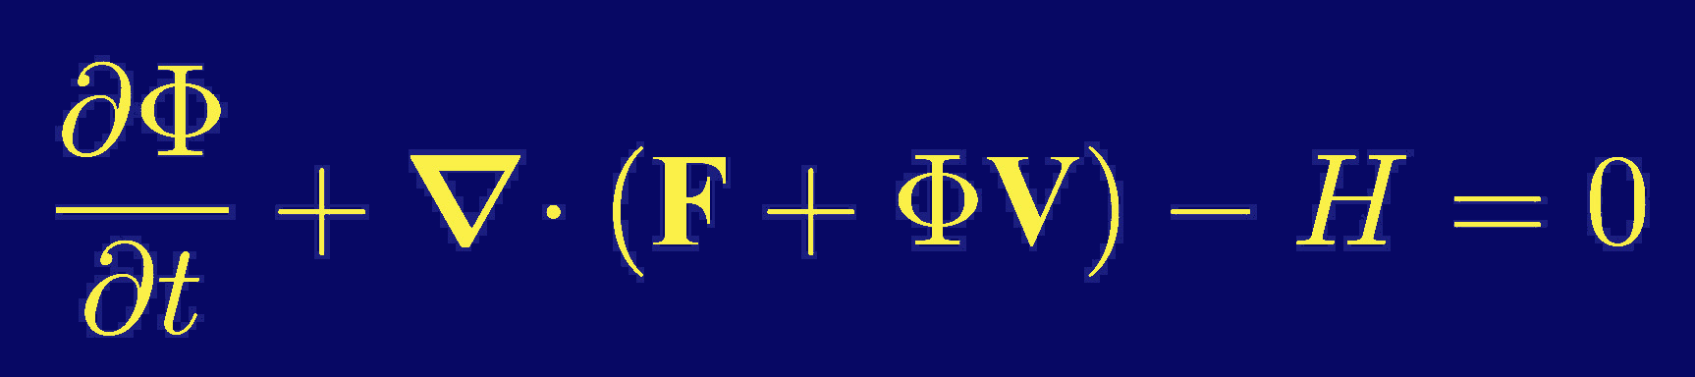
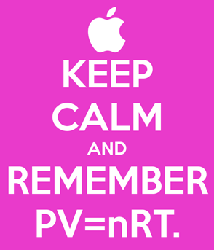
Conservation Equation
Notes:
Clearly state what problem you’re trying to solve that is of interest to meteorologists.
HABIT code also has many of these equations…. However the source terms’ initialization and boundary conditions are not so complex and complicated.
“You can’t get something for nothing”
“ɸ” is volume density of stuff.
H is a source or sink.
F is the flux of ɸ in the absence.
Newton Law, Fick’s Law and Bernoulli Law.

Slide 4


HABIT COMPUTER CODE
HABIT was reengineered from EXTRAN (1991)
Version 1.1 (1995): IBM/DOS code. Available at RSICC/ORNL
Version 1.2 (2015): Windows 7/8 (64-bit) code. Available at RAMP/NRC
Http://www.USNRC-RAMP.com
Notes:
EXTRAN was developed by J. V. Ramsdell (PNL) for “estimating concentration of toxic substances at control room intakes”
An integrated FORTRAN code that is used for determining the risk of control room operators in the event of releasing nearby.
What NRC has used in the past, why HABIT needs to be improved, how it will be used once it’s fixed, etc.
Explained the theoretical basis and physical assumptions made by each of the modules in HABIT and gives detailed information about the data entry windows. The Supplement 1 (1998) provided sample runs for the HABIT v1.1, included I/O files
V&V are based on these three demo samples that provided in the Supplement 1 (September 1998) .

Slide 5
User-Need Request: NRO-2011-007
HABIT Code Evaluation and Update
  NRO TL – Syed Haider (NRO/DSRA/SBCV)
  RES COR – Casper Sun (RES/DSA/RPB)
Action Items:
  Phase 1: Re-hosting HABIT to Windows 7
  - Upgrade FORTRAN and modernize GUI
  Build-in tooltips and develop “User’s Manual”
  Phase 2: Adding Dense-Gas Functions
    Add DEGADIS and SLAB to HABIT
    Update RG 1.78 and associated TBDs
RG 1.78: Evaluating the Habitability of a Nuclear Power Plant Control Room During a Postulated Hazardous Chemical Release (2001)
Notes:
Driver is from User-Need Request (UNR) RG 1.78, “Evaluating the Habitability of a Nuclear Power Plant Control Room During a Postulated Hazardous Chemical Release” requires HABIT code to be used.
Integrate DEGADIS and SLAB into HABIT v1.2 code is one of the recommendation from ACRS.
Phase-2 completion sets on 9/30/2016.

Slide 6
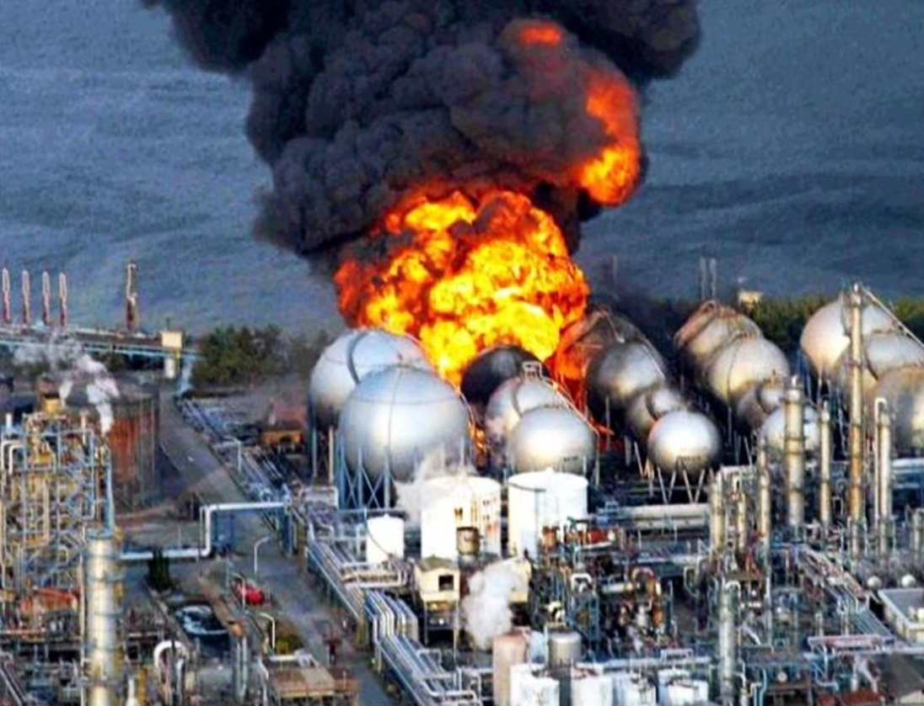
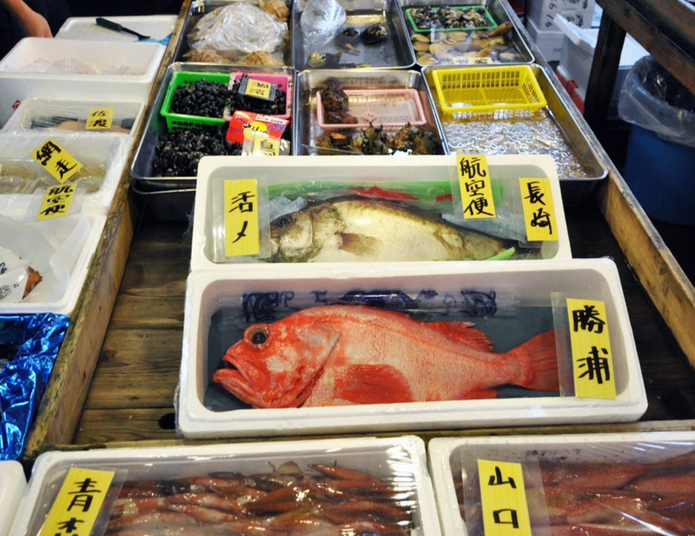
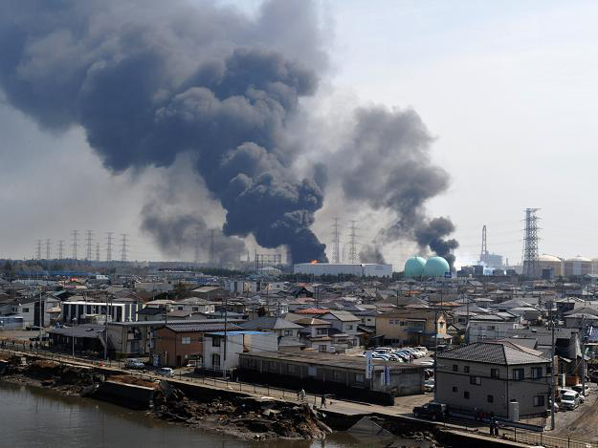
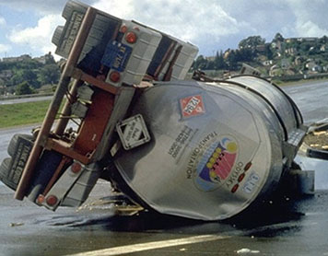

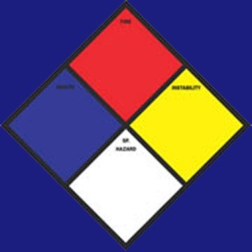
Notes:
Real world: Accidents do happen and they are more than what we can manage.
(1) As meteorologist, you like to see the discharge plume size and window flow directions. But it is not always guaranteed
(2) Signals for risk communication of hazardous materials: (Blue –Health; Red – flammable; Yellow – instability; and white – others)
LHS photos are from March 2011 Fukushima (福島第一原子力発電所事故) : The top right is current Hazard communication sign for transporting chemcial and flammable and toxic materials, but NO radioactive…
The Fukushima Daiichi nuclear disaster (Fukushima Dai-ichi) is a series of equipment failures, nuclear meltdowns, and releases of radioactive materials at the Fukushima I Nuclear Power Plant, following the Tōhoku earthquake and tsunami on 11 March 2011. The Japanese government has set up a 20-kilometer (12 mile) exclusion zone around the plant, banned fishing along much of the northeast coast and set up evacuation centers for the tens of thousands forced to leave their homes. The top-right photo is also about Fukushima. Soon after the aceeidient, all fishes in the market have to displace the location of the catches.
A tank truck carrying the chemical toluene overturned, causing a potentially dangerous spill. (NOAA).

Slide 7
What’s New in HABIT v1.2 (2015)
Used Intel Visual FORTRAN compiler for compatibility with Windows 7 (64-bit)
  I/O are identical as HABIT v1.1
  Backwards compatible for old designed (.DSG) files and FORTRAN input (.INP) files
Used new Microsoft .NET technology for graphical user interface (GUI) development
  Consistent module interface design (tabs)
  Section 508 Compliance (e.g., color blinder or muted use of color, JAWS accessibility)
Notes:
Key: is HABIT V1.2 can run under Windows 7 and met the 508 requirement.
JAWS: A screen reader, called "Job Access With Speech" is commonly referred to as JAWS. This software is manufactured by Freedom Scientific. Currently, JAWS is the most commonly used screen reader, however, many more exist, such as SuperNova, Window-Eyes, Etc., just to name a few of the most popular ones. For the sake of simplicity, this article only deals with JAWS, but all claims made about testing can be applied to any screen readers. The reason for picking JAWS as opposed to any other screen readers is that many people refer to a screen reader as JAWS, given its popularity.

Slide 8
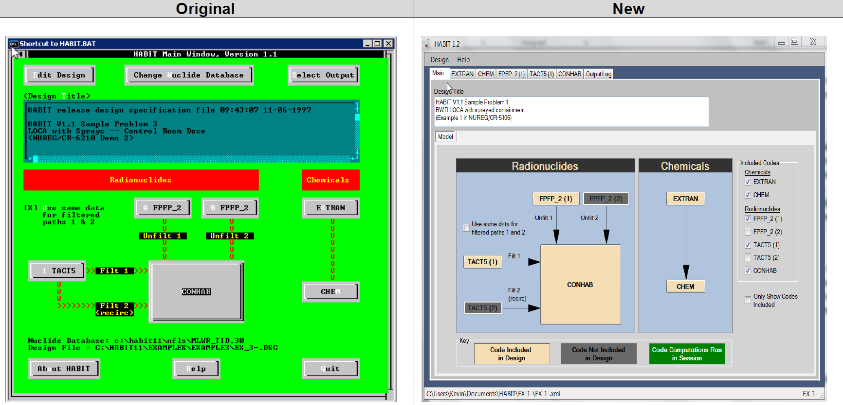
Main Screen Makeover
Notes:
New main GUI and the color to meet Section 508 compliance

Slide 9
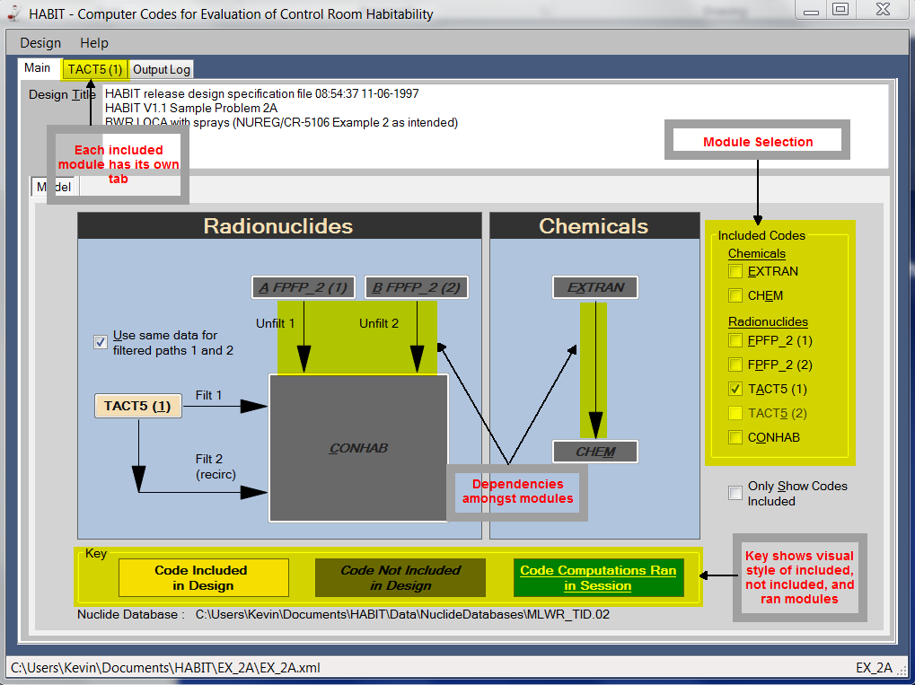
HABIT v1.2: GUI
The GUI
(1) depict the relationships between the modules and
(2) show running modules in the current calculation.
Notes:
Go over with all the RED text boxes indicated.

Slide 10
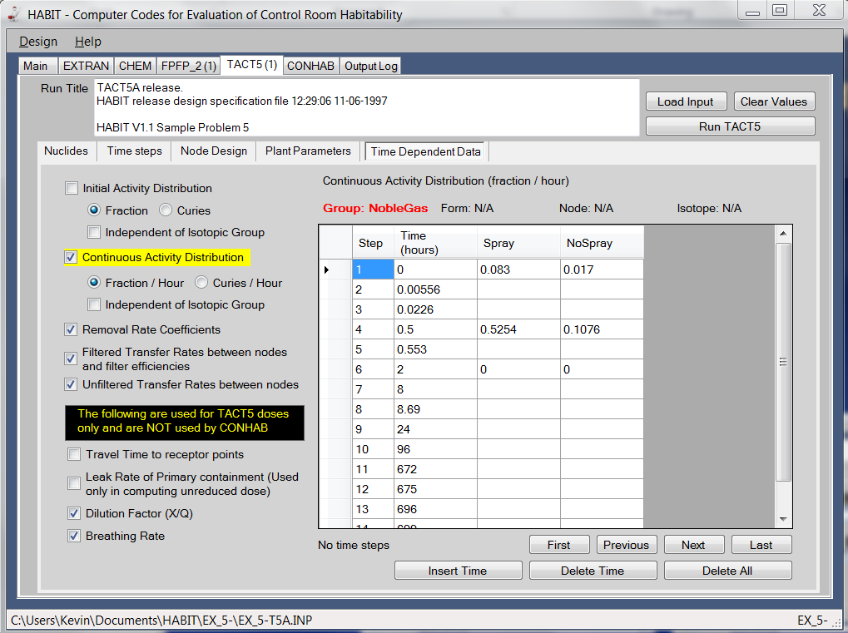
GUI: Input to Modules
Input to modules are selected from the main GUI screen. Each module has its own I/O tab.
Notes:
Mechanics of software for I/O:
Go over all items as detail as possible within given time.

Slide 11
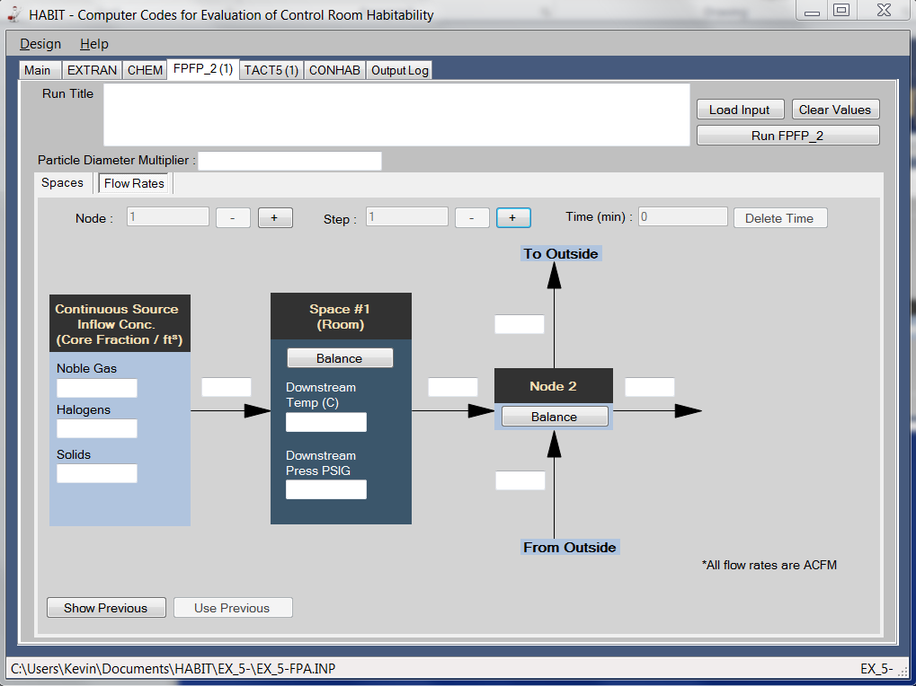
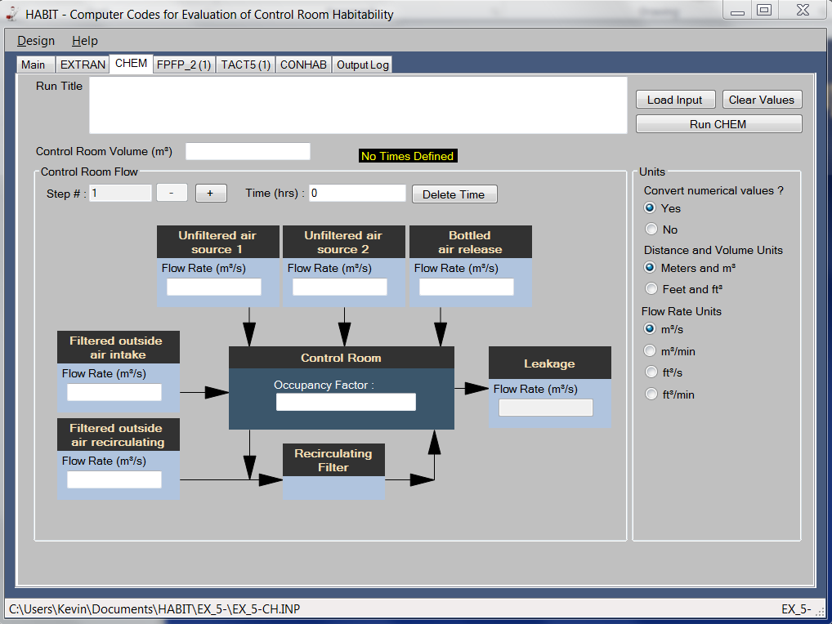
Example screens HABIT v1.2 GUI
Notes:
Show date fields that are for required model calculations

Slide 12
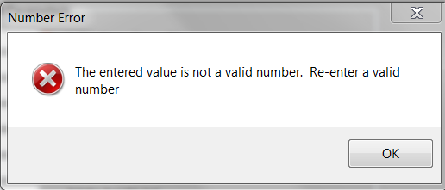
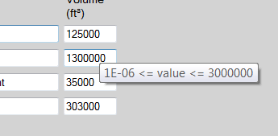
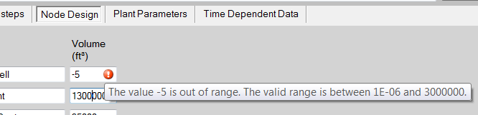

HABIT v1.2: Tooltips
Tooltips provide a convenient way to see the expected range for fields and provide validations to prevent entering bad data.
Valid Range
Validation Error
Range Validation Warning
Required Field Warning
Notes:
Tooltips is biuld-in and activate them in two methods…

Slide 13

Verification and Validation
FORTRAN modules and I/O data:
  Bugs identified and modified in HABIT v1.1
  Precision of reproduced results
Operational steps in the new HABIT v1.2 “User Manual”
Notes:
V&V likes the battleship: Identified problem consist with housekeeping and remove infinite routine traps.
In addition to bugs, LM also upgrade FROTRAN that could be compiled using the new compiler.
Precision means digit of accuracy obtained from new FORTAN compiler. We keep in at least four digits of the accuracy.

Slide 14
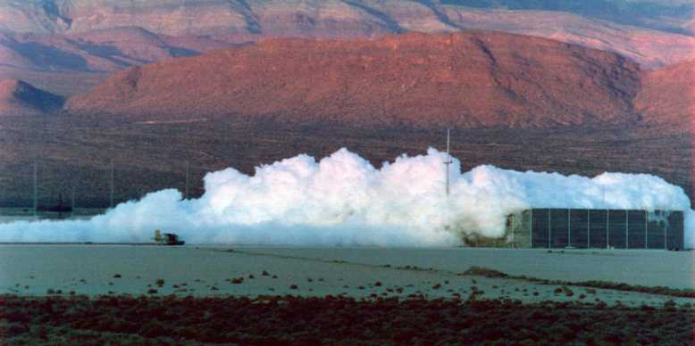
Dense-Gas Models
DEGADIS solves the gas concentrations by gravity-driven, over flat terrain, then into the entrainment layers
SLAB solves gas concentrations by mass, energy, and momentum balances at downwind locations.
Both Models can perform for release from pool evaporation, jets, and explosion scenarios.
Notes:
Professor Dr. Tom Spicer at U. of Arkansas and Dr. Donald Ermak (LLNL) are the original coders.
Both DAGADIS and SLAB will be superimposed separately.
But, analyze the calculation intermediate steps or plotting for comparison by Excel ….

Slide 15
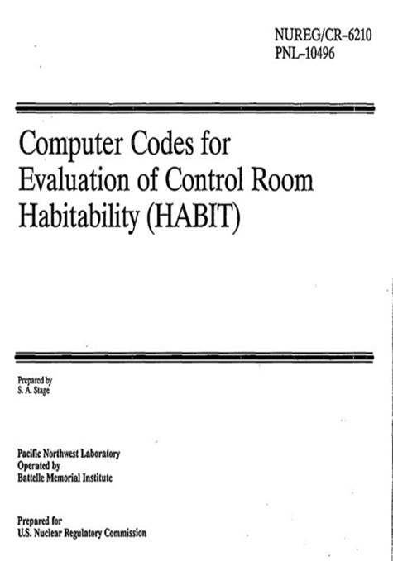
Work-in-Progress
Re-host DEGADIS and SLAB
Improve HABIT ATD computations
Design GUI and interface I/O with Excel©
Update TBDs
Targeted completion date: 12/30/2016
Notes:
Both DAGADIS and SLAB will be superimposed separately.
But, analyze the calculation intermediate steps or plotting for comparison by Excel ….
The NUREG could be done solely by NRC.

Slide 16
On-Going Enhancements
Add SI units
Add chemicals
Add ICRP 60/103 dose coefficients
Move into RAMP
Notes:
Website for RAMP http://www.internal.nrc.gov/RES/projects/RAMP/
The Radiation Protection Code Analysis and Maintenance Program (RAMP) is being coordinated by the U.S. Nuclear Regulatory Commission (USNRC) and will include a number of domestic and international organizations. The purpose of RAMP is to support the efforts to obtain a well thought-out view of the accuracy and validity of USNRC radiation protection/dose assessment (RP/DA)computer codes RASCAL, RADTRAD, HABIT, VARSKIN, PIMAL, and the Radiological Toolbox, over their range of applicability, while suggesting possible improvements, as needed, to the codes. Quantitative methods are used by RAMP members to characterize the accuracy of the codes; and code development activities within the domestic and international community will help support these methods. Collaboration is necessary to conserve resources throughout the domestic and international community by sharing the effort and benefit among participants.

Slide 17

Casper.Sun@NRC.gov

