Slide 1

LAND-SEA INTERACTION AND RELATED ATMOSPHERIC PROCESSES IN THE NEW YORK CITY REGION
By
Dr. Tal Meir
A DISSERTATION
ADVISORY COMMITTEE :
Dr. Julie Pullen, Chairman
Dr. Alan F. Blumberg
Dr. Teddy R. Holt
Dr. Knut Stamnes

Slide 2
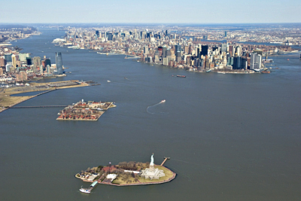
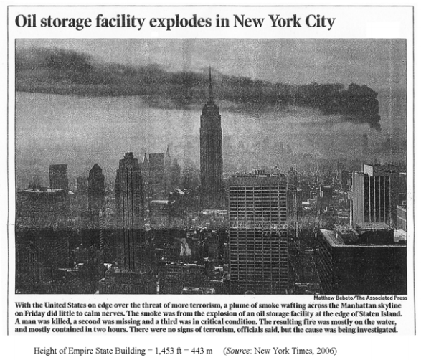
Hypothesis and Approach
Hypothesis:
Regions in the vicinity of ‘urban land-sea’ boundary are more sensitive to atmospheric complexities, with far-reaching consequences for emergency response applications.

Slide 3
The Sequence Of This Study:
Phase 1
MODEL EVALUATION
Use observations to evaluate numerical models with a focus on city and land-sea boundaries
[COAMPS 1km
NAM 12km]
Phase 2
INTEGRATE MET MODEL INTO TRANSPORT & DISPERSION TOOL
Use MET models output into transport and dispersion (T&D) prediction tools
[HPAC]
Phase 3
EMERGENCY RESPONSE APPLICATION
Evaluate the integrated system of models for emergency response applications
[NATO-ATP 45]

Slide 4
Phase 2
INTEGRATION OF METEOROLOGICAL PREDICTIONS INTO TRANSPORT & DISPERSION TOOL
Understanding sea influences on air flow of contaminants

Slide 5
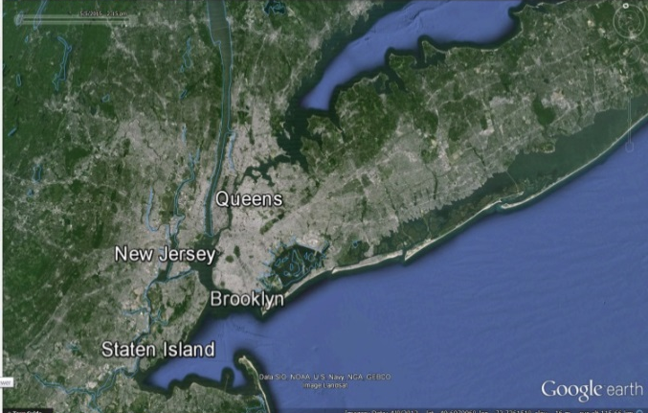
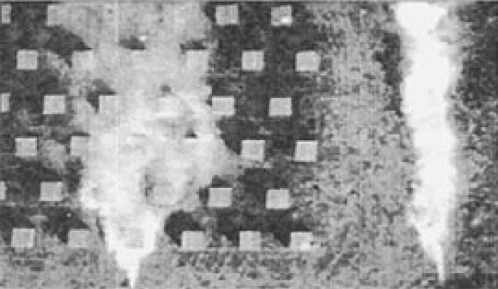
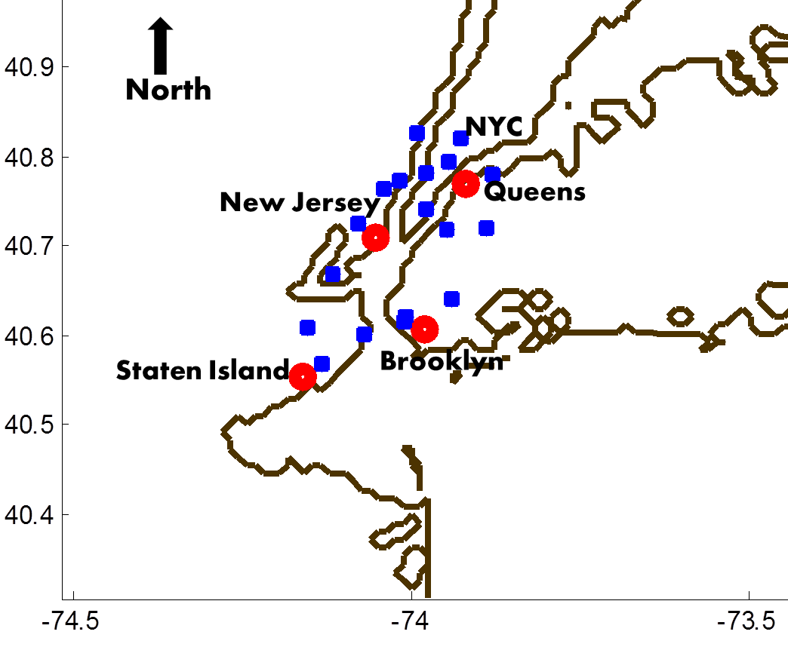
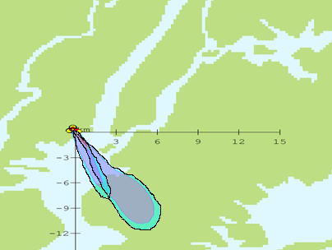
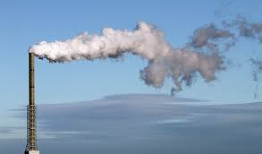
Transport and Dispersion (T&D) Brief Introduction
Land characteristics
Staggered cubes vs. unobstructed fetch (Brown.2004)
Analysis Method:
- Horizontal: % overlap
- Vertical: cross section in downwind direction
Data setup
Notes:
Fraction overlap is used to analyze the size percent overlap between two individual plumes. It is calculated at a fixed time (two hours after a release), for a fixed dosage level (18e-06 $\frac{kg ∗sec}{m^{3}}$) and is defined as the ratio of the area of intersect divided by area of true plume.

Slide 6
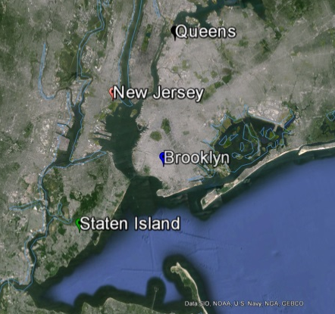
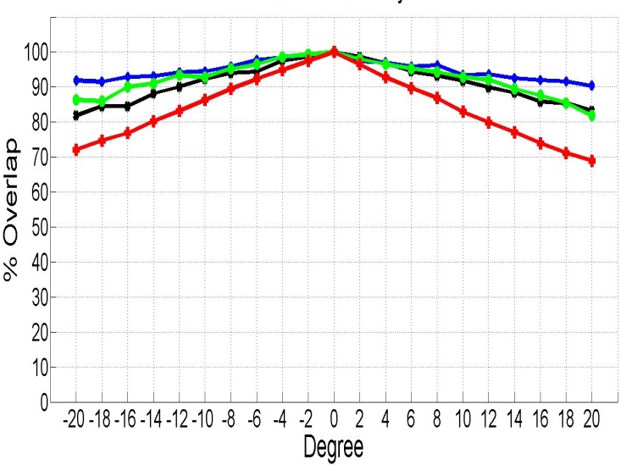
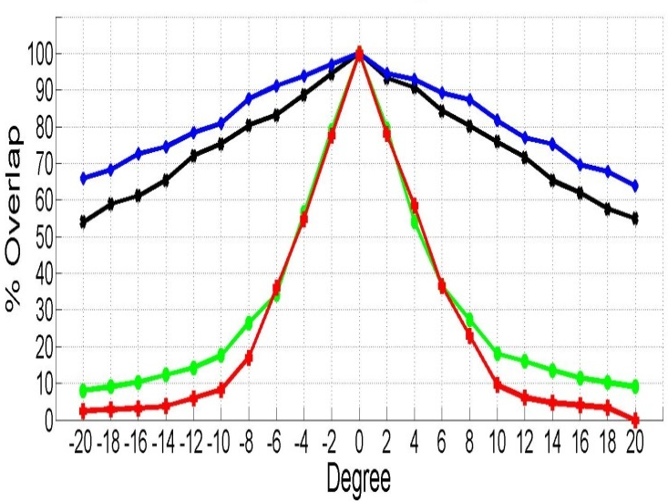
Air Transport Sensitivity to Wind Direction Variations
NW Winds
Wind
2 deg.
4 deg.
Day-Time
Night-Time
Brooklyn
Queens
Staten Island
Jersey City
Night time Releases are more sensitive to wind direction variability
Air flow over water is more sensitive to wind direction variability
Notes:
Transport and dispersion uncertainty plots for mode 1 as it relates to wind field variability in 2 degree increments for night and day releases under southwest, northwest and southeast wind directions. Red= Jersey City, NJ [40.70, -74.05], Green= Staten Island, NY [40.55,-74.16], Black= Queens, NY [40.77,-73.91], Blue=Brooklyn, NY [40.60,-73.98]

Slide 7
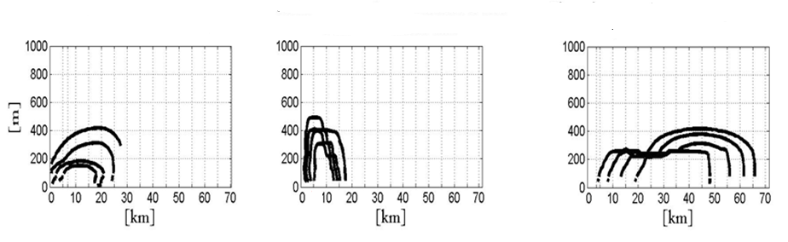
Resolution Influence on Transport and Dispersion Predictions
Influence of Horizontal Resolution
Influence of Vertical Resolution
Plume derived from several near-surface observations
Plume derived from high resolution meteorological model near-surface outputs
Plume derived by from high resolution meteorological model near-surface and vertical outputs
Notes:
T&D processes are sensitive to vertical resolution and less so to horizontal resolution

Slide 8
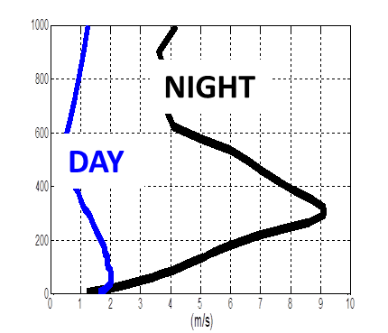

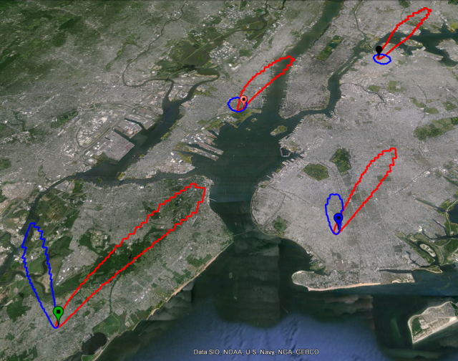
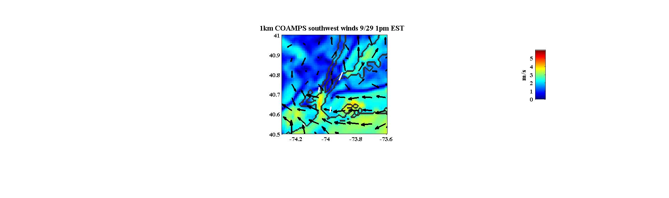
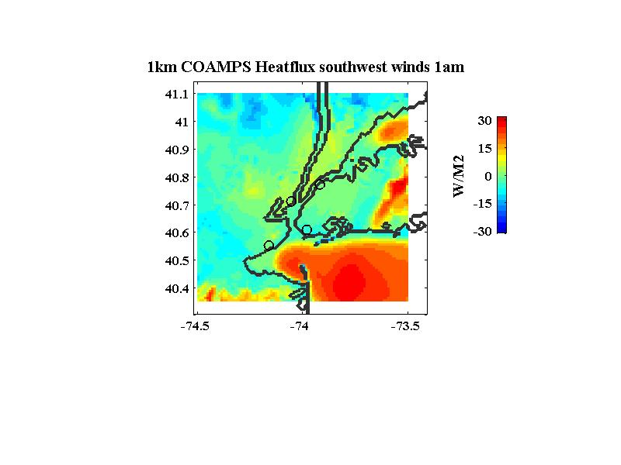
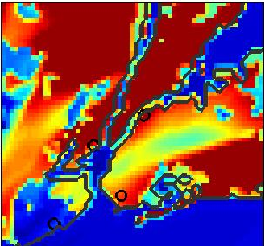
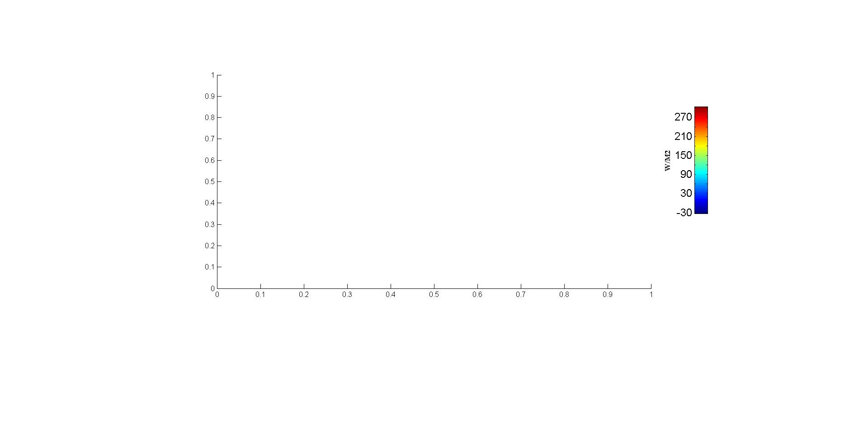
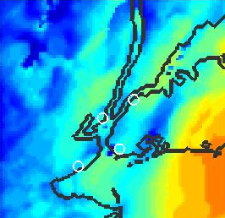
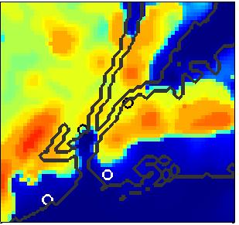
Day and Night Comparison of Near-Surface Atmosphere
Night time
Day time
Winds
[m/s]
Winds
[m/s]
Heat
flux
[W/M2]
Heat
flux
[W/M2]
DAY / NIGHT
Internal Boundary Formation
BL
Depth
[m]
BL
Depth
[m]
DAY / NIGHT

Slide 9
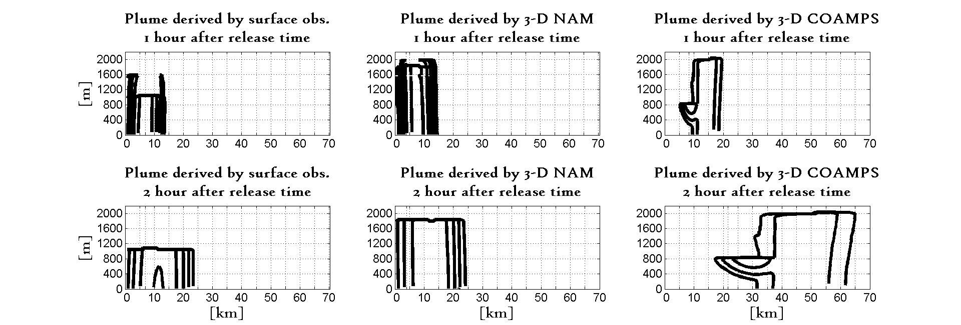
Internal Boundary Layer - Vertical Characteristics
Day time
[m]
A formation of an internal boundary layer downwind of the coastal interface.
The atmospheric characteristics are dominated by the marine roughness.
A transition zone inland, where the atmosphere structure adjusts to a change in surface roughness

Slide 10
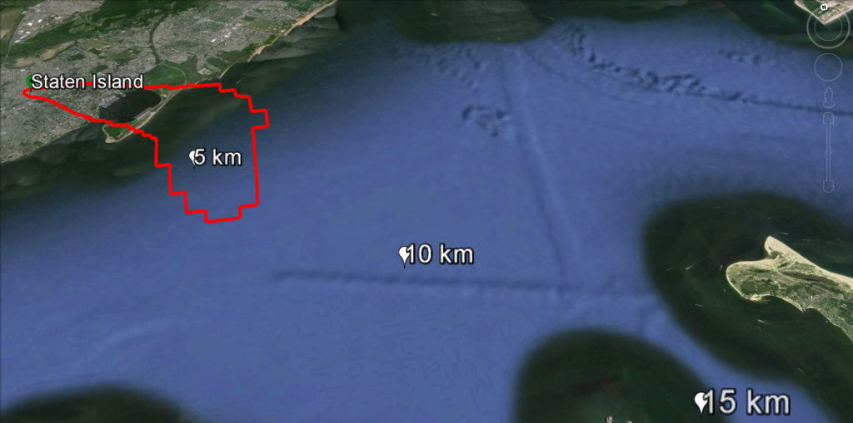
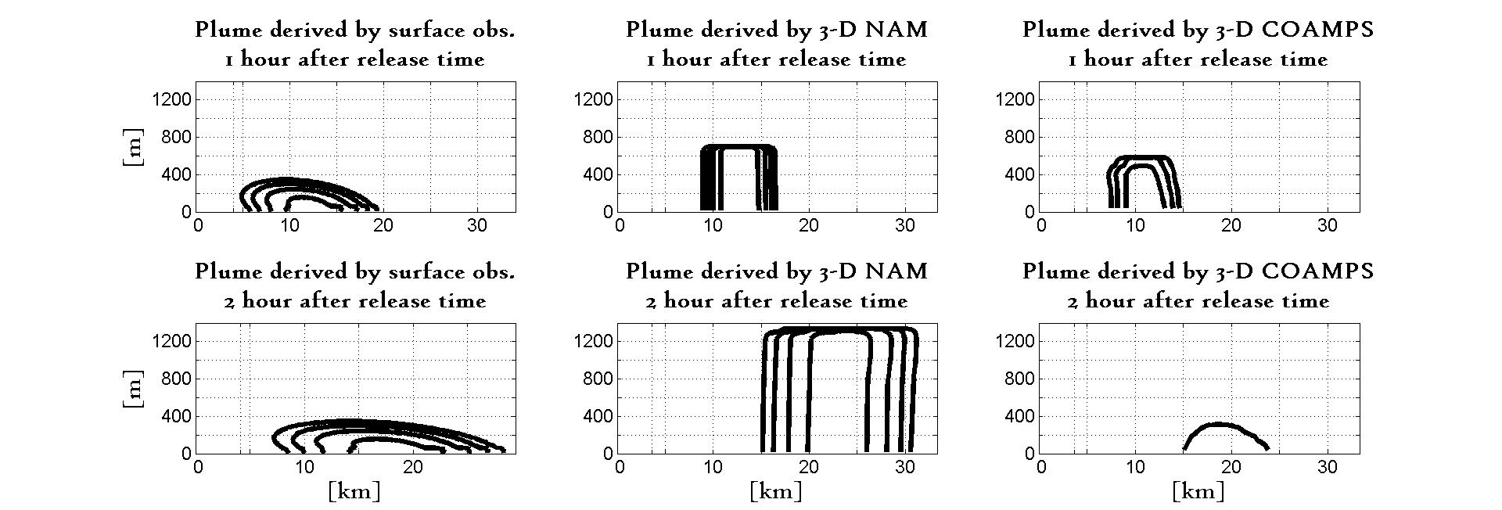
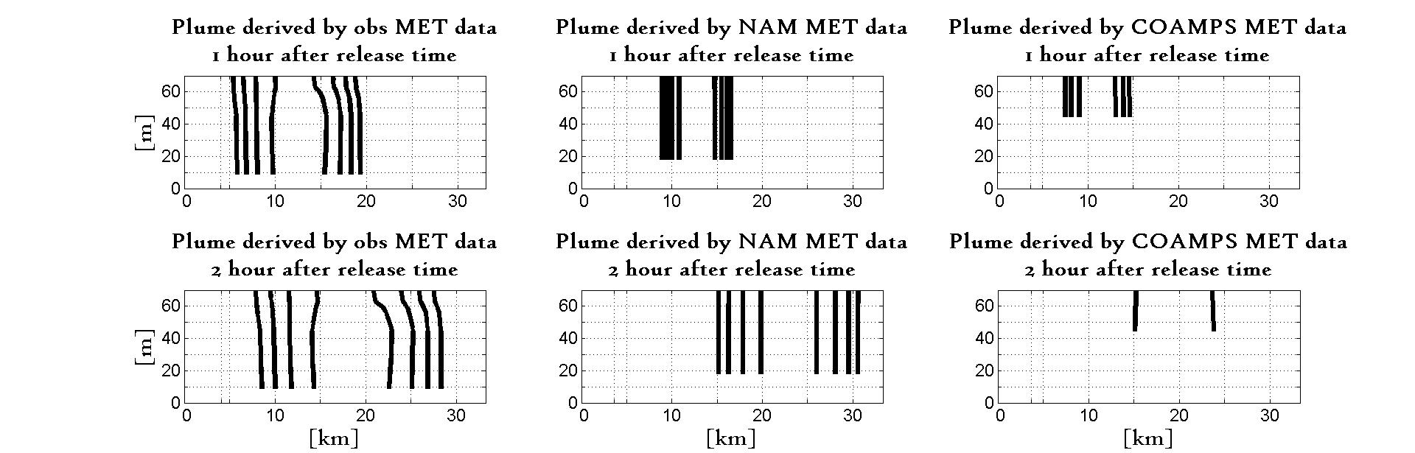
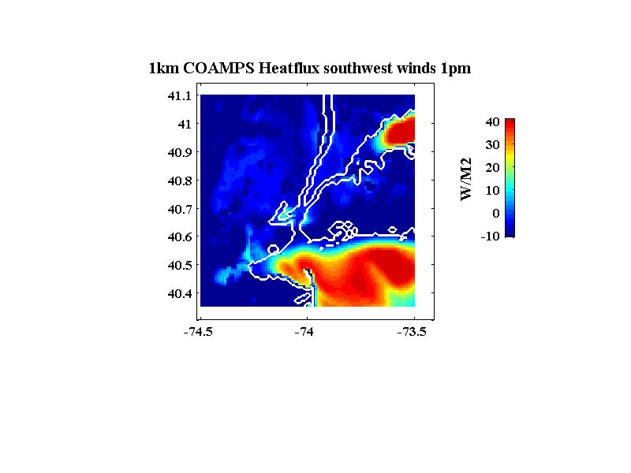
Air Flow Complexity Over Land-Sea Boundary lines
[m]
[m]
[km]
[km]
Heat flux

Slide 11
Phase 3
EMERGENCY RESPONSE APPLICATION
Integration of predictions using Google Earth, and bench marked against NATO-ATP45

Slide 12
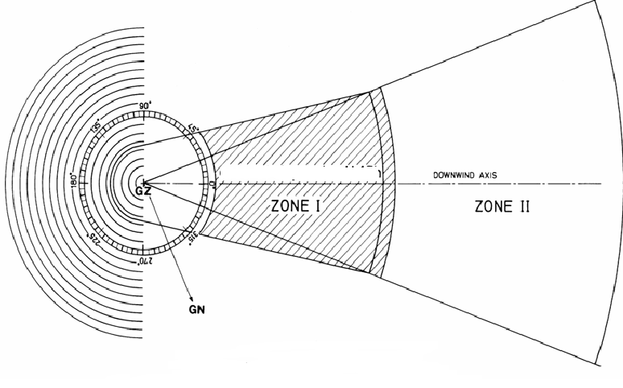
Phase 3: Emergency Response Application Tools
NATO Allied Tactical Publication (ATP) 45: Reporting Nuclear Detonations, Biological and Chemical Attacks, and Predicting and Warning of Associated Hazards and Hazards Areas.
Down Wind
Zone I: 1 km radius where immediate protective action is needed
Zone II: 10 km downwind of predicted hazardous area

Slide 13
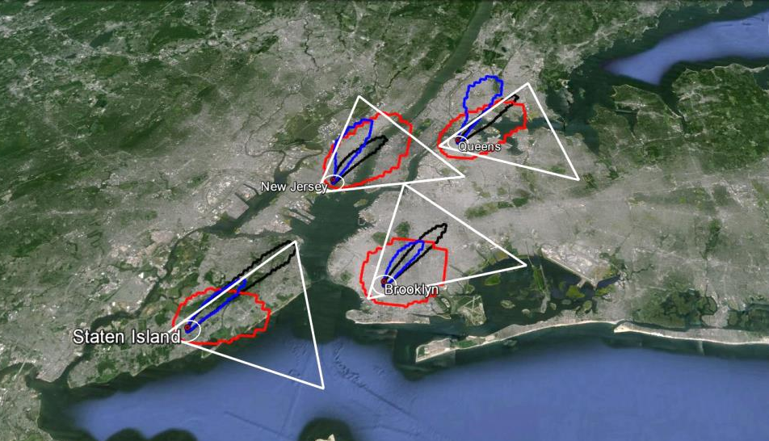
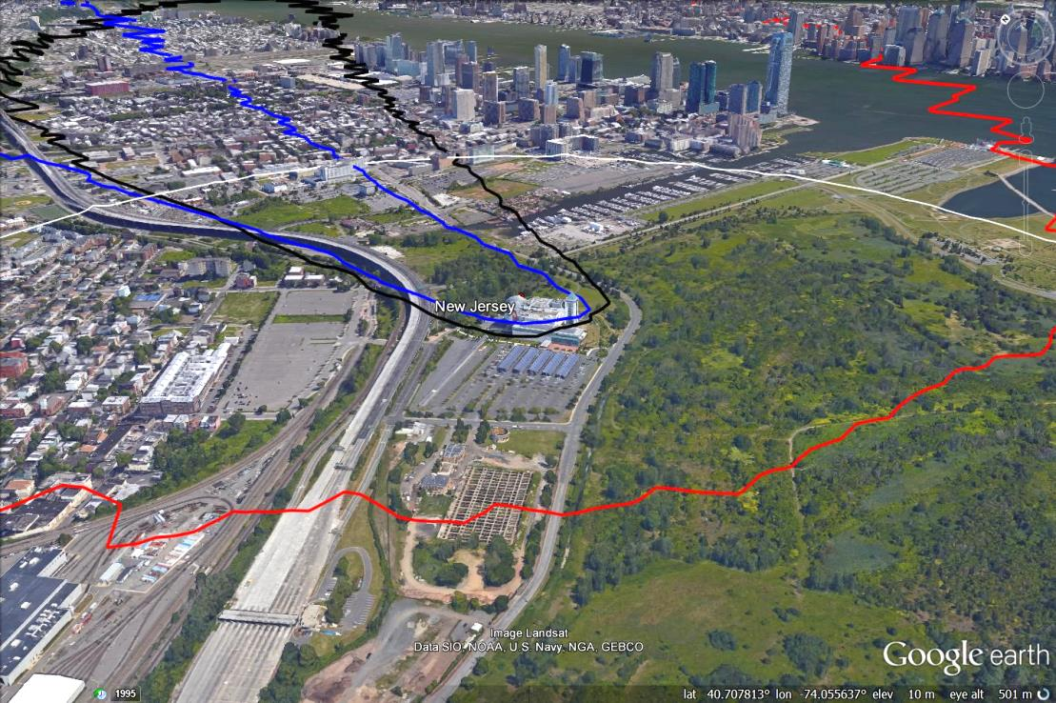
Phase 3: Integrated Plumes vs. NATO doctrine
Plumes predicted based on:
Red= surface observed meteorology
Black= High resolution MET predictions
Blue= Low resolution MET predictions
White= NATO’s Allied Tactical Publication-45(C) doctrine
New Jersey Release Site

Slide 14
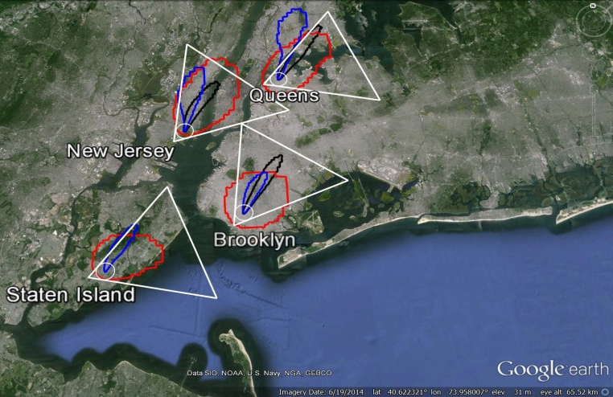
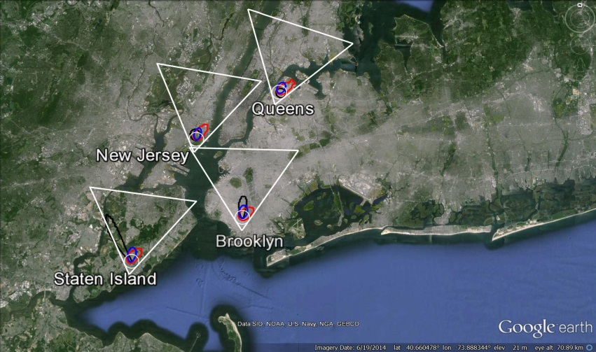
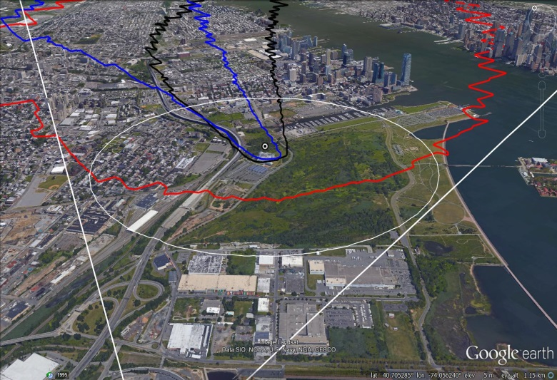
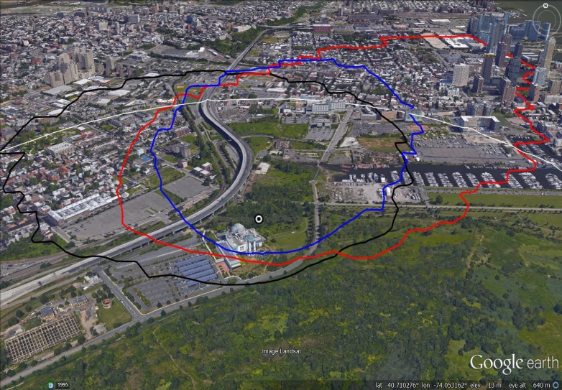
Phase 3: Integrated plumes vs. NATO doctrine
Night Time Release
Day Time Release
59% False Positive
34% False Negative
97% False Positive
28% False Negative
New Jersey Release site
New Jersey Release site

Slide 15
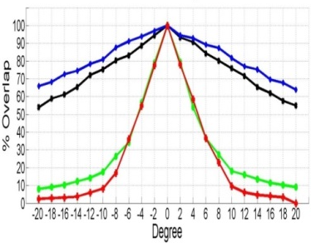
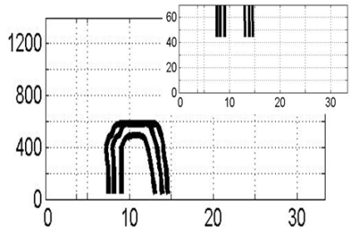
Conclusions
Air Flow is sensitive to surface wind direction particularly when
transport is over water.
Day conditions result in strong vertical transport leaving small
surface foot print. The opposite applies for night time.
  Day time Boundary Layers are deeper. (Δ~800m)
  Day time heat flux are stronger (Δ~260 w/m2)
  Softer vertical wind gradient
High resolution predictions capture unique local
transitions in air flow.
The transition from land to water is
delineated by heat fluxes.
Final recommendation: As urban coastal communities continue to grow and develop, it is important to maintain a local most current land-surface characteristics data base.
BL Depth [m]
Heat Flux

Slide 16
Final Recommendations
Land Surface Characteristics: As urban coastal communities continue to grow and develop, it is important to maintain a most current land-surface characteristics data base that could be used for local numerical models calculations.
Land-sea boundary: Atmospheric processes in the vicinity of urban-coastal boundaries are more sensitive to further complexities/deviations during summer season and night time conditions.

Slide 17
Questions?

Slide 18
References
Brown Michael, 2004: Urban Dispersion- challenges for fast response modeling. Los Alamos National Laboratory, Los Alamos . New Mexico
Gao Y., Fu J S., Drake J B, Liu Y, Lamarque J-F. 2012: Projected changes of extreme weather events in the eastern United States based on a high resolution climate modeling system. Environmental Research Letters, Vol 7.
Gedzelman, S. D., S. Austin, R. Cermak, N. Stefano, S. Patridge,S. Quesenberry, and D. A. Robinson, 2003: Mesoscale aspects of the urban heat island around New York City. Theor. Appl. Climatol., Vol 75, 29–42
Holt, T., and J. Pullen, 2007: Urban canopy modeling of the New York City metropolitan area: A comparison and validation of single- and multilayer parameterizations. Mon. Wea. Rev., Vol 135, 1906–1930.
Meir T., Orton M. P., Pullen J., Holt T., William T.T., Arend F.M, 2013: Forecasting the New York Urban Heat Island and Sea Breeze During Extreme Heat Event. Weather and Forecasting. Vol 28, Page 1460-1477
Pullen J., Holt T., Blumberg F.A., Bornstein D.R., 2007: Atmospheric Response to Local Upwelling in the Vacinity of New York-New Jersey Harbor. American Meteorological Society. Vol 46, pages 1031-1052
Thompson, W., T. Holt, and J. Pullen, 2007: Investigation of a sea-breeze front in an urban environment. Quart. J. Roy. Meteor. Soc., Vol 133, 579–594

Slide 19
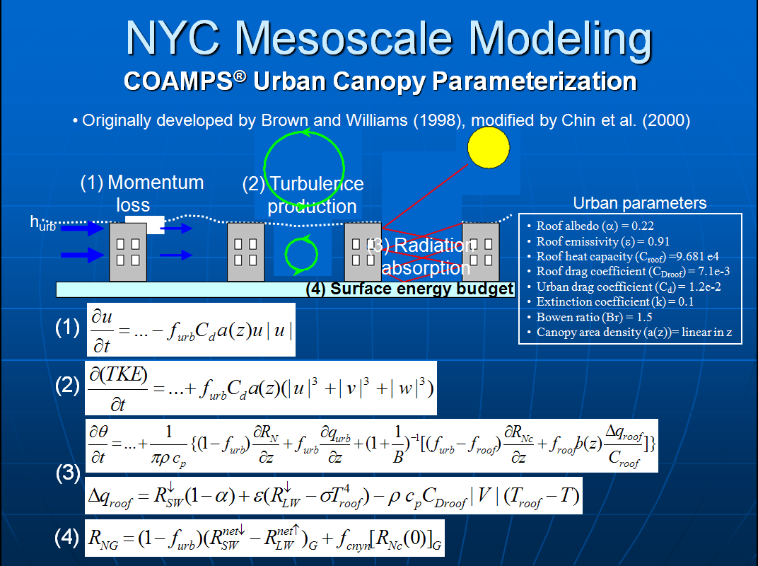

Slide 20
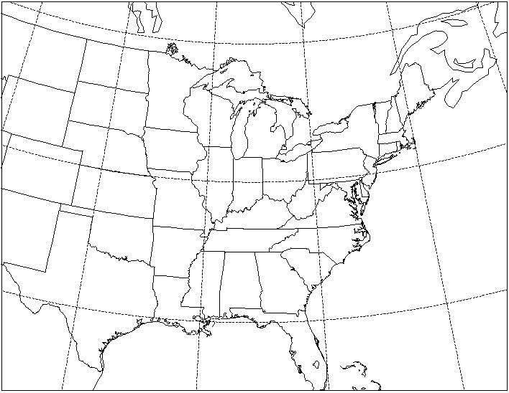
Model Configuration
1
2
3
Manhattan
4
NJ
Brooklyn
nest 1 (36 km)
nest 2 (12 km)
nest 3 (4 km)
nest 4 (1.33 km)
nest 5 (0.44 km)
COAMPS grid-4 vegetation type derived from 1-km USGS land use are:
1 = urban and built-up land…
16 = water bodies
Nests 4 & 5 use an urban canopy parameterization and hourly time-varying model-derived SSTs

Slide 21
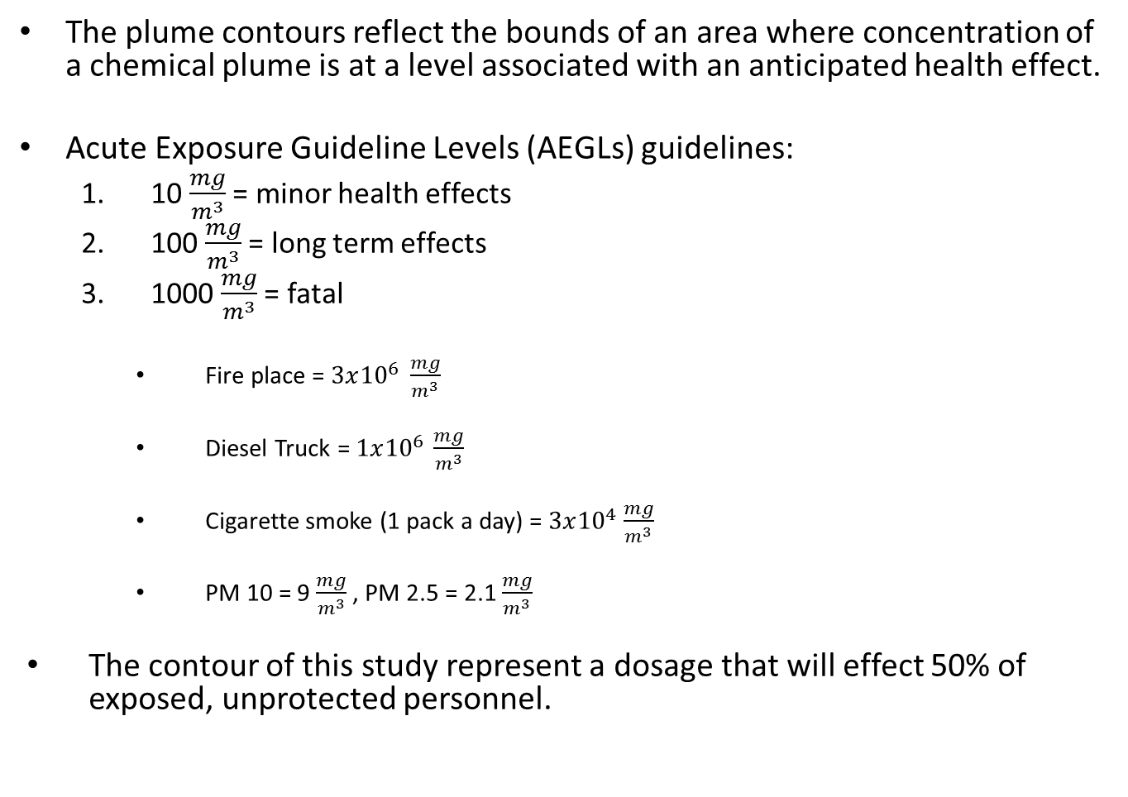
U.S. Toxicity Criteria
The plume contours reflect the bounds of an area where concentration of a chemical plume is at a level associated with an anticipated health effect.
Acute Exposure Guideline Levels (AEGLs) guidelines:
  10 $\frac{mg}{m^{3}}$ = minor health effects
  100 $\frac{mg}{m^{3}}$ = long term effects
  1000 $\frac{mg}{m^{3}}$ = fatal
    Fire place = $3x{10}^{6 }$ $\frac{mg}{m^{3}}$
    Diesel Truck = $1x{10}^{6 }\frac{mg}{m^{3}}$
    Cigarette smoke (1 pack a day) = $3x{10}^{4}$ $\frac{mg}{m^{3}}$
    PM 10 = 9 $\frac{mg}{m^{3}}$ , PM 2.5 = 2.1 $\frac{mg}{m^{3}}$
The contour of this study represent a dosage that will effect 50% of exposed, unprotected personnel.

