Slide 1
Verification of a Plume Rise Model Against Laboratory Simulations of a Highly Buoyant Plume
Stefano Alessandrini¹, Enrico Ferrero², Domenico Anfossi³,
Luca Delle Monache¹
¹National Center for Atmospheric Research (NCAR), Boulder, CO, USA
² Università del Piemonte Orientale, Italy
³ ISAC-CNR, Italy
9 June 2015, 19th Annual George Mason University Conference on Atmospheric Transport and Dispersion Modeling, Fairfax (VA)

Slide 2
Motivation
Plume rise schemes used in Lagrangian stochastic particle models (LPM) are generally based on Briggs (1975) analytical equations designed for buoyant emissions from stacks
The proposed algorithm is able to simulate particular cases (i.e., multiple plumes intersections, unusual emission shapes) where analytical equations are not available
The algorithm has been already tested in Alessandrini et al. (2013) against data from two laboratory experiments in neutral (Huq and Stewart, 1996) and stable (Contini et al., 2011) stratified flows and, from field campaigns (Hanna and Paine, 1987, 1989)
The model is now used to simulate a buoyant emission in a convective boundary layer (water tank experiment, Weil, 2002) with a temperature inversion at the top

Slide 3
Plume rise model
It is based on a hybrid Lagrangian-Eulerian approach similar to what used for the chemical reaction computation (Chock and Winkler, 1994, Alessandrini and Ferrero, 2009) in LPM
The air entrainment into the plume is considered by using a scalar representing the excess of plume temperature and momentum respect to the background atmosphere

Slide 4

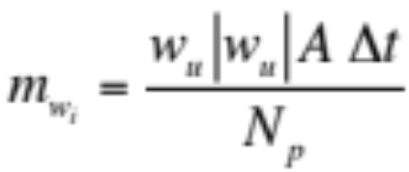
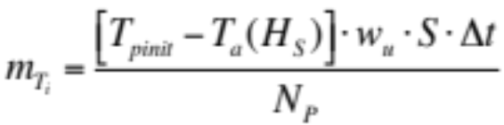
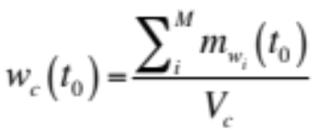
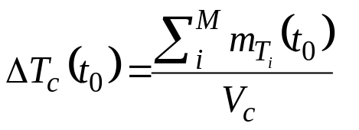
Plume rise model
We assign to any emitted particle in the time interval the “equivalent mass” m_{T} and m_{w}, defined as follows (excess of temperature, and momentum):
The vertical velocity w_{c} and air-plume temperatures difference for any cell c at the time t₀ are:
Volume V_{c}

Slide 5

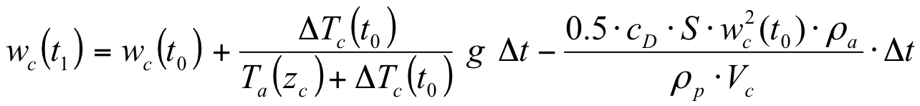
Plume rise model
At the time
A correction for taking into account non-isothermal atmosphere is applied:
Afterwards, the value of w_{c} at the time t₁ is computed for every cell using the following equation:
Buoyancy
Drag

Slide 6
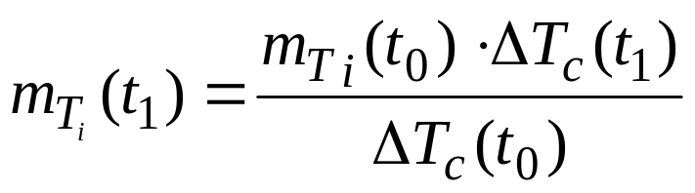
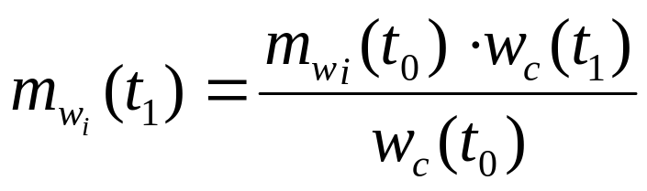
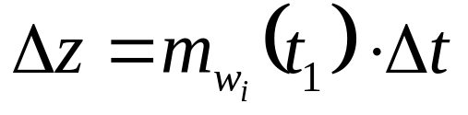
Plume rise model
The “equivalent mass” for temperature difference and momentum is computed for each particle following the method proposed by Chock and Winkler (1994):
Eulerian, cell momentum and temperature computation
Lagrangian particle displacement
6

Slide 7
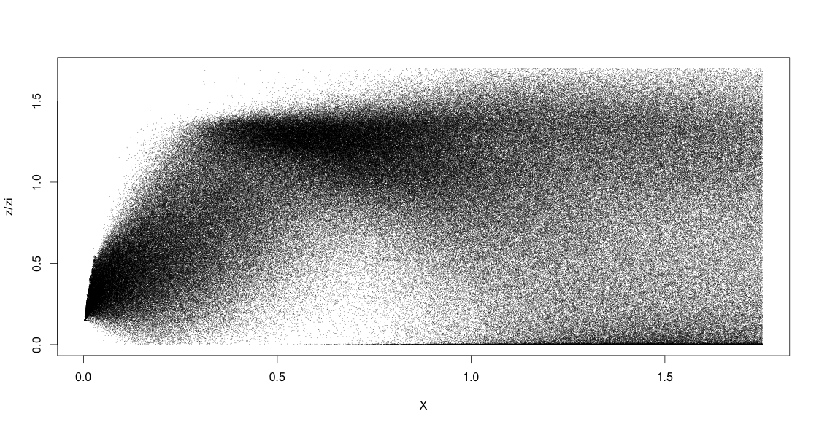


Water tank experiment
(Weil, 2002)
A buoyant plume is emitted from an elevated source in a boundary layer with a strong inversion at the top
Dimensions of the tank have been scaled conserving the Froude number
4 experiments with different emissions temperatures T= 303 K, 327 K, 355 K, 429 K and exit velocity of 19.8 m/s
Ambient temperature T_{a}= 303 K, w*=1.48 m/s
U = 4.14 m/s
z/zi

Slide 8
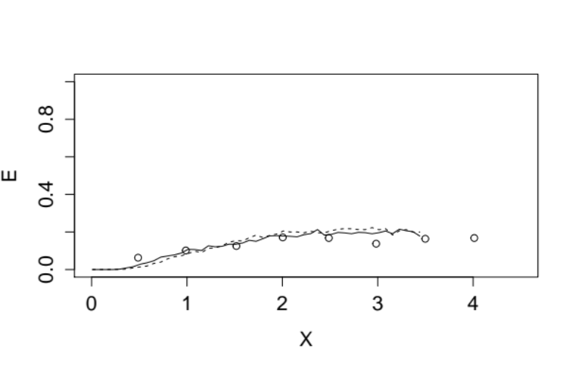
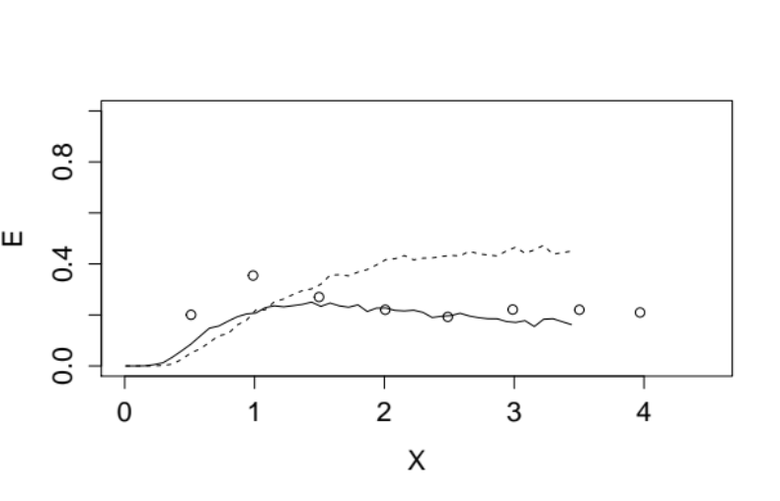
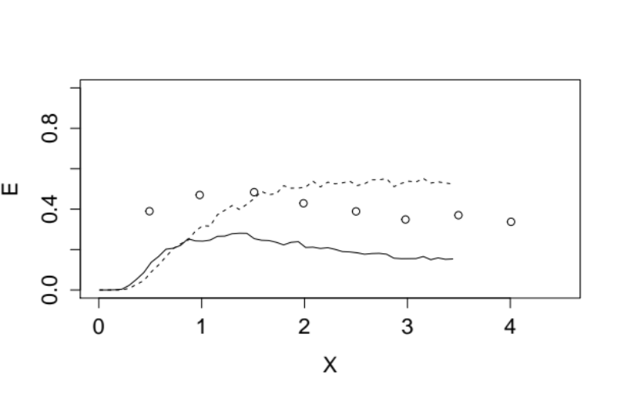
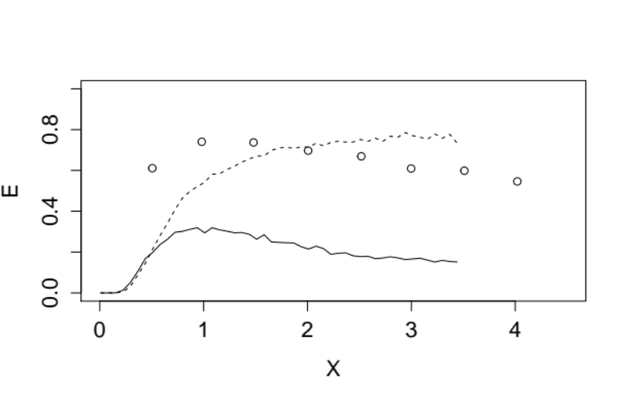
Model verification
(Entrapment)
T=303 K
T=327 K
T=355 K
T=429 K
The entrapment (E) vs. normalized distance from the emission computed for four different experiments. The circles represent the observations, the dashed lines the new model results and the continuous lines Anfossi et al. 1993.

Slide 9
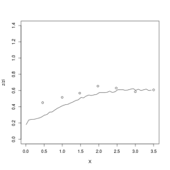
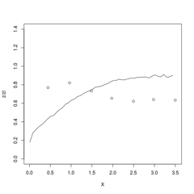
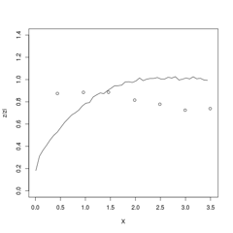
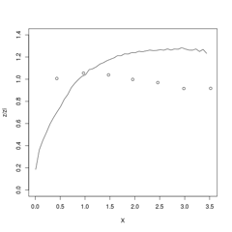
Model verification
(Z mean)
T=303 K
T=327 K
z/zi
z/zi
T=355 K
z/zi
z/zi
T=429 K
Mean height Z normalized by the inversion height zi vs. normalized distance from the emission computed for four different experiments

Slide 10
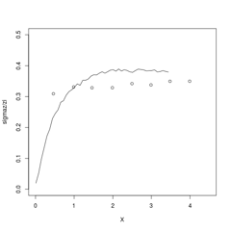
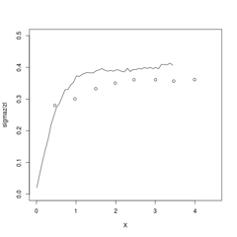
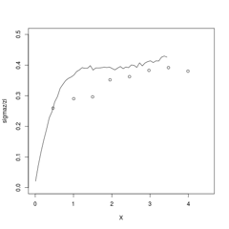
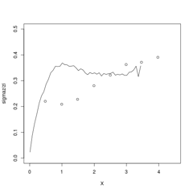
Model verification
(σ_{z})
T=303 k
T=327 K
σ_{z}
σ_{z}
σ_{z}
σ_{z}
T=355 K
T=429 K
σ_{z} normalized by zi vs. normalized distance from the emission computed for four different experiments

Slide 11
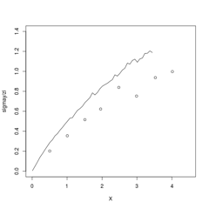
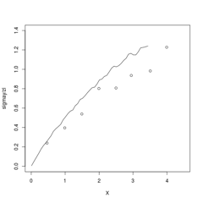
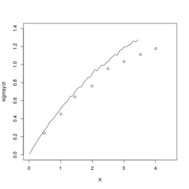
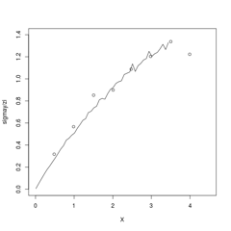
Model verification
(σ_{y})
T=303 K
T=327 K
σ_{y}
σ_{y}
σ_{y}
σ_{y}
T=355 K
T=429 K
σ_{y} normalized by zi vs. normalized distance from the emission computed for four different experiments

Slide 12
Conclusions
The new plume rise model shows satisfactory results when compared to observed data
Few observed discrepancies (e.g., over estimation of the mean plume height) are likely due to a poor representation of the drag in the water tank
The new model is more reliable in simulating the entrapment than the analytical model based on Briggs (1975)
A generalized version of this plume rise model able to treat also dense gas releases has been proposed by Kaplan (2015)

Slide 13



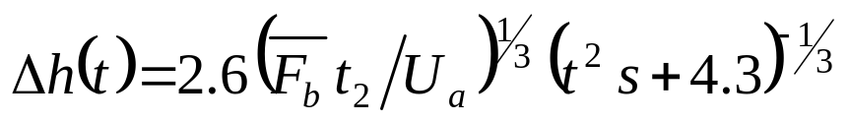


“Old “ Plume rise method
To each i-th particle a normally distributed buoyancy flux is assigned at the stack exit, fixing the mean value equal to the mean buoyancy flux and the standard deviation equal to
Plume centerline grows according to a plume rise formula describing both the transitional and final phases and different stability conditions (Anfossi, 1985; Anfossi et al., 1993):
thus
plume rise
and
turbulence

