Slide 1
Impact of Meteorological Uncertainty on Source Estimation in Complex Coastal Terrain
Don Lucas, Matthew Simpson, Gardar Johannesson,
Philip Cameron-Smith, and Ron Baskett
Lawrence Livermore National Laboratory
June 9, 2015
Nineteenth Annual George Mason University Conference on
Atmospheric Transport and Dispersion Modeling
This work performed under the auspices of the U.S. Department of Energy by
Lawrence Livermore National Laboratory under Contract DE-AC52-07NA27344
LLNL-PRES-672178

Slide 2

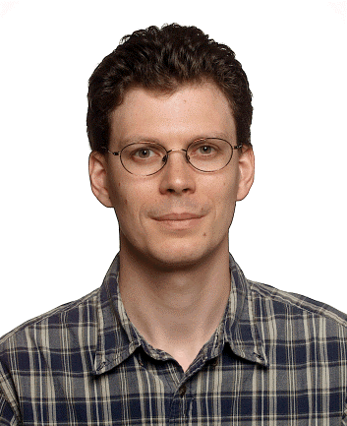

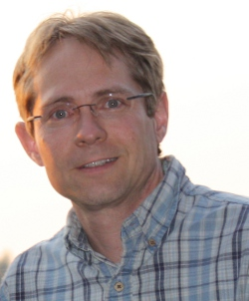


Atmospheric Source Estimation Team
  Ron Baskett, PI (AEED/Atm Sci)
  Overall responsibility {30 years NARAC experience}
  Philip Cameron-Smith, Co-PI (AEED/Climate)
  Guide implementation and technical lead
  Akshay Gowardhan (AEED/Atm Sci)
  Urban CFD and dispersion modeling
  Don Lucas (AEED/Atm Sci)
  Ensemble modeling and UQ methods
  Matthew Simpson (AEED/Atm Sci)
  WRF modeling
  Gardar Johannesson (Former LLNL Engr/Statistician)
  Consultant on source inversion methodology
LLNL-PRES-672178

Slide 3
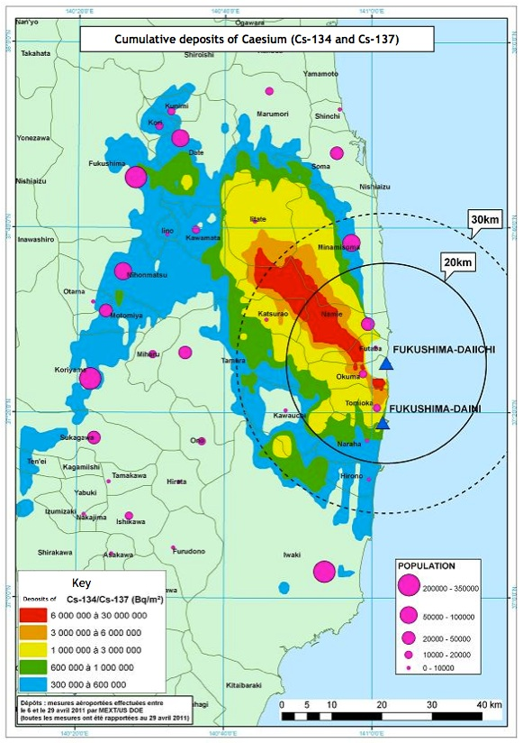
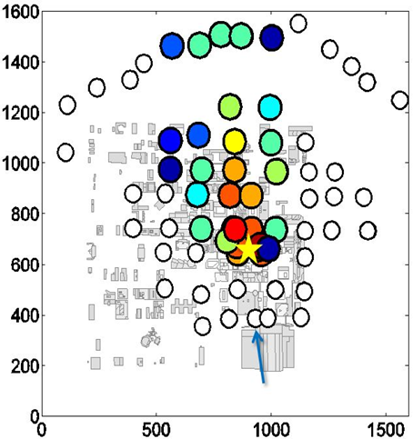
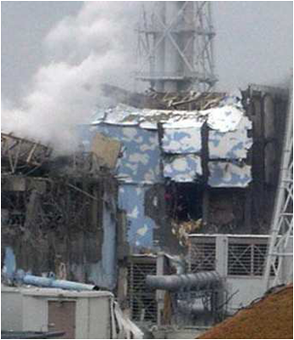
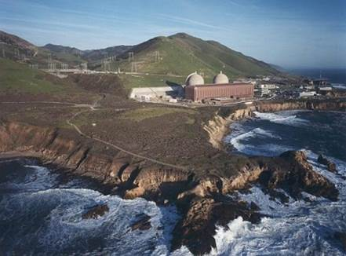
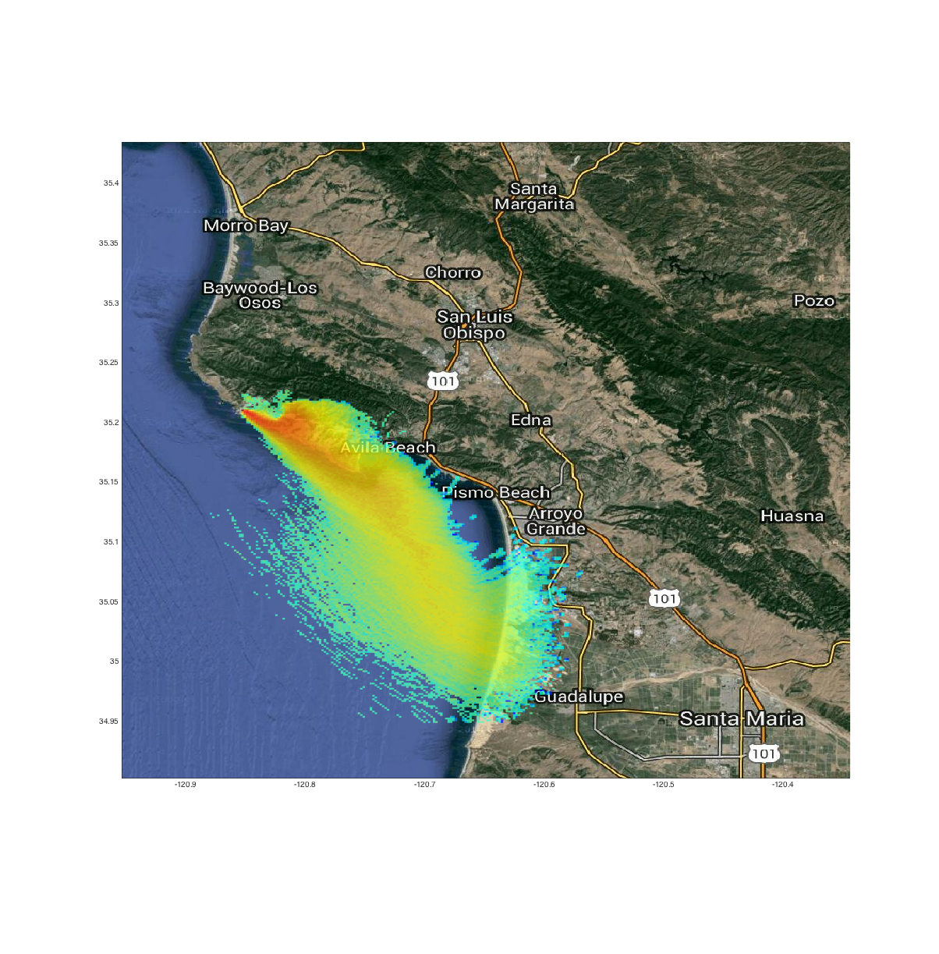
Three-Year Laboratory Directed Research and Development Project
FY2014 FY2015 FY2016
1. Implement urban modeling system with inversion code [Run against Oklahoma City tracer case]
2. Develop ensemble regional model with inversion code
[Run against Diablo Canyon NPP tracer case]
3. Build, test, and document final system
[Run against Fukushima NPP accident]
LLNL-PRES-672178

Slide 4
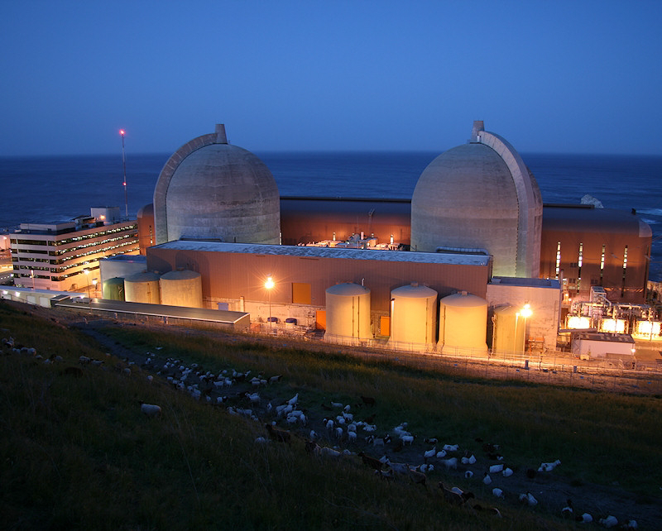
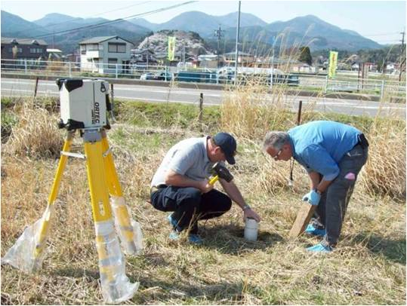
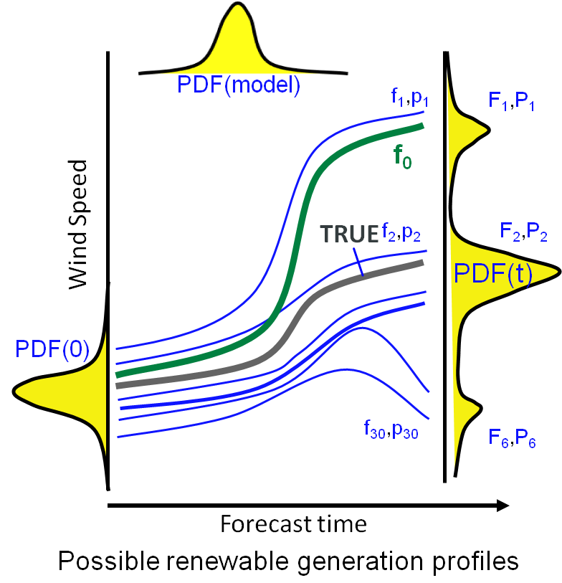
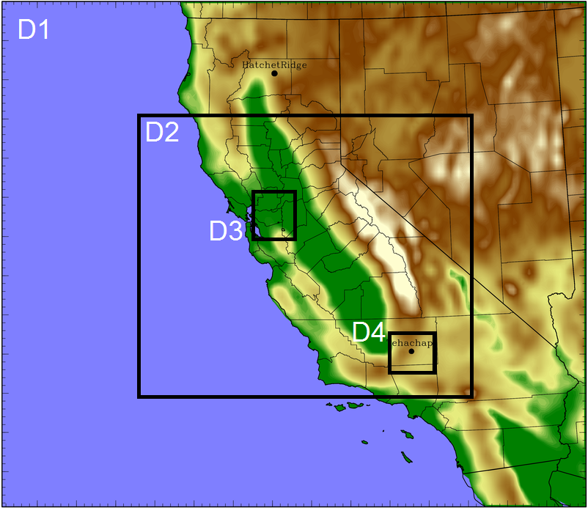
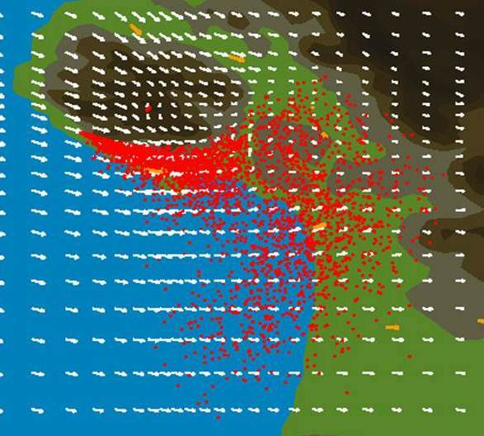
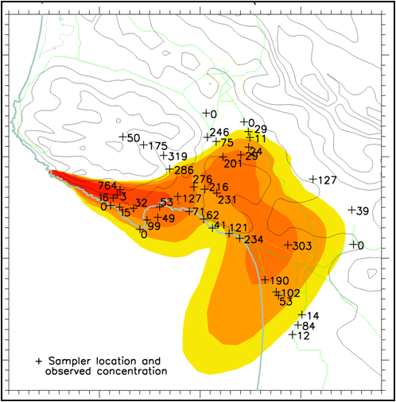
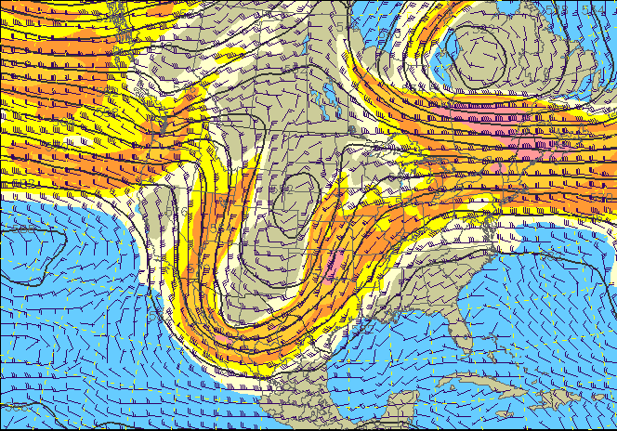
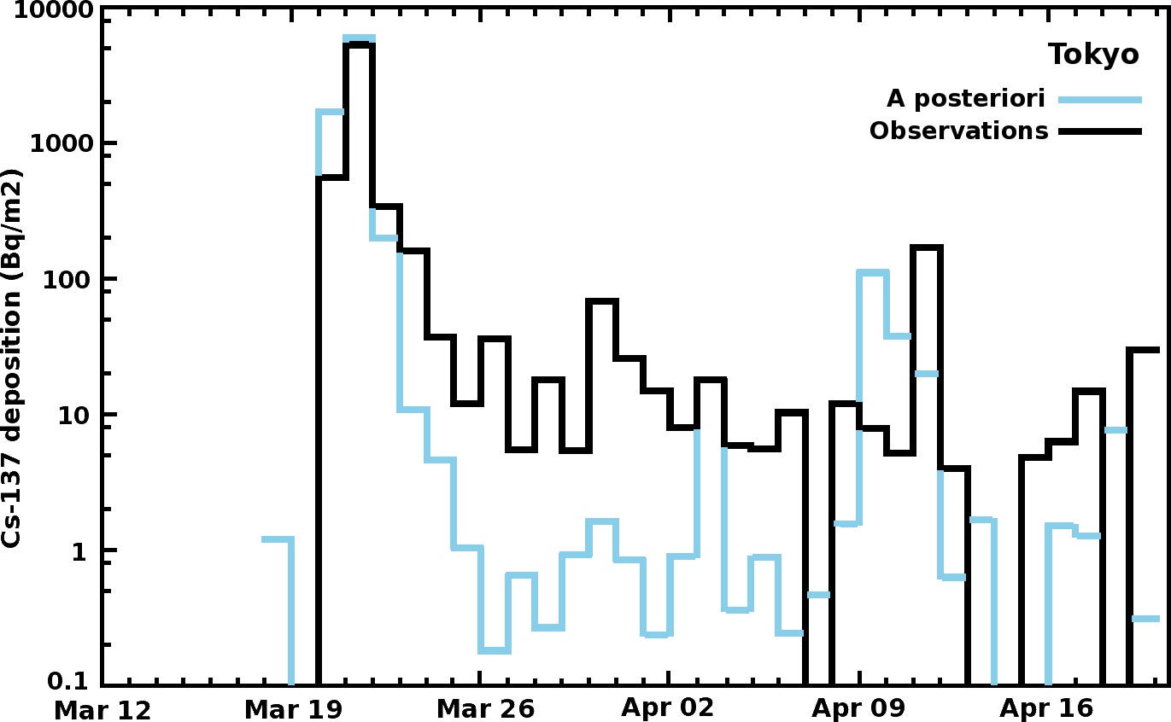
Atmospheric Source Estimation Using Ensembles
observations
source
measurement error
A
Source characteristics
dispersion code
meteorology
model error
Field observations
Plume predictions
Apply
Monte
Carlo
optimization
WRF regional model
Dispersion model
Gridded analyses
A = source loop
B = meteorology loop
C = discrepancy loop
C
B
Uncertainty & bias of model & obs
LLNL-PRES-672178
Notes:
Our Advanced Source Reconstruction Capability will be built on the current modeling tools resident at LLNL.
The model run stream involves using global gridded meteorological analyses to initialize the Weather Research & Forecast model. WRF in turn creates the meteorological inputs for the dispersion model. We bring in the source characteristics to generate plume predictions to compare with field observations. All this currently exists at Livermore.
A. First, we will implement code to determine the source terms that are consistent with observations using Monte Carlo optimization techniques.
B. Second, we will create an ensemble of meteorological conditions that are consistent with observations. Then sample those ensemble members at the same time as loop A.
C. Third, we will develop a system to simultaneously detect unresolved biases between the model and the observations.
These three simultaneous cycles will provide a complete assessment to achieve optimal source characteristics and associated level of uncertainty, which we will now discuss in more detail.

Slide 5
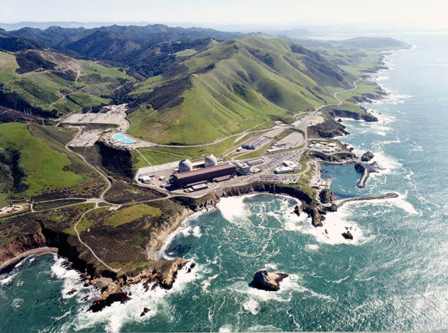
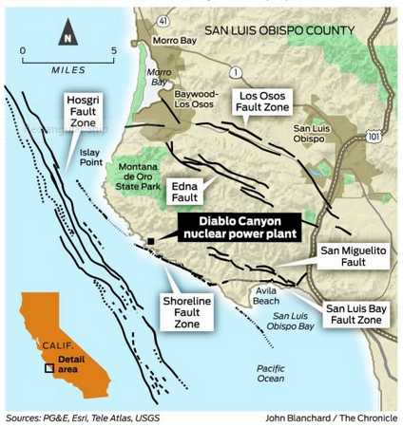
Complex terrain on a regional scale
Diablo Canyon NPP Tracer Experiment (DOPPTEX)
Looking SE
400 m
backup tower
primary tower
Central coastal CA near San Luis Obispo
Only active NPP on West Coast
Study commissioned by PG&E in 1986
Eight SF₆ release experiments between Aug 31-Sep 17 (CF₃Br released too)
15 met stations & 150 tracer stations
“PG&E overlooked key seismic test at Diablo Canyon nuclear plant,” San Francisco Chronicle, March 12, 2015.
LLNL-PRES-672178

Slide 6
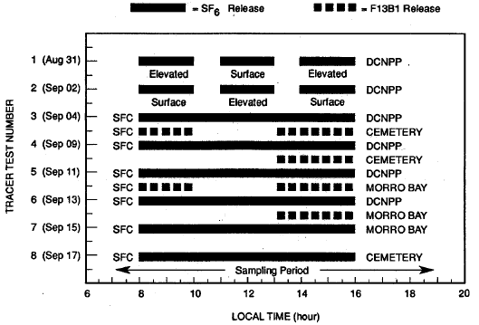
Complex terrain on a regional scale
Diablo Canyon NPP Tracer Experiment (DOPPTEX)
Looking SE
Focus on Test 3 release
400 m
backup tower
primary tower
Central coastal CA near San Luis Obispo
Only active NPP on West Coast
Study commissioned by PG&E in 1986
Eight SF₆ release experiments between Aug 31-Sep 17 (CF₃Br released too)
15 met stations & 150 tracer stations
R. H. Thuillier (1992) Evaluation of a Puff Dispersion Model in Complex Terrain, JAWMA, 42:3, 290-297
~146 kg of SF₆ released over 8 hours continuously
LLNL-PRES-672178

Slide 7
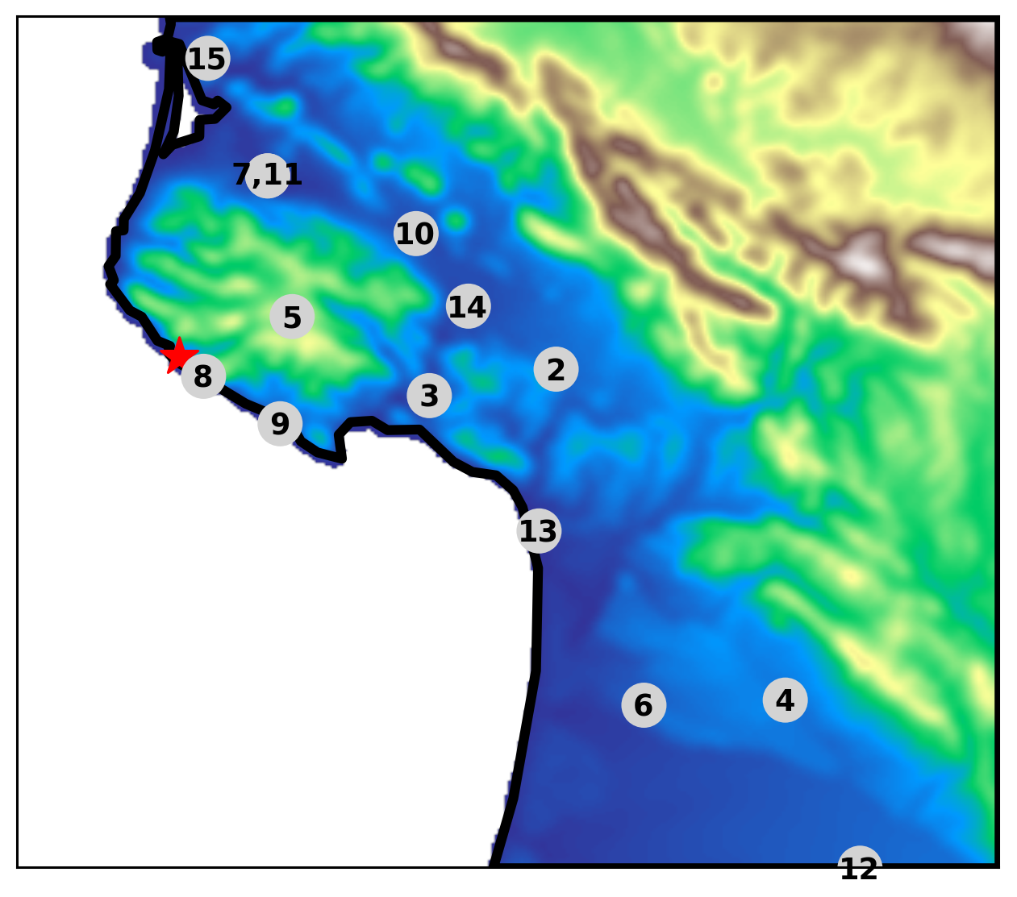
Complex terrain on a regional scale
Diablo Canyon NPP Tracer Experiment (DOPPTEX)
Looking SE
400 m
Evaluate at 15 met surface sites
backup tower
primary tower
Central coastal CA near San Luis Obispo
Only active NPP on West Coast
Study commissioned by PG&E in 1986
Eight SF₆ release experiments between Aug 31-Sep 17 (CF₃Br released too)
15 met stations & 150 tracer stations
LLNL-PRES-672178

Slide 8
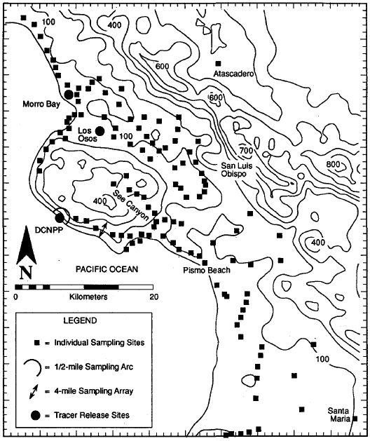
Complex terrain on a regional scale
Diablo Canyon NPP Tracer Experiment (DOPPTEX)
Looking SE
Evaluate at 150 tracer sites
400 m
backup tower
primary tower
Central coastal CA near San Luis Obispo
Only active NPP on West Coast
Study commissioned by PG&E in 1986
Eight SF₆ release experiments between Aug 31-Sep 17 (CF₃Br released too)
15 met stations & 150 tracer stations
R. H. Thuillier (1992) Evaluation of a Puff Dispersion Model in Complex Terrain, JAWMA, 42:3, 290-297
LLNL-PRES-672178

Slide 9
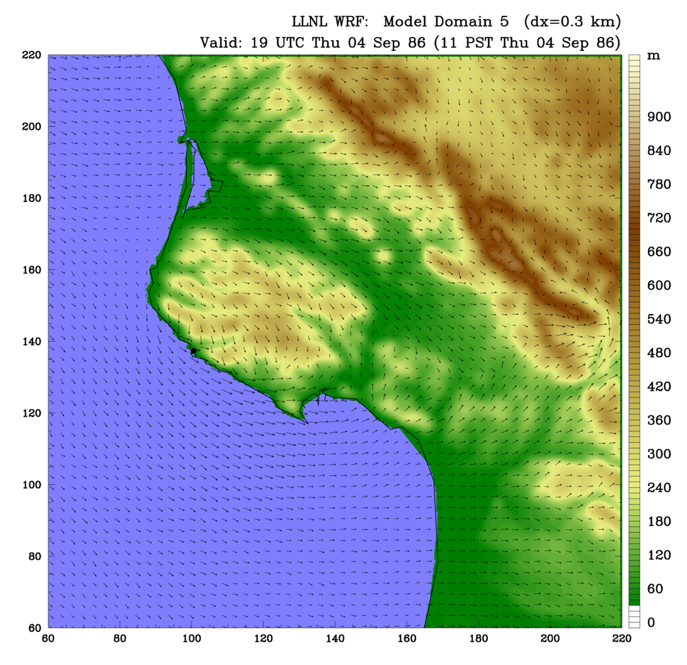
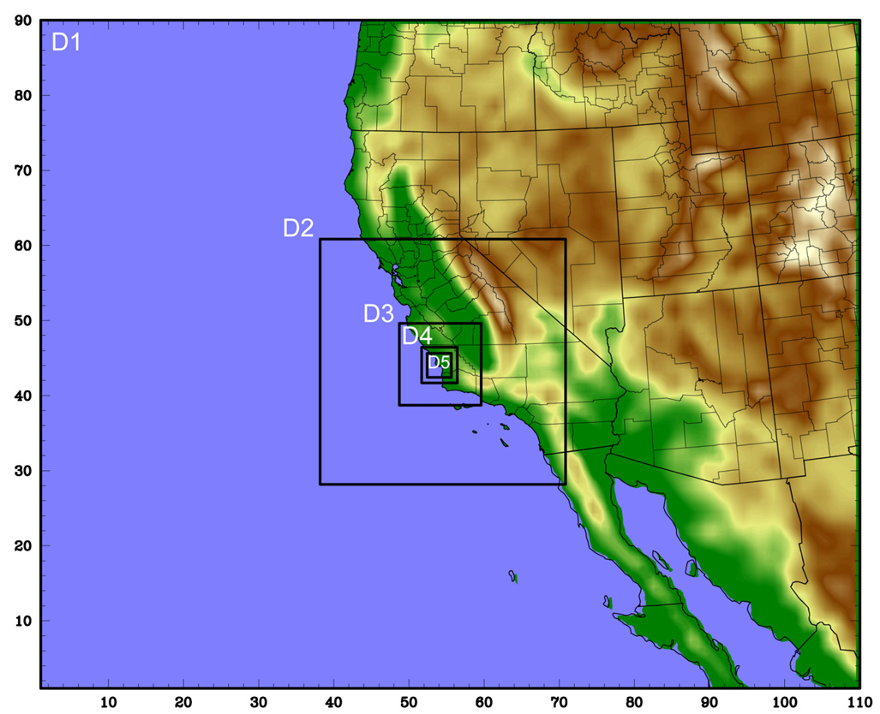
Complex terrain on a regional scale
Diablo Canyon NPP Tracer Experiment (DOPPTEX)
Weather Research & Forecast (WRF) meteorological model with 5 nested domains
FLEXPART dispersion using WRF met and 1M particles
Inner domain resolves winds using 300 m resolution
Main objective: characterize meteorological uncertainty in WRF and propagate through FLEXPART and source inversion
LLNL-PRES-672178
Notes:
To allow the MCMC system to sample alternative meteorological conditions (Loop B), we will pre-generate a meteorological ensemble that covers the uncertainty in initial state, global meteorology, and model physics. This will propagate the uncertainty in the meteorology through the system to determine its impact on source estimation. This will be one of the main research topics for our project.
We will explore and evaluate several approaches from simple to complex:
The simplest is to extract multiple initial states from neighboring timesteps of an initial run, which will then be nudged towards observations ( ie reanalysis data) during the simulation, which is similar to the approach of the weather prediction centers. If that is not sufficient, we will also examine sampling alternative model parameterizations, and a full data assimilation system using a community model.
The Figure shows the wind speed 100-meters above the surface measured using a lidar (black dots) and simulated using a 200-member WRF ensemble (solid lines).

Slide 10
Complex terrain on a regional scale
Diablo Canyon NPP Tracer Experiment (DOPPTEX)
Meteorological uncertainty is assessed using 20 different WRF configurations
1. Base case (NARR, MYJ PBL, Noah LSM, FDDA, obs nudging) | 6. Physics (YSU PBL, Noah LSM) | 11. Physics (MYNN PBL, Thermal LSM) | 16. Nudge 0.9 (base x 0.9)
2. ECMWF reanalysis | 7. Physics (YSU PBL, RUC LSM) | 12. Physics (MYNN PBL, Noah LSM) | 17. Nudge 0.99 (base x 0.99)
3. Initialize 6 hours earlier | 8. Physics (QNSE PBL, Thermal LSM) | 13. Physics (MYNN PBL, RUC LSM) | 18. Nudge 0.999 (base x 0.999)
4. 900 m resolution | 9. Physics (QNSE PBL, Noah LSM) | 14. Nudge low (no FDDA, obs nudging) | 19. Nudge 0.6 (base x 0.6)
5. Physics (YSU PBL, Thermal LSM) | 10. Physics (QNSE PBL, RUC LSM) | 15. Nudge high (base x 10) | 20. Nudge 3.3 (base x 3.3)
LLNL-PRES-672178
Notes:
To allow the MCMC system to sample alternative meteorological conditions (Loop B), we will pre-generate a meteorological ensemble that covers the uncertainty in initial state, global meteorology, and model physics. This will propagate the uncertainty in the meteorology through the system to determine its impact on source estimation. This will be one of the main research topics for our project.
We will explore and evaluate several approaches from simple to complex:
The simplest is to extract multiple initial states from neighboring timesteps of an initial run, which will then be nudged towards observations ( ie reanalysis data) during the simulation, which is similar to the approach of the weather prediction centers. If that is not sufficient, we will also examine sampling alternative model parameterizations, and a full data assimilation system using a community model.
The Figure shows the wind speed 100-meters above the surface measured using a lidar (black dots) and simulated using a 200-member WRF ensemble (solid lines).

Slide 11
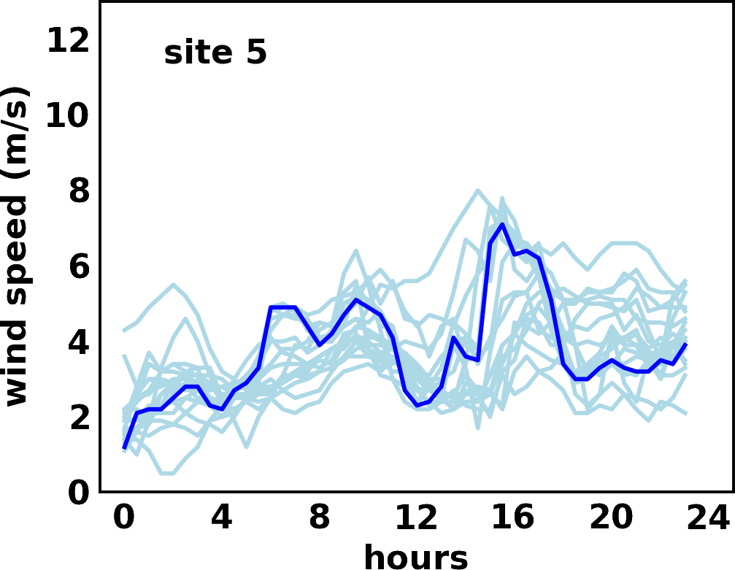
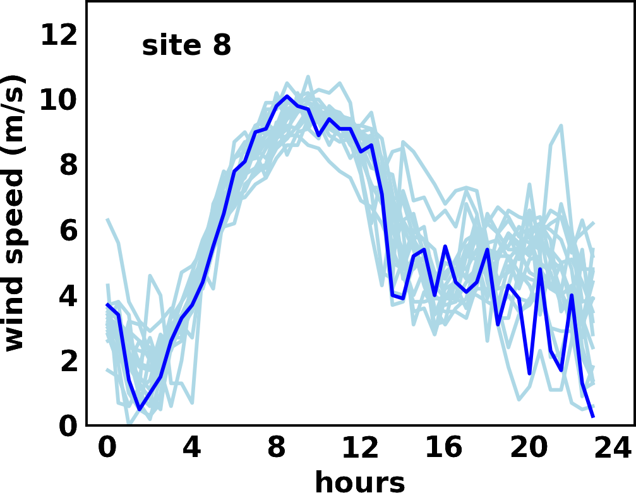
Complex terrain on a regional scale
Diablo Canyon NPP Tracer Experiment (DOPPTEX)
WRF base
15 met surface sites
WRF ensemble
LLNL-PRES-672178

Slide 12
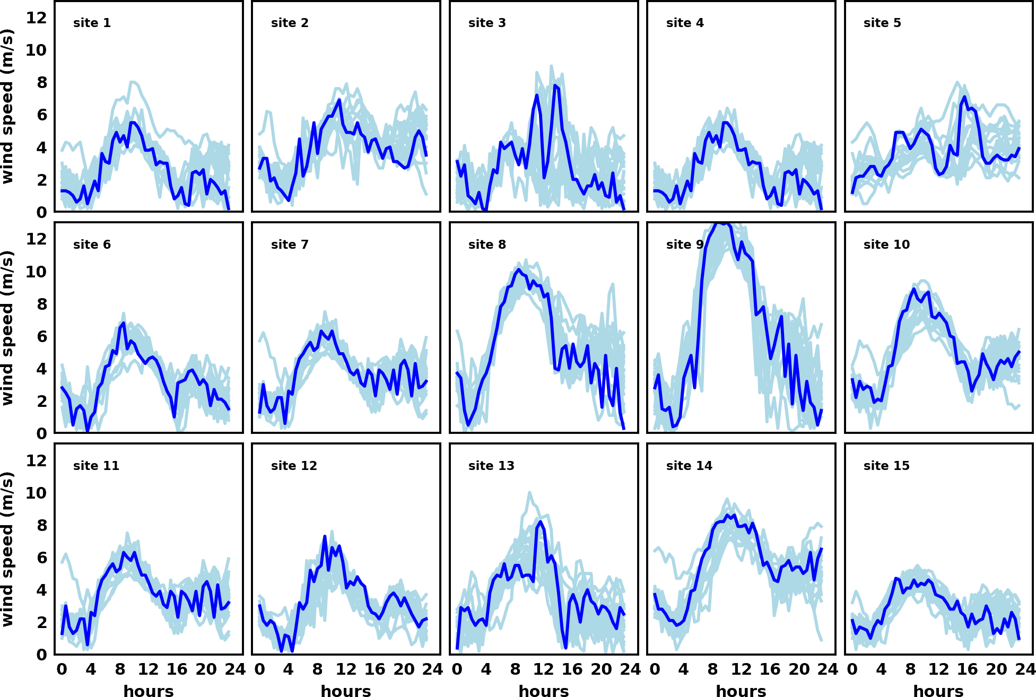
Complex terrain on a regional scale
Diablo Canyon NPP Tracer Experiment (DOPPTEX)
WRF ensemble variations are significant at the 15 met sites
WRF base
WRF ensemble
LLNL-PRES-672178

Slide 13
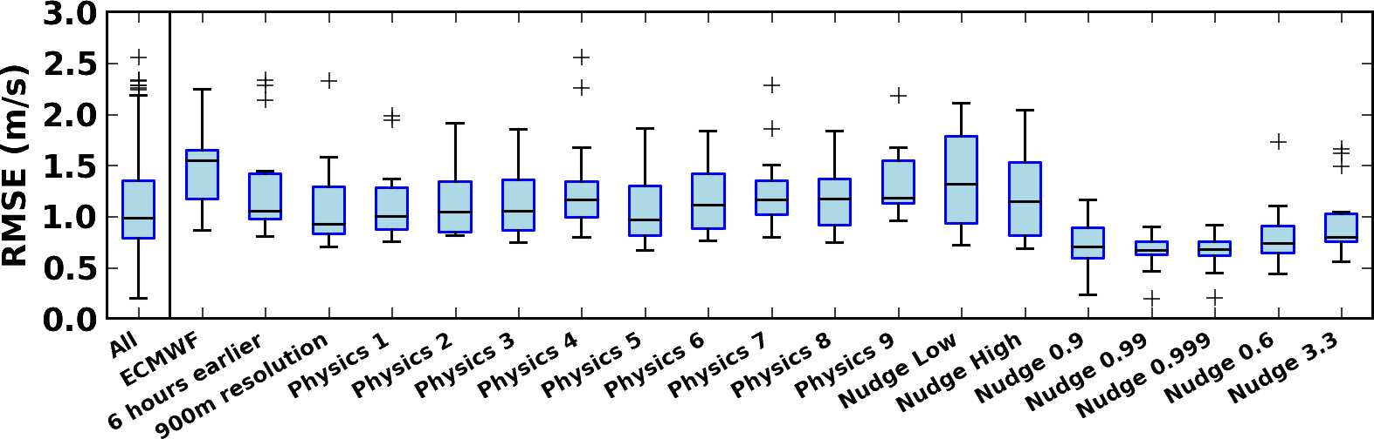
Complex terrain on a regional scale
Diablo Canyon NPP Tracer Experiment (DOPPTEX)
WRF base
Which WRF configurations cause the largest deviations in wind speed from the Base case?
WRF ensemble
Compute RMSEs between ensemble members and the Base case at each site.
Aggregate RMSEs across the sites.
LLNL-PRES-672178

Slide 14
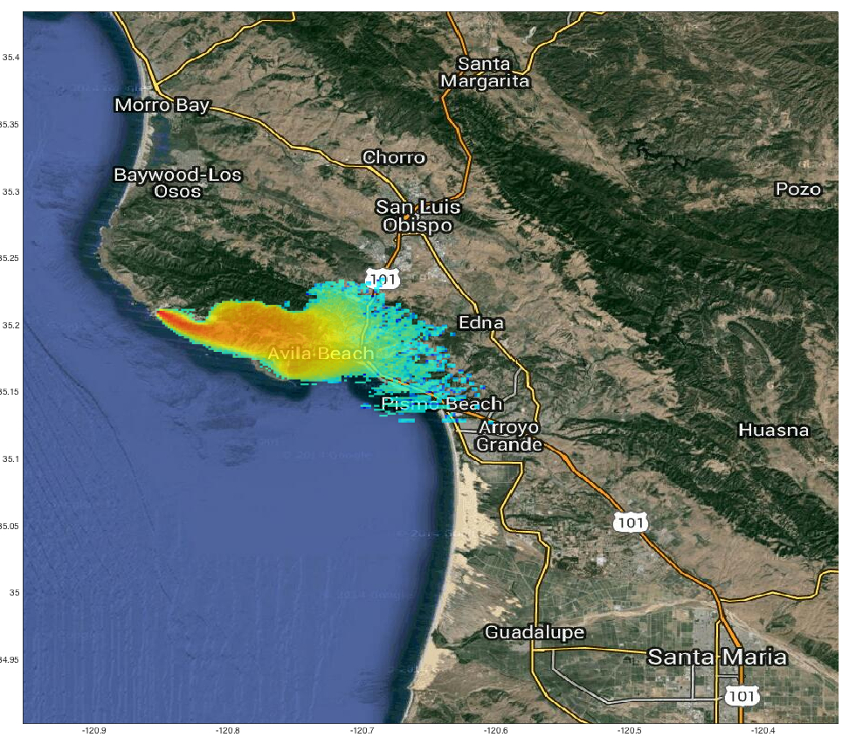
Complex terrain on a regional scale
Diablo Canyon NPP Tracer Experiment (DOPPTEX)
Model initialization significantly influences Diablo Canyon predicted plume locations and concentrations
NARR
ECMWF
Predicted 30-minute average air concentrations valid at 17:30 UTC on 4 Sept 1986 for a WRF-FLEXPART model run initialized with a standard US forecast (Control-left) and a run initialized with the European Community Medium Weather Forecast (ECMWF-right)
LLNL-PRES-672178
14

Slide 15
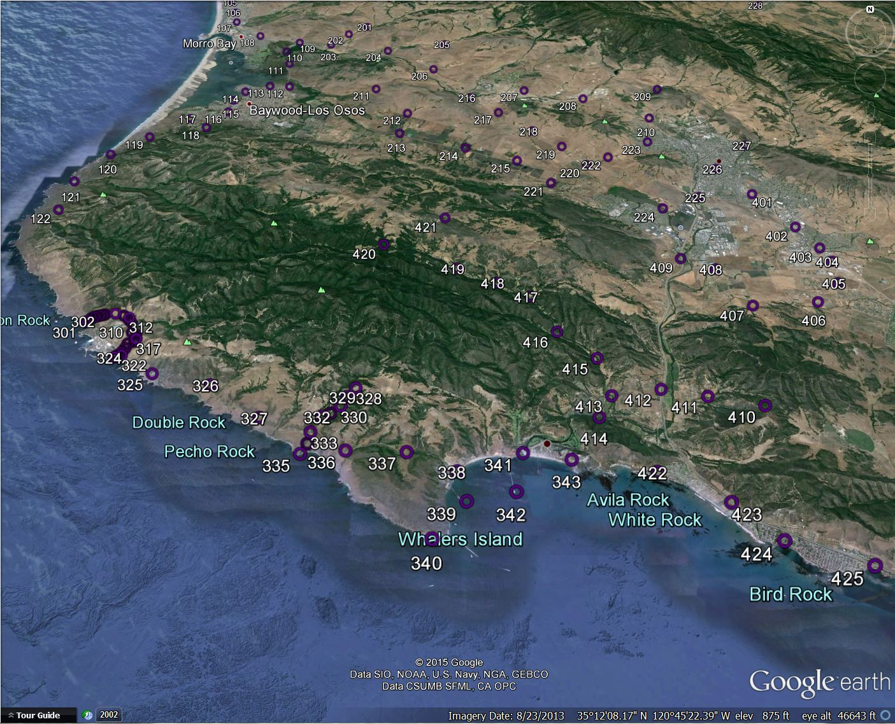
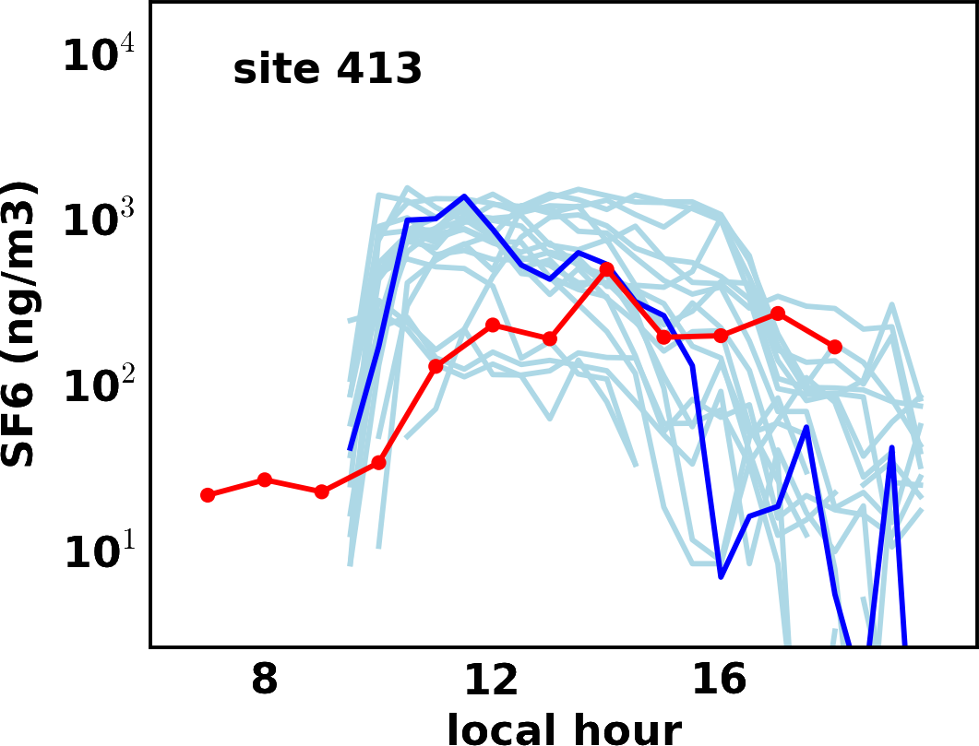
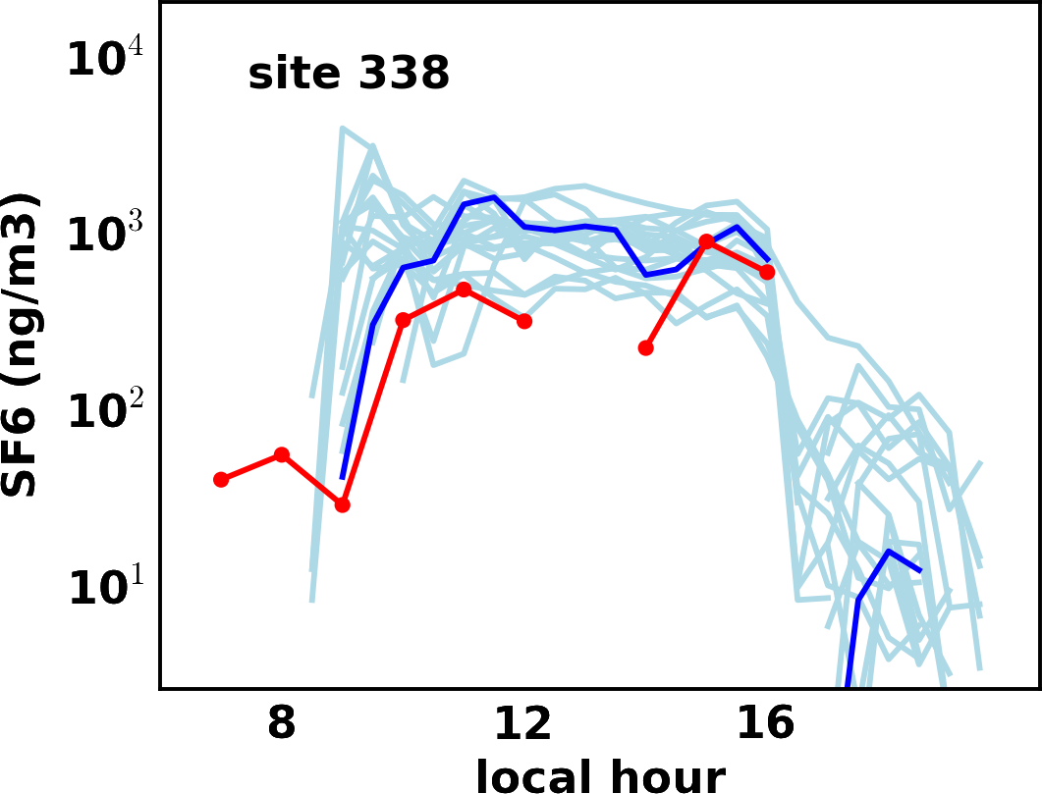
Complex terrain on a regional scale
Diablo Canyon NPP Tracer Experiment (DOPPTEX)
WRF base
WRF ensemble
Obs
Observation sites
Different WRF configurations lead to very significant spread in FLEXPART concentrations
LLNL-PRES-672178
15

Slide 16
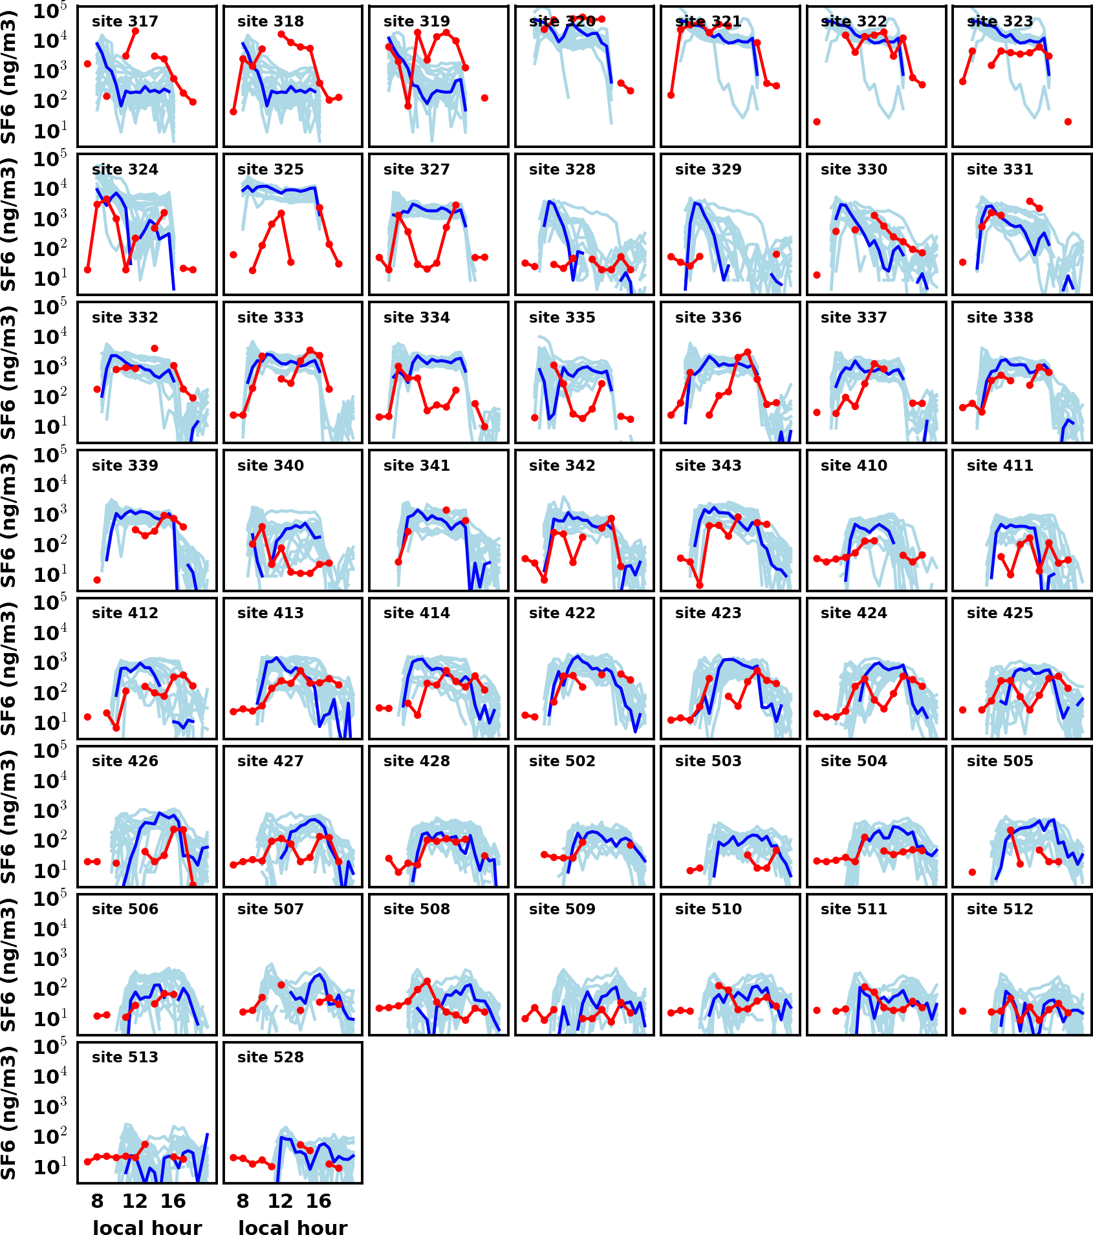
Complex terrain on a regional scale
Diablo Canyon NPP Tracer Experiment (DOPPTEX)
Observation sites
Different WRF configurations lead to very significant spread in FLEXPART concentrations
WRF base
WRF ensemble
Obs
LLNL-PRES-672178
16

Slide 17
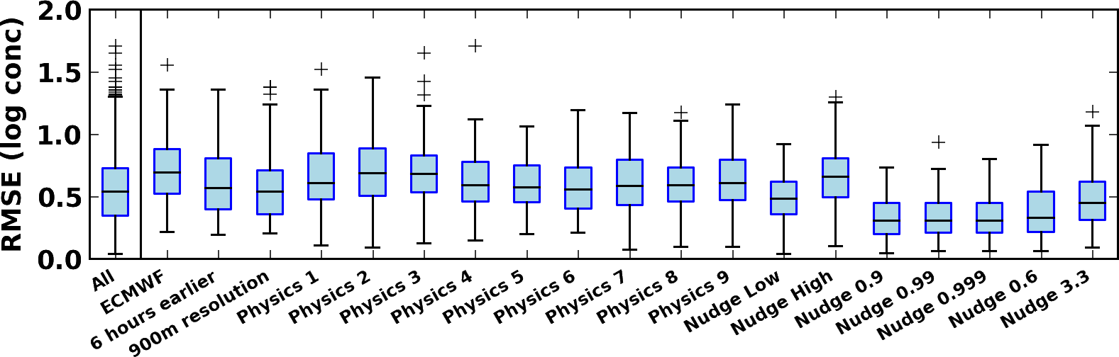
Diablo Canyon experiment provides lots of observations.
Model uncertainty significantly influences concentrations
WRF base
Which WRF configurations cause the largest deviations in SF6 from the Base case?
WRF ensemble
Obs
Compute RMSEs between ensemble members and the Base case at each site.
Aggregate RMSEs across the sites.
LLNL-PRES-672178
17

Slide 18
Summary and next steps for DOPPTEX
Simulated DOPPTEX Test 3 case using a 20-member WRF ensemble & FLEXPART
Different WRF configurations lead to large spreads in wind speed (~2 m/s) and SF6 concentrations (factor of 10)
Identified factors that lead to large (reanalysis) and small changes (physics)
Run WRF simulations over 2 or more simultaneous factors
Use model-observation differences in winds and concentrations to quantify uncertainty in WRF simulations and
WRF base
WRF ensemble
WRF base
WRF ensemble
Obs
LLNL-PRES-672178
Notes:
These two distributions, of uv and of sigma, are based on MCMC that samples the uv using random walk proposal distribution that jumps between already computed runs (the gray dots, a subset of size 5,000 of the 25,000 runs). The “likelihood” is Gaussian for u and v observation where the mean is given the the predicted u/v component (runs) and the sigma is sampled (with non-informative prior, p(sigma) propto 1/sigma).
The posterior points in the uv plot are colored according to how often each was “hit” by the MCMC algorithm. And the second plots shows the empirical posterior density of sigma.
As for data, I randomly picked 10, 20, or all (55) of the sensors to use in the inversion.

Slide 19
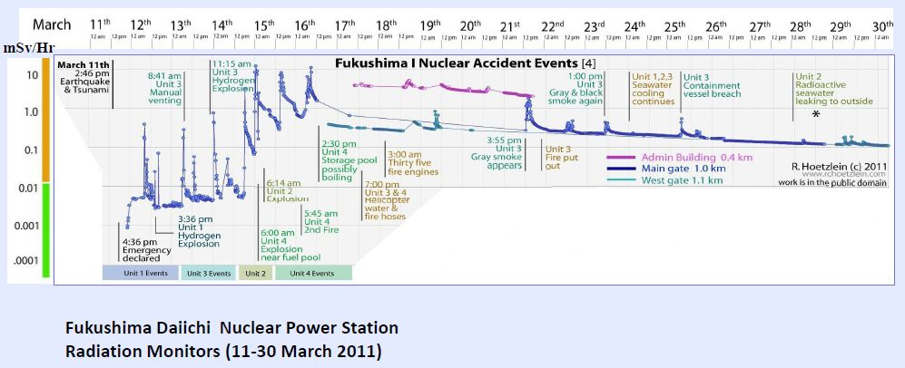
Next year: Reconstruct Fukushima releases
Fukushima Source Inversion
Mesoscale ensemble WRF modeling
Determine sensitivity of model physics to measured dose rate data
Analyze sensitivity to precipitation scavenging and wet deposition
Estimate time-varying source rate
Determine model-observation bias
Quantify uncertainty
LLNL-PRES-672178
Notes:
There was no clear pattern of “hits” and “misses” which would have led one to change model input source parameters such as release amount, time, or height; or meteorological parameters such as wind direction, mixing height, dry or wet deposition velocity.
The Japanese and US’ recommendations for their citizens to relocate within 20 and 80-km radii were based on uncertain plant conditions, not forecasted releases.

Slide 20
Questions?
LLNL-PRES-672178

