Slide 2

An approach to model selection and calibration for Bayesian inverse problems
Paul B. Westoby
Andrew R. Webb
Uk official
Notes:
Aim:
To Bayesian model selection in inverse problems context
To exploit historical trials data as part of the model selection procedure
To discuss some of the technical issues
To introduce model selection, averaging and combination approaches in inverse problems
General introduction

Slide 3
Outline of presentation
Modelling physical systems
Bayesian inference
  Issues
Model selection, model averaging, model combination
Model selection as a calibration problem
  Bayes factors
Summary
Uk official
Notes:
Outline:
Introduce some of the issues associated with a Bayesian analysis
Briefly discuss the terms, model selection, model averaging and model combination, but we shall focus on model selection.
View model selection as a calibration problem and introduce Bayes factors
Summary

Slide 4
Introduction: modelling physical systems (1)
Computer models of complex physical systems
  Forward model: computer simulation
  Complex set of differential equations
  Sparse observations (spatially and temporally)
  Disparate data types
  Physics not represented faithfully in simulator (model inadequacy)
  Computer simulations are demanding
  Numerical integration required
Uk official
Notes:
. . . and credits
General introduction on modelling physical systems
Model selection and uncertainty in inverse models
Making inference about physical parameters of interest using observations from field experiments together with detailed computer models of a complex physical system has received considerable attention in the Bayesian inference literature. The forward model is usually a computer simulation of a mathematical model of a large scale physical system, often described by the solution of a complex set of differential equations. Widely known application domains include meteorological modelling (Raftery, A.E. et al., 2005), where the inverse problem is to determine spatial and temporal distributions of physical quantities such as pressure and tempera­ture given sparse observational data; geophysics research (e.g. Zhang, F. et al., 2005), where the aim is to continuously update reservoir properties; modelling of the carbon cycle (e.g. Kennedy, M.C. et al., 2006; Harris, K., et al., 2009), where the aim is to gauge carbon fluxes and their uncertainties as part of understanding of the role played by terrestrial ecosystems in the carbon cycle; galaxy formation (Vernon, I., et al., 2014); and modelling the dispersion of contaminants after an accidental of deliberate release (Robins, P. et al., 2009; Yee, E., 2012; Bieringer, P.E. et al., 2013). The applications often share several features in common: observations are sparse (spatially and temporally); measurements are gathered using disparate sensor types; computer simulations are demanding and approxima­tions must be made; the physics is not represented faithfully in the simulator – a source of model inadequacy; numerical integration is required to evaluate the forward model for a given set of input conditions; and the common aim is to address the inverse problem in order to achieve predictions for the physical system at other times and locations.

Slide 5
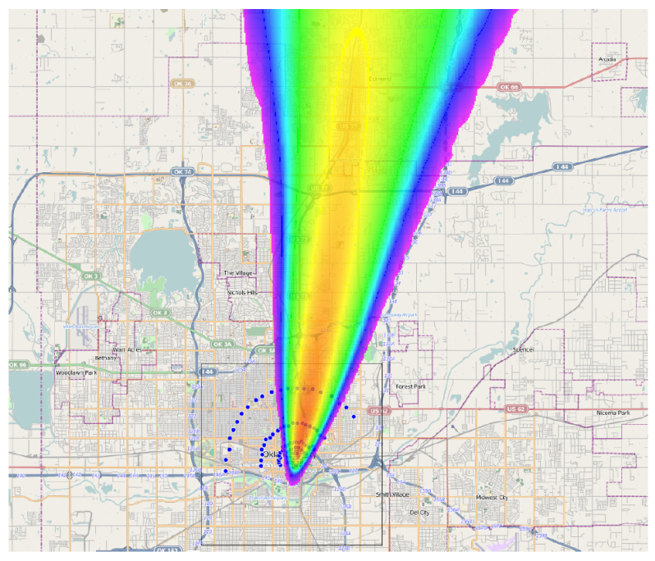
Introduction: modelling physical systems (2)
Examples:
  Meteorological modelling
  Geophysics research
  Galaxy formation
  Dispersion of contaminants
Many features in common
Aim: to address the inverse problem in order to achieve predictions at other times and locations
Uk official
Notes:
Contd.
Motivating example: release of hazardous pollutant (accidental or deliberate); requirement to alert surrounding populations; hazard prediction from dispersion model; must infer source term properties: location, time, type (properties of pollutant, nature of release); whether a release has occurred;

Slide 6
Introduction: model uncertainty
Parameter uncertainty
  uncertainty in the inputs to the model (internal uncertainty)
Mismatch between the mathematical/computer model and the physical system
  Model inadequacy (external uncertainty)
Observation process
Computer code
Parametric variability
Uk official
Notes:
Sources of uncertainty - brief introduction
There are numerous sources of uncertainty in modelling problems such as those described above and the quantification of uncertainty in inverse problems is an area of growing interest (Stuart, A., 2013). Often, many inverse analyses focus on parameter uncertainty: the uncertainty in the inputs to the model that is addressed in the statistical inverse problem through the specification of a prior distribution and a likelihood model (termed internal uncertainty, Goldstein, M., 2010). However, there will also be a mismatch between the mathematical/computer model and the physical system: the predicted value (the output of the model) will differ from the true value, even with the correct values of the inputs. This model inadequacy is sometimes termed external uncertainty (Goldstein, M., 2010). Other sources of uncertainty include those due to the observation process; the computer code (arising from code complexity and the practical implementation of systems of analytically intractable differential equations; Chkrebtii, O., et al, 2013); and parametric variability (uncertainty due to unspecified input conditions; for example, terrain or meteorological conditions in the dispersion modelling problem). See Kennedy, M.C. and A. O’Hagan (2001) for a summary of sources of uncertainty in computer models.
Thus many sources of uncertainty. We are interested in model uncertainty . . .

Slide 7
Introduction: model selection and averaging
A Bayesian analysis will provide preferences for a particular model given the data
Model comparison
  Model selection
    choose the ‘best’ model out of the set of models considered to be used for further analysis and prediction
    Not which model is ‘true’
  Model averaging
    all models are weighted according to the evidence provided by the data in support of the model and are retained for prediction
  Model combination
    the outputs from different models are combined
Uk official
Notes:
Model comparison, model selection;
This paper focuses on uncertainty arising due to choice of the model. The conclusions of a Bayesian analysis (or indeed, of any model-based analysis) are conditional on the appropriateness of the model: do the assumptions made in selecting the model lead to a model that is a reasonable approximation to reality? Many approaches, including Bayesian ones, ignore the uncertainty associated with model selection, which leads to underestimation of the uncertainty about quantities of interest. Yet, a Bayesian approach can simultaneously handle model and parameter uncertainty. Continual advances in computer technology coupled with ongoing developments of Markov chain Monte Carlo (MCMC) methods for posterior computation has seen significant developments in the application of the Bayesian approach both to parameter and model uncertainty. However, we note that a Bayesian analysis that incorporates model uncertainty will not inform which model is ‘true’, but provide preferences for a particular model given the data. This may form the basis of a model selection step (in which the ‘best’ model out of the set of models considered is selected and used for further analysis and prediction; Wasserman, L., 2000; Carlin, B.P. and S. Chib, 1995); or a model averaging step (in which all models are weighted according to the evidence provided by the data in support of the model and are retained for prediction; Clyde, M. and E.I. George, 2004; Hoeting, J.A. et al., 1999; Penny, W.D., et al., 2006; Gibbons, J.M. et al., 2008).
We note here that there is a difference between Bayesian Model Averaging (where there is a prior over candidate models) and Bayesian Model Combination (which seeks to find an optimal combination of models using a Bayesian approach). In situations where none of the candidate models is an accurate representation of reality (as in the urban environment), Bayesian Model Combination can give better results. See Westoby, P.B. and A.R. Webb (2014) for a discussion of Bayesian model combination in a source term estimation context.

Slide 8
Problem statement
To determine the properties of a release given sensor measurements, with a view to providing a reliable picture of the developing situation
The choice of model includes
  the choice of physical model for the environmental conditions
  the model complexity (e.g. the fidelity of the terrain model)
Model must be calibrated using historical trials data
Combine the calibration and the Bayesian inverse modelling procedures
Uk official
Notes:
The requirement is to develop an approach to model selection for inverse problems and assess performance on the problem of source term estimation. We adopt a Bayesian model selection approach and seek to exploit historic trials data together with current observational data in the model selection process. [The work differs from that presented in Westoby, P.B. and A.R. Webb (2014), where the aim in that paper is to determine a combination of models from a set of candidates rather than select a single model from the set. ]
This work
develops a Bayesian approach to model selection for inverse problems that selects the best model over the current observational set and the historic trials data;
simultaneously addresses model selection and inverse problem;
applies the work to model selection in source term estimation.

Slide 9
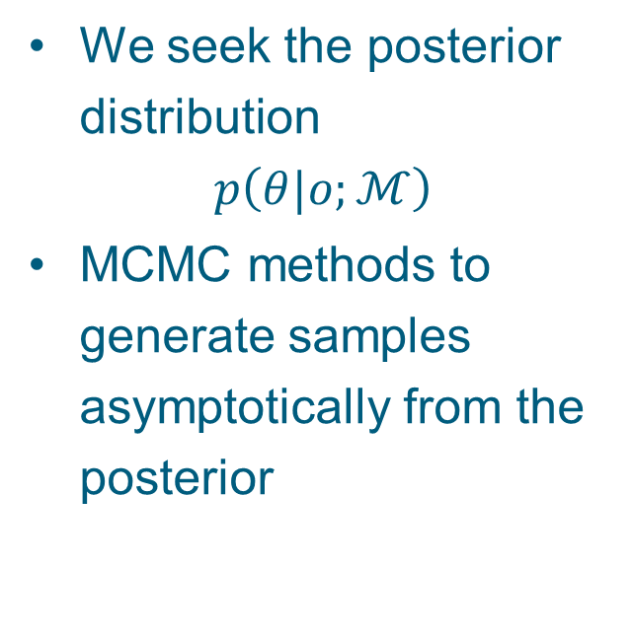
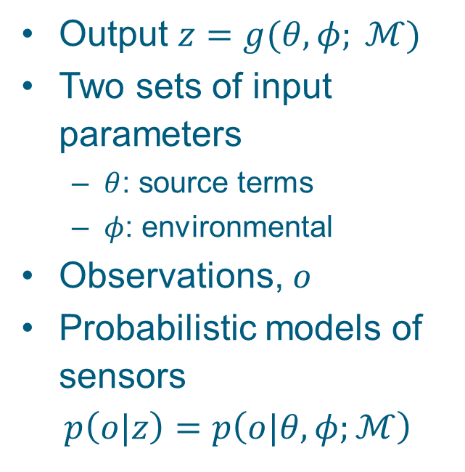
Bayesian inference
Output $z=g(θ,φ; ℳ)$
Two sets of input parameters
  $θ$: source terms
  $φ$: environmental
Observations, $o$
Probabilistic models of sensors
$$p\left(o|z\right)=p\left(o|θ,φ;ℳ\right)$$
We seek the posterior distribution
$$p\left(θ|o;ℳ\right)$$
MCMC methods to generate samples asymptotically from the posterior
Uk official
Notes:
We assume that our model, $ℳ$, has two sets of inputs, $θ$ and $φ$, and delivers a set of outputs, $z$, which is some function, $g$, of the model inputs
$$z=g\left(θ, φ; ℳ\right)$$
where the input parameters, $θ$, are known for the calibration data sets but unknown in application, where the aim is to determine the parameters through an inverse modelling procedure. The parameters $φ$ are unknown for both the calibration data and the operational conditions. $ℳ$ is a model identifier characterising two main aspects of the computer model. One is the choice of mathematical model of the physical system and the other is the model complexity (how many free parameters do we allow in the model).
The sensor is characterised by the probability distribution, $p\left(o|z\right)$ (e.g. clipped normal);
We take a Monte Carlo approach to draw samples from the posterior distribution

Slide 10
Bayesian inference: issues
Prior model
Likelihood model
  Computation of forward model
    Choice of dispersion model, sensor models
Model complexity
  Complexity of terrain and meteorological model
  Choice of dispersion model
MCMC procedure
  Generation of samples
  Convergence of Markov chain
Uk official
Notes:
Issues in Bayesian inference

Slide 11
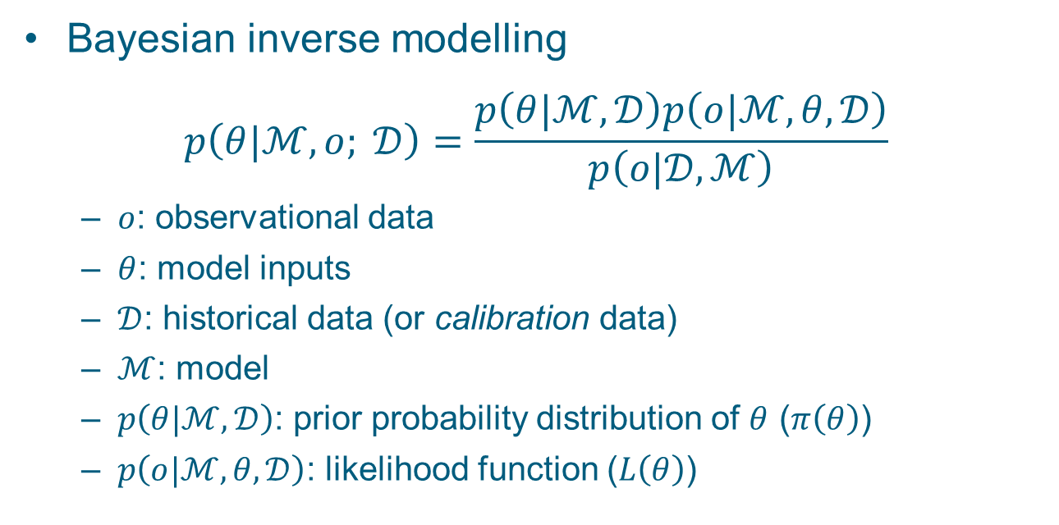
Bayesian inference: model selection
Bayesian inverse modelling
$$p\left(θ|ℳ, o; 𝒟\right)=\frac{p\left(θ|ℳ,𝒟\right)p\left(o|ℳ,θ,𝒟\right)}{p\left(o|𝒟, ℳ\right)}$$
  $o$: observational data
  $θ$: model inputs
  $𝒟$: historical data (or calibration data)
  $ℳ$: model
  $p\left(θ|ℳ,𝒟\right)$: prior probability distribution of $θ$ ($π\left(θ\right)$)
  $p\left(o|ℳ,θ,𝒟\right)$: likelihood function ($L\left(θ\right)$)
Uk official
Notes:
Bayesian inverse modelling
In the Bayesian approach, we seek to estimate the posterior distribution of source term parameters, $θ$,
$$p\left(θ|ℳ, o; 𝒟\right)=\frac{p\left(θ|ℳ,𝒟\right)p\left(o|ℳ,θ,𝒟\right)}{p\left(o|𝒟, ℳ\right)}$$
where $o$ denotes the set of sensor observations (concentration data) from the trial or scenario under study; $ℳ$ is the model considered; and $𝒟$ denotes the historical data (or calibration data) from previous trials for which observations were recorded for known source term parameters; $p\left(θ|ℳ,𝒟\right)$ ($=π\left(θ\right)$) is the prior probability distribution of $θ$ before the observations were available, but conditioned on the historical data (this is discussed further in the following section); $p\left(o|ℳ,θ,𝒟\right)$ ($=L\left(θ\right)$) is the likelihood function; $p\left(o|𝒟, ℳ\right)$ ($=\int{L\left(θ\right)π\left(θ\right)dθ}$,) is the evidence ensuring normalisation of the posterior and used in the calculation of Bayes factors (DiCiccio, T.J. et al., 1997).
Bayesian approach handles parameter uncertainty; but other sources of uncertainty . . .

Slide 12
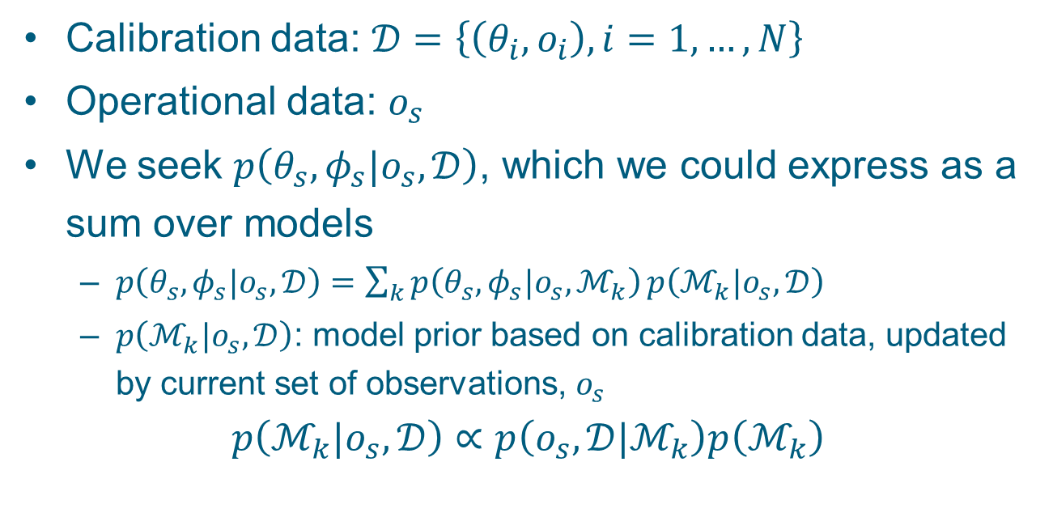
Model selection: as a calibration problem (1)
Calibration data: $𝒟=\left\{\left(θ_{i},o_{i}\right), i=1, …, N\right\}$
Operational data: $o_{s}$
We seek $p\left(θ_{s},φ_{s}|o_{s},𝒟\right)$, which we could express as a sum over models
  $p\left(θ_{s},φ_{s}|o_{s},𝒟\right)=\sum_{k}{p\left(θ_{s},φ_{s}|o_{s},ℳ_{k}\right)}p\left(ℳ_{k}|o_{s},𝒟\right)$
  $p\left(ℳ_{k}|o_{s},𝒟\right)$: model prior based on calibration data, updated by current set of observations, $o_{s}$
$$p\left(ℳ_{k}|o_{s},𝒟\right)∝p\left(o_{s},𝒟|ℳ_{k}\right)p\left(ℳ_{k}\right)$$
Uk official
Notes:
The calibration data comprise the set of paired measurements, $𝒟$,
$$𝒟=\left\{\left(θ_{i},o_{i}\right), i=1, …, N\right\}$$
where $N$ is the number of historical trials; $o_{i}$ is a set of sensor observations for trial $i$ and $θ_{i}$ are the corresponding model input terms. The relationship between the a set of observations, $o$, and the model output, $z$, is described probabilistically by $p\left(o|z\right)$ and is specified using knowledge of the physics of the sensor model.
For our operational scenario, we also have a set of observational data, $o_{s}$, but not the corresponding source terms, $θ_{s}$, nor the environmental parameters, $φ_{s}$.
We seek the posterior distribution
$$p\left(θ_{s}, φ_{s}\right|o_{s}, 𝒟)$$
Expressing this as a sum over models, we have
$$p\left(θ_{s}, φ_{s}\right|o_{s})=\sum_{k}{p\left(θ_{s}, φ_{s}\right|o_{s},ℳ_{k})p(ℳ_{k}|o_{s},𝒟)}$$
where $p(ℳ_{k}|o_{s},𝒟)$ is the model prior based on the historical trials data $𝒟$, updated by the current set of observations, $o_{s}$; $θ_{s}$ and $φ_{s}$ depend on $𝒟$ only through the model, $ℳ_{k}$ (since they are the parameter estimates relating to the observations, $o_{s}$, only). Samples from this posterior, $p\left(θ_{s}, φ_{s}\right|o_{s})$, can be obtained by combining sets of samples from the posteriors of each trained model, $p\left(θ_{s}, φ_{s}\right|o_{s},ℳ_{k})$, using the posterior probability of the model $p(ℳ_{k}|o_{s},𝒟)$, which may be written
$p\left(ℳ_{k} | o,𝒟\right)=\frac{p\left(o,𝒟 | ℳ_{k}\right)p(ℳ_{k})}{\sum_{l}{p\left(o,𝒟 | ℳ_{l}\right)p(ℳ_{l})}}$ ( 1 )
where the evidence, $p\left(o,𝒟 | ℳ_{k}\right)$, is influenced by the current trial set of observations, $o$, as well as the historical data, $𝒟$:
$p\left(o,𝒟 | ℳ_{k}\right)=p\left(o | ℳ_{k}\right)\prod_{i}{p\left(𝒟_{i} | ℳ_{k}\right)}$ ( 2 )
and is a product of the (integrated) likelihoods. Here, $𝒟_{i}$ denotes the calibration data for calibration set $i$ (that is, the set $\left(θ_{i},o_{i}\right)$). Each factor on the right-hand side of Equation ( 2 ) is evaluated on each data set separately. For the calibration data sets, the source term parameters are fixed and the environmental parameters are estimated. For the operational data, both the source terms and the environmental parameters are estimated.
Equation ( 1 ) provides the posterior distribution for model $ℳ_{k}$ given the data. Comparison of two models is summarised by the posterior odds, which updates the prior odds through a quantity termed the Bayes factor.

Slide 13
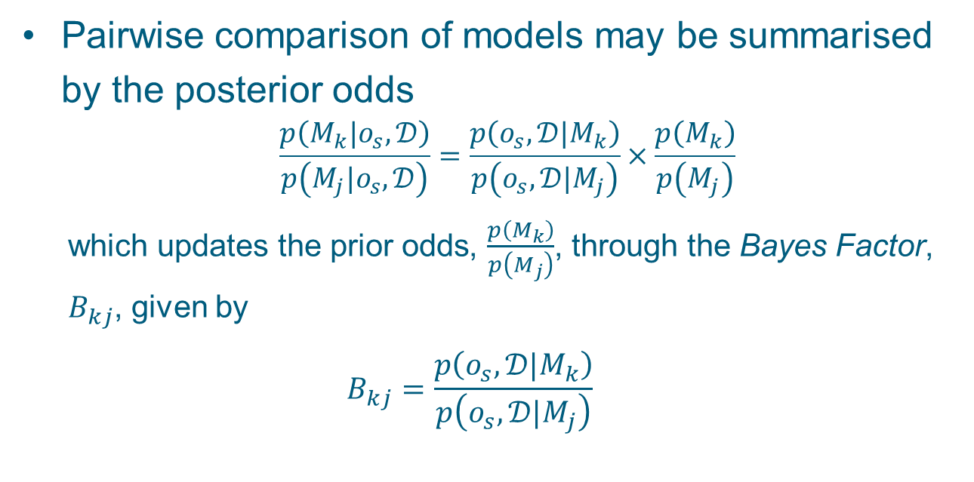
Model selection: as a calibration problem (2)
Pairwise comparison of models may be summarised by the posterior odds
          $$\frac{p\left(M_{k}|o_{s},𝒟\right)}{p\left(M_{j}|o_{s},𝒟\right)}=\frac{p\left(o_{s},{𝒟|M}_{k}\right)}{p\left(o_{s},𝒟|M_{j}\right)}×\frac{p\left(M_{k}\right)}{p\left(M_{j}\right)}$$
  which updates the prior odds, $\frac{p\left(M_{k}\right)}{p\left(M_{j}\right)}$, through the Bayes Factor, $B_{kj}$, given by
  $$B_{kj}=\frac{p\left(o_{s},{𝒟|M}_{k}\right)}{p\left(o_{s},𝒟|M_{j}\right)}$$
Uk official
Notes:
Introduce the term Bayes factor.
Pairwise comparison of models, for measurement data $ℰ$, may be summarised by the posterior odds,
$$\frac{p\left(M_{k}|ℰ\right)}{p\left(M_{j}|ℰ\right)}=\frac{p\left({ℰ|M}_{k}\right)}{p\left(ℰ|M_{j}\right)}×\frac{p\left(M_{k}\right)}{p\left(M_{j}\right)}$$
which updates the prior odds, $\frac{p\left(M_{k}\right)}{p\left(M_{j}\right)}$, through the Bayes Factor, $B_{kj}$, given by
$B_{kj}=\frac{p\left({ℰ|M}_{k}\right)}{p\left(ℰ|M_{j}\right)}$ ( 3 )
which is the ratio of the posterior odds of $M_{k}$ to the prior odds. It is a summary of the evidence provided by the data in favour of one model as opposed to another (Kass, R.E. and A.E. Raftery, 1995).
In the particular case when $ℰ$ can be partitioned into data from independent trials and operational sensor data, $ℰ=\left\{o,\left\{𝒟_{i}\right\}\right\}$, then the posterior odds is given by
$$\frac{p\left(ℳ_{k}|o,𝒟\right)}{p\left(ℳ_{j}|o,𝒟\right)}=B_{kj}\frac{p\left(ℳ_{k}\right)}{p\left(ℳ_{j}\right)}$$
where the Bayes factor, $B_{kj}$, may be written using Equation ( 2 ) as a product of Bayes factors evaluated on separate data sets (the calibration data set and the operational data set),
$B_{kj}=B_{kj}^{s}\prod_{i=1}^{N}{B_{kj}^{i}}$ ( 4 )
where $B_{kj}^{s}$ is the Bayes factor evaluated on the operational data set
$B_{kj}^{s}=\frac{p\left(o|ℳ_{k}\right)}{p\left(o|ℳ_{j}\right)}$ ( 5 )
and $B_{kj}^{i}$ is the Bayes factor evaluated on calibration set $i$,
$B_{kj}^{i}=\frac{p\left(𝒟_{i}|ℳ_{k}\right)}{p\left(𝒟_{i}|ℳ_{j}\right)}$ ( 6 )
Need to say somewhere how useful a Bayes factor is. It is used for model comparison and there are various interpretations of the value. E.g.
$−∞<B≤0.1$ Strong against
$0.1<B≤1/3$ Substantial against
$1/3<B<1$ Barely worth mentioning against
$1≤B<3$ Barely worth mentioning for
$3≤B<10$ Substantial for
$10≤B<∞$ Strong for

Slide 14
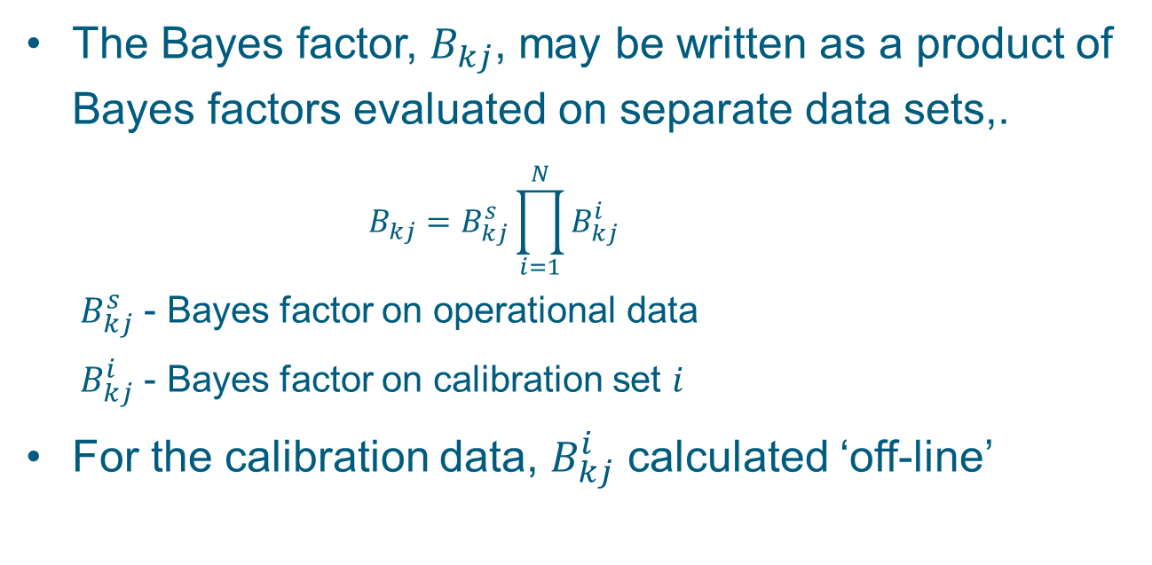
Model selection: as a calibration problem (3)
The Bayes factor, $B_{kj}$, may be written as a product of Bayes factors evaluated on separate data sets,.
      $$B_{kj}=B_{kj}^{s}\prod_{i=1}^{N}{B_{kj}^{i}}$$
  $B_{kj}^{s}$ - Bayes factor on operational data
  $B_{kj}^{i}$ - Bayes factor on calibration set $i$
For the calibration data, $B_{kj}^{i}$ calculated ‘off-line’
Uk official
Notes:
The key point to note is that the Bayes factor evaluation for the combined (calibration and operational) data set may be evaluated for each data set separately and combined using Equation ( 4 ). Also, the dominant contribution to the Bayes factor, for large $N$, comes from the historic trials. This means that for a particular operational scenario, the model may be selected based on sufficient historic trials in similar settings. <how are Bayes factors used? – give reference>
Also mention procedures for Bayes factor calculation; there are several methods; there is an R module, for example.

Slide 15
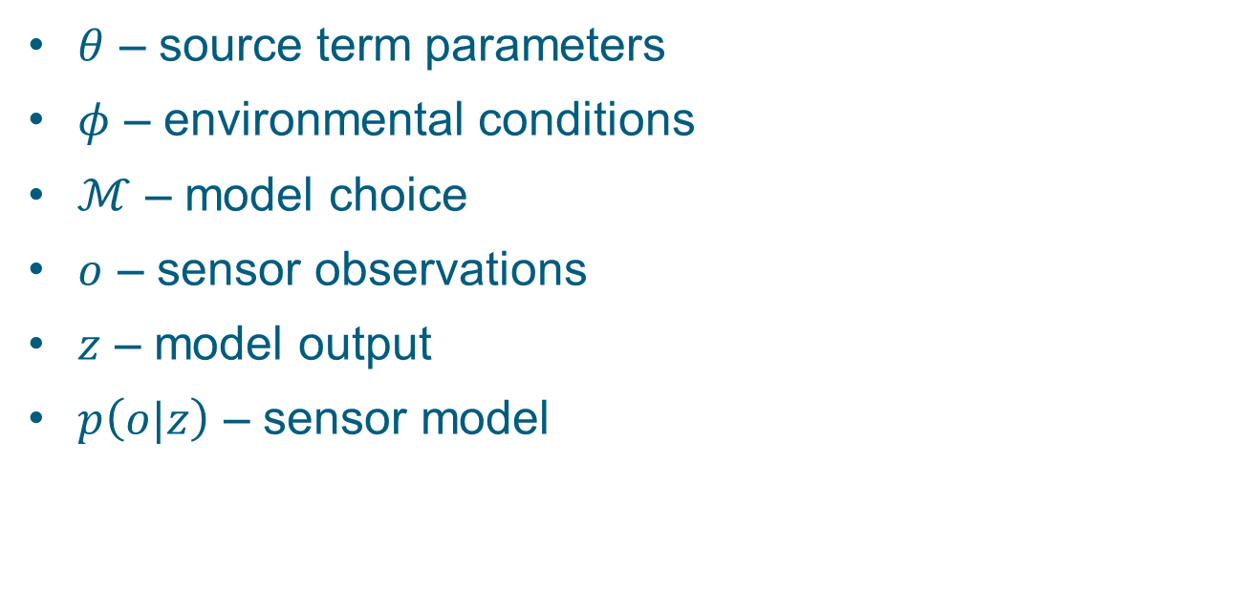
Application to source term estimation
$θ$ – source term parameters
$φ$ – environmental conditions
$ℳ$ – model choice
$o$ – sensor observations
$z$ – model output
$p\left(o|z\right)$ – sensor model
Uk official
Notes:
Application to source term estimation.
The primary application of the methodology developed is to source term estimation. For this application, $θ$ represents the source term parameters; the parameters $φ$ represent the environmental conditions, for example, the terrain properties and the meteorological conditions as a function of time and space; $ℳ$, the model choice, includes both the dispersion model and the degree of complexity of modelling environmental conditions. <elaborate>. Typically, the $o_{i}$ are concentration measurements at specific locations and times. The model outputs $z$ characterise the concentration distribution at a particular location, usually its mean and variance. Popular models for the sensor model, $p\left(o|z\right)$, are the clipped normal and the clipped gamma probability distributions.
The calibration set, $𝒟$ comprises a set of historic trials that have taken place in similar terrain and environmental conditions. <etc>

Slide 16
Summary
Bayesian approach to model selection using
  Historical trials data (calibration data)
  Operational data
Bayes factors
  Pre-computed and stored with other meta-data for the calibration data sets
Easy inclusion/exclusion of trials in the model selection process
Uk official
Notes:
Summary
An approach to model selection that uses historical trials data together with operational data has been presented. The approach described uses Bayes factors that may be calculated for each calibration set separately and combined with the Bayes factor for the operational conditions to form a basis for model selection. Other approaches to model selection, such as penalised likelihood based criteria (Akaike Information Criterion, Bayes Information Criterion and Deviance Information Criterion) may similarly be calculated for historic calibration sets separately and combined to form an overall measure. These values may be pre-computed and stored with other meta-data for the data set.
Thus, given an operational environment that is characterised, say, as urban/open terrain; day/night; dry/wet; still/windy/very wind; and so on, the Bayes factors from the relevant historic trials are combined to be used to select a model for the operational environment.
The advantage of the approach is that it allows easy inclusion/exclusion of trials in the model selection process. Handles uncertainty in the model parameters and the choice of model. Further work <characterisation of data sets; experiments; etc>

Slide 17
Notes:
This slide may be shown at the end of the presentation.

