Slide 1
Measurement of Source Terms and Plume Chemical Evolution for Massive Ammonia and Chlorine Releases
Ram A. Hashmonay, Sc.D.
CTO, Atmosfir Optics Ltd.
8801 Fast Park Drive, Suite 301, Raleigh, NC 27617
ram@atmosfir.net P (919) 747-8895, M (919) 616-6336
Shannon B. Fox, Ph.D.
Senior Research Scientist / Project Manager
U.S. Department of Homeland Security –
Chemical Security Analysis Center (CSAC)
3401 Ricketts Point Road, Aberdeen Proving Ground, MD, 21010
Shannon.Fox@st.dhs.gov, 410-417-0906

Slide 2
Source Term Measurement Design
Monitors’ dynamic range (From release to off-gassing)
Flux measurements in at least two planes downwind – two measurement configurations and custom combinations are presented
Chemical and phase evolution monitoring

Slide 3
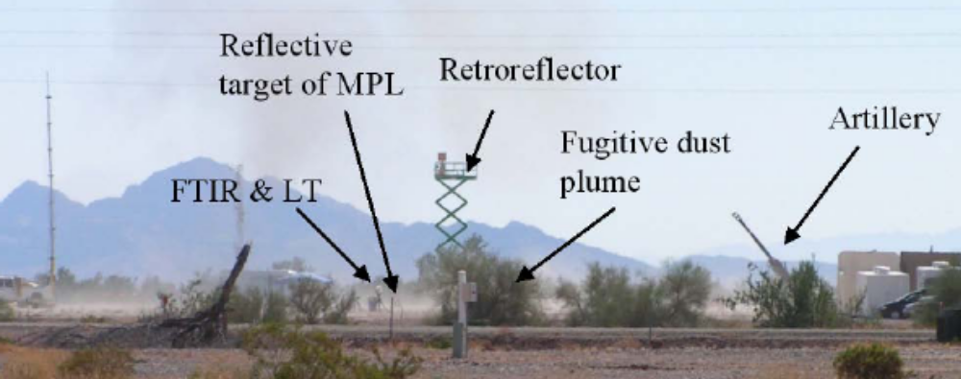
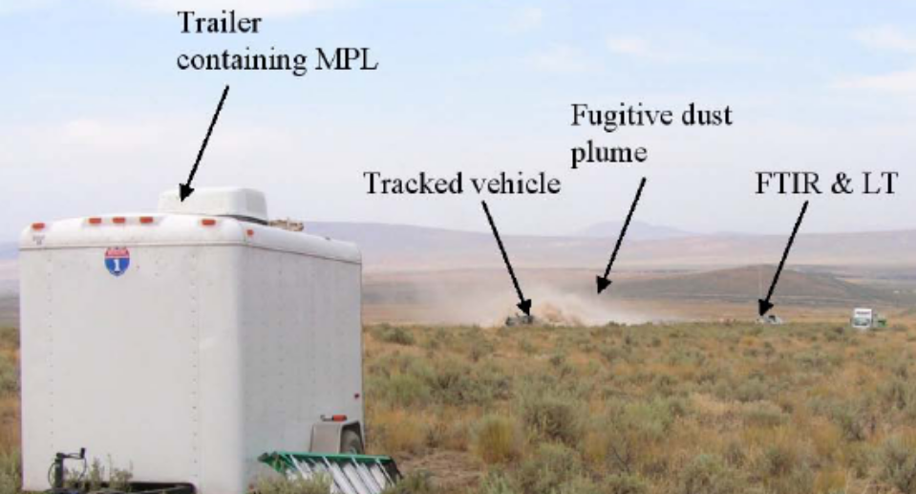
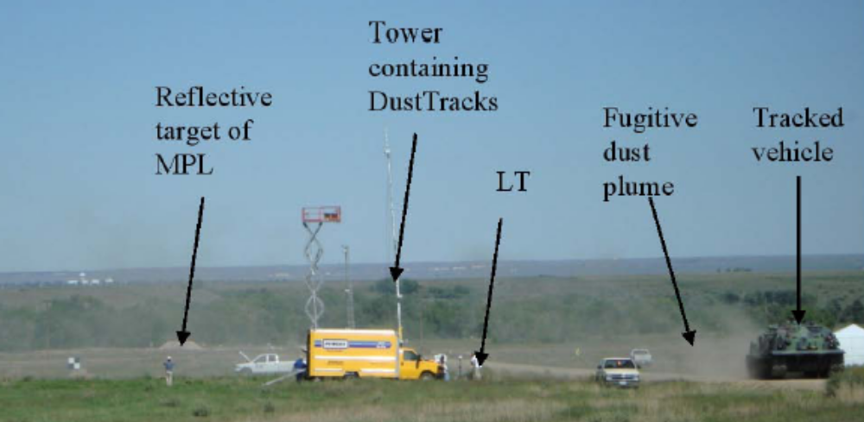
2005 Back Blast Artillery, 2006 & 2008 Tracked Vehicles

Slide 4
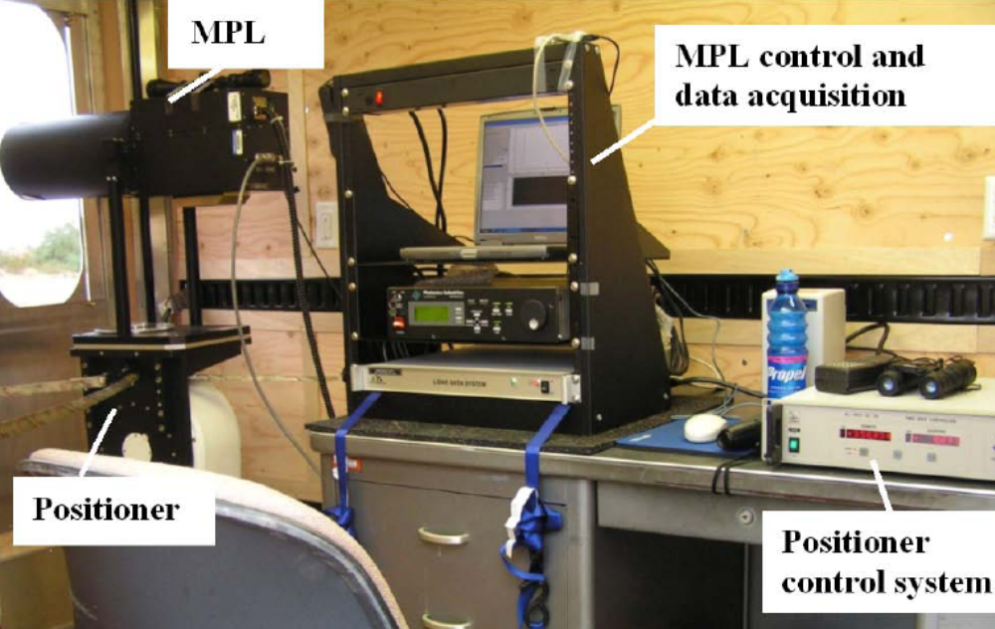
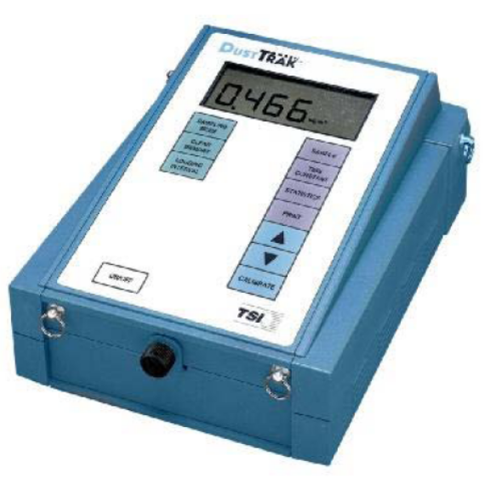
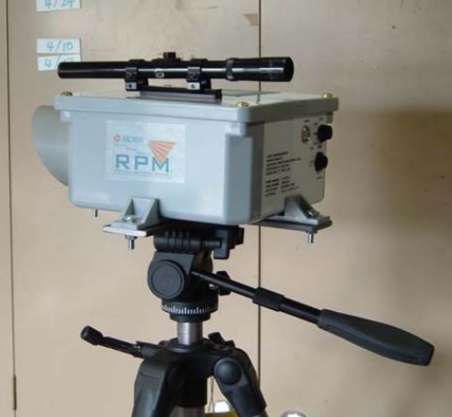
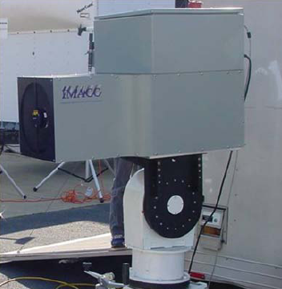
Customized Monitors

Slide 5
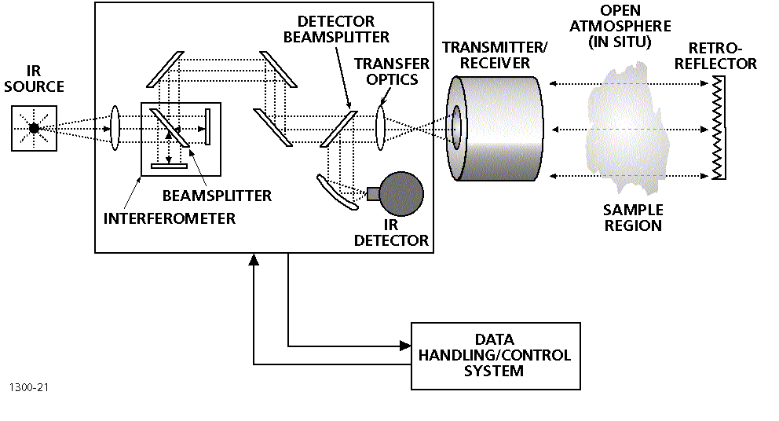
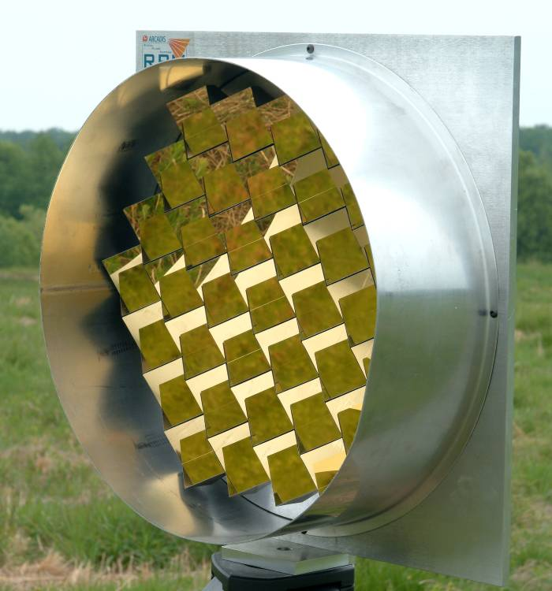
OP-FTIR: the ultimate petrochemical and chemical industry emission monitoring system for VOCs, inorganics, PM, and GHG
Hundreds of compounds (organic and inorganic)
High temporal resolution (concentration roses)
Multiple path provides spatial information and allows measurement of flux (OTM-10)
Can be situated in two planes downwind to investigate downwind chemical and phase evolution

Slide 6
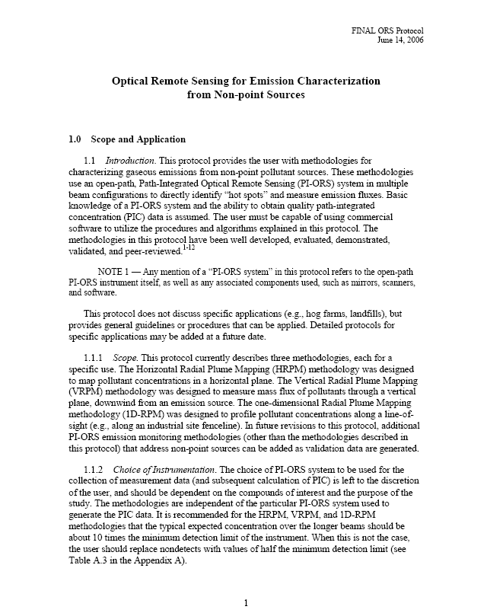
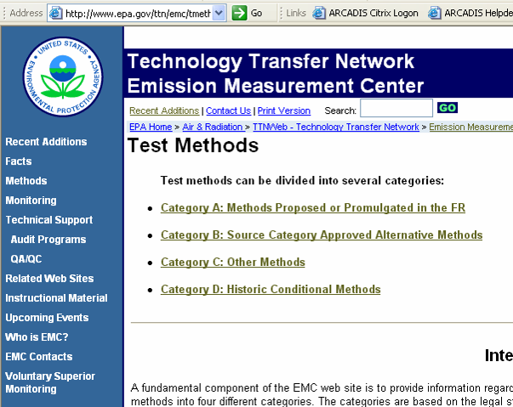
USEPA OTM-10 http://www.epa.gov/ttn/emc/tmethods.html
6
Notes:
6

Slide 7
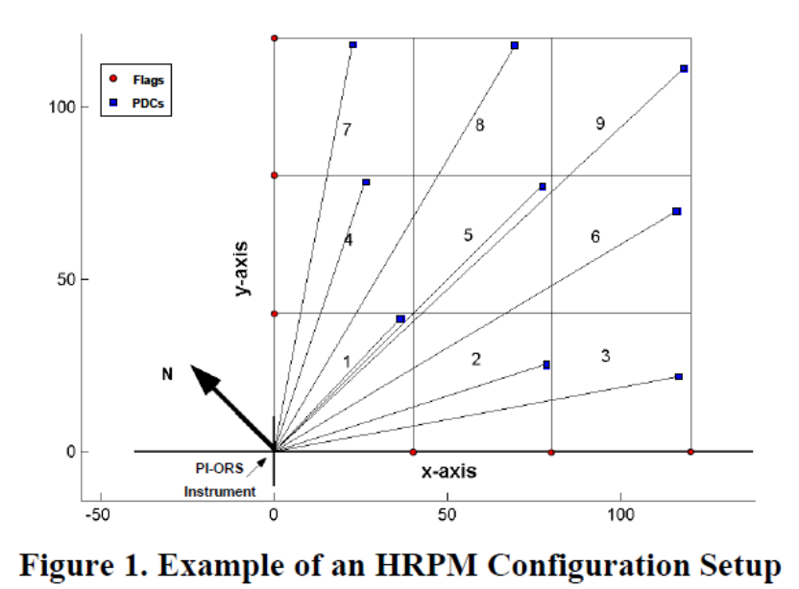
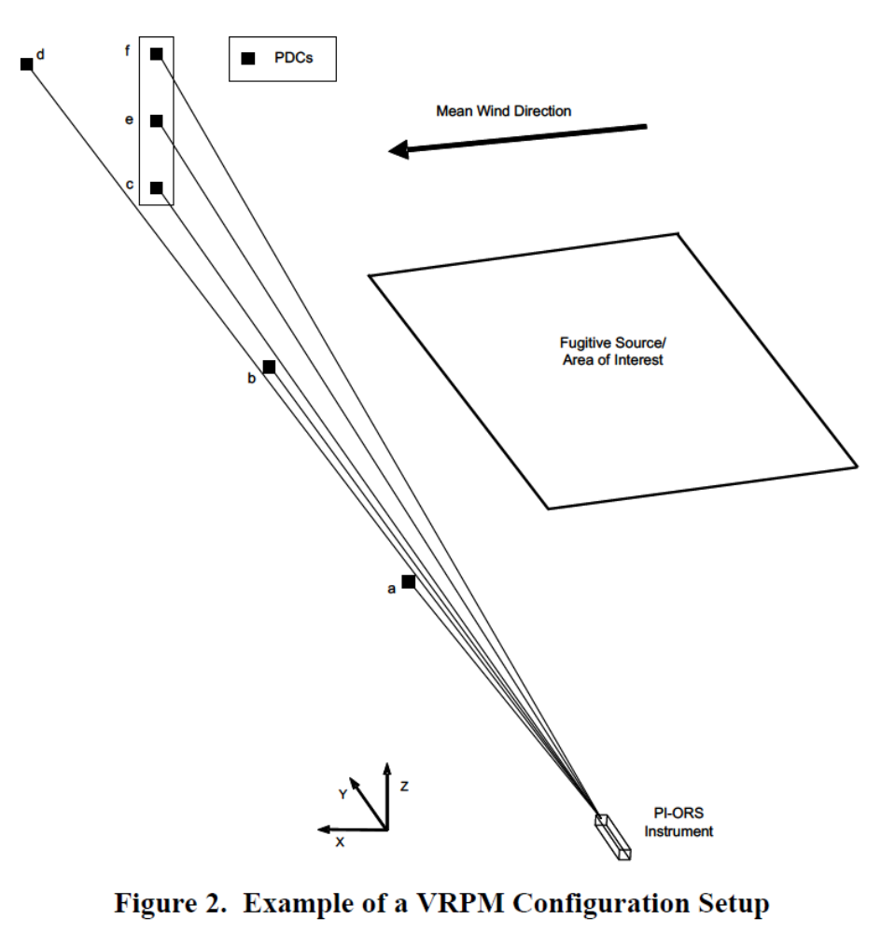
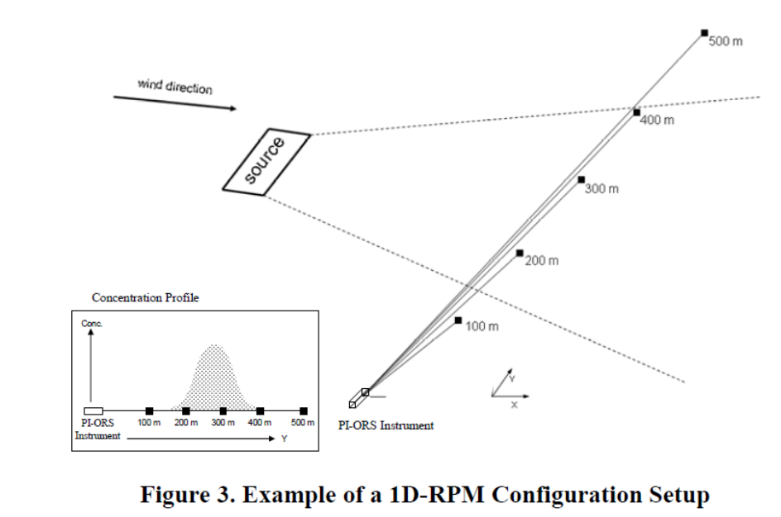
The Radial Plume Mapping Configurations

Slide 8
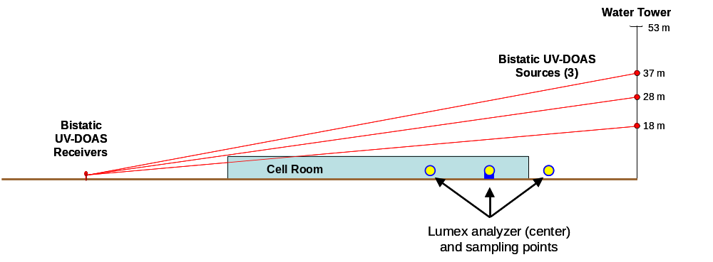
Side View of OTM 10 Configuration

Slide 9
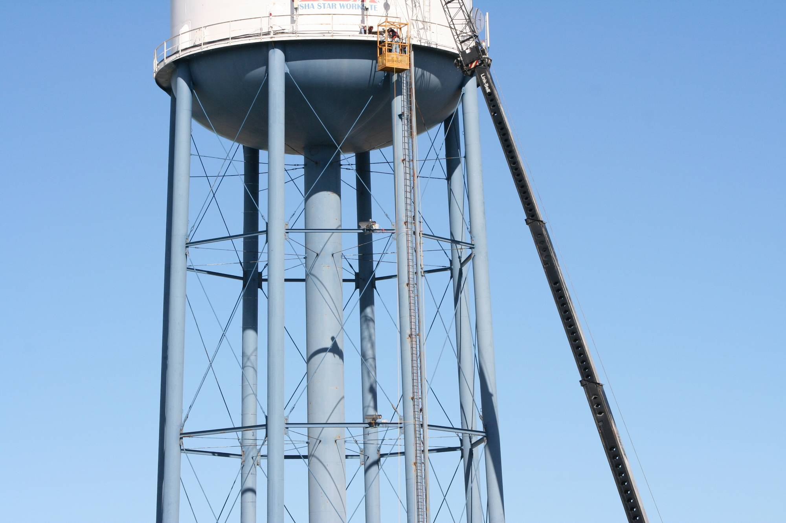

Slide 10
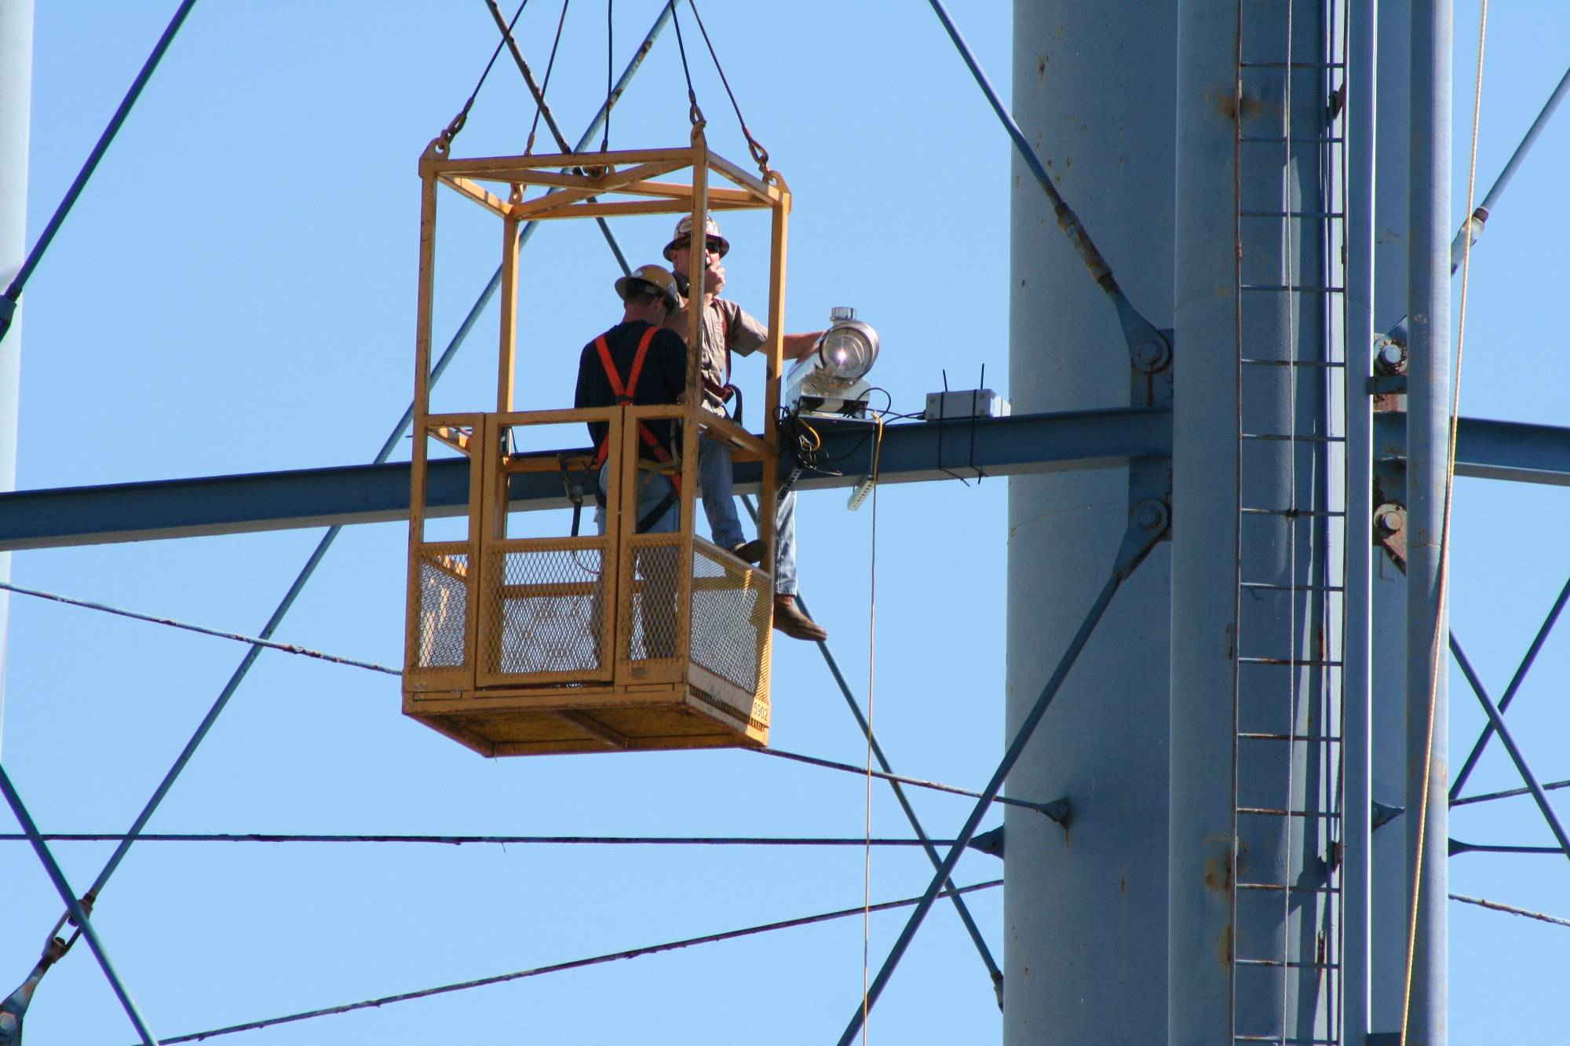

Slide 11
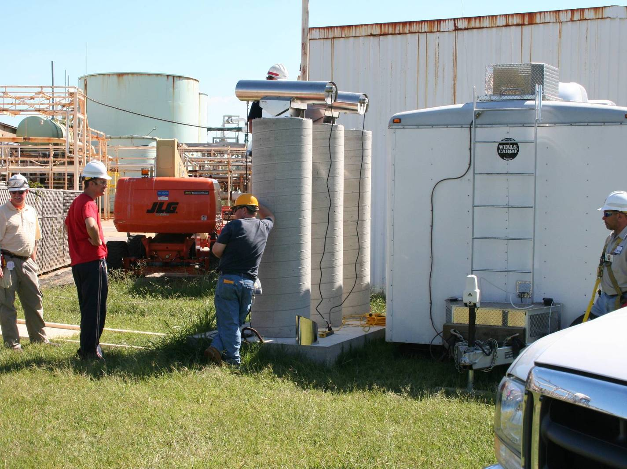

Slide 12
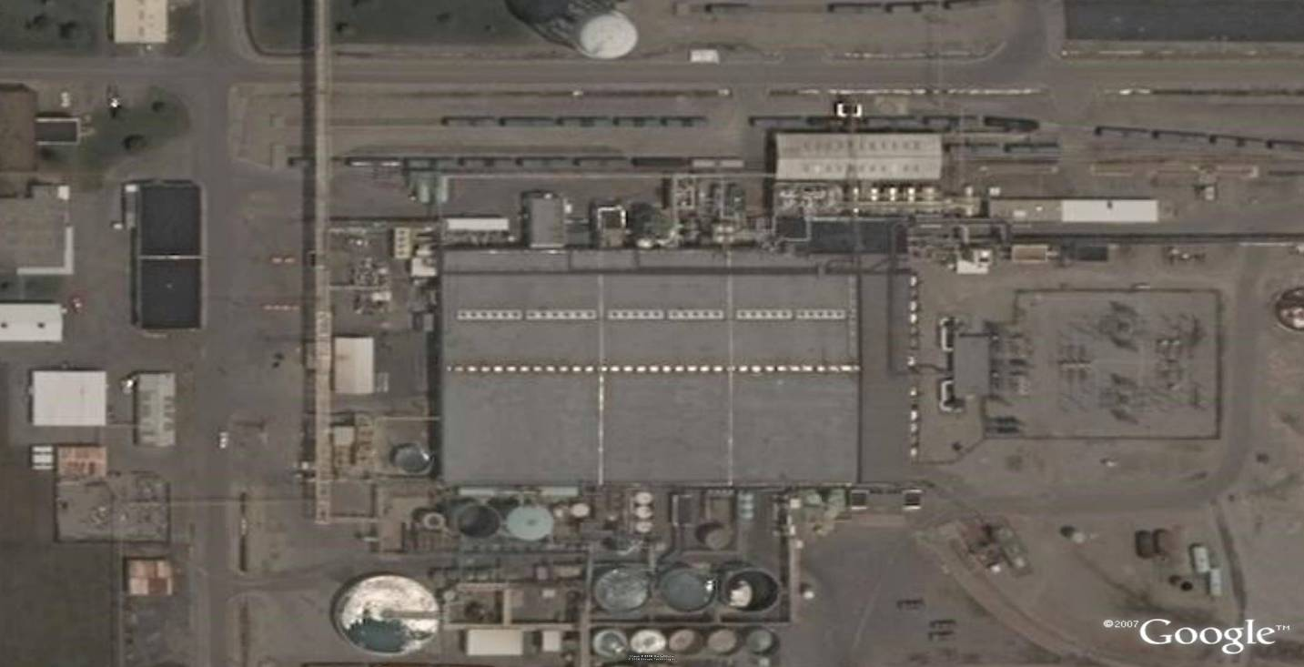
50m Water Tower
N
W E
S
Lumex
Roof Vents (Monitored)
Cell Room
OTM 10 Plane
Prevailing wind
Outside Sources
12

Slide 13
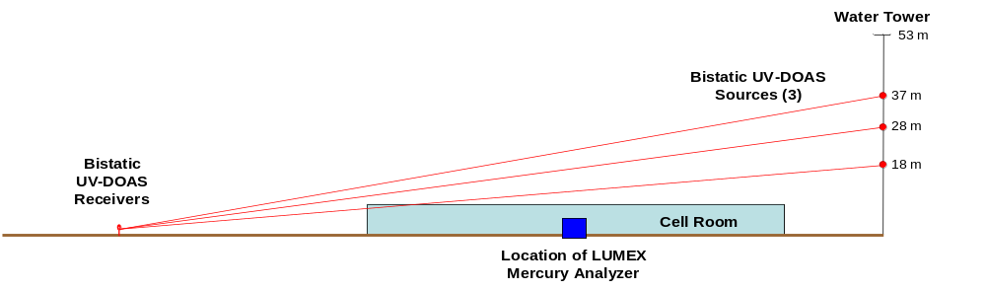
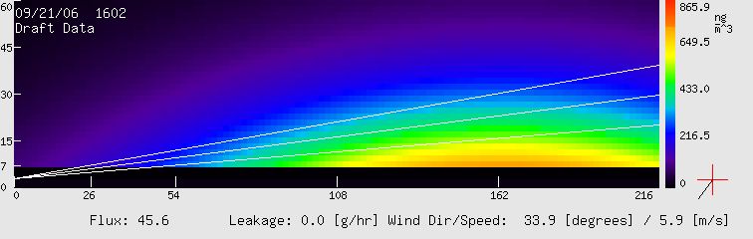
VRPM Plume Reconstructions
Chlor-Alkali Plant
Notes:
13

Slide 14
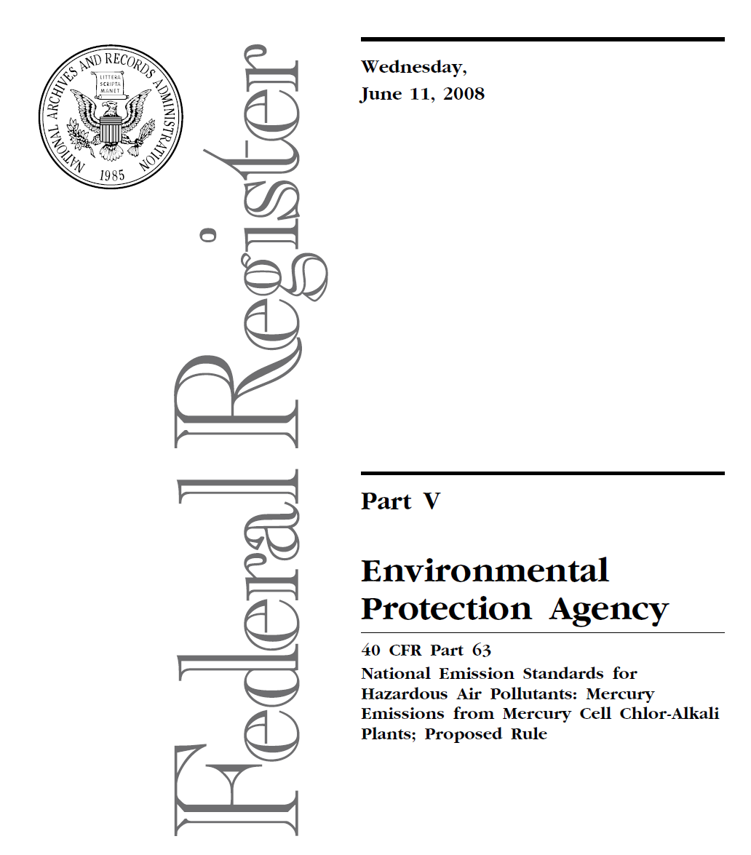
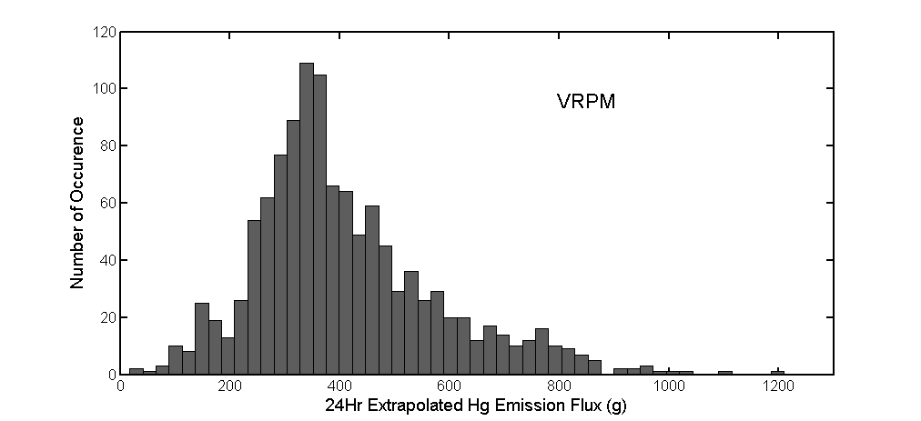
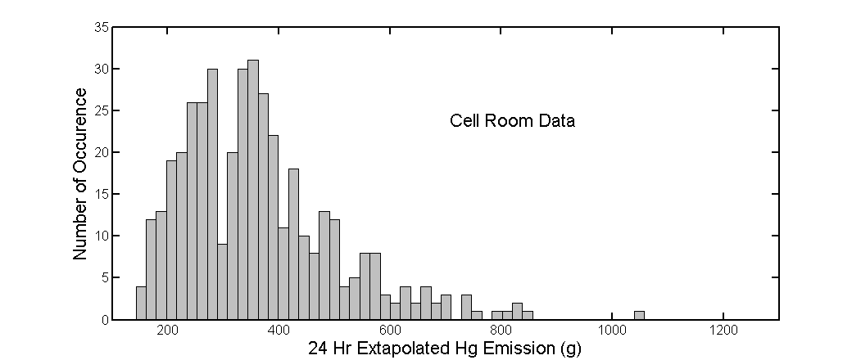

Slide 15
Four Corners Configuration
Wind
Surround the pond with four OTM 10 planes

Slide 16
Four Corners Configuration
Wind
4-Corners Technique is forgiving to wind direction changes
Set up and leave configuration for a long period of time

Slide 17
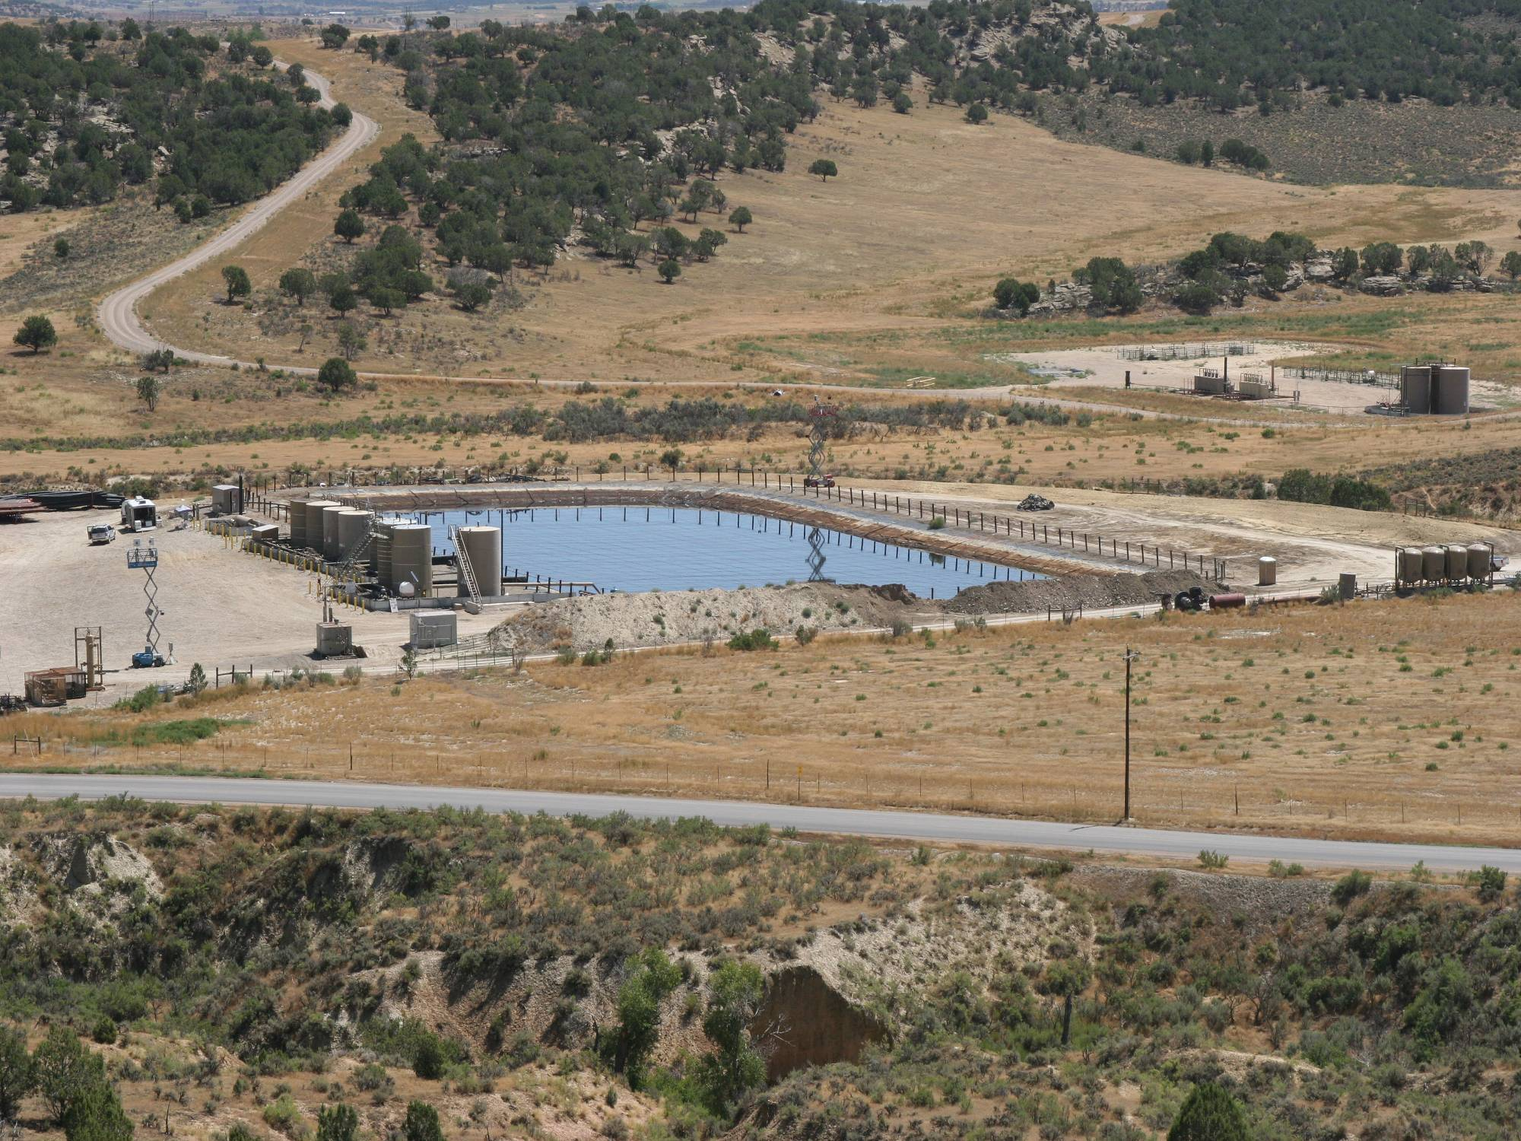
OTM 10 For Produced Water Ponds

Slide 18
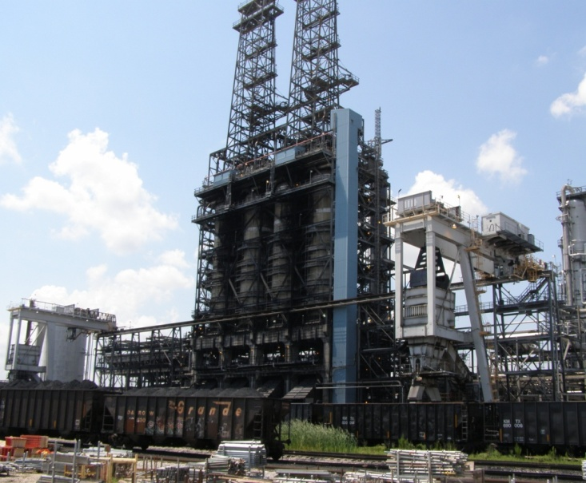
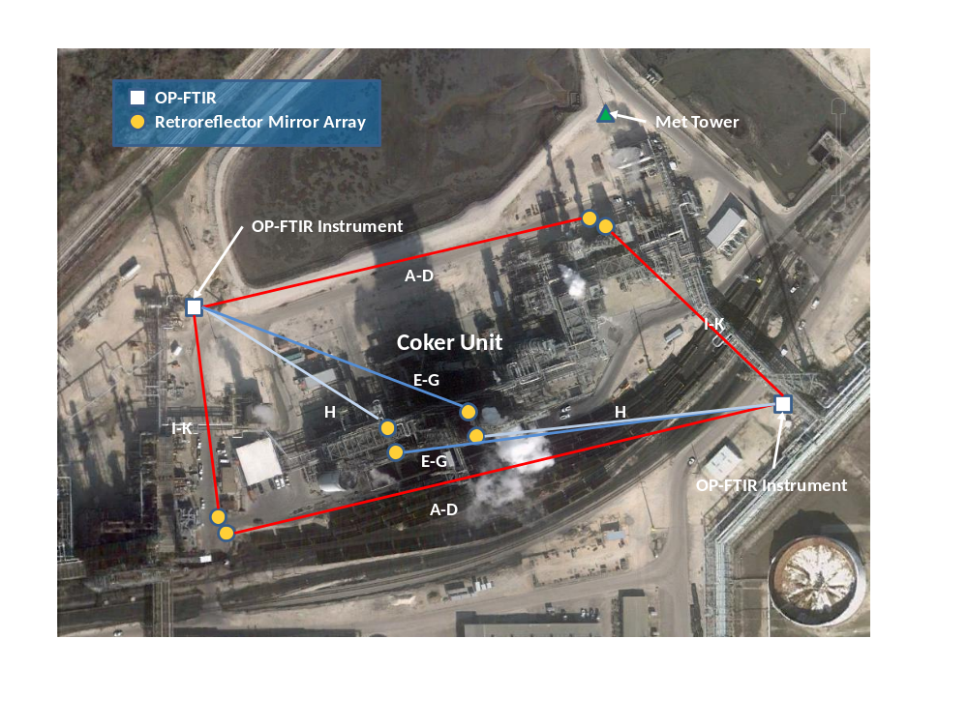
Delayed Coker at a Refinery
Use of Differential Absorption LIDAR (“DIAL”) and Vertical Radial Plume Mapping (“VPRM”) to measure emissions of total alkanes, speciated olefins, speciated air toxics and methane from a delayed coker.

Slide 19
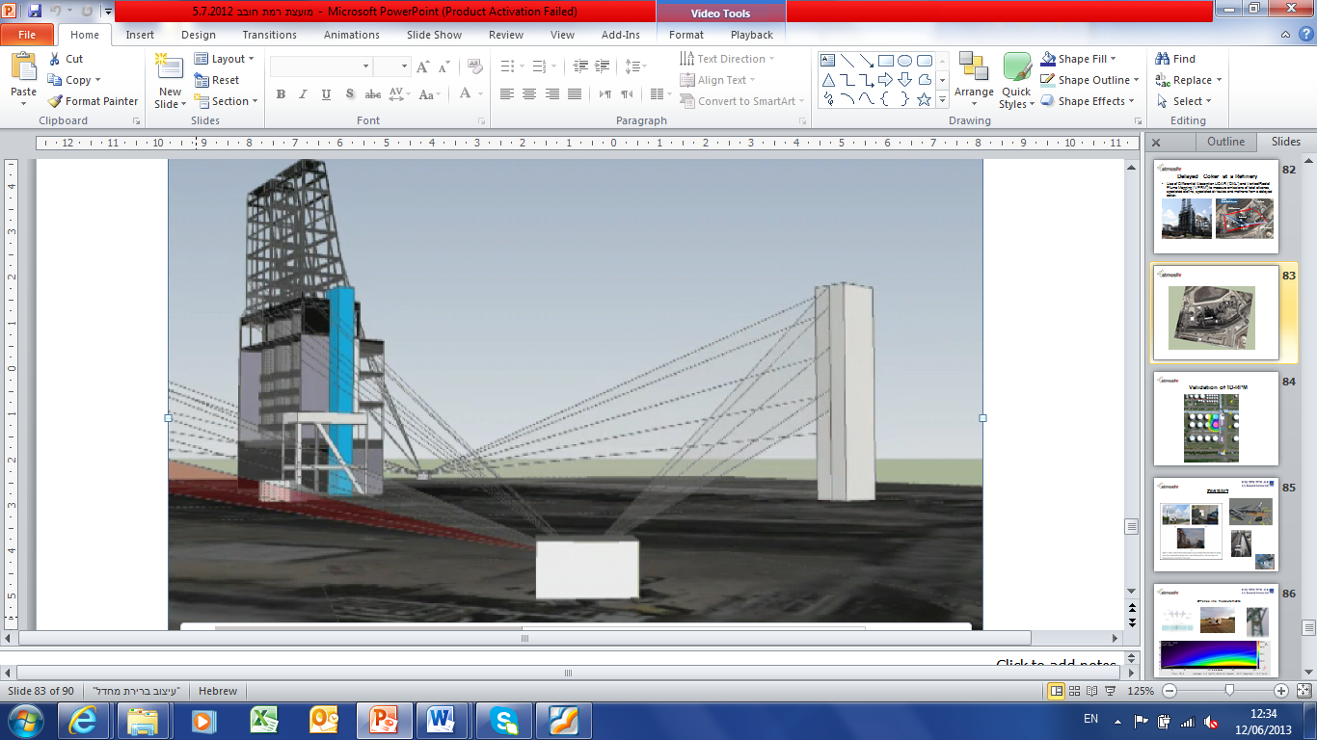
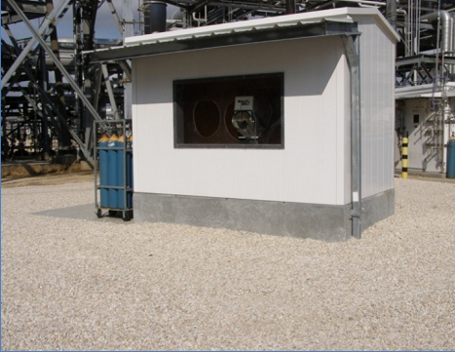
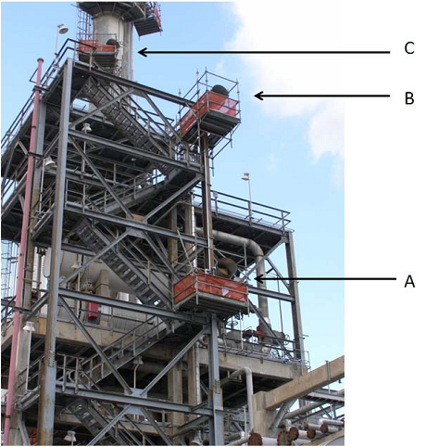
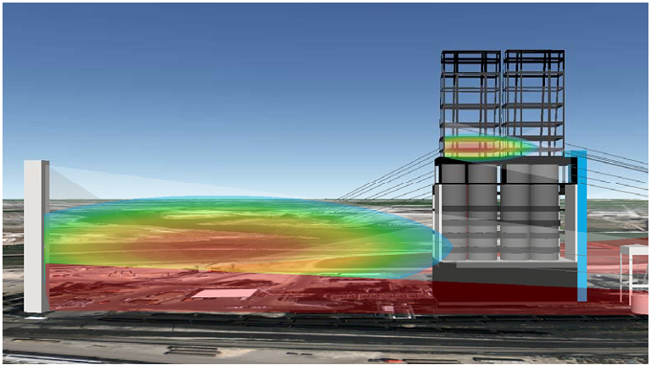

Slide 20
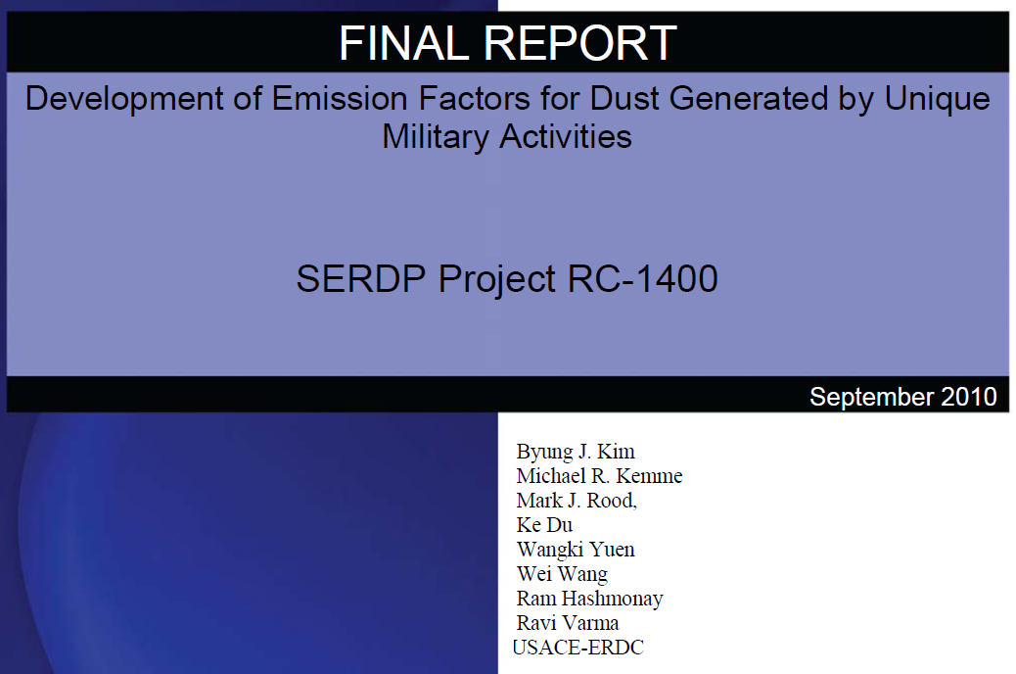
2005 – 2008 Military Activities Generated Dust

Slide 21
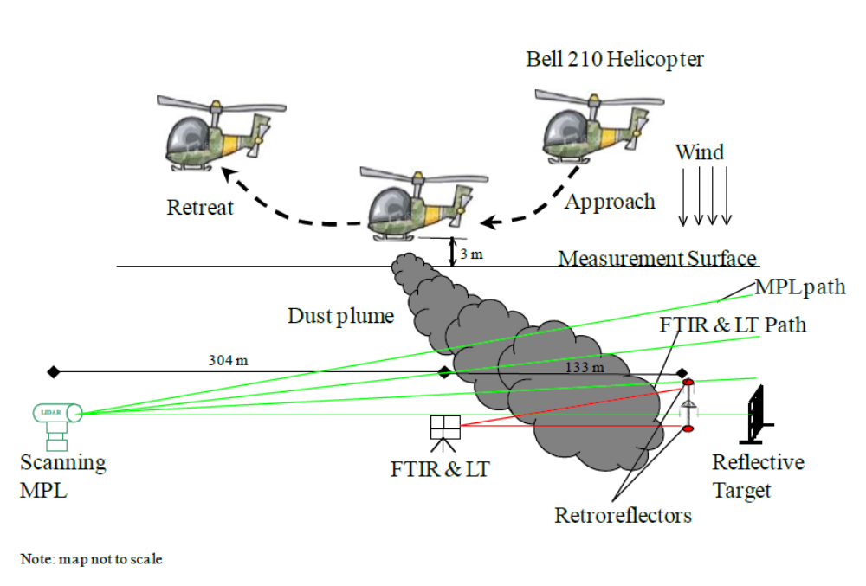
2007 Low Flying Helicopter

Slide 22
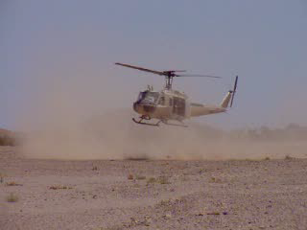

Slide 23
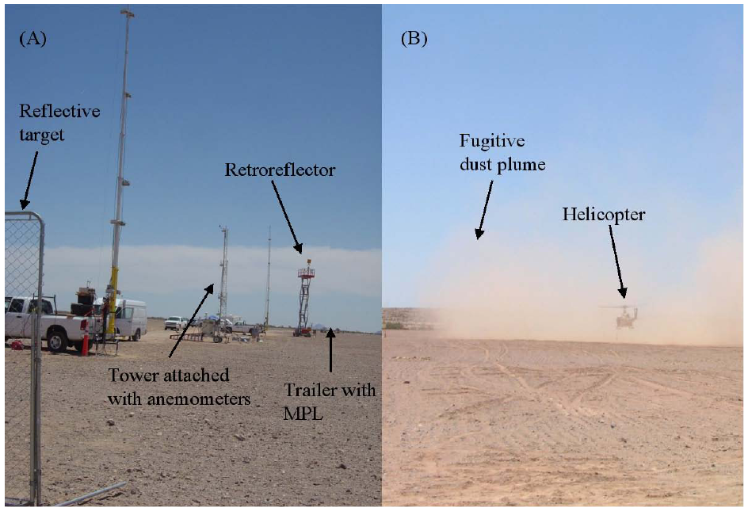

Slide 24
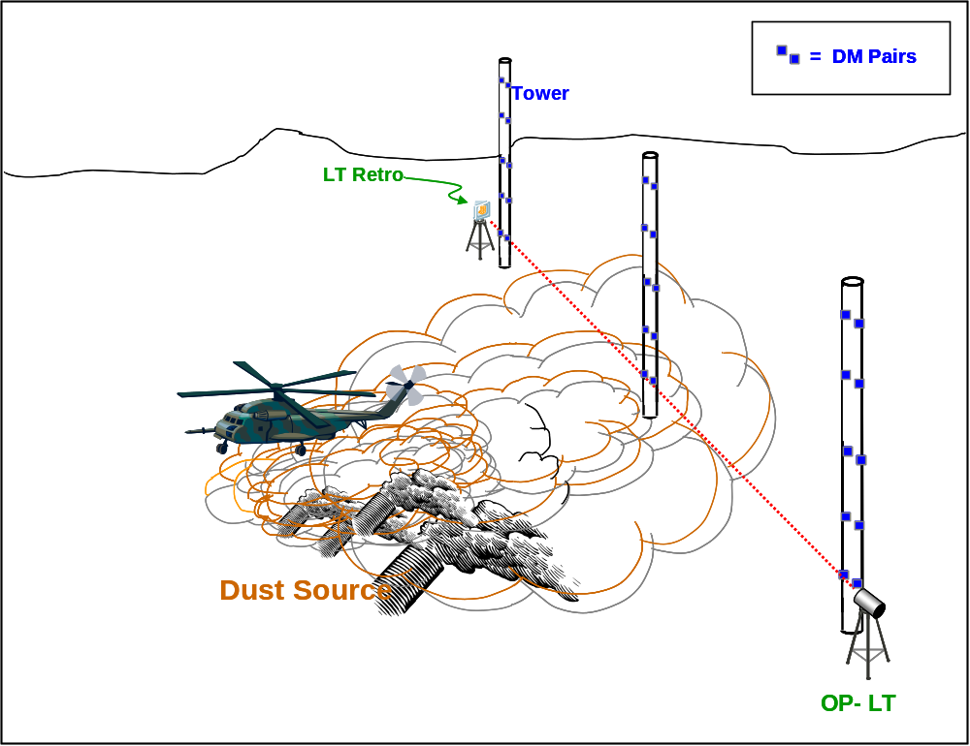
First Opportunity for Hybrid Approach

Slide 25
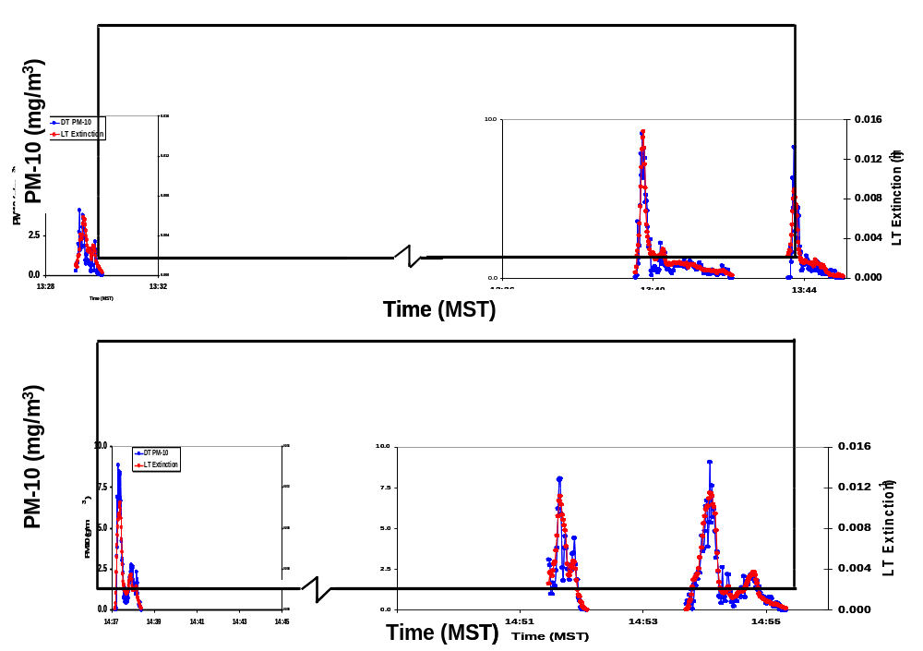
LT - Point-DM Hybrid Approach: Calibration

Slide 26
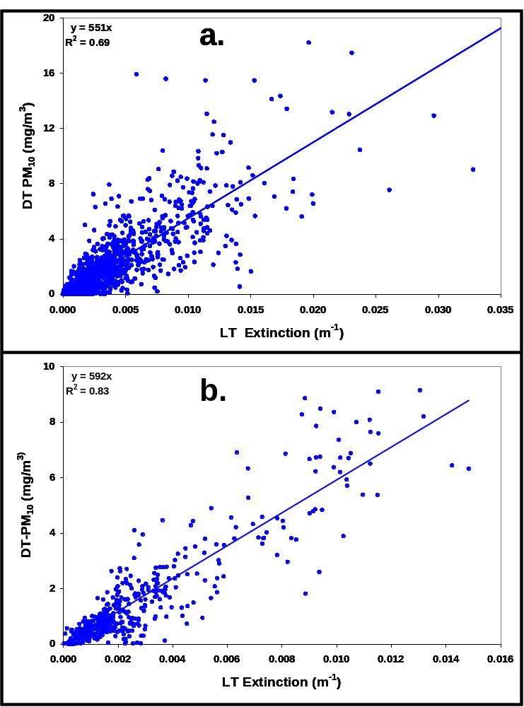

Slide 27
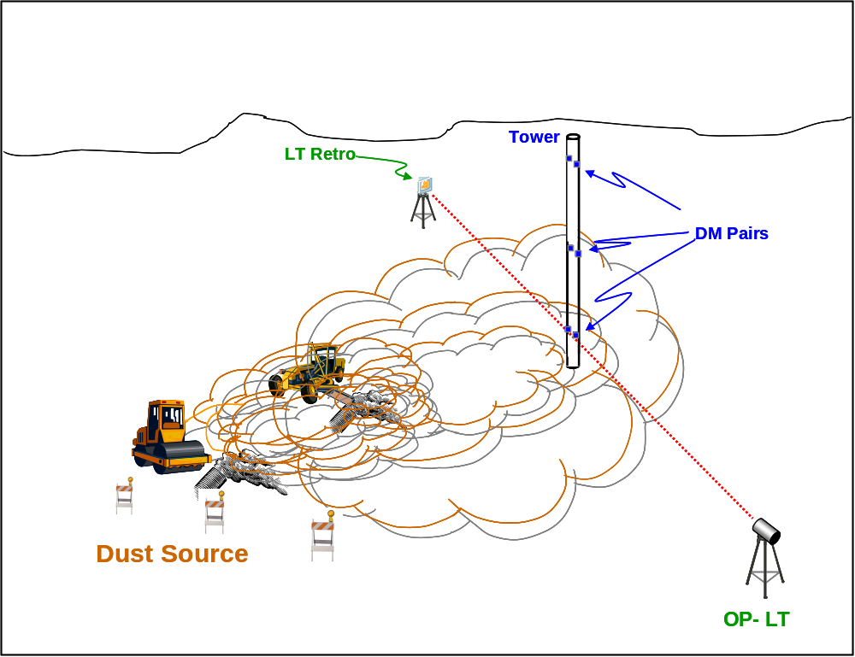
LT/Point-DM Approach: Small Sources

Slide 28
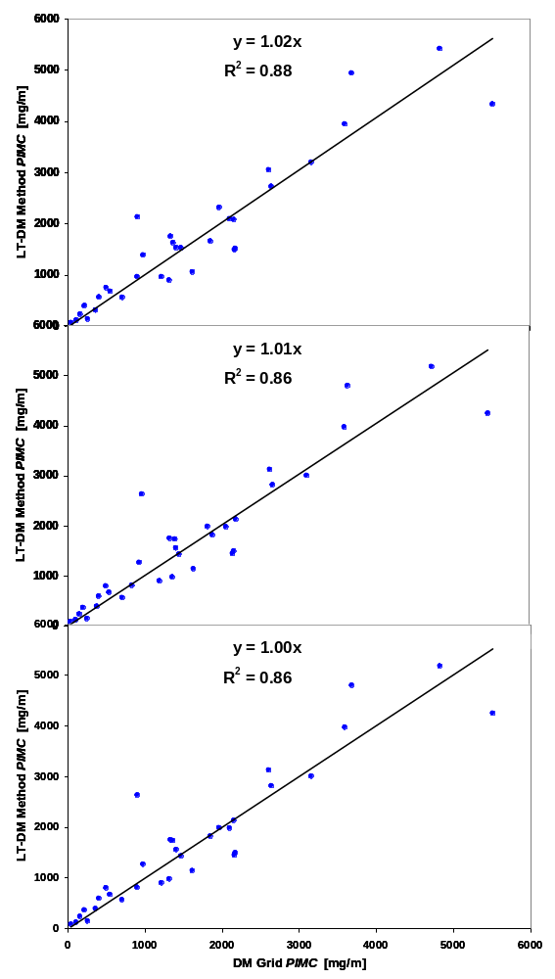
Hybrid vs. Grid of Point-DM

Slide 29
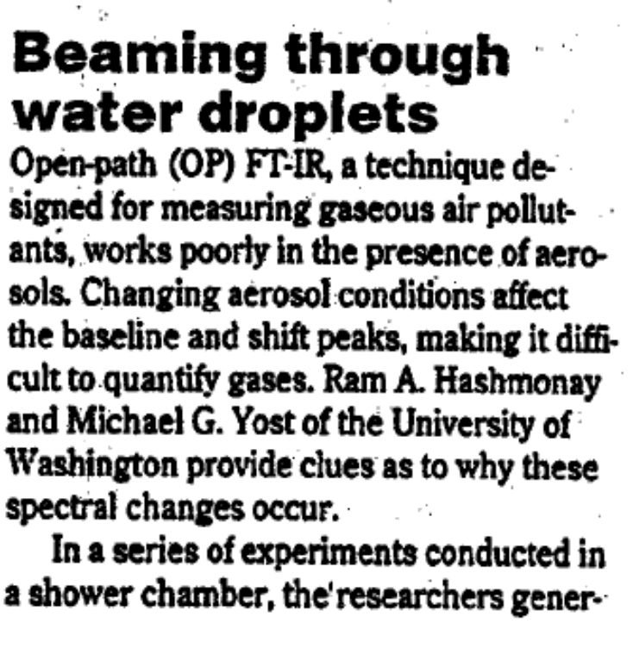
Magic: Mie Theory Works Again
Mean 7μm
SD 2 μm
Mean 10 μm
SD 2 μm

Slide 30
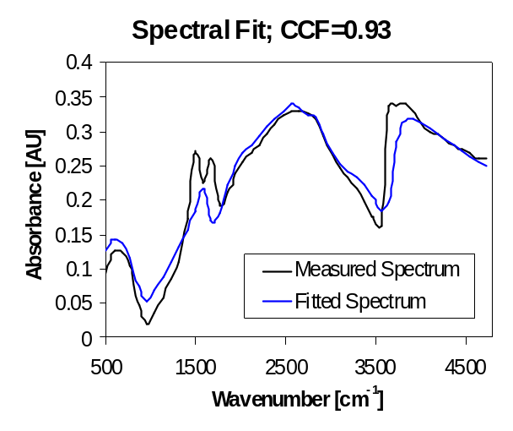
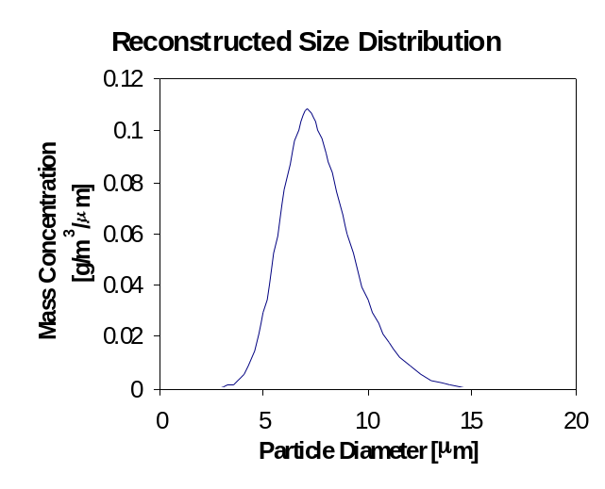
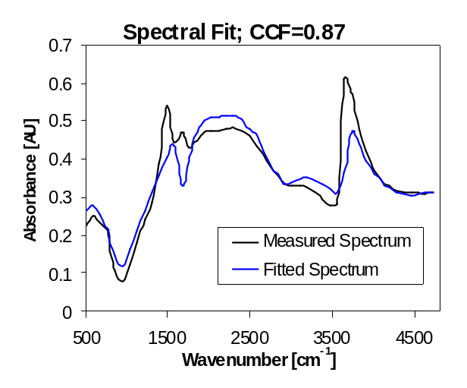
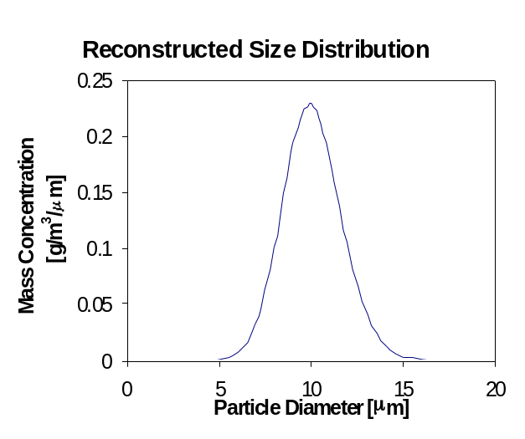
Shower Experiment Results

Slide 31
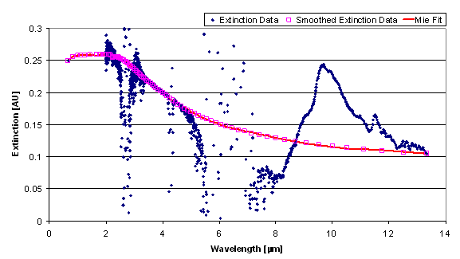
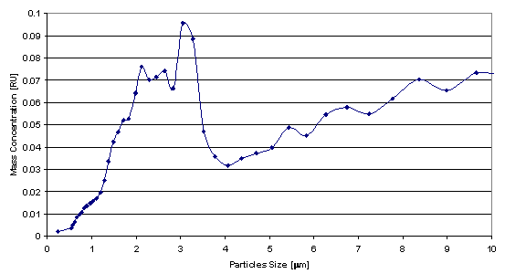
OP-FTIR/Laser Tranmissometer Combined Approach

Slide 32
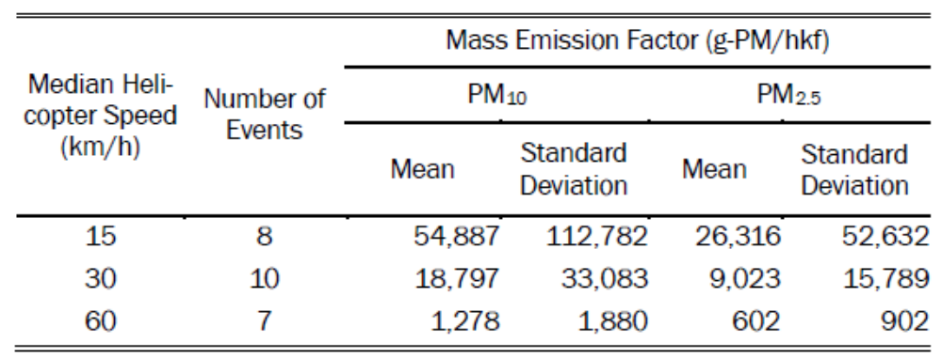
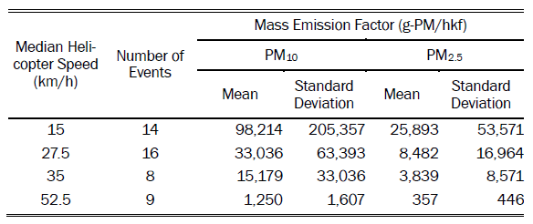
Results: Undisturbed and Disturbed

Slide 33
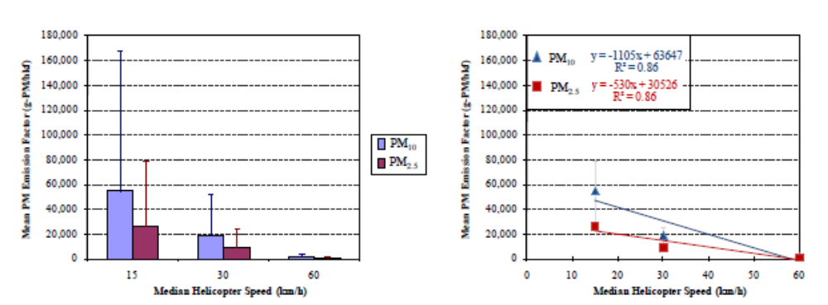

Results: Undisturbed and Disturbed

