Slide 1
Atmospheric transport and dispersion from non-periodic LES atmospheric fields
Brian Gaudet, David Stauffer, Nelson Seaman, Aijun Deng
Penn State University
16th Annual GMU Conference on Atmospheric Transport and Dispersion Modeling
July 17-18, 2012

Slide 2
Background
Mesoscale models (e.g., WRF) include multiple atmospheric and surface processes from the synoptic scale (thousands of kilometers) down to scales of hundreds of meters.
But – turbulent structures are not explicitly represented; rather, averaged turbulent quantities (e.g., turbulent kinetic energy (TKE)) are parameterized via closure assumptions.
Large Eddy Simulation (LES) models can explicitly represent the largest eddies in atmospheric turbulence (up to several kilometers in scale in convective boundary layers).
However, LES models require time to ‘spin-up’ eddies; idealized cases typically simulate beyond Lagrangian eddy spin-up time scale while using periodic lateral boundary conditions (LBCs).

Slide 3
Realistic Lateral Boundary Conditions
Must accommodate mesoscale atmospheric and surface gradients
Thus -- traditional periodic LBCs are not applicable
The LBCs consistent with mesoscale gradients may also be variable on time scales on the order of the eddy spin-up time (~ several z_{i} / w* ).
WRF-ARW now can support nested domains that possess LES-type subgrid closures (Moeng et al. 2007) while making use of the nonperiodic time-dependent LBCs available from the parent model – as well as the multiple physics suite options (microphysics, land surface model, radiation) found in the WRF framework.

Slide 4
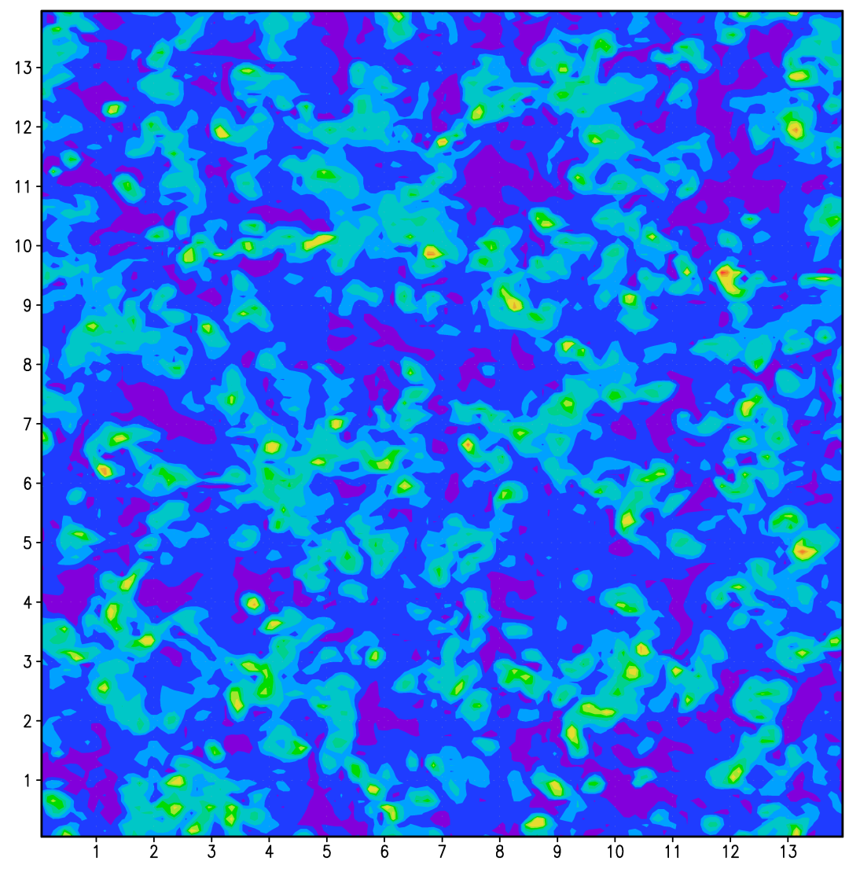
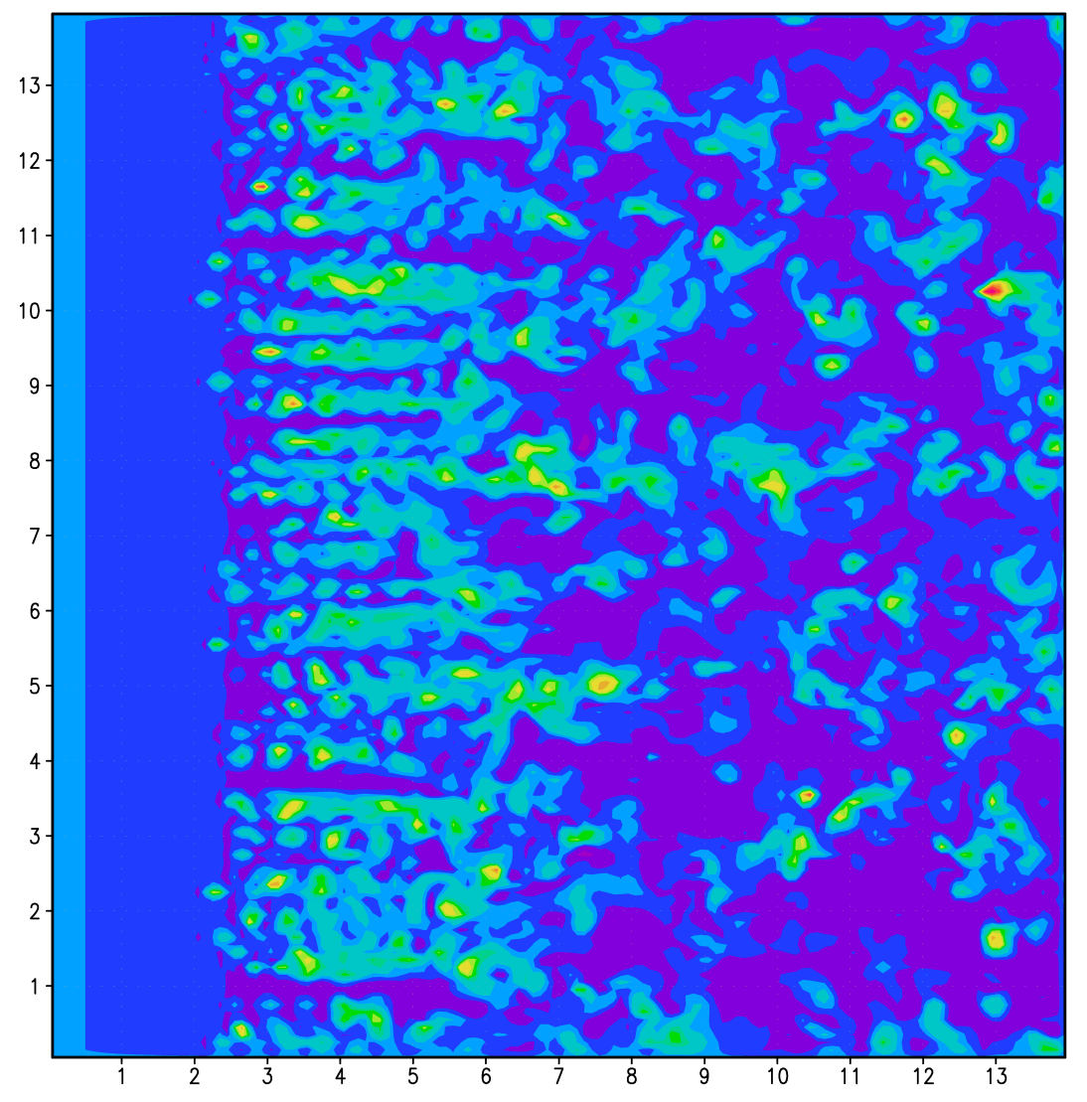
Potential Temperature Perturbations
CM1 (Bryan and Fritsch 2002) z = 371 m, t = 7200 s
(every 0.1 K shown)
permanently eddy-deficient inflow
4 m s⁻¹
4 m s⁻¹
periodic LBCs
non-periodic LBCs
1 km

Slide 5
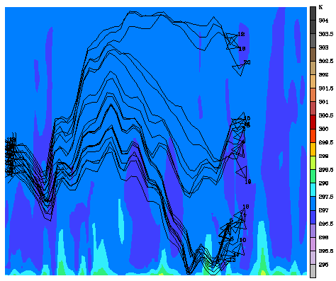
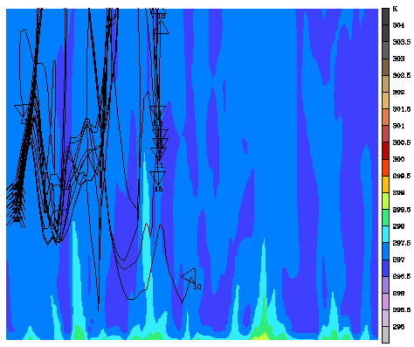
WRF-LES (Moeng et al. 2007) central cross section, 0-1 km trajectories 3600 – 6000 s
periodic LBCs
non-periodic LBCs

Slide 6
Possible Remedies
Nest LES within LES within mesoscale model and utilize results from finer domains only (Zhu et al. 2010)
Nest LES within mesoscale model, and use eddy recycling at inflow boundary with ‘magic slice’ (Mayor et al. 2002)

Slide 7
‘Eddy Seeding’ Method
Realistic eddy structures are pre-computed within an offline ‘canned LES’ simulation with periodic LBCs (output every 10 s between 3600 s and 7200 s is saved)
Retrieve canned eddy structures during an LES with nonperiodic LBCs, and add to mesoscale flow to obtain realistic inflow boundary conditions
Use similarity theory, if necessary, to scale canned eddy structures to be appropriate to those of the nonperiodic LES (e.g., by use of w* and z_{i} in the convective mixed layer)

Slide 8
Newtonian Relaxation toward Eddies
Lateral Boundary
of LES
Mean wind vector
Width of Blending Zone = 20 Δx
Interior
of LES
Z_{i}

Slide 9
Homogeneous Surface Tests
A canned LES was generated using the Cloud Model 1 (CM1) (Bryan and Fritsch 2002) with no initial wind, 0.1 K m s⁻¹ surface heat flux, initial thermodynamic sounding (mixed layer with z_{i} = 1350 m) derived from Kang and Davis (2008), and periodic boundary conditions (100 x 100 x 122; Δx = Δy = 100 m; z_{top} = 3500 m) .
Another periodic (‘truth’) simulation was performed with the same thermodynamic sounding, but with u = 4 m s⁻¹ and surface heat flux of 0.2 K m s⁻¹ , extending out to 3 hours, and 140 x 140 in horizontal extent.

Slide 10
Homogeneous Surface Tests (cont.)
A ‘control’ simulation was performed, identical to the ‘truth’ simulation, but using nonperiodic LBCs (for tests shown here, time-dependent conditions on potential temperature and normal velocity that match the evolution of the truth simulation, to mimic behavior of nested LES domain).
A final simulation was performed in which eddy seeding was introduced into the blending zone of the control simulation.
For these buoyancy-driven boundary layer tests, only potential temperature eddy structures were used.

Slide 11
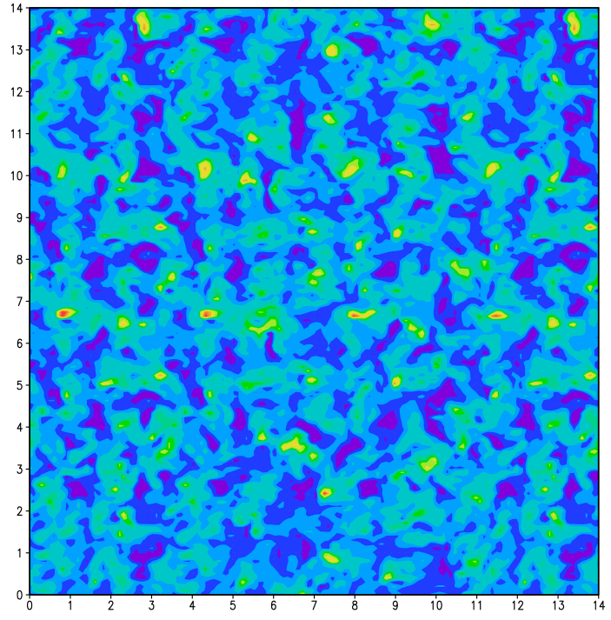
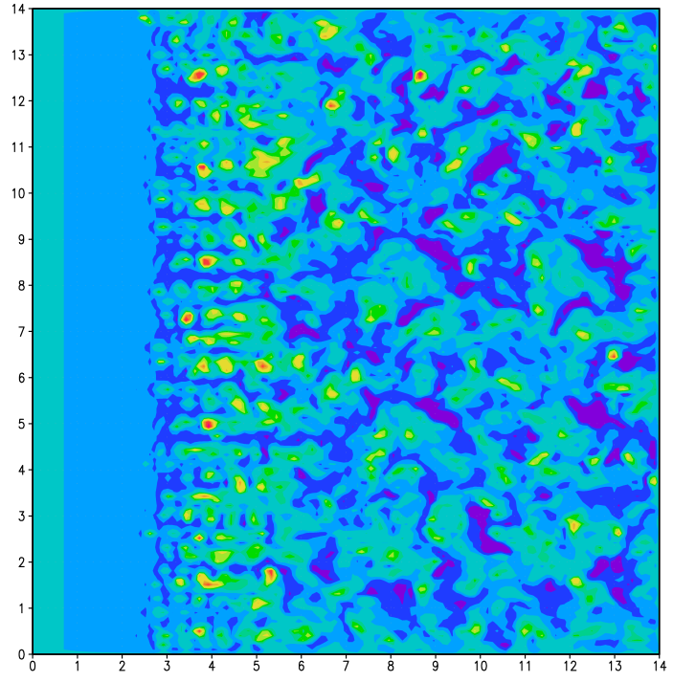
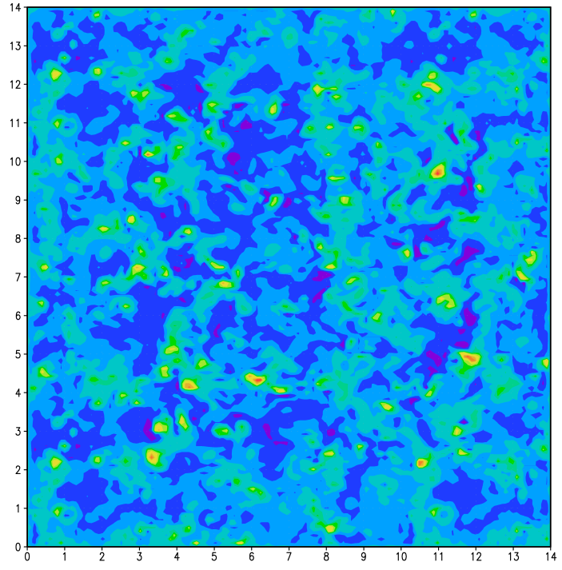
Potential Temperature Perturbations
(every 0.1 K shown) t = 900 s, z = 371 m
14 km
periodic LBCs
non-periodic LBCs
non-periodic LBCs with canned eddy relaxation

Slide 12
Resolved Turbulent Statistics
Left Blending Region
Interior Region

Slide 13
Resolved Turbulent Statistics
Left Blending Region
Central Region

Slide 14
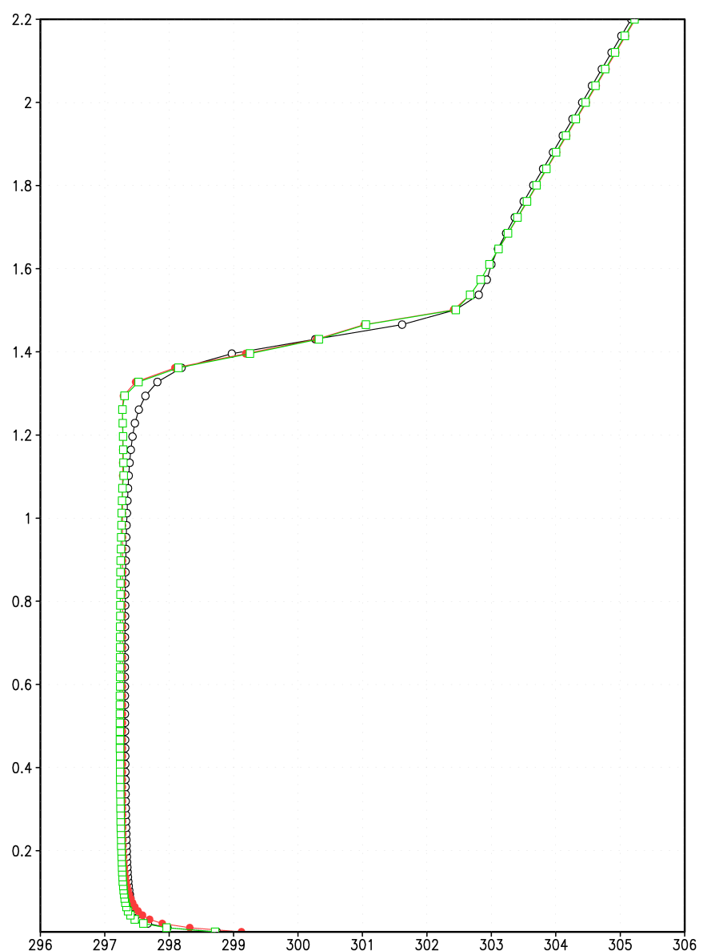
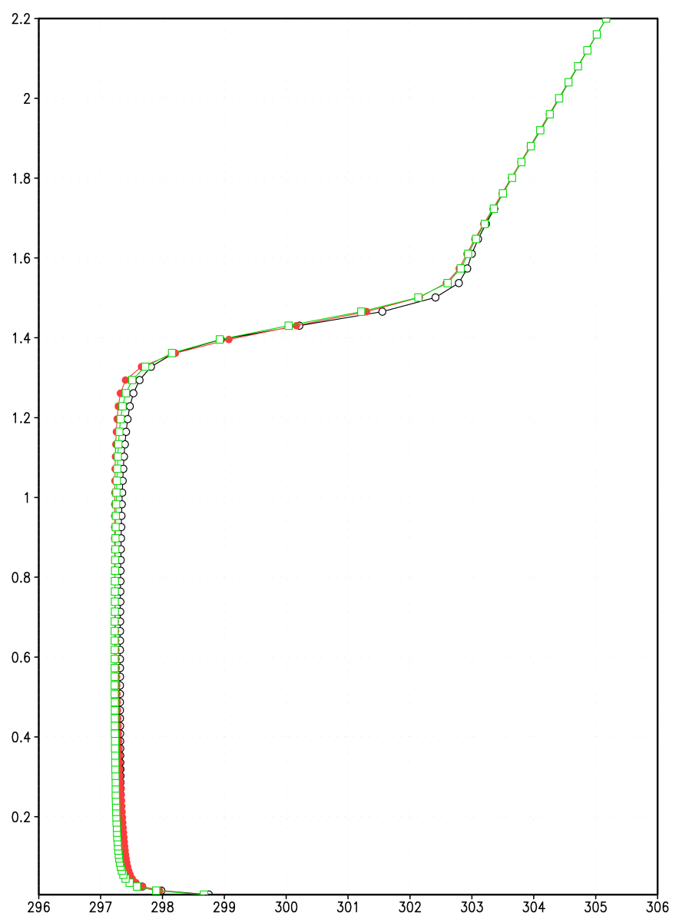
Temporally- and Horizontally-Averaged Potential Temperature Profile at t = 120 min
Left Blending Region
Interior Region
Periodic LBCs
Non-Periodic Time-Dependent LBCs, With Eddy Seeding
Height (km)
Non-Periodic Time-Dependent LBCs, No Eddy Seeding

Slide 15
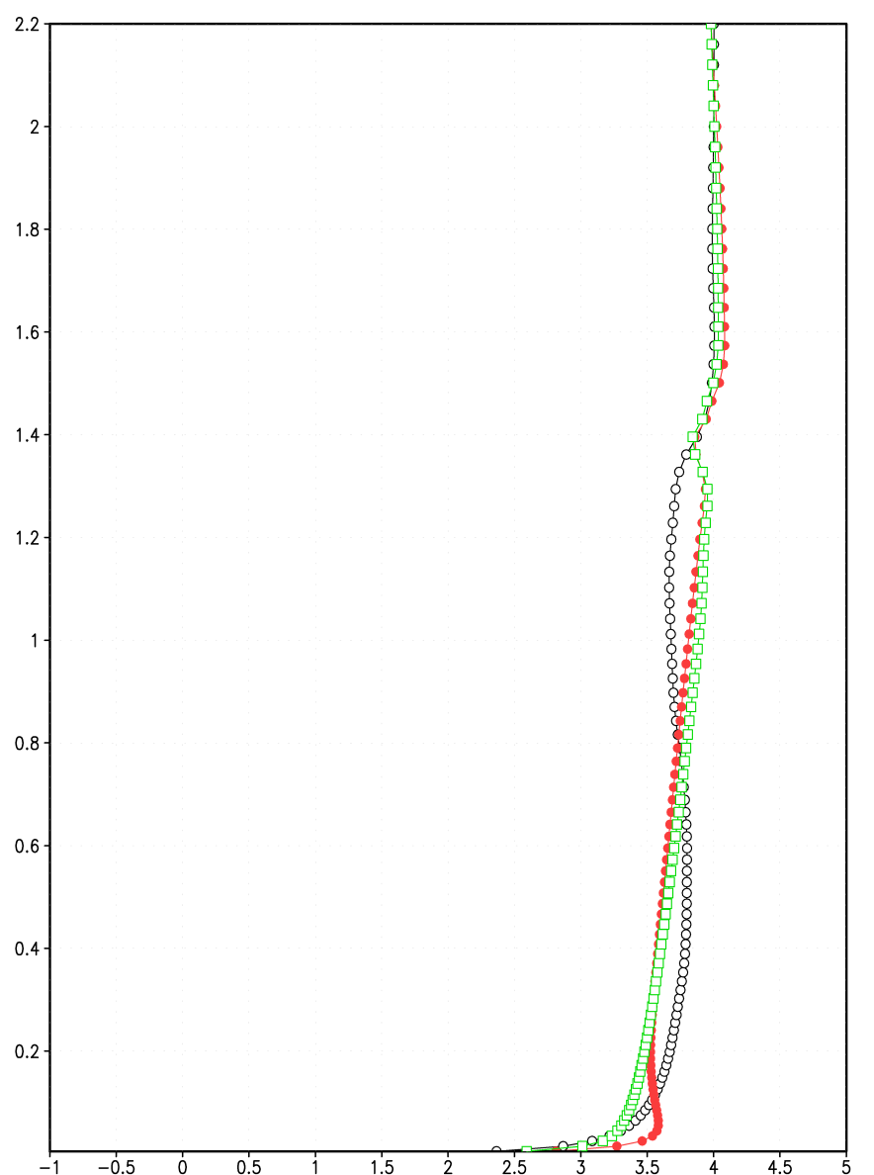
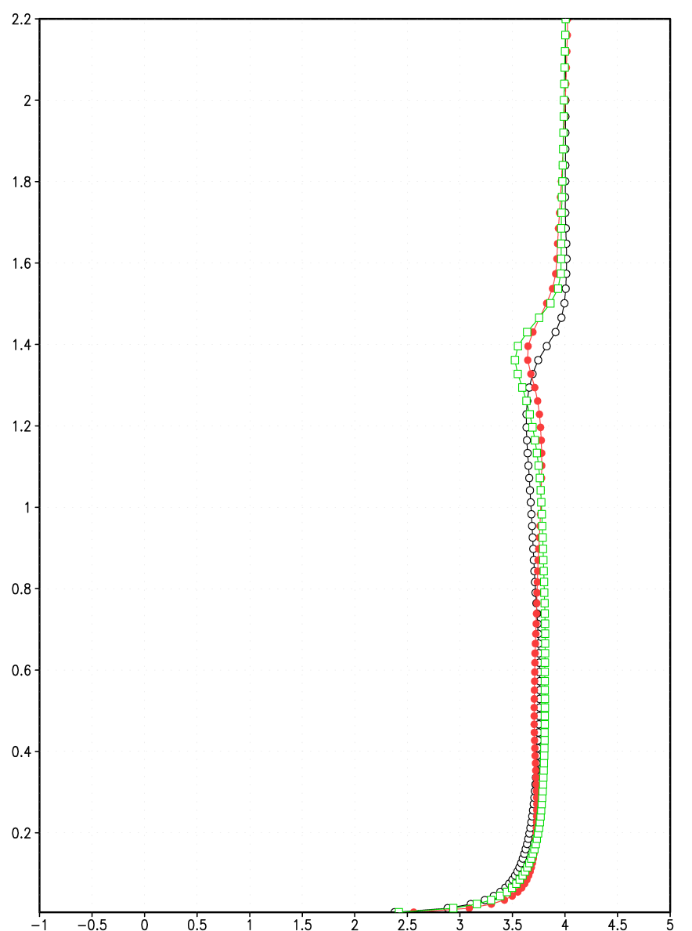
Temporally- and Horizontally-Averaged U-Component Profile at t = 120 min
Left Blending Region
Interior Region
Non-Periodic Time-Dependent LBCs, With Eddy Seeding
Non-periodic mean fields can match periodic mean fields, but only when particular time-dependent lateral boundary conditions are imposed.
Periodic LBCs
Height (km)
Non-Periodic Time-Dependent LBCs, No Eddy Seeding

Slide 16
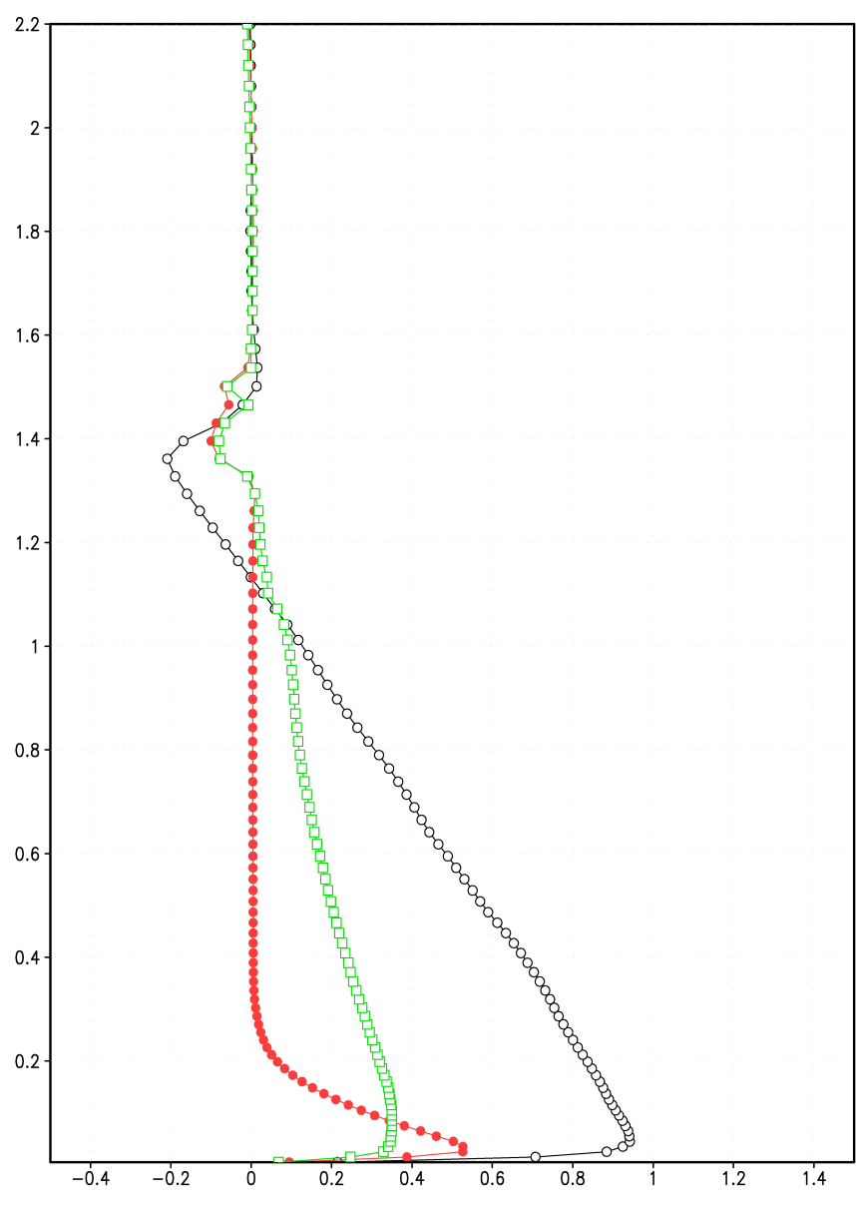
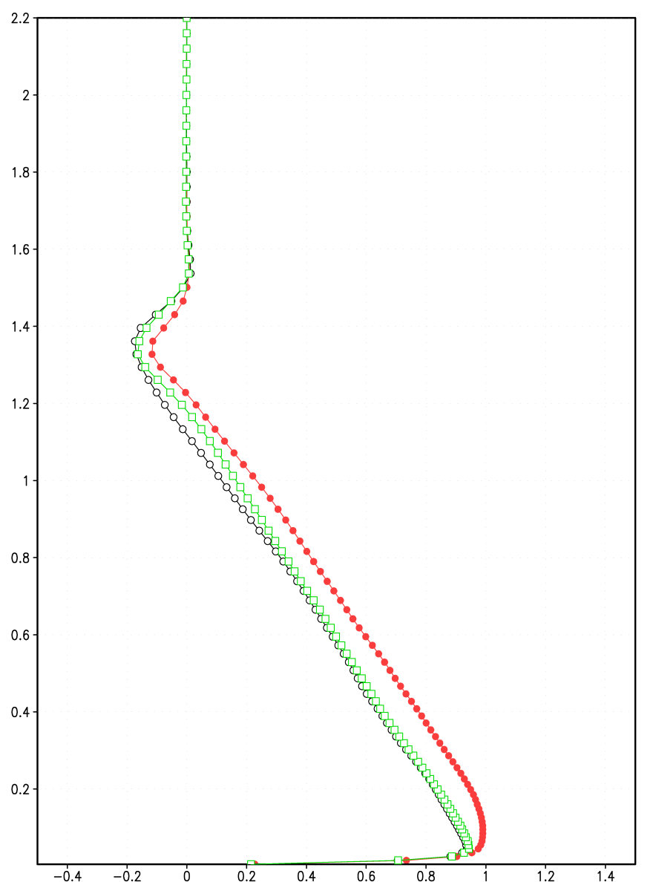
Temporally- and Horizontally-Averaged Resolved Normalized Heat Flux at t = 120 min
Left Blending Region
Interior Region
Non-Periodic Time-Dependent LBCs, With Eddy Seeding
Height (km)
Periodic LBCs
Non-Periodic Time-Dependent LBCs, No Eddy Seeding

Slide 17
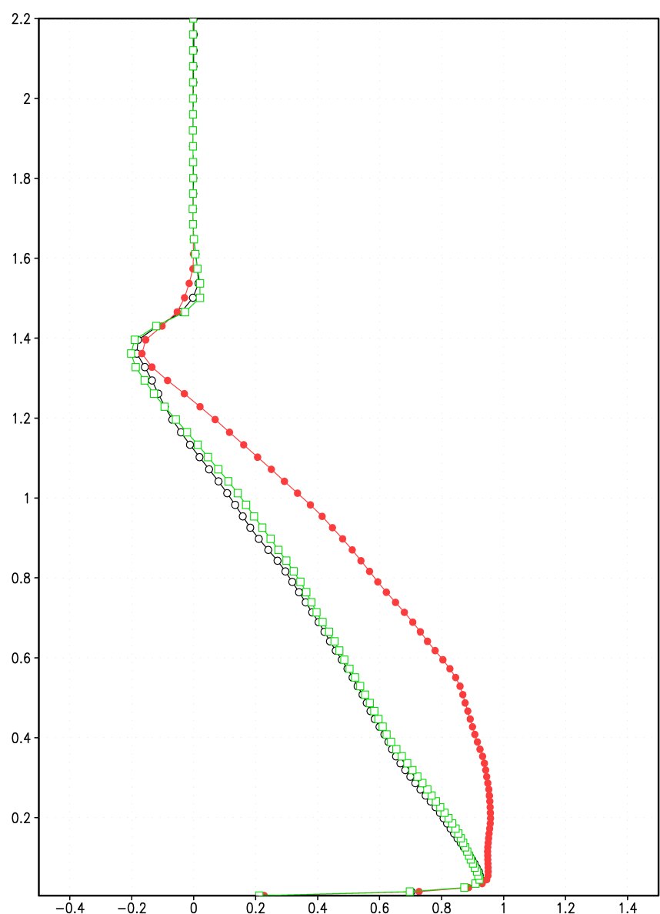
Temporally- and Horizontally-Averaged Resolved Normalized Heat Flux at t = 120 min
Left Blending Region
Central Region
Non-Periodic Time-Dependent LBCs, With Eddy Seeding
Height (km)
Periodic LBCs
Non-Periodic Time-Dependent LBCs, No Eddy Seeding

Slide 18
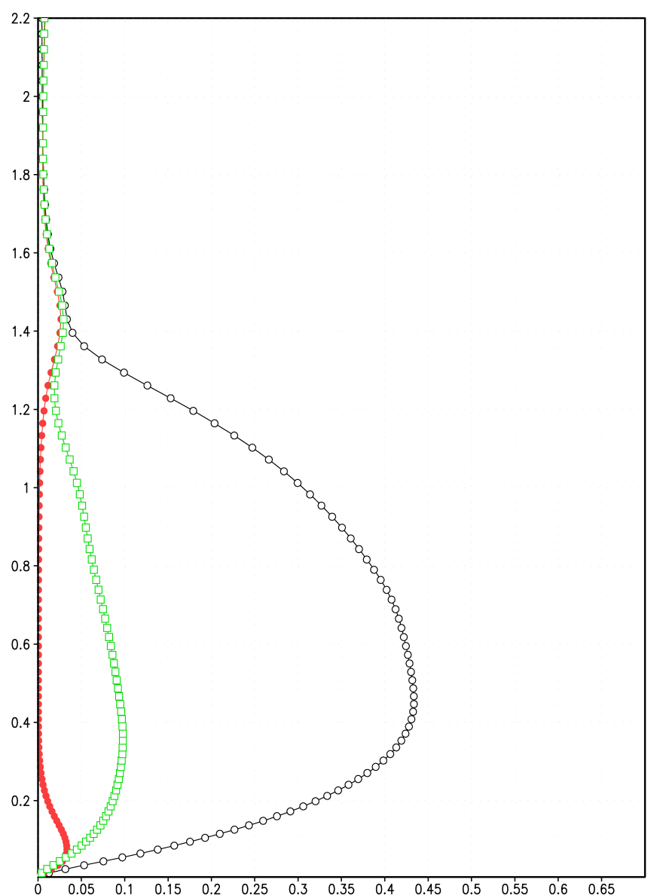
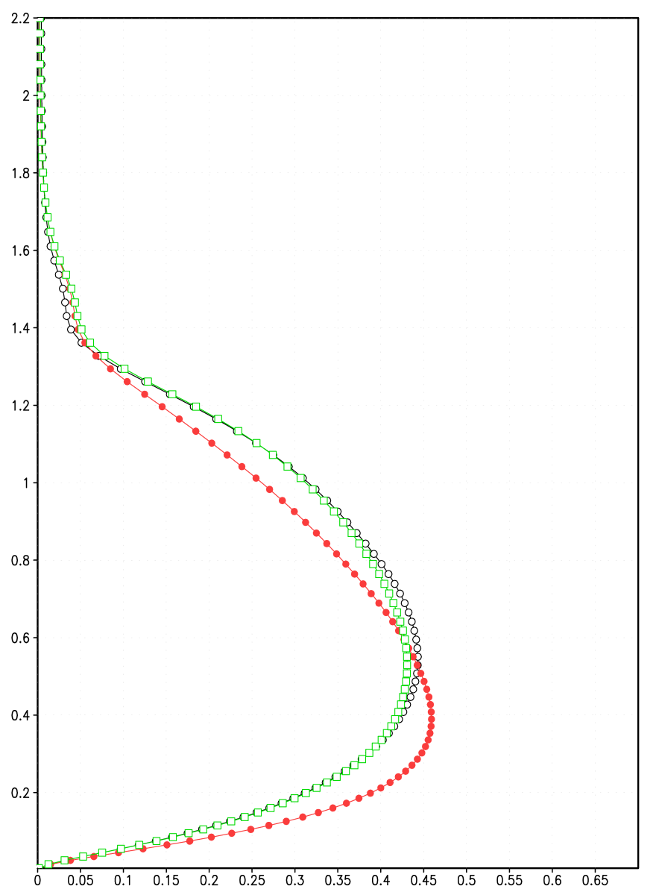
Temporally- and Horizontally-Averaged Resolved Normalized Vertical Velocity Variance at t = 120 min
Left Blending Region
Interior Region
Non-Periodic Time-Dependent LBCs, With Eddy Seeding
Periodic LBCs
Height (km)
Non-Periodic Time-Dependent LBCs, No Eddy Seeding

Slide 19
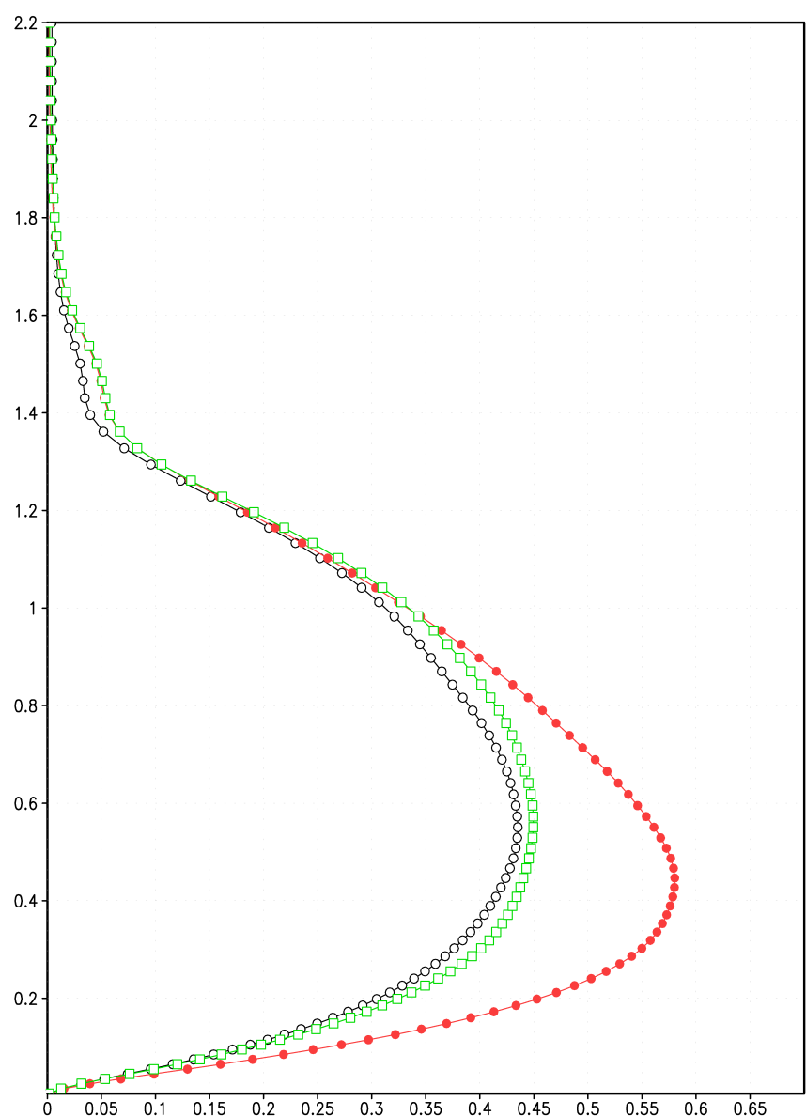
Temporally- and Horizontally-Averaged Resolved Normalized Vertical Velocity Variance at t = 120 min
Left Blending Region
Central Region
Non-Periodic Time-Dependent LBCs, With Eddy Seeding
Non-periodic resolved turbulent statistics are severely depressed in inflow region, with unrealistic compensation even in the domain center.
Periodic LBCs
Height (km)
Eddy-seeded resolved turbulent statistics are improved in inflow region, and closely approximate the periodic solution near the domain center.
Non-Periodic Time-Dependent LBCs, No Eddy Seeding

Slide 20
WRF-LES Experiments
WRF-LES experiments (version 3.3.1) have been set up using the same (single) domain size, thermodynamic sounding, and surface heat flux as the set of CM1 experiments.
There are a few small differences between the WRF-LES and CM1 applications (eta coordinate vs. height coordinate, and differences in scaling with physical height; 1-minute vs. 10-second data storage in canned simulation)
Open / radiative LBCs here for both control and eddy-seeded experiments

Slide 21
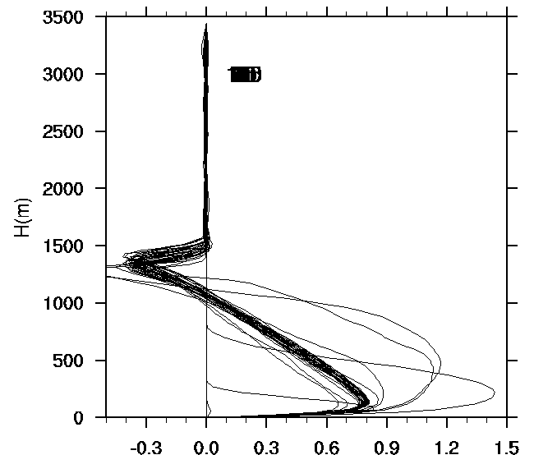
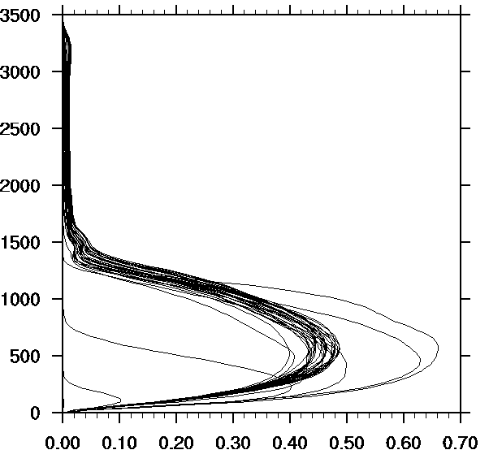
WRF-LES Turbulent Profiles (Periodic Case)
Normalized Vertical Heat Flux
Normalized Vertical Velocity Variance
(every five minutes shown)

Slide 22
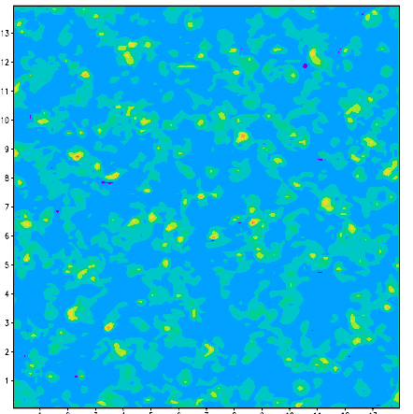
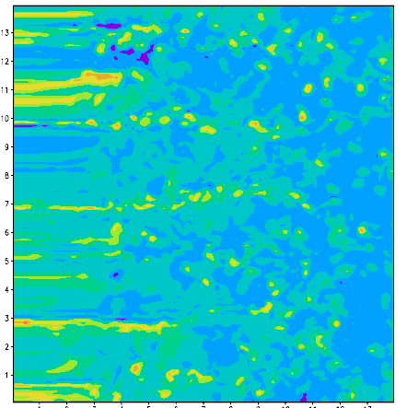
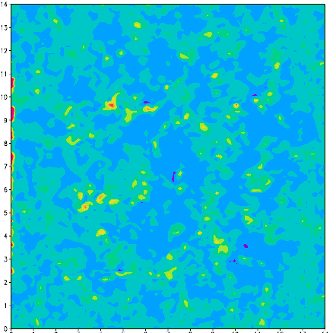
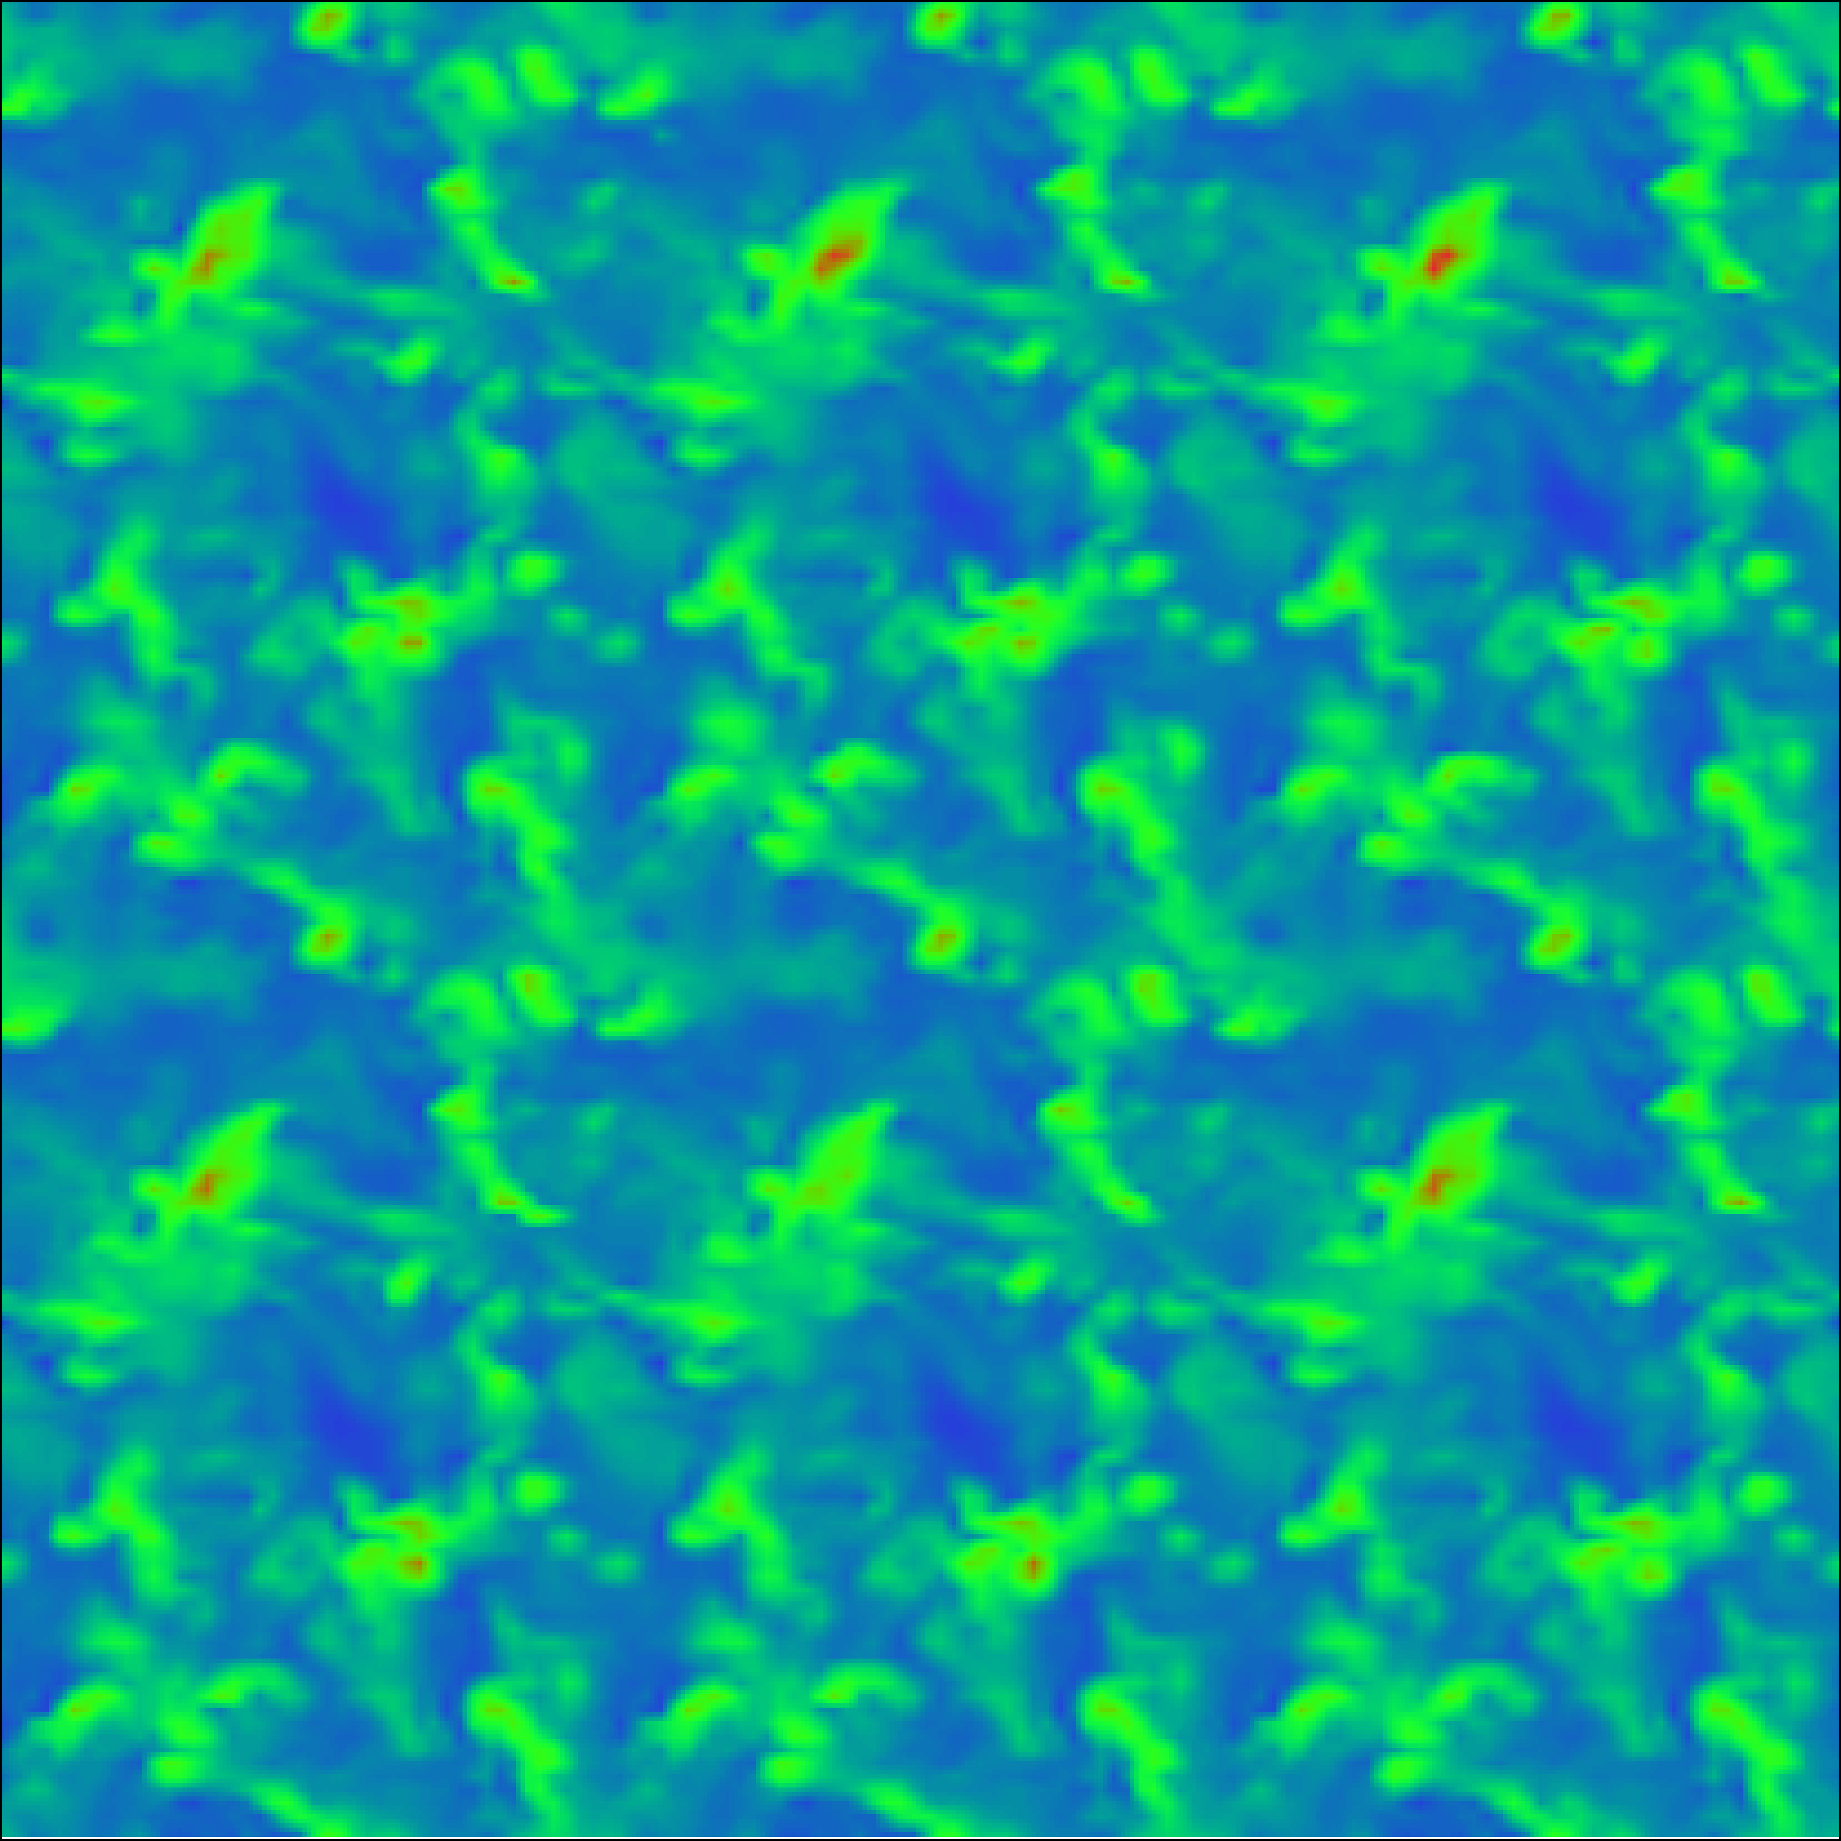
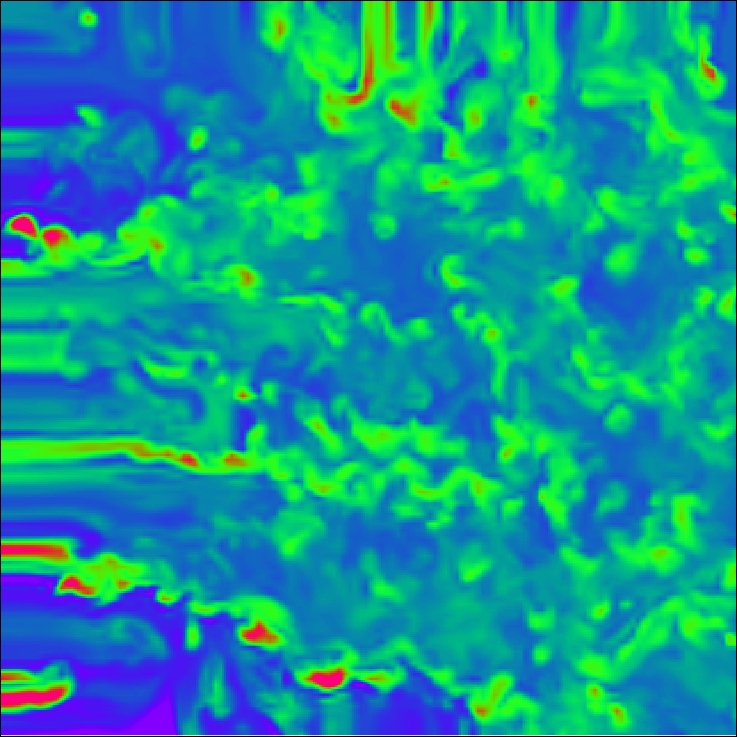
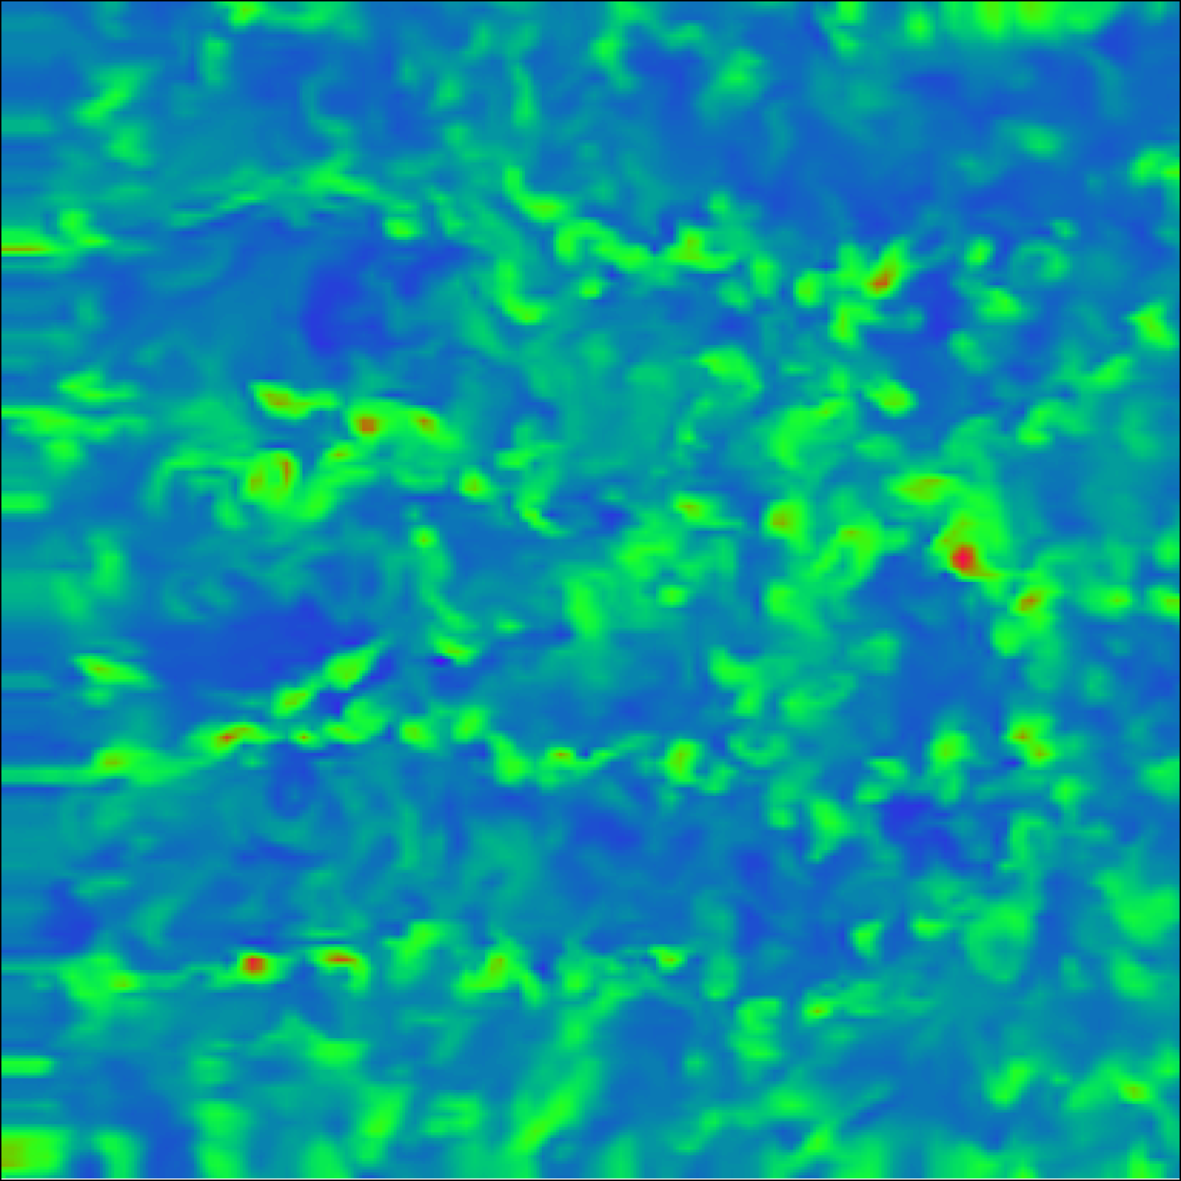
CM1 vs. WRF-LES t = 3600 s
CM1
z = 371 m
WRF
z = 375 m
periodic
open / radiative
open /radiative with eddy seeding

Slide 23
Proposed Mesoscale / LES Nested Modeling System
“Canned LES”
homogeneous with periodic LBCs
after rescaling, provides realistic eddy structures within blending zone
Nested LES
Parent Mesoscale Model
provides realistic LBCs, surface fluxes, z_{i}, and wind profiles to nested LES
Nested LES
possesses realistic non-periodic LBCs and heterogeneities in atmospheric and surface fields

Slide 24
Summary
Qualitatively, the eddy seeding method shows promise in being able to quickly generate realistic eddy structures in nonperiodic nested LES models.
Resolved turbulent statistical quantities in nonperiodic LESs without eddy seeding were highly deficient, as expected, near the inflow region, but even in the domain center suffered from unrealistic ‘overcompensated’ values.

Slide 25
Summary (cont.)
The use of eddy seeding alleviates the deficient turbulent statistics in the inflow nudging region, and closely matches the turbulent statistics from the periodic truth simulation in the central region of the domain.
A preliminary implementation of the method has been performed in WRF-LES and is consistent with corresponding CM1 LES experiments.

Slide 26
Current / Future Work
Complete WRF-LES implementation of eddy seeding
Apply to parent mesoscale / nested LES configuration
Apply to cases of heterogeneous surface fluxes and/or different atmospheric soundings
Evaluate utility of more rigorous scaling (e.g., momentum variables)

Slide 27
Acknowledgements
This research was funded by the Defense Threat reduction agency under contract HDTRA1-10-0033, under the supervision of John Hannan and Anthony Esposito.
We acknowledge the technical assistance and helpful discussions with George Young, John Wyngaard, and Song-Lak Kang.

