Slide 1
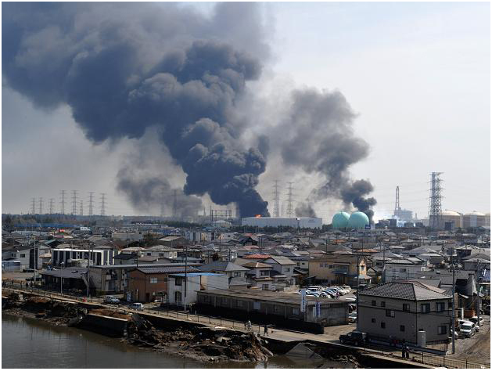



Assessment of the atmospheric release induced by the Fukushima nuclear power plant accident
Presentation of the method and validation of the source term by using model to data comparisons
O.SAUNIER, A.MATHIEU, D.DIDIER, M.TOMBETTE, D.QUELO, M.BOCQUET, V.WINIAREK
Anne.mathieu@irsn.fr

Slide 2
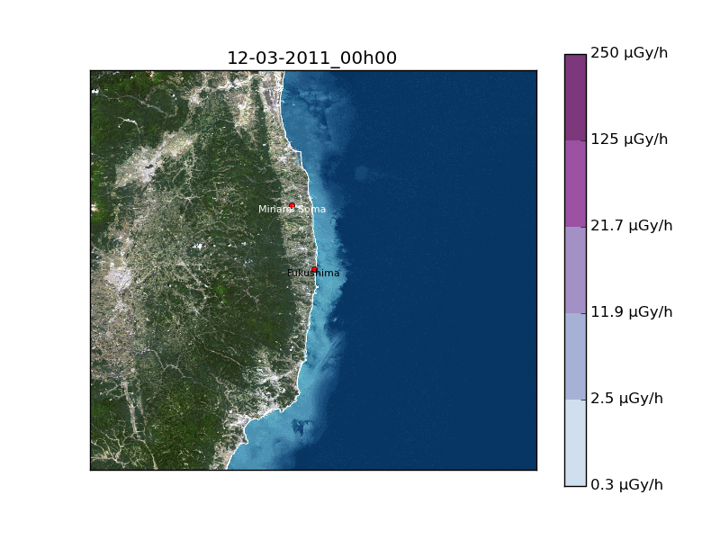
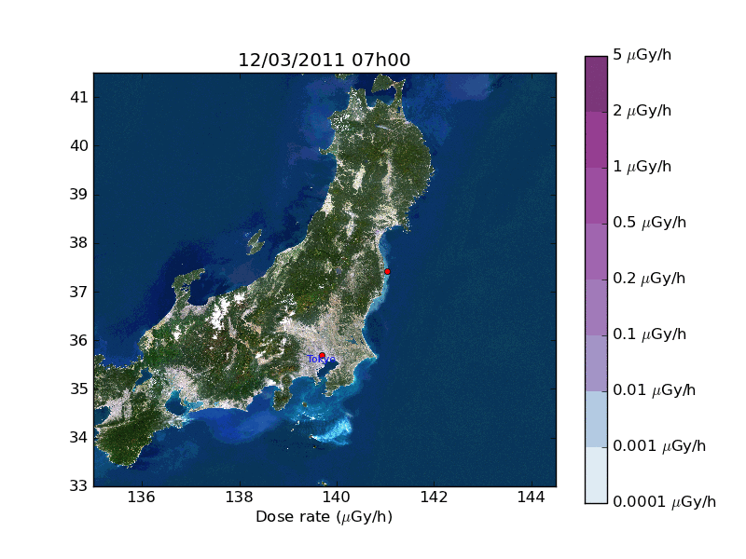
Operational response to the Fukushima crisis
Role of IRSN in case of a Radiological Emergency
  Assess risk induced by accidental situation
  Provide technical expertise to French public Authorities
The strong uncertainties prevent to have a complete understanding of the nuclear accident
To improve the estimate of the source term: Inverse modelling approach Source term : time evolution of the release rate and its distribution between radioisotopes
The Fukushima crisis
  Activation of the Technical Emergency Centre for 6 weeks (24/7 – 100 p)
  Local response: Projection of a technical adviser at the French Embassy
Task
  Evaluation of the reactors state, releases (diagnostic/prognosis)
  Evaluation of the radiological consequences (doses et depositions)
  Analysis of the measures over the world
Providing a relevant technical information to the media and French people in Japan

Slide 3
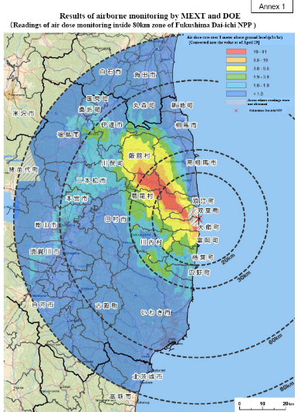
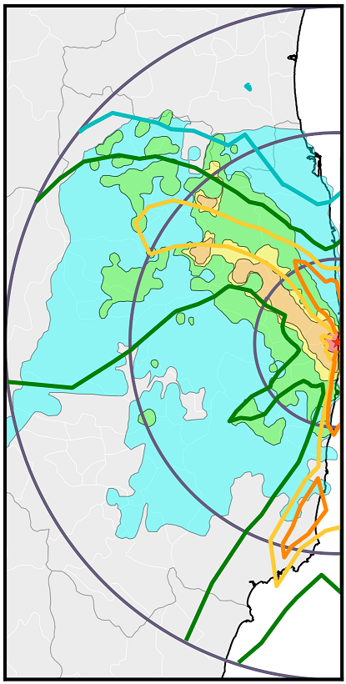

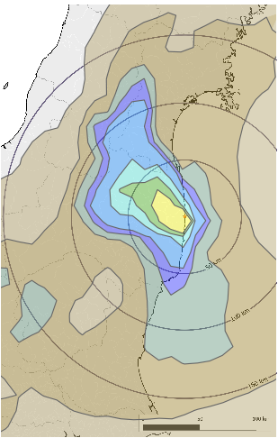
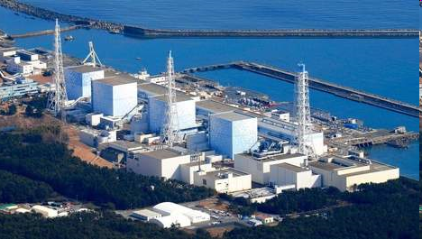
Outline
Gamma dose rate observations
Ingredients of the reconstruction
Reconstruction of the Fukushima Daiichi source term
Conclusions

Slide 4
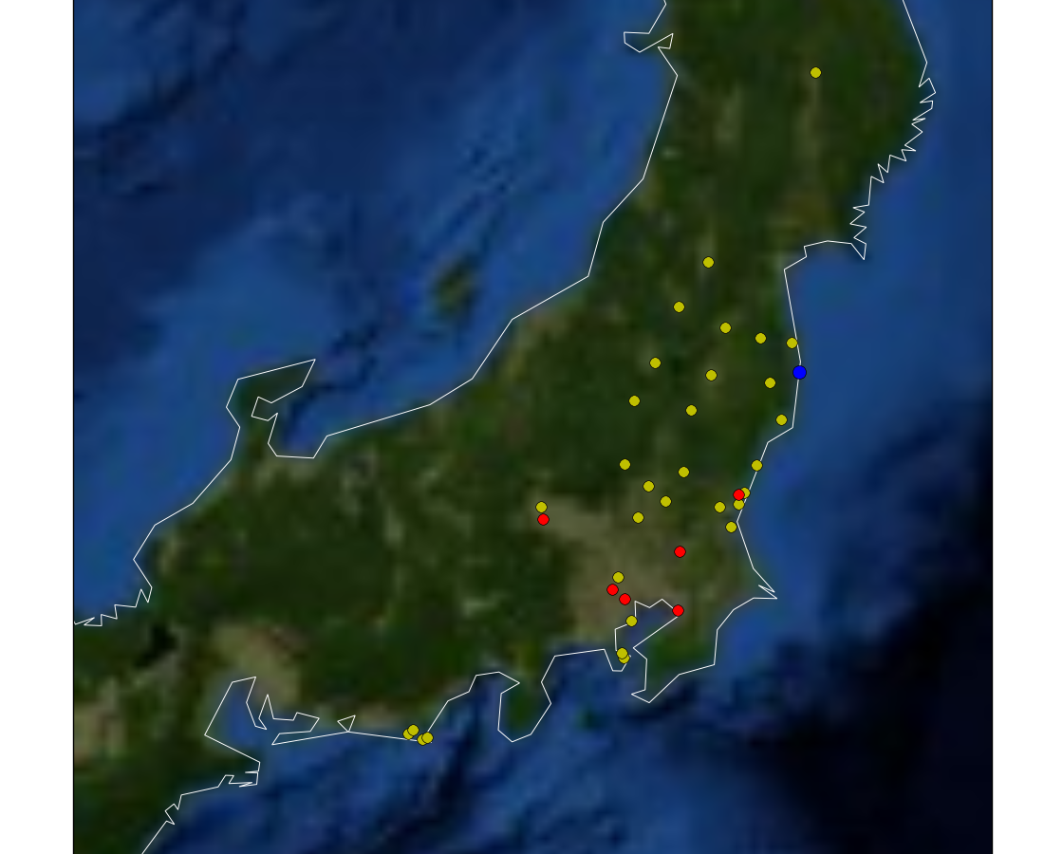
Ingredients of the reconstruction: observations
Fukushima Daiichi NPP
Air concentration
Dose rate
Inverse modelling approach:
the novelty of the presented method is the use of dose rate observations
Observations | + | -
Air concentration | Easy to use (Model parameter & Isotopic composition) | Number & frequency (Very few data & Time integrated)
Deposition | Easy to use (Model parameter & Isotopic composition) | Number & frequency (Very few data during the release & Time integrated)
Dose rate | Number & Frequency | Difficult to use (Not a model parameter & Aggregate all the gamma radiations emitted by any radionuclides present on the ground and in the air)
Observations | + | -
Air concentration | Easy to use (Model parameter & Isotopic composition) | Number & frequency (Very few data & Time integrated)
Deposition | Easy to use (Model parameter & Isotopic composition) | Number & frequency (Very few data during the release & Time integrated)
Dose rate | Number & Frequency | Difficult to use (Not a model parameter & Aggregate all the gamma radiations emitted by any radionuclides present on the ground and in the air)
4

Slide 5
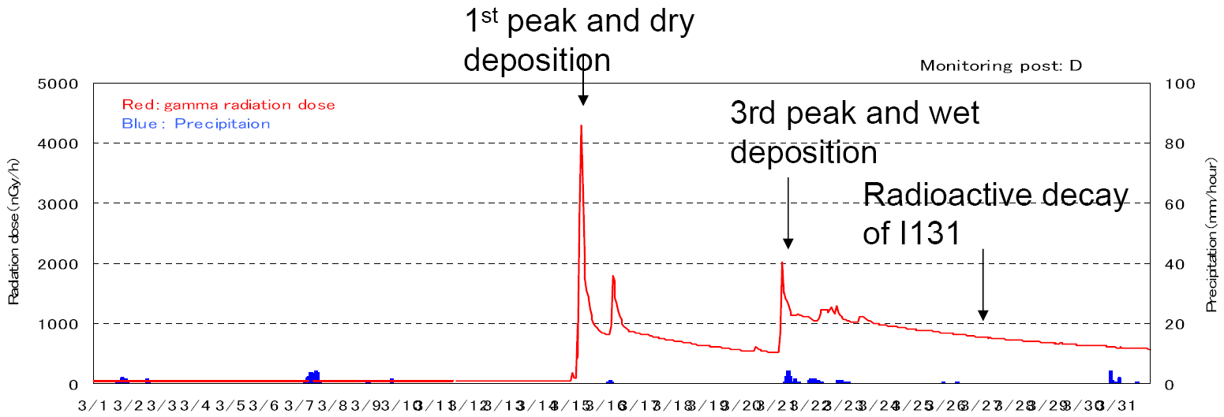
Ingredients of the reconstruction: the observations
Gamma dose rate observations
Information contained in the dose rate signal :
  Plume detection when it blew over the station: timing of the release events
  The slope due to the radioactive decay of the deposit: information on the isotopic composition
  The value of the observed dose rate: quantities released
5

Slide 6
Ingredients of the reconstruction: the inverse problem
The physical model for the tracers (radionuclides) can be formalized by
The objective is to assess the source term σ so that the error ε is minimized.
Cost function (minimized by using L-BFGS-B algorithm)
Requirement
  Number of observations >> Number of unknowns
Hypothesis
  No prior knowledge of the source term (σ_{b} = 0)
  Model and observations are supposed to be perfect (R = B = I)
Vector of errors
Vector of observations
Estimator of the source term
Source receptor matrix
computed with the forward or adjoint model + observation operator
6

Slide 7
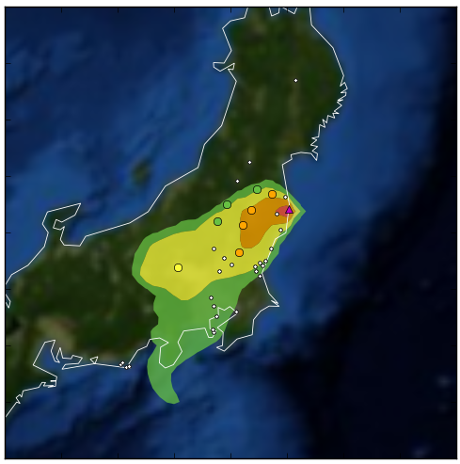
Ingredients of the reconstruction: the model
Dispersion model : Eulerian model ldX from the operational C3X platform
ldX Simplest reasonable numerical scheme
  Dry deposition: v_{dep} = 2 10⁻³ cm/s
  Wet deposition: Λs = ap_{o}^{b}, with a = 5 10⁻⁵ and b = 1
  Vertical diffusion: Troen and Mahrt scheme
  Radioactive decay + filiation
Met. data: ECMWF (0.125°)
Spatial resolution: 0.125° x 0.125°
Consequences model : consX from C3X
Dose rate estimations
Observations
ldX simulations
7

Slide 8
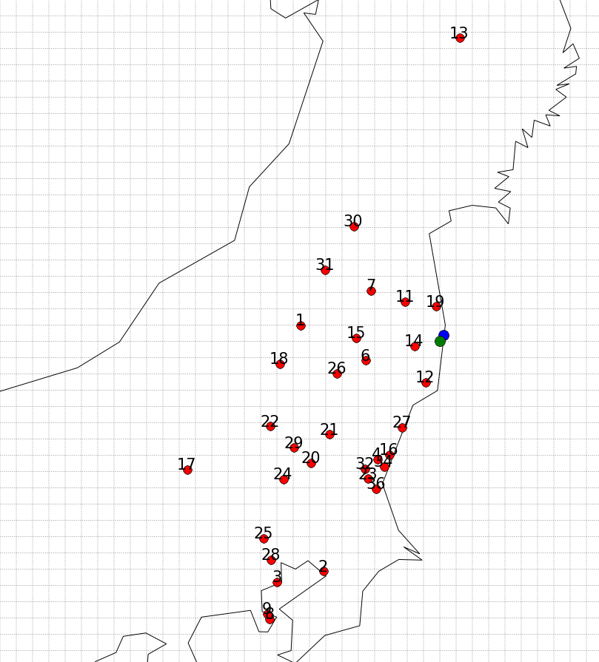
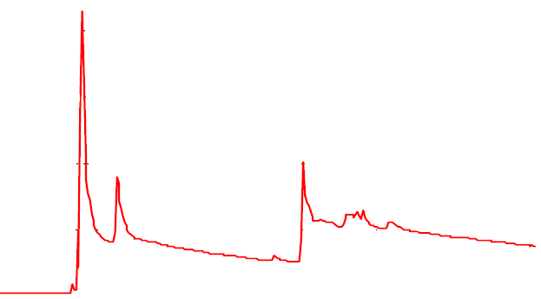
Ingredients of the reconstruction: Fukushima
The Fukushima case
Measurements: dose rate signal
  The observed signal is mainly due to the contribution of Cs-134, Cs-137, Ba-137m, I-131, I-132, Te-132, Xe-133
  ~30 dose rate stations are considered
  between the 11th and the 26th of March 11430 measurements
Source term assessment for the 7 main isotopes
    Cs-134 + Cs-137 + Ba-137m
    I-131
    I-132 + Te-132
    Xe-133
from the 11/03 till the 26/03: 7 isotopes x 380 time steps = 2660 unknowns
Insufficient number of observations: reduce the number of unknowns
8
Notes:
8

Slide 9
Dose rate measurements inversion : the method
Designed approach:
  Several steps :
      Inverse modelling to retrieve the timing of the release events
      Inverse modelling to retrieve the amount in time of each isotope released
  Constraints on the isotopic composition

Slide 10
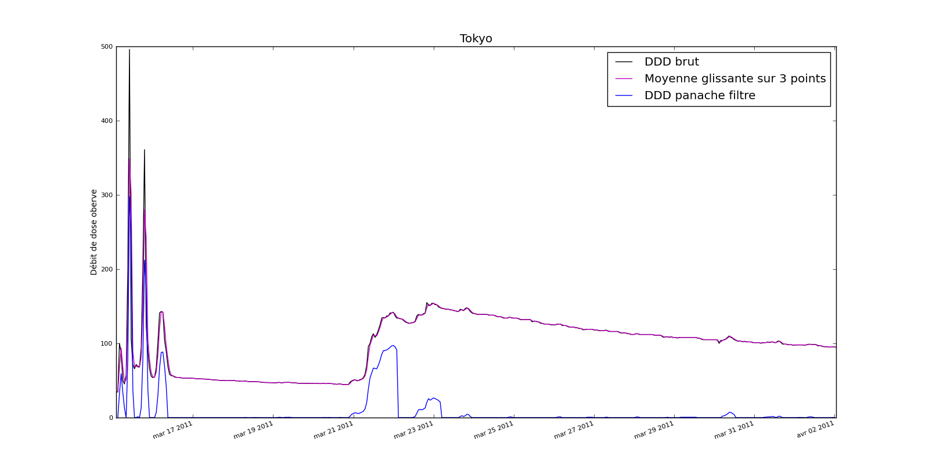
Ingredients of the reconstruction: step 1
Step 1: Inverse modelling to assess the timing of the release events
    Measurements: Extraction of the dose rate signal when the plume blew over the station
Observed dose rate
Plume component
10
Notes:
10

Slide 11
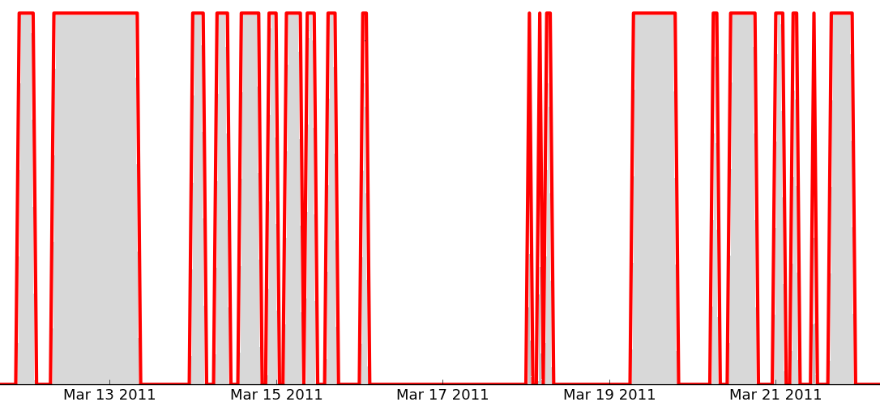
Ingredients of the reconstruction: step 1
  Inversion to assess the timing of the release events of one isotope (Xe-133 in order to have no deposition).
    Measurements: dose rate due to the plume component
    Cost function to minimize:
Results of the 1st Step: potential periods of release are identified
Potential release periods
Inverse
modelling
Plume extraction
11
Notes:
11

Slide 12
Dose rate measurements inversion
Step 2: Inverse modelling to assess the source term of the 7 main isotopes
Measurements: the complete dose rate signal
It is required that the release events are among the periods identified by the 1st step of the method
Soft constraints on isotopic ratio are imposed:
The cost function to minimize use a barrier function in order to enforce the constraints
Barrier function
12
Notes:
12

Slide 13
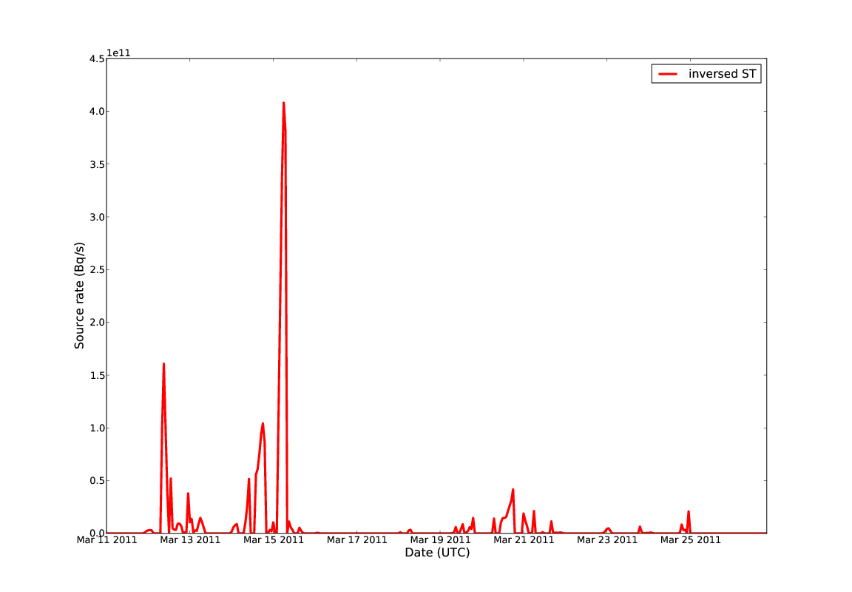
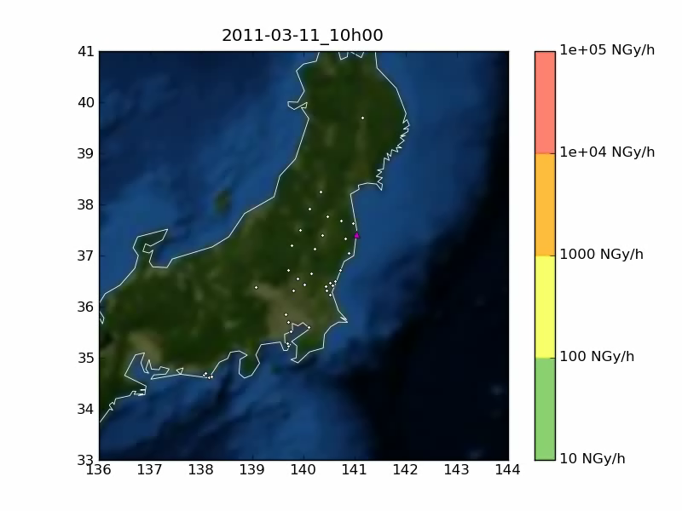
Comparisons with other ST
Reconstruction of the Fukushima-Daiichi source term
Model to data comparisons
(dose rate - plume component)
Cs-137 Inversed ST
Observations
ldX simulations
13
Notes:
13

Slide 14
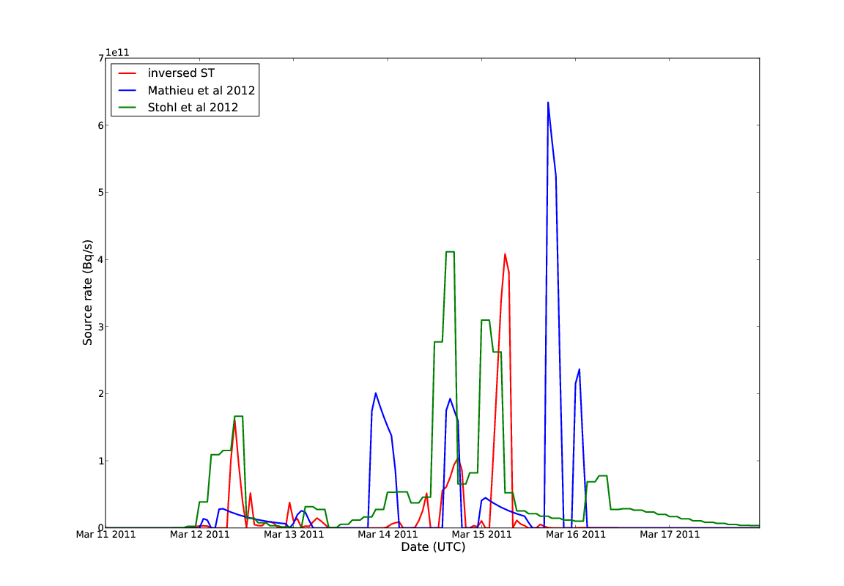
Comparisons with other ST
Reconstruction of the Fukushima-Daiichi source term
Model to data comparisons
(dose rate - plume component)
Cs-137 Inversed ST
Cs-137 Mathieu et al 2012
Cs-137 Stohl et al 2012
Mathieu et al 2012 Elements
Stohl et al 2012 Atmos.Chem.Phys.
Chino et al 2011 JNST
Winiarek et al 2012 JGR
Observations
ldX simulations
Good consistency between the different ST
Discrepancies due to uncertainties because of inaccurate meteorological forcing (precipitation, wind direct)
Model to data comparison : good agreement
14
Notes:
14

Slide 15
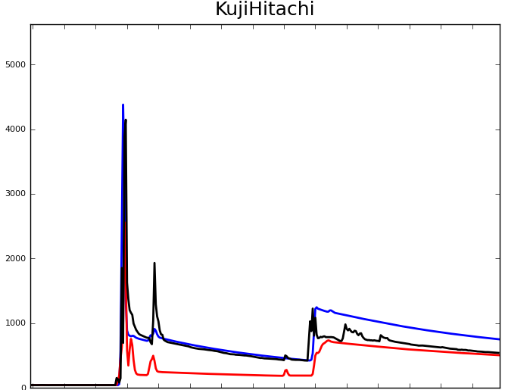
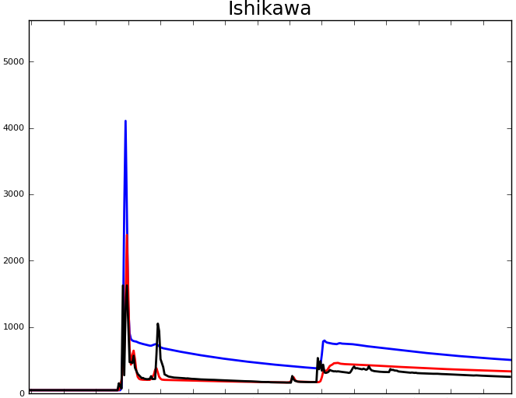
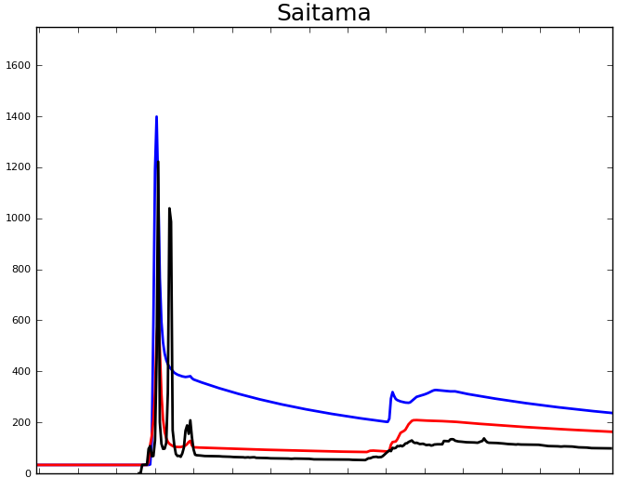
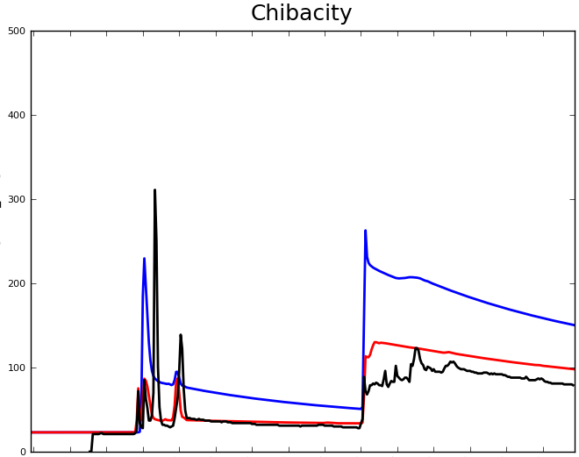
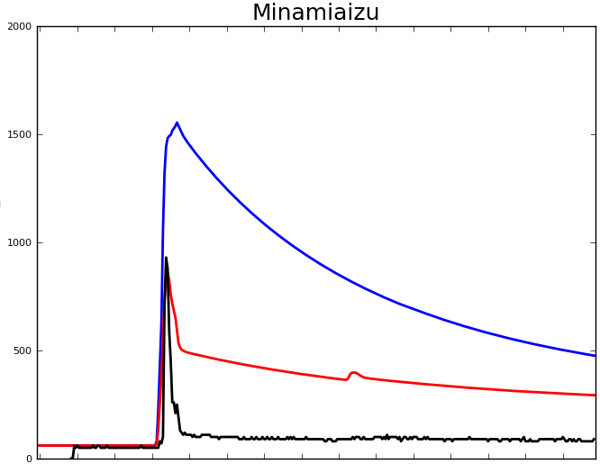
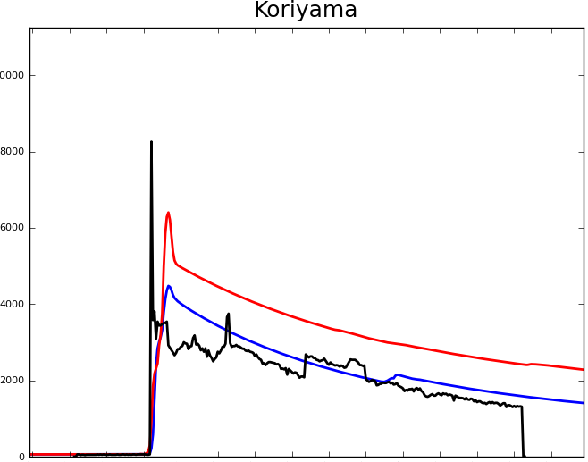
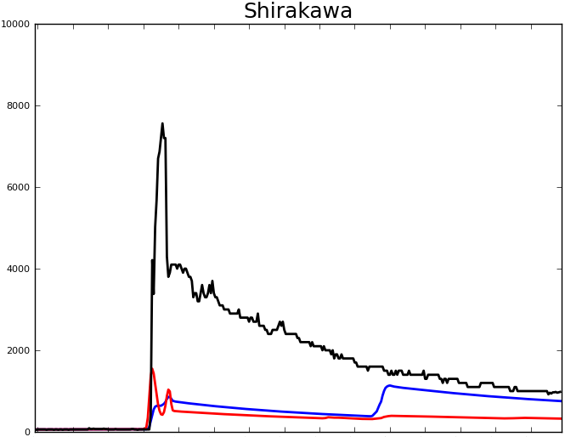
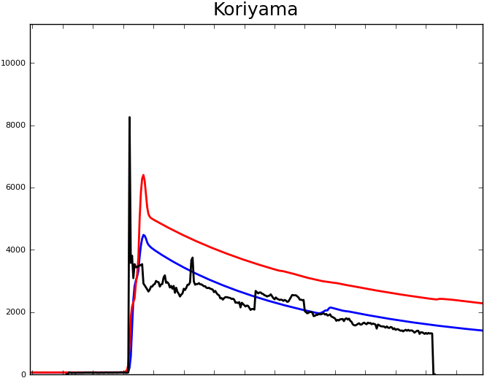
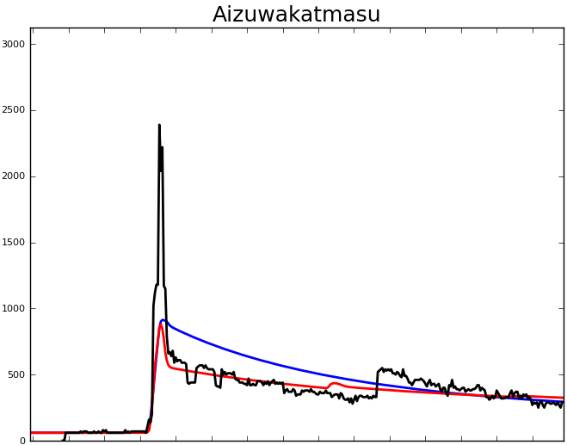
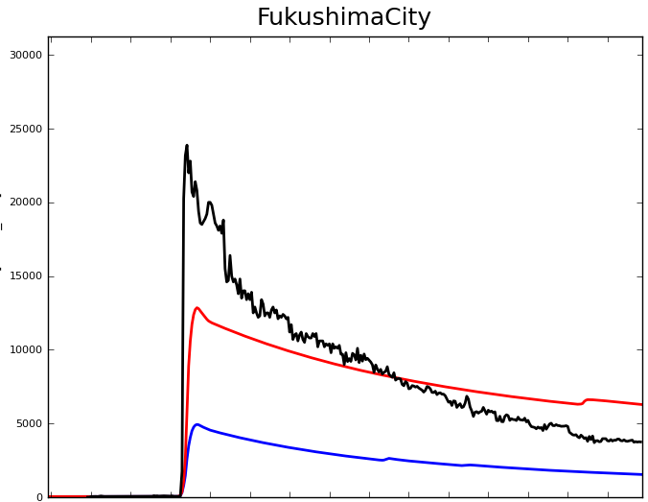
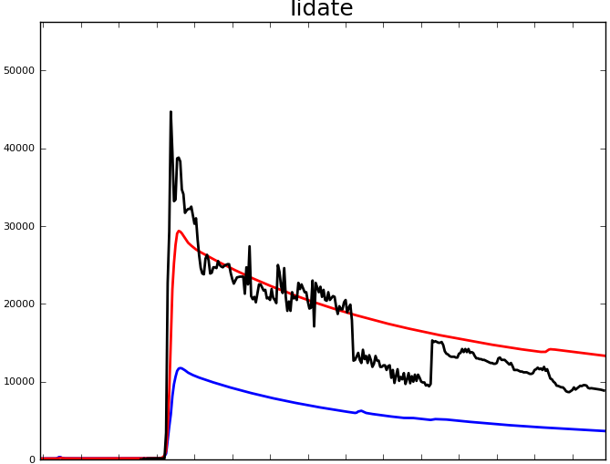
Reconstruction of the Fukushima source term
South
West – South West
Inversed ST
Mathieu et al 2012
Dose rate observed
West – North West
Good agreement between model and observations
Additional releases are identified with the inverse modelling method
Discrepancies are due mainly to inaccurate meteorological forcing (precipitation, wind direct)
15
Notes:
15

Slide 16
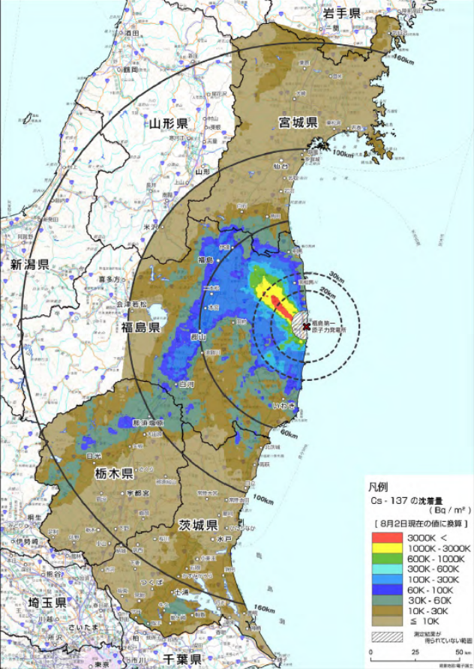
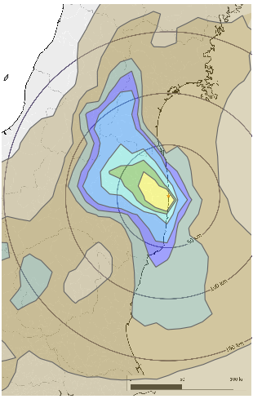
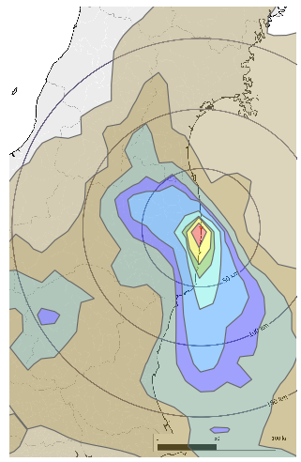

Reconstruction of the Fukushima source term
Comparisons with observations
Deposition observed
Inversed ST
Mathieu et al 2012
Good agreement
Under estimation
Under estimation
Under estimation
Fairly good agreement between model (with inversed ST) and observations of deposition
Differences are due
  to inaccurate meteorological forcing (precipitation, wind)
  to deposition scheme
16
Notes:
16

Slide 17
Conclusions & Perspectives
Reliable inversed modelling method to assess the source term by using dose rate observations
Performances
  Good results achieved on the Fukushima accident.
  The quality of the meteorological forecast is a key point to retrieve a realistic source term.
  The reconstruction of the isotopic composition is still tricky.
Perspectives
  Improve the reconstruction of the isotopic composition: air concentration, deposition and dose rate observations
  Extend the method to all spatial scales
Use
  The method proved to be perfectly suited to crisis management
  Efficient tool to improve the understanding of an accident
17
Notes:
17

Slide 18
Questions ?
18
Notes:
18

