Slide 1
Effects of Submeso Motions on AT&D in the Stable Boundary Layer
Joshua Hoover¹, Scott Richardson¹, Astrid Suarez¹, Brian Gaudet¹
Larry Mahrt², Dave Stauffer¹, Nelson Seaman¹
¹Department of Meteorology, Pennsylvania State University, PA, USA
²COAS, Oregon State University, OR, USA
16th Annual GMU Conference on Atmospheric Transport and Dispersion Modeling
July 17-18, 2012

Slide 2
Goals
The goals of this combined observation and modeling study are to:
  Use observations from towers and sodars to determine the characteristics of a lee wave and its effects on a surface cold pool and AT&D.
  Use a sub-km resolution daily WRF run to assess the 4D evolution of the lee wave and its environment.
  Use SCIPUFF to assess the impact of the lee wave on transport and dispersion of C7F14, released at various locations and times.

Slide 3
Introduction
Day of year (DOY) 236 - August 24, 2011 - shows signs of wave motions over Nittany Valley. A large amplitude lee wave is quasi-stationary over the Rock Springs, PA observation network.
This case study provides the opportunity to assess the transport and dispersion impacts of an atypical series of events that result from the lee wave, including abrupt temperature changes of up to ~7ºC and wind speed changes of up to ~4 ms⁻¹ near the surface.

Slide 4
Description of Case Study
On most nights, as the net radiation to the surface becomes negative, and the inversion builds, atmospheric stability is established.
Occasionally, intermittent turbulent events, which can be associated with a variety of causes, disrupt the stability and briefly increase temperatures and wind speeds.
On DOY 236, however, the opposite scenario takes place; that is, although the night is stable, a quasi-stationary lee wave appears to be associated with increased temperatures and wind speeds for extended periods of time, and this tendency is intermittently and briefly interrupted by lower wind speeds and temperatures.

Slide 5
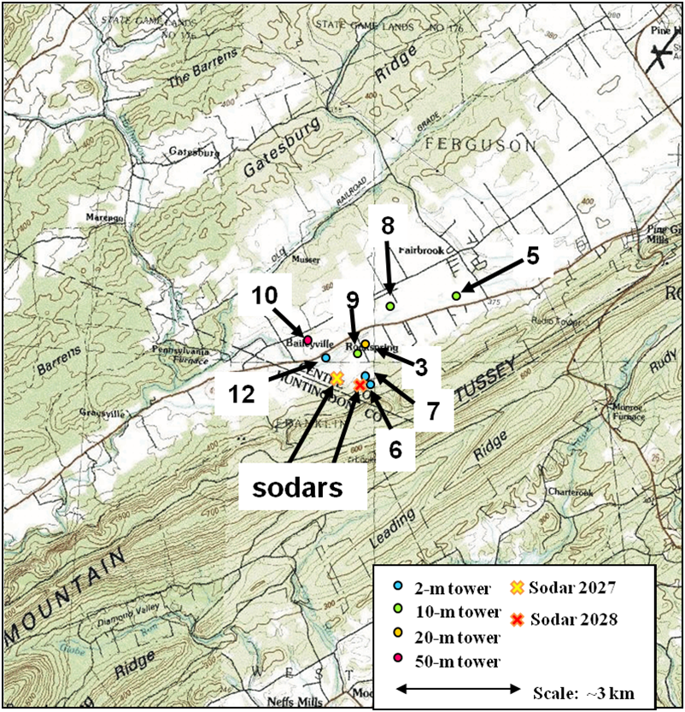
Rock Springs, PA
Instrument index
Thermocouples
  Omega Eng. TMTSS- 020G
Thermistors
  Campbell Sci. T107
2D Sonic Anemometers
  Vaisala WS425
3D Sonic Anemometers
  Campbell Sci. CSAT3
miniSodars
  ASC 4000E WindExplorer
WRF Cross section

Slide 6
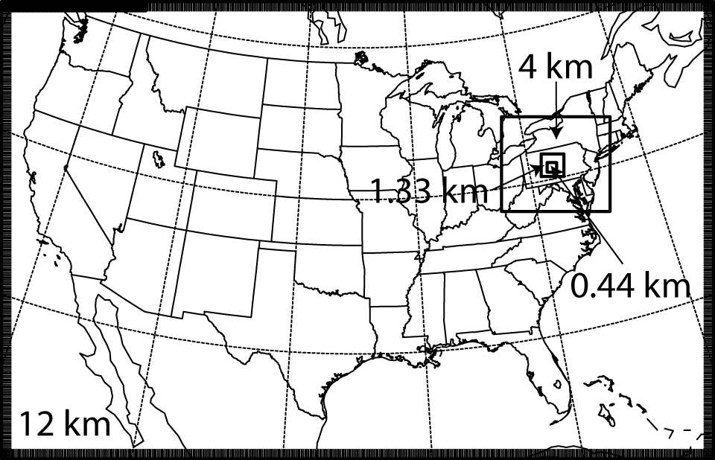
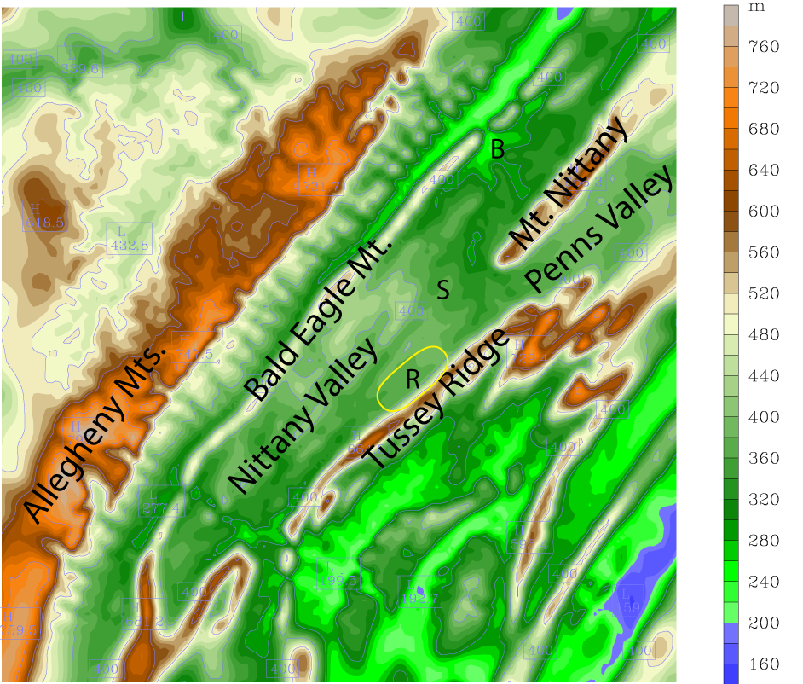
Daily Realtime WRF System
Four one-way nested domains: 12, 4, 1.33, and 0.44 km
Initialized at 0000 UTC and integrated for 12 h
GFS 0.5˚x0.5˚ meteorological initial and boundary conditions
MYJ TKE scheme
WSM 3-class microphysics
RRTM longwave / Dudhia shortwave radiation (with 30 min radiation update)
Kain-Fritsch cumulus parameterization on 12-km domain only
10 km scale
0.44-km domain

Slide 7
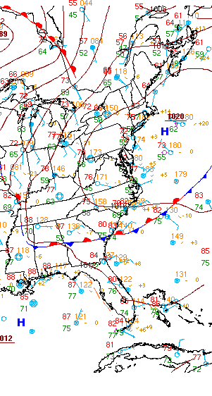
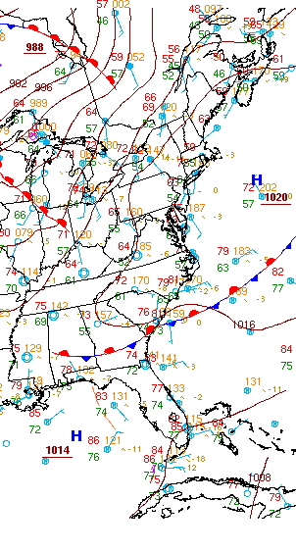
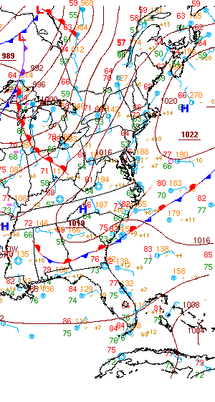
DOY 236 Synoptic Conditions
0000 UTC
0600 UTC
1200 UTC
High pressure and gradually increasing southerly flow over central PA.

Slide 8
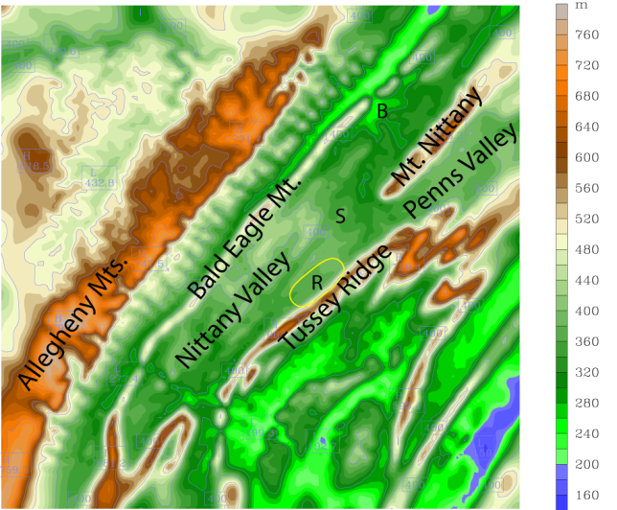
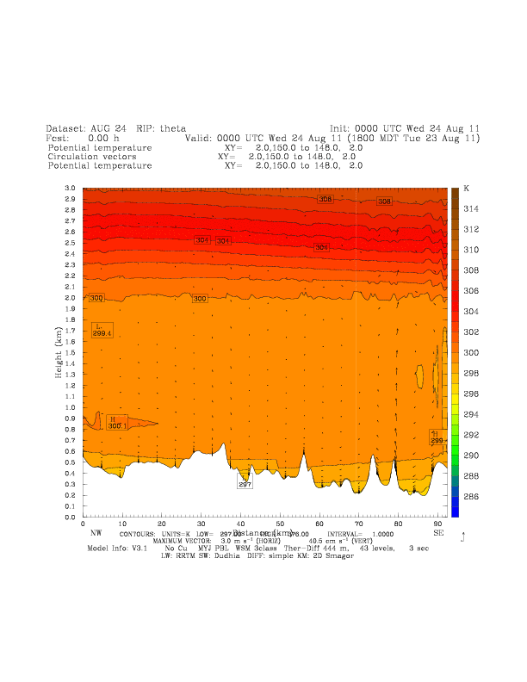
Realtime High-Resolution
WRF Data
10 km scale
3 km
Mean wind direction from SE
Relatively high-amplitude wave-like oscillations throughout night developing over elevated terrain
Cold pools developing in valleys
NW
SE
Allegheny Ridge
Tussey
Ridge
Rock Springs

Slide 9
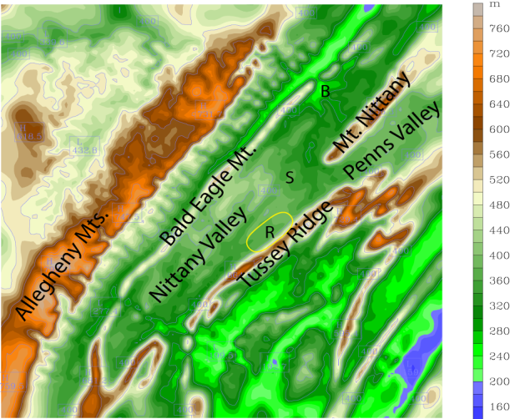
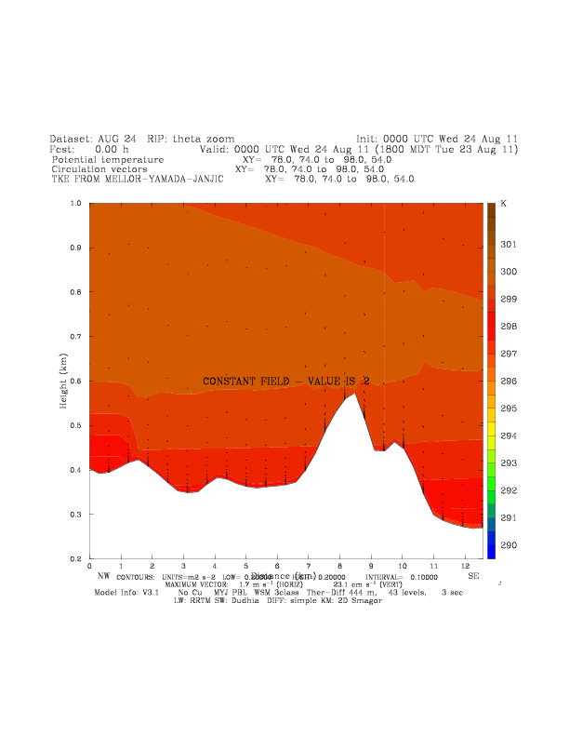
Realtime High-Resolution
WRF Data
10 km scale
1 km
Increased TKE seen along entire leeward side of Tussey Ridge
Some small pockets of increased TKE over Rock Springs early
Relatively thin layer of TKE at Rock Springs evident after 0200 UTC
Consistent increased TKE at Rock Springs especially after 0600 UTC
Nittany Valley
Tussey Ridge
NW
SE
Rock Springs

Slide 10
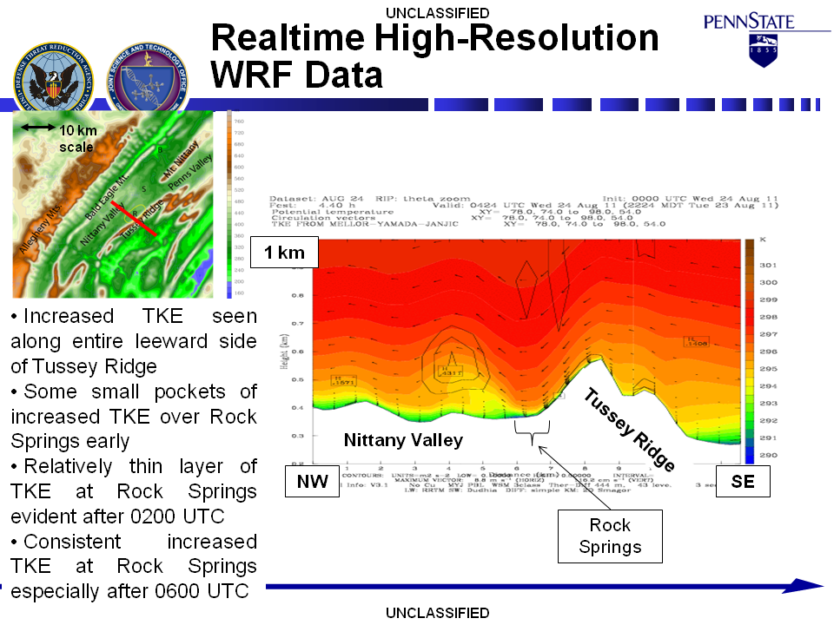

Slide 11
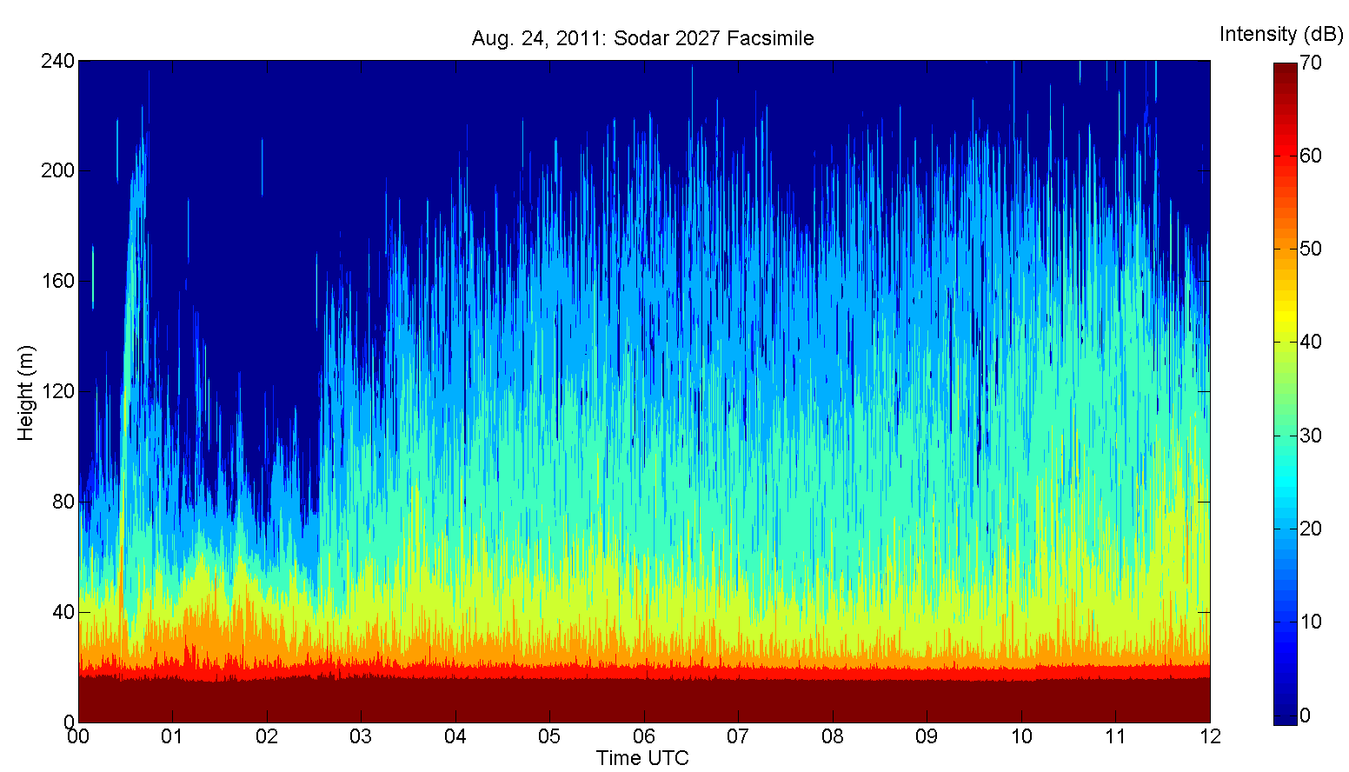
Sodar 2027 Echo Intensity
Notes:
The intensity is fairly consistent throughout the night. High heights achieved. Any evidence of waves is slight. 0500-0600, 0700-0900, 1000-1100 – the times of strong downward motion. Between 0500 and 0600 there is a slight increase in height of echo at lower levels, and a decrease at high levels. Between 0700 and 0900 there is a decrease in echo height at higher levels , but no significant change at lower levels. Between 1000 and 1100 there is an increase in echo height at lower and mid levels, and a slight decrease in intensity at higher levels.

Slide 12
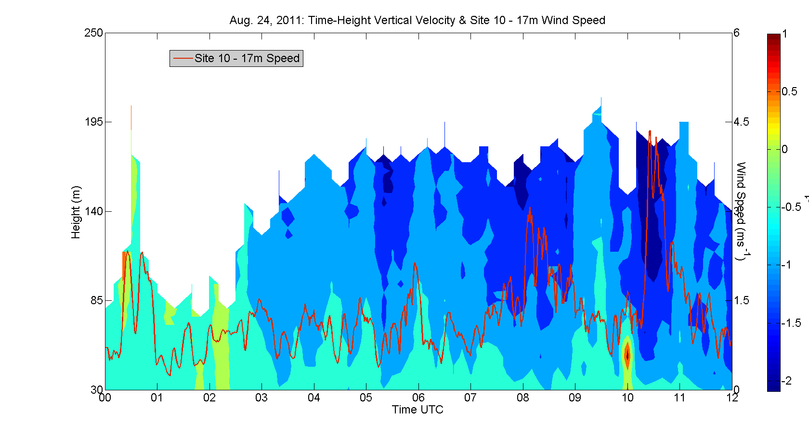
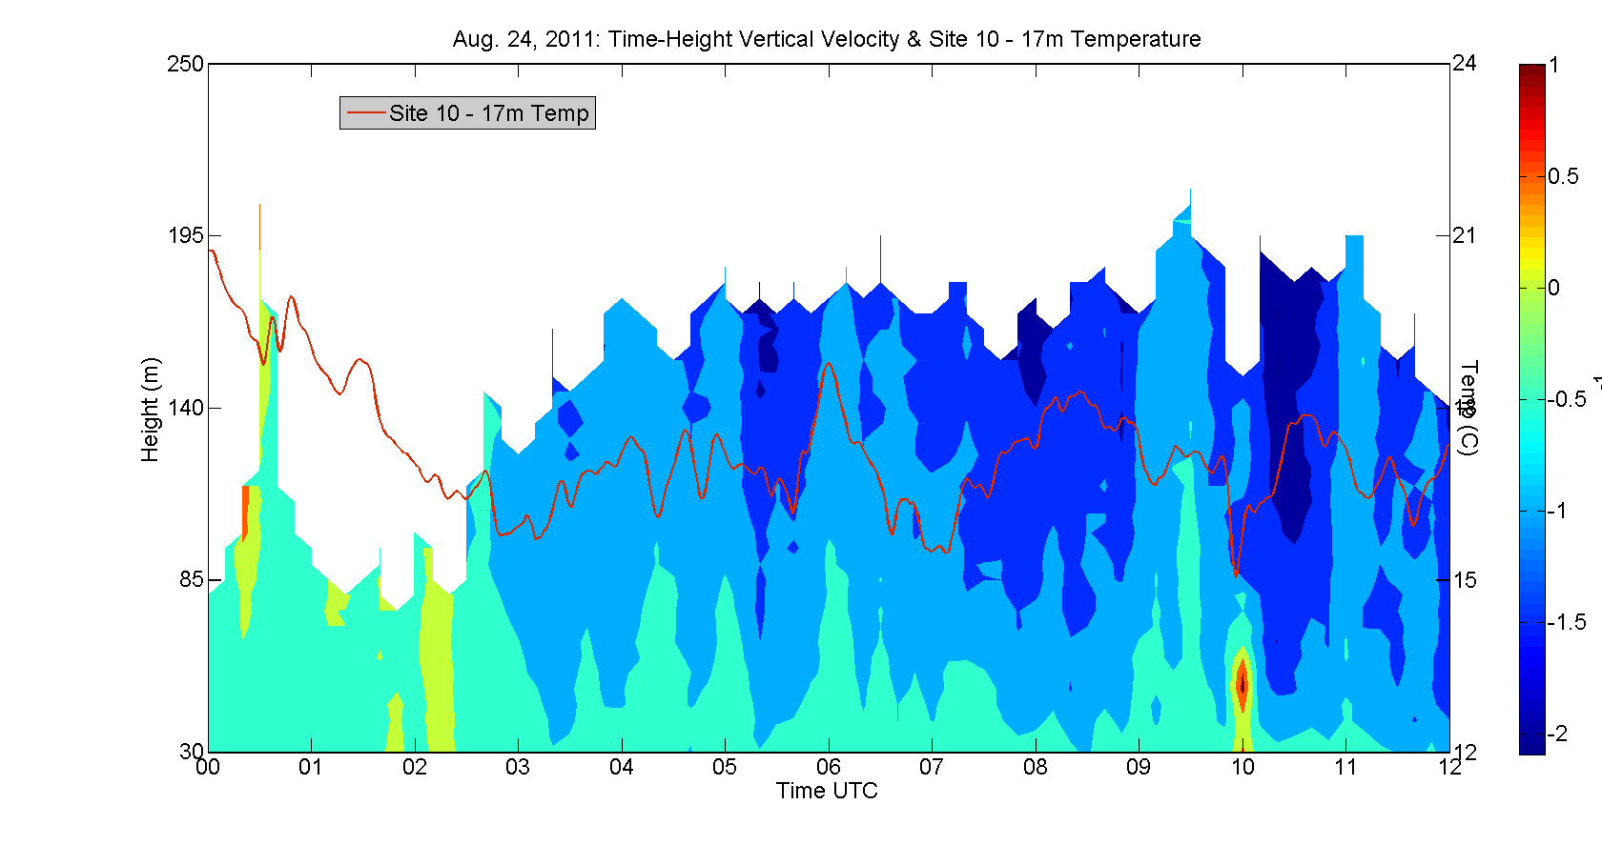
Sodar 2027 Time-Height
Cross Section of W
& Site 10 - 17m Wind Speed
Downward motion increases around 0300 UTC, and is coincident with a slight increase in wind speed and a gradual increase in T.
Intense downward motions between 0500-0600, 0700-0900 and 1000-1100 UTC correspond to significant increases in wind speed and T.
Notes:
Wind speed increases when downward motion is strongest. Periods of strong downward motions take place at heights from 30-200 m. Could periods of strong downward motion be evidence of wave activity? Note the periods of 0500-0600, 0700-0900, 1000-1100

Slide 13
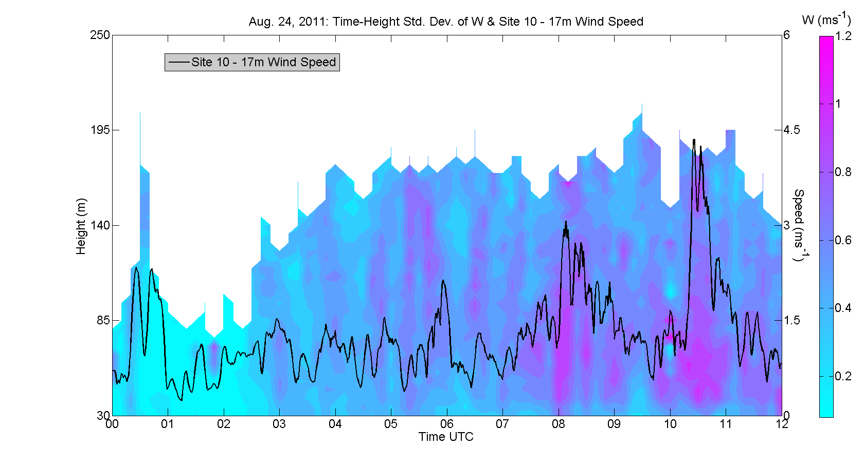
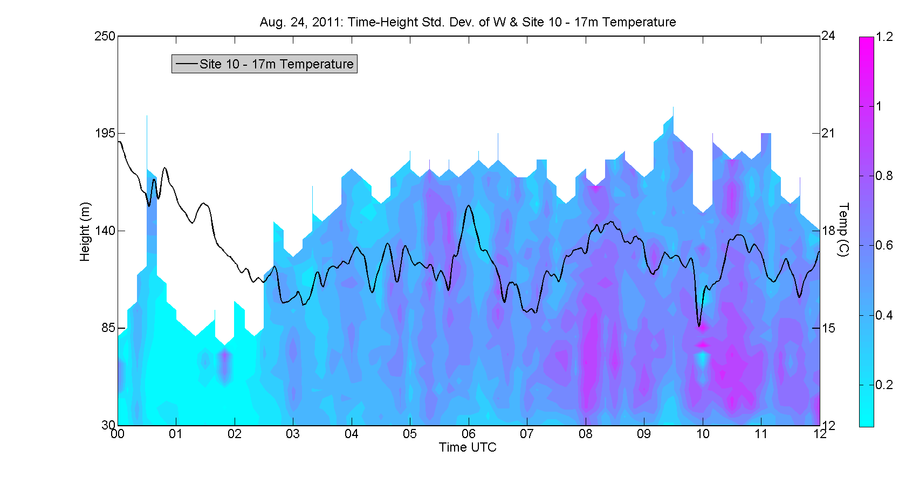
Sodar 2027 Time-Height
Cross Section of σ_{w}
& Site 10 - 17m Wind Speed
σ_{w}
Increased σ_{w} during the periods of strong downward motion corresponds to increased wind speeds and temperatures.

Slide 14
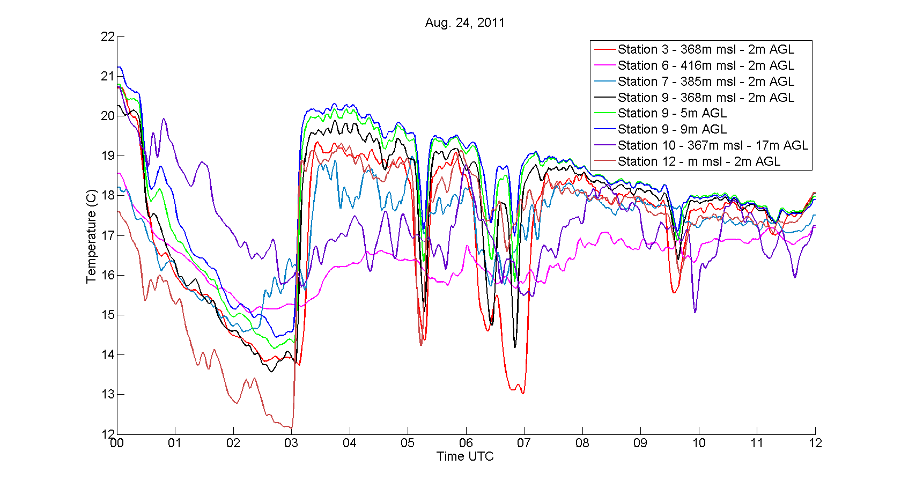
Temperature Time Series
Decrease of ~ 5ºC
Increase of ~ 7ºC
Decrease of ~ 6ºC
Decrease of ~ 3ºC

Slide 15
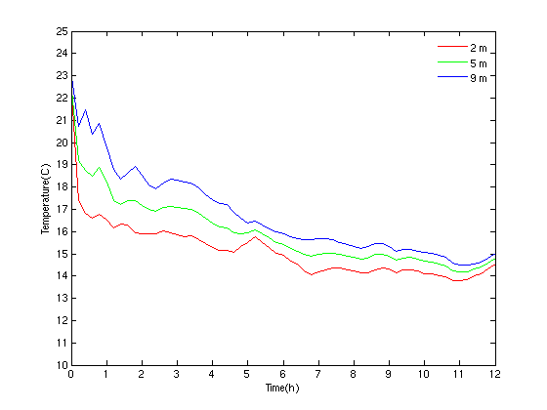
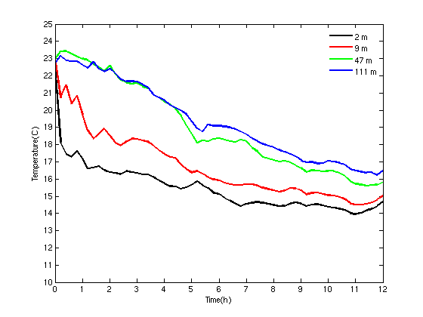
WRF Temperatures – Site 9 Location
WRF does capture a low-level warming event soon after 0500 UTC, but the amplitude is too small.

Slide 16
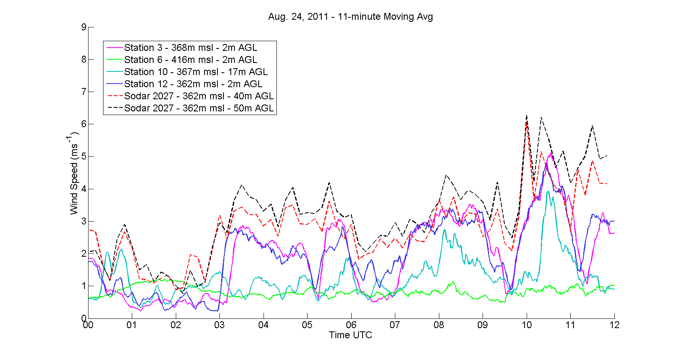
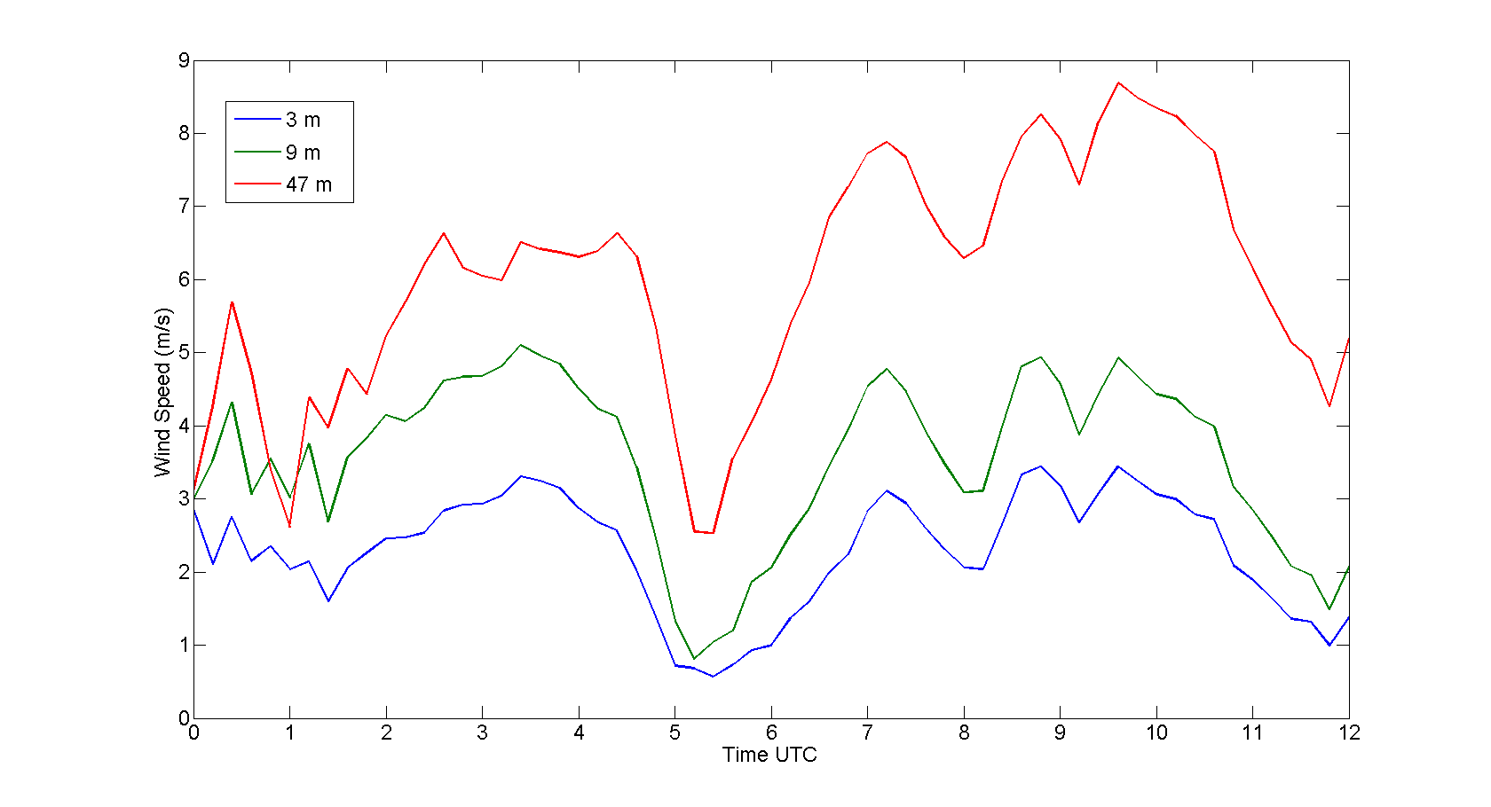
WRF Wind Speeds Site 9 &
Observed Wind Speeds from Rock Springs
WRF tends to overestimate the wind speeds, and does not reproduce many of the short timescale changes in the observations. WRF does, however, match observations by predicting a large decrease in wind speeds around 0500 UTC.

Slide 17
Large – Scale Variability (LSV)
LSV is a SCIPUFF parameterization for horizontal subgrid motion effects, and originally designed for much coarser grids.
SCIPUFF allows the use of LSV operational or no LSV. Operational LSV is often used by Reachback.
For grids with high enough resolution, such as our daily WRF runs, LSV may be unnecessary and may cause unrealistic diffusion, leading to incorrect hazard area forecasts.

Slide 18
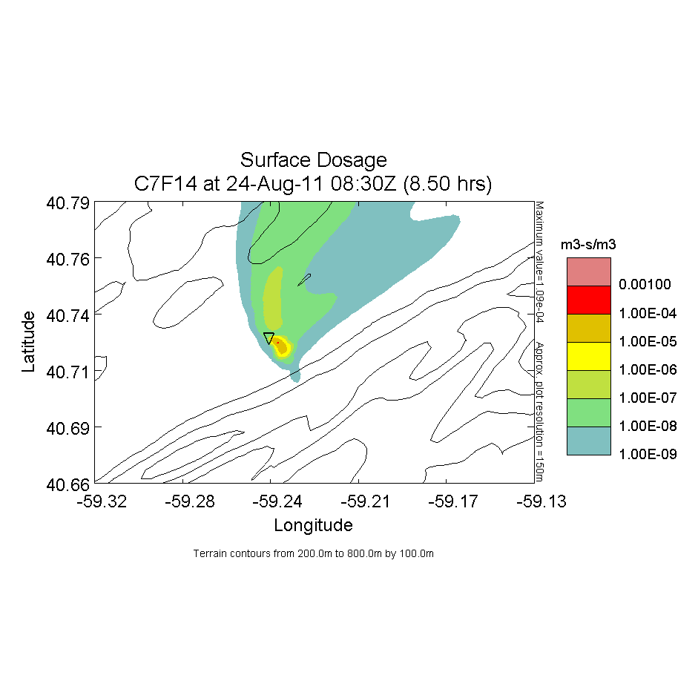
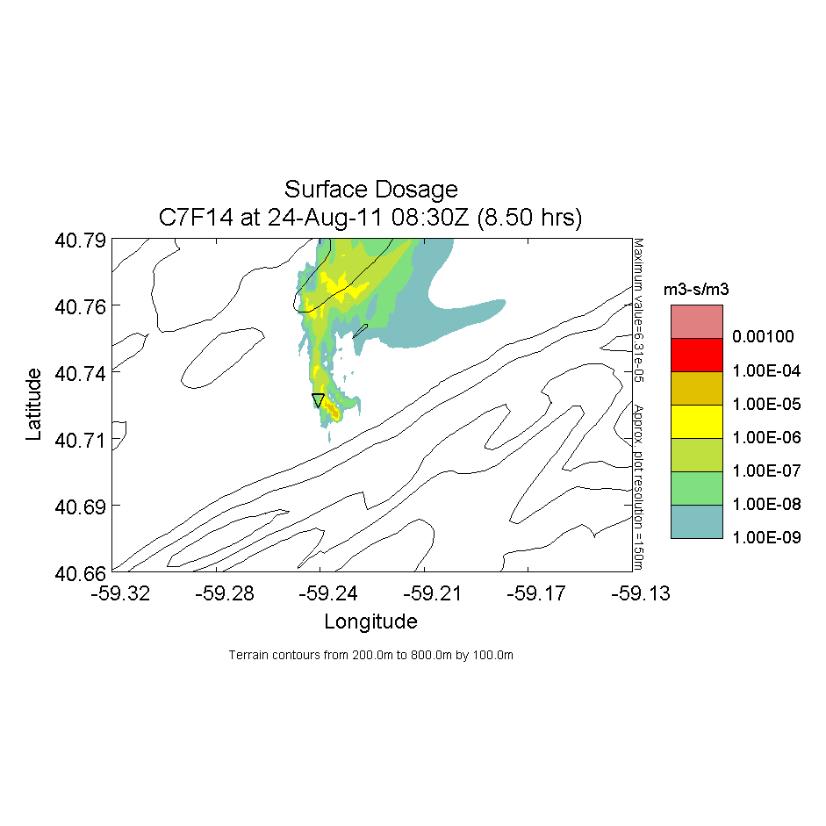
12 min Release at 0630 – Surface Dosage
Mid-Nittany Valley
LSV: Operational
LSV: None
Directed toward Tussey Ridge

Slide 19
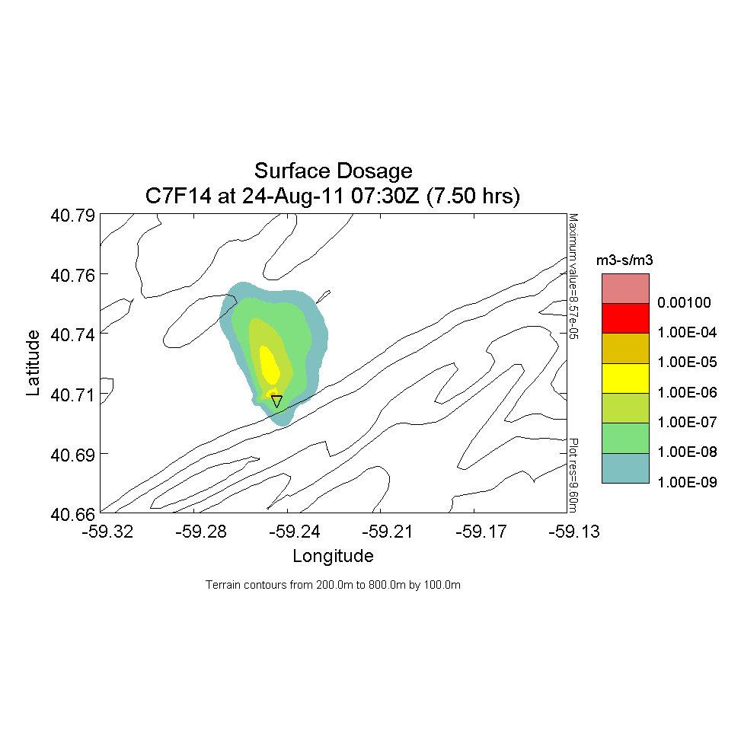
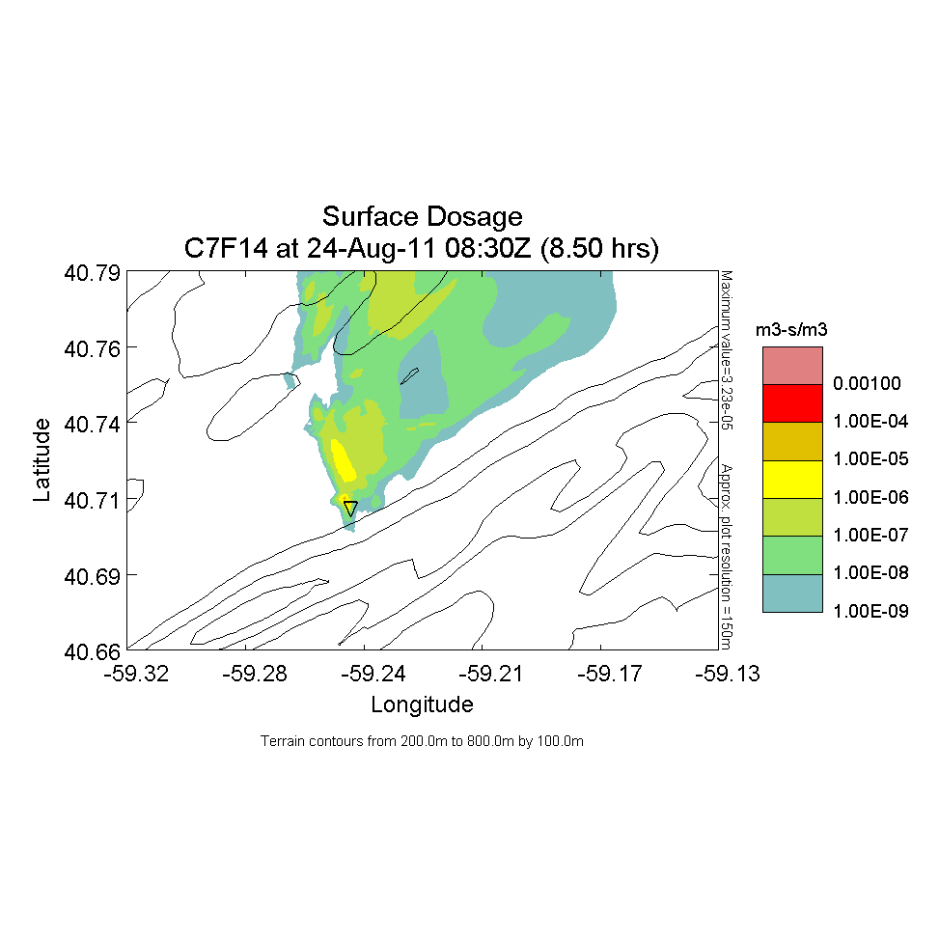
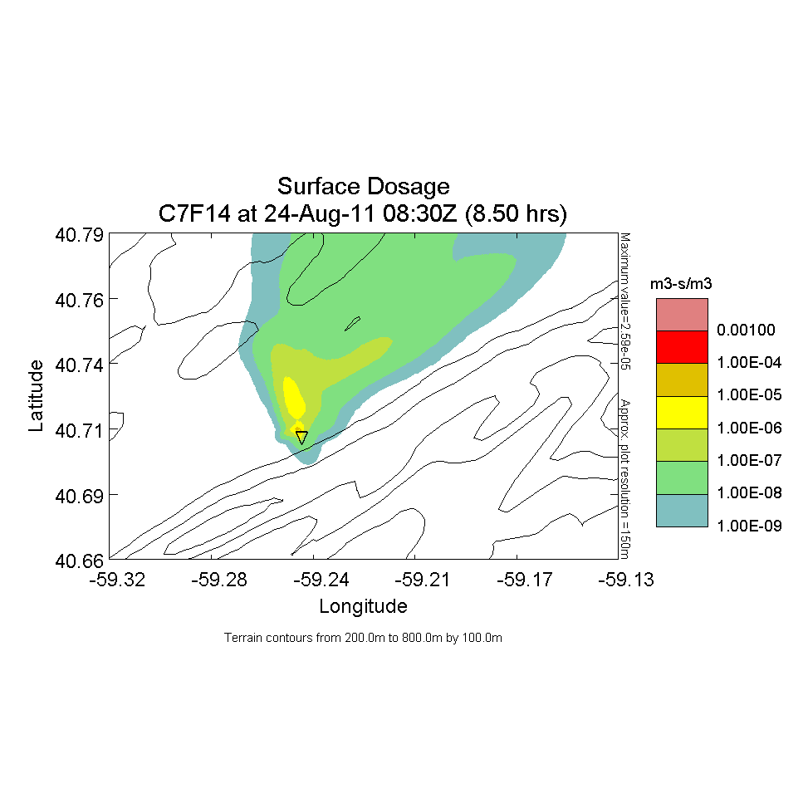
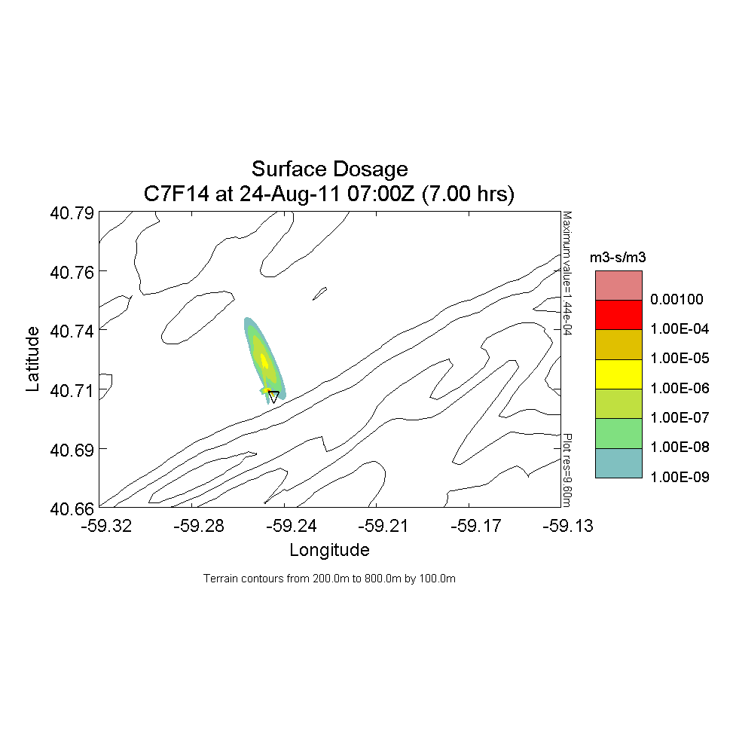
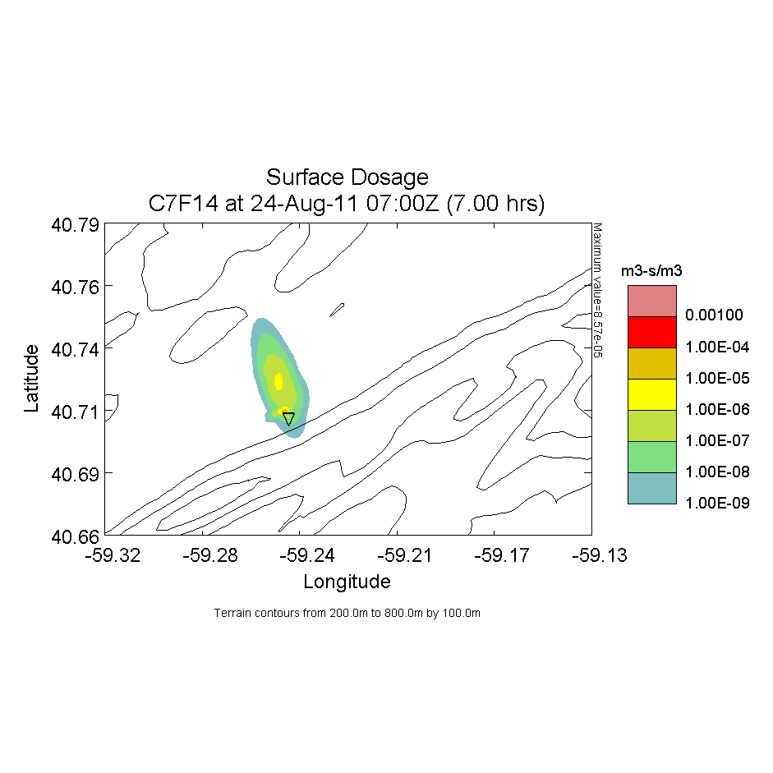
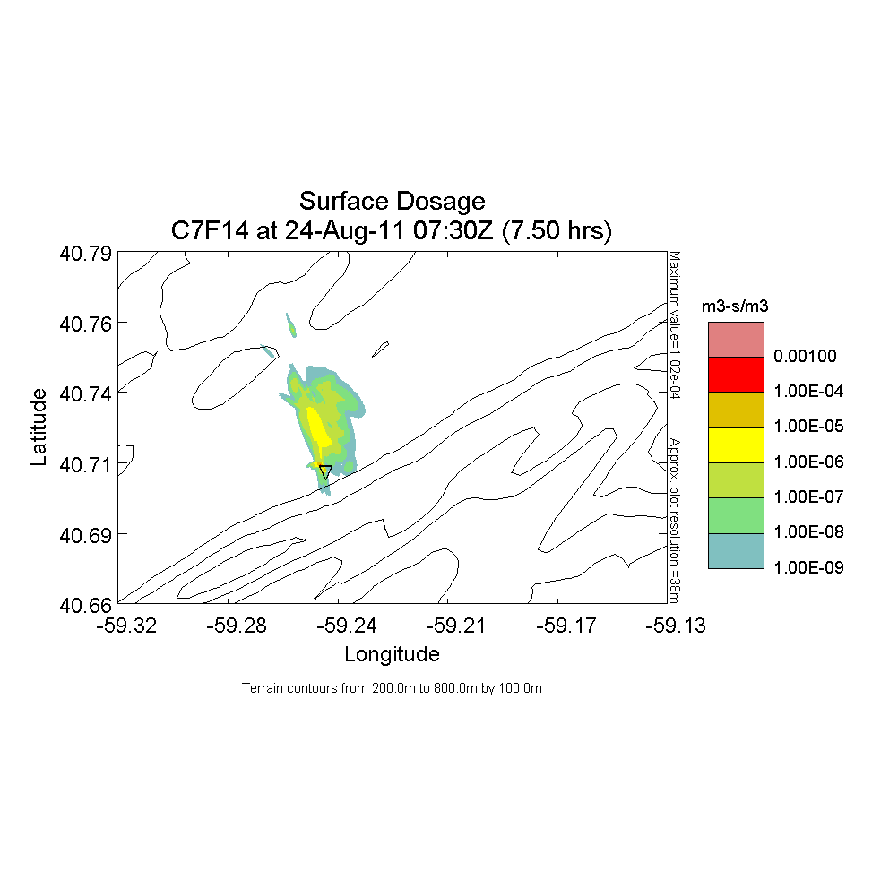
12 min Release at 0630 – Surface Dosage
Site 9 Location
LSV: Operational
LSV: None

Slide 20
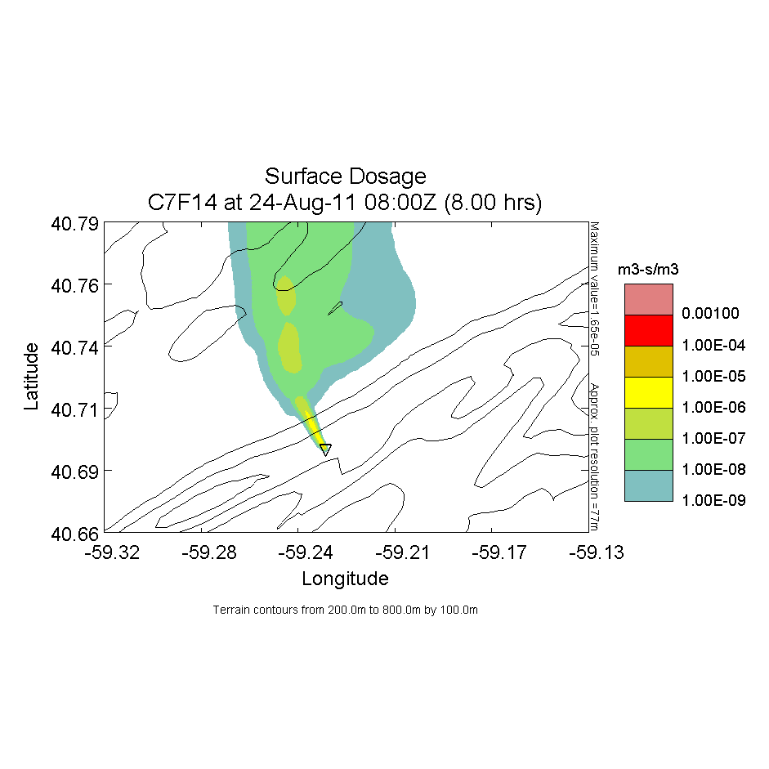
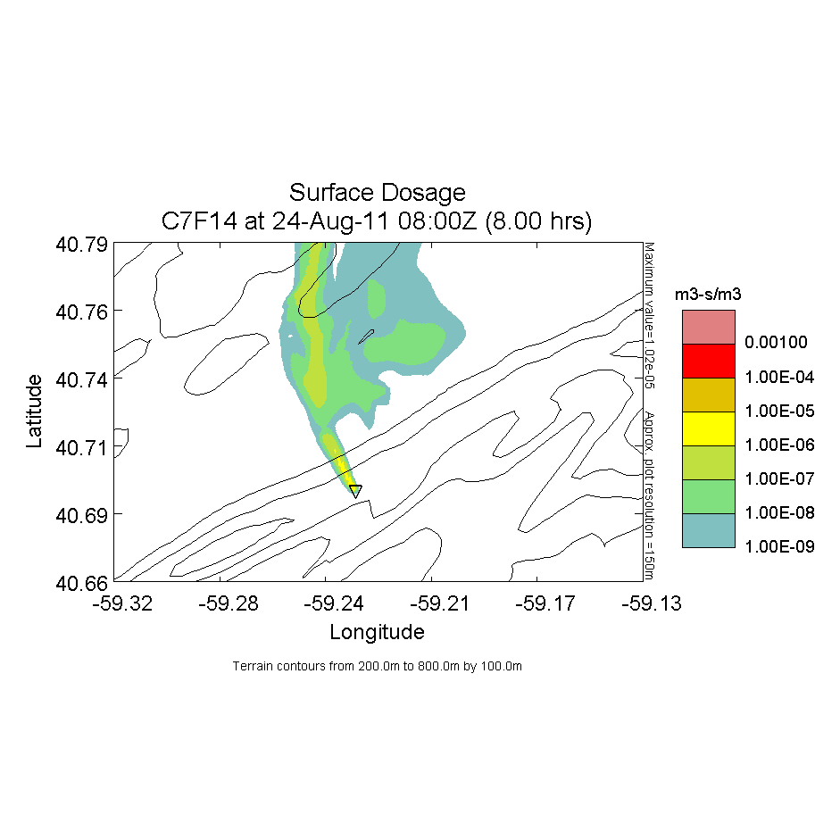
12 min Release at 0630 – Surface Dosage
Near Crest of Tussey Ridge
LSV: Operational
LSV: None

Slide 21
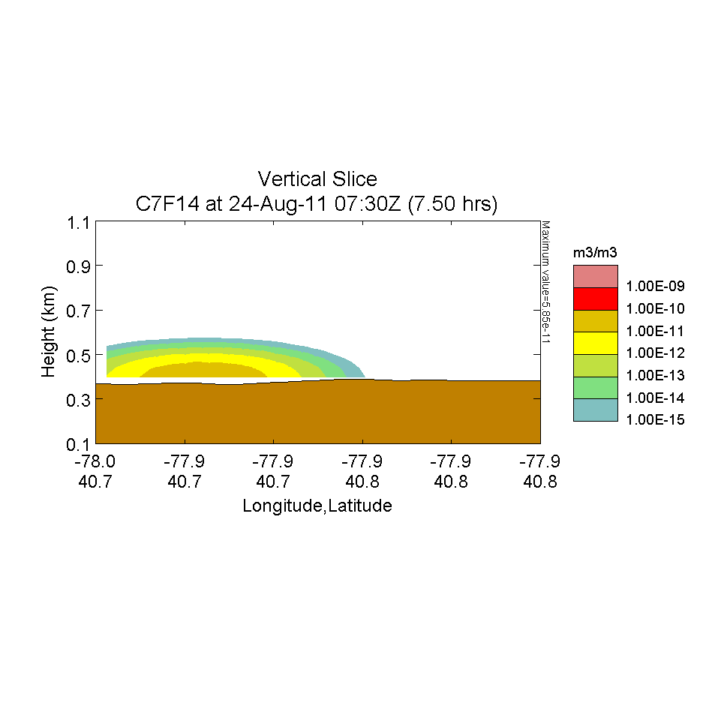
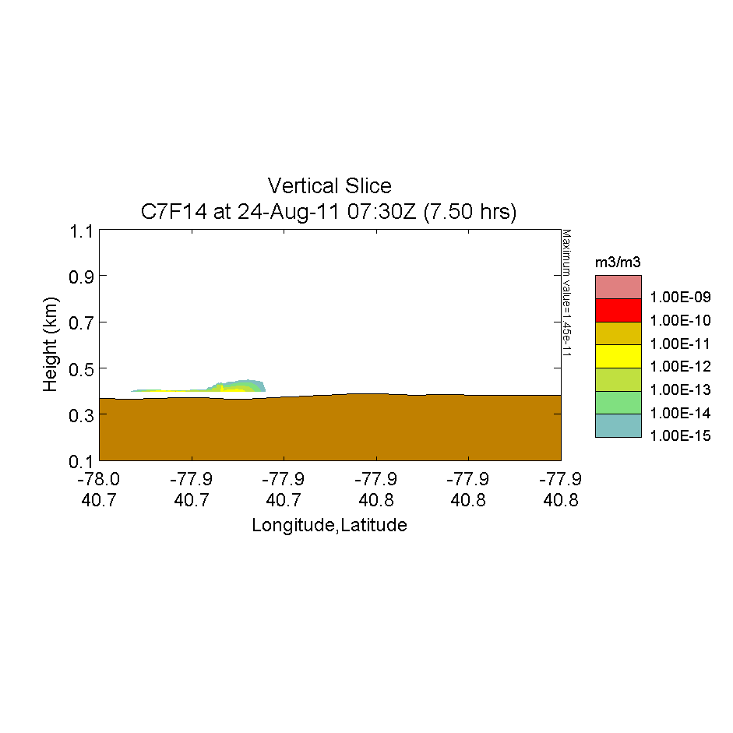
0630 Release – Concentration
Site 9 Location
Along Nittany Valley Toward PSU
LSV: Operational
LSV: None

Slide 22
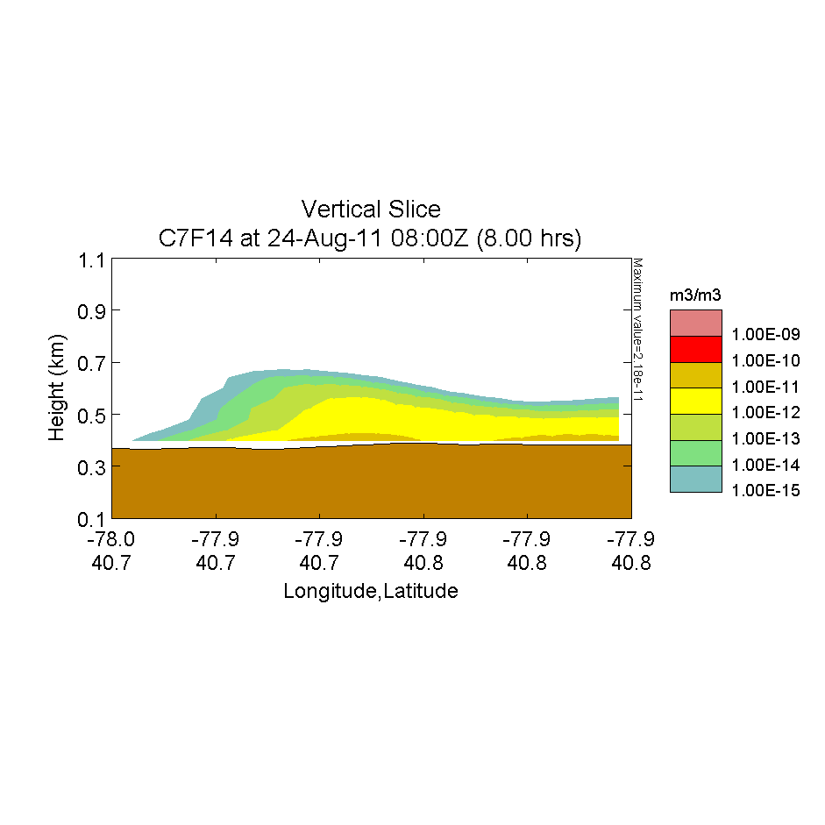
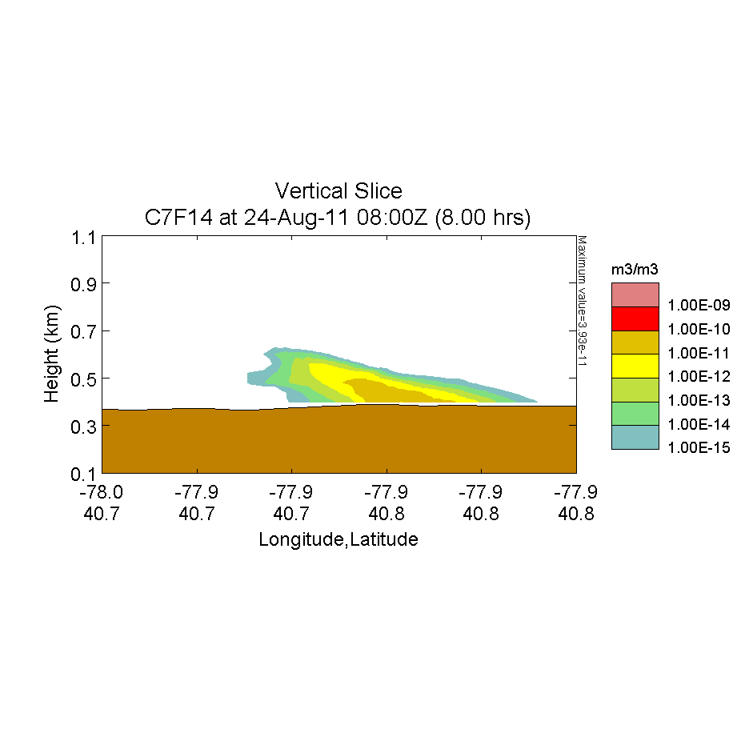
0630 Release – Concentration
Site 9 Location
Along Nittany Valley Toward PSU
LSV: Operational
LSV: None

Slide 23
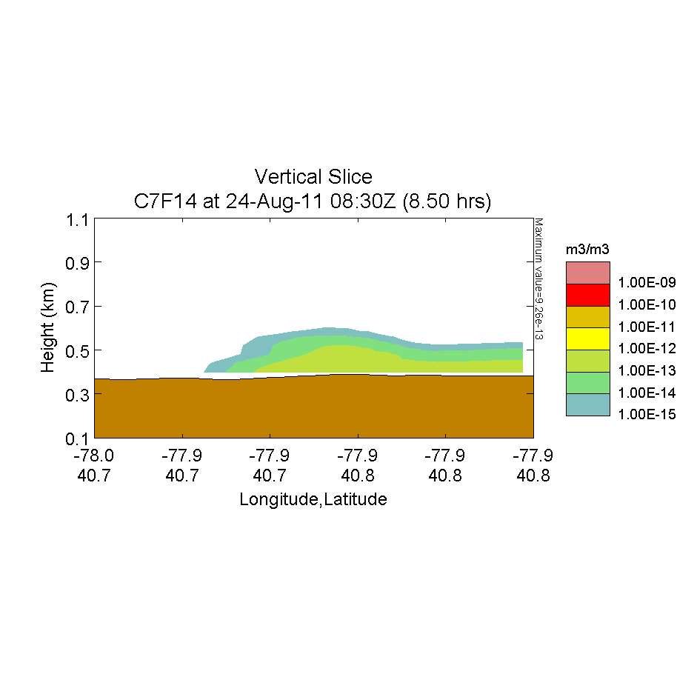
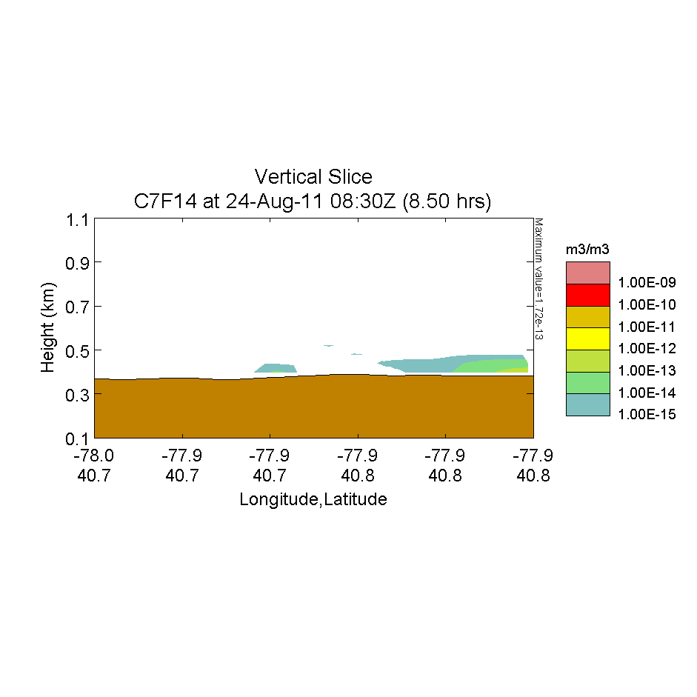
0630 Release – Concentration
Site 9 Location
Along Nittany Valley Toward PSU
LSV: Operational
LSV: None

Slide 24
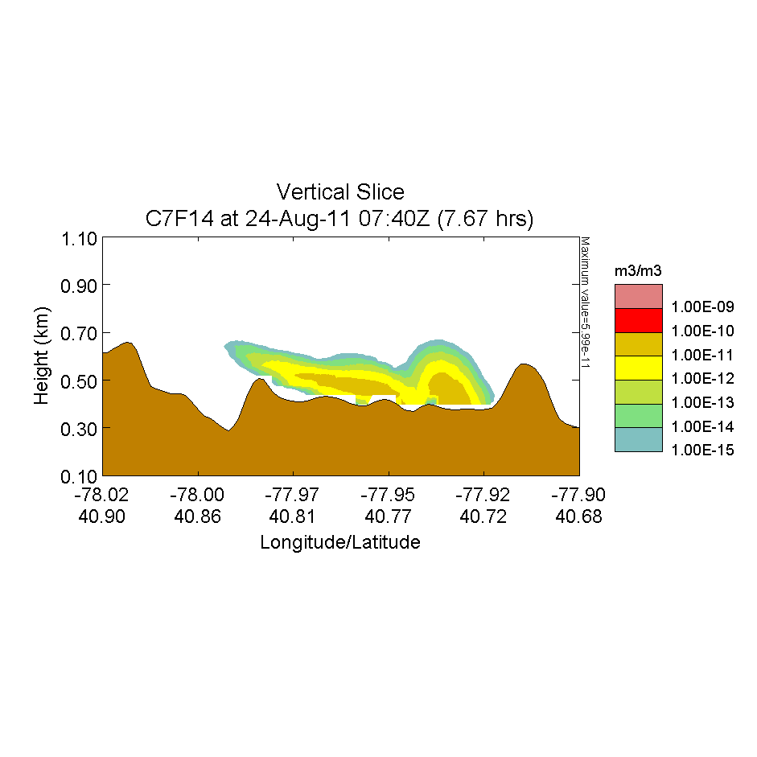
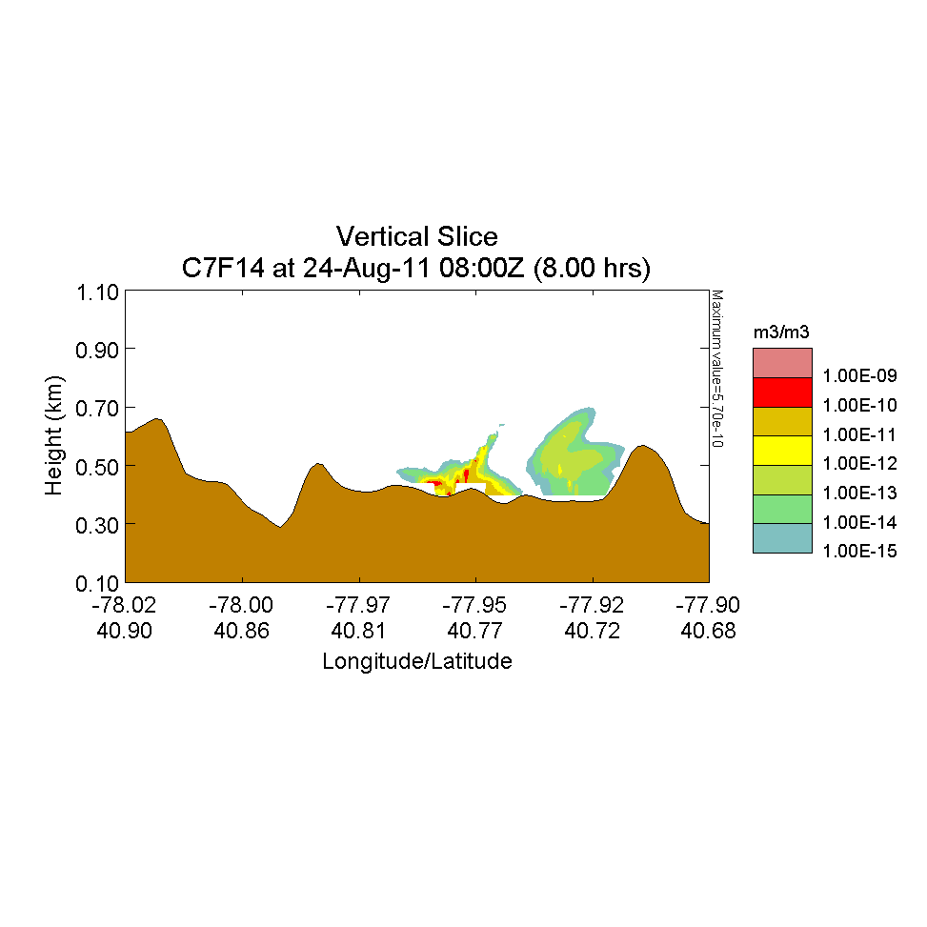
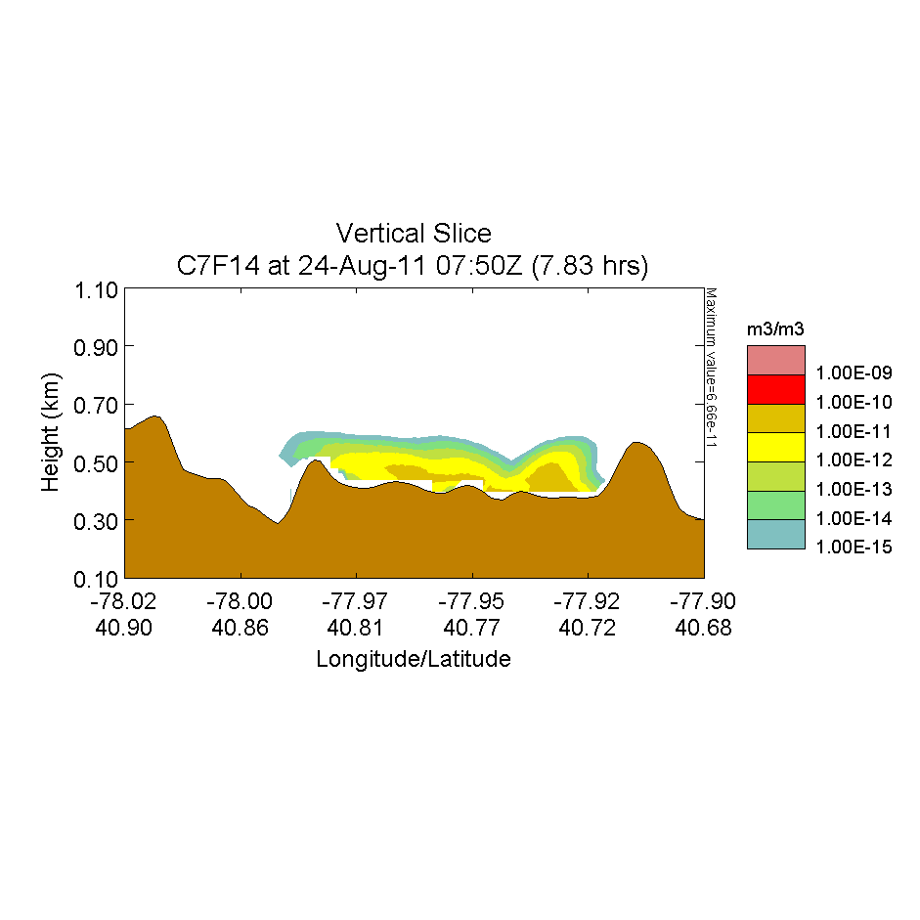
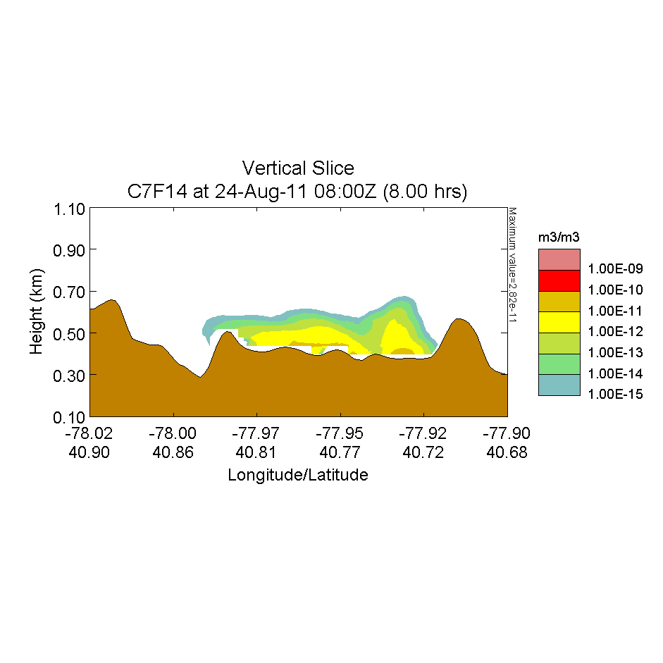
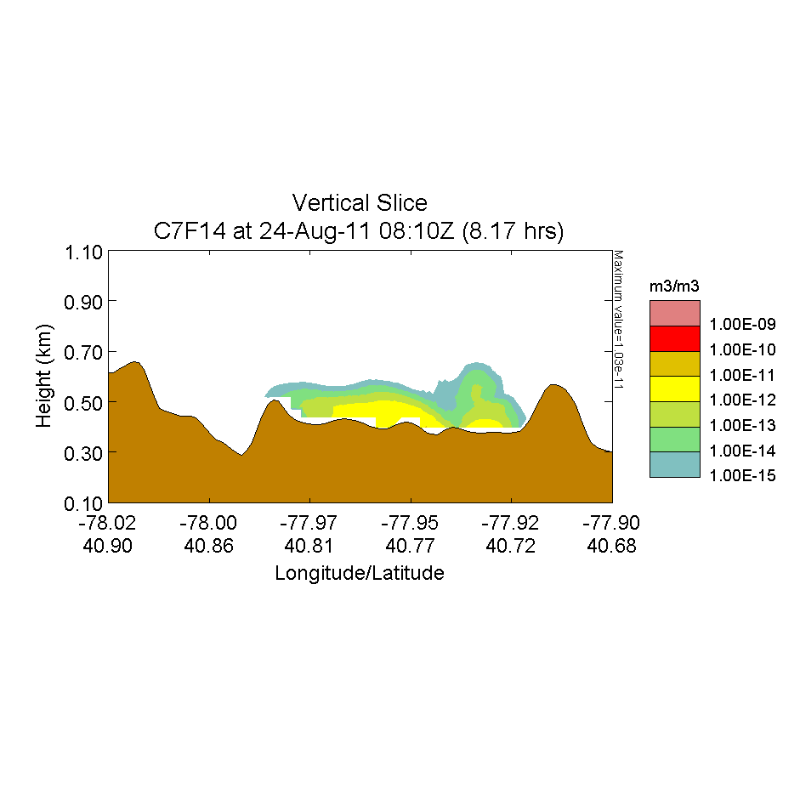

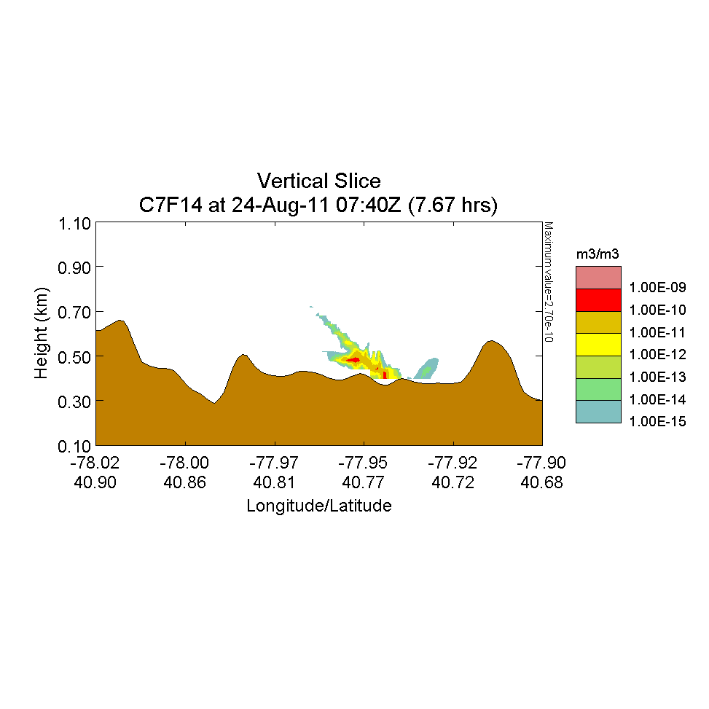
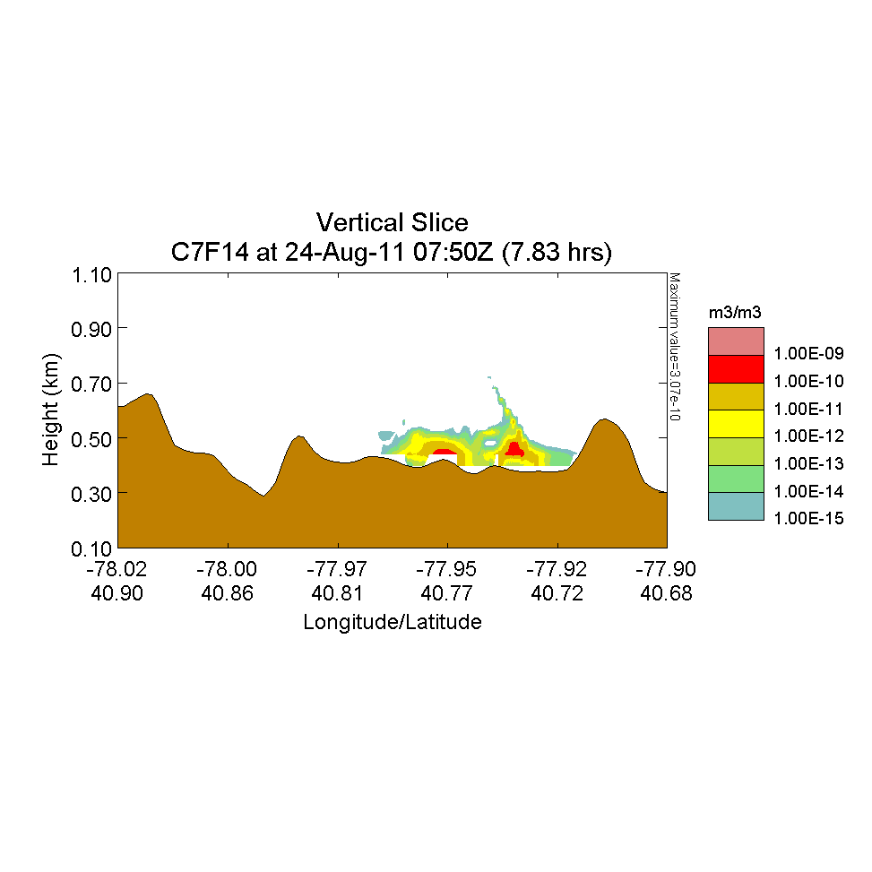

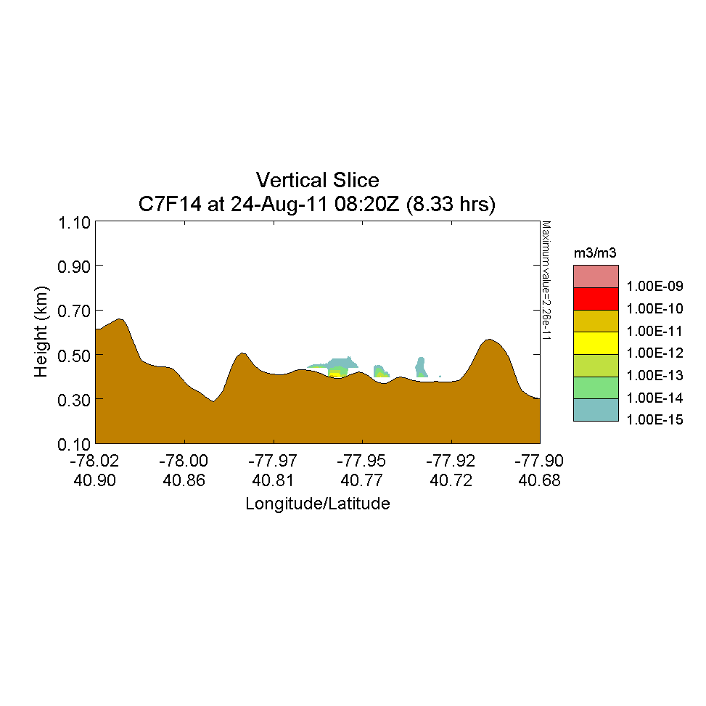
12 min Release at 0630
Across Nittany Valley
LSV: Operational
LSV: None

Slide 25
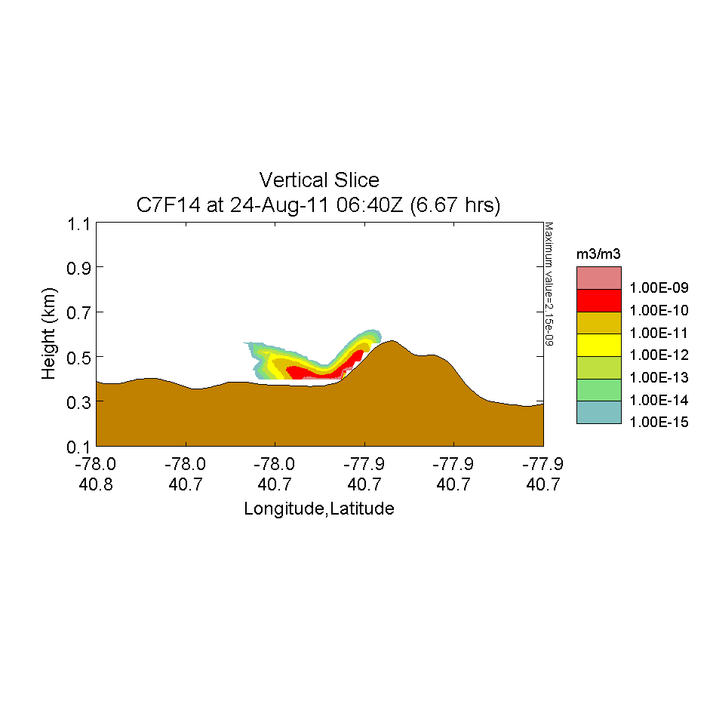

Release at 0630 – Concentration
Near Crest of Tussey Ridge
Across Nittany Valley
LSV: Operational
LSV: None

Slide 26
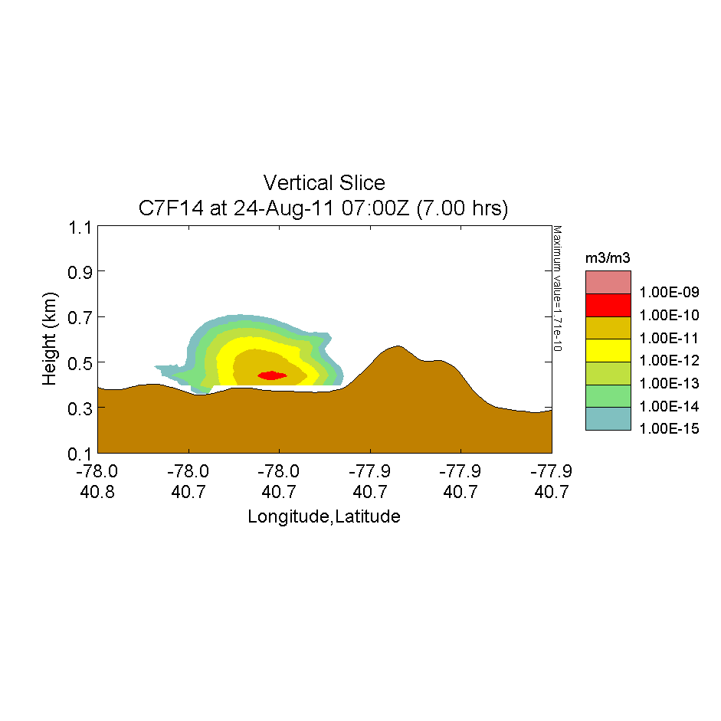
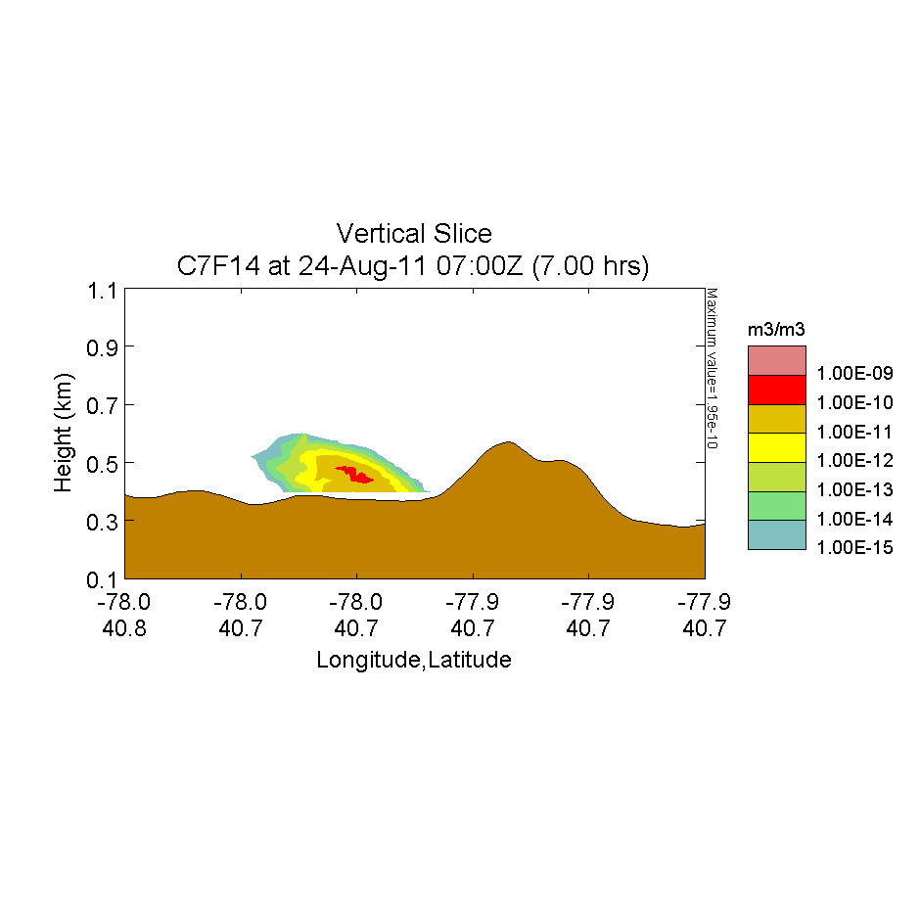
Release at 0630 – Concentration
Near Crest of Tussey Ridge
Across Nittany Valley
LSV: Operational
LSV: None

Slide 27
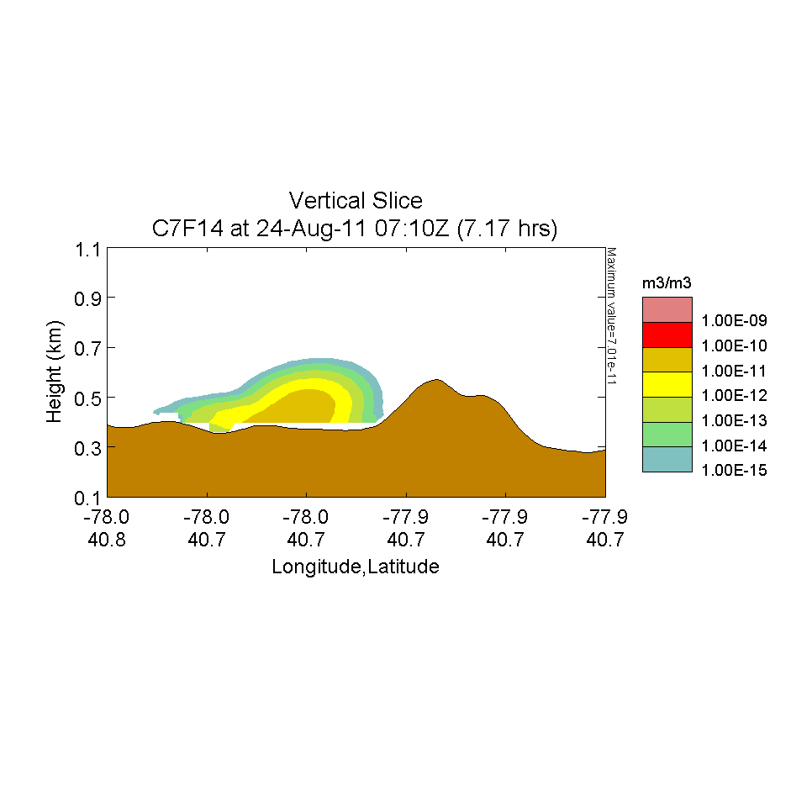
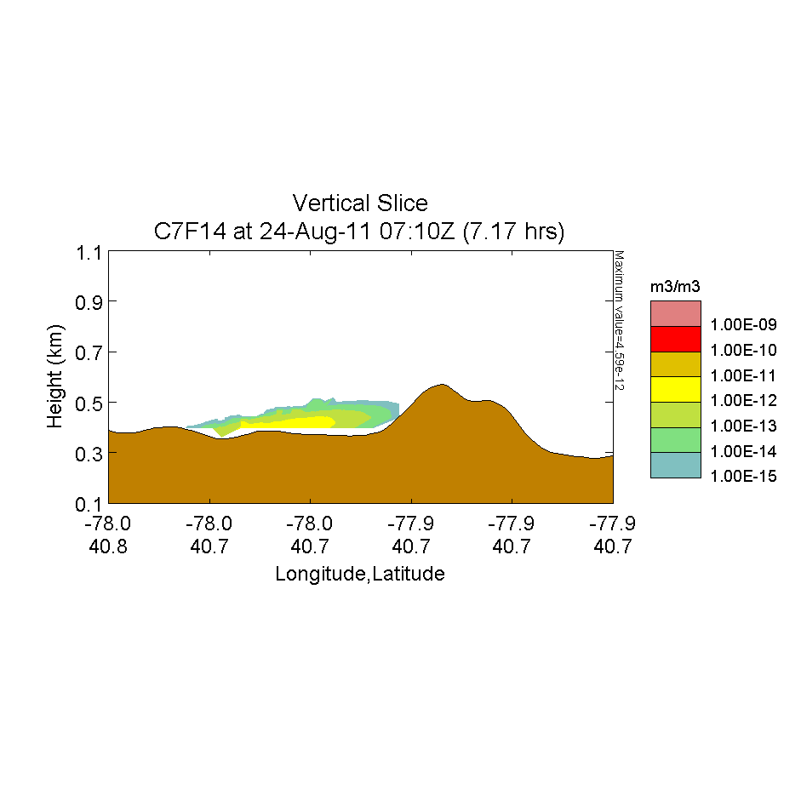
Release at 0630 – Concentration
Near Crest of Tussey Ridge
Across Nittany Valley
LSV: Operational
LSV: None

Slide 28


Release at 0630 – Concentration
Base of Tussey Ridge
Across Nittany Valley
LSV: Operational
LSV: None

Slide 29


Release at 0630 – Concentration
Base of Tussey Ridge
Across Nittany Valley
LSV: Operational
LSV: None

Slide 30


Release at 0630 – Concentration
Base of Tussey Ridge
Across Nittany Valley
LSV: Operational
LSV: None

Slide 31


Slide 32
DOY 236 – Aug. 24, 2011 Summary
  WRF: Quasi-stationary lee wave and increased local TKE over Rock Springs after 0300 UTC. Wind speeds are relatively high until about 0500 UTC, when they decrease to ~1 ms⁻¹ near the surface.
  0230 UTC: Echo intensity plot reveals increased turbulence developing aloft, over the cold pool.
  0300 UTC: Sodar shows downward motions from 30 - ~130m and increases in σ_{w}. This motion brings increased turbulent mixing downward until it scours the cold pool around Rock Springs. This results in temperatures from near surface thermistors increasing dramatically and wind speed increases across network, except for the Sites 6 and 10 which are above the cold pool.
  0510, 0620, 0650, 0940 UTC: Weakening of surface turbulence from the wave or its advection away from the surface briefly allows cold air from regions that were unaffected by the TKE to slosh over Rock Springs, temporarily reducing wind speeds to ~ 0 ms⁻¹ and causing temperature drops of up to 6ºC.

Slide 33
Conclusions
High-resolution WRF was able to produce a lee wave and the observed general wind patterns, but was unable to reproduce the detailed wind and temperature tendencies for this case.
Internal waves and submeso motions can greatly affect hazard predictions, and contribute to increased AT&D uncertainty.
Compared with no LSV, SCIPUFF runs with operational LSV produce puffs that tend to be larger, travel further and to persist for longer periods of time.

Slide 34
Conclusions (cont.)
Further research and development is needed to fully understand all these complex processes.
Stochastic parameterization of submeso effects in the models should be investigated for regions with detailed observations.

Slide 35
Acknowledgements
This research was funded by DTRA Grant No. HDTRA1-10-1-0033 under the supervision of John Hannan and Anthony Esposito.
Funding for sodars and additional tower instrumentation were provided by the US Army Research Office by DURIP Grant No. W911NF-10-1-0238 under the supervision of Walter Bach.
Ken and Josh Underwood at Atmospheric Systems Corp. are thanked for their installation and incessant maintenance assistance.
Dennis Thomson is thanked for helpful insight on acoustic measurements of the atmosphere.

Slide 36
Supplemental

Slide 37

DOY 236 Thermocouples

Slide 38


DOY 236
850 mb Pressure Map

