Slide 1

Modelling Elevated Sources in Urban Environments
16th GMU Conference on ‘Atmospheric Transport and Dispersion Modelling’, 17-18th July 2012.
Steven Herring¹, David Hall², Angela Spanton²
¹Dstl, ²Envirobods Ltd.
Notes:
THIS SLIDE TO BE SHOWING PRIOR TO STARTING CLASS.
ONE
iCAS
New Starter

Slide 2
Contents
Background
Dispersion Components
Array Experiments
Analysis of Experimental Data
Array Interaction Model
Summary
Questions

Slide 3
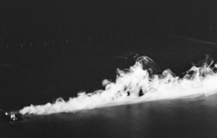
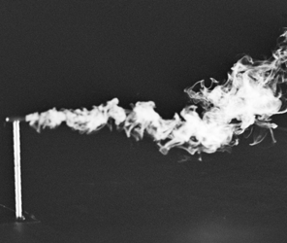
Background
The Urban Dispersion Model (UDM) was originally developed for modelling dispersion from ground level sources.
To model elevated releases, the model must predict the effect of source height on:
  Basic dispersion due to boundary layer turbulence.
  The interaction of elevated puffs with obstacles.
Ground level source
Elevated source

Slide 4

Dispersion Components (1)
The total dispersion (σ_{t}) is the quadrature sum of turbulence (σ_{bl}) and aerodynamic (σ_{a}) components:
  The turbulence component is determined from equations obtained from validated models (e.g. AERMOD).
  The aerodynamic component is obtained from wind tunnel data.
Notes:
In urban environments the initial dispersion is usually dominated by the aerodynamic component..

Slide 5

Dispersion Components (2)
Boundary layer (σ_{xbl}) longitudinal dispersion has components due to turbulence (σ_{xt}) and vertical wind shear (σ_{xs}):
  Simple models combine these as:
  The ground-based longitudinal dispersion equations in UDM have been modified to account for varying vertical shear spread with puff height.
The aerodynamic dispersion, σ_{a}, of elevated puffs is due to:
  Single building interactions (handled by existing model).
  Interaction of elevated puffs with arrays.
Notes:
Simple representations of combine the effects of these in the form
Longitudinal dispersion is dominated by shear spreading 2-5 > atmospheric turbulence.
The shear spreading term uses results produced by Chatwin and Wilson.

Slide 6
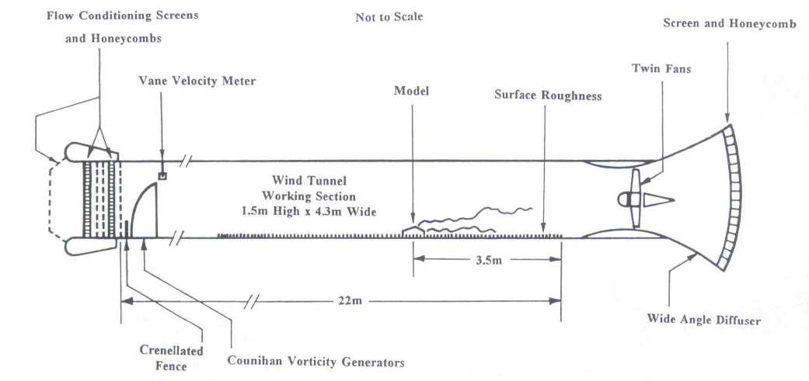
Array Experiments (1)
Array experiments conducted in the BRE windtunnel (1.5m high, 4.3m wide, 22m long) using methane tracer gas and Flame Ionisation Detectors (FIDs).
Release in block array
Notes:
Experiments similar to those for ground level releases, u=1.5 m/s.
Blocks only set with their long sides normal to the wind.
Lateral and vertical dispersion measured from plume releases using sampler arrays. Lateral at ground and at H.

Slide 7
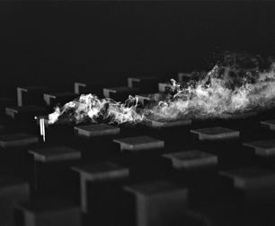
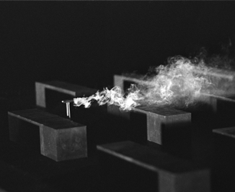
Array Experiments (2)
Reference windspeed 1.5 m·s⁻¹.
Characteristics of arrays:
  Areal densities, A= 16% and 40%.
  Cubes height H = 0.1m.
  Blocks 4H x H x H.
Data acquired for:
  Source heights (h/H): 0, 0.5, 1.0, 1.5, 2, 3
  Downwind distances (x/H): 5, 10, 20 or 25.
Plume and puff releases made in wakes immediately downwind of obstacles.
Release at 1.5H in 16% cube array
Release at 1.5H in 16% block array
Notes:
Experiments similar to those for ground level releases, u=1.5 m/s.
Blocks only set with their long sides normal to the wind.
Lateral and vertical dispersion measured from plume releases using sampler arrays. Lateral at ground and at H.

Slide 8
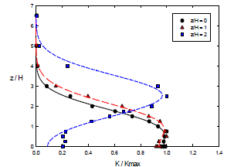
Analysis of Experimental Data (1)
Regulatory models typically partition plumes to give non-Gaussian vertical profiles.
Experimental data showed no evidence of partitioning.
Simple Gaussian fits gave effective height, z_{c}, and σ_{z}.
Little change in σ_{z} with h.
Variation of vertical dispersion with plume source height, 16% density cubes, x/H=20
Release height
h/H=0
h/H=1
h/H=2
Measurement height (z/H)
Concentration (C/C_{max})
Notes:
It was not clear what behaviour σ_{z} would show.
Scatter too great to determine variation in σ_{z} due to array properties.

Slide 9
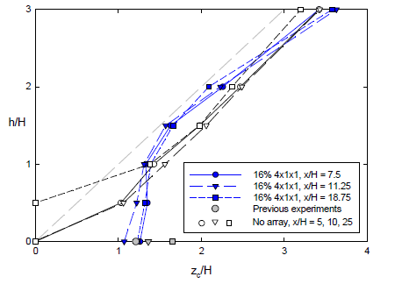

Analysis of Experimental Data (2)
Variation in plume centroid height (z_{c}) with source height similar for all arrays.
Measurements without arrays showed z_{c}>h_{p}.
z_{c} values show enhanced vertical dispersion for releases in arrays (i.e. z_{c}/H >1 for h_{p}/H<1).
Variation in plume centroid height with source height, 16% density blocks.
Canopy height
z_{c}= h_{p}
Source height (h_{p}/H)
Height of plume centroid (z_{c}/H)

Slide 10
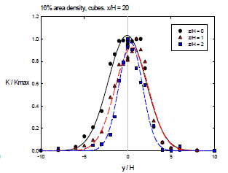
Analysis of Experimental Data (3)
σ_{y} showed significant increases at the ground, especially for block obstacles.
σ_{y} diminished with height above the array.
Data too scattered to discern any behaviour attributable to array except height.
Variation in horizontal dispersion with plume source height, 16% density cubes, x/H=20.
Release height
h/H=0
h/H=1
h/H=2
Concentration (C/C_{max})
Measurement position (y/H)

Slide 11
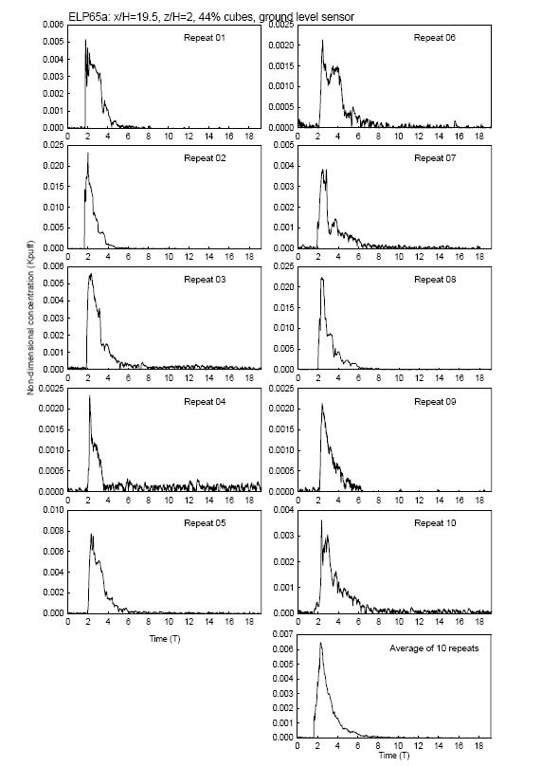
Analysis of Experimental Data (4)
σ_{x} and advection velocity (u_{p}) derived from puff releases averaged over ten repeats.
Values of u_{p} based on max puff concentration suggested:
  A constant advection velocity within canopy;
  A linear increase above.
Gaussian fit of zero skew found to give σ_{t} then: σ_{x} =u_{p}σ_{t}.
Concentration
Notes:
Longitudinal dispersion measured from puff releases generated using solenoid valve
Advetion velocities determiend from concentration maximums.

Slide 12
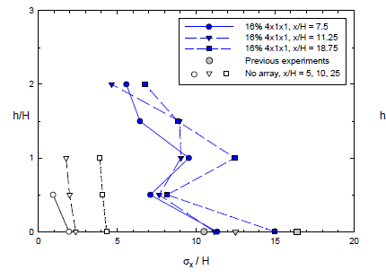
Analysis of Experimental Data (5)
Variation in σ_{x} with release height and downwind distance, 16% block array
Within the scatter of the data, σ_{x}:
  Did not vary over depth of array.
  Reduced with increasing height above the array.
Release height (h/H)
Canopy height
Longitudinal spread (σ_{x}/H)

Slide 13
Analysis of Experimental Data (5)
Variation in σ_{x} with release height and downwind distance, 16% block array
Within the scatter of the data, σ_{x}:
  Did not vary over depth of array.
  Reduced with increasing height above the array.
Release height (h/H)
Canopy height
Longitudinal spread (σ_{x}/H)

Slide 14
Analysis of Experimental Data (5)
Variation in σ_{x} with release height and downwind distance, 16% block array
Within the scatter of the data, σ_{x}:
  Did not vary over depth of array.
  Reduced with increasing height above the array.
Release height (h/H)
Canopy height
Repeatability
Longitudinal spread (σ_{x}/H)

Slide 15
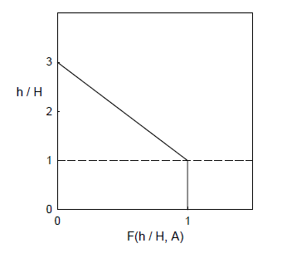
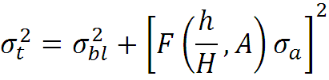
Array Interaction Model (1)
Secondary dispersion effects from array occur for h≤3H.
Common correction function for x, y, and z components of σ_{a}.
F(h/H,A) scales σ_{a} with height:

Slide 16
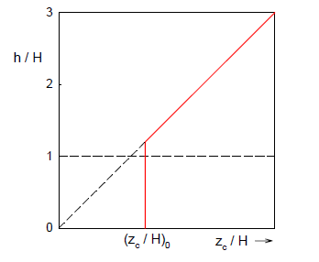




Array Interaction Model (2)
Effective puff height (z_{c}) given by:
z_{c0} is the value from ground based data.
Note: arbitrary intercept
Notes:
Note the break between the 2 functions does not have to occur at H, data analysed by Spanton and Hall showed some variation with the intercept above and below H.

Slide 17
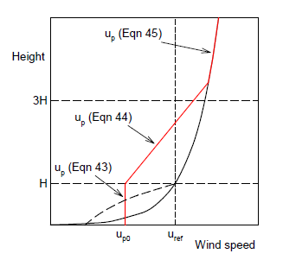
Array Interaction Model (3)
Variation in advection velocity u_{p} with source height
Equation (3)
Source height
Equation (2)
Typical logarithmic wind speed profile
Equation (1)
Representative wind speed profile below z₀

Slide 18






Array Interaction Model (4)
Puff centroid advection velocity u_{p} is constant within canopy and defined by existing UDM equation:
(1)
Above the canopy, u_{p} is linearly blended back towards the logarithmic profile:
(2)
(3)

Slide 19
Summary
Experimental data showed:
  No evidence of puff partitioning.
  Secondary dispersion due to array confined to h≤3H.
  Linear variation of parameters between h=H and h=3H.
  Enhanced vertical dispersion of puffs released below the canopy height in arrays, leading to effective puff heights of z_{c}/H >1.
Simple model developed to predict variation in aerodynamic dispersion parameters for releases from elevated sources interacting with urban arrays.

Slide 20
Questions?

