Slide 1
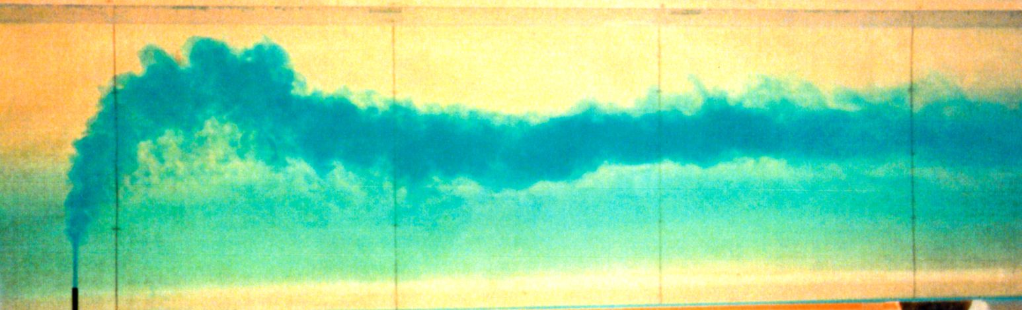
Impact of Density Stratification
on Dispersion in Urban Canopies
Pablo Huq (huq@udel.edu)
University of Delaware
Pasquale Franzese
George Mason University

Slide 2
Motivation and Objective
To determine effects of stable density stratification on dispersion from ground level and elevated plumes.
Framework for analysis of field data

Slide 3
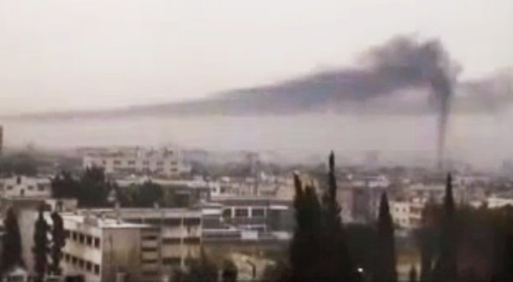

Slide 4
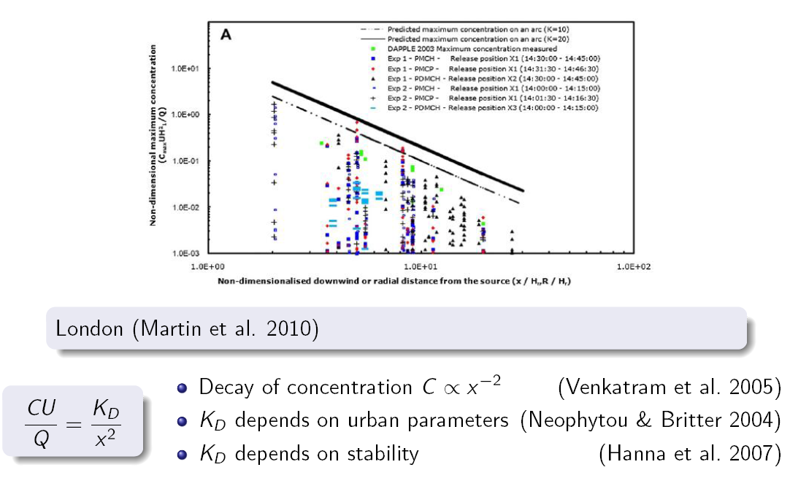

Slide 5
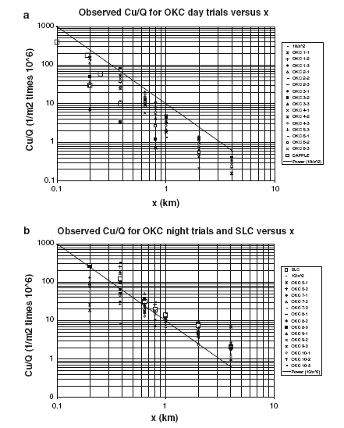

Slide 6
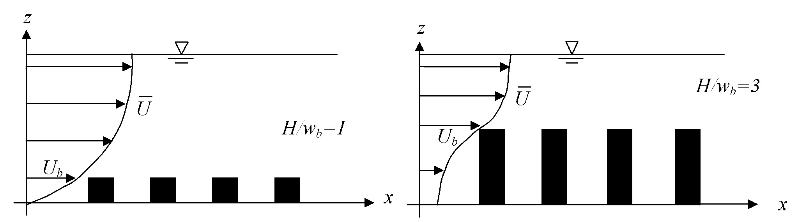
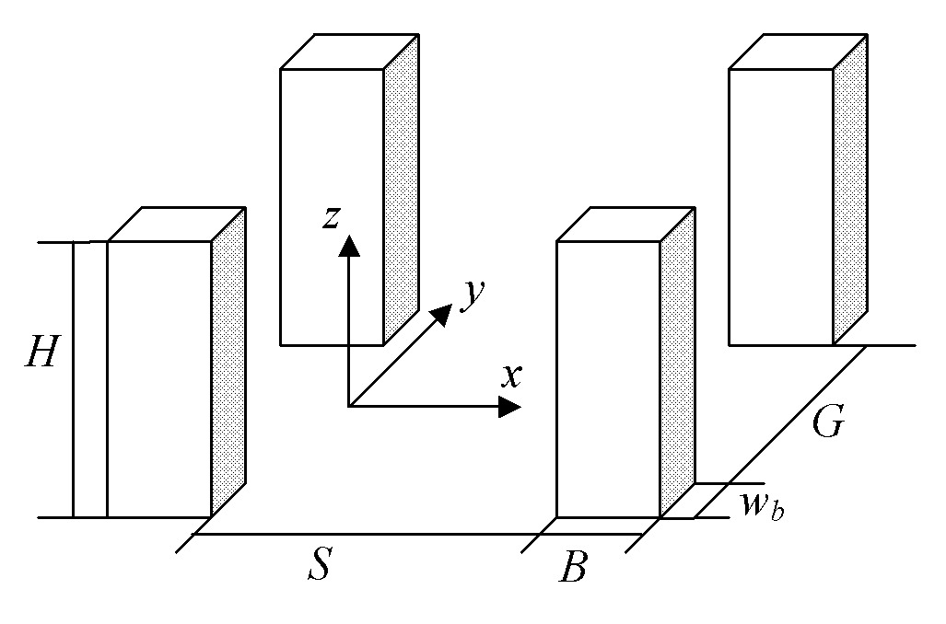
Methodology: water tunnel experiments
Velocity Field
Particle Image Velocimetry (PIV)
Direct measurements of U, W, u’, w’, and uw
Measurements taken in x-z plane
Concentration Field
Microscale conductivity probe
Salt solution, neutral density
Measurements taken in x-z plane

Slide 7
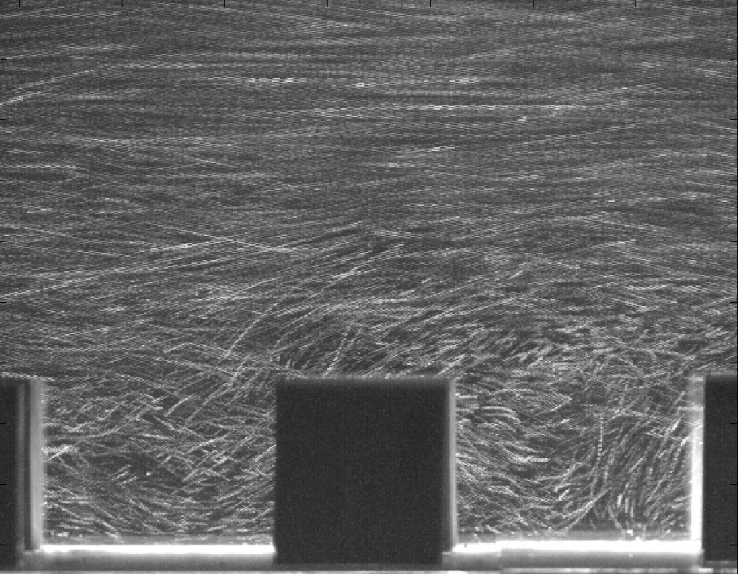
Particle Streaks for LA: Canyon Centerline
U

Slide 8
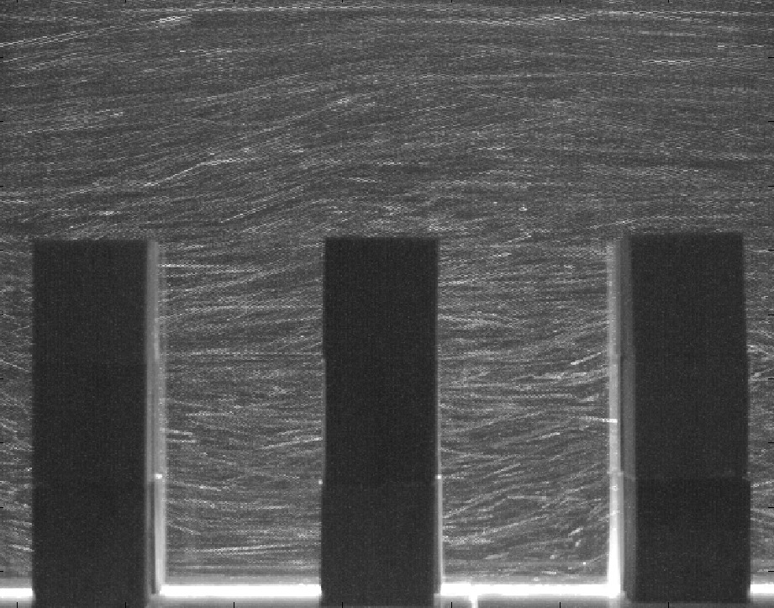
Particle Streaks for NYC: Canyon Centerline
U

Slide 9
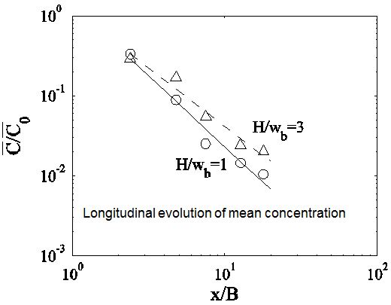
Concentration vs X/B scaling

Slide 10
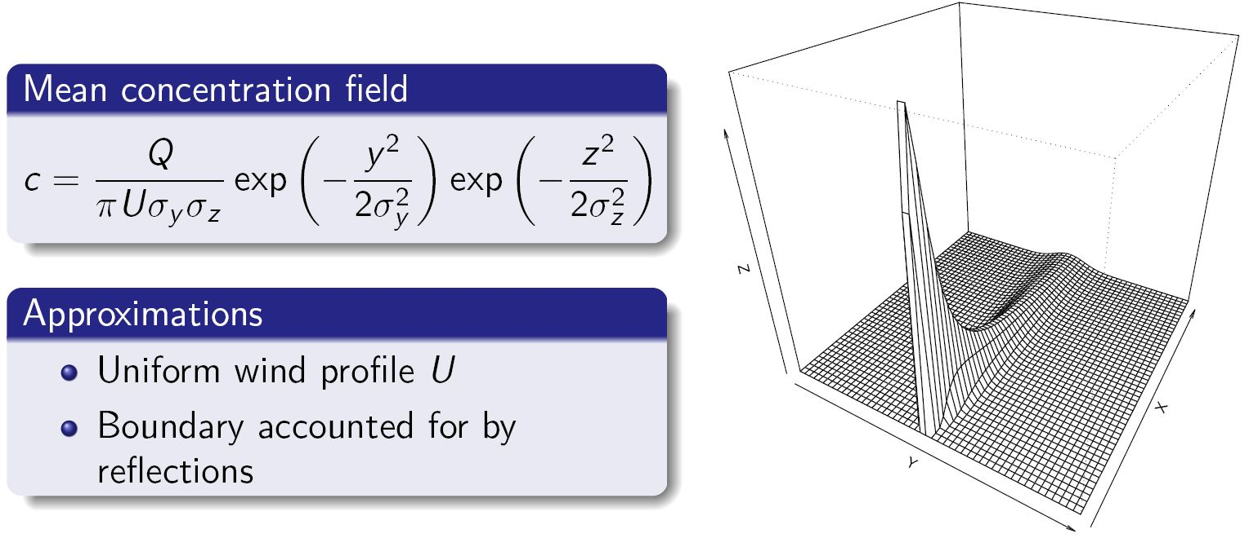
Gaussian Plume Model
σ_{y} , σ_{z} ~ width, thickness of plume

Slide 11
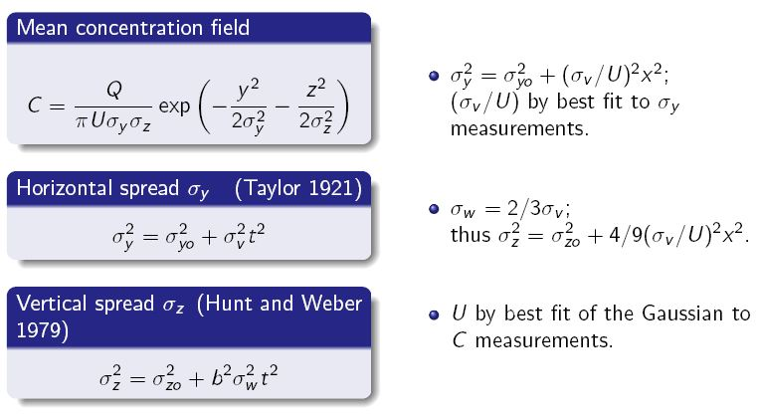
Gaussian plume model

Slide 12
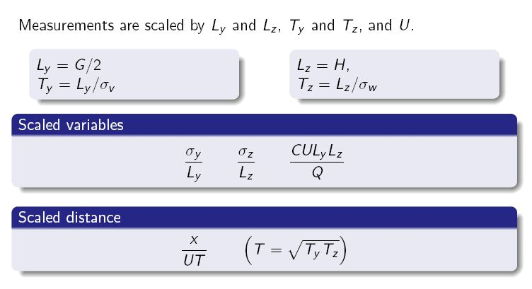
Scaling

Slide 13
Concentration vs X/B scaling

Slide 14
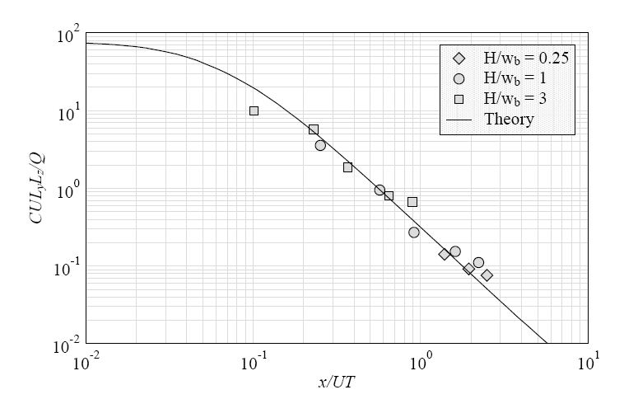
Model comparison – Predicted vs nondimensional C

Slide 15
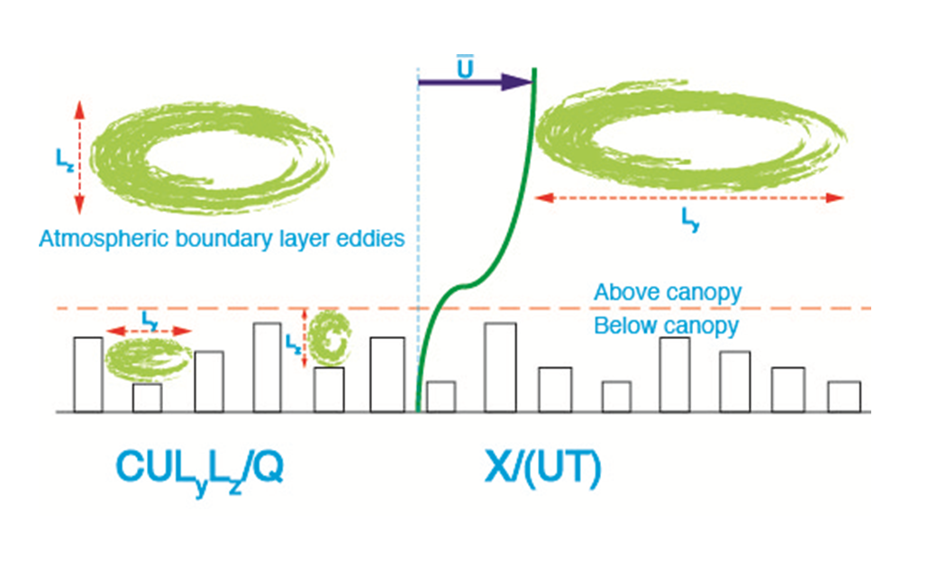

Slide 16
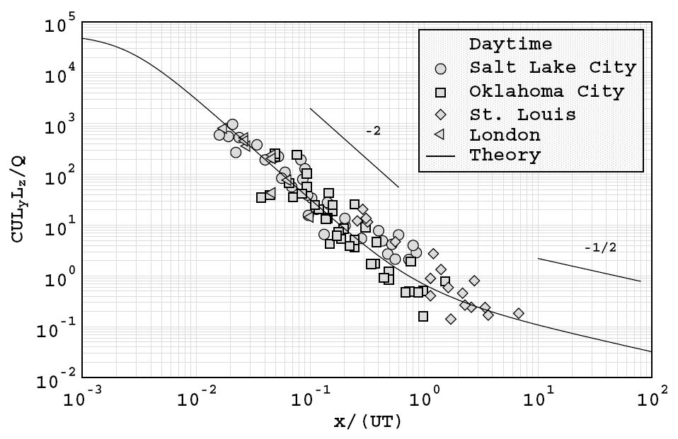
Non-dimensional representation - Daytime

Slide 17
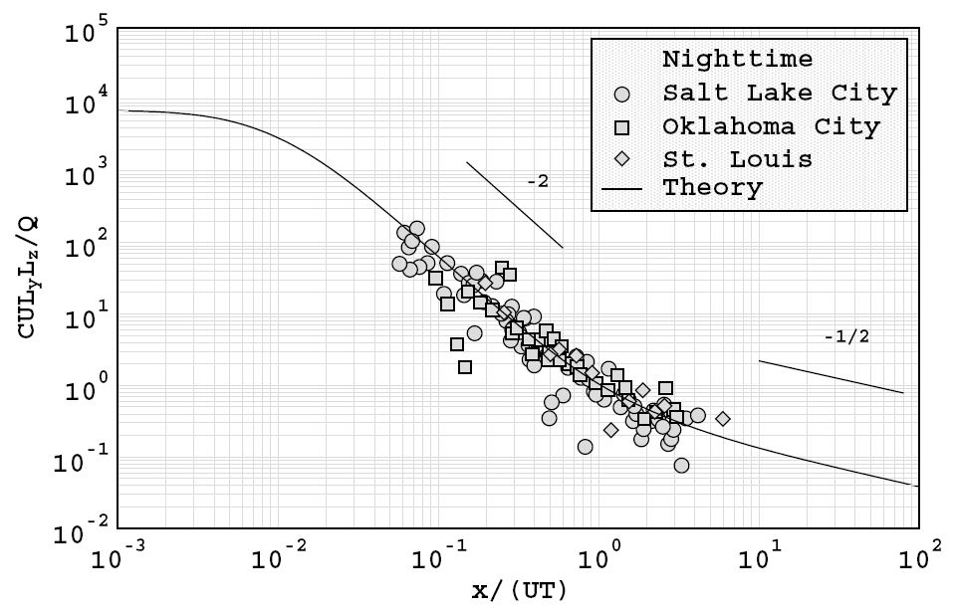
Non-dimensional representation - Nighttime

Slide 18
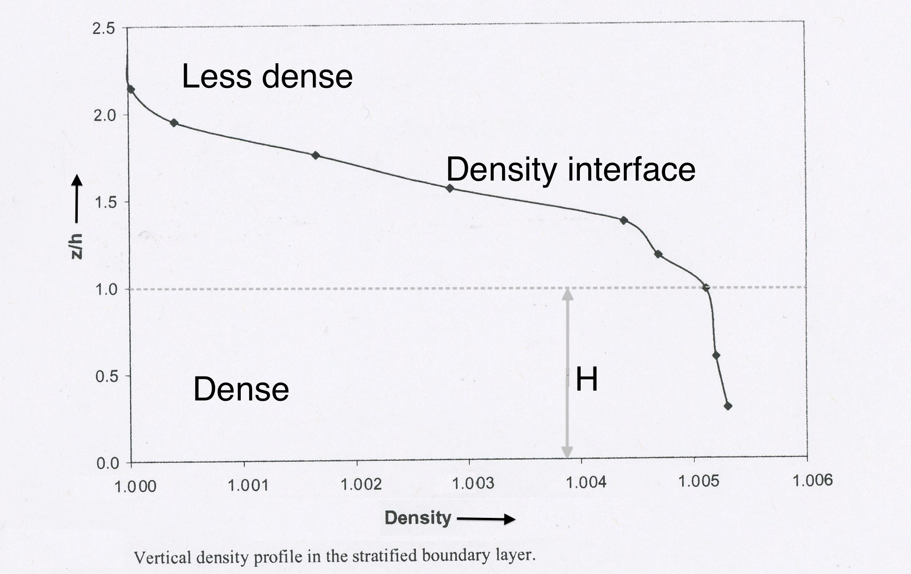

Slide 19
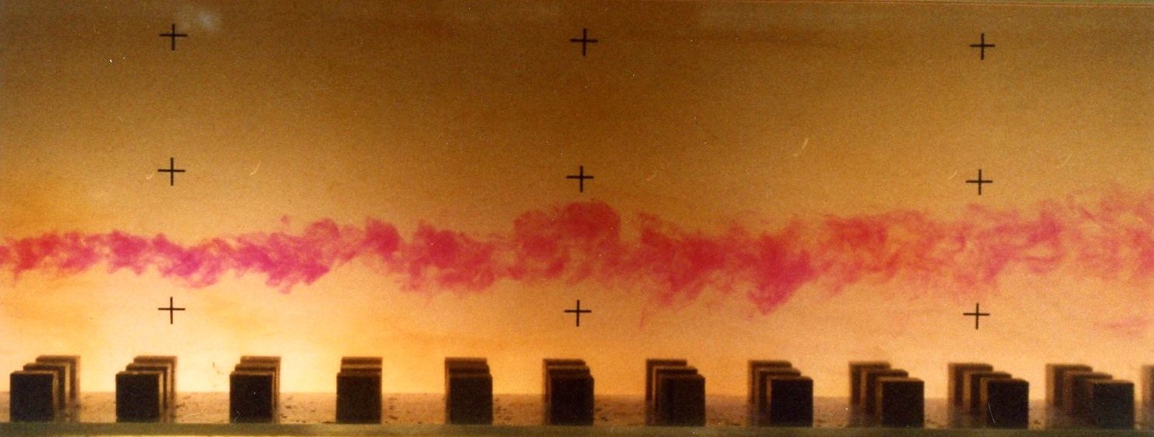
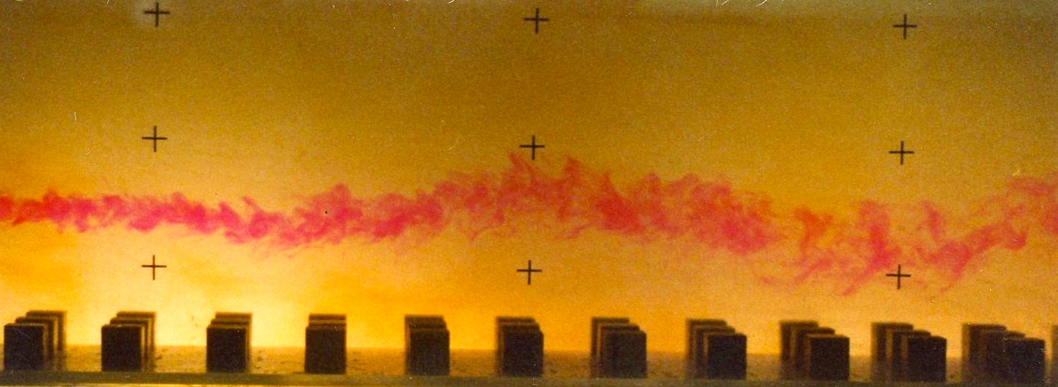
Plume in Neutral Stratification
Plume in Stable Stratification

Slide 20
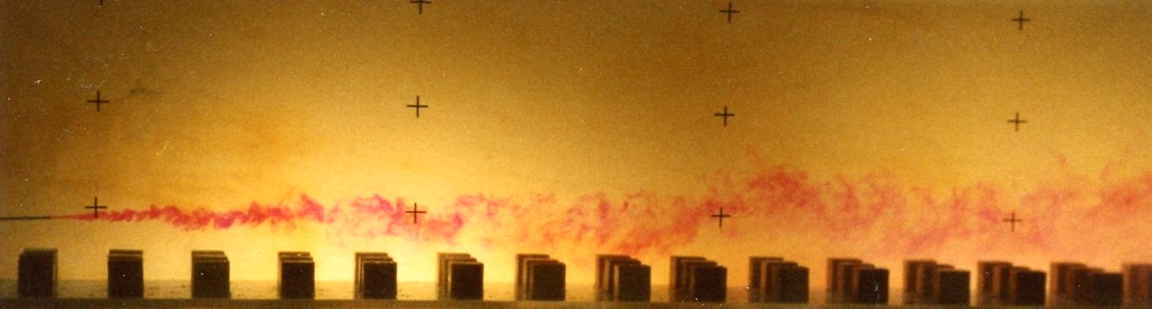
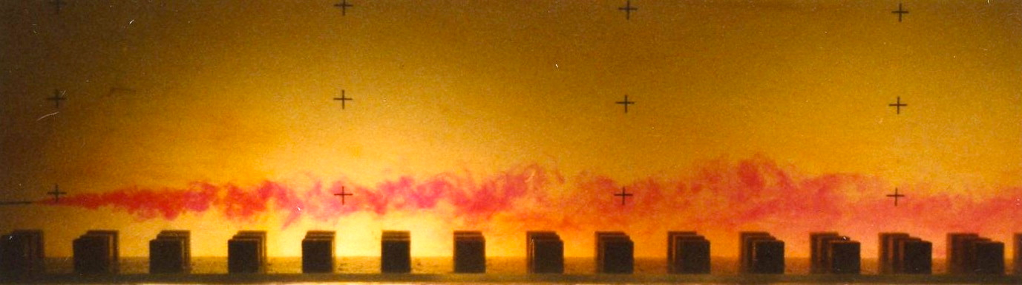
Elevated Plume in Neutral Stratification
Elevated Plume in Stable Stratification

Slide 21
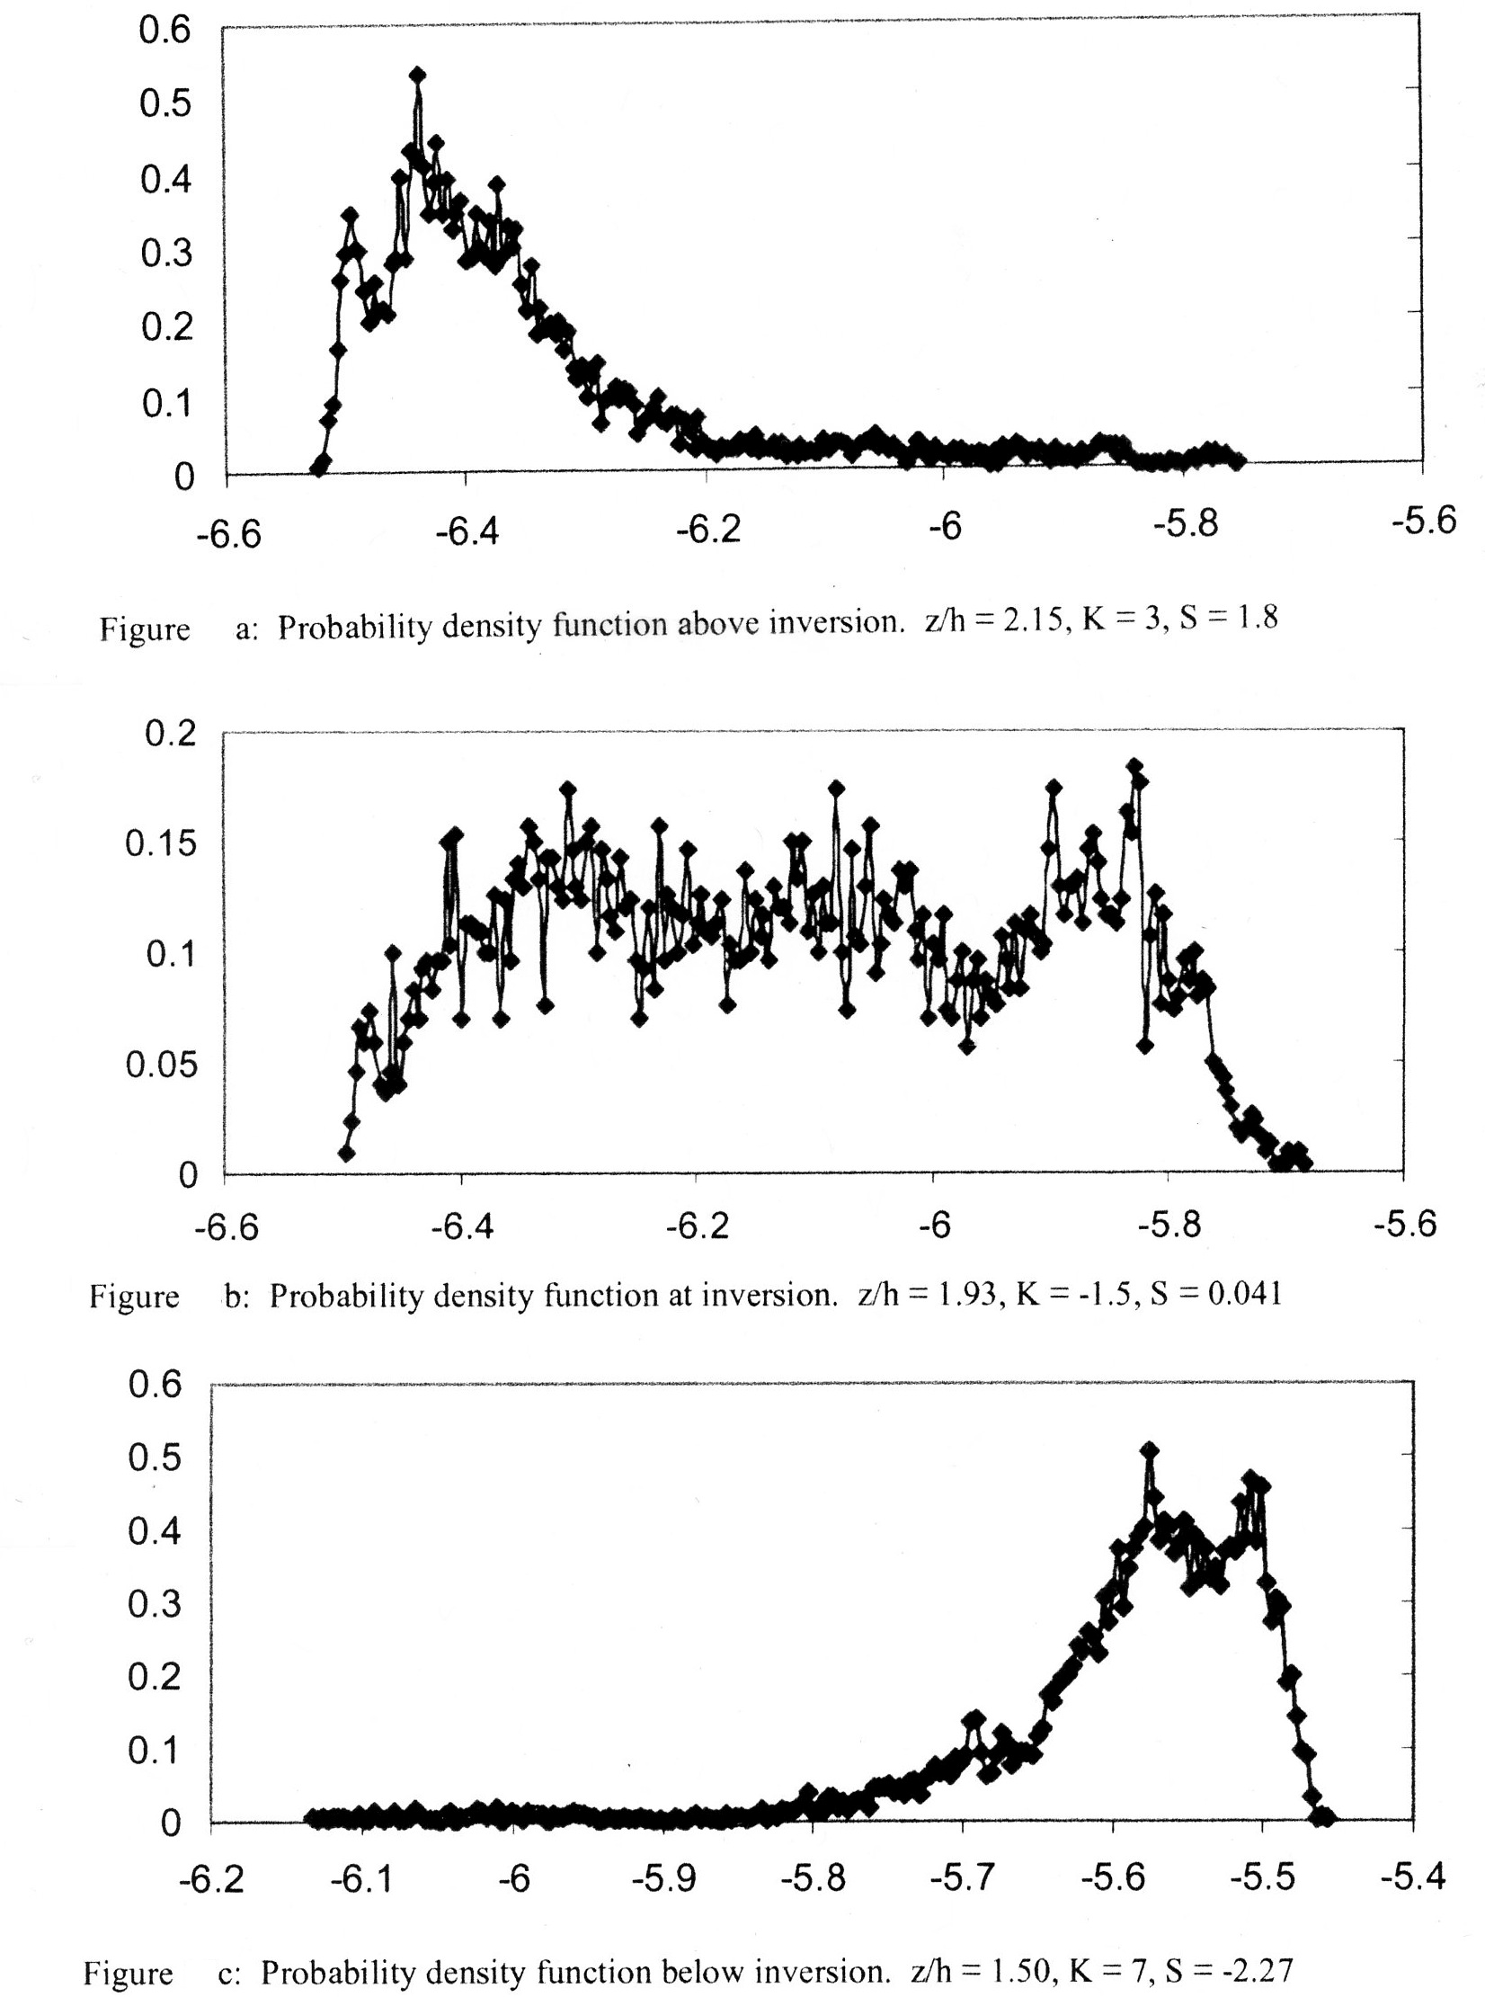

Slide 22
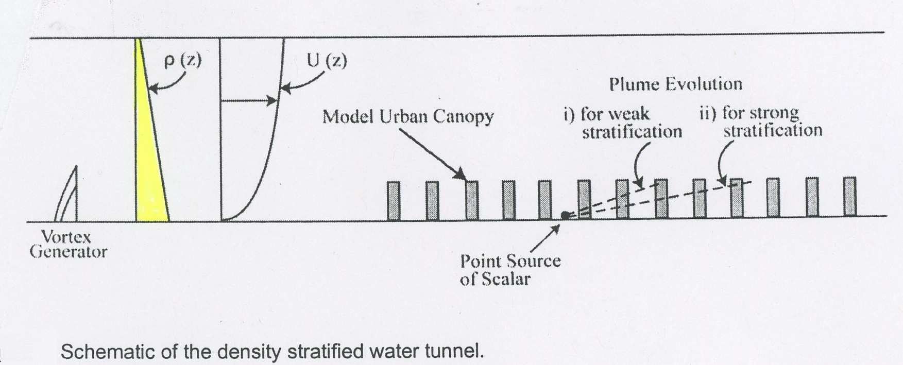

Slide 23
Conclusions
For ground level releases, ground level plume concentrations at Salt Lake City are a factor of 3 or 4 times greater at nighttime than at daytime.
New water tunnel experiments with density stratification are being carried out to investigate this observation.
Franzese & Huq (2011) Boundary Layer Meteorology, vol. 139:395-409

