Slide 1
Operational Predictions of Atmospheric Dispersion at National Oceanic and Atmospheric Administration (NOAA)
Ivanka Stajner
National Weather Service
OFCM Panel, July 17, 2012

Slide 2
NOAA operational predictions of atmospheric dispersion
Routine predictions:
Smoke predictions nationwide
Dust predictions over contiguous 48 states (CONUS)
http://airquality.weather.gov/
Incident support:
Volcanic ash
Radiologic contamination

Slide 3

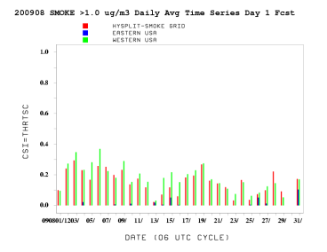
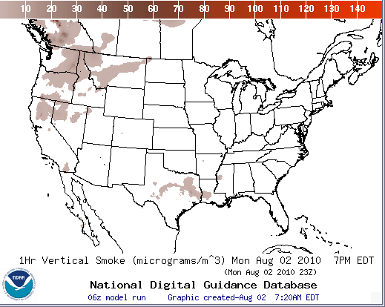
Smoke Forecast Tool
Major Components
NWP Model
NAM/NMMB
NOAA/NWS
Weather
Observations
NOAA
USFS
NESDIS HMS
Fire Locations
HYSPLIT Module:
NOAA/OAR
USFS’s BlueSky
Emissions Inventory:
USFS
Verification:
NESDIS/GASP Smoke

Slide 4
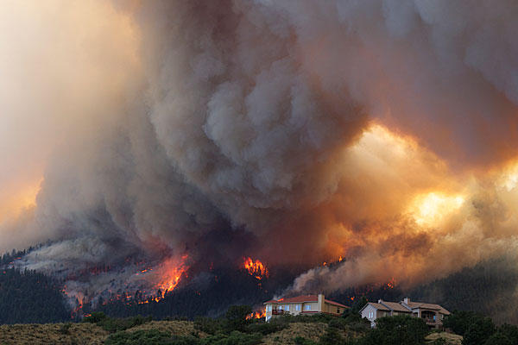
Waldo Canyon Fire, CO
Began on June 23, 2012 west of Colorado Springs
Close to 19,000 acres burned
Smoke plume reached heights of 20,000 feet
More than 32,000 people evacuated
Many homes burned
Fire 100% contained as of July 17
Waldo Canyon fire on June 26 in Colorado Springs

Slide 5
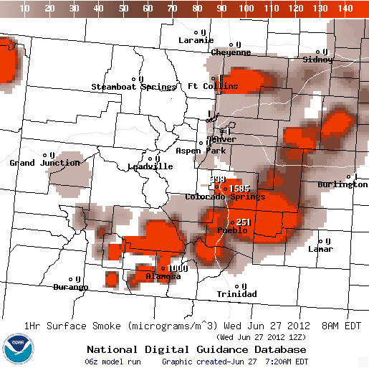
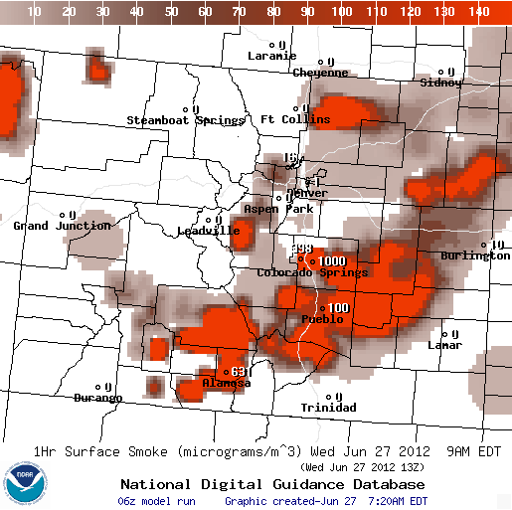
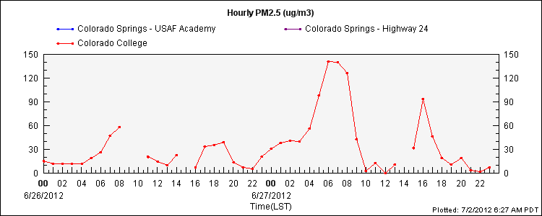
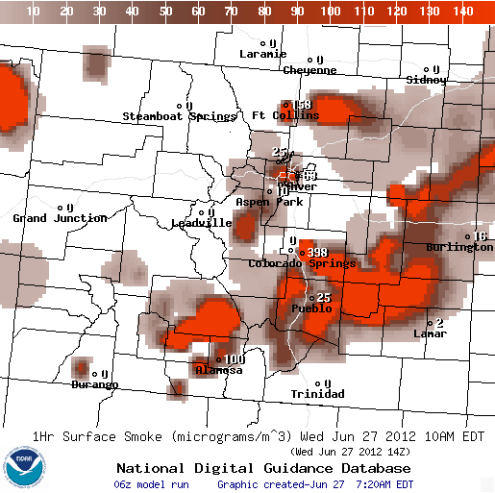
NOAA’s smoke predictions correctly predicted observed downward trend in PM2.5 due to Waldo Canyon fire, but concentrations were overestimated

Slide 6
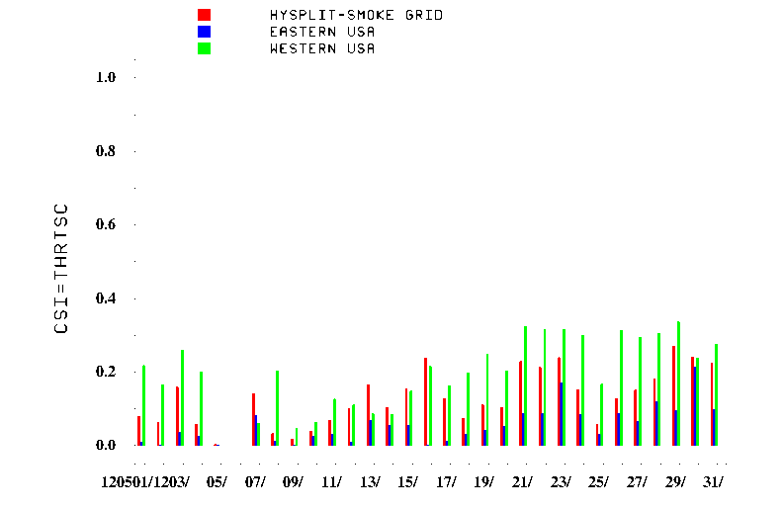
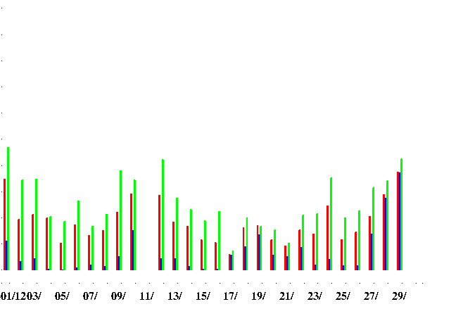
Smoke Prediction Improvements
Resolution of smoke predictions for Hawaii refined from 12 km to 3 km grid since October 2011
Meteorological model used to drive dispersion predictions transitioned from the NAM to NMMB meteorological model in October 2011
CONUS smoke predictions are currently done at 12 km resolution. Testing at 4 km resolution is ongoing. Updates to plume rise and deposition parameters are in progress.
Routine near-real time verification of smoke predictions over CONUS
Rolph GD, Draxler RR, Stein AF et al (2009) Description and Verification of the NOAA Smoke Forecasting System: The 2007 Fire Season. Weather and Forecast 24:361-378.
May 2012
June 2012
Date

Slide 7
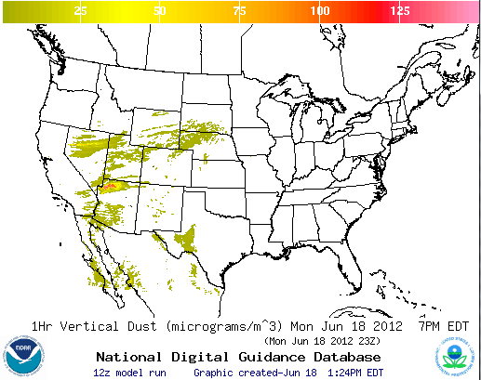
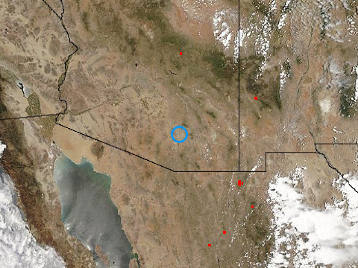
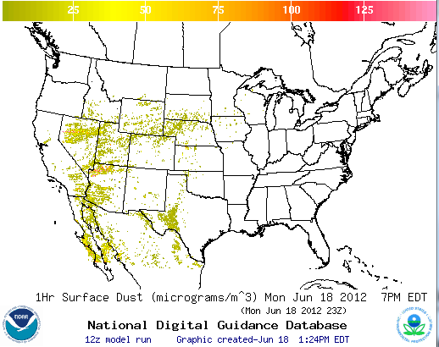
Dust prediction over CONUS
  Wind-driven dust emitted where surface winds exceed thresholds over source regions. Emissions modulated by real-time soil moisture information
Source regions with emission potential estimated from monthly MODIS deep blue climatology (2003-2006)
  HYSPLIT model for transport, dispersion and deposition
Operational
Visible dust
AQUA MODIS image on June 18, 2012
Draxler, R. R., P. Ginoux, and A. F. Stein (2010), An empirically derived emission algorithm for wind‐blown dust, J. Geophys. Res., 115, D16212, doi:10.1029/2009JD013167.

Slide 8
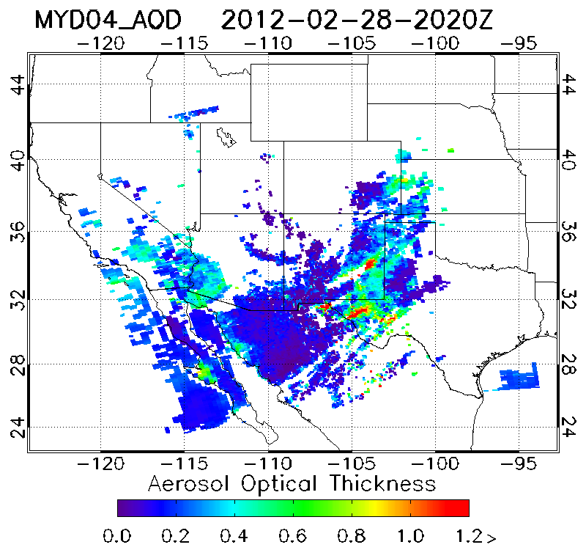
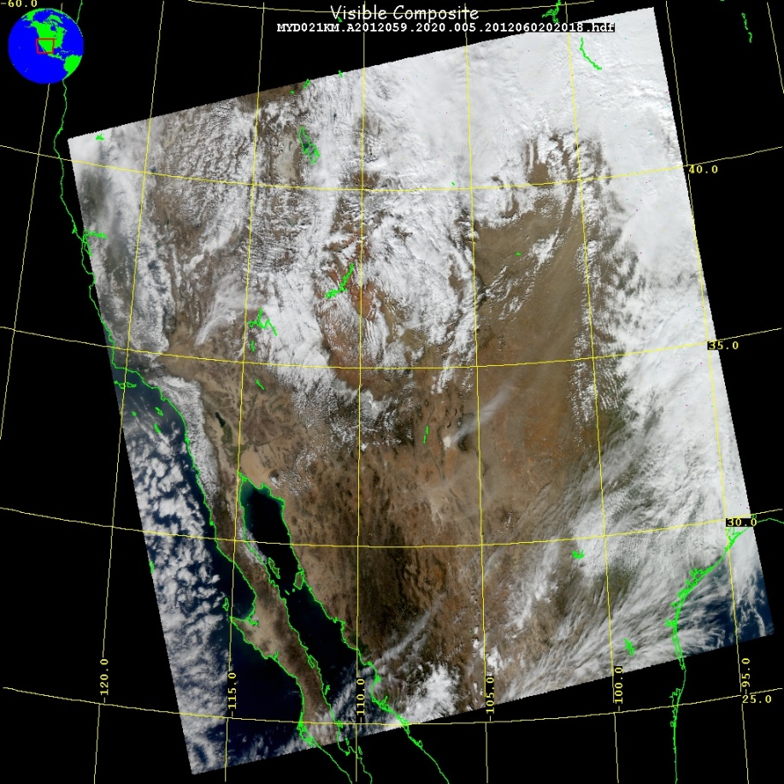
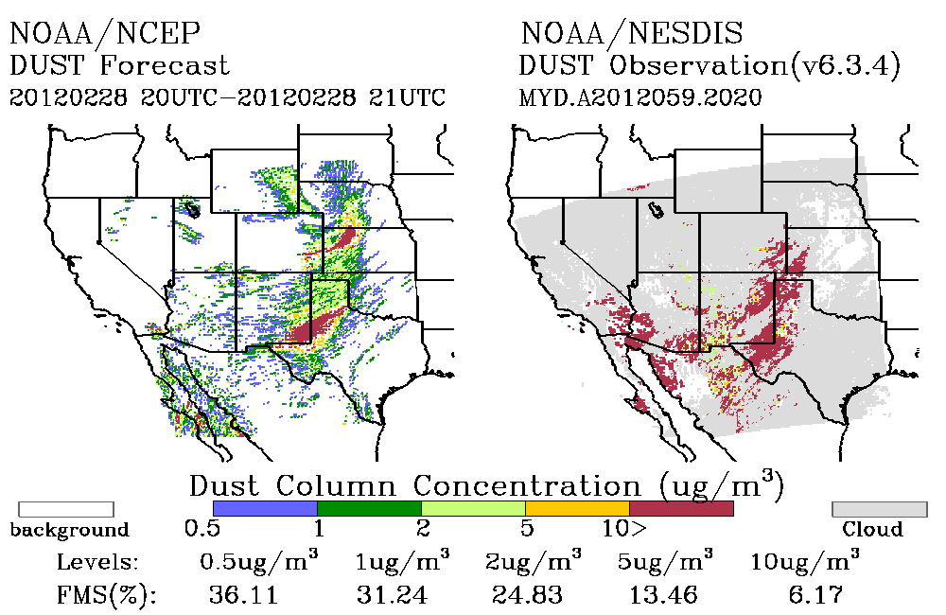
Dust Event and Verification on 02/28/2012
MODIS AOD
NESDIS developed dust retrieval using MODIS Deep Blue retrievals for verification of NWS dust predictions
Large dust storm occurred in Central Plains resulting in large swath of blowing dust
Generated from eastern New Mexico, Western Texas, Texas Panhandle, southeast Colorado, Oklahoma Panhandle, and Western Kansas

Slide 9
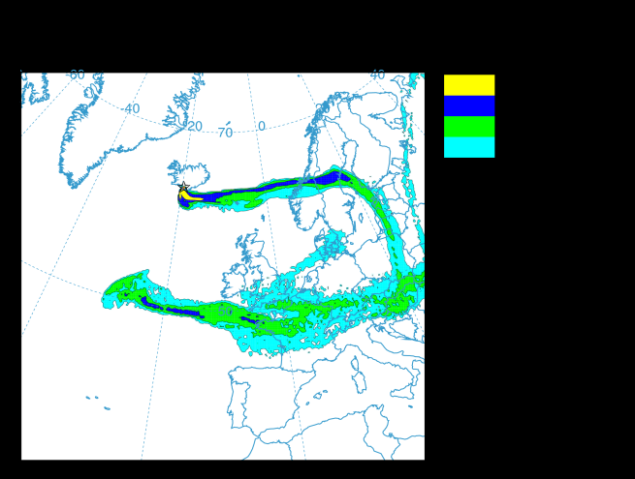
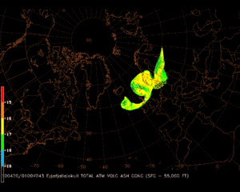
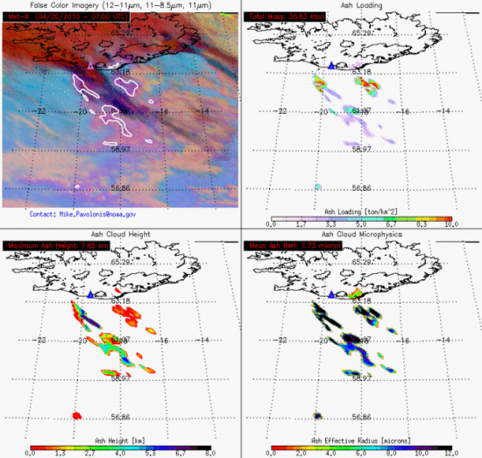
NOAA’s Volcanic Ash Assets
Response to the Eruptions of Eyjafjallajokull Volcano
NESDIS (Satellite imagery resources – top and horizontal extent of cloud)
Washington and Anchorage VAACs (detection/tracking, forecasting)
NWS/OAR (HYSPLIT) - Stunder, B.J.B., J.L. Heffter, R.R. Draxler (2007), Airborne Volcanic Ash Forecast Area Reliability, Weather and Forecasting, 22:1132-1139, DOI: 10.1175/WAF1042.1
Meteorological Watch Offices (Aviation Warnings for Volcanic Ash – SIGMETs)
  NWS/NCEP Aviation Weather Center
  NWS Weather Forecast Office Honolulu
  NWS Alaska Aviation Weather Unit
Center Weather Service Unit (1 per FAA Air Route Traffic Control Center)
NOAA’s Volcanic Ash Program

Slide 10
Dispersion of radioactive material
NOAA is the home for the U.S. Regional Specialized Meteorological Center under WMO that supports International Atomic Energy Agency (IAEA)
For the Fukushima Daiichi's nuclear power plant incident:
  IAEA requested NOAA transport simulations, which were shared with IAEA member countries
  NOAA worked with DOE and Nuclear Regulatory Commission to inform the federal community about the transport of radiation
  NOAA atmospheric modeling group provided estimates of deposition into the ocean for NOAA’s ocean radiation simulations
  HYSPLIT runs were used for these simulations (NOAA/ARL, NOAA/NCEP)
  Draxler, R. R., and G. D. Rolph (2012), Evaluation of the Transfer Coefficient Matrix (TCM) approach to model the atmospheric radionuclide air concentrations from Fukushima, J. Geophys. Res., 117, D05107, doi:10.1029/2011JD017205.
NOAA is planning to implement an on-demand backtracking capability and provide potential source locations to the Comprehensive Nuclear-Test-Ban Treaty Organization CTBTO

Slide 11
Backup

Slide 12
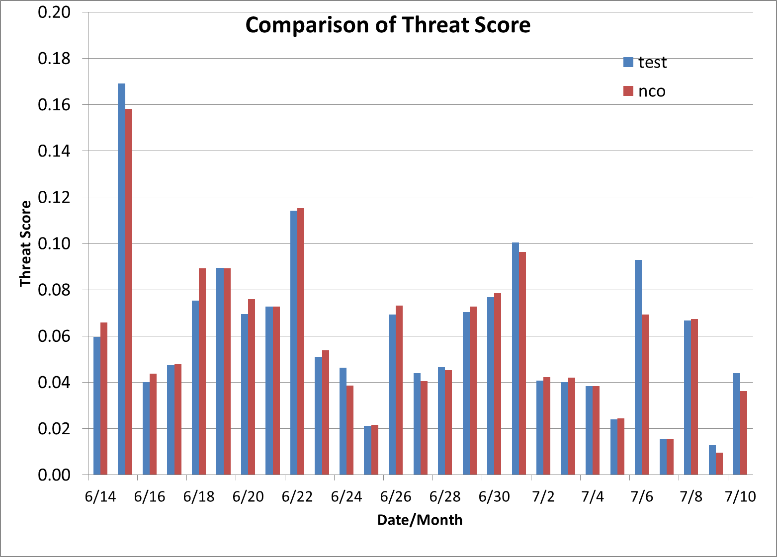
Reducing the wall clock time for dust predictions
Evaluating the impact of increasing the time step in HYSPLIT from 6 to 10 minutes
Test
Operational run

