Slide 1

Scale Interactions
Bridging the Scale Gap Between Mesoscale and Microscale
Branko Kosović
National Center for Atmospheric Research
Acknowledgements: Andrew Annunzio, Jimy Dudhia, Sue Haupt, Peggy Lemone, Richard Rotunno (NCAR), Jason Ching (UNC), Robert Bornstein (SJSU), James Brasseur (PSU), Jeffrey Mirocha (LLNL), Sukanta Basu (NCS), Julie Lundquist (CU)
16th Annual GMU Conference on Atmospheric Transport and Dispersion
Washington, D. C., July 17-18, 2012

Slide 2
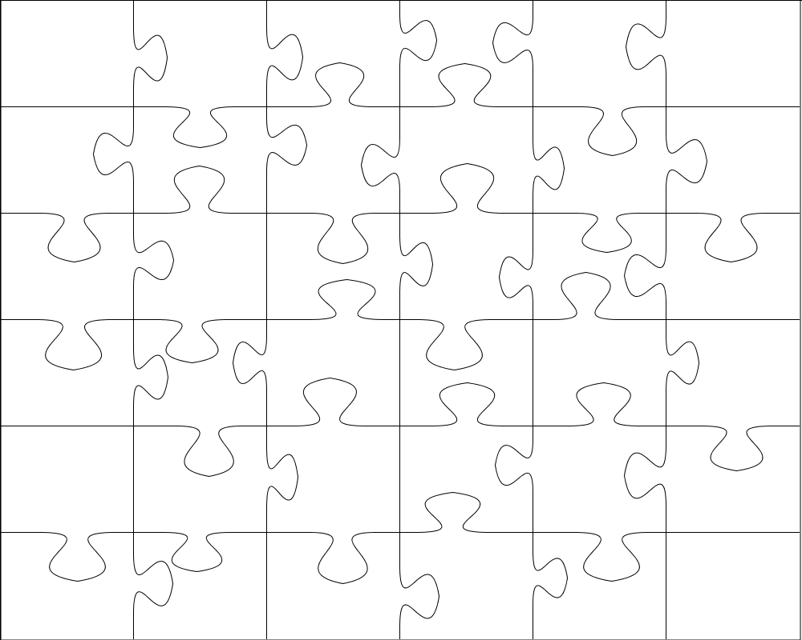
MULTISCALE MODELING CHALLENGE

Slide 3
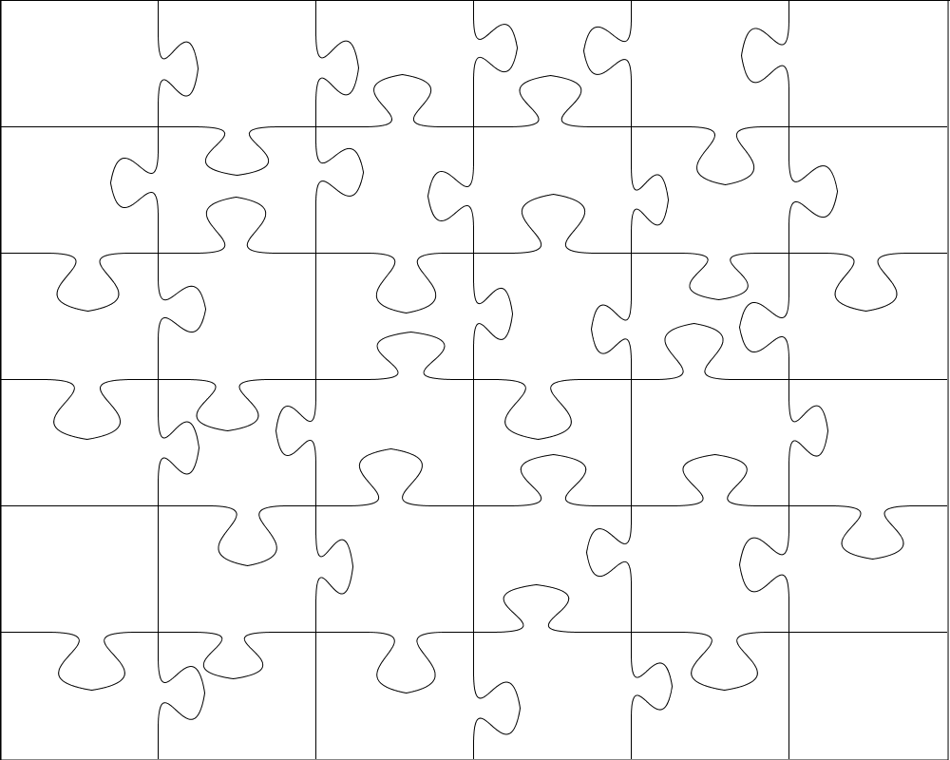
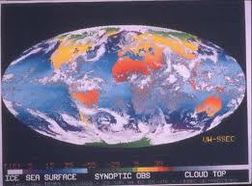
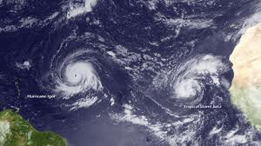
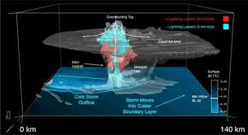
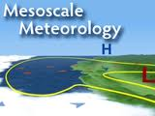

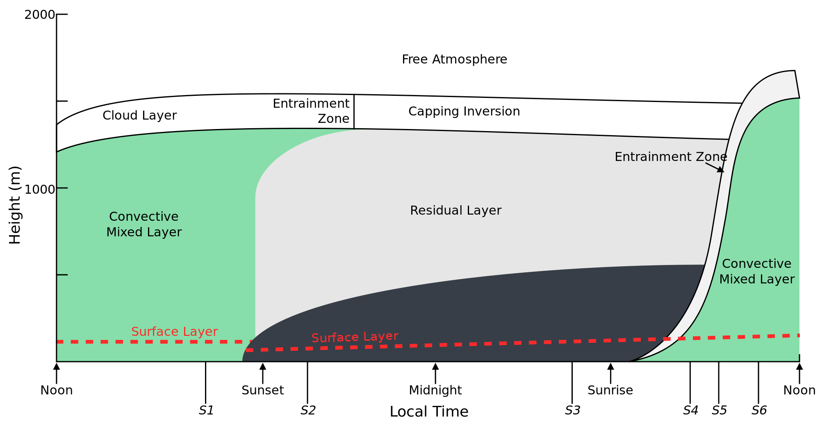
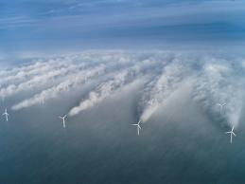
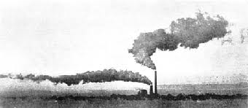
MULTISCALE MODELING CHALLENGE

Slide 4
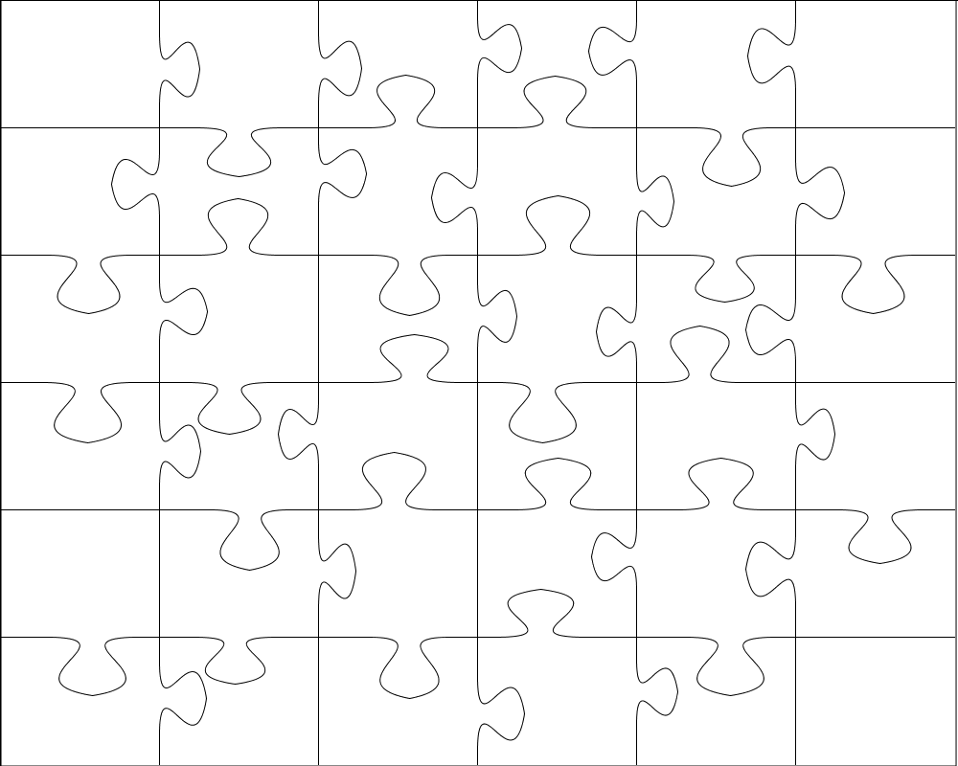
MULTISCALE MODELING CHALLENGE

Slide 5
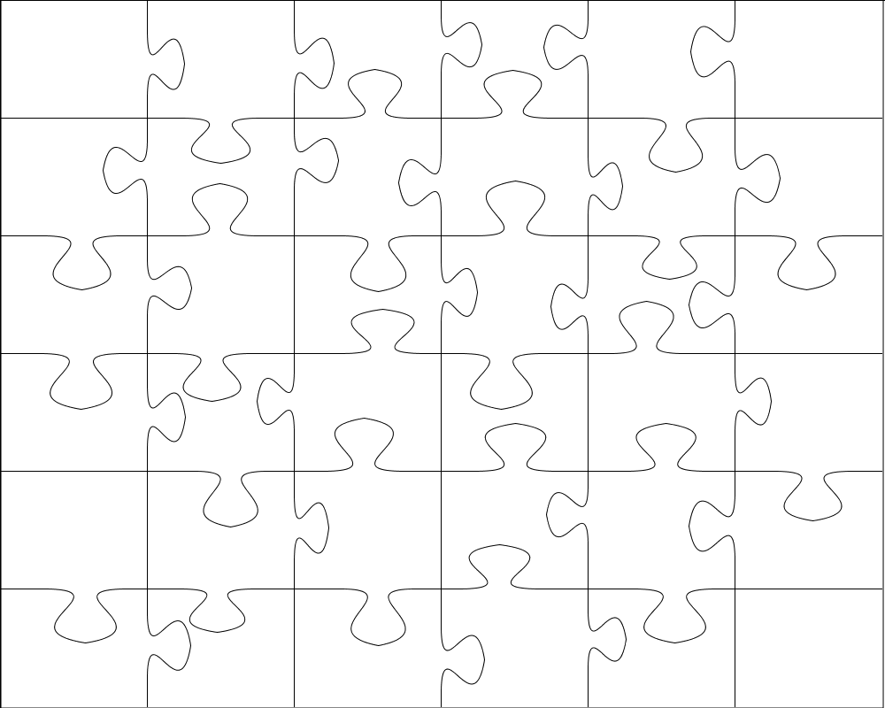
MULTISCALE MODELING CHALLENGE

Slide 6
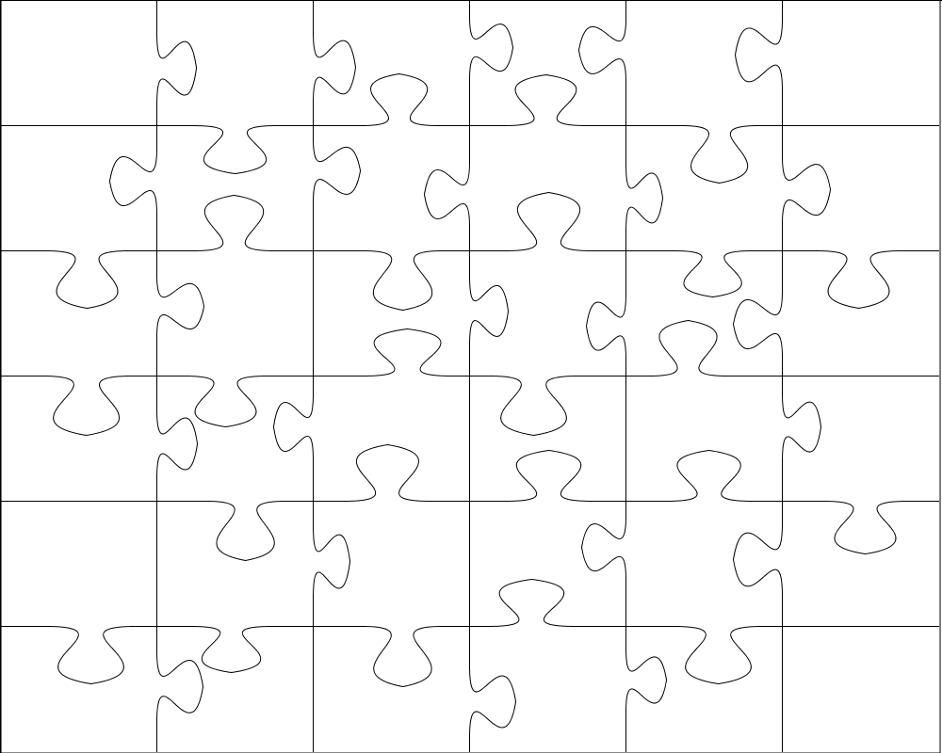
MULTISCALE MODELING CHALLENGE

Slide 7
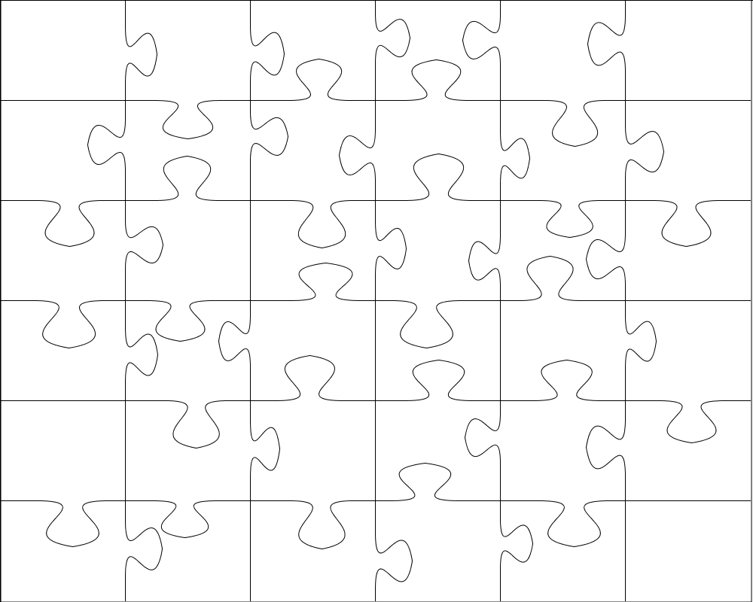
MULTISCALE MODELING CHALLENGE

Slide 8
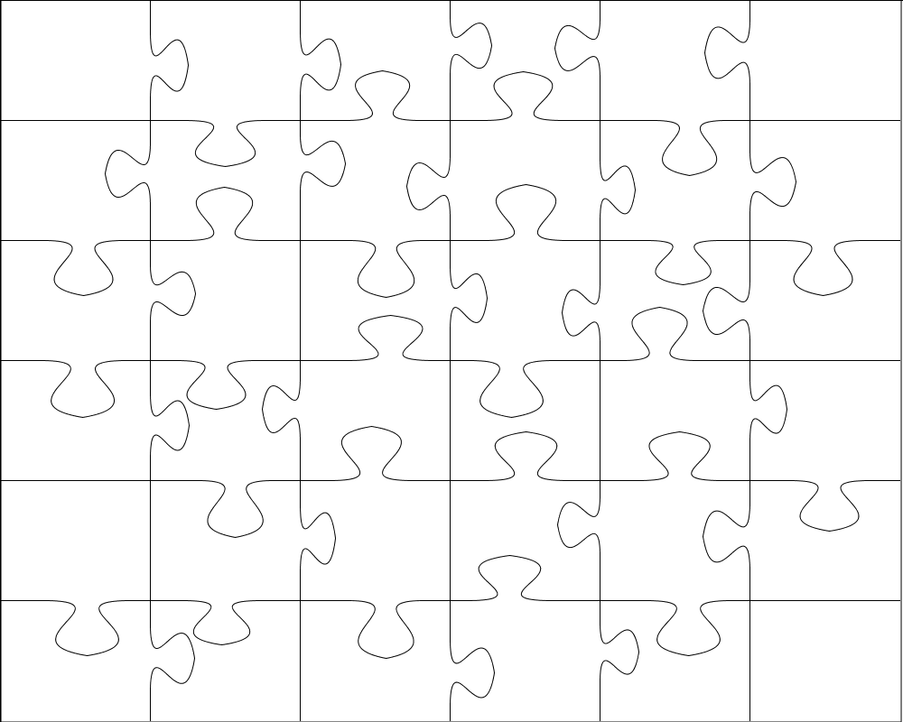
MULTISCALE MODELING CHALLENGE

Slide 9

MULTISCALE MODELING CHALLENGE

Slide 10
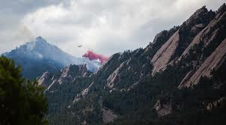
Why are Scale Interactions Important?

Slide 11
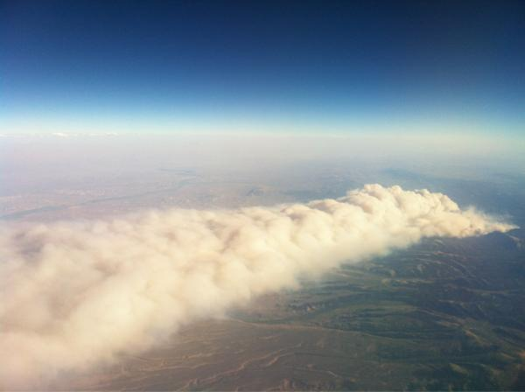
Why are Scale Interactions Important?

Slide 12
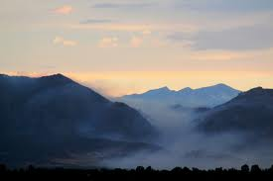
Why are Scale Interactions Important?
Atmospheric Flows Span a Wide Range of Scales.

Slide 13
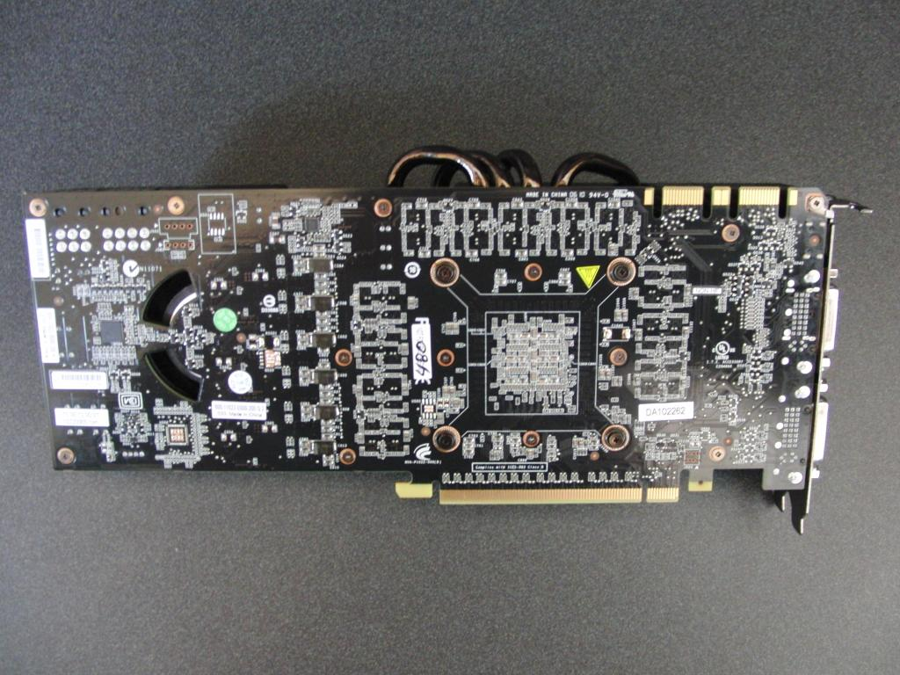
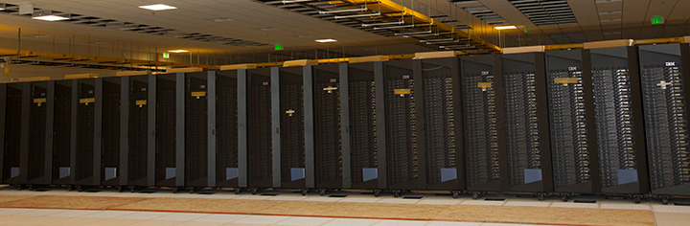
Why Multiscale Simulations Now?
High performance computing enables multiscale simulations
Intel’s Many Integrated Core (MIC) CPU (50 cores)
GPUs (Nvidia Fermi)
Both platforms achieve ~1000 GF/s peak performance
WRF is being tested on Intel MIC CPU (John Michalakes, 13th Annual WRF Users’ Workshop)
Multi GPU HPC enabled LES of a flow over entire Netherlands (~4000x4000x100 grid cells, Jerome Schalkwijk et al., 20th Symposium on Boundary Layers and Turbulence)

Slide 14
Gap Between Grid-Cell Size in Mesoscale and Microscale Simulations is Diminishing
Grid-Cell Size [km]
Time
Adapted from Wyngaard

Slide 15
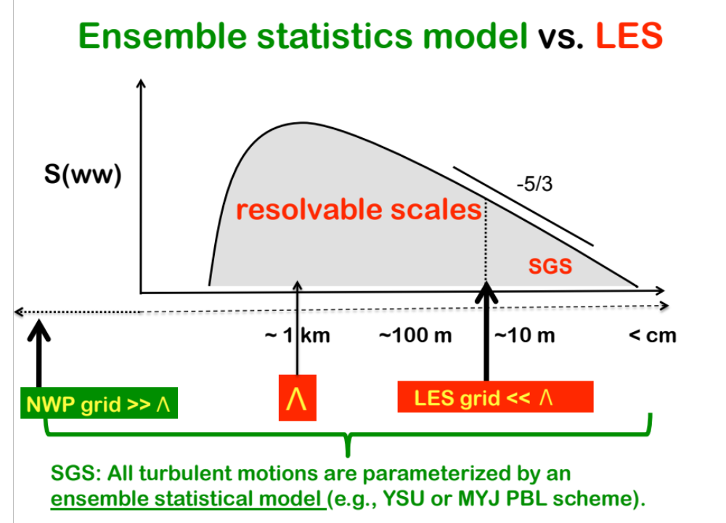
Moeng, 2011, 12th WRF Users’ Wrokshop

Slide 16
Gap Between Mesoscales and Microscales is Wyngaard’s “Terra Incognita”
Adapted from Wyngaard 2004

Slide 17
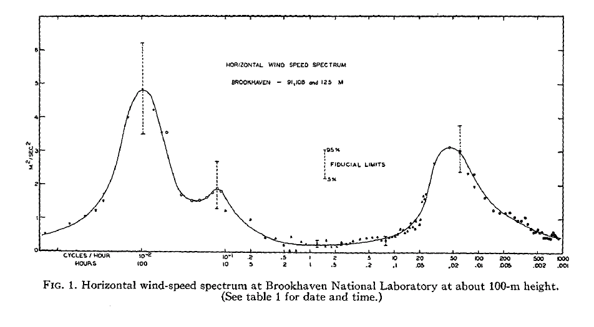
Atmospheric Boundary Layer Models are Often Based on the Assumption of Spectral Gap,…
| ← Mesoscale Models →|
| ← LES Models →|
4-day
1 min
Compensated Energy Spectrum [m²s⁻²]
Semi-Diurnal
Swell waves
5 min
1000 100 10 5 2 1 0.5 0.2 0.1 0.05 0.02 0.01 5e-3 2e-3 1e-3
Van der Hoven, 1957, JAM, based on data from
Brookhaven National Lab at 90-125m height
Period of fluctuations (hr/cycle)
Spectral gap between meso and micro scales of motion (based on Brookhaven costal observations)

Slide 18
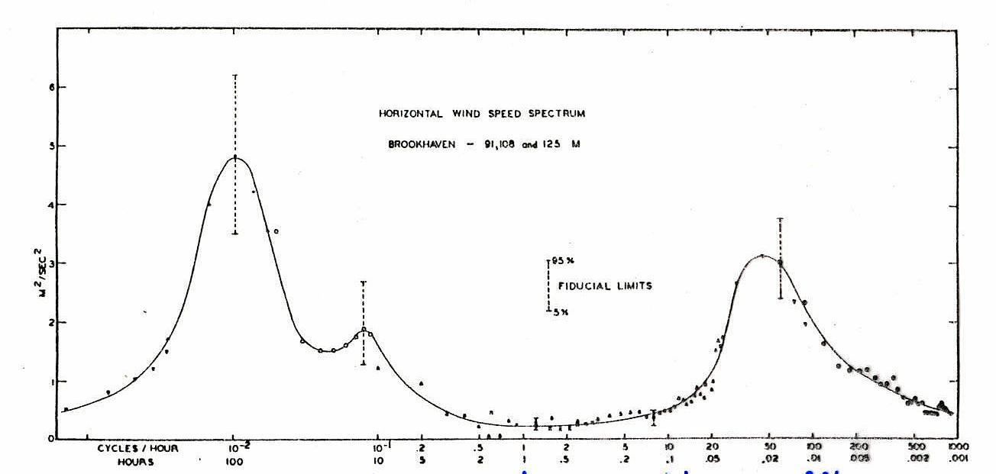
… However, in Atmosphere Spectral Gap is Rarely Observed
10
-2
Cabauw Data 1987 (10m)
diurnal harmonics
10
-3
cyclones
10
-4
Energy Spectrum of Wind
10
-5
10
-6
10
-7
Brookhaven Data 1957
10
-8
10000
1000
100
10
1
Period in Hours

Slide 19
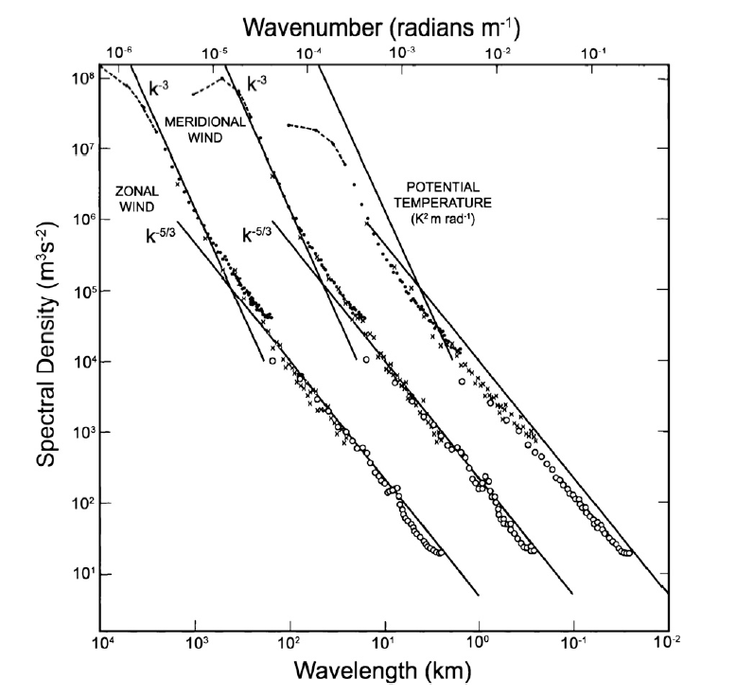
Upper Troposphere Observations Display
Continuous Mesoscale Spectrum
Nastrom and Gage, JAS 1985

Slide 20
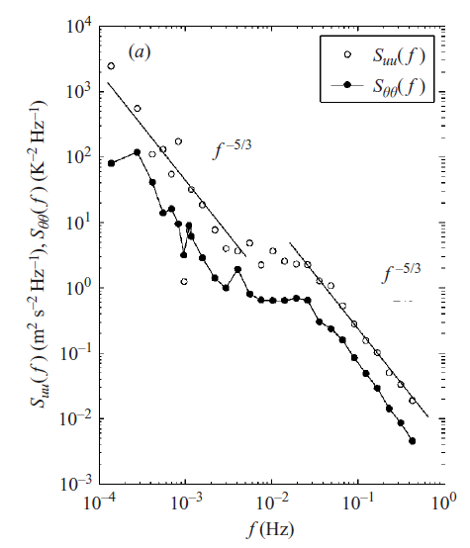
Lower Atmosphere Spectra Under Stably-Stratified
Conditions Display Discontinuity But Not A Gap
Muschinski et al., JFM 2004

Slide 21
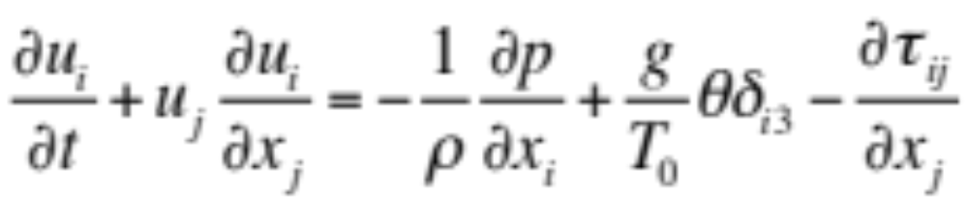
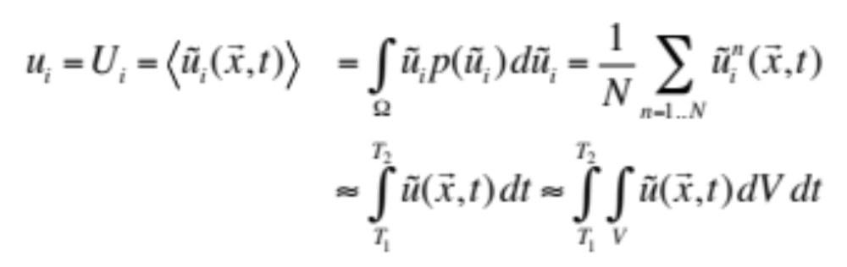
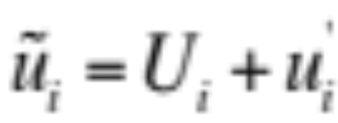
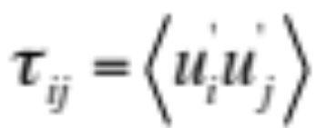
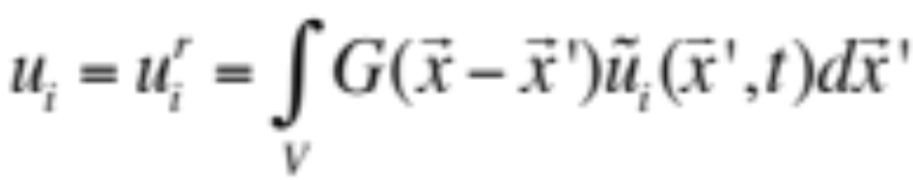
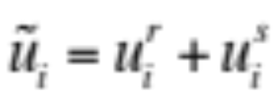
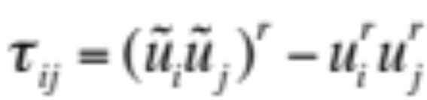
Mesoscale and Microscale Simulations Employ
Ensemble Averaging and Filtering Approach
Reynolds Averaged Navier Stokes – Ensemble Average
Large-Eddy Simulation – Filtered Quantity

Slide 22
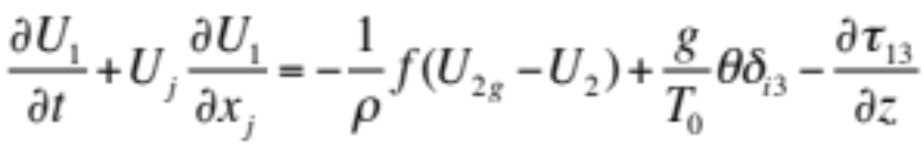
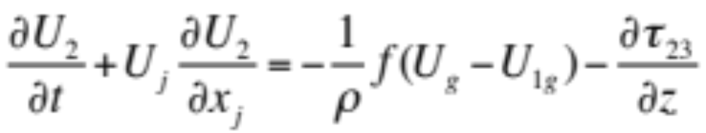
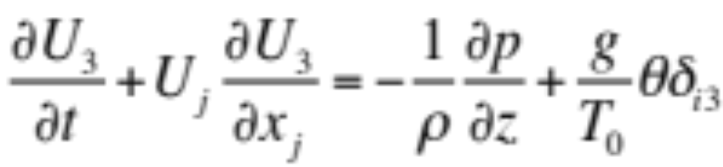
In General Horizontal Homogeneity Assumption
is Used in LES and PBL parameterization

Slide 23
In General Horizontal Homogeneity Assumption
is Used in LES and PBL parameterization

Slide 24
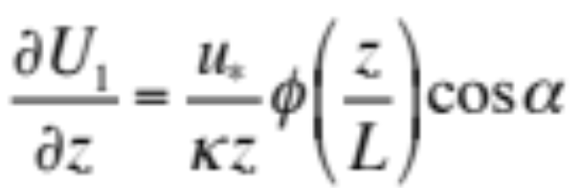
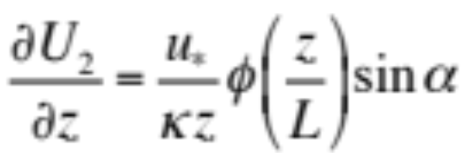
In General Horizontal Homogeneity Assumption
is Used in LES and PBL parameterization
Boundary conditions are based on Monin-Obukhov similarity theory

Slide 25
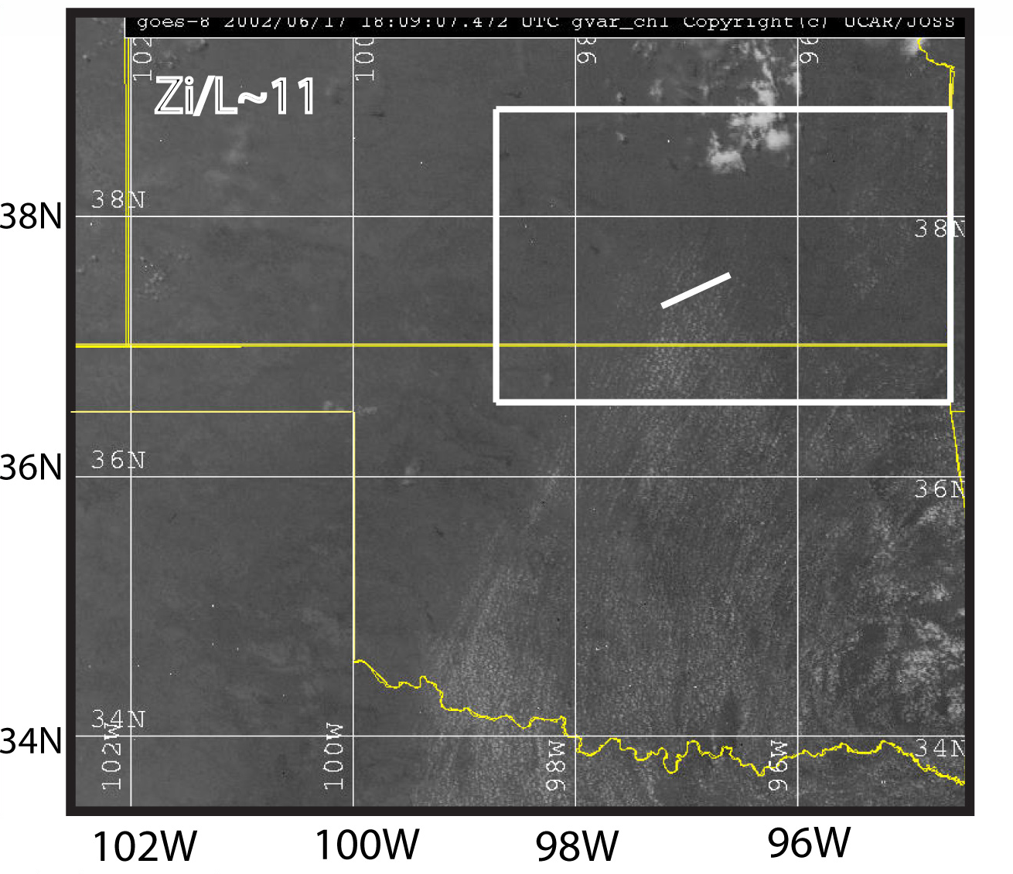
Cloud Streaks Observed During IHOP Experiment
Indicate Presence of Convective Rolls

Slide 26
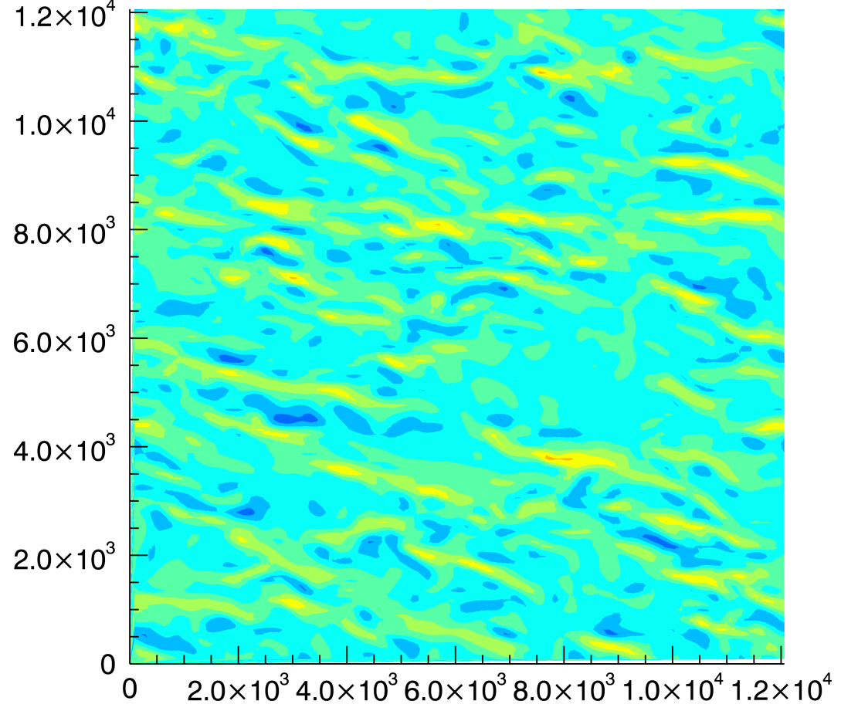
Canonical Convective ABLs Contain Mesoscale Structures – Convective Rolls
z_{i}/L ~ 10
Y
X
LES of convective ABL with 90m X 90m X 10m grid cells
Contours represent vertical velocity

Slide 27
Canonical Convective ABLs Contain Mesoscale Structures – Convective Rolls
z_{i}/L ~ 10
Y
Mesoscale
X
LES of convective ABL with 90m X 90m X 10m grid cells
Contours represent vertical velocity

Slide 28
Canonical Convective ABLs Contain Mesoscale Structures – Convective Rolls
z_{i}/L ~ 10
Y
Mesoscale
Microscale
X
LES of convective ABL with 90m X 90m X 10m grid cells
Contours represent vertical velocity

Slide 29
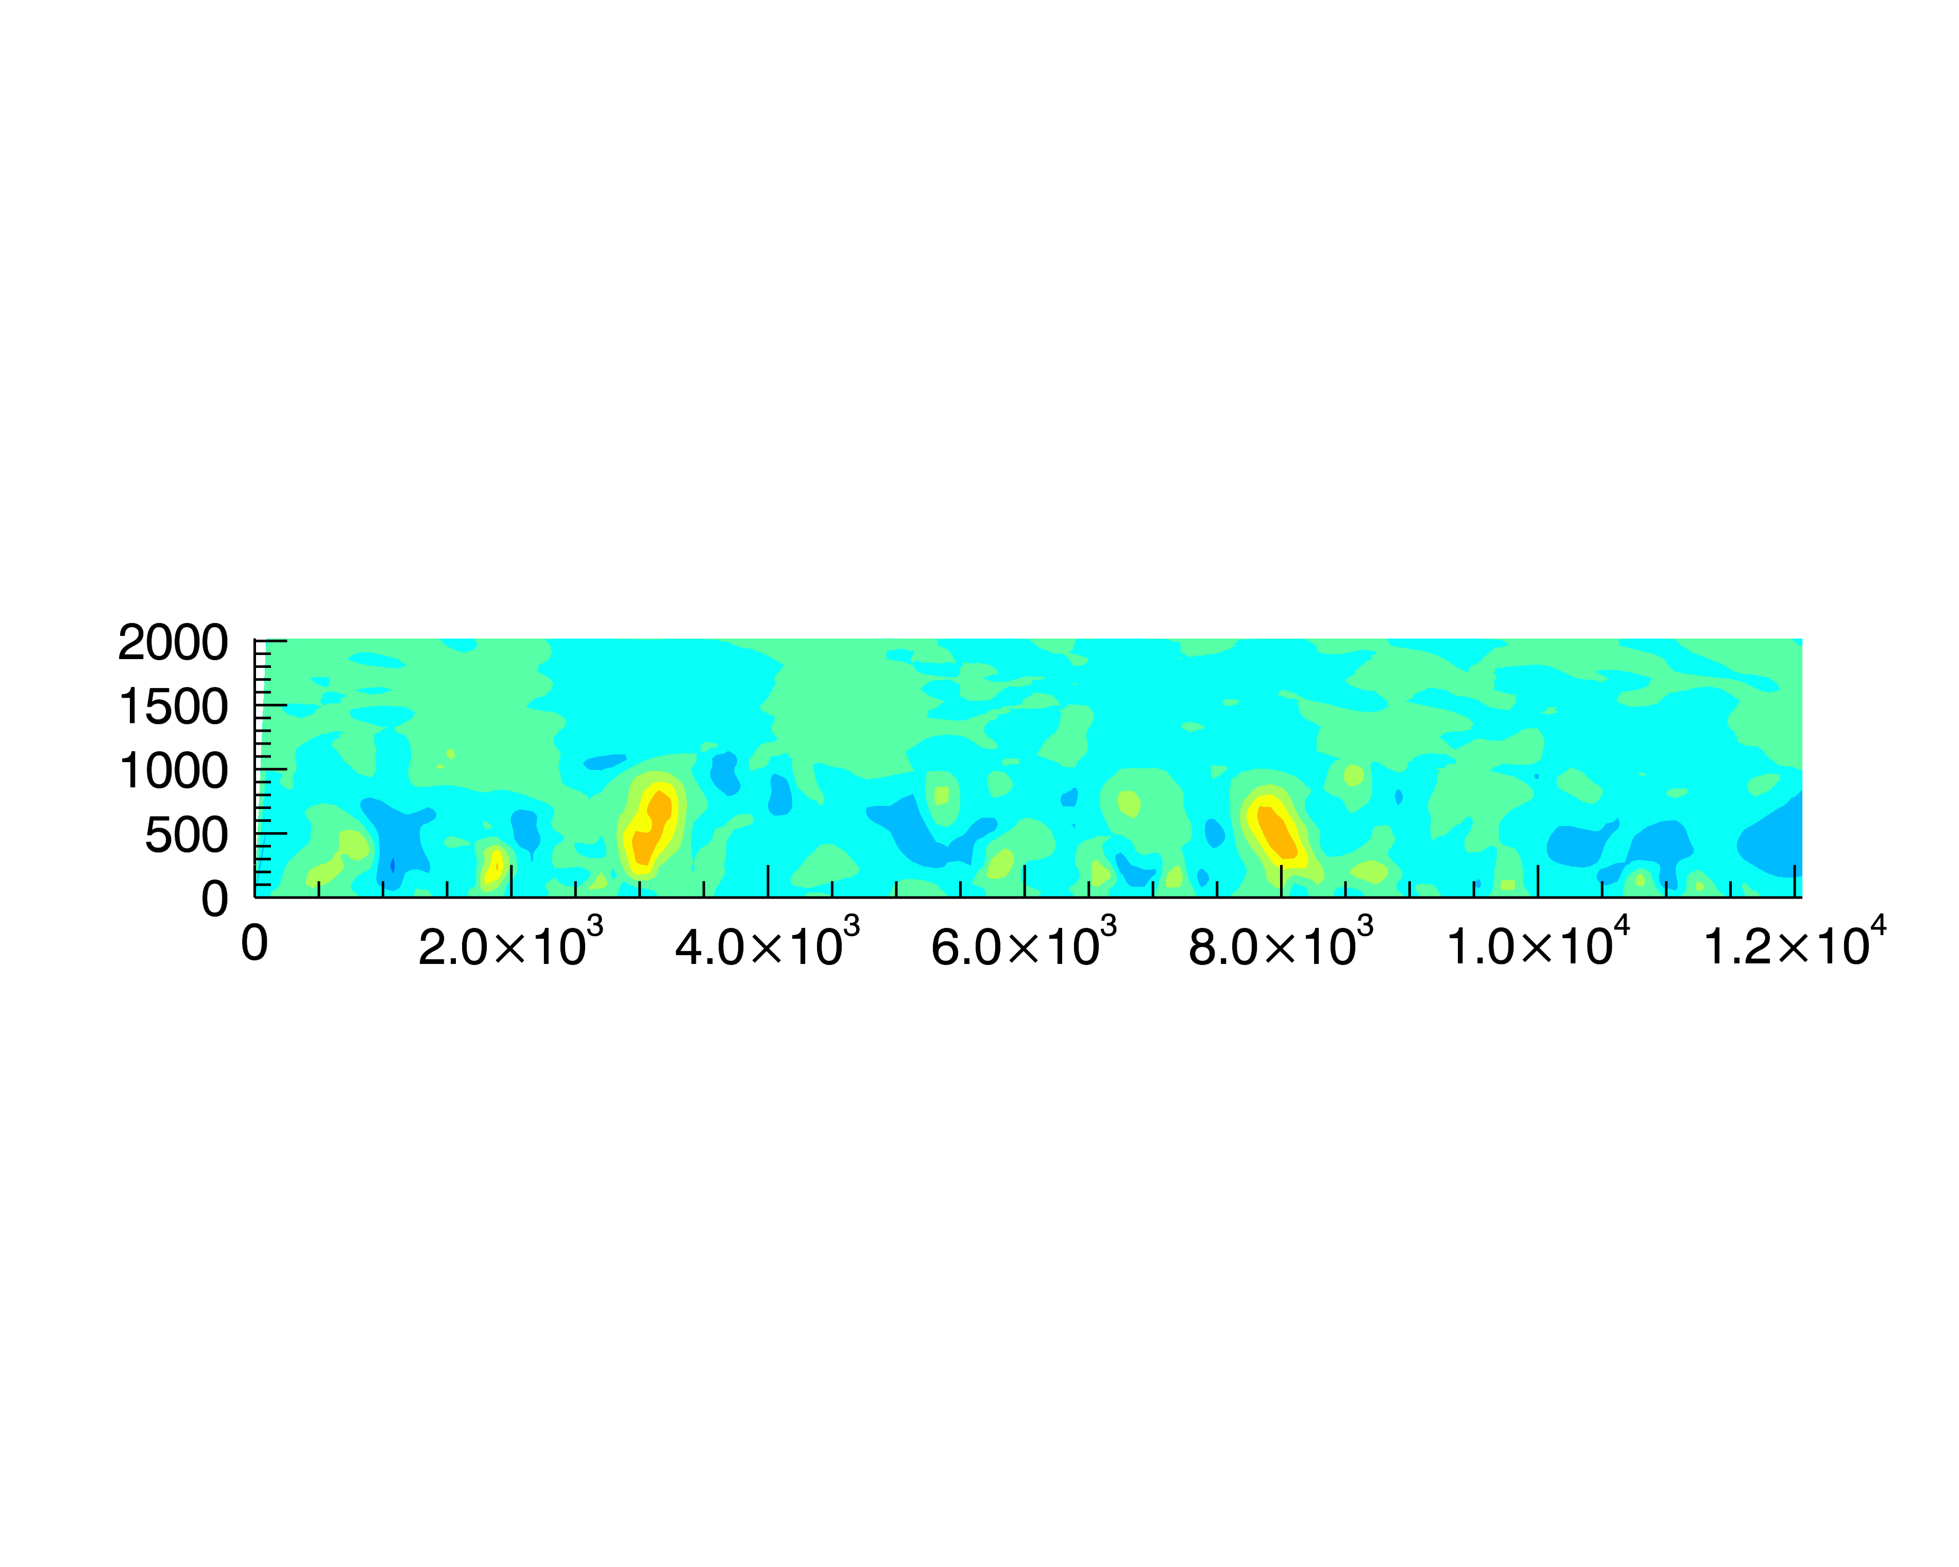
Stream-wise Scale of Convective Rolls is in
Mesoscale Range and Vertical Scale in Microscale
z_{i}/L ~ 10
Microscale
LES of convective ABL with 90m X 90m X 10m grid cells
Contours represent vertical velocity

Slide 30
DOE EERE Workshop on Complex Flow Identified
Multiscale Modeling as One Topics of Future Focus
From Mike Robinson

Slide 31
Scale Interactions and
Multiscale Modeling Challenges
How do we address:
(Non)existence of spectral gap
Transition from PBL schemes to LES
Surface boundary condition (replace MOST?)
PBL parameterizations without assumption of horizontal homogeneity
Ensemble averaging vs. filtering
Ways to observe heterogeneous boundary layers
Required accuracy and acceptable uncertainty
…

