Slide 1


Military Protective Action Distances:
A Pilot Study
John M. Fregeau
Jim Heagy
Institute for Defense Analyses
Science and Technology Division
Sponsor: Jerry Glasow, DTRA

Slide 2

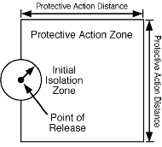
Motivation
Emergency Response Guidebook (ERG)
  Developed by USDOT, and carried by all US, Canadian, and Mexican first responders.
  Provides protective action distances
  (PADs) for hundreds of hazardous materials (HAZMATs).
  PADs are based on extensive
  Monte Carlo analysis conducted
  by Argonne National Laboratory
  (ANL).
  The PAD is defined as the 90th percentile distance at which concentration falls below a specific toxicity threshold, known as AEGL-2.
  The protective action area is a square whose side length is the PAD distance.
http://www.phmsa.dot.gov/staticfiles/PHMSA/DownloadableFiles/Files/erg2008_eng.pdf
Notes:
NATO document ATP-45 is often used to determine hazard areas following CBRN events. However, the ATP-45 boundaries do not correspond to clearly documented health effects, suffer difficulties with variable winds or wind speeds near 10 km/h, and sometimes drastically overestimate downwind hazard distances and areas.

Slide 3
A flexible framework for calculating protective action distances
Want to create something similar for military use.
Methodology
  Perform ensemble of T&D calculations, Monte Carlo-ing over a range of input parameters (such as boundary layer height, atmospheric stability, wind speed, surface roughness).
  For each run, calculate the quantity of interest (dosage, concentration, F_{AEGL}, etc.) at each point in space at the times of interest.
  Group runs into a logical set (e.g., daytime large release, nighttime small release) and, at each point in space, calculate desired percentile of quantity of interest.
  Report results based on resulting single data set.

Slide 4
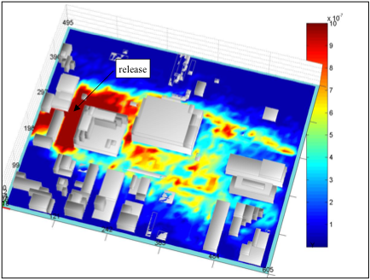
T&D Model: QUIC
Tracer Release in Boston
QUIC = Quick Urban and Industrial Complex
  Particle-based method that runs on a laptop (Windows, Linux, Mac OSX).
  Developed by Los Alamos National Lab (LANL).
  Designed for Urban T&D, but can easily do T&D in non-urban settings
  Fairly easy to run in batch mode.
We’ve written a simple Python interface for QUIC.
qpp = QUIC.InputFile(innerdir+'/QP_params.inp', QUIC.QPParamsDefs)
qpp.setval('z0', 0.01)
qpp.setval('Npart’, 100000)
qpp.setval('duration', 1800.0)
qpp.write()

Slide 5
Acute Exposure Guideline Levels
AEGLs
  Worldwide effort to establish exposure levels corresponding to levels of toxic effects in humans
  Data come from studies on animals (dogs, mice, etc.) and non-lethal studies on humans
  Include toxic load effects
An AEGL has two components:
  A threshold concentration
  An exposure time
3 AEGL severities
  AEGL 1: Discomfort, irritation, or other reversible non-disabling effect
  AEGL 2: Irreversible, long-lasting adverse health effect
  AEGL 3: Life-threatening health effects or death
Notes:
As an example of how much consideration goes into the AEGL values, the technical support document for chlorine contains about 60 pages of content.

Slide 6
Calculating AEGL values from T&D codes
AEGL threshold concentrations are defined for discrete exposure times (10, 30, 60 min, …).
However, the output of a T&D code is a concentration time series.
A method for estimating from the concentration time series the exposure time and the corresponding AEGL threshold dosage is described in S. Stage, Determination of AEGLs in a Dispersion Model, J. Air and Waste Mngmt. Assoc., 54, 49-59, 2004.
This paper also defines a continuous AEGL function, F_{AEGL}, as a function of dosage and exposure time, which equals 1, 2, and 3, for AEGL-1, 2, and 3.

Slide 7
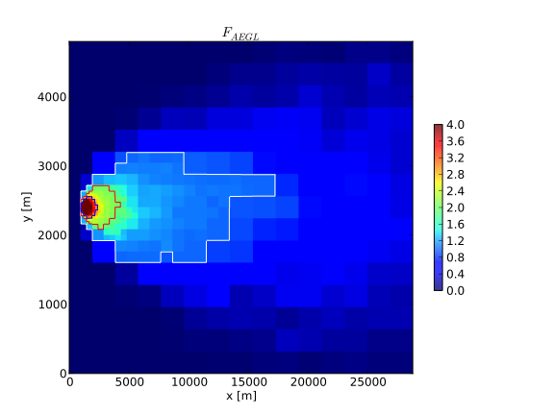
Calculating AEGL values from T&D codes
An additional difficulty is that since we use a particle-based method, we suffer from statistical noise at low dosages.
To overcome this we use an adaptive spatial mesh that grows volume cells until they contain a specified number of particles (typically 64, time-integrated).

Slide 8
Input parameters (for sarin runs)
Release Size
  “Small”: 100 kg instantaneous release of sarin at ground level
  “Large”: 1000 kg instantaneous release of sarin at ground level
Wind speed (1 hour averages); fixed direction for now
  Day releases: Weibull draw with k=1.637 and λ=4.387
  Night releases: Weibull draw with k=1.842 and λ=2.383
Atmospheric Stability
  Day: Choose PGT stability class randomly on {1, 2, 3}
  Night: Choose PGT stability class randomly on {5, 6, 7}
Surface Roughness
  For all releases choose surface roughness uniformly on 2 values: 0.001 m (nearly barren) and 0.05 m (grassland)
T&D calculation duration is 1 hr for all runs.

Slide 9
Methodology (detail)
Perform ~1000 runs, Monte Carlo-ing over input parameters.
For each run, calculate F_{AEGL} at each point in space.
Group runs into logical sets: large/small release, day/night, z0=0.1,5cm, etc.
For each logical set, take 90th percentile of F_{AEGL} at each point in space and draw F_{AEGL}=1,2,3 contours on resulting field.

Slide 10
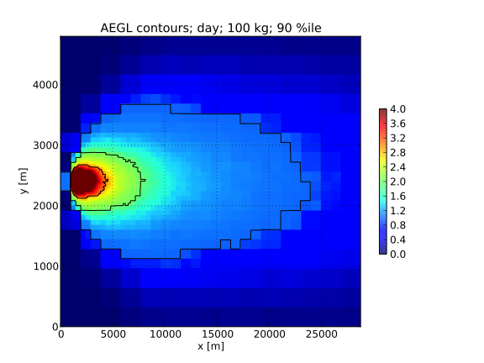
90th percentile F_{AEGL}: small/day
AEGL 3
AEGL 1
AEGL 2
Notes:
Here we present our results for a small (100kg) daytime release of sarin placed at 1km in the x-direction, and with the wind coming from the west. We perform ~150 simulations of small daytime releases, choosing the wind speed, surface roughness, and atmospheric stability class in Monte Carlo fashion. For each simulation we calculate the continuous AEGL function, F_{AEGL}. At each point in our spatial domain we take the 90th percentile of F_{AEGL}, and plot it using the color map on the right. We then draw contours for F_{AEGL}=1, 2, and 3 for the AEGL-1, 2, and 3 values. For this case, the maximum downwind hazard distance for AEGL-2 is 7.1km.

Slide 11
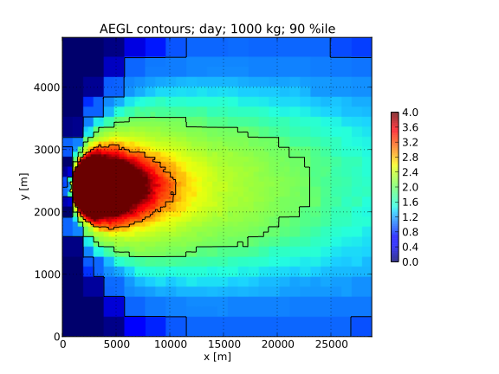
90th percentile F_{AEGL}: large/day
Notes:
Here we present our results for large (1000kg) daytime releases of sarin. Here the maximum downwind hazard distance is 22km.

Slide 12
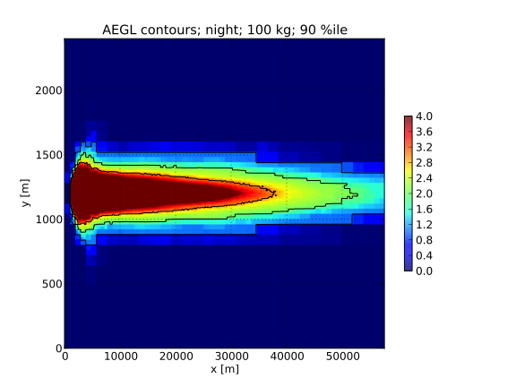
90th percentile F_{AEGL}: small/night
Notes:
For nighttime releases the 90th percentile contours are distinctly different in shape from the daytime contours. The larger crosswind distances near the source are due to the very low wind speeds that sometimes occur.
Most notably for this small nighttime release, the maximum downwind AEGL-2 distance is a very large 52km! We suspect that our use of the extremely stable index 7 atmosphere, combined with the upper end of the wind speed distribution, conspire to produce these large downwind distances.
In reality, however, such conditions may occur only rarely in nature.

Slide 13
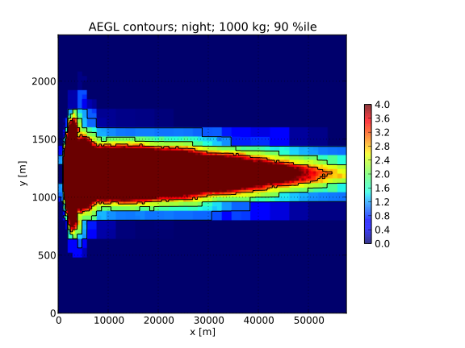
90th percentile F_{AEGL}: large/night
AEGL 3
AEGL 2
Notes:
For the large nighttime release the AEGL-2 contour may extend beyond the computational domain.

Slide 14
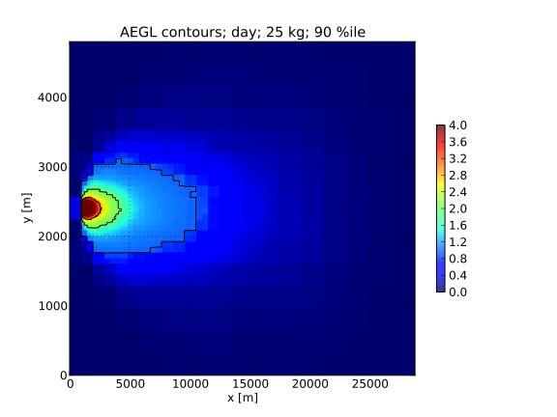
ERG direct comparison:
25 kg sarin release: day, contours at 30 min
ERG gives 2.3 km PAD
We find 3.3 km PAD
Notes:
For daytime releases, we reproduce the ERG downwind distance fairly well.

Slide 15
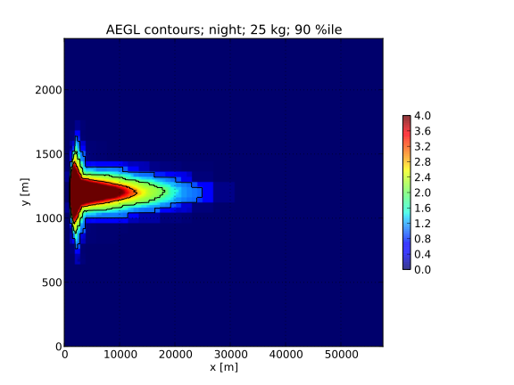
ERG direct comparison:
25 kg sarin release: night, contours at 30 min
ERG gives 4.5 km PAD
We find 17.2 km PAD!
Notes:
For nighttime releases our downwind hazard distance is significantly larger than the ERG 2008 value.

Slide 16
Summary
PAD methodology established.
  Relevant inputs identified.
  Flexible computational framework established.
PADs for sarin computed, but not yet operationally useful.
  Crosswind distances seem reasonable.
  Downwind distances very long, especially at night; raises questions on met inputs.
Since F_{AEGL} is computed and saved at each point in space, method yields protective action regions, not just distances, for any desired level of confidence (percentile).
  For large scale releases in heavily populated areas, the detailed protective action regions may reveal safe pockets, reducing the scale of protective action responses.
  They may also reveal unsafe areas outside the canonical protective action areas.
Use of QUIC allows inclusion of more complex terrain, if desired.

Slide 17
Appendix

Slide 18
QUIC “Validation”/Cross-Comparisons
QUIC vs. Select Prairie Grass Releases
  NOTE: Short range comparison (≤ 800 m)
QUIC vs. ALOHA
  Continuous release
  Concentration comparison (ALOHA AEGL implementation is wrong)
QUIC vs. HPAC
  Several instantaneous release comparisons
  AEGL and dosage comparisons
Notes:
We sought to validate our use of QUIC with one field experiment (Prairie Grass), and to compare it with two other T&D codes (ALOHA and HPAC).

Slide 19
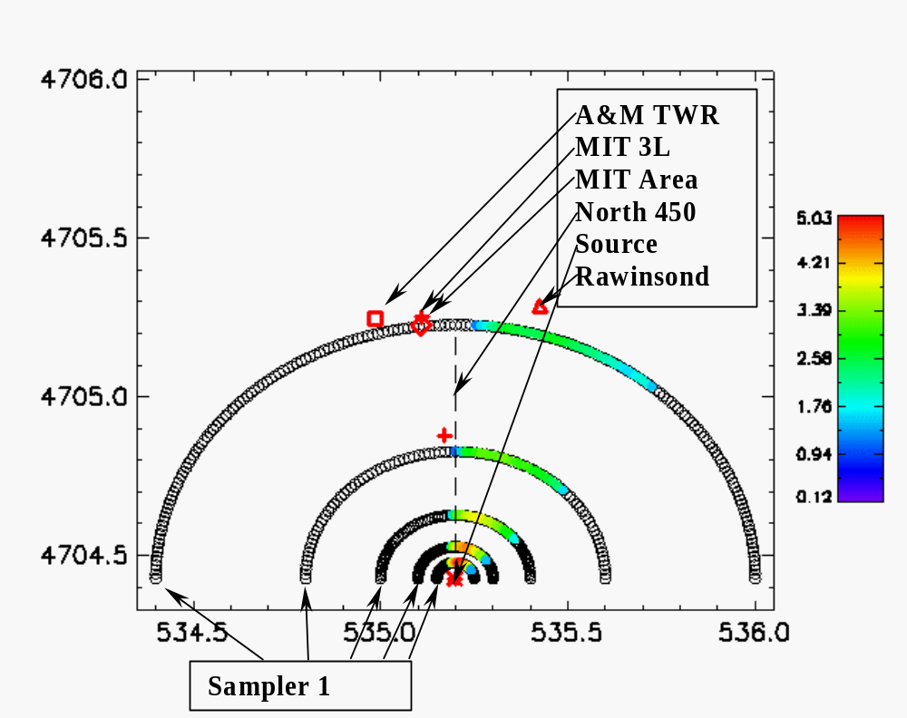
Prairie Grass Review
Prairie Grass Project: large
collaborative effort to study
the transport and dispersion of
a tracer gas (SO₂) in a large open field in Nebraska in 1956.
Copious data and detailed
reports are available.
Sensors placed at height
1.5m in arcs out to 800m.
Wealth of weather data collected with ground instruments, rawin-sonde, and aircraft.
Notes:
Again, we note that the largest downwind distance where measurements were taken in Prairie Grass is 800m.

Slide 20
QUIC Inputs for Prairie Grass Runs
Site info
  Topography, vegetation, etc.
  Surface roughness
Weather
  Wind speed and direction as a function of position and altitude
  Temperature profile
  Relative humidity
  Boundary layer height
  Stability parameter (Monin-Obukhov length)
Simulation parameters
  Source type (basic, dense gas, explosive, etc.)
  Source strength
  Particle splitting
  Wall roughness
Notes:
Fortunately, much detailed information about the Prairie Grass terrain and meteorology is contained in the three published documents detailing the experiment. To successfully compare with the field trials, we note that we turned on particle splitting in QUIC. With this technique, particles are split into lower mass particles when the local dispersant density is below a specified threshold. This allows one to faithfully resolve the very low concentrations that occur far downwind, while keeping the computational cost low.

Slide 21
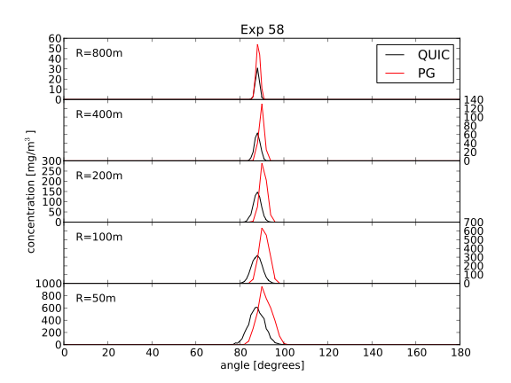
QUIC vs. PG: Stable Case (Nighttime)
QUIC underpredicts PG
Notes:
Here we compare QUIC with Prairie Grass for one of the nighttime field trials for which there was full data coverage. The agreement in both direction and value is good, although QUIC tends to underpredict the experimental values by a factor of about 2.

Slide 22
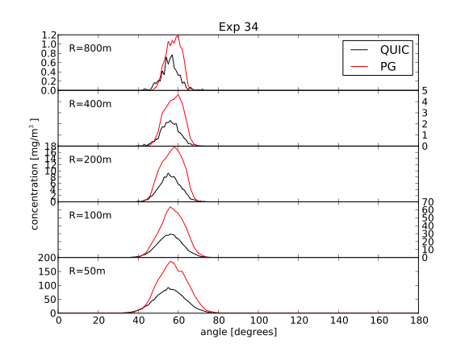
QUIC vs. PG: Neutral Case
QUIC underpredicts PG
Notes:
Here we compare QUIC and Prairie Grass in a neutral atmosphere.

Slide 23
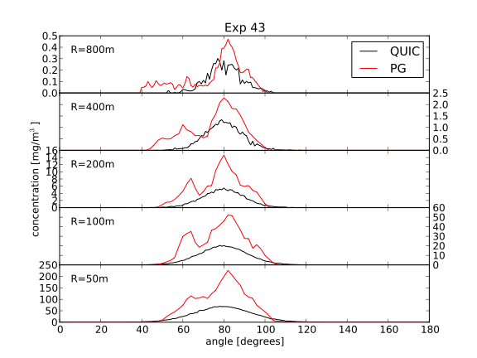
QUIC vs. PG: Unstable Case (Daytime)
QUIC underpredicts PG
Notes:
Here we compare QUIC and Prairie Grass for an unstable, daytime run.

Slide 24
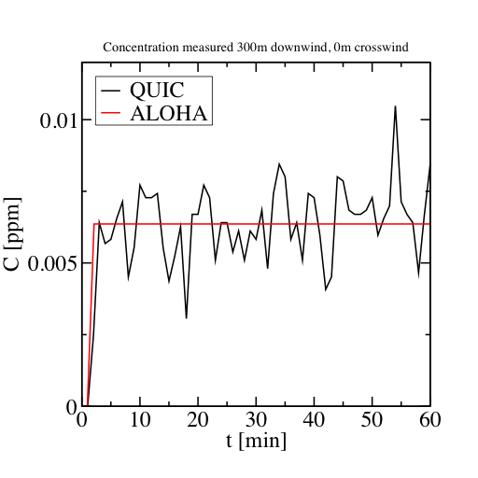
QUIC/ALOHA Comparison (1)
ALOHA uses a simple Gaussian plume model.
ALOHA uses an incorrect interpretation of AEGLS, so we compared concentration (steady-state and time varying) with QUIC for a continuous release of 1kg of sarin over 1 hr.
Parameters: u=3m/s at 2m AGL, z₀=1.2cm, stability class C.
Time series agrees well. Note that fluctuations are due to particle nature of the QUIC T&D method.
Notes:
ALOHA uses the AEGL values incorrectly. For a simulation duration of 60 minutes, for example, it uses the 60-minute AEGL concentrations, and finds the locations where the maximum concentration (in time) exceeds the AEGL values. However, the effective exposure time may be much less than the simulation duration. (For an instantaneous release in high winds, the effective exposure time could be as small as a few minutes.) The result is that the hazard areas drawn by ALOHA are smaller than they should be, since for shorter exposure times, the AEGL concentrations are smaller.

Slide 25
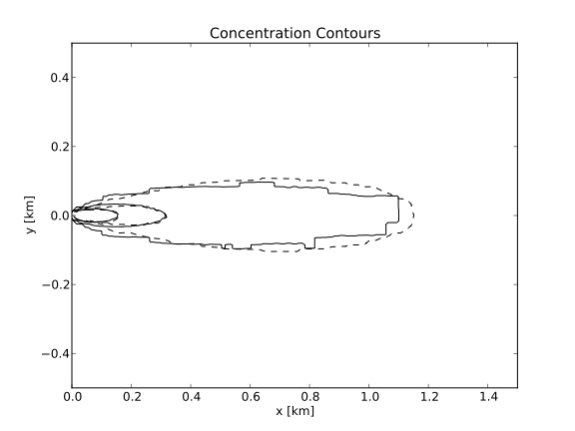
QUIC/ALOHA Comparison (2)
ALOHA
QUIC
4.8x10⁻⁴ ppm
0.022 ppm
0.006 ppm
Concentration contours agree well
Notes:
The agreement between ALOHA and QUIC is quite remarkable, although we note that ALOHA doesn’t perform upwind dispersion while QUIC does. This is most apparent near the source.

Slide 26
HPAC Settings for QUIC Comparison
Analytic Incident model with a 100kg instantaneous release
Fixed wind profile with zero meteorological uncertainty
Large-scale meteorological variability is turned off, since QUIC does not treat it (Want to compare apples to apples)
Conditional averaging is turned off, since QUIC does not treat the effects of weather uncertainty
The DEGRADE module is also turned off

Slide 27
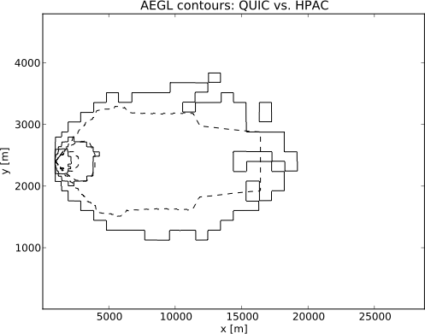
QUIC vs. HPAC: Day, AEGL Contours
Comparable downwind distances for AEGL-1 and 2.
AEGL-3 downwind distance is noticeably larger in HPAC, but the enclosed area is comparable. (Upwind transport is the likely culprit.)
HPAC
QUIC
AEGL-2
AEGL-1
AEGL-3

Slide 28
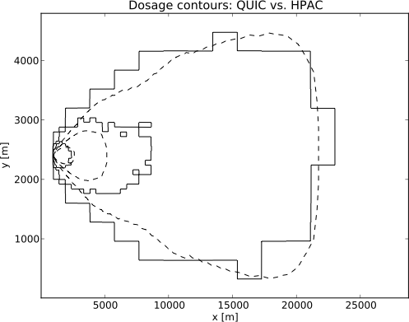
QUIC vs. HPAC: Day, Dosage Contours
Outermost and innermost contours agree nicely.
Surprisingly, intermediate contours (10⁻²
g-s/m³) differ by factor of almost 2 in downwind distance
10⁻³ g-s/m³
10⁻² g-s/m³
HPAC = dashed
QUIC = solid
HPAC
QUIC
10⁻¹ g-s/m³

Slide 29
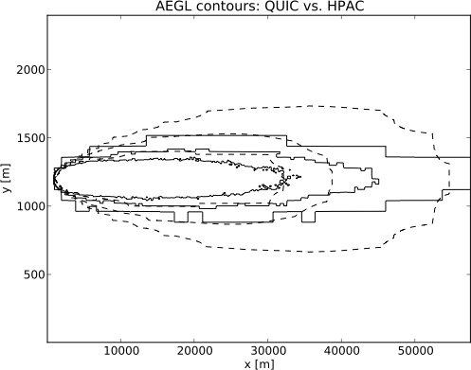
QUIC vs. HPAC: Night, AEGL Contours
HPAC
QUIC
Very nice agreement in downwind distances, but crosswind distances differ by up to a factor of 2.
AEGL-1
AEGL-3
AEGL-2

Slide 30
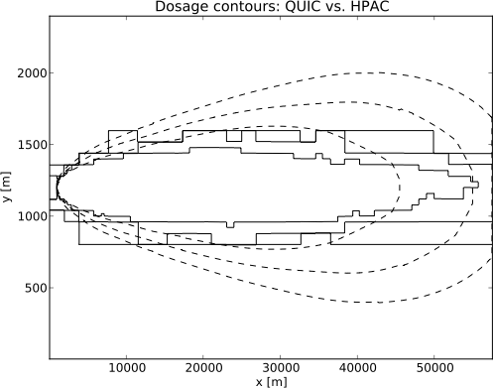
QUIC vs. HPAC: Night, Dosage Contours
Grid was not large enough to resolve QUIC downwind distance, even for the intermediate dosage contour.
Surprisingly, the crosswind distance disagreement is even larger with dosages than with AEGLs.
HPAC
QUIC
10⁻³ g-s/m³
10⁻¹ g-s/m³
10⁻² g-s/m³

Slide 31
Are Fixed Winds the Culprit?
Test by comparing fixed and varying winds using real measured data from the FFT07 data set
  Day: average speed = 3.5 m/s
  Night: average speed = 2 m/s
Results presented in the following slides are for one simulation, not a Monte Carlo average
Preliminary results show that varying wind direction does not appreciably affect downwind hazard distance during the day, but does at night.
Need to perform more simulations to get an understanding of the resulting F_{AEGL} distributions
Notes:
To study the effect of variable winds, we take wind direction data from the FFT07 data set. We average the observed wind data in 5 minute windows over a 30 minute time span. We then rotate them so the average direction is along the positive x-axis. We fix the wind speed at 3.5 m/s during the day and 2 m/s during the night.

Slide 32
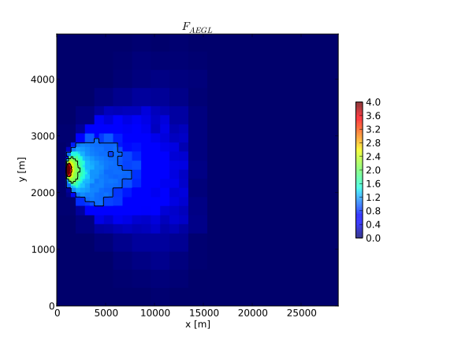
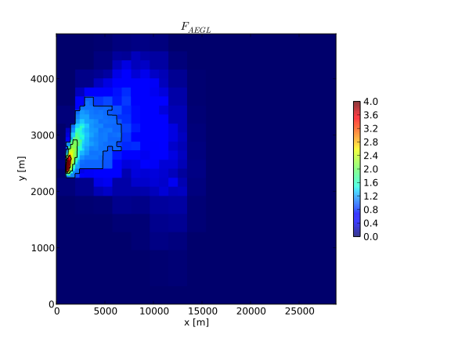
Varying Winds: Day
Fixed Winds
Spatially Varying Winds
Comparable Downwind PADs
Comparable Crosswind PADs

Slide 33
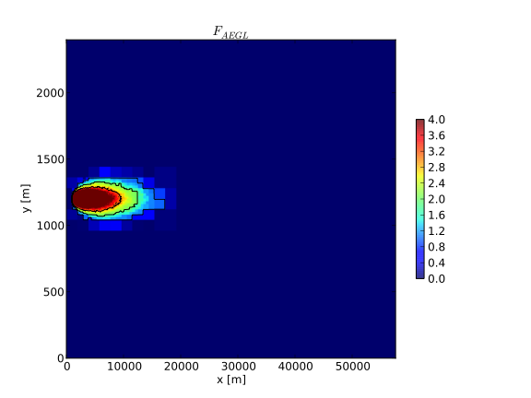
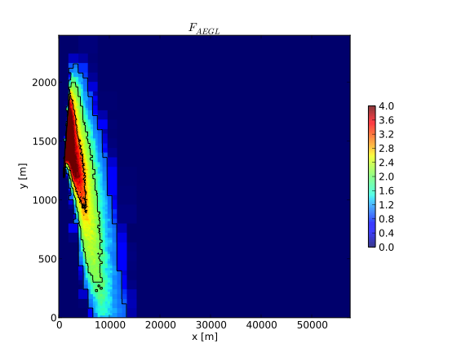
Varying Winds: Night
Fixed Winds
Spatially Varying Winds
Comparable Downwind PADs
Crosswind PAD Significantly Larger for Varying Winds
Notes:
If one takes as the definition of the downwind distance the largest distance from the source that a non-negligible amount of dispersant reaches, then as seen in the rightmost plot the downwind distance in this case is significantly larger when the wind has variable direction. Note that the average wind direction over the duration of the simulation in the rightmost figure is parallel to the x-axis.

Slide 34
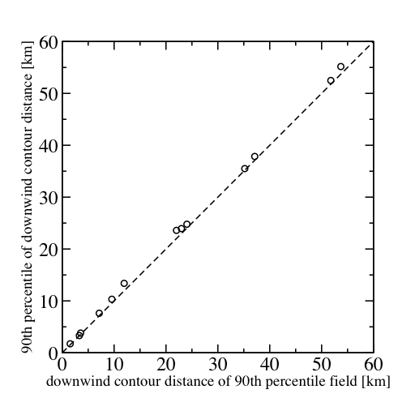
Downwind Distances on 90th Percentile Field
Is taking the downwind distance on the 90th percentile AEGL field equivalent to taking the 90th percentile of the downwind distance?
Notes:
For each set of parameters (night/day, large/small release) and for each AEGL value (1, 2, 3) we record the maximum downwind distance of the contour drawn from the 90th percentile of the continuous AEGL function (our standard method), and also record the 90th percentile of the maximum downwind distance of the contour drawn from the AEGL function for each run. As this plot shows, the two methods are essentially equivalent.

Slide 35
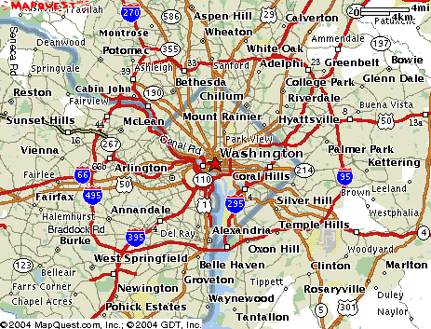

Largest ATP-45 Chemical Template Encloses DC Beltway
My House
Template area: 1560 km²
Area of Rhode Island: 2706 km²
Population of Wash. DC alone: 572059 (2000 Census)
Land area of Wash. DC:
159 km²
50 km
Notes:
As shown in the slide above, the largest chemical template has a downwind hazard distance of 50 km and encloses an area of 1560 km² (note that the area is larger than that of a equilateral triangle of height 50 km; this is because the downwind hazard distance is measured from the center of the attack circle). The template is seen to enclose the Washington DC Capital Beltway. A lower bound on the number of people enclosed by the template can be estimated as follows. According to the 2000 U.S. Census, Washington DC has 572059 residents and a land area of 159 km², giving an average population density of approximately 3600 persons/km². Assuming a population density of one tenth of this value for the enclosed land area outside of Washington DC (likely a low estimate), (1560-159) km² =1401 km², one gets a total enclosed population of about 108 million.

Slide 36
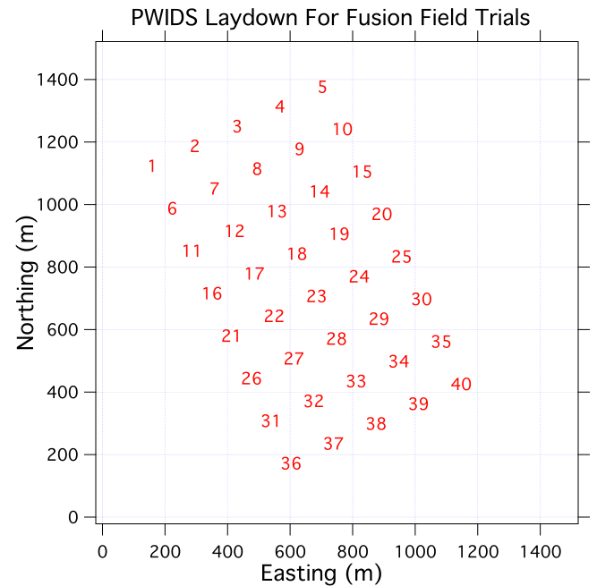
Wind Inputs
Wind speed distributions extracted from 1 month of wind data collected from array of 40 Portable Weather Instrument Display Systems (PWIDS) during DTRA-sponsored Fusion Field Trial Tests (Dugway Proving Ground, Sept. 2007)

Slide 37
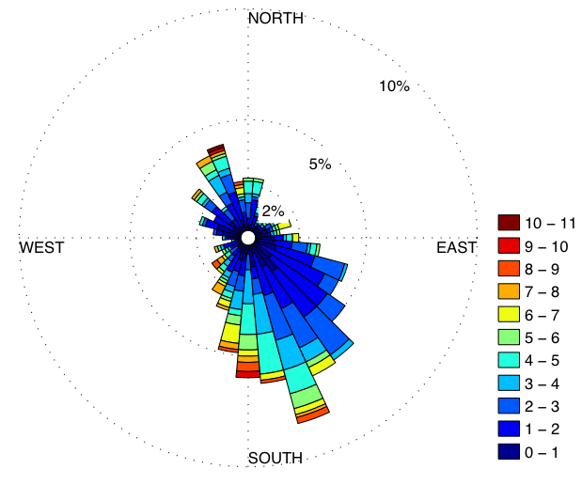
1 Hour Average Wind Rose
(m/s)
Winds are predominately from SSE, explaining the orientation
of the PWIDS array

Slide 38
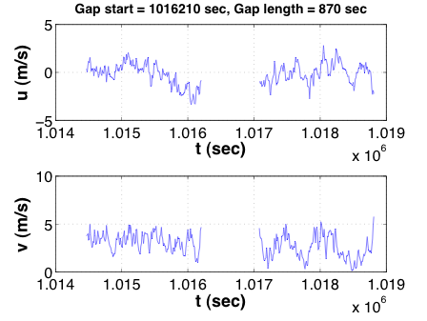
Wind Processing: Raw Data
Raw wind data
  Wind speed components (U and V) measured at each PWIDS at 10 second sampling interval for ~ 30 days: 259170 points per time series
  Elevation: 2m AGL
Data Dropouts
  No single PWIDS time
  series spans entire month
  Dropout rates range from
  ~ 1% - 32% across the
  array
PWIDS 28

Slide 39
Common Wind Speed Distributions
Rician Distribution
  If x and y are uncorrelated zero mean Gaussian random variables with standard deviation σ, then
  with A>0, is a Rician random variable
Weibull Distribution
  k is shape parameter; λ is scale parameter
Notes:
There are at least two common wind speed distributions in use in the literature.

Slide 40
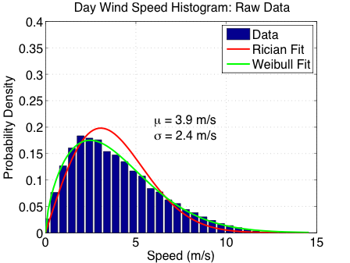
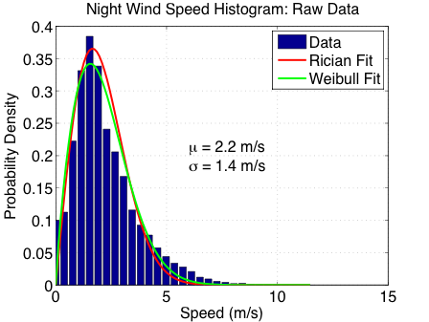
Day and Night Wind Speed Histograms
For purposes of this study, day and night are 6 hour intervals defined as follows:
  Day: 10:00 ≤ local time ≤ 16:00
  Night: 22:00 ≤ local time ≤ 04:00 (NOTE: Times are not DST)
Histograms for 10 sec (“raw”) sampling rate
Day and night histograms well modeled by Weibull distribution
Day and night histograms well-modeled by Weibull distribution
Notes:
Note that these histograms are for the full, 10-second time resolution data.

Slide 41
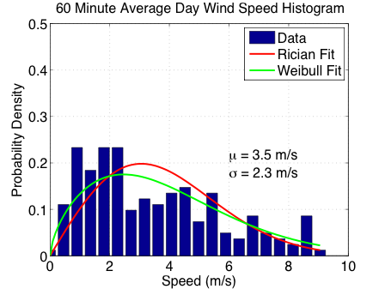
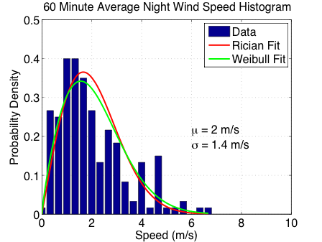
1 Hour Average Wind Speed Histograms
Day Night
  k= 1.637; λ =4.387
  k= 1.842; λ =2.383
Notes:
We are interested in the average wind speed over longer intervals than 10 seconds, so we average the wind speeds over a 1 hour time window. We then fit a Weibull distribution and extract its parameters for night and day.

Slide 42
Wind Processing: Filling Gaps
Goal: Construct continuous time series for U and V that span entire month
  Find PWIDS detector with a low dropout rate and whose longest gap is among the shortest
  Where possible, replace gaps with spatial average of nearest neighbors
  Replace remaining single point gaps with time average of two immediate neighbors in time
  Replace remaining multiple point gaps with points generated from Autoregressive (AR-1) model (see backup slides)
PWIDS # | # of Gaps | Longest Gap | Dropout rate (%)
14 | 1948 | 114 | 0.752
28 | 1961 | 106 | 0.757
18 | 1978 | 113 | 0.763
10 | 2096 | 141 | 0.809
38 | 2172 | 119 | 0.838
Notes:
Here we describe our procedure for filling the numerous gaps that exist in the FFT07 wind speed data.

Slide 43
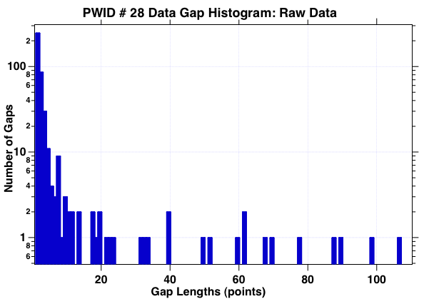
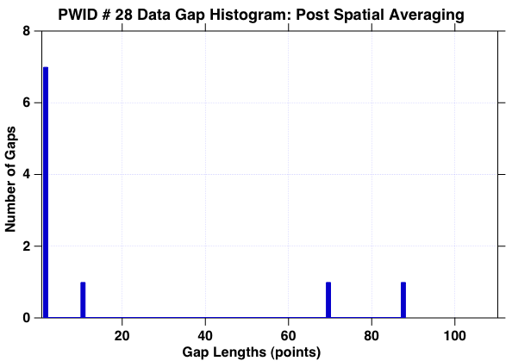
Wind Processing: Spatial Averaging
Before Spatial Averaging:
1961 gaps, many large gaps
After Spatial Averaging:
10 gaps, 3 of length > 1
Notes:
One of the techniques we use for filling data gaps is spatial averaging of the samples.

Slide 44
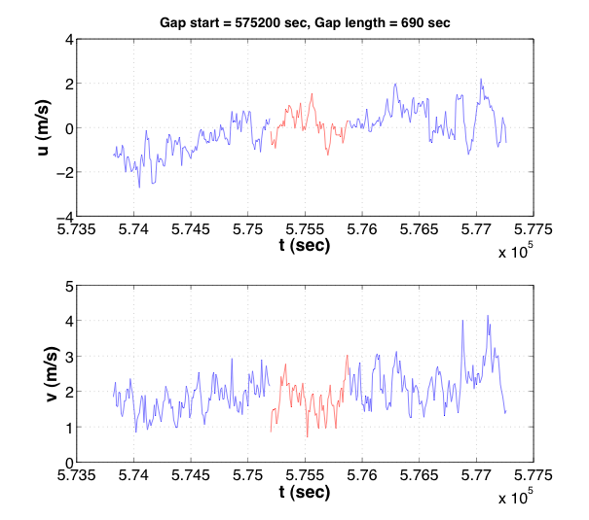
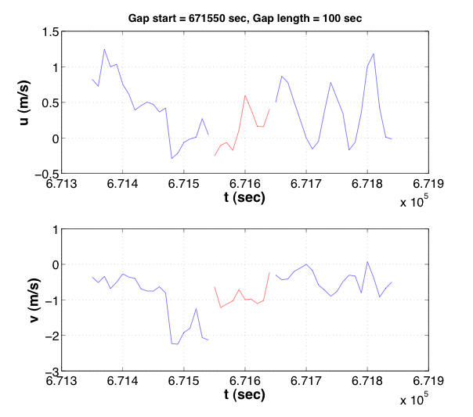
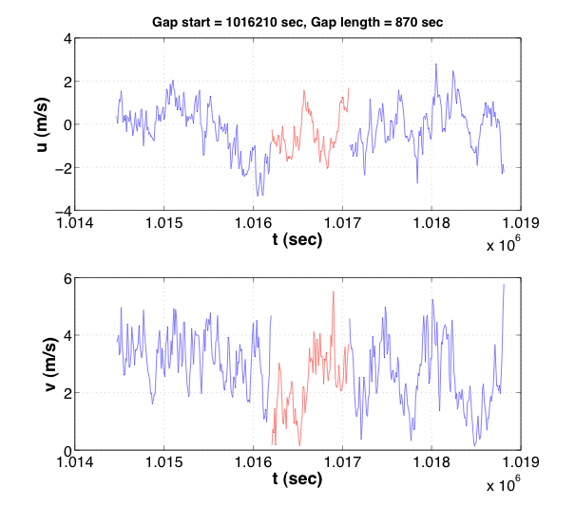
Wind Processing: Filling Large Gaps
Gaps are filled with AR-1 statistical model
Parameters c, φ, and σ_{ε} are determined by mean, variance, and autocorrelation of surrounding data
Zero mean Gaussian random noise,
with variance σ_{ε}
Notes:
To fill the longer gaps that can’t be filled by temporal or spatial averaging, we employ the AR-1 statistical model.

