Slide 1
Modeling the Dispersion and Transport of Aerosols Emitted from an Industrial Facility During the 2005 and 2008 Outbreak of Legionnaires’ Disease in Norway
15th Annual George Mason University Conference on
Atmospheric Transport and Dispersion Modeling
H. E. Fossum
M. Tutkun
B. Anders Pettersson Reif
Ø. Andreassen
Fairfax, VA
July 12, 2011

Slide 2

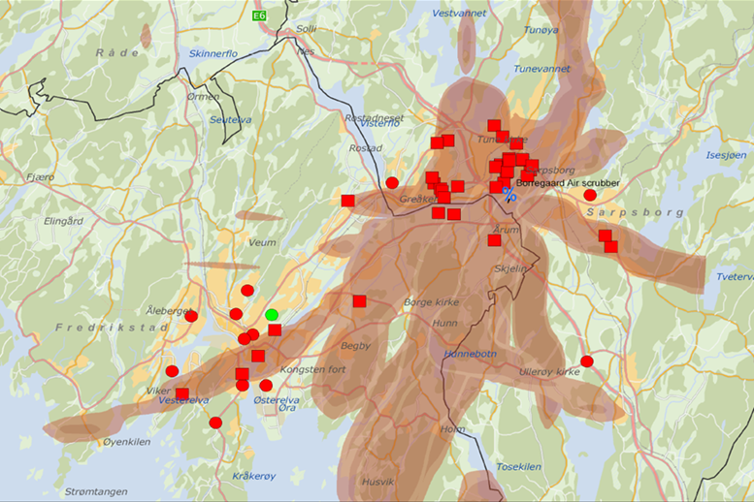
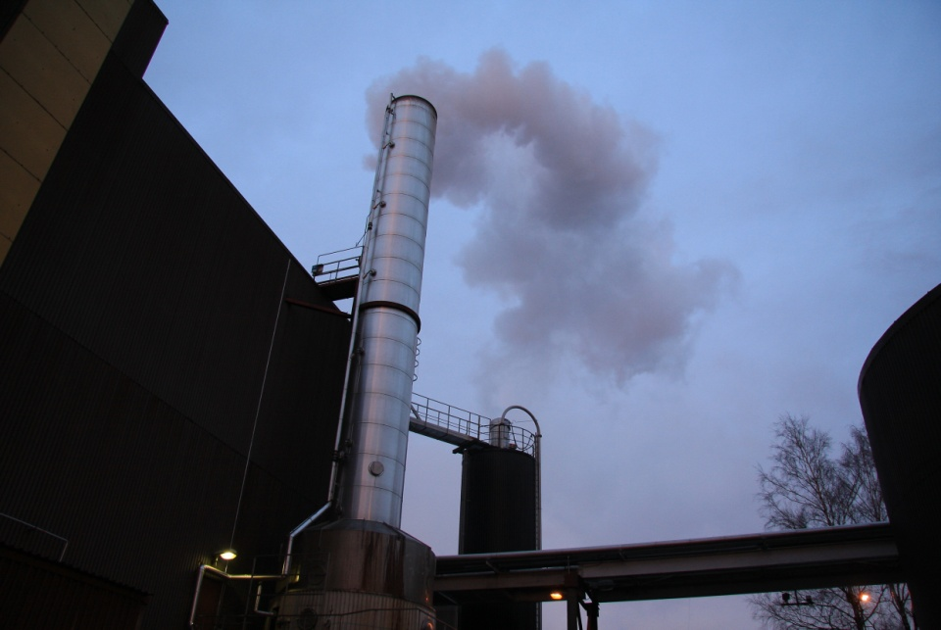
2005 and 2008 outbreaks of Legionnaires’ Disease
Two largest outbreaks ever recorded in Norway
The Norwegian Institute of Public Health concludes
Reason: Long-distance aerial transport of aerosols containing
Legionella bacteria (> 10 km)
Source: Borregaard Industries
Consequences:
More than 100 persons infected
10 persons died
10 km
One of the air scrubbers at Boregaard
Clinical Infectious Diseases Volume 46, Issue 1, Page 61–69, Jan 2008

Slide 3
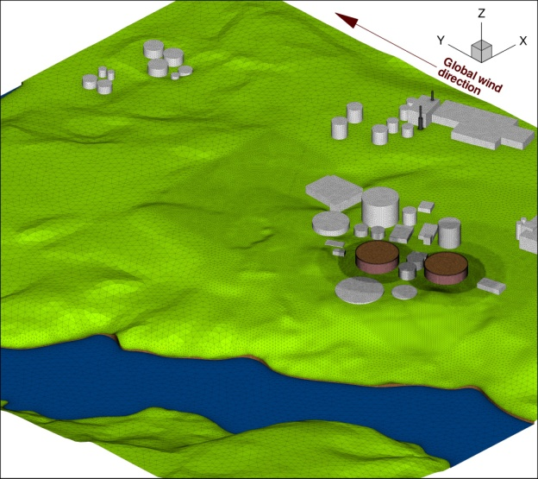
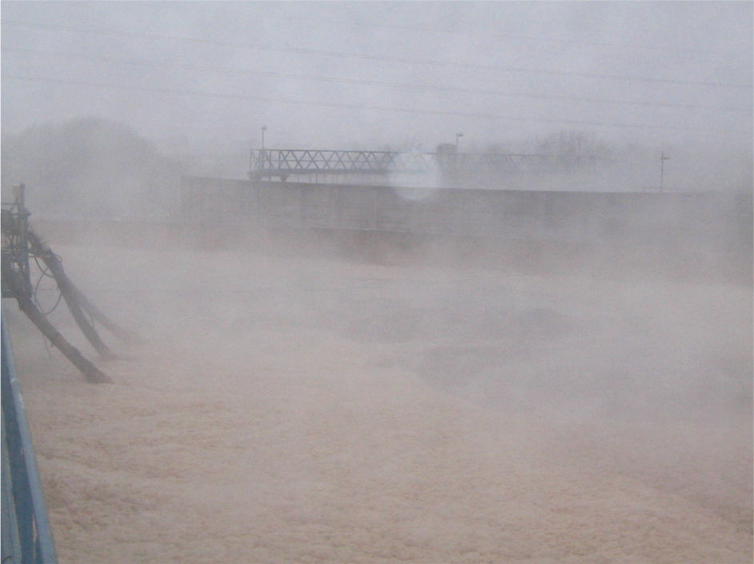
2005 and 2008 outbreaks of Legionnaires’ Disease
Two largest outbreaks ever recorded in Norway
Two possible dissemenation routes
were initially considered:
The biological treatment plant at Borergaard Ind. (aeration ponds)
  40 m diameter, 12 m deep
  Release at ground level
  Low-momentum source
  30.000 m³/h air from each pond
Aerosol dispersion from air scrubbers.
  Release 25 m above ground
  High-momentum source (20 m/s)
  60.000 m³/h of air + water 4 m³/hour from each scrubber
Authorities conclude:
Air scrubbers most likely source

Slide 4
Objectives
Seeking answers to …
Are the air scrubbers particularly well suited to disperse aerosols over large distances (> 10 km) retaining significant plume concentration levels?
Can aerosols generated at the areation ponds be transported over long distances (>10 km) retaining significant plume concentration levels?
Can Legionella containing aerosols from the areation ponds contaminate the air scrubbers ?
What are the ground deposition characteristics of aerosols emitted from the ponds?
…

Slide 5
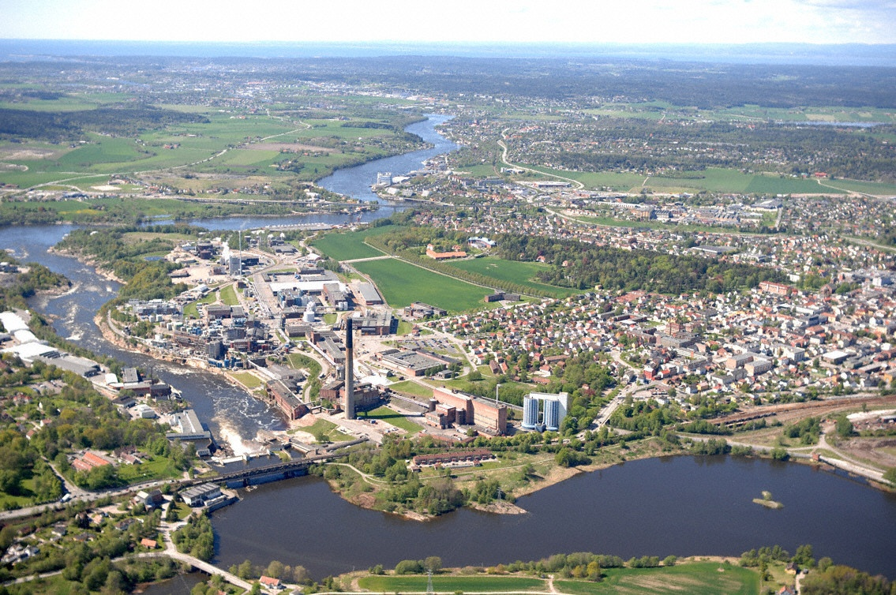
Fredrikstad
River Glomma
Sarpsborg

Slide 6
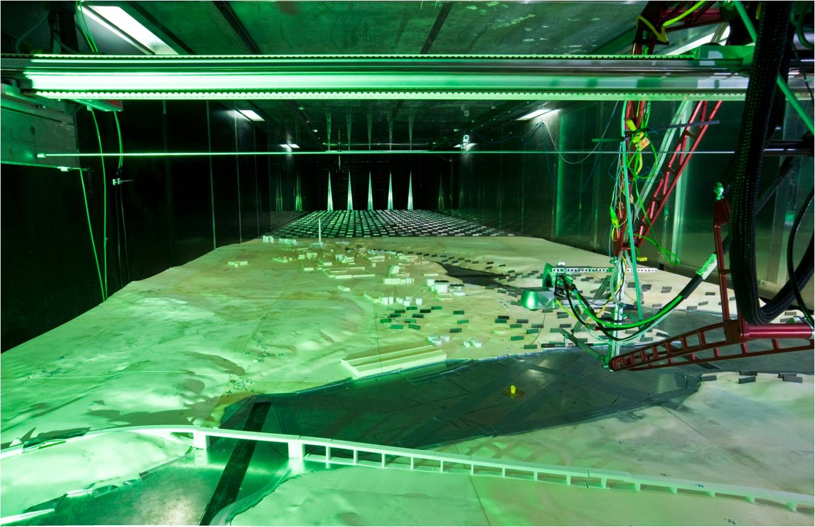
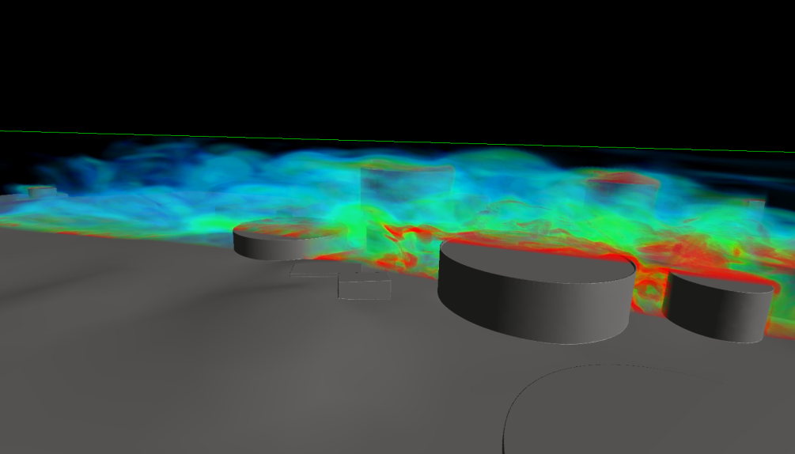
Methodologies
Wind-tunnel experiments
  Environmental Flow Research Center (University of Surrey, UK)
    20 m x 3.5 m x 1.5 m
  Model scale:1:500 (5 x 1.7 km²)
  Isothermal and stable conditions
  LDA (Laser Doppler Anemometry)
  FID (Fast Flame Ionization Detector)
  Tracer gas: mixture of propane/air
Large Eddy Simulations
  Dynamic Smagorinsky
  Passive scalar field
  Lagrangian discrete particles
    2 and 18 μm (measured)
  Computational domain:
    700x800x400 m³
    42 x10⁶ cells
  Δt = 0.015 s
  Statistics collected >16000 time steps

Slide 7
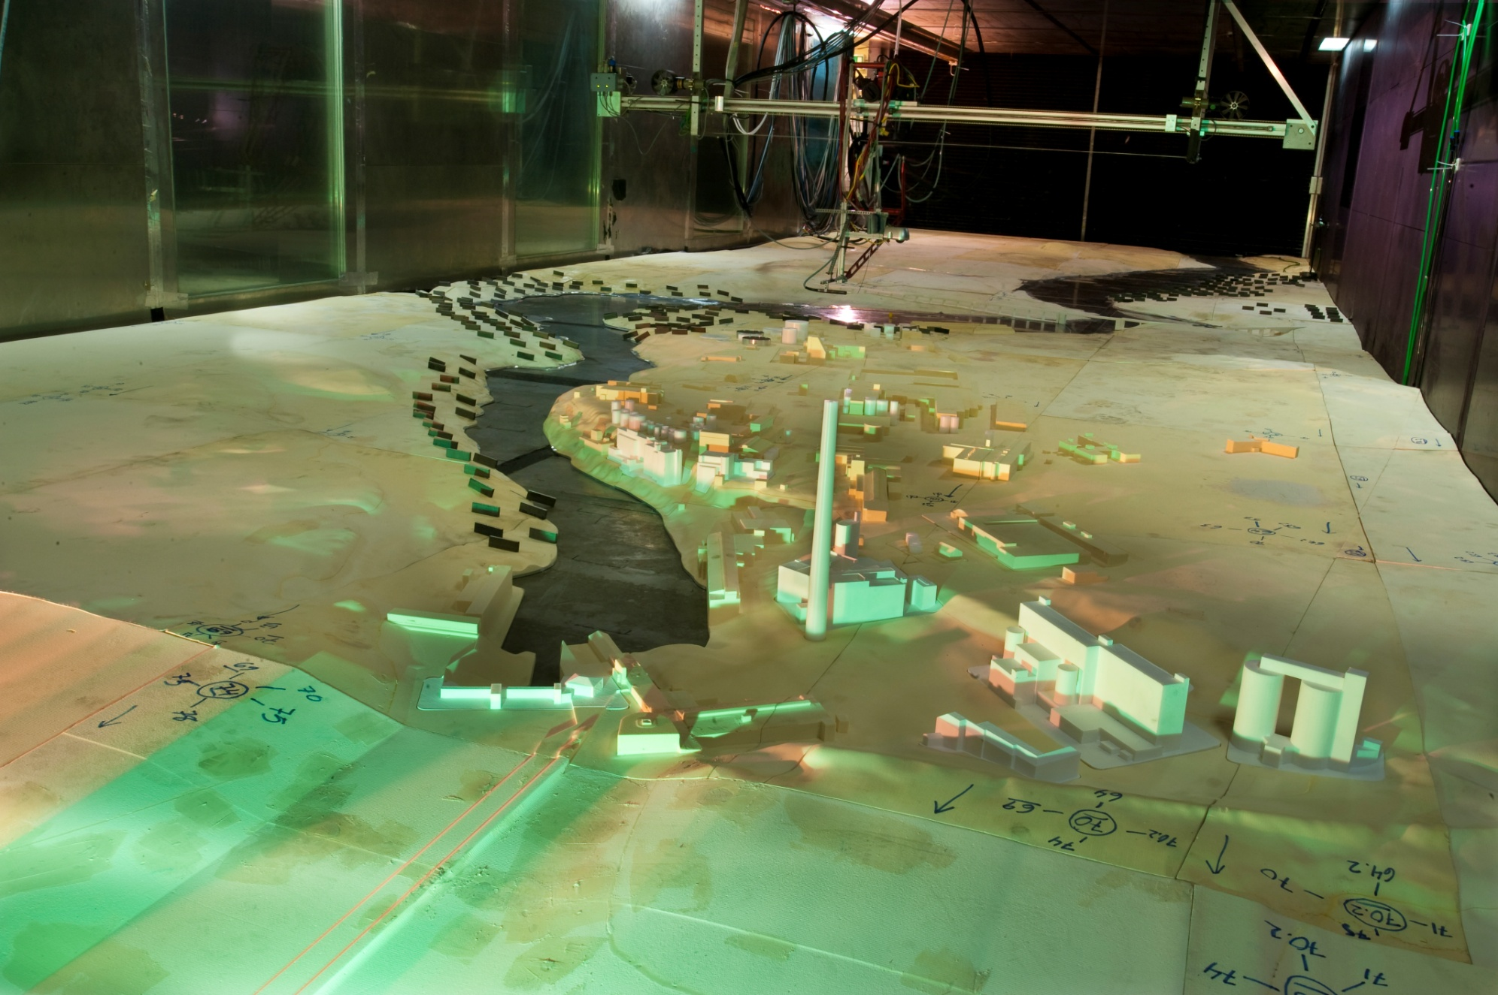
Atmospheric stability
Neutral conditions
Isothermal environment
Free stream velocity: 2.5 m/s
Stably stratified conditions
Free stream velocity: 2.5 m/s
Glomma river (WT floor): 8 ºC
V ceiling: 80 ºC
T(z) varies approximately linearly at WT inlet
(20 – 80 ºC)
During outbreaks 2005 and 2008
Neutral/unstably stratified conditions!
Dynamically stable conditions: z > 20 m

Slide 8
Neutral (isothermal) atmospheric conditions
No significant difference between the air scrubbers and areation ponds
’Conservative’ extrapolation
Deposition neglected (ca 15-25%).
(also Vegetation neglected that would increase deposition)
Flat/smooth terrain wo/buildings > 3000 m.
Not realistic → incresaed mixing expected in real life
< 0,1 % of source concentration > 10 km!!
Scrubbers vs ponds
no difference > 1000 m from source

Slide 9
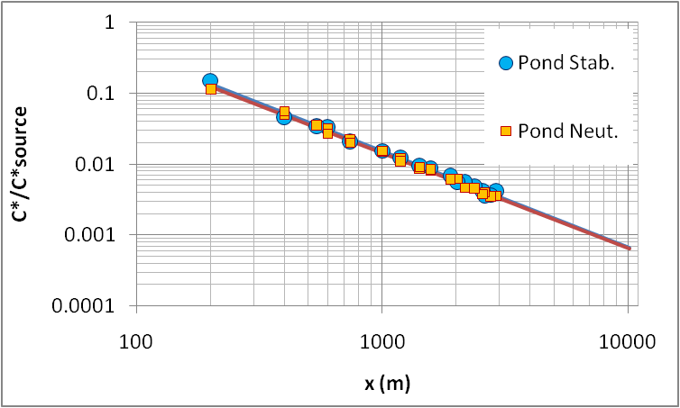
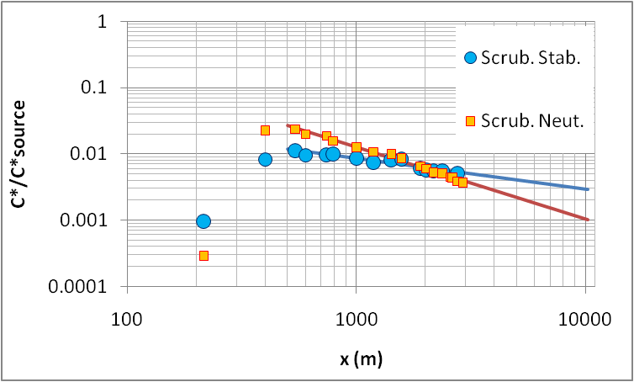
Emission (mean) from the ponds are not affected by the stratified atmospheric condition even at long distances.

Slide 10
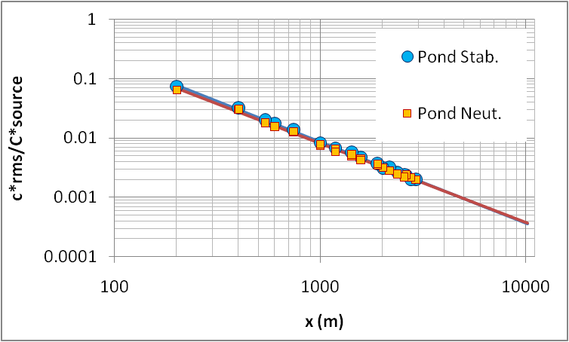
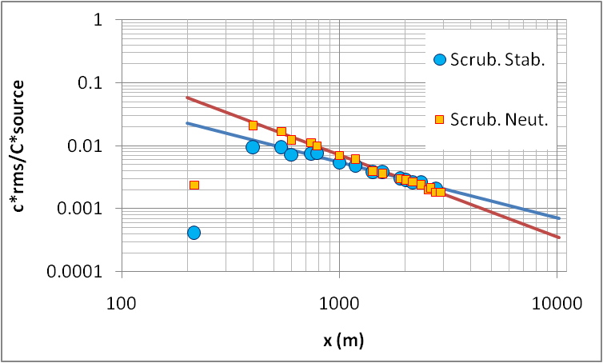
RMS fluctuations Release from the ponds also seem to be insensitive to different atmospheric conditions.

Slide 11
Operational models
Tentative results indicates challenges associated with source description
What happens in the near field?

Slide 12
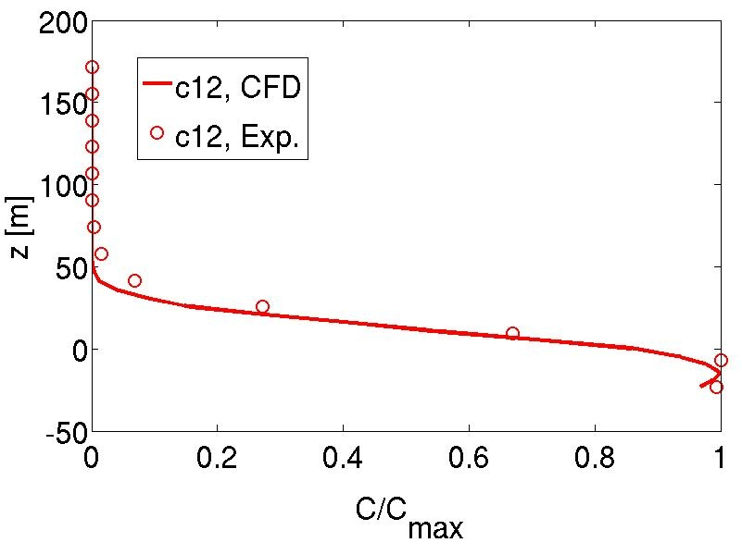
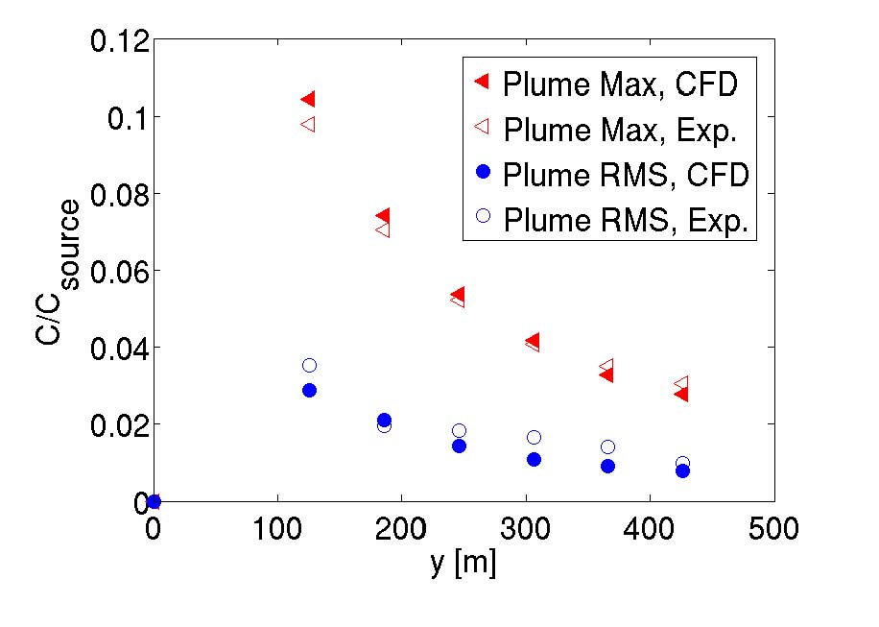
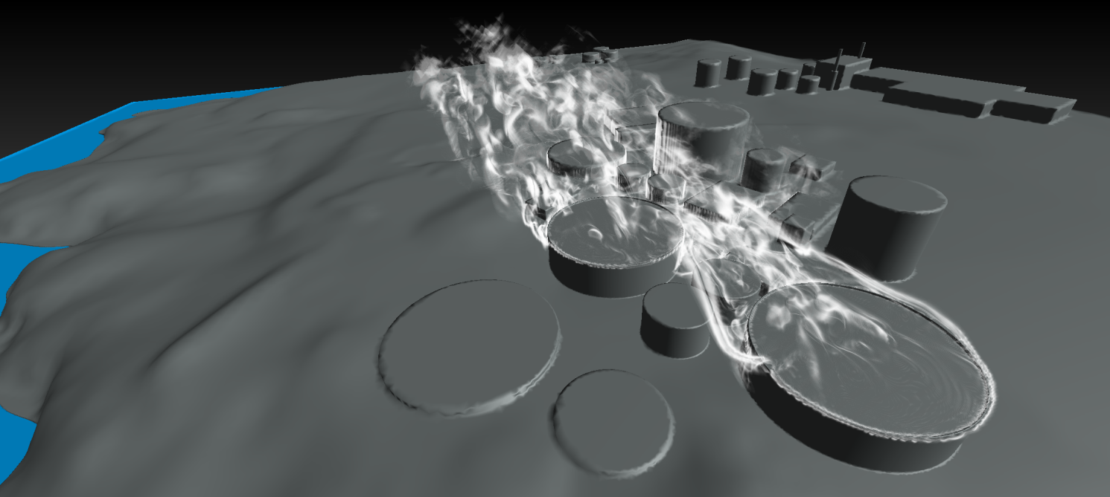
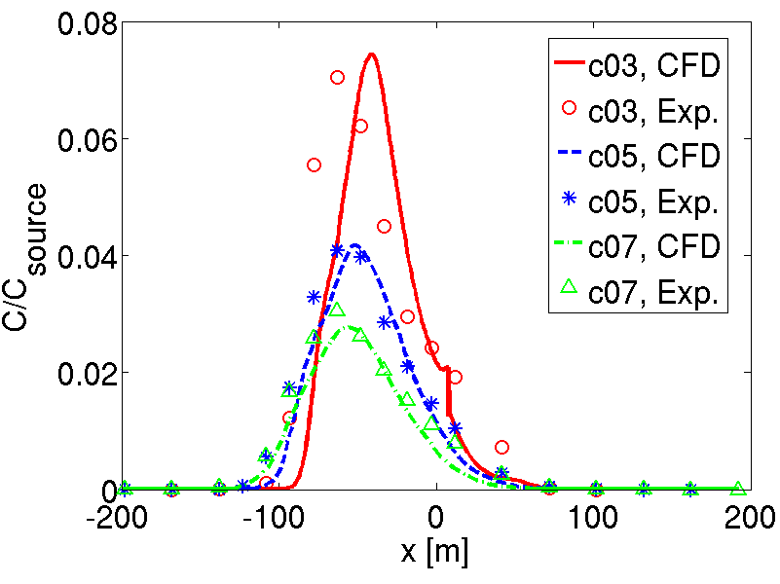
Plume height
Mean concentration
Plume deacy
Downstream development
10 m from ground
Plume width
Mean concentration

Slide 13
Concluding remarks
Rapid plume concentration decay;
  ~ 0.01 % at 10 km
Long distance transport from Borregaard Ind. is unlikely (given the atmospheric conditions during the outbreaks)
The difference in the plume position/strength emitted from the two sources cannot be distinguished (assuming same strength):
  > 1000 m (neural)
  > 1300 m (stably stratified)
Source characteristics only important in the near-field
Contamination of scrubbers max ~ 10% of ponds source concentration.
Air scrubber unlikely the emission source at the outbreaks 2005 and 2008

Slide 14
Final remark and lesson learned
The study has clearly demonstrated the importance to consider each and every local-scale dispersion incidence individually.
’Bad news’ (although not surprising)
Details matters if plume dimensions ~ O(atmospheric boundary layer thickness). No general rule-of-thumb exists for near-field dispersion processes …
Multidiciplinary challenges that requires close collaboration between persons with different background (biology, physics, mathematics, informatics, engineering, end-users, …)
Acknowledgements
Professor Alan Robins (University of Surrey),
Drs Viggo Waagen (Borregaard), Paul Hayden (University of Surrey), Anders Helgeland (FFI), Janet Blatny (FFI)
Emma M. M. Wingstedt (FFI), Jasmina Koric (FFI), Jan Rune Nilsen (FFI), Per Arne Ulseth (FFI), Sarpsborg kommune, and Fingal Olsson.

Slide 15
Thank you for the attention !
Questions ?

Slide 16
Justification using tracer gas
Stokes number Ratio between the particle relaxation time T = ρ_{p}d²/(18μ), and the
characteristic time scale (t) for the wind field.
A priori estimate global Stokes number
Aerosol (H₂O) density: 998kg/m³ (at 20C),
Molecular viscosity: μ_{air} = 1.67x10⁻⁵ Ns/m² (at 20C),
Characteristic wind field time scale t ~10⁻¹ s
Aerosol diameter d < 20μm:
St_{max} = T/t ≈ 3.7x10⁻² << 1
Consistency check
St = St(x, t)
Wind field time scale
t = t(x,t) = 1 /|S|

Slide 17
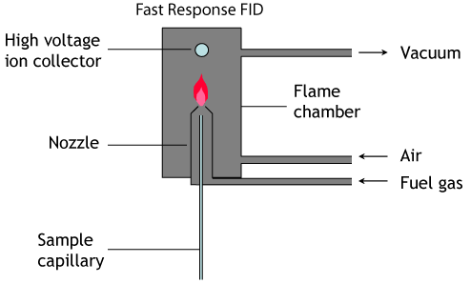
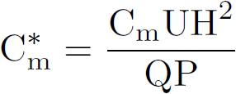
Non-dimensional concentration (C*)
Tracer
(propane-air)
C_{m} : Measured concentration (ppm) using Fast FID
U : Characteristic velocity scale
H : Characteristic height
Q : Flow rate of the release from the sources
P : Ratio of the propane in the released gas from the sources

