Slide 1





Validating local-scale airborne hazard models
– possibilities, limitations and challenges
B. Leitl , S. Trini Castelli , T. Reisin , K. Baumann-Stanzer , F. Barmpas
COST Action ES1006
joint effort of 19 COST countries

Slide 2
Motivation
how safe are we regarding small-size/local-scale releases of airborne hazards? ('Seveso Directives' 85/201 EWG, 96/82 EG, 2003/105/EG etc.)
information data bases indicate increasing number of local-scale incidents (UK Health and Safety Executive, ARIA BARPI, Ility Engineering, Infosis/ZEMA, …)
increasing need for disaster protection and effective emergency response and management tools
variety of different tools is developed / applied in local-scale airborne hazard management
… different model approaches matter of opinion ?

Slide 3
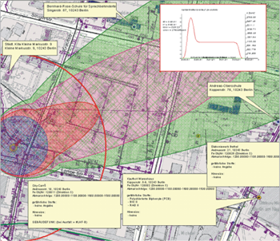
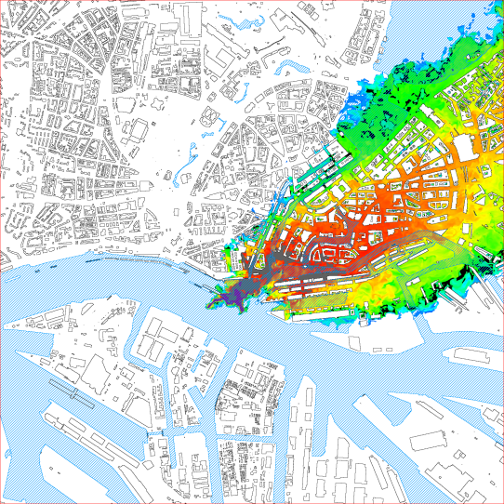
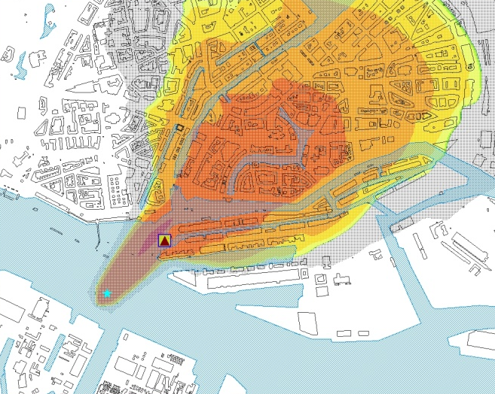
Motivation
… when to use which type of tool ?
… how to apply a tool to obtain adequate/reliable results?
… where to get which reliable simulation input data?
… how safe/unsafe are the predictions?
… how to improve reliability of predictions?
DISMA, TÜV Rheinland
Fast3D-CT, NRL
CT-Analyst, NRL

Slide 4
Objectives
definition of relevant threat scenarios
compilation of a model inventory
defining measures for model performance regarding
… 'accuracy' of dispersion modeling
… efficiency / speed (computational demands)
… manageability (operational demands)
… information output
…

Slide 5
Objectives
definition of methods for application-specific benchmarking / development of tools and means for efficient testing
identification of limitations in currently applied model approaches
development of strategies for model improvement
best practice guidance for implementation and use of existing emergency response model approaches

Slide 6
Working Groups
Working Group 1 (input)
'Threats, Models and Data Requirements'
structured catalogue of threat scenarios and source terms of concern
compilation of test data sets qualified for evaluating and quantifying the reliability of emergency response models
a strategy to benchmark and improve local-scale airborne hazards modelling

Slide 7
Working Groups
Working Group 2 (modelling)
'Test, Evaluation and Further Development'
application-oriented quality assurance procedures
Detailed quantitative documentation of scientific and applied modelling capabilities
new improved modelling concepts

Slide 8
Working Groups
Working Group 3 (output)
'Applicability, Implementation and Practical Guidance'
documentation of recommended application-oriented procedures for modelling of threats
information on what type of 'tool' to be used for which type of threat scenario with confidence
quantitative information on reliability/uncertainty of model results at application level
practical guidance for the optimum use of modelling approaches

Slide 9
Output
current Action website http://www.cost.esf.org/domains_actions/essem/Actions/ES1006
annual workshops / symposia
Year 1 - The state-of-the-art in emergency response modelling
Year 2 - Quantifying uncertainty in emergency response modelling
Year 3 - Improving the quality of emergency response modelling
Year 4 - Future emergency response modelling

Slide 10
… thank you for your attention.

