Slide 1
Large Eddy Simulations of the release of liquified chlorine from a pressurized tank
Thomas Vik
Bjørn Anders P Reif

Slide 2
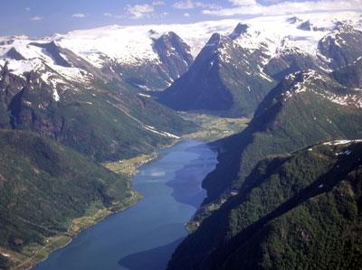
Background and motivation
Interested in dispersion of dense gases
Complex terrain
Numerical simulations of the release of chlorine
Compare with Jack Rabbit field trials

Slide 3
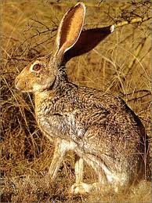
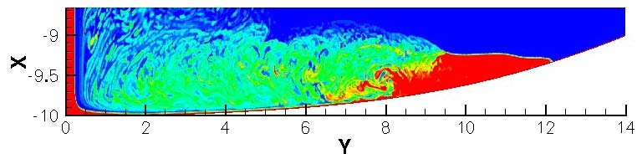
Jack Rabbit field trials
Conducted at Dugway Proving Ground, Utah, USA 2010
Initiated by the US Department of Homeland Security
Tests to study the soure term (not transport term)
Depression beneath the jet to capture the material → simulate a much larger release.
FFI:
  Initial simulation to aid in experimental setup
  Perform detailed CFD, compare with experiment
Initial axi-sym 2D RANS
Vapour mass fraction →
when release is finished
2D slice, axisymetric about x-axis.
Release point av Y = 0, X = -7

Slide 4
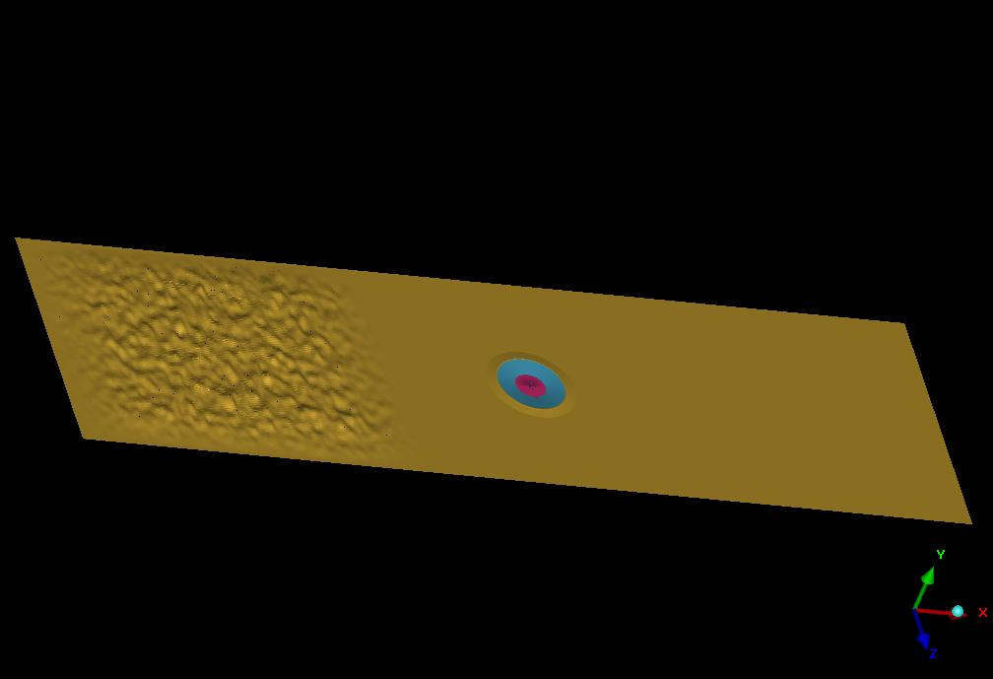
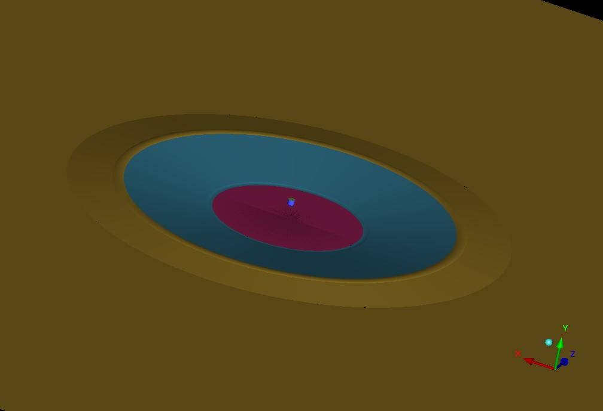
LES
Fluent
  Smagorinsky-Lilly
  Species transport
Computational domain: 655 x 200 x 36 m³
26 M grid cells
Bumps to generate incoming turbulent boundary layer

Slide 5
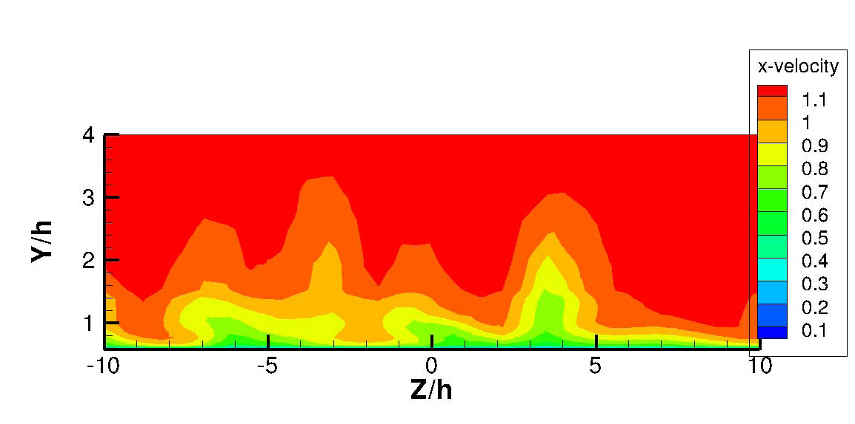
LES (2)
Upstream boundary conditions
  Plug flow with U = 1 m/s → atm boundary layer developed over bumps
  Instantaneous streamwise velocity upstream the depression
  h = depression depth (2 m)

Slide 6
Chlorine release
Circular chlorine jet:
  r = 24.5 cm
  m_{liq} = 82.38%, m_{vap} = 17.62%
  mass flow = 67.2 kg/s
  T_{jet} = 239.05 K
  T_{air} = 278.15 K
32.9 s release time (2000 kg released)
Phase transition:
  Q_{air} + Q_{cl2} – Q_{L} = 0 → T_{mix}
  ρ_{mix} calculated with the ideal gas law
In the following figures: chlorine release starts at t = 0s; ends at t = 32.9 s

Slide 7
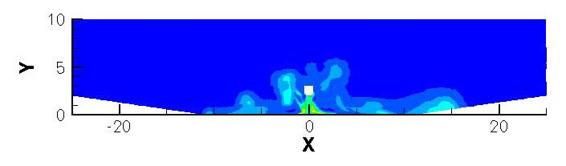
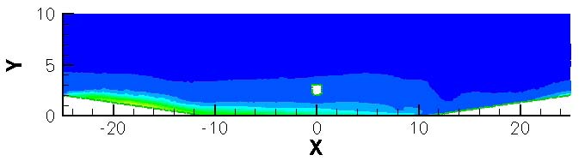
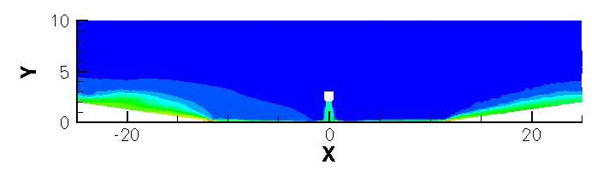
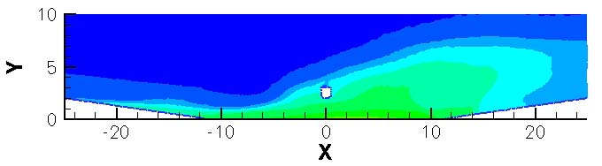
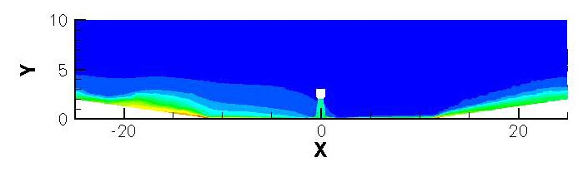
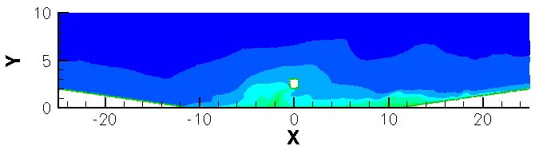
Results:
Vapour mass fraction, streamwise plane
t = 1 s
t = 41 s
t = 20 s
t = 51 s
t = 32.9 s
t = 61 s

Slide 8
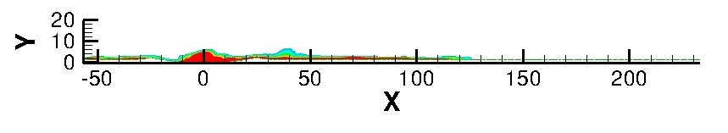
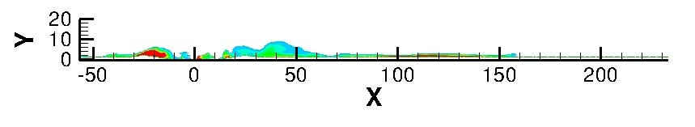
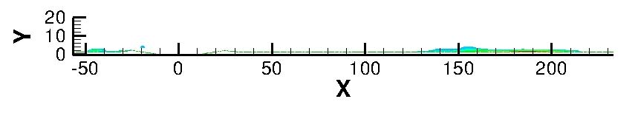
Results, post release:
Vapour mass fraction, streamwise plane (2)
Initial cloud
  Early times: good agreement.
  Disagreement at later time: due to difference in source term?
t = 61 s
t = 91 s
t = 151 s
: experiment cloud centroid track (next slide)

Slide 9
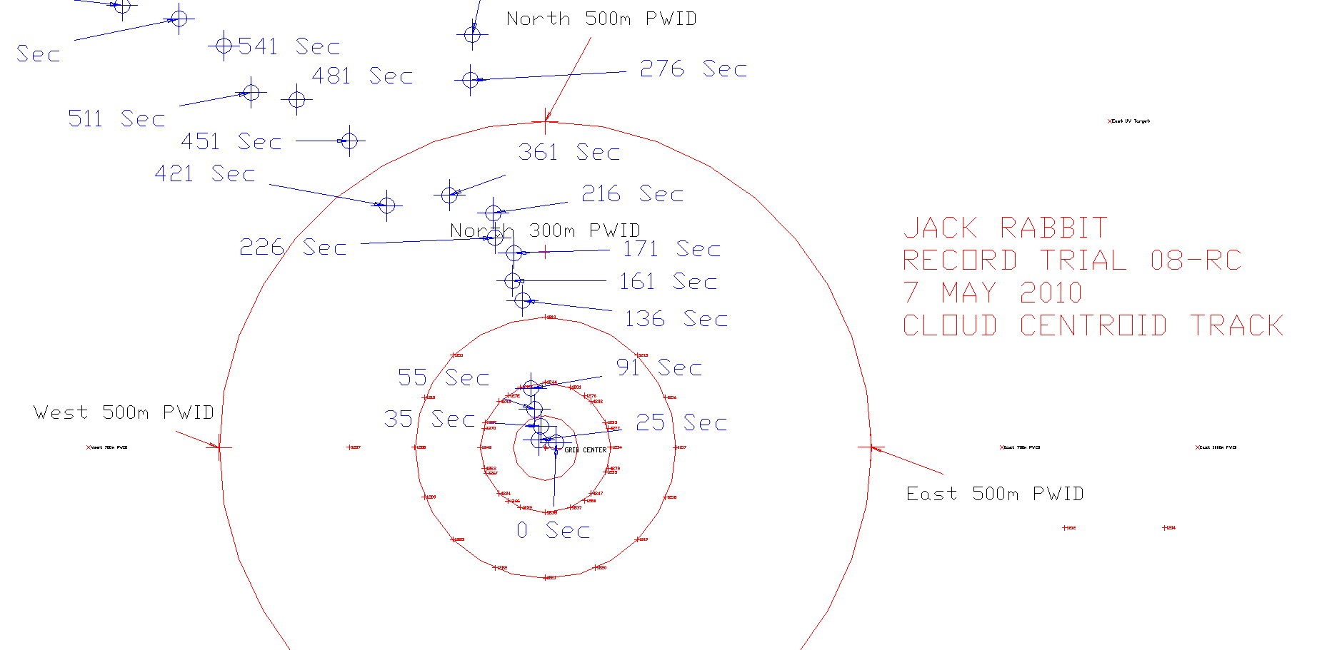
Jack Rabbit, cloud centroid track
t = 151 s
t = 61 s, 91 s
: simulation

Slide 10
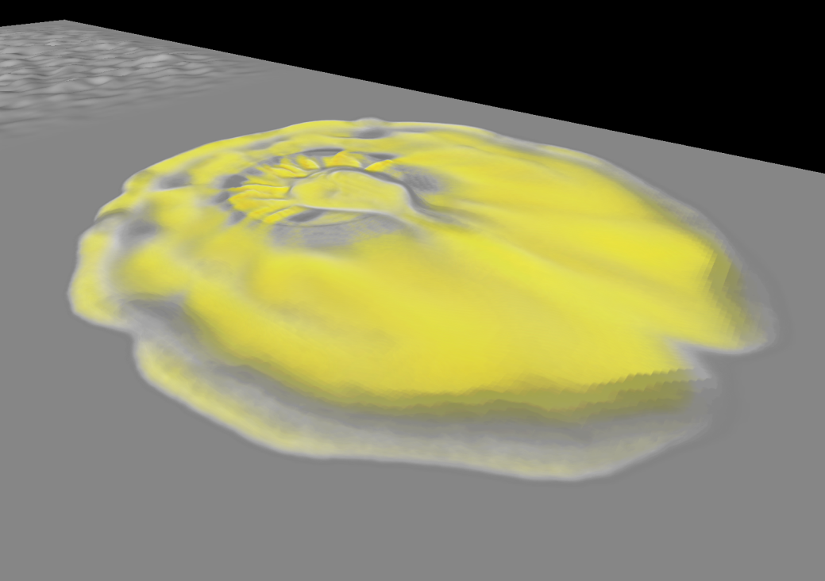
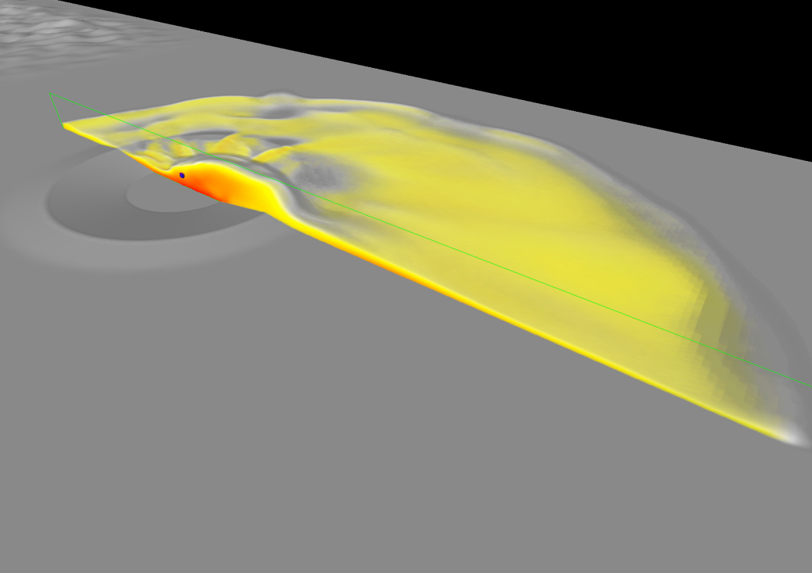
LES results: Vapour mass fraction
20 s after release

Slide 11
CDP simulation
Unstructured finite-volume-based LES code.
Energy conserving scheme → more accurate?
Developed at Stanford.
Status:
  3D boundary layer
  Same configuration as previous simulation
Next:
  Variable density solver for chlorine release

Slide 12
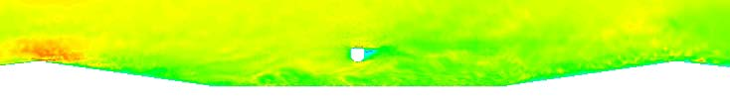
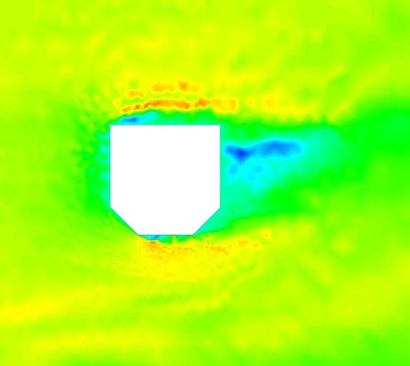
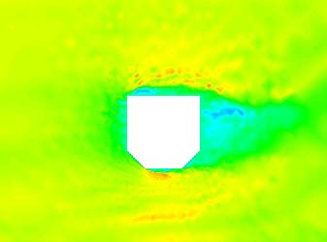
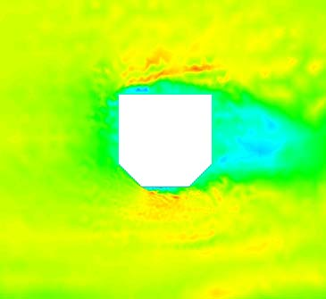
CDP results: streamwise velocity in the depression
mean wind direction
Three snapshots, 2 s between each.

Slide 13
Conclusions and further work
Two Fluent simulations of the release of chlorine from a pressurized tank performed:
  Initial URANS for aid in experimental setup
  LES for detailed comparison with experiments
Good qualitative agreement with experimental results
Third simulation with CDP
  Velocity field finished
  Chlorine release and dispersion. Actual release time.
Detailed comparison with experimental data
Simulate chlorine jet in detail. Multiphase. Smaller domain.

Slide 15






Governing equations, LES
Filtered Navier-Stokes:
Smagorinsky-Lilly:

Slide 16




Governing equation, LES (2)
Species transport:
Phase transition:
Energy equation:

