Slide 1

LES validation for turbulent flow
in an urban environment
Denise Hertwig, Frank Harms, Bernd Leitl
Meteorological Institute, Environmental Wind Tunnel Laboratory,
KlimaCampus, University of Hamburg
d
Gopal Patniak, Mi Young Obenschain, David Fyfe
Laboratory for Computational Physics and Fluid Dynamics,
U.S. Naval Research Laboratory, Washington D.C.
Challenges of LES validation
Validation of FAST3D-CT
Outlook on validation strategies
15th Annual George Mason University Conference on
Atmospheric Transport and Dispersion Modeling
July 12 – 14, 2011
George Mason University, Fairfax (VA), USA

Slide 2
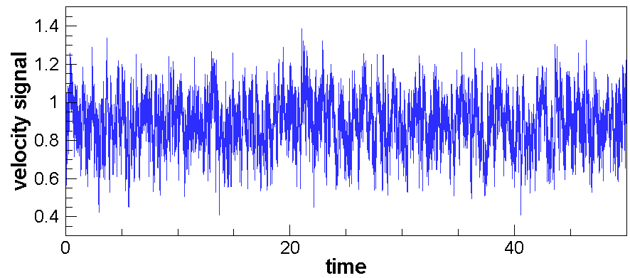
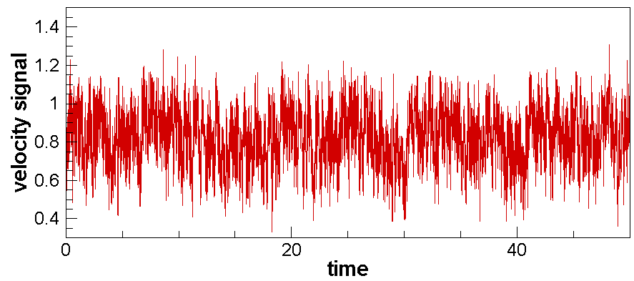
Challenges of LES validation
Quality of reference data
time/space resolution
suitable to characterize turbulent flow fields?
Validation procedures
mean plus turbulent flow characteristics
information from time series analyses?
Measures of performance quality
quantitative assessment of (dis-)agreements
basis for comparisons?
Numerical simulation
Experiment

Slide 3
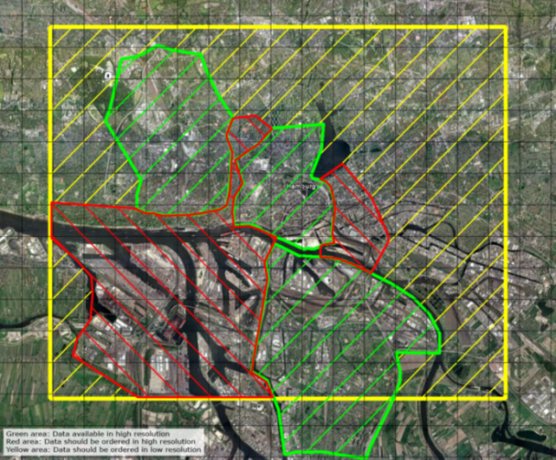
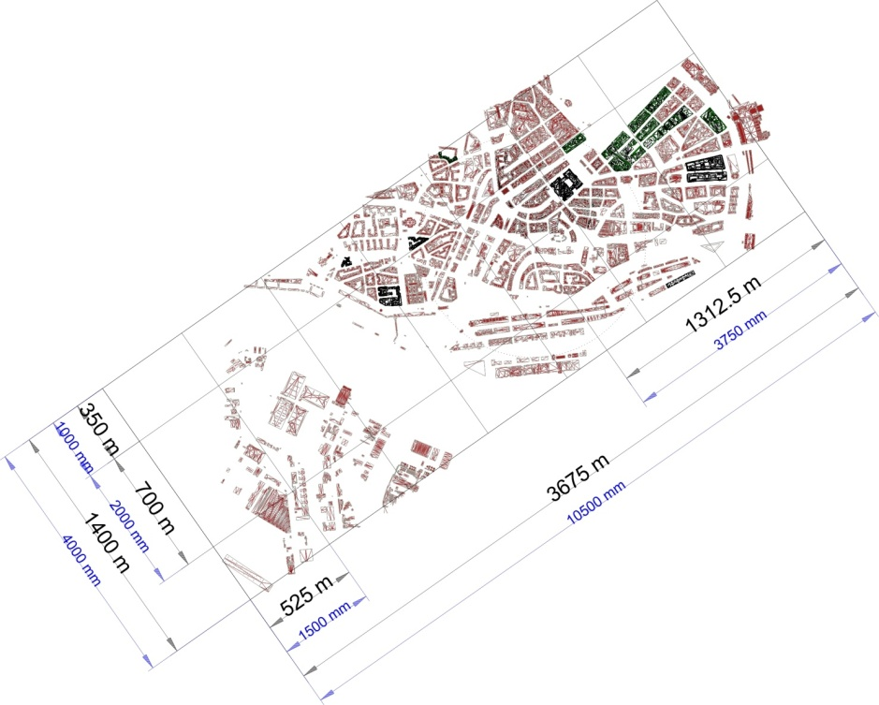
Validation of FAST3D-CT
Numerical model FAST3D-CT
N
implicit LES (MILES)
4 x 4km computational domain
2.5m grid resolution
Wind tunnel model
geometric scale 1:350
3.7 x 1.4km model domain
NRL ~ 4.5h full scale
EWTL ~ 17.5h full scale
max Δx ~ max Δy ~ 1.6m
min Δx ~ 0.03m
min Δy ~ 0.18m
approach flow 235°

Slide 4
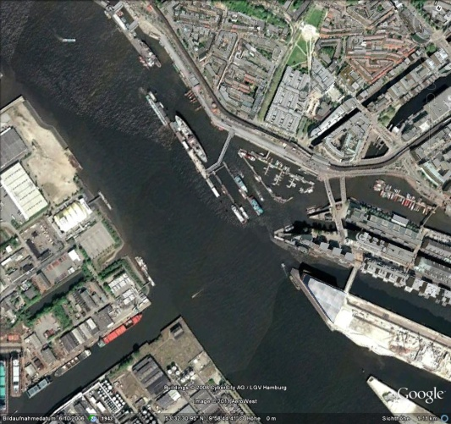
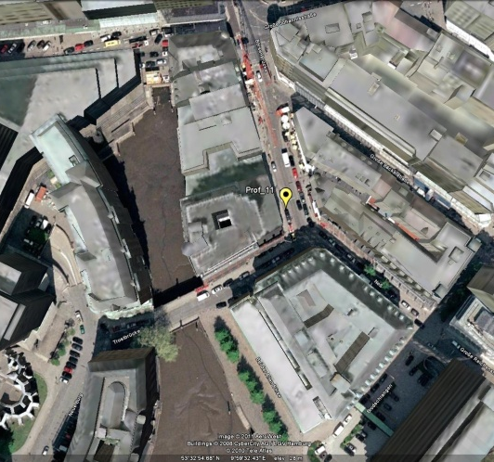
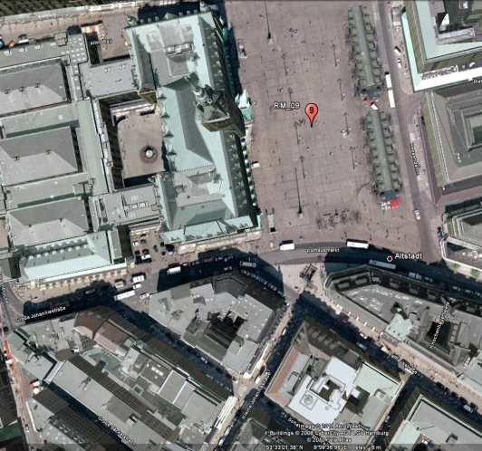
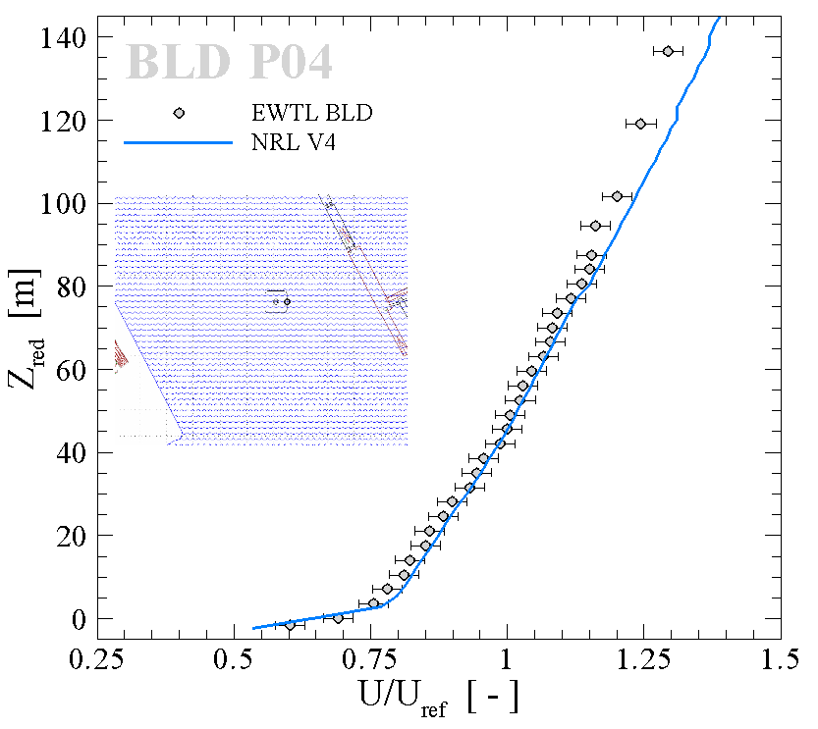
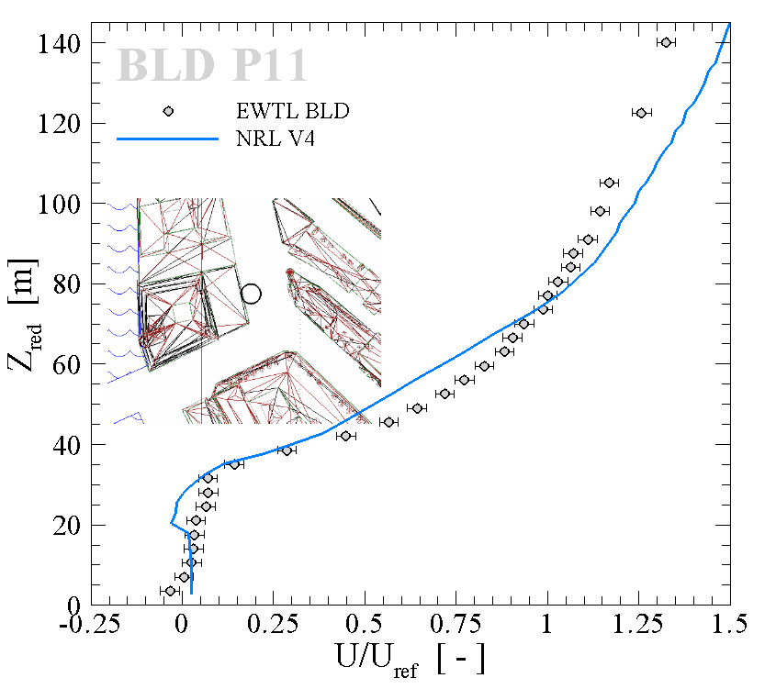
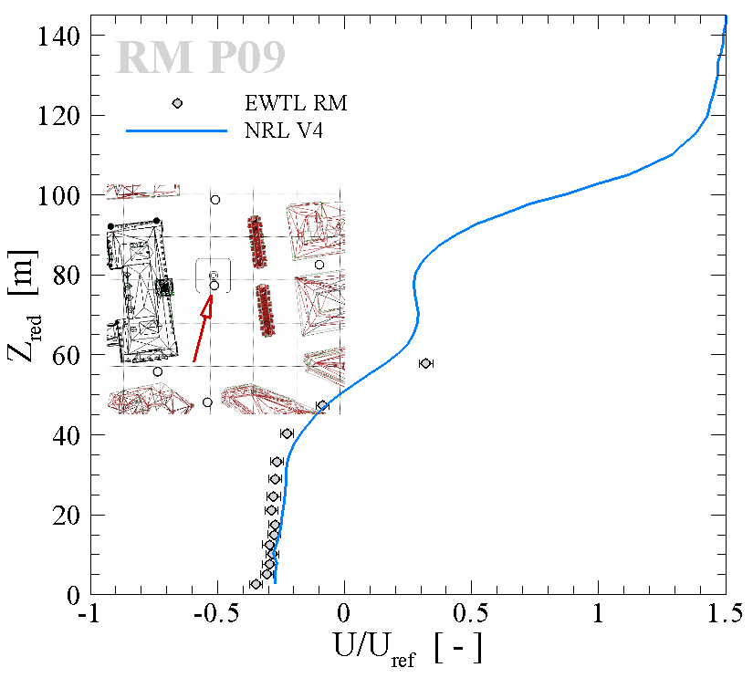
Mean flow characteristics
Vertical profiles of streamwise velocities
above river
narrow street canyon
urban plaza

Slide 5
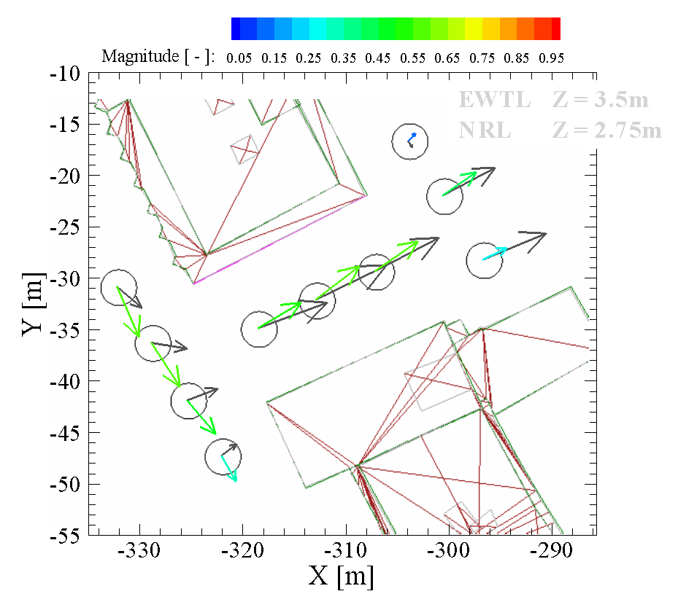
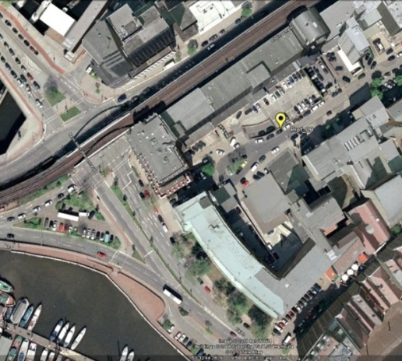
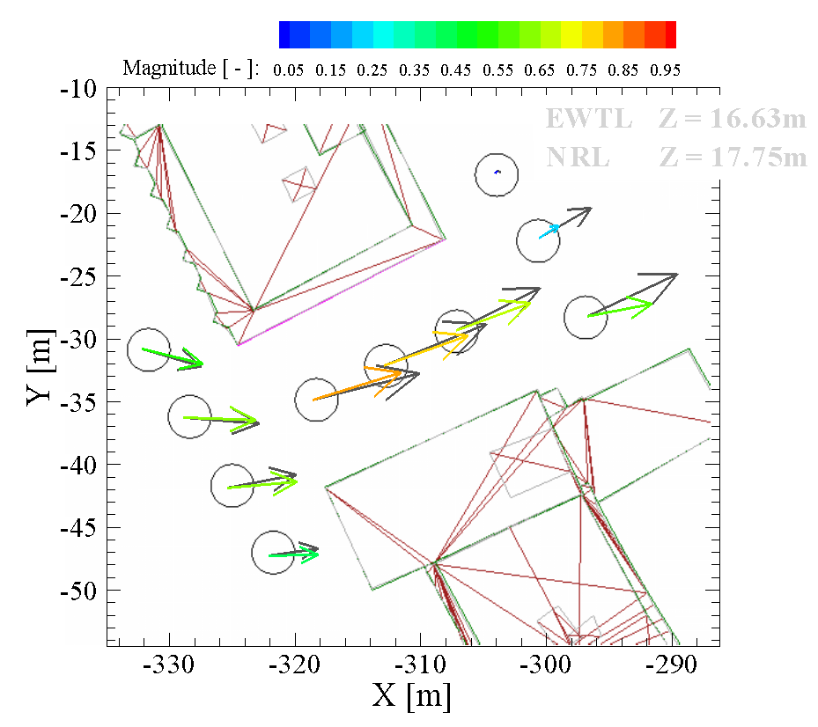
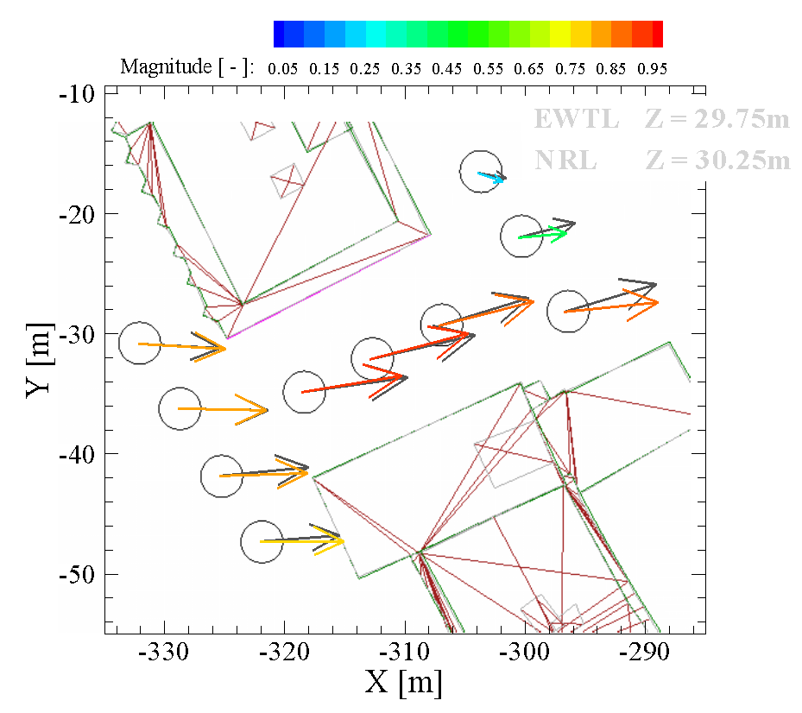
Mean flow characteristics
Horizontal flow fields
z = 3.5m
courtyard entrance
z = 17m
z = 30m

Slide 6
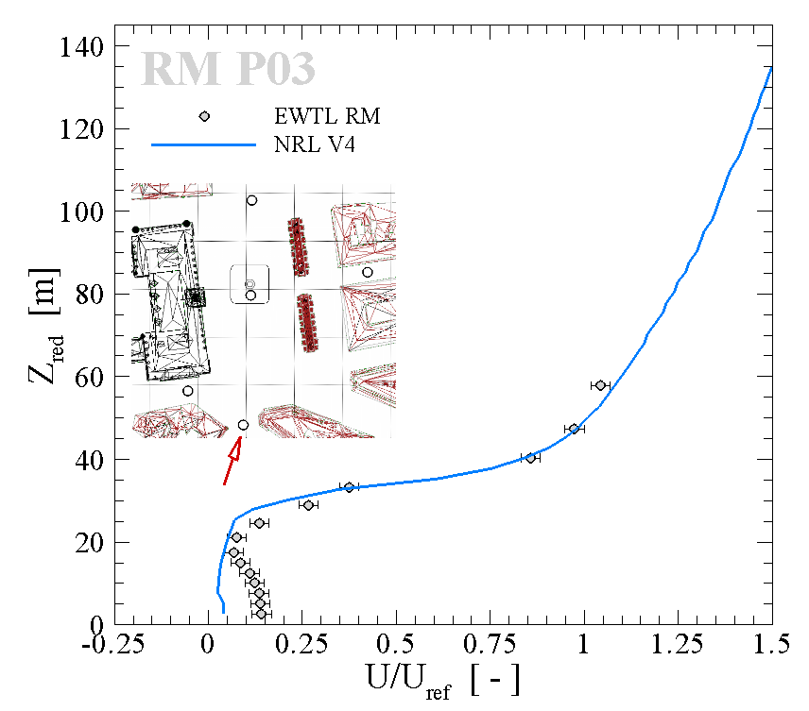
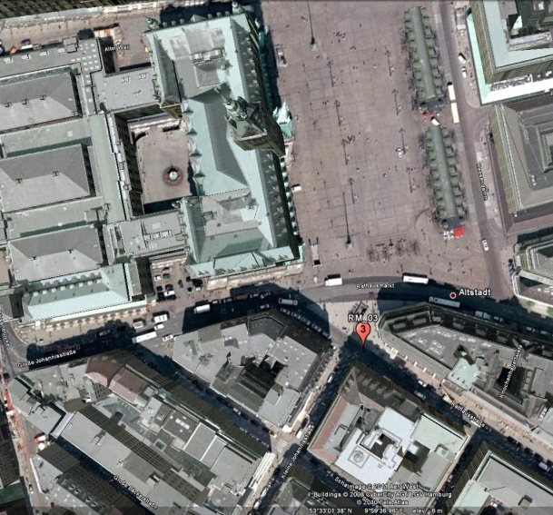
Analysis of velocity time series
Velocity histograms
magnitudes of horizontal wind speeds
directional information of the flow field
fluctuation about the mean wind direction
complex intersection

Slide 7
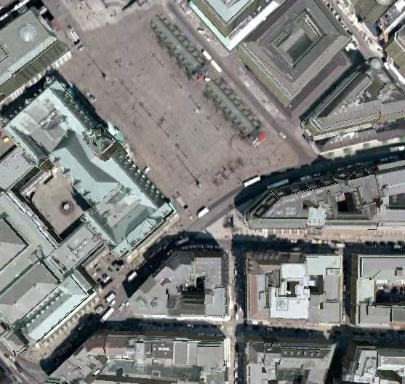
Wind roses
EWTL
NRL
z = 2.5m
235°
EWTL
NRL
z = 21m
235°

Slide 8
Wind roses
EWTL
NRL
z = 33m
235°
EWTL
NRL
z = 58m
235°

Slide 9
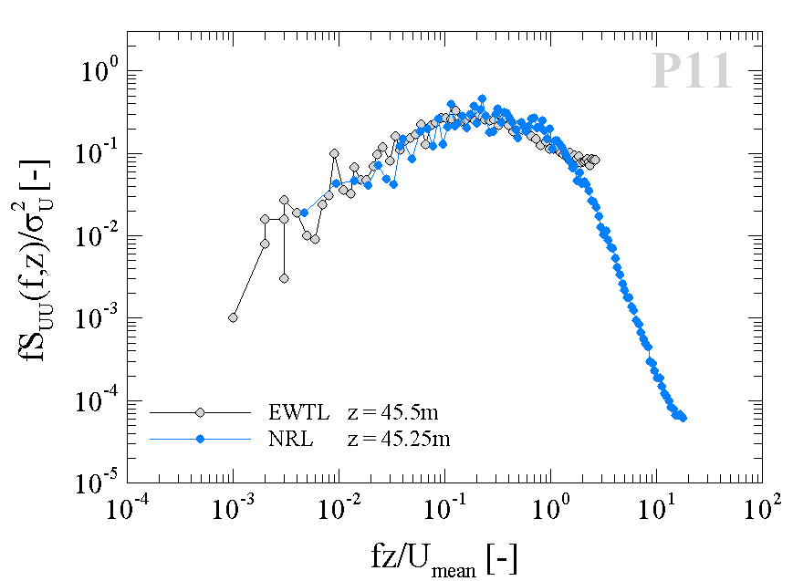
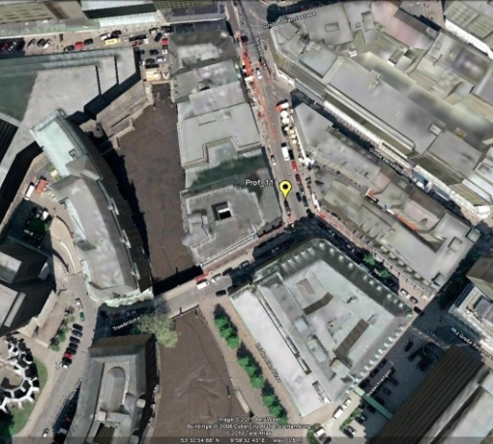
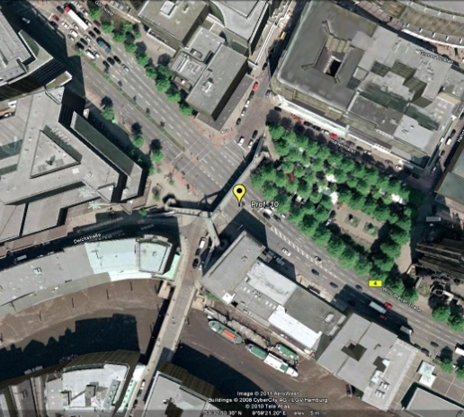
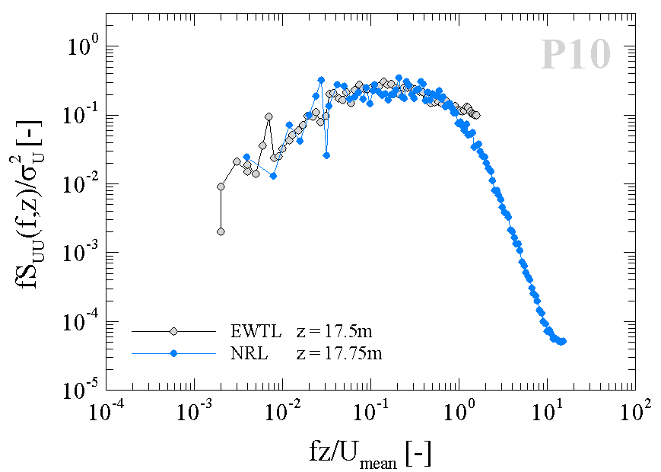
Turbulent energy spectra
Frequency information (streamwise component)
z = 45.5m
~ 1.3H_{mean}
Δ
narrow street canyon
z = 17.5m
~ 0.5H_{mean}
Δ
complex intersection

Slide 10
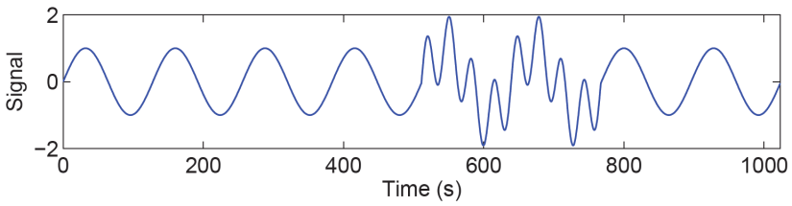
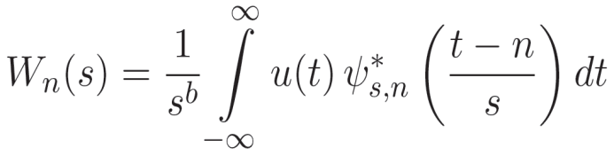
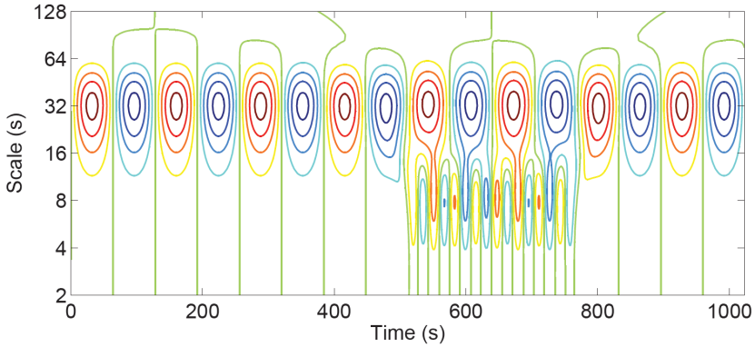
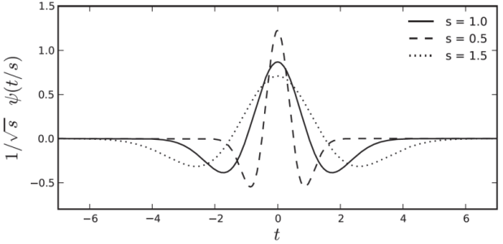
Joint time/frequency analysis
Continuous wavelet transform (CWT)
joint time/frequency information of the flow
occurrence of rare events can be determined
comparisons based on temporal characteristics
Mexican-hat wavelet

Slide 11
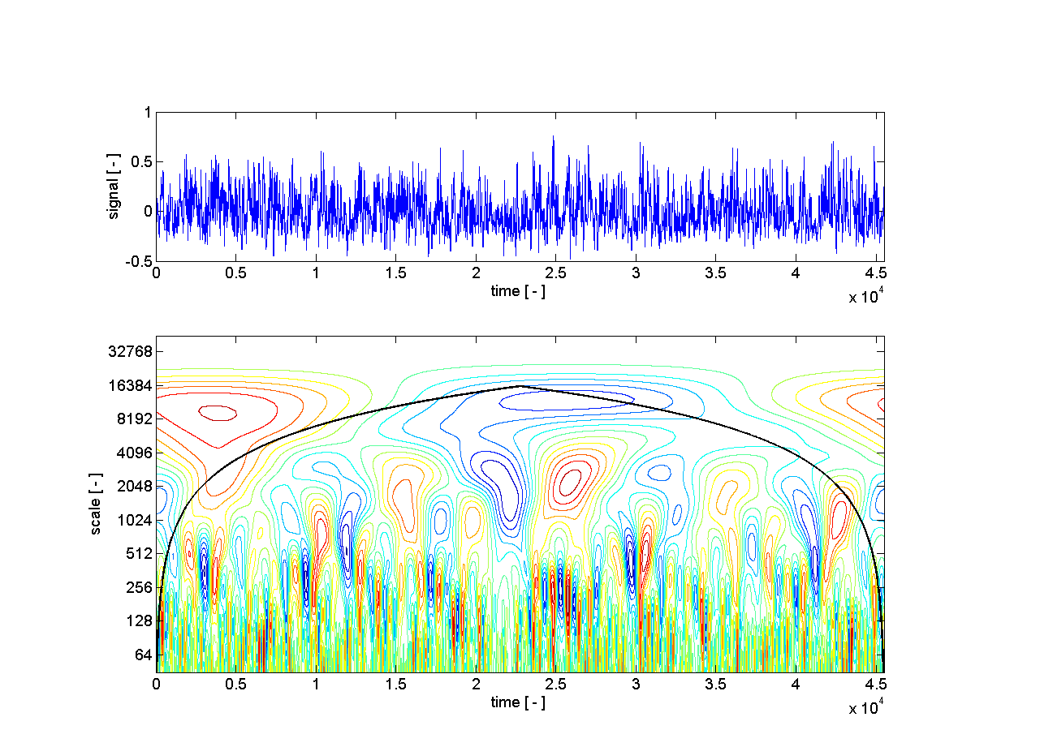
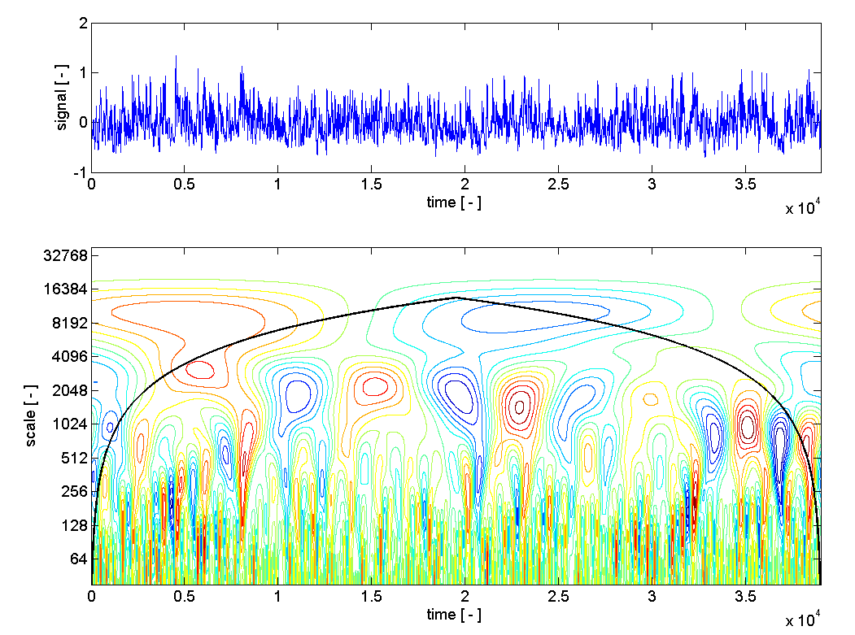


Joint time/frequency analysis
Wavelet coefficients
streamwise velocity component
approx. equal f*, T*
Mexican-hat wavelet
z = 45.5m
EWTL
NRL

Slide 12
Outlook
Validation strategies
take into account the nature of LES!
evaluation of space/time characteristics
histograms of wind speed/direction
energy density spectra
joint time-frequency analyses
turbulence integral length scales
…
What analysis methods are suitable for an ‘adequate’ LES validation?
How can quantitative measures be defined to assess the quality of the model performance?

