Slide 1
A Review of the Critical Updates to Swift and MSS During the Previous HPAC Maintenance Build
D. Buty, C. Olry , J. Moussafir (Aria), O. Oldrini (Mokili), *J. Beale (SAIC)
Presented at the 15th Annual George Mason University Conference on Atmospheric Transport and Dispersion Modeling

Slide 2
Swift
Swift is a rural wind model which accounts for variation in terrain by satisfying the continuity equation to generate vertical velocities resulting in a mass consistent wind field.
A nested capability has been incorporated into HPAC which allows for improved handling of terrain and met data in inner regions
The code base for nested Swift and MSwift has been made identical to minimize maintenance and allow for a future nesting enhancement.

Slide 3
MicroSwift
MicroSwift is identical to NSwift but is specifically tailored for use in urban environments through clever selection of input parameters.
The model takes into account variations due to terrain and properly accounts for boundary conditions due to building walls.
Röckle zones are used to model the flow around the buildings including roof-top zones.
An iterative approach is employed to satisfy the continuity equation to produce a mass-consistent wind field which accurately models flow around buildings.

Slide 4
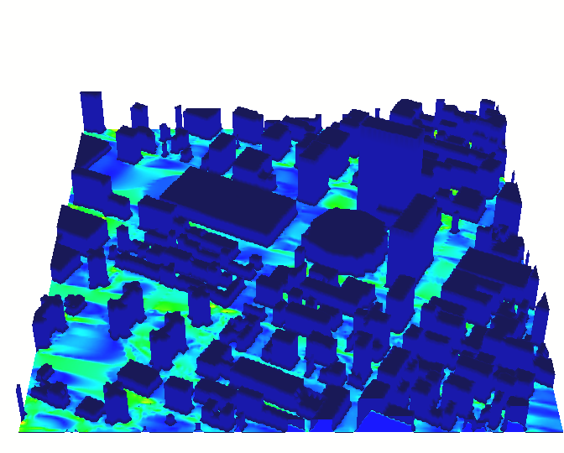
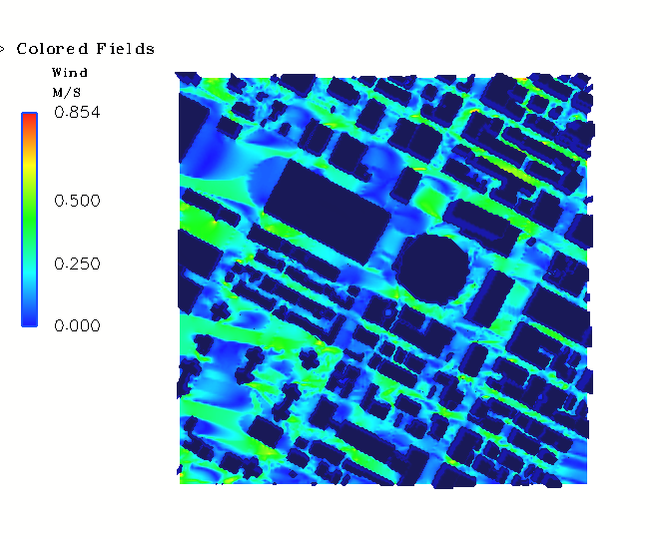
Micro Spray
Micro Spray is a Lagrangian particle-based method.
Particles are transported in accordance with the mean local flow as predicted by Micro Swift and local turbulent fluctuations
Model treats wet & dry deposition and radioactive decay of particles.

Slide 5
Concentration Data Storage
MSS formerly used a “least common multiple” of the internal time-step and the SCIPUFF time-step to make sure that data was saved at each output time.
This resulted in huge result files of which 75-85% of the space could never be accessed through HPAC because the times didn’t correspond to a SCIPUFF save time.
We implemented the SCIPUFF “save-on-demand” interface and were able to reduce the size of the concentration file by a factor of 5-8.

Slide 6
Multiple Releases/Materials
Previously, MSS in HPAC was limited to a single release of a single substance. This limitation has been removed for non-dense gases.
For non-dense gases, the current limit is 10 materials and 10 release locations.
Domain size is an issue. If the distance between the releases is ~ domain size, MSS may not be able to handle the release. User discretion is advised.

Slide 7
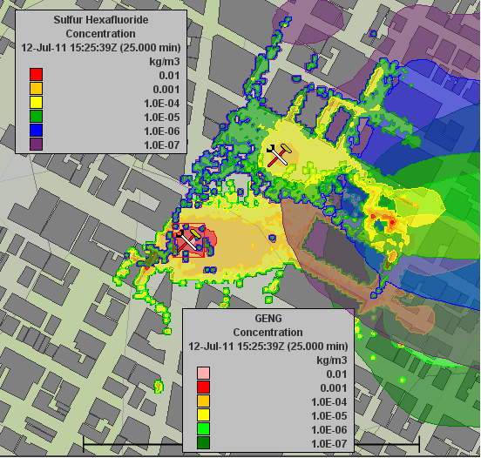
Multiple Releases/Materials
Simultaneous release of SF6 and GENG
1000 particles released every 5 seconds for 30 min
The number of particles is allocated to a release proportional to the mass flow ratio
The combined conc field is shown at 25 minutes.
A key HPAC configuration - see the next slide ->

Slide 8
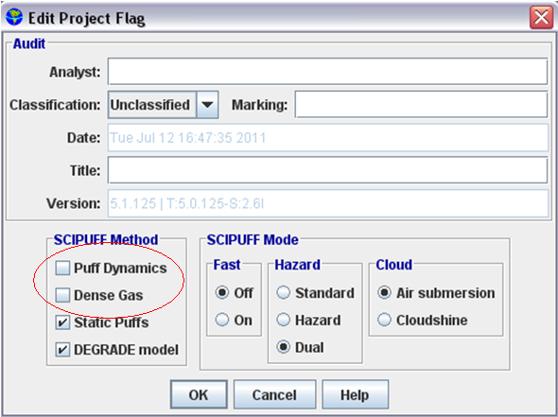
Multiple Releases/Materials
In order to run MSS with multiple releases and/or multiple materials, it is necessary to uncheck the Puff Dynamics and the Dense Gas boxes under SCIPUFF Method.
These are checked by default. This is the only way to specify a passive gas analysis.

Slide 9
Upper Air Climo
Swift directly reads the new NCAR upper air climo database to provide higher resolution data for historical weather.
The API developed by Doug Henn of Sage provides a single code base for ease of maintenance within HPAC
There is a performance degradation but it isn’t dramatic. Roughly 15-20% additional time is taken in the data access.
However, the code itself is much simpler. :)

Slide 10
Swift Canopy Treatment
Doug Henn’s canopy formulation has been implemented in Swift to correct the previous approach of moving the measurements above the canopy.
Swift has been validated against SCIPUFF and produces the correct results

Slide 11
MSS Robustness
One of our primary goals in the current release of MSS was to fix the errors which prevented MSS from running in a number of cases.
One error was the inability to handle releases at zero height above ground. Unfortunately, that is the default so … MSS would fail by default.
Another problem was in creating many puffs which were very small.
Not every case in which MSS does not run is a bona fide error
Error handling was improved so that if an error occurs, the message passed to the user is more informative.

Slide 12
Swift Blending History
HPAC Build 82 Blending
  In 1997, Dr. Sontowski proposed an exponential blending option that used a scaling parameter of 500 m.
HPAC Build 84 No blending
  2008 validation studies showed that HPAC/MSS produced high concentration levels and low wind speeds.
  The ‘quick fix’ was to disable the blending function (circa Build 84).
HPAC 2010 MB
  The choice was made to use exponential blending with a parameter of 50m.

Slide 13
SWIFT Blending procedure
Formulation:
ub(i,j,k) = w(k) u(i,j,2) + (1 – w(k)) u(i,j,k)
u(i,j,k)
ub(i,j,k)
w(k)
k
Hb: blending scale
k=2
u(i,j,2)

Slide 14
Swift Blending (DP26)

Slide 15
Swift Blending (DP26)

Slide 16
Dense Gas Model
The MSS dense gas capability has been integrated into HPAC.
The ratio of RHO(release)/RHO(air) drives the Glendening equations so, starting from the release characteristics (buoyancy
and momentum for instantaneous release, continuous and moving sources), exit temperature and emission velocity for Stack Release, we compute a temperature perturbation and update the density, using the ideal gas law.
Certain assumptions have been made as to how to interpret the user-specified parameters in the GUI. A description of how the UI parameters affect the model follows.

Slide 17
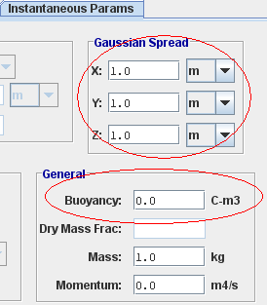
Dense Gas Model
In an instantaneous release, the density of the gas is adjusted by a temperature perturbation based on the buoyancy divided by the initial volume, which is defined by the Gaussian spread terms:

Slide 18
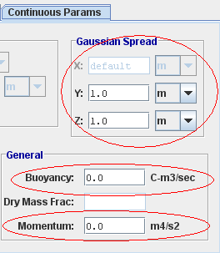
Dense Gas Model
In a continuous release, we use the specified buoyancy and the initial momentum to solve simultaneously for the temperature perturbation and the vertical velocity component:
Note: The horizontal component of
velocity is unknown, assumed
to be 1.2 m/s.

Slide 19
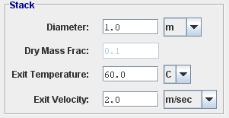
Dense Gas Model
In a stack release, the exit temperature is specified directly along with the velocity and diameter of the source, so there is no need to massage the parameters. We simply update the density of the gas in accordance with the ideal gas equation:

Slide 20
Dense Gas Test Cases
Most dense gas tests are not urban so it is difficult to directly validate in HPAC. We adopt a two-step approach.
Comparison of MSS in HPAC with stand-alone version to show that MSS in HPAC produces the same results as the stand-alone.
Validation of stand-alone has been performed against Thorney Island, Burro and Coyote, Kit Fox, Macdona rail car accident.

Slide 21
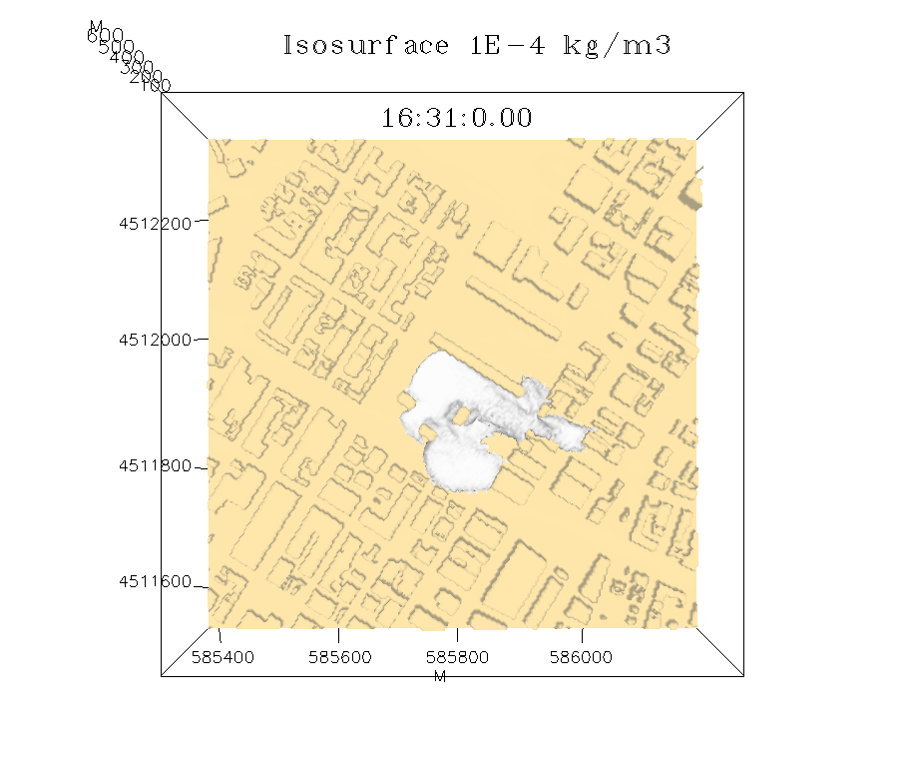

Isosurface of 1.0E-04 kg/m^3
HPAC
SPRAY Stand-alone V11
Concentrations averaged over 60s

Slide 22
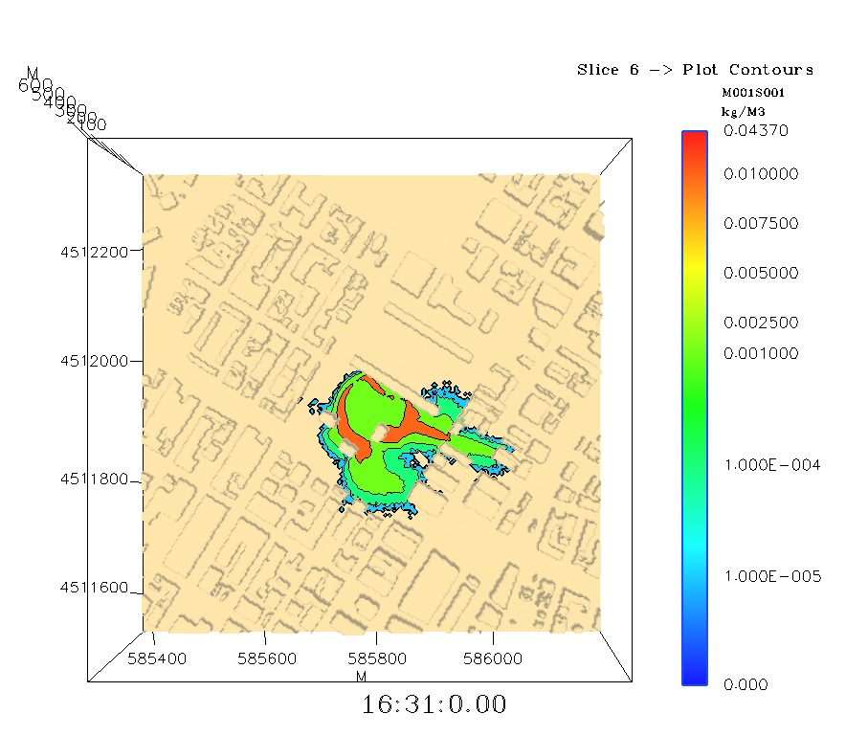
Concentration at Ground Level
HPAC
SPRAY Stand-alone V11
Concentrations averaged over 60s

Slide 23
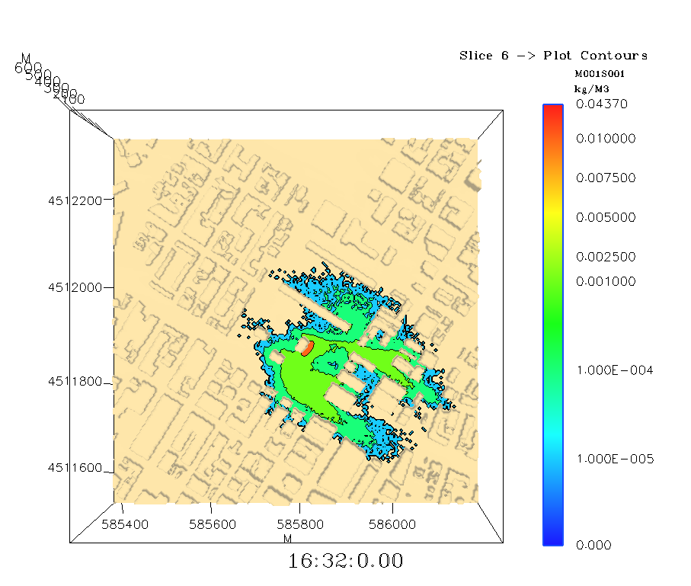
Concentration at Ground Level
HPAC
SPRAY Stand-alone V11
Concentrations averaged over 60s

Slide 24
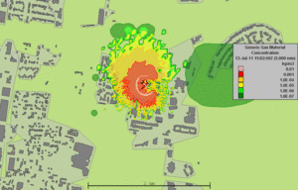
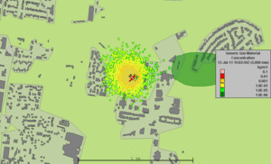
Dense Gas vs. Passive Gas
Dense Gas
Passive Gas
The terrain slopes off to the SW, whereas the wind west to east.
The dense gas model predicts an initial transport down hill but, with dilution, the gas quickly transitions to a passive gas with a resulting concentration distribution similar to the passive gas model.
Run time is substantially longer for the dense gas model.

