Slide 1
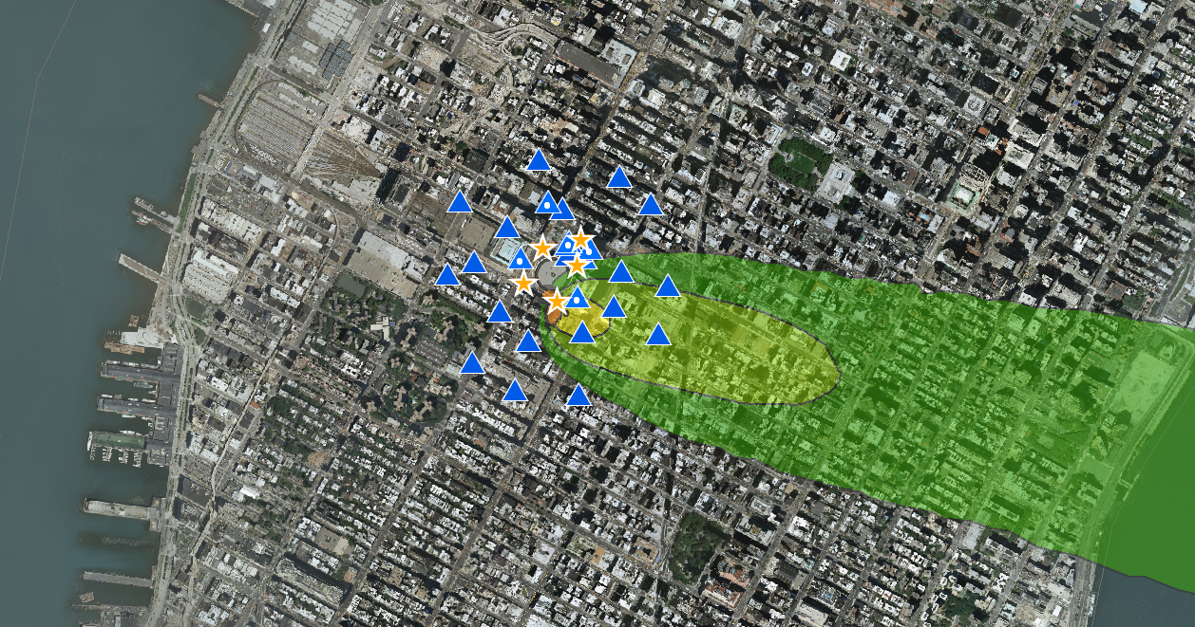
15th GMU Conference on
Atmospheric Transport and Dispersion
Fairfax, VA
12-14 July 2011
HPAC Urban Model Validation
Comparison of Madison Square Garden 2005
Experiments with latest HPAC Builds 99, 125
Daniel Nakada dnakada@ida.org
Nathan Platt nplatt@ida.org

Slide 2
Background
This briefing presents a comparison of field trial data with predictions from recent HPAC Releases – Build 99 and Build 125 (Maintenance Build) – within an urban environment (Madison Square Garden 2005 experiments). We compared predictions with observations using a Measure of Effectiveness (MOE) that compares the “hazardous” region above a concentration threshold of interest.
Steve Hanna (Sage Management) et al. provided the HPAC project file inputs used in this analysis.

Slide 3
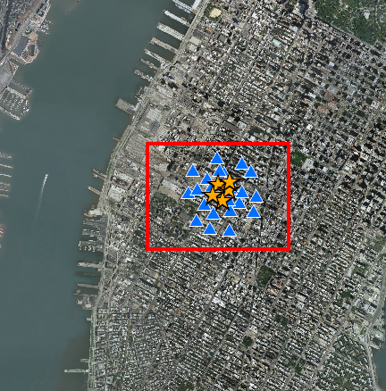
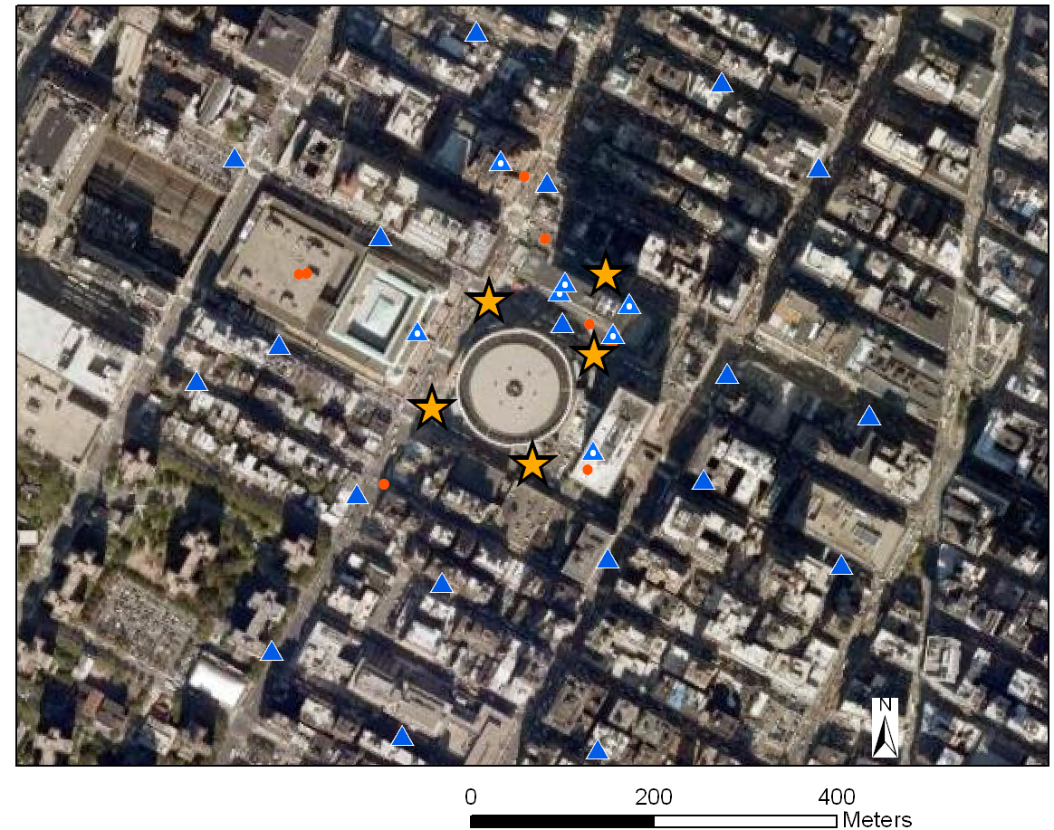
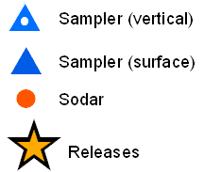
MSG 2005 Field Study
~1-km-by-1-km Area in Midtown Manhattan
6 Perfluorocarbon Tracers simultaneously released at 5 sites
26 Perfluorocarbon Tracer samplers
Hudson River
Midtown
Manhattan
Intensive Operating Period 1 | Intensive Operating Period 2
March 10, 2005 Rel 1: 0900 – 1100 Rel 2: 1130 – 1330 | March 14, 2005 Rel 1: 0900 – 1100 Rel 2: 1130 – 1330
Imagery Source: U.S. Geological Survey

Slide 4
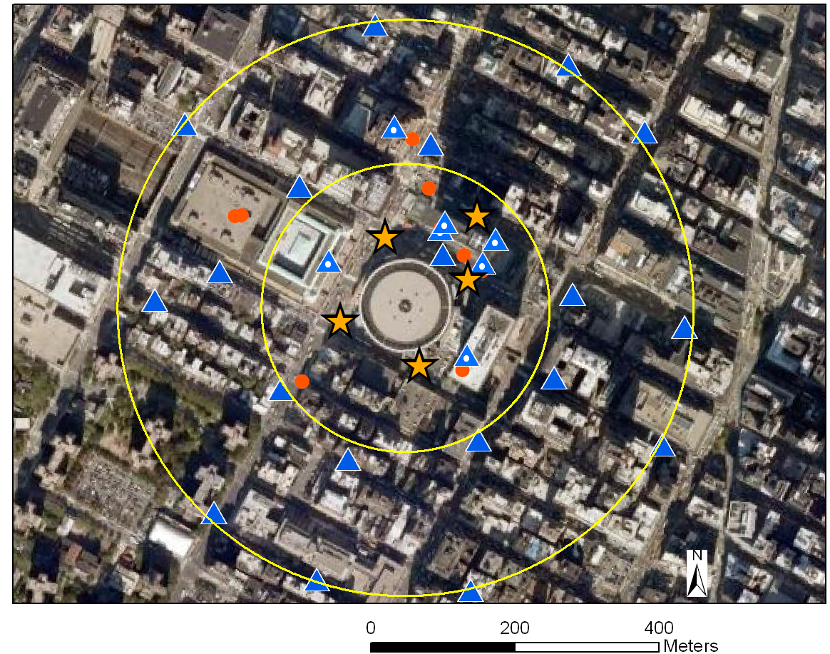
MSG 2005 Field Study
Intensive Operating Period 1
Hudson River
Midtown
Manhattan
oc-PDCH
1PTCH
PMCP
PECH
PMCH, i-PPCH
200m arc
(Near)
400m arc
(Far)
Imagery Source: U.S. Geological Survey

Slide 5
HPAC Comparison Approach
HPAC simulations used 1 sec time step; concentrations were averaged over 30 minutes with background concentration levels added
Used 5 Perfluorocarbon Tracers with sufficient data
To be included in the quantitative evaluation, a data pair must have either the predicted concentration or observed concentration exceed a threshold concentration
For a brief look, 2 Meteorological Input Options / 2 Urban Model Options were examined:
Meteorological Input Options | HPAC Urban Model Options
Single (SNG) – Wind speed and direction at rooftop, averaged over several sites | UC – Urban Canopy in SCIPUFF
MEDOC (MED) – MM5 MEDOC outputs using 4 km resolution runs | UDM – Urban Dispersion Model

Slide 6
Measure of Effectiveness
Determine threshold T exceedance quantities for each Tracer Gas and Release Period, then grouped by Regime (Near, Far and All Surface).
MOE yields up to 20 data points (5 Gases x 4 Releases) for each of 3 Regimes (Near, Far, ALL).

Slide 7
HPAC Contour /
MOE Comparisons
Single Wind / | UDM
MEDOC / | UC

Slide 8
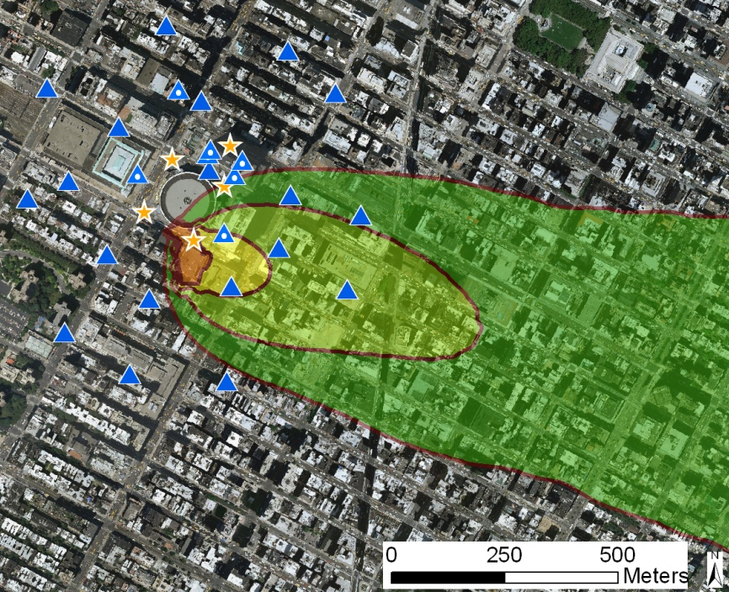
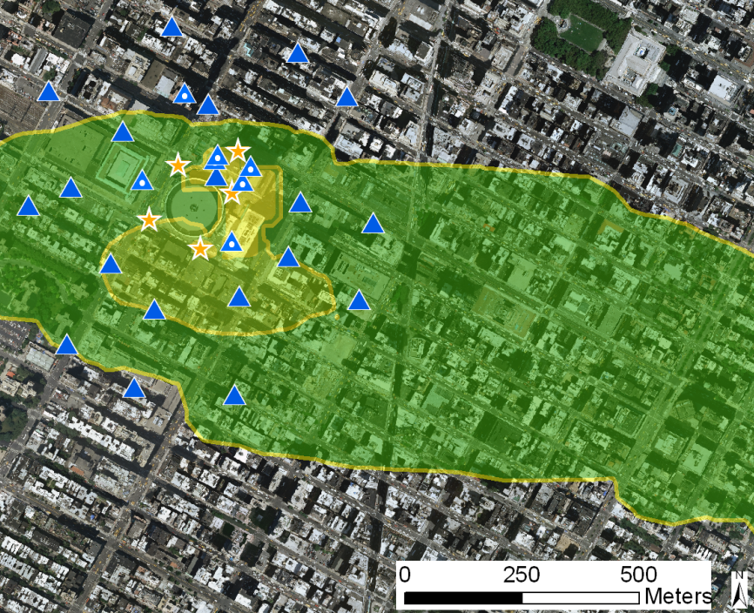
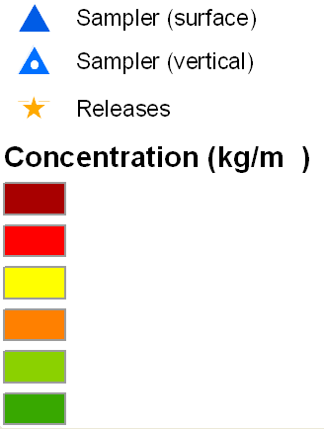
HPAC 5 Contour Comparisons
Example: MSG 2005 IOP1 Release 1 of PMCH – SNG / UDM
HPAC Build 99
PMCH (30min after release)
HPAC MB
PMCH (30min after release)
10⁻⁸
10⁻⁹
10⁻¹⁰
10⁻¹¹
10⁻¹²
10⁻¹³

Slide 9
Comparison with Tracer Data
IOP1 / IOP 2 –SNG / UDM
HPAC 99
PMCH – after 30 minutes (IOP1 Release 1)
HPAC MB
PMCH – after 30 minutes (IOP1 Release 1)
Note: Logarithmic Scale is shown for Concentration
Sampler
Release Location
FALSE NEGATIVE
FALSE POSITIVE
OVERLAP

Slide 10
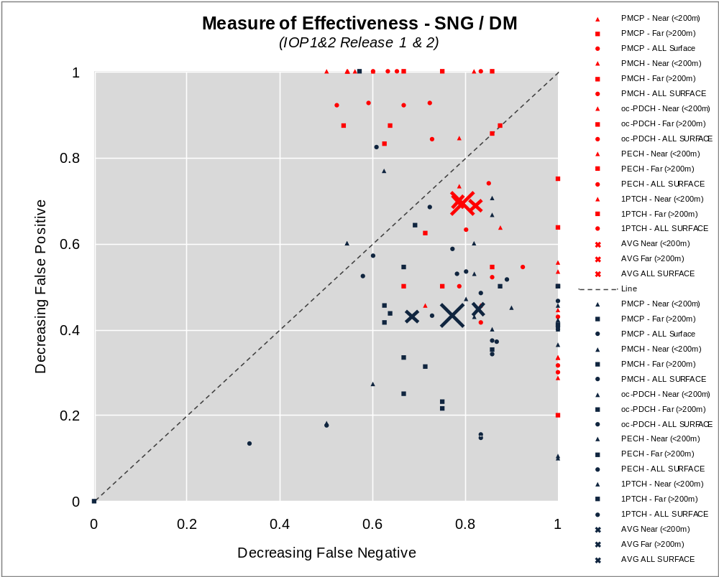
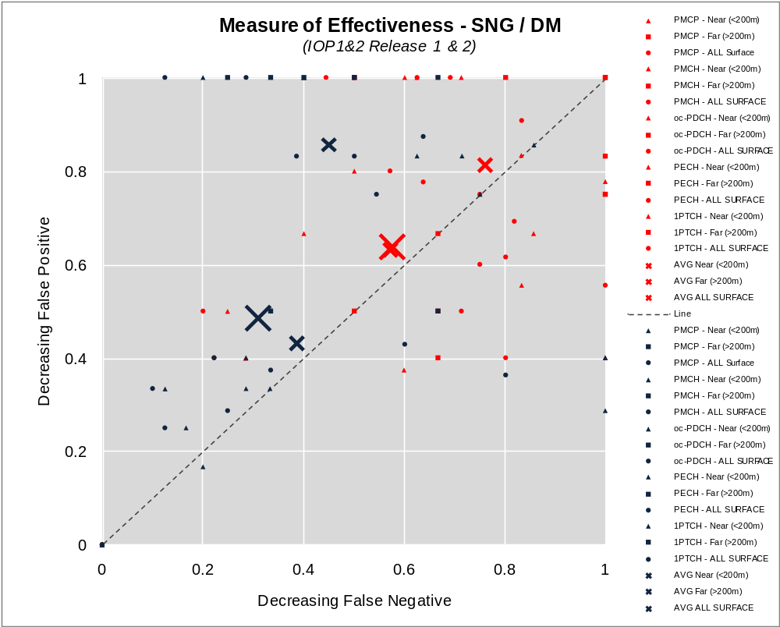
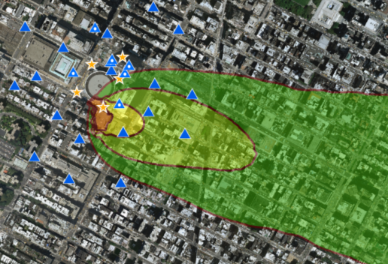
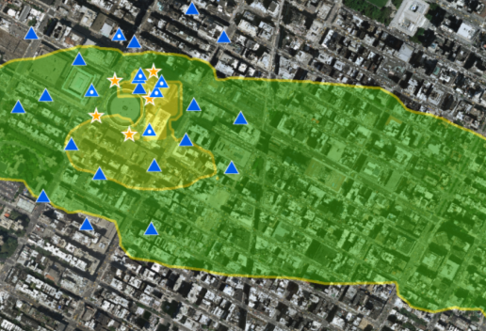
Comparison with Tracer Data
IOP1 / IOP 2 –SNG / UDM
Lower Threshold
Higher Threshold
Decreasing False Positive
Decreasing False Positive
Decreasing False Negative
Decreasing False Negative
HPAC 99
HPAC MB
HPAC Build 99
HPAC MB
UDM: HPAC 99 shows better performance for hazard area estimation than HPAC MB

Slide 11
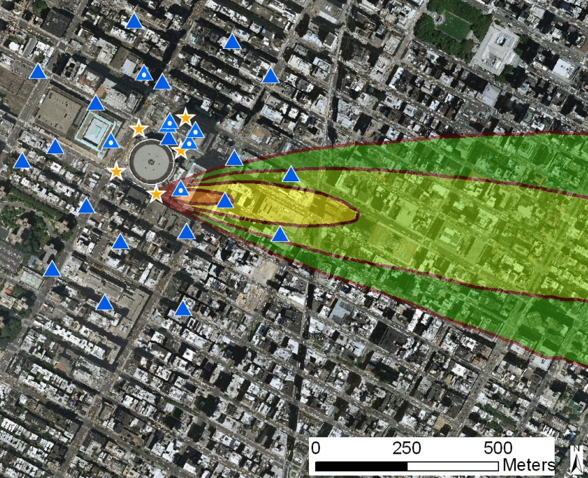
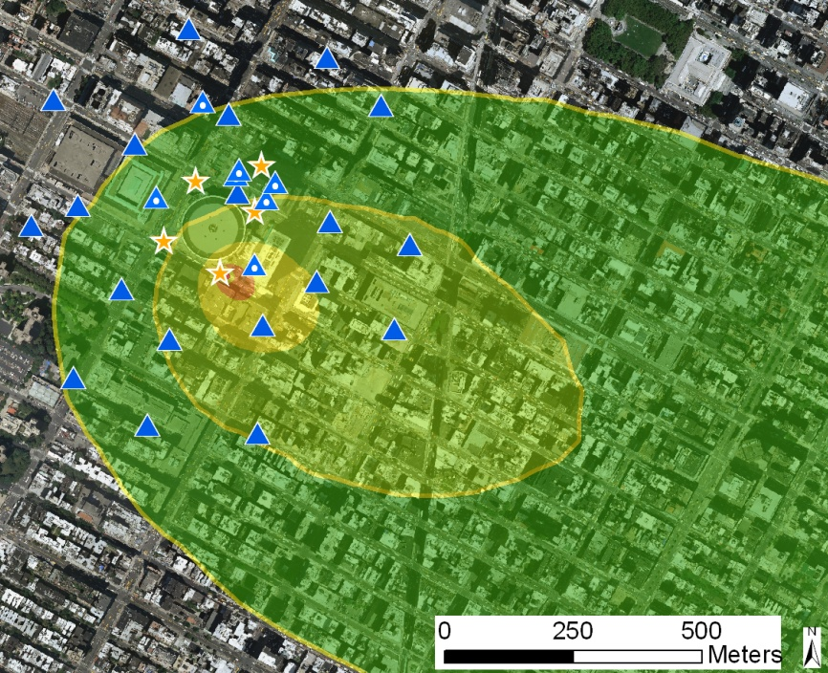
HPAC 5 Contour Comparisons
Example: MSG 2005 IOP1 Release 1 of PMCH – MEDOC / UC
HPAC Build 99
PMCH (30min after release)
HPAC MB
PMCH (30min after release)
HPAC 99: MEDOC winds were used as read from the file
HPAC MB: MEDOC winds reset within the canopy.
10⁻⁸
10⁻⁹
10⁻¹⁰
10⁻¹¹
10⁻¹²
10⁻¹³

Slide 12
Comparison with Tracer Data
IOP1 / IOP 2 –MEDOC / UC
HPAC 99
PMCH – after 30 minutes (IOP1 Release 1)
HPAC MB
PMCH – after 30 minutes (IOP1 Release 1)
Note: Logarithmic Scale is shown for Concentration
Sampler
Release Location
FALSE NEGATIVE
FALSE POSITIVE
OVERLAP

Slide 13
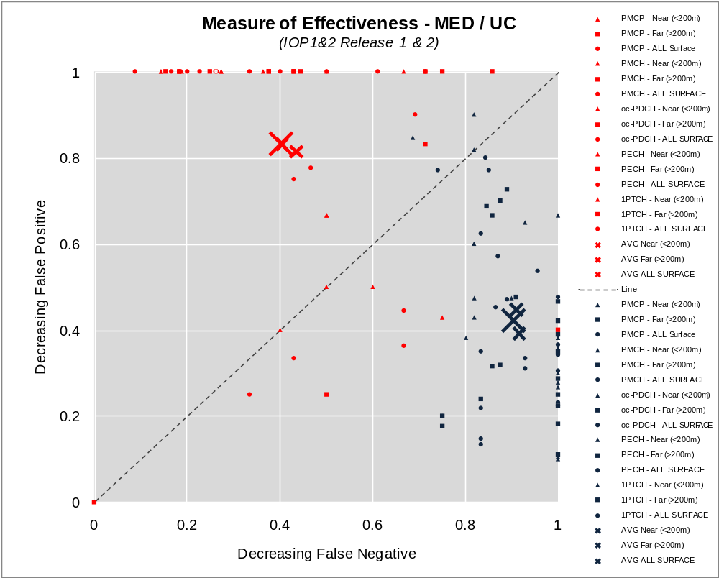
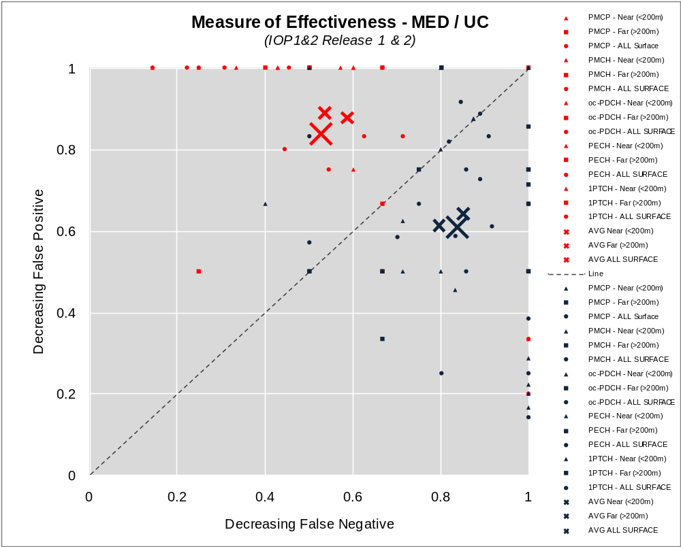
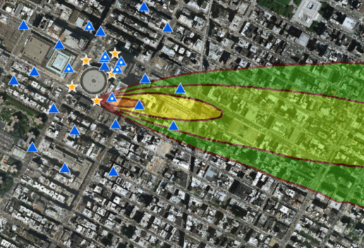
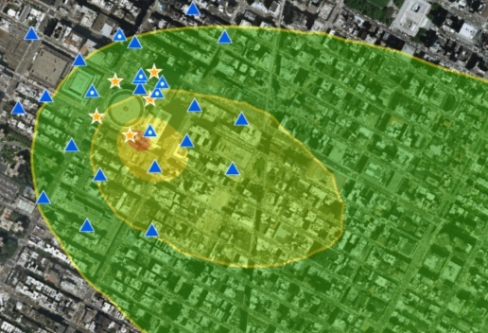
Comparison with Tracer Data
IOP1 / IOP 2 –MEDOC / UC
Lower Threshold
Higher Threshold
Decreasing False Positive
Decreasing False Positive
Decreasing False Negative
Decreasing False Negative
HPAC 99
HPAC MB
MEDOC: HPAC 99 predicts more false negatives while HPAC MB predicts more false positives.
HPAC Build 99
HPAC MB

Slide 14
Conclusions
UDM – HPAC 99 shows better performance for hazard area estimation than HPAC MB - HPAC MB increases the number of false positives for lower threshold analyses and both false negatives and false positives for higher threshold analyses.
MEDOC – Generally produces wider plumes in HPAC MB, therefore predicting more false positives. Plumes in HPAC 99 tend to be narrower, predicting more false negatives.

Slide 15
Backup

Slide 16
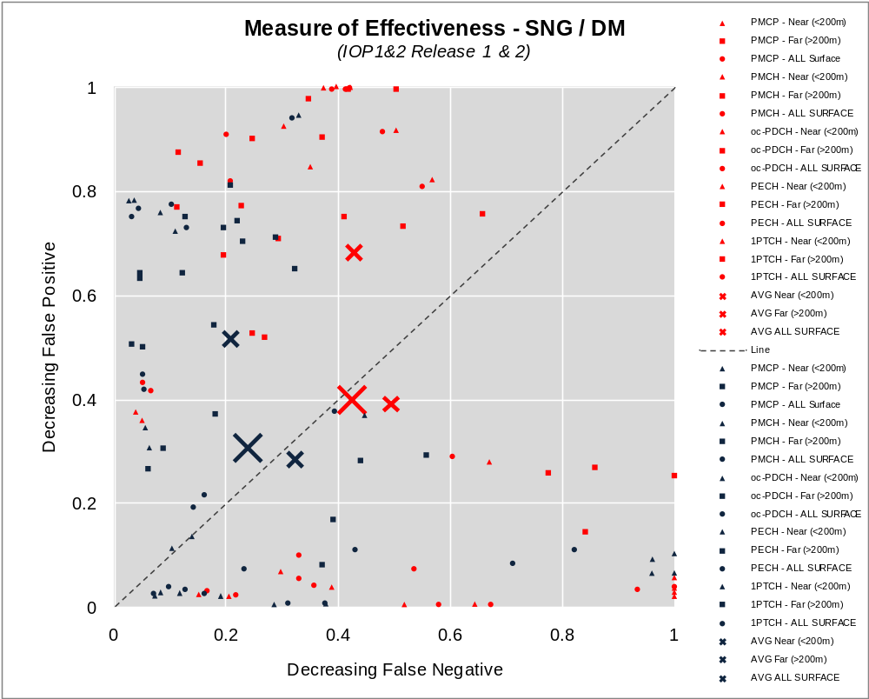
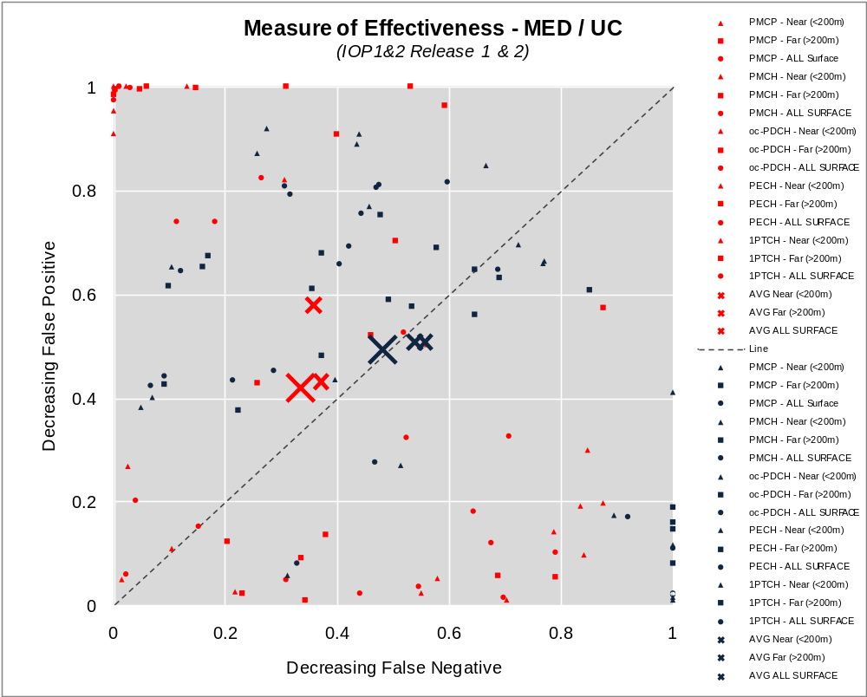
Comparison with Tracer Data
Average Concentration Based MOE Calculations IOP1 / IOP 2
SNG - UDM
MEDOC - UC
Decreasing False Positive
Decreasing False Positive
Decreasing False Negative
Decreasing False Negative
HPAC 99
HPAC MB
HPAC Build 99
HPAC MB

