Slide 1
Decision Support Tool for More Effective
CB Threat Warning
S. Masters, S. Rottmann, M. Kienzle, S. Maminakis,
J. Piotrowski, R. Thomas
ENSCO, Inc.
15th Annual George Mason University Conference on Atmospheric Transport and Dispersion Modeling
12-14 July, 2011

Slide 2
Detector Placement Overview
Joint Biological Tactical Detection System (JBTDS)
    Lightweight, low cost, man-portable and battery operable capability system to detect, collect and identify airborne biological pathogens and toxins in a tactical employment
    Providing continuous biological surveillance for a 2km by 2km area in an austere environment for 72 hours
    Infantry battalion unit area or a Forward Operating Base (FOB)
ENSCO Value Proposition
    Provide an objective solution for placing detectors in an array that provides maximum protection while minimizing cost

Slide 3
Detector Placement Overview
The best chemical or biological detectors placed in the wrong locations will provide poor hazard warning and protection
Meteorology is the single most significant influence on optimal detector placement
Other factors affecting system performance include detector specifications, terrain, natural and manmade obstructions and structures, all of which can significantly affect the ability to detect a downwind hazard condition
“How does the warfighter determine the optimal number and location of CB detectors in a dynamic battle space to achieve a required level of detection?”

Slide 4
Detector Placement Process
Generate
Met Forecast
Data
Mesoscale Model
(RAMS, WRF)
Java Interface
Display
Data &
Results
Hazard
Model
Simulation
Transport and Dispersion
Model (SCIPUFF, SLAM)
Google Earth™
Detector
Placement
Calculation
PoD Algorithm
OPT Algorithm
FAR Algorithm (future)
Notes:
4

Slide 5
PoD Definition
Definition of Probability of Detection (PoD)
    Detector PoD – the probability that a detector will alarm when challenged at or above the minimum limit of detection for all agent threats
    Network (Array) PoD – the probability that a network of sensors will detect an “effective attack” released 0.5-10km upwind of unit front
is the probability that the network will alarm at hour i given that a detectable plume from source j is present to the network as configured at hour i
is the probability that the plume came from source j
is the probability that a detectable plume is present to the network (at hour i) given that the plume (at hour i) originated from source j

Slide 6
Optimization Algorithm Inputs
GUI/User Defined
  Number of Detectors available to operator for deployment
  Detector PoD (fixed value for each detector in the network)
  Duration of the mission (start/stop time)
  System PoD required
  Area of protection (encampment)
Threat Concentration Data
  T&D model output concentration data within the encampment
Weighted Threat Regions (currently not available through GUI)
  Default (all potential release locations are considered equally possible)
  Percentages for each release location can be adjusted to indicate more/less likely release scenarios given the total weighting of all potential sources must sum to 1

Slide 7
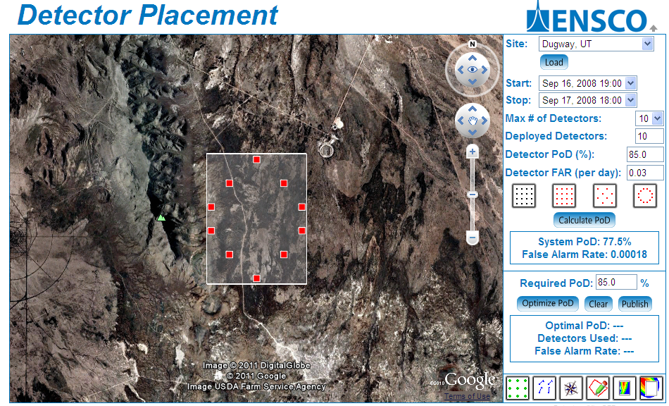
Fixed Detector Placement
Notes:
7

Slide 8
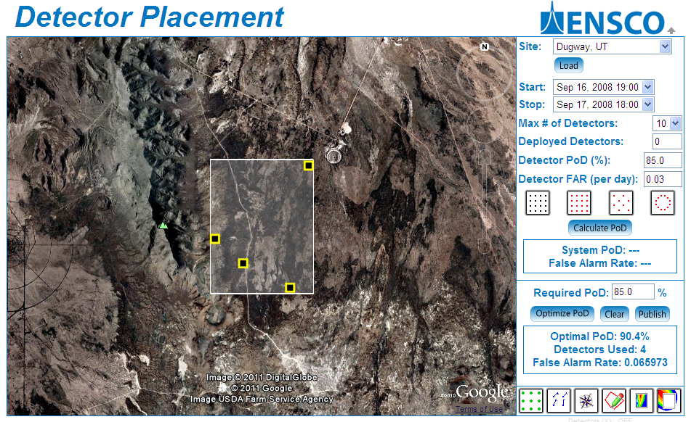
“Optimized” Detector Placement
Notes:
8

Slide 9
Optimization Methodology
Rank Order Individual Detectors
  Calculate PoD for each detector for all time periods during the mission and order them from highest to lowest PoD
Subsequent Detector Selection
  Pair individual detectors with secondary detectors that observe “unique” source events
  Order network combinations for the entire mission period using a set of rules to achieve the “best” system level PoD
Optimization Completed When:
  Detector network has an average PoD over the time period of the mission greater than the required PoD AND the network PoD for each individual time period within the mission period is greater than or equal to the required PoD
  OR
  The maximum number of available detectors is reached

Slide 10
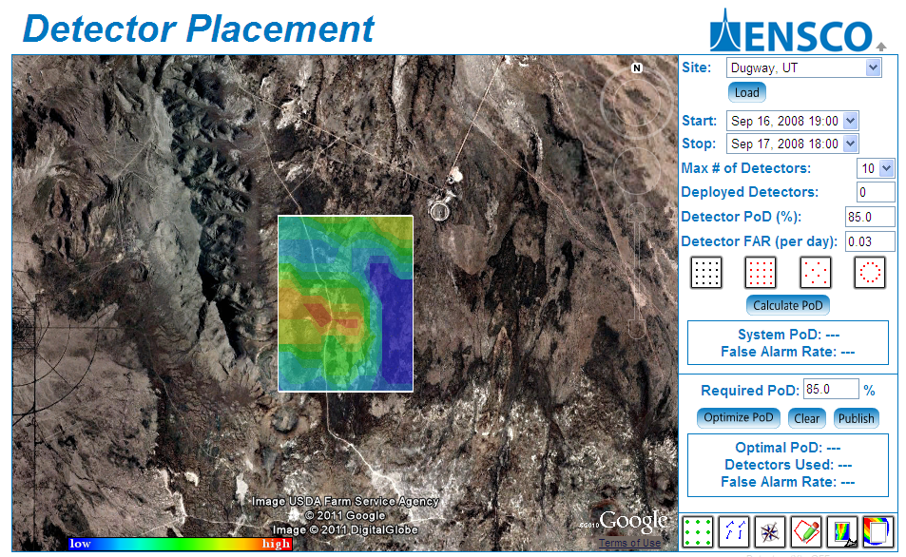
Threat Vulnerability Display

Slide 11
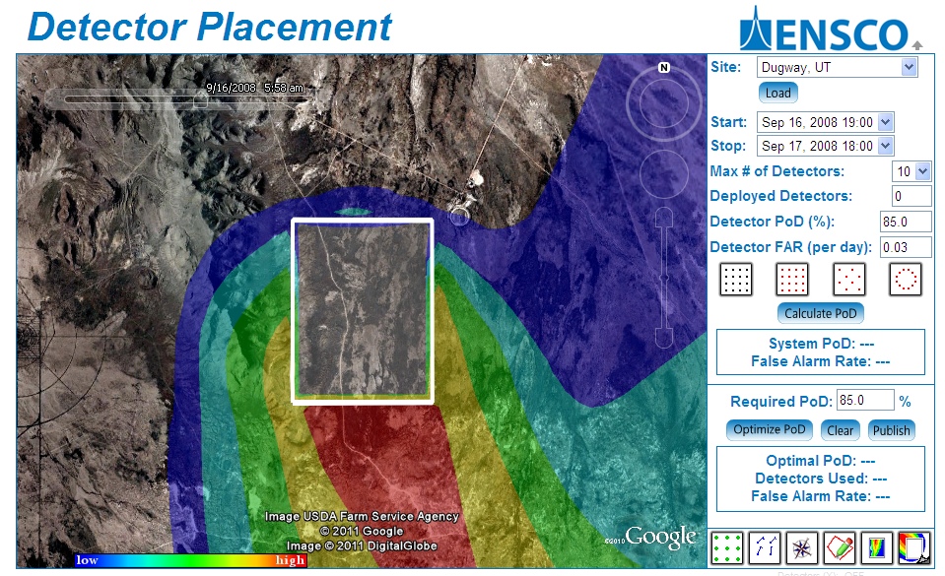
External Threat Vulnerability

Slide 12
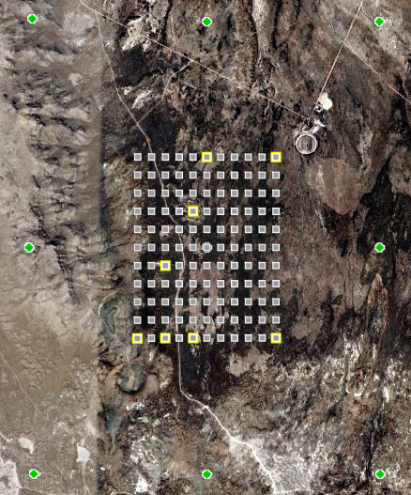
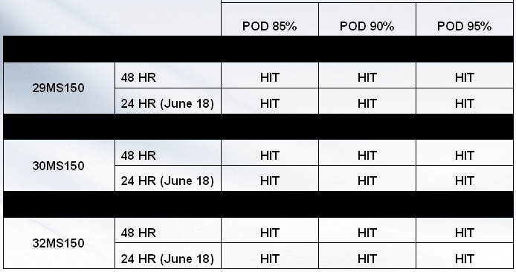
Validation Exercises
Effect of Additional Attack Points
  Use optimized detector placement locations ( ) for a POD requirement of 85%
  Challenge with additional ( ) release points
  Calculate the number of detections vs. the total number of attacks (Efficiency = 96.5%)
Challenge Against Field Data
  Data used in this evaluation provided by ECBC from Dugway Proving Ground Range Test Validation System field trial in June 2008
  ECBC interpolated the test data to each ENSCO predicted detector location
  “Hit” occurs when the released plume concentration exceeds the threshold detection limit anywhere within the grid and at least one ENSCO detector location is above threshold

Slide 13
Detector Placement Summary
Optimized detector placement reduces the number of detectors deployed resulting in reduced logistical and overall operating costs.
Detector Placement Model could also be adapted to improve the effectiveness of both chemical and radiation point detector arrays and chemical stand-off detectors.
ENSCO offers a unique system-level modeling and detector array network algorithm for optimizing biological, chemical, and radiological sensor placement, performance, and density to maximize the probability of detection.

Slide 14
Additional Contact Information
Mr. Richard Thomas
thomas.richard@ensco.com
443-484-2366
Dr. Jeff Piotrowski
piotrowski.jeff@ensco.com
321-775-7574
Questions?

