Slide 1
Institute for Defense Analyses
4850 Mark Center Drive • Alexandria, Virginia 22311-1882
13th Annual George Mason University Conference on Atmospheric Transport and Dispersion Modeling
Fairfax, Virginia
July 14-16, 2009
Evaluation of Atmospheric Transport and Dispersion Models for Suitability in a DHS Chemical Supply Chain Risk Assessment
Jeffry T. Urban, jurban@ida.org
Nathan Platt, nplatt@ida.org
Kimberly M. Papadantonakis, kpapadan@ida.org
Eric A. Adelizzi, eadelizz@ida.org
Christine R. Bucher, cbucher@ida.org
James F. Heagy, jheagy@ida.org
Sponsor:
U.S. Department of Homeland Security / Chemical Security Analysis Center (DHS / CSAC)

Slide 2
Introduction
The Department of Homeland Security’s Chemical Security Analysis Center (DHS CSAC) is developing a study to assess the risk to human health from attacks within the national chemical supply chain
The risk assessment requires the use of atmospheric transport and dispersion (AT&D) modeling to help estimate the potential consequences associated with the release of toxic industrial chemicals (TICs) from such attacks
DHS CSAC has tasked IDA with conducting a study to help determine which AT&D models, or sets of models, would be most suitable for this risk assessment application

Slide 3
Chemical Supply Chain Risk Assessment
Implications of the risk assessment methodology on the choice of AT&D modeling systems:
  The use of representative scenarios implies that very detailed site-specific meteorology, building layouts, tank rupture conditions, etc. may not be available or relevant – these parameters may need to be treated in a more generic way
  The need for accurate casualty estimation implies that the modeling systems must include or be able to support high-fidelity toxic effects models; worst-case hazard areas are not relevant
  The large number of parameters to be varied implies that the time to set up, run, and process the outputs of the model should be reasonably short; run batching is desirable

Slide 4
Study Overview
IDA is conducting a multi-year study that consists of several stages
  Study began in 2008 and is scheduled to conclude in 2010
  Study progress is periodically reviewed at workshops of key stakeholders and subject-matter-experts
Study progress to date:
  Screened over 100 AT&D modeling systems and selected four models for evaluation (CHARM, HPAC, PHAST, and TRACE)
    These results were presented at a September 2008 workshop
  Reviewed past model evaluation studies and relevant AT&D field experiments
  Acquired each of these models and characterized their operation and performance using test scenarios
  Comparing model predictions to the observations from selected tracer releases from the Project Prairie Grass field experiment

Slide 5
Initial Model Characterization
Four models are being considered
  CHARM 11 (BREEZE Software; Dallas, TX) – commercial/proprietary
  HPAC 5.0 (U.S. Defense Threat Reduction Agency) -- U.S. Gov’t. and contractors
  PHAST 6.53.1 (DNV Software; London, UK and Oslo, Norway) – commercial/proprietary
  TRACE 9.1 (SAFER Systems; Camarillo, CA) – commercial/proprietary
Upon subject-matter-expert recommendation we are also examining HGSYSTEM 3.0 (Shell Research Ltd.) as a comparison referent
  HGSYSTEM is no longer being supported or distributed to non-Shell affiliates
The study team began its characterization of these five AT&D models by running them against a notional scenario
  80-ton chlorine tank pipe rupture under very stable atmospheric conditions
  Scenario taken from AIChE-CCPS monograph, Guidelines for Use of Vapor Cloud Dispersion Models (2nd ed.) (1996)

Slide 6
Initial Model Observations [1 of 2]
Source emissions modeling
  CHARM, PHAST, and TRACE can model the discharge of chemicals from a container given the storage conditions and hole size
  HPAC can model container discharges only by specifying a general level of container damage or a weapon-on-target effect (IFac and ITrans modules)
    Can only model container wall breaches; no pipe ruptures
    User cannot directly specify a container hole size or location
    Releases cannot have a horizontal momentum component
  All of the models support user-defined release scenarios
    Due to the aforementioned HPAC source emissions limitations we modeled the chlorine pipe rupture scenario as an HPAC analytical (user-defined) release
Terrain, Obstacles, and Time-Varying Winds
  CHARM and HPAC can model AT&D in the of presence of terrain elevation changes, obstacles to the dispersion, and changing winds
  PHAST and TRACE cannot model terrain, obstacles, or changing winds

Slide 7
Initial Model Observations [2 of 2]
Outputs
  All of the models can output concentration contours at different times
  Only HPAC supports the output of detailed concentration time histories at a large number of user-defined locations
  The models support varying degrees of consequence estimation (from none to population exposures to number of fatalities)
Runtimes
  All of the models except CHARM took from several seconds to several minutes to run the chlorine tank pipe rupture scenario; CHARM takes hours or more to run depending on grid size

Slide 8
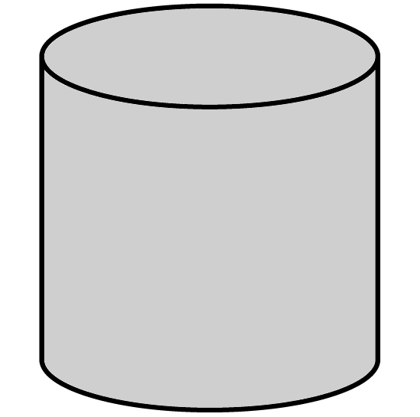
Chlorine Tank Pipe Rupture Scenario
2 m/s wind at 10 m
Stability Class F
Fill line
1.5” dia. pipe
80 tons Cl₂
8 atm / 25 °C
2-phase jet
Release ~ 1.5 hr
0
5 m

Slide 9
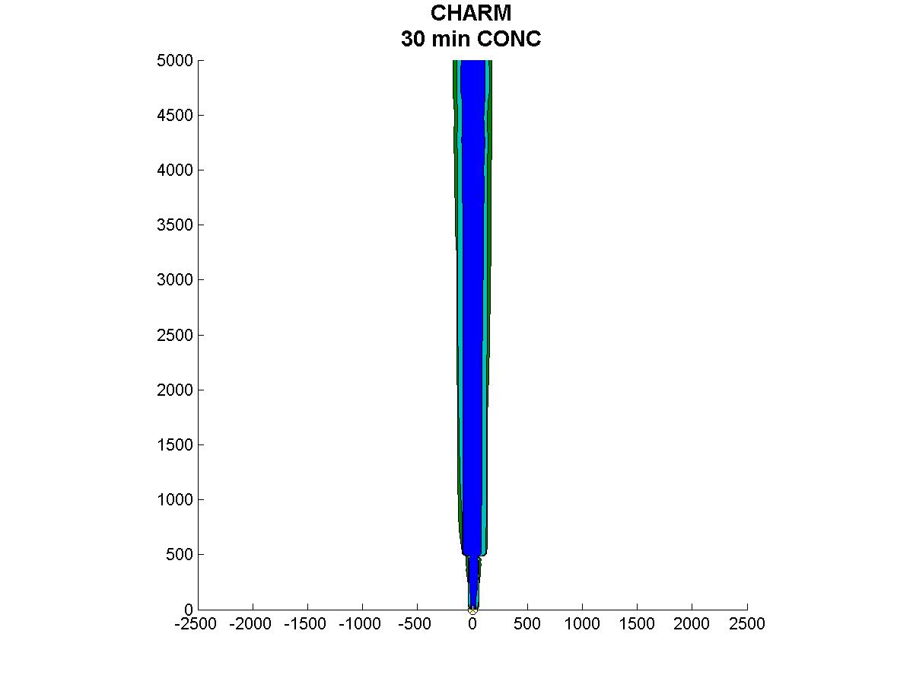
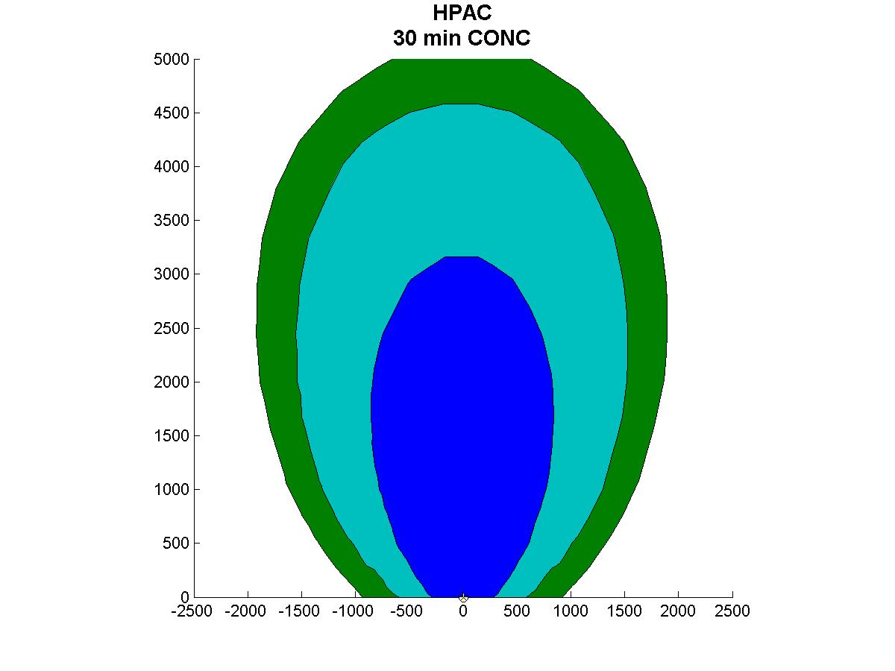
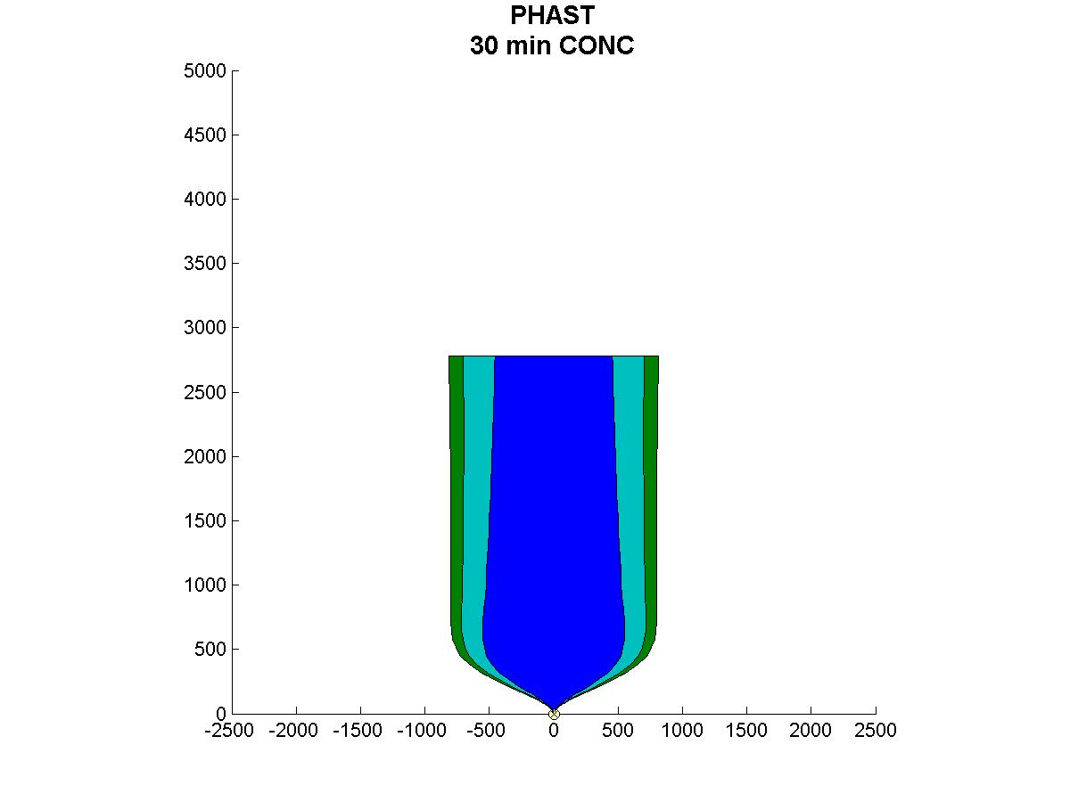
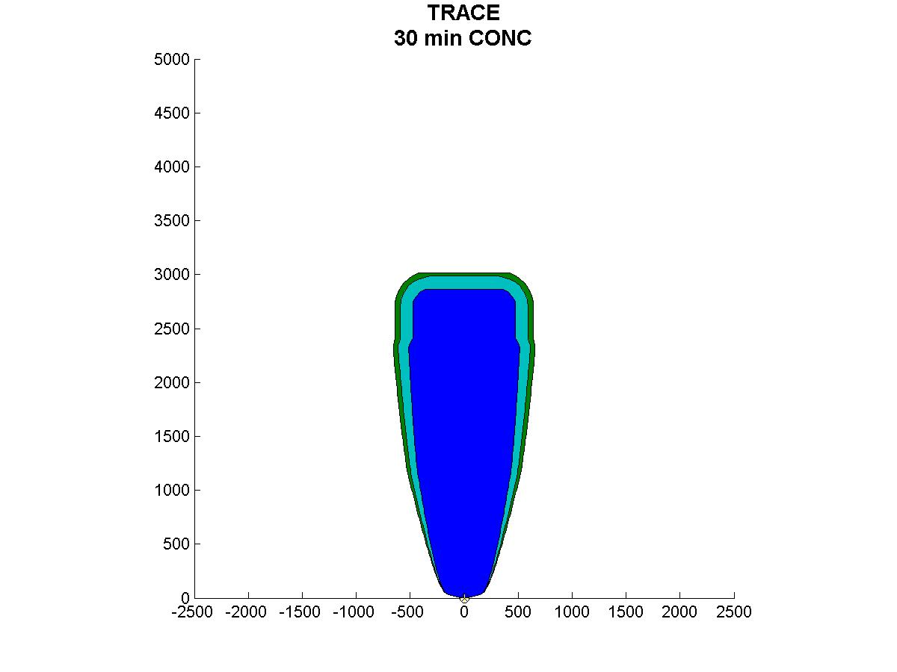
Chlorine Concentration: 0.5 hr After Start of Release
CHARM
HPAC
0.5 ppm
5 km
2.0 ppm
20.0 ppm
PHAST
5 km
TRACE

Slide 10
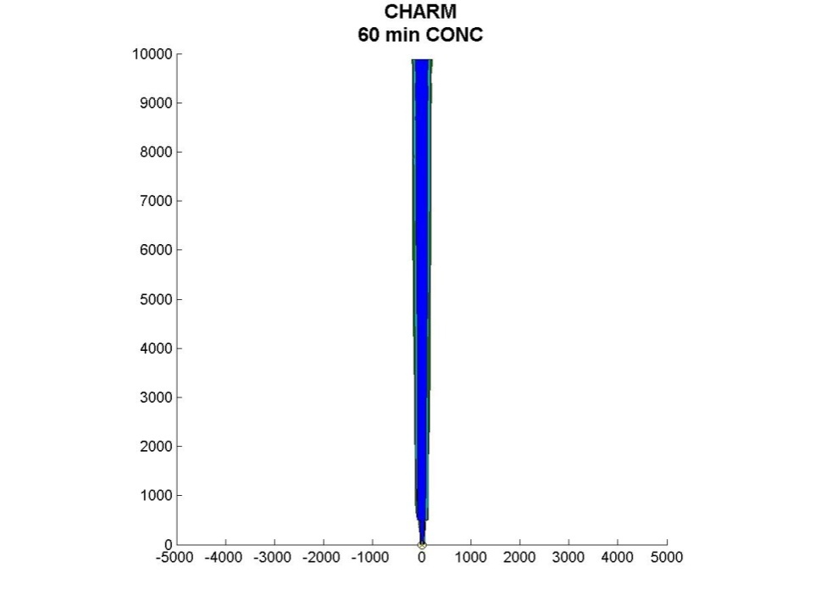
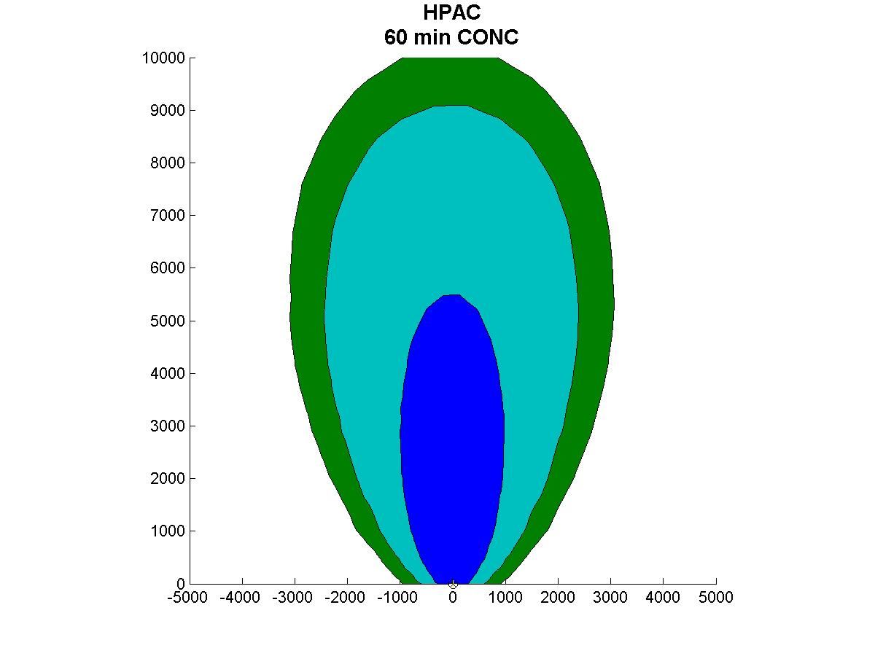
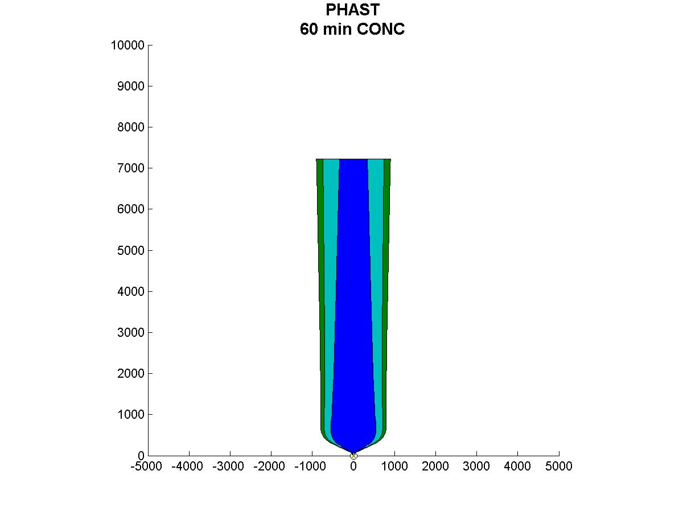
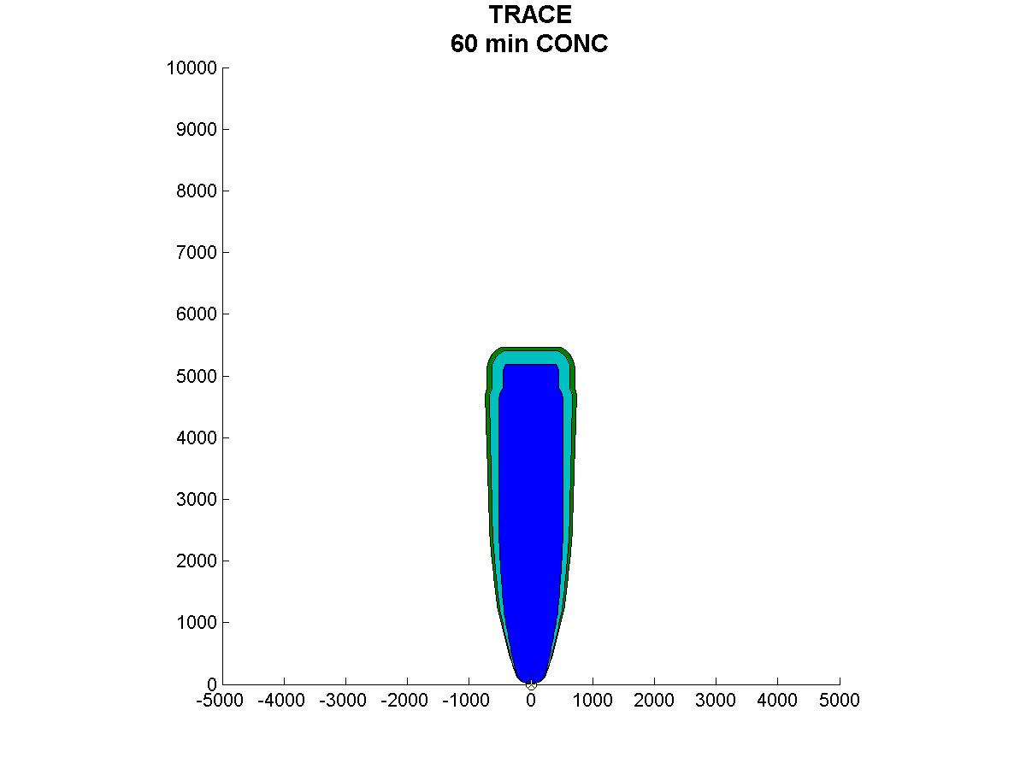
Chlorine Concentration: 1 hr After Start of Release
CHARM
HPAC
10 km
PHAST
10 km
TRACE

Slide 11
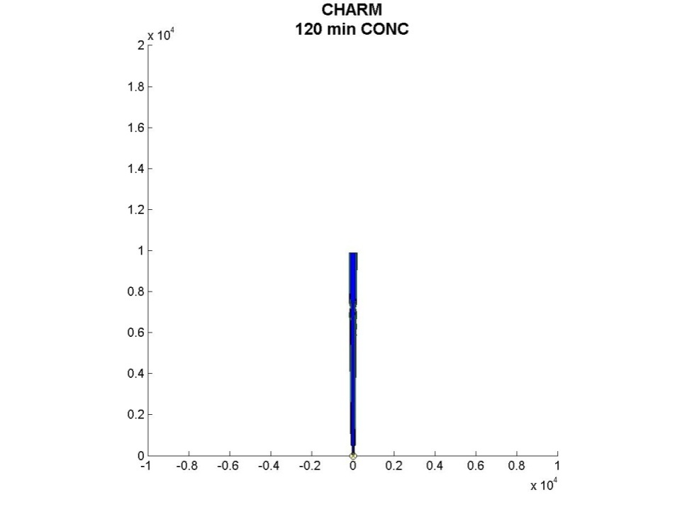
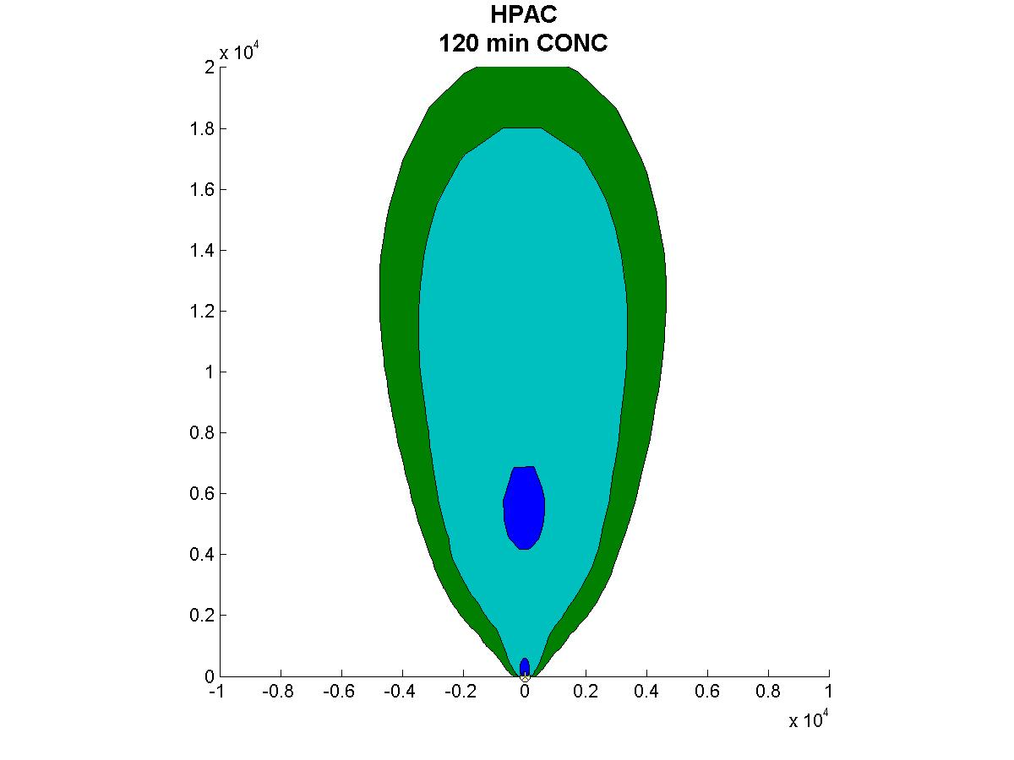
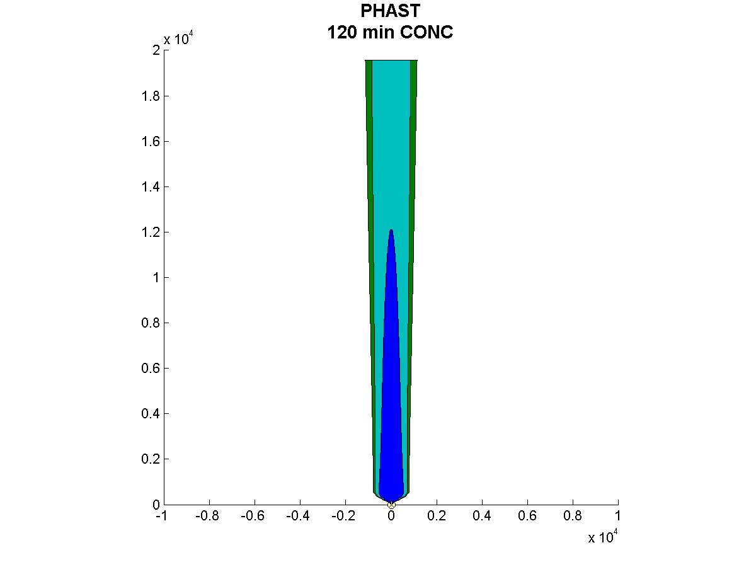
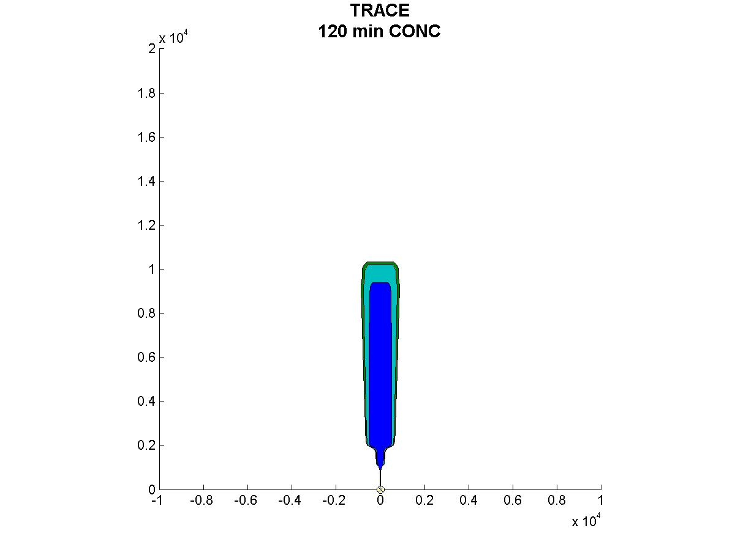
Chlorine Concentration: 2 hr After Start of Release
CHARM
HPAC
20 km
PHAST
20 km
TRACE

Slide 12
Chlorine Scenario Observations
The instantaneous chlorine contaminated areas (“plume footprints”) are comparable between HPAC, PHAST, and TRACE at 20 ppm
  CHARM footprints are much narrower than those of the other models
  HPAC footprints are wider than those of PHAST and TRACE at lower concentrations
HPAC plume footprints are much wider than those of the other models at lower concentration levels (2 ppm, 0.5 ppm)
  Possible effect of HPAC vertical jet limitation or conditional averaging?
PHAST and TRACE have comparable plume footprints (especially widths) but there are differences in the timing and extent of downwind transport
  PHAST appears to transports material downwind faster and farther than TRACE
It is difficult to separate out the pure AT&D effects from the effects of the source emissions modeling and the gravity-driven dense gas flow
  In order to isolate the factors leading to differences in model predictions, we decided to conduct a study of the sensitivity of the models’ predictions to changes in the meteorological inputs

Slide 13
Meteorological Sensitivity Study
This study examines the ability of the models to predict passive dispersion over flat terrain in the absence of obstacles under a variety of meteorological conditions
The key meteorological parameter we varied is the atmospheric stability
The study team selected six sulfur dioxide tracer gas releases from the 1956 Project Prairie Grass field experiment spanning the range of atmospheric stability (Pasquill categories A through F)
  Project Prairie Grass is a canonical passive AT&D field experiment with well-characterized meteorology
  The use of field experiment data will permit us to make assessments of the models’ prediction accuracy
  Model comparisons are underway for CHARM, HPAC, PHAST, and TRACE
Metrics for comparison are 30-minute sampler arc-maximum dosages and cloud widths on the sampler arcs at dosage levels of interest

Slide 14
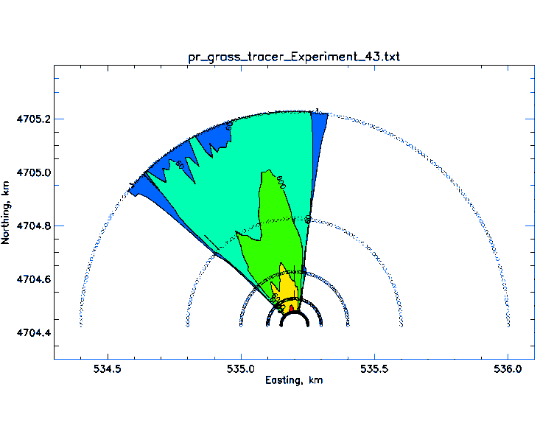
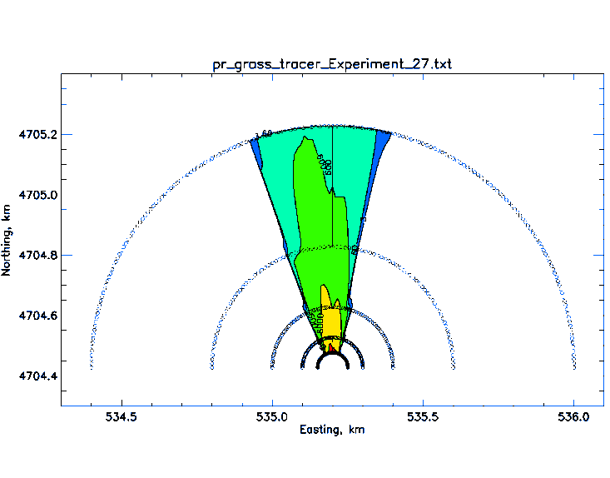
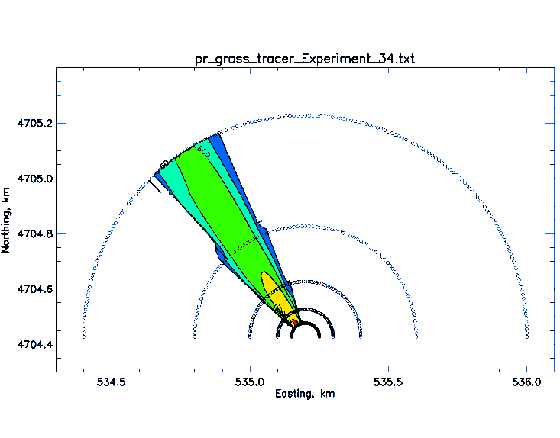
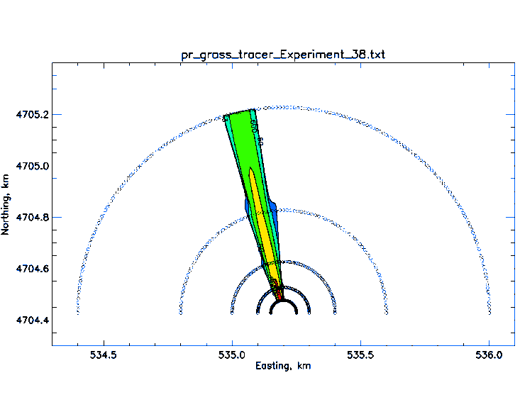
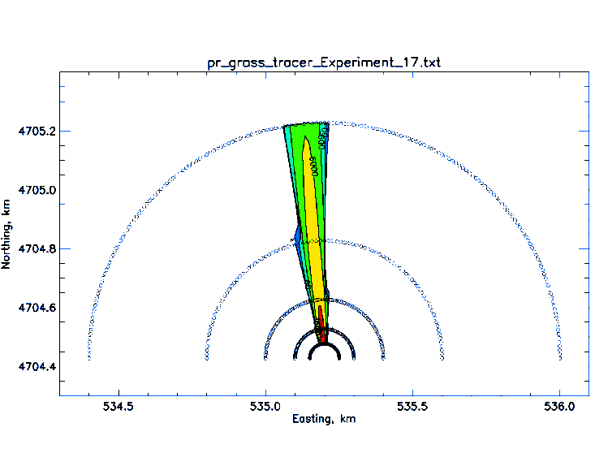
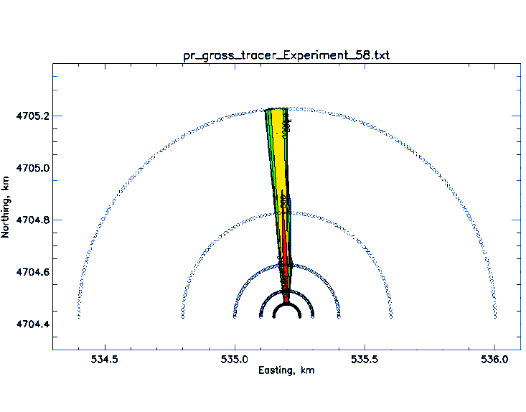
Selected Project Prairie Grass Releases:
Interpolated Observations
A
B
C
800 m arc
D
E
F

Slide 15
Future Efforts
Model evaluations against the six Project Prairie Grass releases are underway
We have begun the process of choosing a dense gas field experiment for the evaluation
  We are reviewing data reports in order to better characterize these experiments
Further characterization of the models’ capabilities can be achieved using parametric studies of notional scenarios
  For example, exploring how difficult it is to turn model outputs into accurate (not “conservative”) estimates of casualties under different assumptions (type of toxicity model, built-in vs. post-processed toxicity modeling, or uniform vs. varying population)
  Further test scenarios to be developed in conjunction with CSAC’s program to develop representative scenarios for the chemical supply chain risk assessment
Further workshops to review study progress (next one in Fall 2009)

