Slide 1
Evaluation of the Sparta Sensor Placement Capability
16 July 2009
Ian Griffiths and Ian Bush

Slide 2
Sparta: Motivation
CBRN sensors limited resource & placement needs to provide maximum information for response & protection
  Minimise casualties & effects
Sparta requirements
  Determine optimal sensor locations to protect personnel
  Easy to use
  Flexible
  Rapid

Slide 3
How It Works
Takes inputs
  Threat
  Population
  Allowable sensor locations
  Sensor properties (including reliability)
  Material properties (toxicity)
  Mitigation availability (Medical, IPE)

Slide 4
How It Works
Samples inputs and builds multiple challenge simulations
Calculates effects and mitigation response for each simulated challenge
  Uses material, sensor & mitigation data
Determines optimal locations using sequential optimiser
  Minimises effects

Slide 5
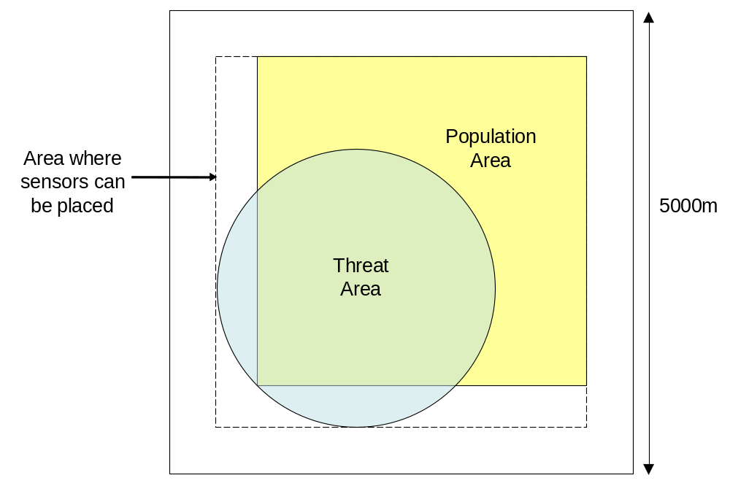
How It Works

Slide 6
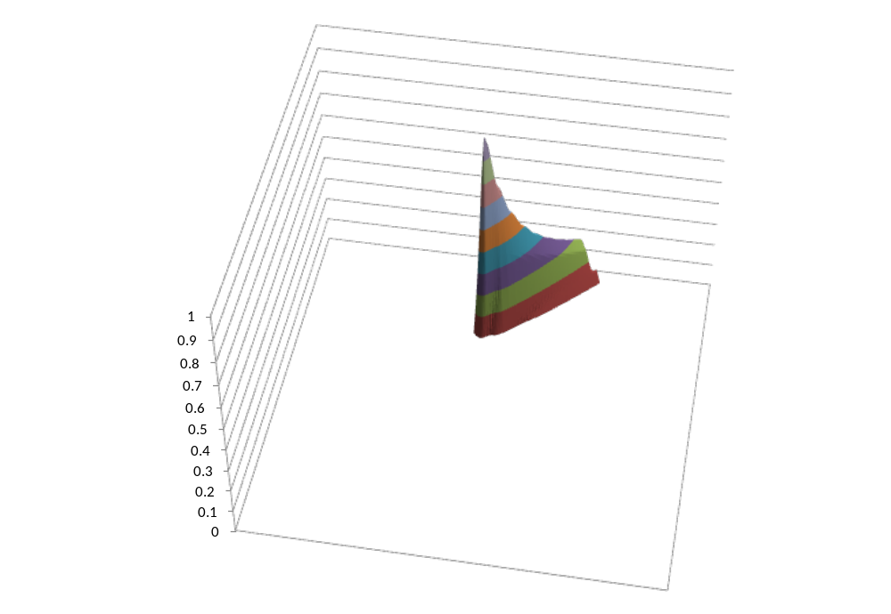
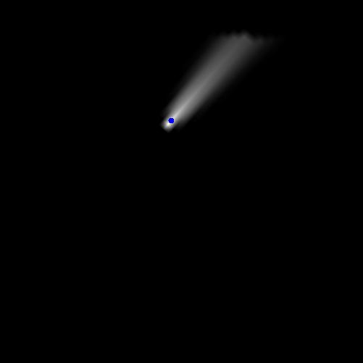
How It Works
Number of simulations: 1
Relative concentration affecting population

Slide 7
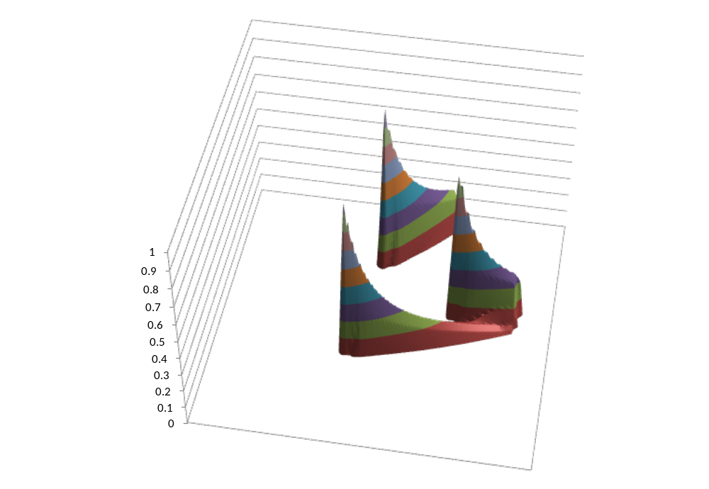
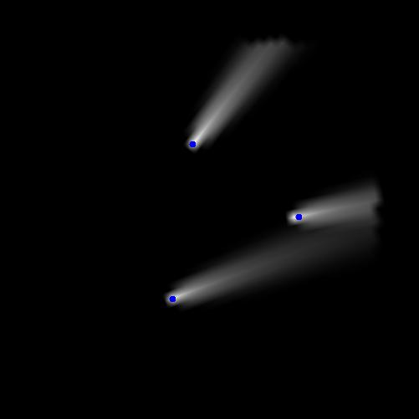
How It Works
Number of simulations: 3
Relative concentration affecting population

Slide 8
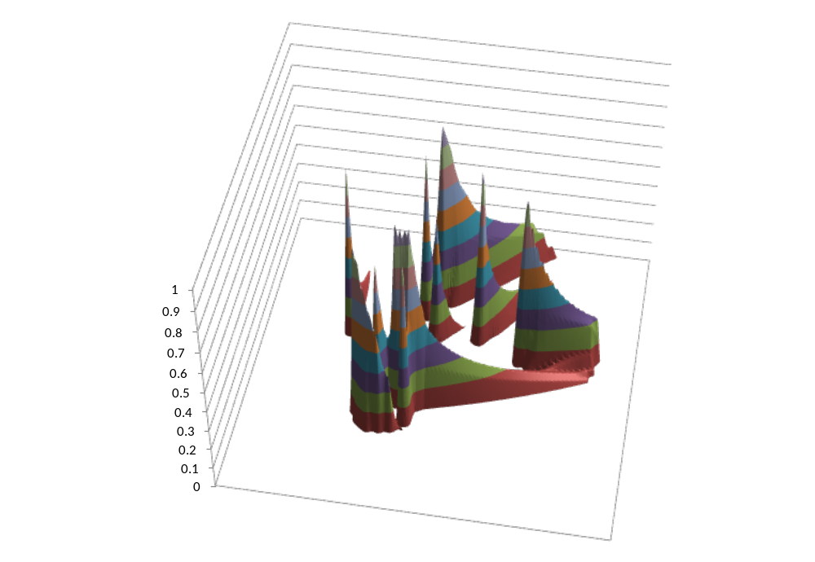
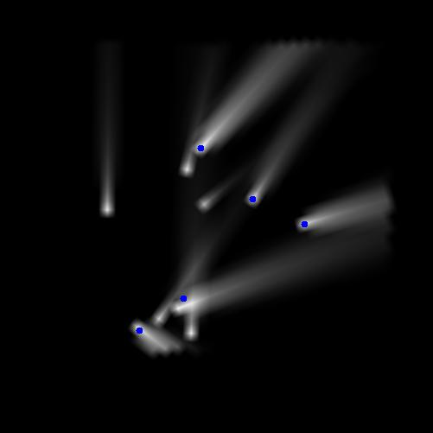
How It Works
Number of simulations: 10
Relative concentration affecting population

Slide 9
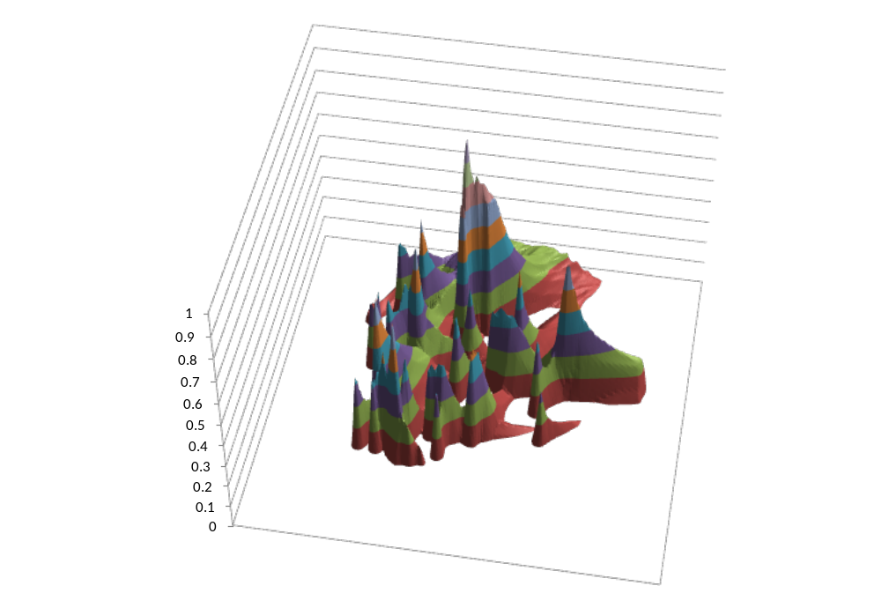
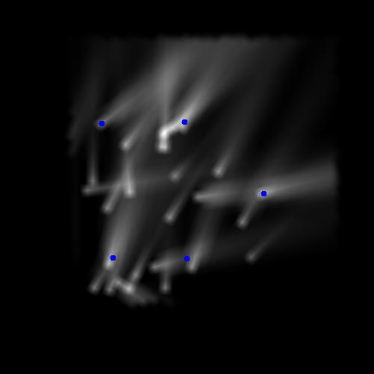
How It Works
Number of simulations: 30
Relative concentration affecting population

Slide 10
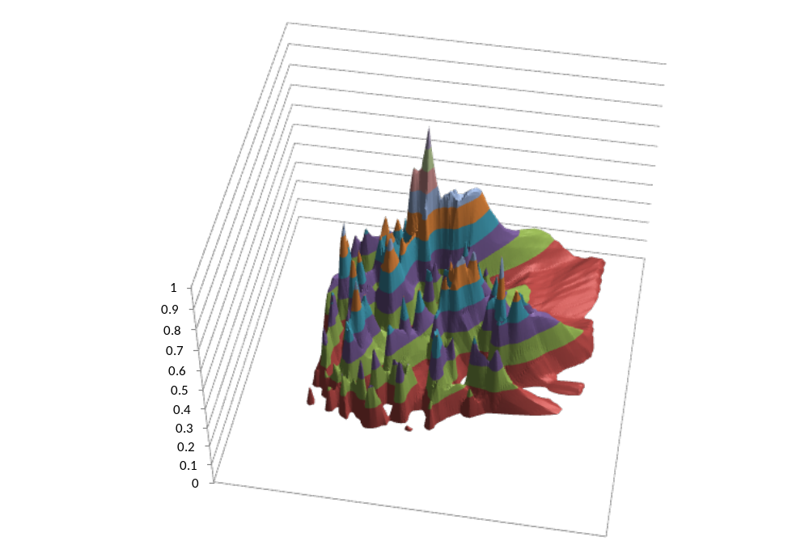
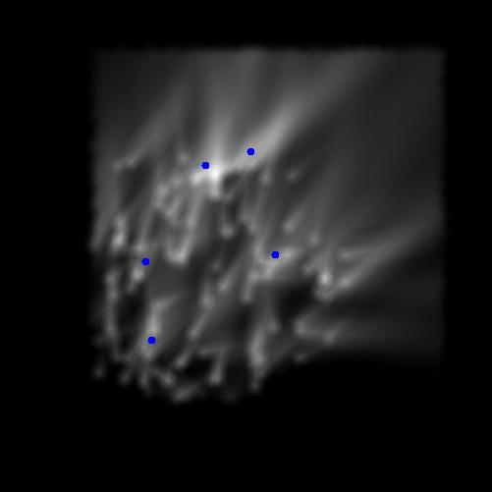
How It Works
Number of simulations: 100
Relative concentration affecting population

Slide 11
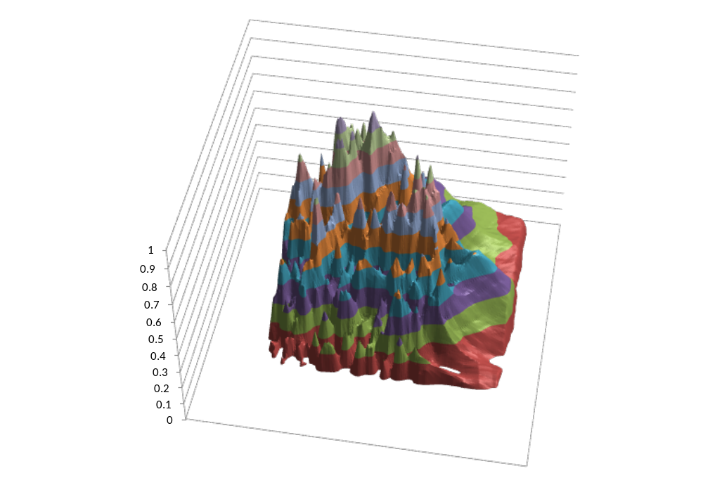
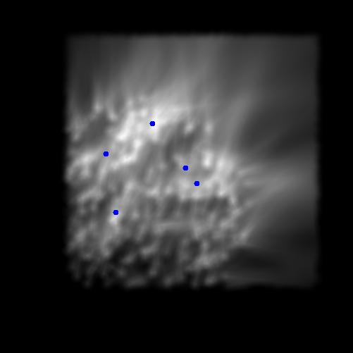
How It Works
Number of simulations: 300
Relative concentration affecting population

Slide 12
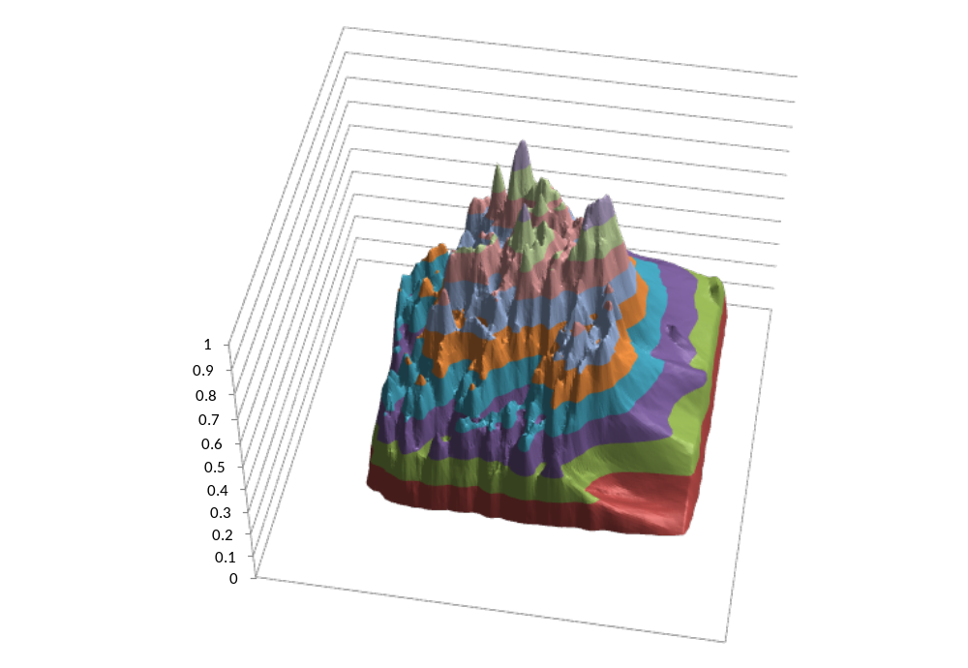
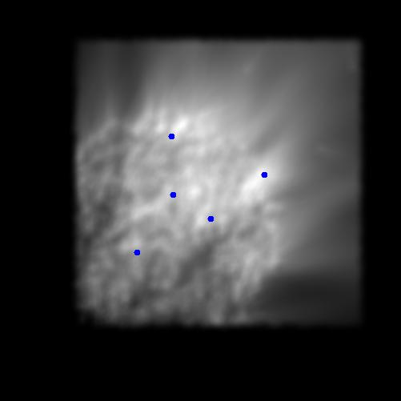
How It Works
Number of simulations: 1,000
Relative concentration affecting population

Slide 13
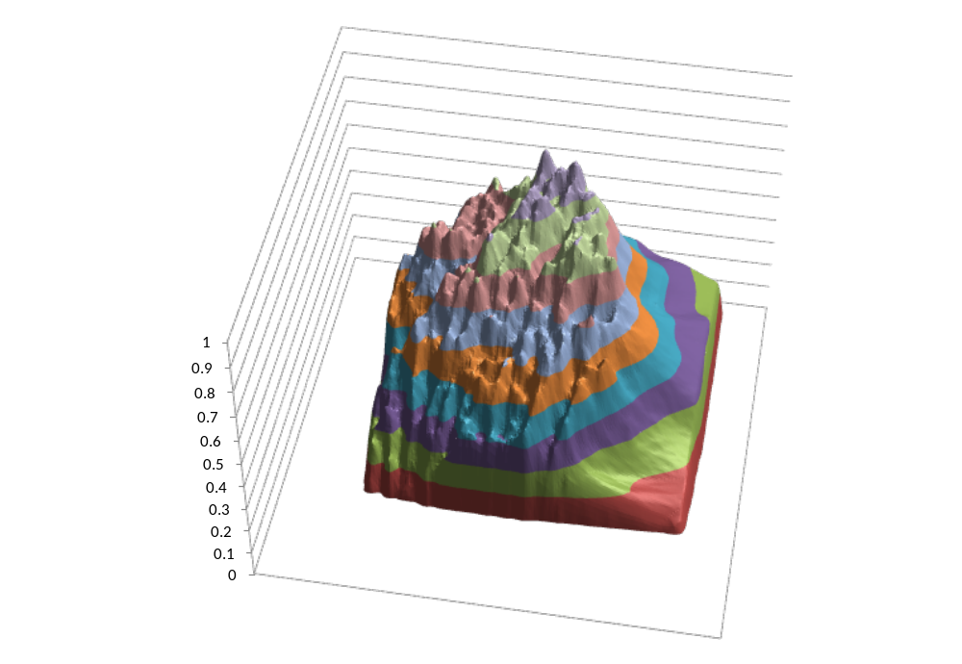
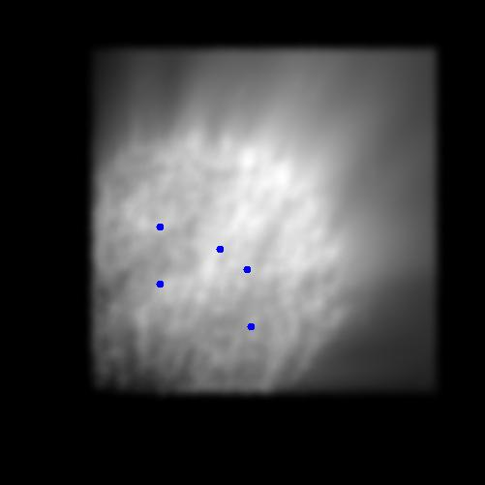
How It Works
Number of simulations: 3,000
Relative concentration affecting population

Slide 14
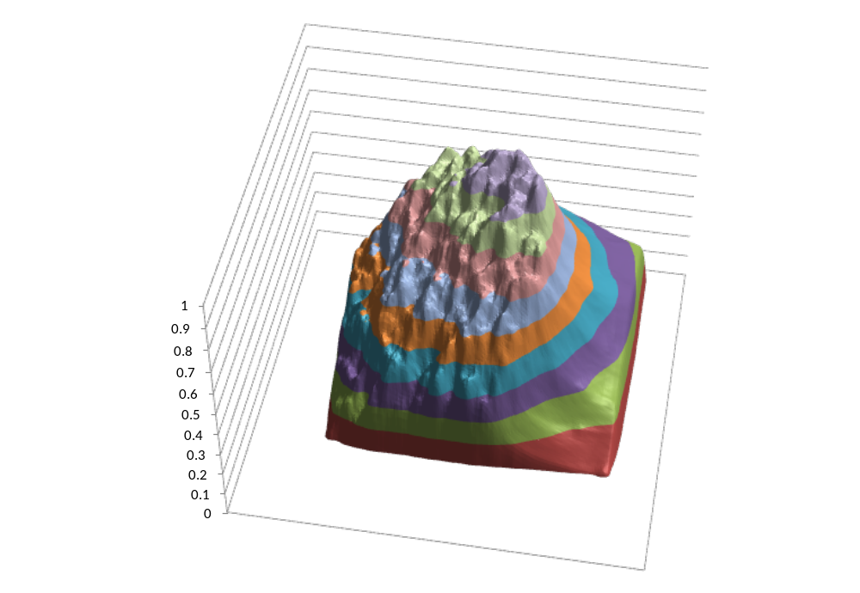
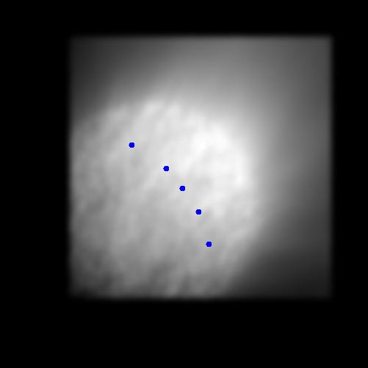
How It Works
Number of simulations: 10,000
Relative concentration affecting population

Slide 15
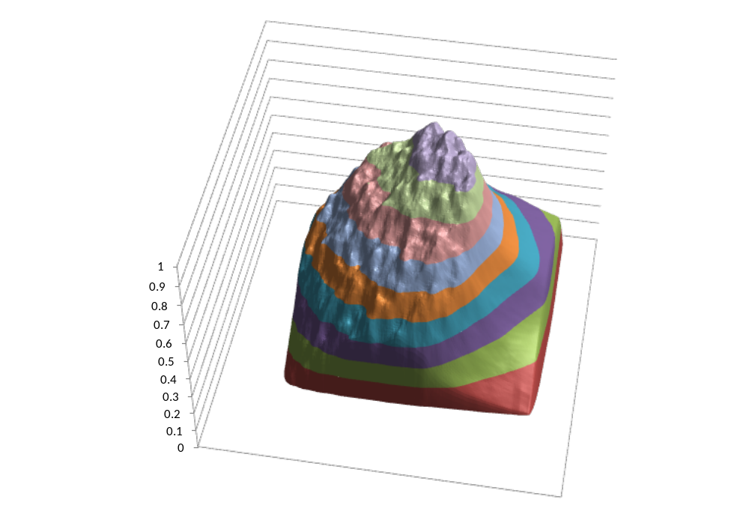
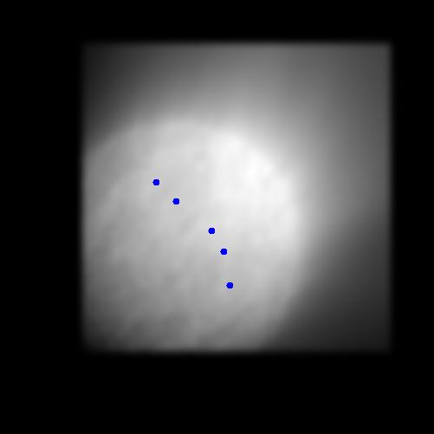
How It Works
Number of simulations: 30,000
Relative concentration affecting population

Slide 16
How It Works
Provides output
  Sensor locations (in prioritised order)
    Will identify unnecessary sensors
  Estimate of casualty reduction for each sensor placed
  Numerous other outputs (all optional)
Can also choose to
  Fix location positions
  Evaluate sensor layout

Slide 17
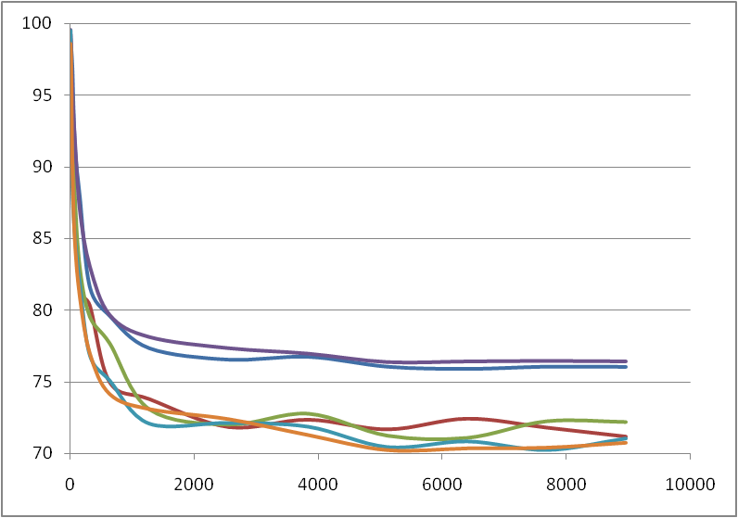
How Many Challenges?

Slide 18
Evaluation Overview
Evaluation is challenge
  Field trials difficult
  Need to conduct numerous evaluations in different simulations
  Need to compare it against something
Approach
  Use synthetic challenge data (using TES)
  Use FFT07 data
  Compare against a rules-based approach

Slide 19
Rules-Based Approach
For evaluation have developed simple rules-based approach
Rules are:
  If threat area is outside area of protection, place sensors evenly around perimeter of protection area
  If threat area overlaps area of protection, place sensors evenly throughout protection area
  Adjust sensor positions to ensure they are in allowable locations
This is our own algorithm developed for the purpose of study

Slide 20
Evaluation Part 1: Simulated Challenge

Slide 21
Overview
Scenarios
  Simple test cases
  More realistic scenario
Evaluation
  Sparta’s internal estimation
  Synthetic challenges from Test & Evaluation System

Slide 22
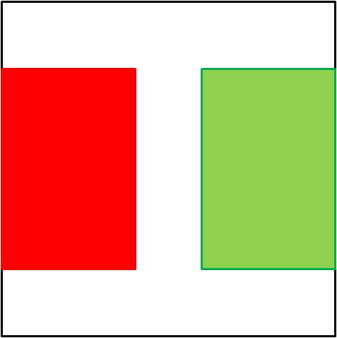
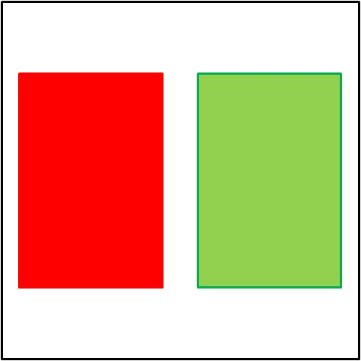

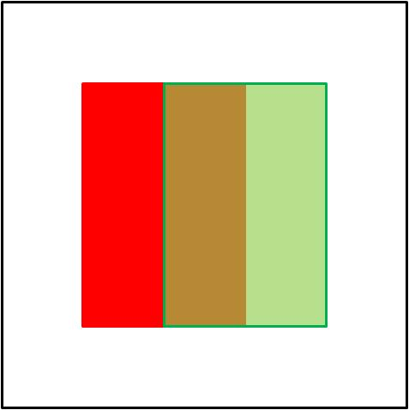
Test Case 1
Threat & population
5 material types (3 chem, 2 bio)
6 chem & 6 bio sensors available
4 met wind roses
For each sub-test
  3000 plumes sampled
  Run time 10 mins

Slide 23

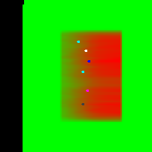

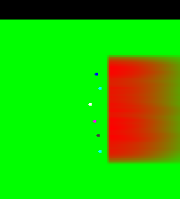
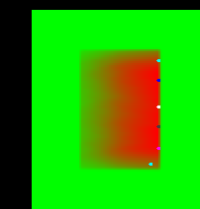
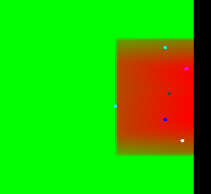
Test Case 1: Sample Output
chem
bio

Slide 24
Test Case 1 Results (Estimated %age Reduction in Casualties)
 | Chem | Bio | Chem | Bio | Chem | Bio | Chem | Bio
From W 2º sig | Sp: 60 Ru: 13 | Sp: 95 Ru: 44 | Sp: 61 Ru: 15 | Sp: 94 Ru: 44 | Sp: 56 Ru: 15 | Sp: 96 Ru: 41 | Sp: 40 Ru: 12 | Sp: 93 Ru: 30
From W 6º sig | Sp: 62 Ru: 13 | Sp: 92 Ru: 47 | Sp: 62 Ru: 14 | Sp: 91 Ru: 46 | Sp: 58 Ru: 14 | Sp: 92 Ru: 42 | Sp: 40 Ru: 12 | Sp: 90 Ru: 34
From W 12º sig | Sp: 67 Ru: 14 | Sp: 91 Ru: 54 | Sp: 65 Ru: 13 | Sp: 93 Ru: 51 | Sp: 60 Ru: 15 | Sp: 90 Ru: 47 | Sp: 42 Ru: 11 | Sp: 87 Ru: 40
Uniform met | Sp: 78 Ru: 14 | Sp: 92 Ru: 57 | Sp: 77 Ru: 20 | Sp: 89 Ru: 62 | Sp: 72 Ru: 22 | Sp: 86 Ru: 56 | Sp: 43 Ru: 11 | Sp: 64 Ru: 45

Slide 25
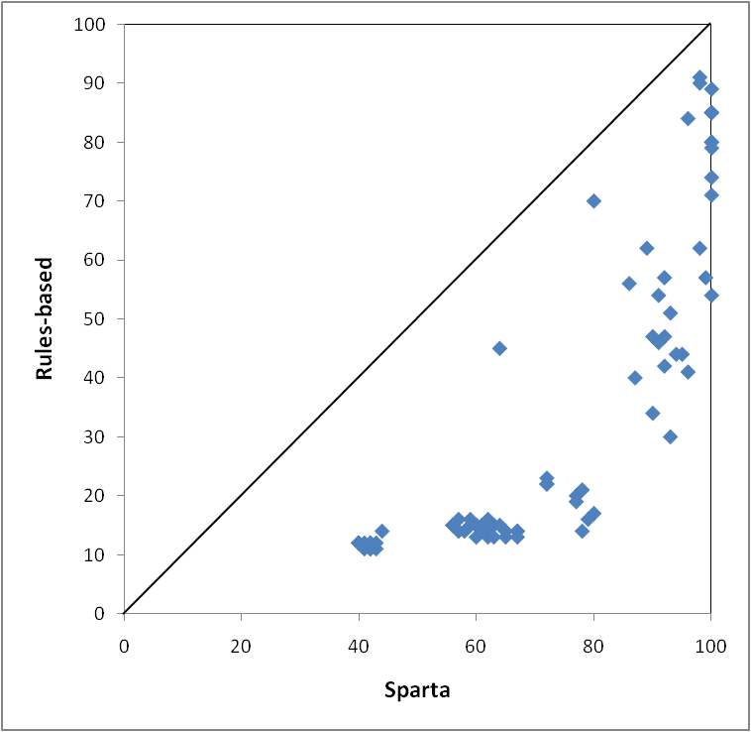
Test Case 1: Comparison of All Results - %age Reduction in Casualties
Rules beating Sparta
Rules improving
Sparta beating Rules
Sparta improving

Slide 26



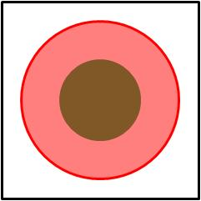
Test Case 2
Threat & population
5 material types (3 chem, 2 bio)
12 chem & 6 bio sensors available
4 met wind roses
For each sub-test
  3000 plumes sampled
  Run time 10 mins

Slide 27
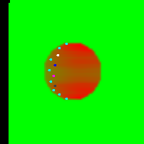
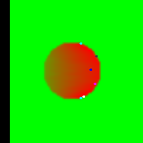
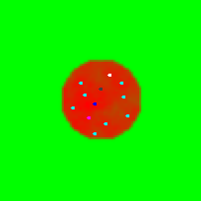

Test Case 2: Sample Output
From W 2º sig
chem
bio
Uniform met

Slide 28
Test Case 2 Results (Estimated %age Reduction in Casualties)
 | Chem | Bio | Chem | Bio | Chem | Bio | Chem | Bio
From W 2º sig | Sp: 92 Ru: 55 | Sp: 98 Ru: 80 | Sp: 98 Ru: 63 | Sp: 100 Ru: 86 | Sp: 92 Ru: 56 | Sp: 99 Ru: 81 | Sp: 70 Ru: 41 | Sp: 99 Ru: 72
From W 6º sig | Sp: 93 Ru: 55 | Sp: 99 Ru: 77 | Sp: 98 Ru: 65 | Sp: 99 Ru: 80 | Sp: 91 Ru: 56 | Sp: 97 Ru: 76 | Sp: 69 Ru: 49 | Sp: 99 Ru: 79
From W 12º sig | Sp: 91 Ru: 55 | Sp: 98 Ru: 72 | Sp: 96 Ru: 65 | Sp: 97 Ru: 76 | Sp: 90 Ru: 53 | Sp: 95 Ru: 72 | Sp: 69 Ru: 52 | Sp: 96 Ru: 71
Uniform met | Sp: 72 Ru: 53 | Sp: 55 Ru: 70 | Sp: 76 Ru: 62 | Sp: 87 Ru: 75 | Sp: 72 Ru: 52 | Sp: 84 Ru: 71 | Sp: 64 Ru: 49 | Sp: 77 Ru: 66

Slide 29
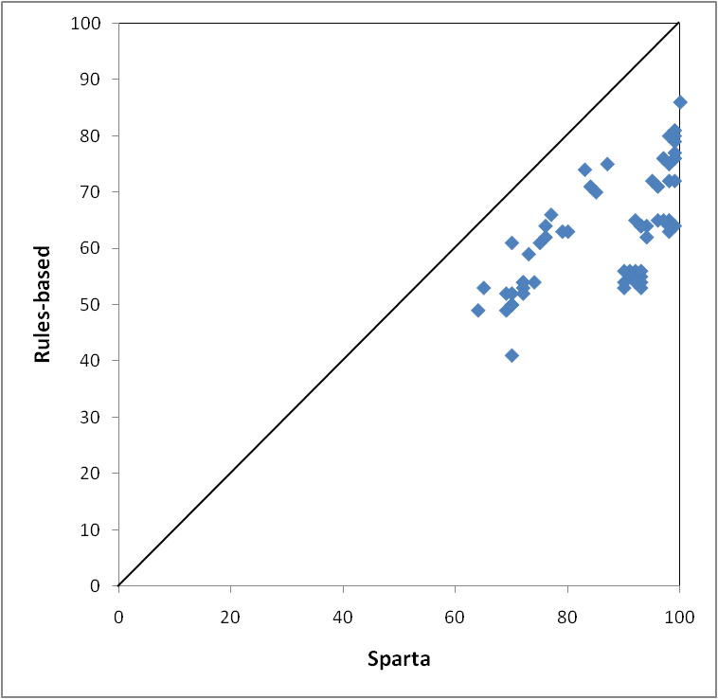
Test Case 2: Comparison of All Results - %age Reduction in Casualties

Slide 30
Bagram Scenario
Threat & population

Slide 31
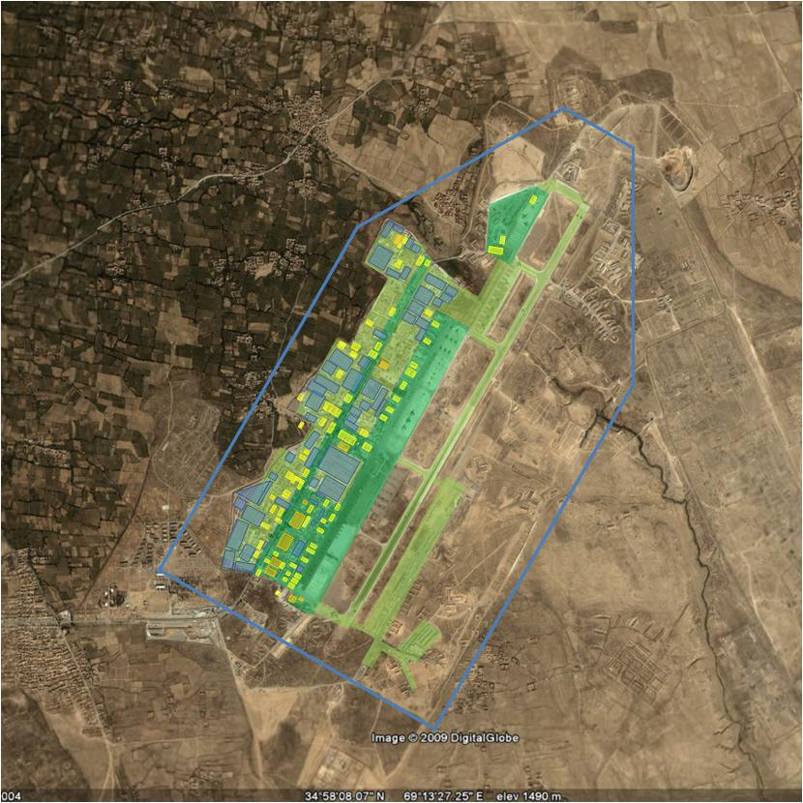
Bagram Scenario
Population
Area of permitted sensor locations

Slide 32
Bagram Scenario
Threat & population
5 deployment periods
  Annual, Winter, August, 5 day
  Threat locations varied by deployment period
5 material types (3 chem, 2 bio)
Sensors available
  10 chem & 25 chem
  4 bio & 10 bio
4 met wind roses
For each sub-test
  5000 plumes sampled
  Run time 15 mins

Slide 33
Bagram Results (Estimated %age Reduction in Casualties)
 | 10 chem | 25 chem | 4 bio | 10 bio
Long-term deployment | Sp: 68 Ru: 57 | Sp: 89 Ru: 84 | Sp: 70 Ru: 54 | Sp: 91 Ru: 90
Winter deployment | Sp: 67 Ru: 26 | Sp: 83 Ru: 62 | Sp: 63 Ru: 35 | Sp: 88 Ru: 79
August deployment | Sp: 89 Ru: 38 | Sp: 95 Ru: 71 | Sp: 86 Ru: 61 | Sp: 99 Ru: 90
5 day deployment | Sp: 96 Ru: 81 | Sp: 99 Ru: 96 | Sp: 94 Ru: 76 | Sp: 99 Ru: 95

Slide 34
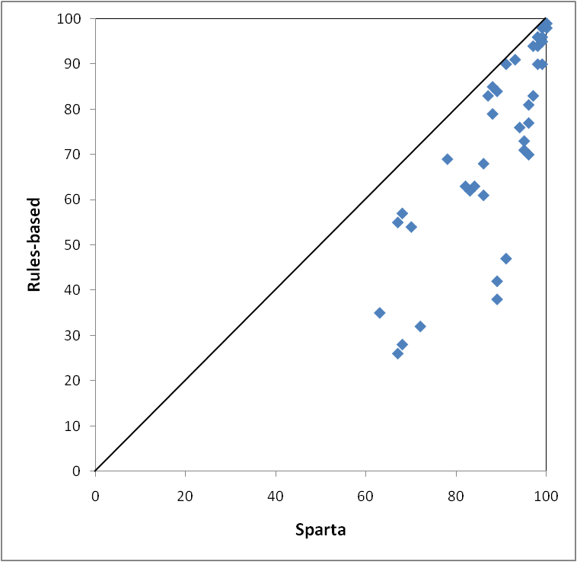
Bagram Scenario: Comparison of All Results - %age Reduction in Casualties

Slide 35
Comparison Using Evaluation System Synthetic Challenges

Slide 36




Comparison Using Evaluation System Synthetic Challenges
Chem
Bio
From W 2º sig
From W 6º sig
From W 12º sig
Uniform met
Sp: 100 Ru: 75.7
Sp: 99.9 Ru: 71.9
Sp: 97.6 Ru: 69.7
Sp: 88.4 Ru: 70.1
Sp: 100 Ru: 100
Sp: 100 Ru: 100
Sp: 100 Ru: 100

Slide 37
Comparison Using Evaluation System Synthetic Challenges
Chem
Bio
Uniform met
August deployment
Winter deployment
Long term deployment
Sp: 88.1 Ru: 77.9
Sp: 81.1 Ru: 63.4
Sp: 86.9 Ru: 69.1
Sp: 100 Ru: 100
Sp: 100 Ru: 100

Slide 38
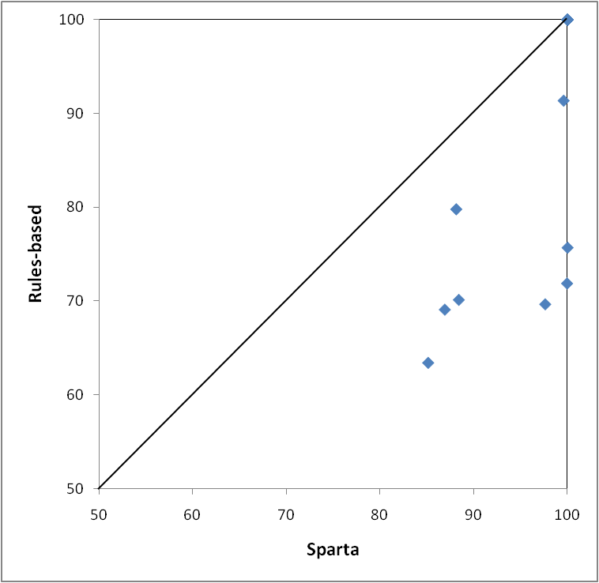
Comparison Using Evaluation System Synthetic Challenges

Slide 39
Evaluation Part 2: FFT07

Slide 40
Overview
Used TES to access FFT07 data
  Prepared wind roses and threat
Sensor placement based on
  Sparta
  Rules based – placed around perimeter and spread evenly through sensor domain
  Looking at sensor measurements from field trials (i.e. in hindsight)
    TES automatically determines optimal locations
Constraints
  Placements limited to FFT07 sensor locations
  Maximise probability of detection

Slide 41
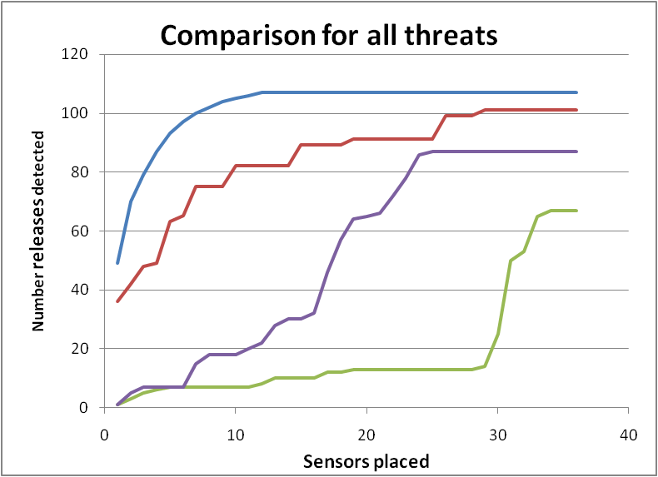
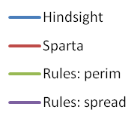
Results: Plume Detection for all Conditions & Threats

Slide 42
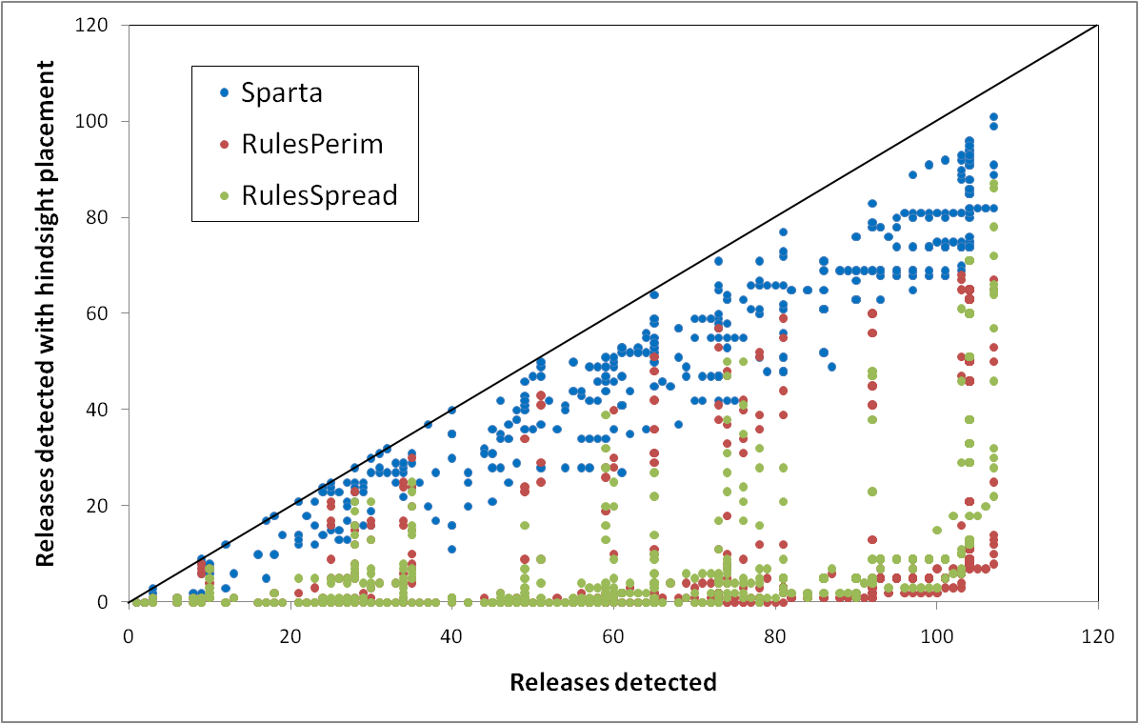
Results: Plume Detection for all Conditions & Threats

Slide 43
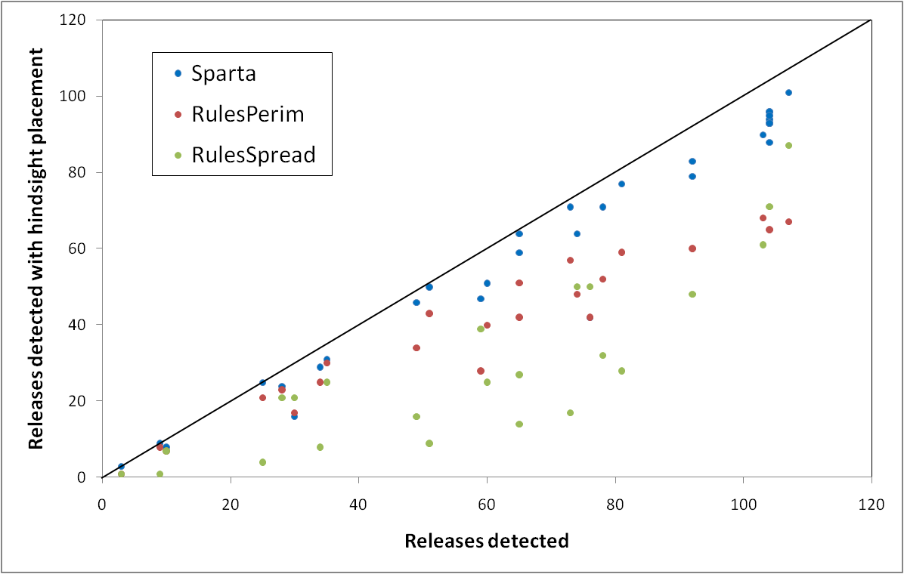
Results: Plume Detection for all Conditions & Threats

Slide 44
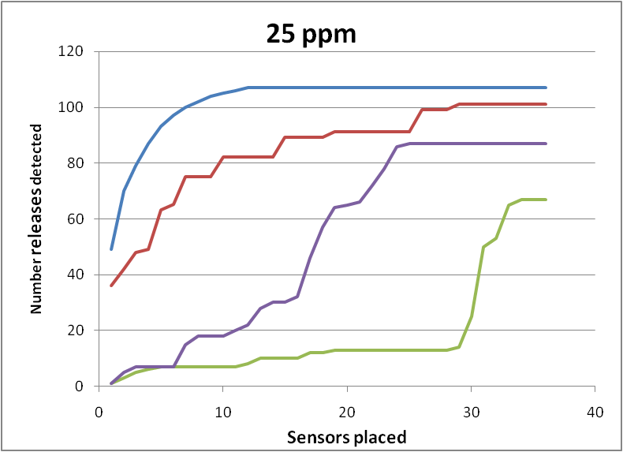
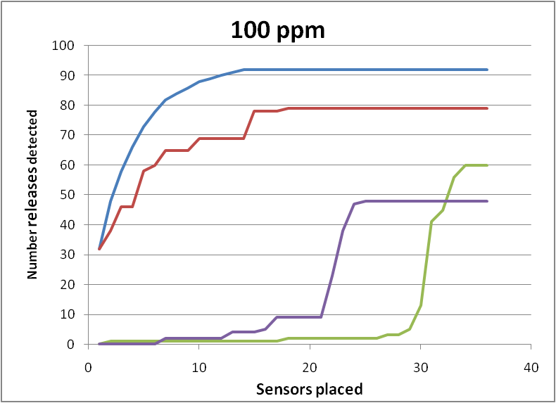
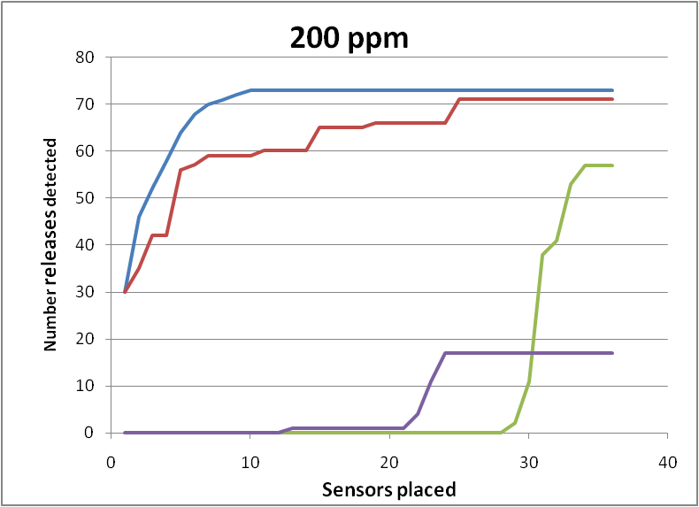
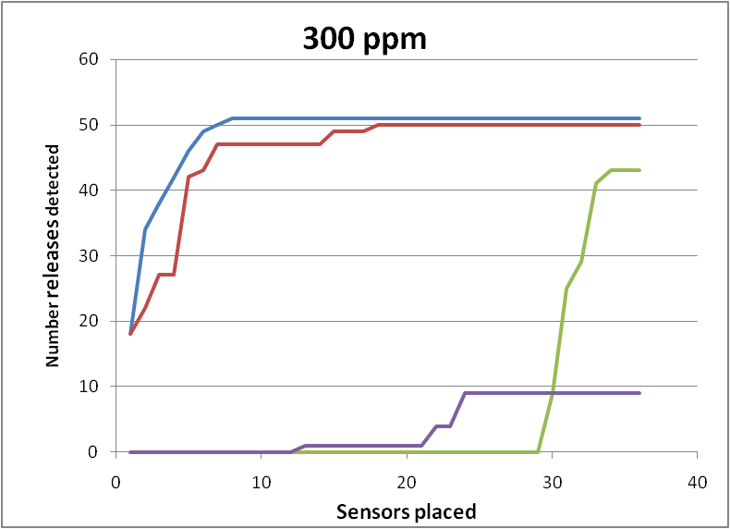
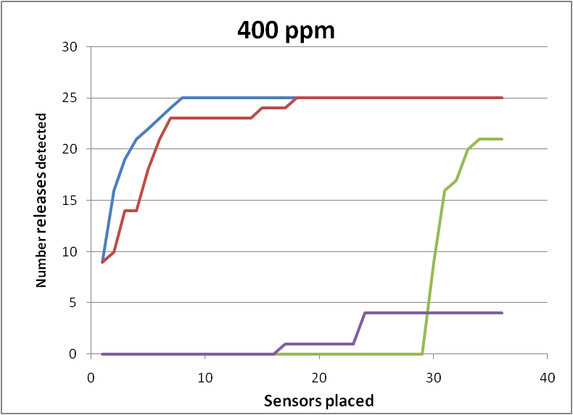
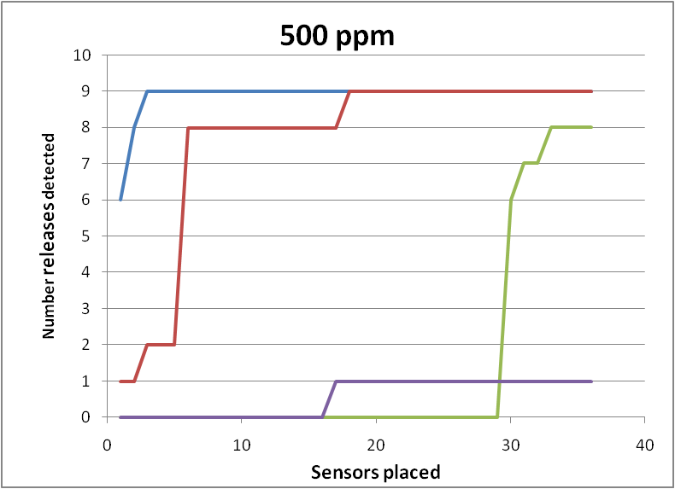
Varying Threshold

Slide 45
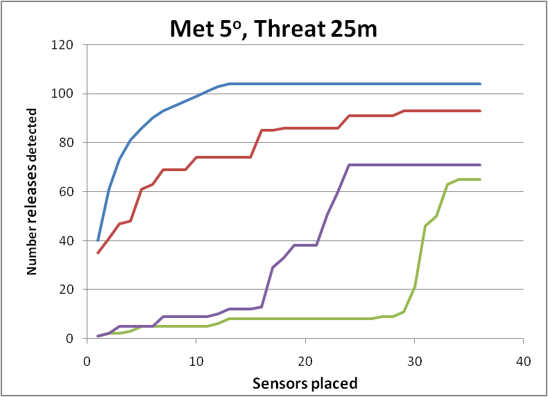
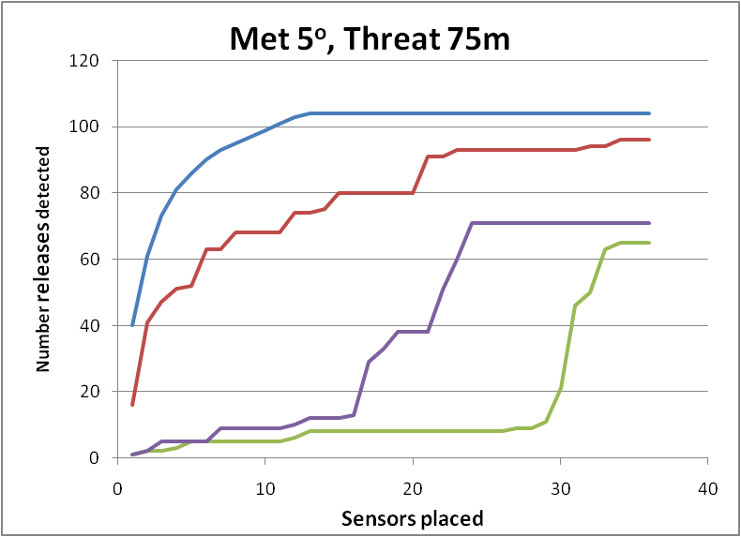







Varying Input Fidelity

Slide 46
Conclusions
Sparta is extremely flexible
  Handles different types of agents, sensors, tox and mitigation
Extremely rapid
Evaluation results
  Performs well against field trials data even when placed with benefit of hindsight
  Performs very well for shorter duration cases where additional information is available. Also always better than rules based even when almost no information available.
  Does particularly well on difficult cases – hard to detect, more toxic
  Places assets in well prioritised order so provides maximum benefits for small number of assets
  Robust to input data fidelity

Slide 47
Conclusions
Results supported by synthetic challenge data and field trials data
Sparta adds value over rules based approach
Evaluation conducted shows Sparta offers benefits to deployment of sensors
  Intercomparison of sensor placement capabilities would be beneficial
  Need agreed evaluation method necessary

