Slide 1
Predicted Influence of Cloud Area Restriction on Chlorine Aerosol Dispersion
Thomas O. Spicer, III, PhD, PE
Professor and Head
Ralph E. Martin Department of Chemical Engineering
15 July 2009

Slide 2
Background
Releases of chlorine under conditions likely to form an aerosol cloud are being considered.
For denser-than-air releases of flammable materials, experience indicates that stable stratification delays the contaminant cloud from moving downwind. This delay or persistence could work to reduce the impact of TIH releases due to:
  Chemical reaction near the source
  Enhanced importance of terrain effects
Simulations are presented to consider:
  What effects are predicted to be observed in the proposed releases?
  Is the scale of the release large enough to capture behavior of large (rail car size) releases?

Slide 3
Planned Releases: Aerosol Formation
Chlorine assumed to be stored under its own vapor pressure at 300 K (flash fraction about 20%)
Aerosol release will form droplets some of which could rainout. Two limiting cases:
  Aerosol formed with stable droplet sizes that do not rainout
  All of the aerosol liquid phase rains out either due to droplet sizes being too large or impact with a surface; all rained out liquid quickly evaporates
Aerosol release likely to entrain air near the source due to jetting. Two limiting cases: 3:1 and 10:1 entrainment of air by volume

Slide 4
Adiabatic Mixing of Chlorine Cloud with (Humid) Air
Chlorine properties based on DIPPR properties
Water is only slightly miscible in condensed chlorine phase (ppm levels), so condensed water is considered to form solid (ice or hydrate with chlorine).
For 3:1 dilution, cloud density is 5.18 kg/m³, chlorine mole fraction is 0.67)
For 10:1 dilution, cloud density is 3.43 kg/m³, chlorine mole fraction is 0.38)

Slide 5
Planned Releases: Area Source
Rate: 1000 kg/min chlorine
Release duration: 2 min (total quantity: 2000 kg)
Basin: 150 ft (46 m) diameter; 4 ft (1.2 m) deep; sloping sides approximated here as cylindrical shape
Objective: Characterize near field behavior, especially persistence
  Reduces downwind concentration (peak and time averaged)
  Enhances any scavenging reactions

Slide 6
Modeling Persistence
HEGADAS, HGSYSTEM based on te Reile (1977), Colenbrander (1980) among others
DEGADIS based on Spicer (1985)
Mist Pool based on Bauer and Fox (2008)
Basic concept: take into account the effect of stable density stratification on the rate at which a contaminant gas flow can be assimilated into the atmospheric flow.

Slide 7
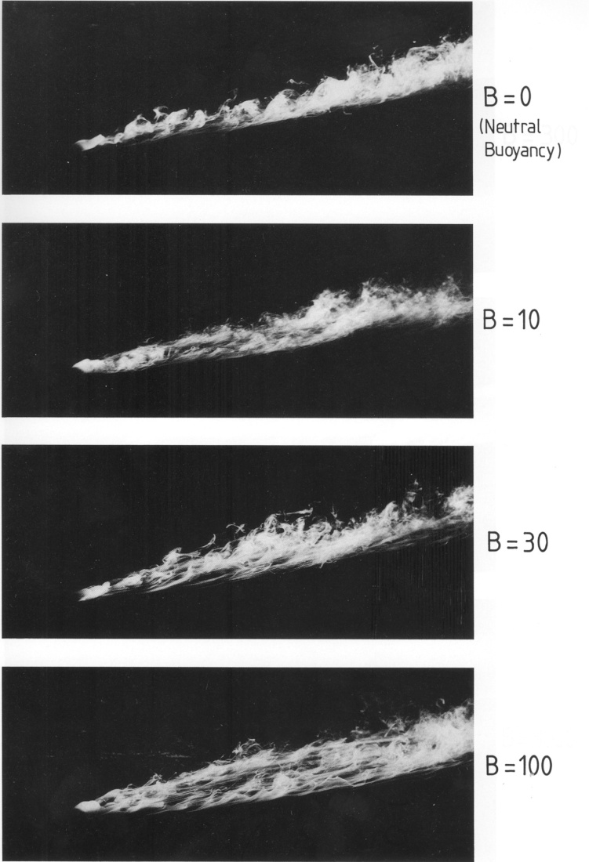
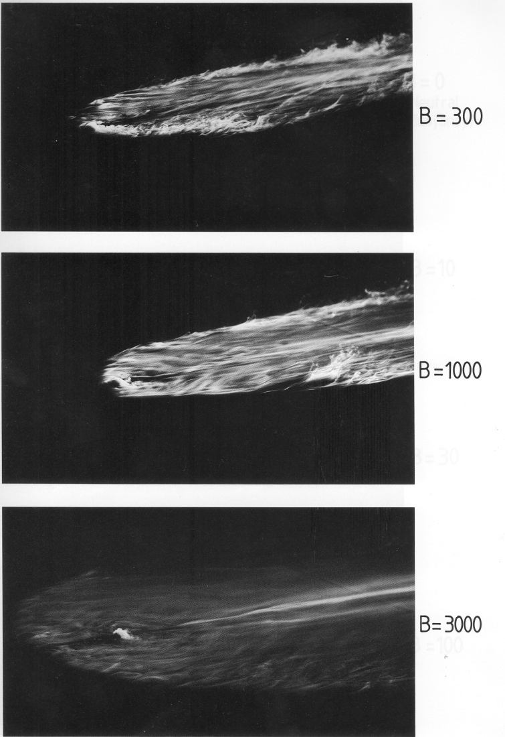
Near Field Effects
Effect of stable stratification on dispersion from (steady state) area sources from Hall and Waters (1989).

Slide 8
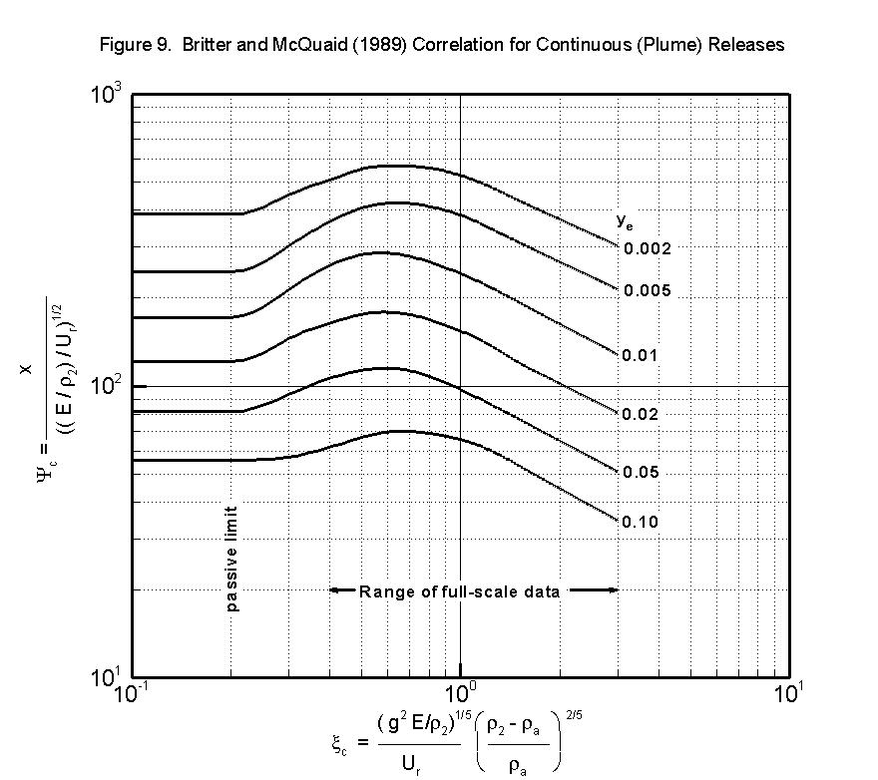
Near Field Effects
For plume releases, taken from Britter and McQuaid (1988).

Slide 9
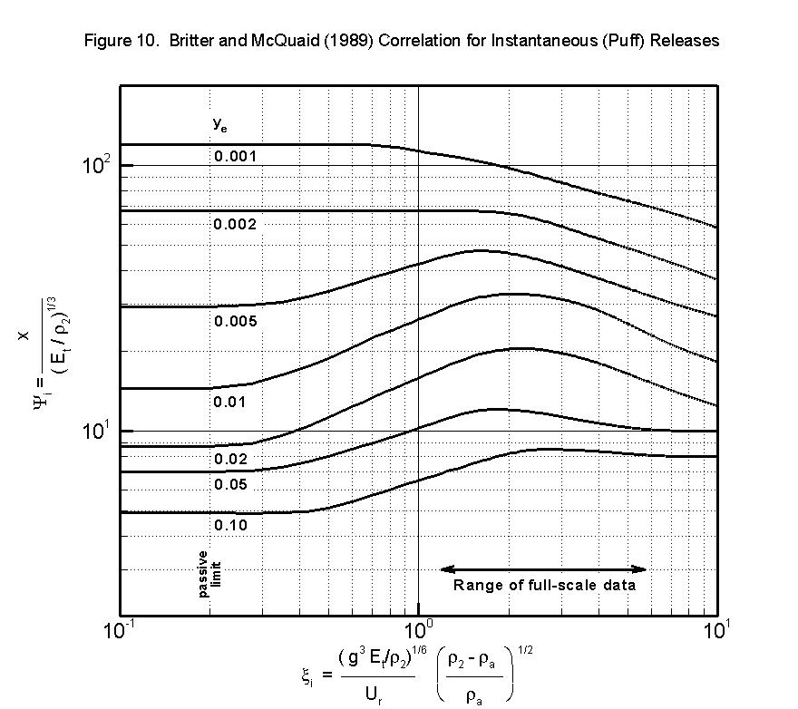
Near Field Effects
For puff releases, taken from Britter and McQuaid (1988).

Slide 10
DEGADIS Area Source Model
Developing boundary layer over the source
Air entrainment due to gravity spreading
Secondary Source
Grade
Primary Source
Side View of Secondary Source Model

Slide 11
DEGADIS Simulations
What effect would making the release in a basin have in comparison with a release on flat terrain?
For the simulations, the basin was considered to be a right circular cylinder so that when the contaminant cloud reached the basin, the air entrainment due to the advancing gravity front was taken to be zero.
Would sloped sides on the basin make a difference? Air entrainment due to the advancing front would continue.
Simulation parameters: 2 m/s at 10 m wind speed; 3 mm surface roughness; D stability; no chemical reaction

Slide 12
Flat terrain
Source | Initial Air Dilution | Maximum Source Cloud Radius | Chlorine mole fraction at the Max Source Cloud Extent | Source Cloud Persistence
Aerosol (no rainout) | 3:1 | 70 m | 0.36 | 3.0 min
 | 10:1 | 79 m | 0.17 | 3.3 min
All liquid rains out and rapidly evaporates | 3:1 | 54 m | 0.25 | 2.8 min
 | 10:1 | 60 m | 0.14 | 3.0 min
  The predicted maximum radius is about twice the size of the proposed basin.
  The cloud is predicted to remain near the source for about 3 min for the 2 minute release duration.

Slide 13
Basin Restricted
Source | Initial Air Dilution | Maximum Cloud Depth | Chlorine mole fraction at 120 s | Source Cloud Persistence
Aerosol (no rainout) | 3:1 | 0.23 m | 0.62 | 53 min
 | 10:1 | 0.81 m | 0.35 | 53 min
All liquid rains out and rapidly evaporates | 3:1 | 0.68 m | 0.59 | 5.3 min
 | 10:1 | 1.0 m | 0.33 | 5.5 min
  When entrainment stops at the advancing gravity front, the more concentrated cloud persists near the source much longer.
  The cloud depth is based on the maximum source cloud depth plus 2.15 times the vertical distribution parameter in the developing boundary layer over the source cloud. (Basin depth looks adequate.)

Slide 14
Sufficient Scale?
Froude number scaling typical of wind tunnel work:
  L_{p} = L_{f}/S; U_{p} = U_{f}/S^{1/2}; Q_{p} = Q_{f}/S^{5/2}
If Q_{f} = 10 T/min and Q_{p} = 1 T/min, then S^{5/2} = Q_{f}/Q_{p}, and S = 2.5
Scale the basin size by the scale factor.
Source | Spill Size | Maximum Cloud Depth | Chlorine mole fraction at 120 s | Source Cloud Persistence
Aerosol (no rainout) | 1 T/min | 0.81 m | 0.35 | 53 min
 | 10 T/min | 1.1 m | 0.31 | 52 min
All liquid rains out and rapidly evaporates | 1 T/min | 1.0 m | 0.33 | 5.5 min
 | 10 T/min | 2.4 m | 0.29 | 19 min
As the density of the initial cloud decreases, the scale of the release must be larger to see the large persistence (stable stratification) effects.

Slide 15
Sufficient Scale?
Froude number scaling typical of wind tunnel work:
  L_{p} = L_{f}/S; U_{p} = U_{f}/S^{1/2}; Q_{p} = Q_{f}/S^{5/2}
If Q_{f} = 1 T/min and Q_{p} = 0.1 T/min, then S^{5/2} = Q_{f}/Q_{p}, and S = 2.5
Scale the basin size by the scale factor.
Source | Spill Size | Maximum Cloud Depth | Chlorine mole fraction at 120 s | Source Cloud Persistence
Aerosol (no rainout) | 1 T/min | 0.81 m | 0.35 | 53 min
 | 0.1 T/min | 0.3 m | 0.28 | 2.0 min
All liquid rains out and rapidly evaporates | 1 T/min | 1.0 m | 0.33 | 5.5 min
 | 0.1 T/min | 0.6 m | 0.22 | 2.0 min
The smaller scale releases persist only as long as the release lasts.

Slide 16
Conclusions
Cloud persistence near the source is expected to be important for chlorine rail car release scenarios:
  Reduction of downwind concentration and exposure
  Allows other mitigating effects to act over longer time scales near the source where concentrations are highest
Releases of the proposed size would not show significant persistence if released on flat terrain. (If the release is significantly larger than the basin, the release would be more like that on flat terrain.)

Slide 17
Conclusions
If cloud spreading is restricted by the basin, cloud persistence is much longer.
  If sloped sides are used, air entrainment would continue at the gravity spreading front, and the cloud persistence would be significantly reduced.
The initial cloud density is an important factor. Any aerosol rainout should be measured (and controlled) as closely as possible; uncontrolled rainout could be mistaken for source cloud persistence.
The scale of the proposed experiments seems large enough to see predicted effects at full scale; significantly smaller scale releases would likely not be large enough to observe the (full) field scale effects.

Slide 18
Questions?
Tom Spicer, PhD, PE
Professor and Ralph E. Martin Leadership Chair in Chemical Engineering
Head, Ralph E. Martin Department of Chemical Engineering
Co-Director, Chemical Hazards Research Center
3202 BEC/CHEG
University of Arkansas
Fayetteville, AR 72701
479-575-6516
479-575-7926 fax

