Slide 1
Comparisons of Predictions from Joint Effects Model Urban Modes to Urban 2000 and Joint Urban 2003 Data, and to Predictions from HPAC Urban Modes
13th Annual George Mason University Conference on Atmospheric Transport and Dispersion Modeling
Fairfax, Virginia
July 15, 2009
Kimberly Papadantonakis
James Heagy, Project Leader
Nathan Platt
Jeffry Urban
Sponsors: Joint Program Executive Office for Chemical and Biological Defense (JPEO-CBD) – Joint Program Manager Information Systems, Defense Threat Reduction Agency (DTRA), Joint Science and Technology Office for Chemical and Biological Defense (JSTO-CBD)

Slide 2
Introduction
The Joint Effects Model (JEM) is being developed by the Joint Program Executive Office Chemical and Biological Defense (JPEO-CBD) to provide the U.S. Department of Defense (DoD) with a single accredited tool to effectively model and simulate the effects of CBRN weapon strikes and incidents.
JEM incorporates components from existing (legacy) models:
  HPAC (DTRA)
  VLSTRACK (NSWC)
  D2-PUFF (IEM for U.S. Army Soldier Biological and Chemical Command)
IDA is tasked to provide support to JSTO-CBD and DTRA for JEM-related science and technology issues.
  As part of this task, we are currently providing support for V&V for the urban components of JEM.

Slide 3
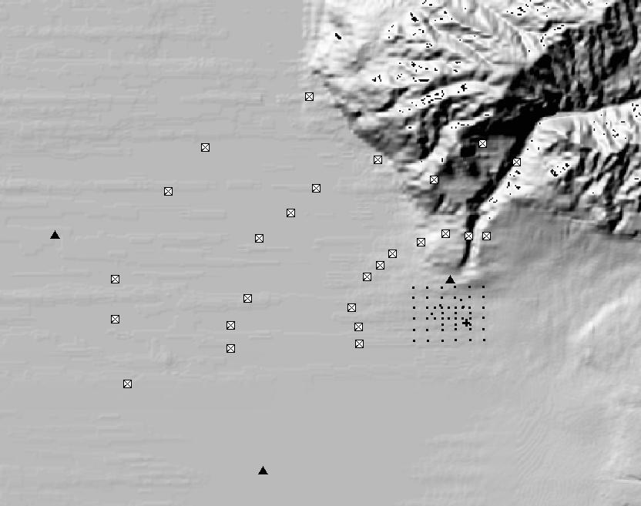
Urban 2000 Overview
Experiment performed in Salt Lake City (SLC) in October 2000.
  Sponsored by U.S. Department of Energy Chemical and Biological National Security Program (CBNP)
Primary objective was the collection of tracer concentrations and meteorological observations throughout an urban area in order to aid evaluation and further the development of atmospheric models.
Series of 18 nighttime 1-hour SF₆ releases from a point or 30 m line source monitored for 2 hours.
Measurements were conducted throughout the urban region with an outermost arc of samplers 6 km downwind of the release.
Locations of SF₆ concentration and meteorological instruments for Urban 2000.
Figure from Warner, et. al., Journal of Applied Meteorology, 43, 829-846.
“SLC”
“LDS”
Downtown
Samplers
4-km
Sampler Arc
Release
6-km
Sampler Arc
2-km
Sampler Arc
“RGW”

Slide 4
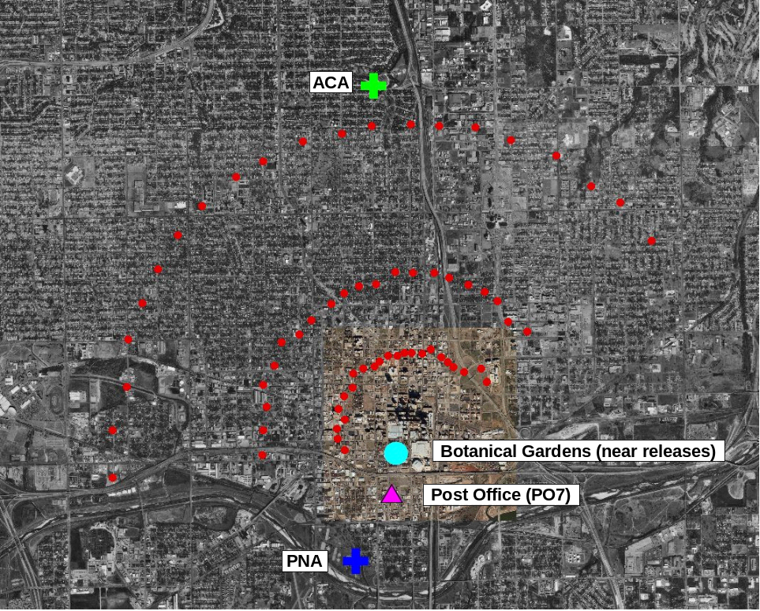
Joint Urban 2003 Overview
Experiment performed in Oklahoma City (OKC) between June 28 and July 31 2003
Sponsored by DTRA and DHS
Primary objective was to collect meteorological and tracer data resolving atmospheric dispersion at scales of motion ranging from flows in and around a single city block, around several blocks in the downtown Central Business District (CBD), and into the suburban Oklahoma City area.
Additional objective was to evaluate and improve existing indoor and outdoor dispersion models
10 IOPs of 8 hours each during which SF₆ was released downtown
Locations of SF₆ concentration arcs and meteorological stations for Joint Urban 2003.
Figure from Warner, et. al., Journal of Applied Meteorology and Climatology, 47, 1910-1928.

Slide 5
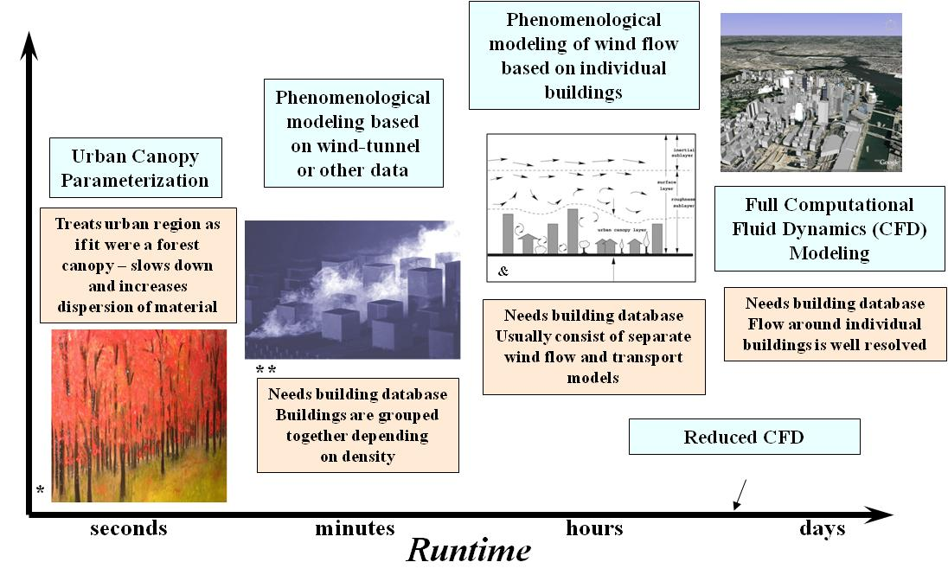

Urban Modes in Both HPAC and JEM
Urban Canopy (UC)
  Simplest and default urban model in HPAC and JEM
  Low-fidelity model that accounts for the large-scale effects of urban terrain, such as drag from buildings and boundary layer perturbations.
Urban Dispersion Model (UDM)
  Developed by Defence Science and Technology Laboratory (Dstl), part of the U.K. Ministry of Defence
  Takes detailed urban features into account, but employs some empirical parameters
  Gaussian puff model that uses empirical rules to account for the dispersive effects of individual and groups of buildings
  Includes retention in building wakes and street channeling effects
* Liquid Amber by Cat Horvoth
** DSTL Presentation Designing an HLA Federation Object
Model for Atmospheric Dispersion Modelling
& Britter R.E. and S.R. Hanna, Flow and Dispersion in Urban Areas
Annu. Rev. Fluid Mech. 2003. 35:469–96

Slide 6
Model Inputs and Set-Up
All releases were specified as Analytical Incidents
UC and UDM modes run for each release
For JU03 examined 29 releases
  Two meteorological inputs (METs)
    Data from OKC Post Office just upwind of the downtown area
    Data from both the sodar and vertical profiler at the PNNL site located ~1.6 km upwind of the release locations.
  Two versions of two models HPAC 5.0 SP1 build 82 and JEM 1.1B3; and HPAC 5.0 SP1 Build 84 and JEM 1.1 B4 were run for each release
  Total of 29 releases x 2 METs x 2 models x 2 versions x 2 urban modes = 464 runs
For Urban 2000 examined all SF₆ releases during the 6 IOPs
  Five meteorological inputs (ALL, LDS, OMG, RGW, and SLC)
  Two models, HPAC 5.0 SP1 build 90 and JEM 1.1B4P2 were examined
  Total of 6 IOPs x 5 METs x 2 models x 2 urban modes = 120 independent model runs
  This represents 4 IOPs x 3 line releases + 2 IOPs x 3 point releases = 18 releases.

Slide 7
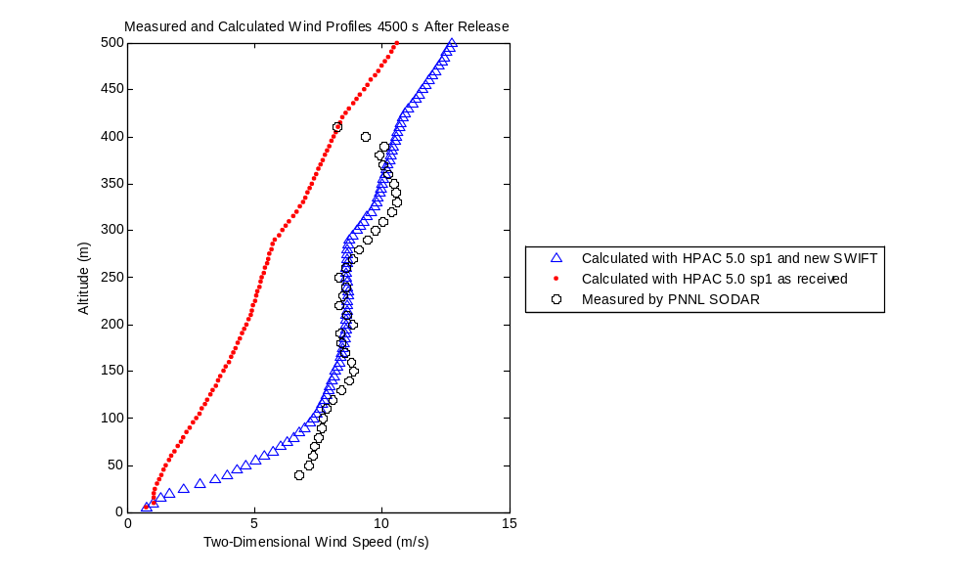
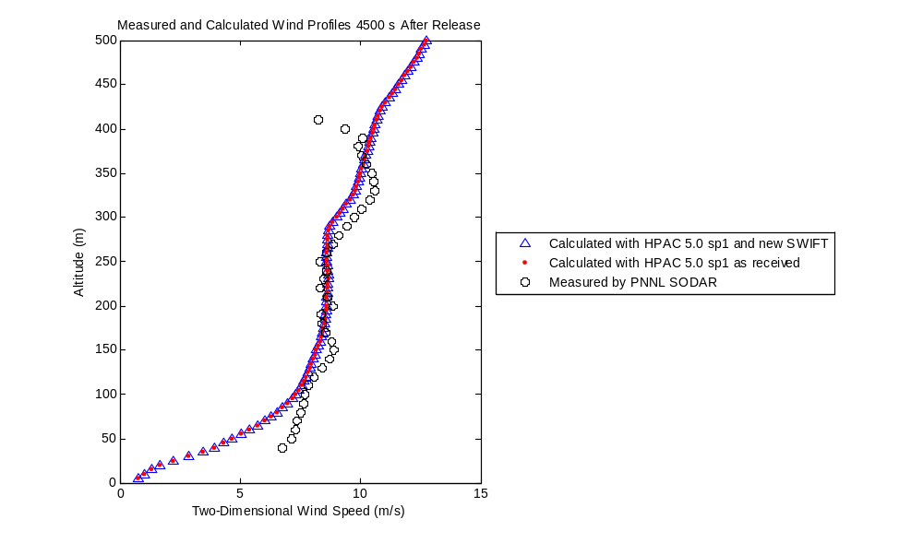
Changes to SWIFT
HPAC and JEM contain two weather modules that can be used to prepare mass-consistent gridded wind fields
  SWIFT is recommended and will run by default unless manually overridden
  MC-SCIPUFF runs otherwise and runs automatically when SWIFT fails to converge to a solution
As part of previous V&V work, it was identified that SWIFT systematically underpredicted wind speeds.
A change to SWIFT was implemented in HPAC 5.0 SP1 and JEM 1.1B3, however the change was only implemented when UDM was invoked.
A new version of SWIFT was issued. The new version creates identical wind profiles for UC and UDM cases.
UC
UDM
Measurements at PNNL JU03 Station
SWIFT calculated wind profile (HPAC 5.0 SP1 Build 82, and JEM 1.1B3)
New SWIFT calculated winds

Slide 8
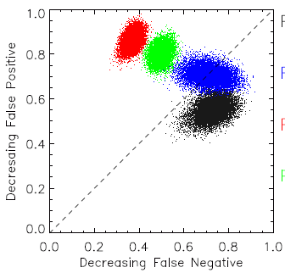
Metrics
2-D Measure of Effectiveness (MOE).
  Compare predictions with experimentally measured concentrations in both time and space.
  Includes directional effects, i.e., the location of a hazard and not just the shape and size of the plume is critical to obtaining a high MOE score.
Statistical measures used were fractional bias (FB), normalized absolute difference (NAD), normalized mean square error (NMSE), fraction of predictions within a factor of two of observations (FAC2) and the MOE.
Separate sets of statistics for JU03 day and night releases.
Non-parametric hypothesis testing was used to determine whether any apparent differences in model performance were statistically significant.
Ideal
False Negative Area
Observations
Overlap
Underprediction
Predictions
Overprediction
False Positive Area
No Overlap

Slide 9
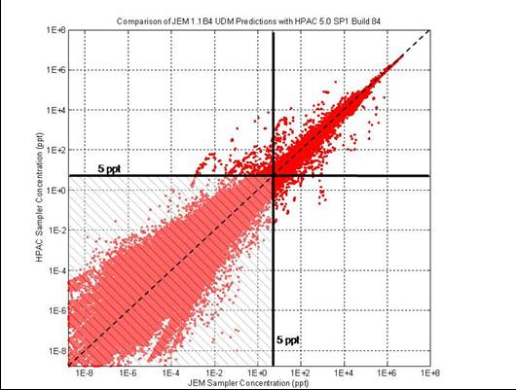
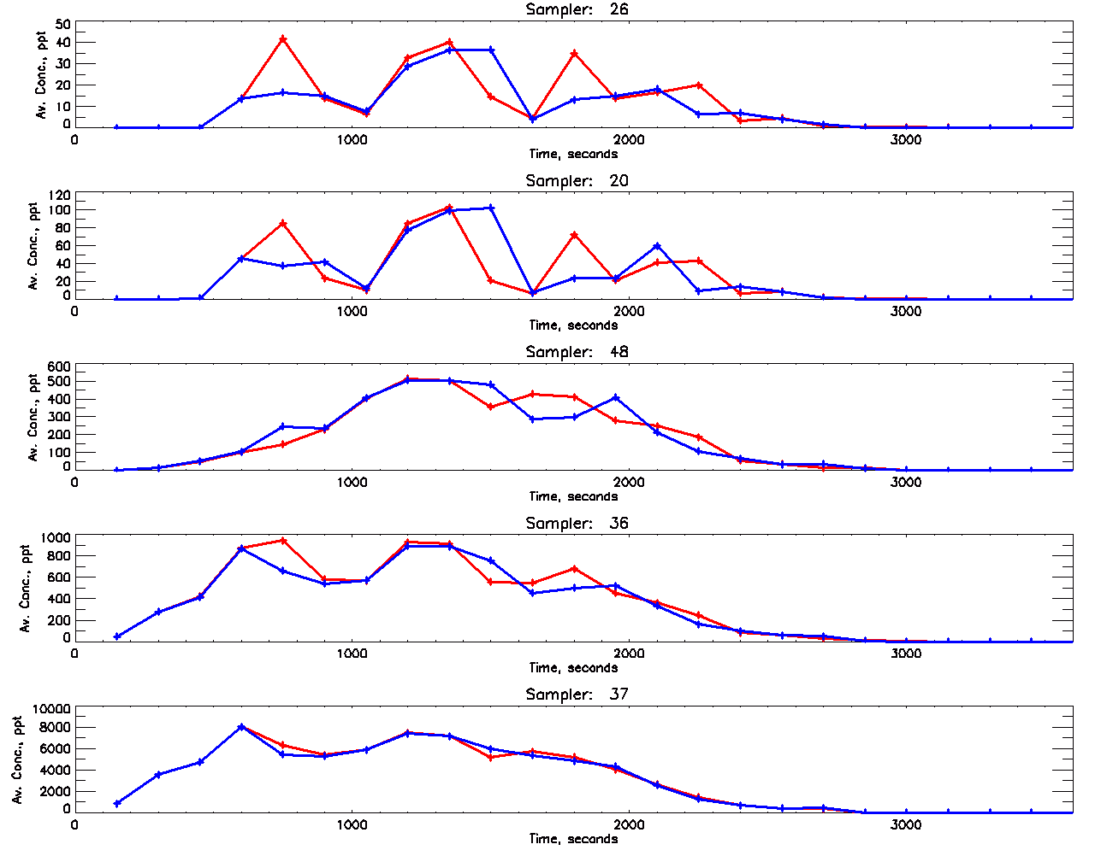
JU03 Results
HPAC 5.0 SP1 Build 82 produced identical predictions to JEM 1.1B3 for both UC and UDM (identical results and errors).
HPAC 5.0 SP1 Build 84 and JEM 1.1B4 produced identical predictions for UC only.
  Different versions of UDM, GEDIS, and the urban database
  Individual 150 s concentration predictions vary, but the average concentrations over 30 minutes do not differ as greatly.
  The 30 minute average values were used for MOEs and statistics, differences between HPAC 5.0 SP1 Build 84 and JEM 1.1 B4 were not statistically different.
Comparison of JEM and HPAC 5 UDM Predictions
JEM 1.1B4
HPAC 5.0 SP1 Build 84

Slide 10
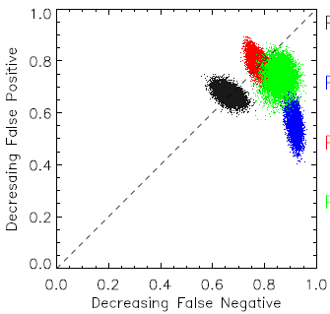
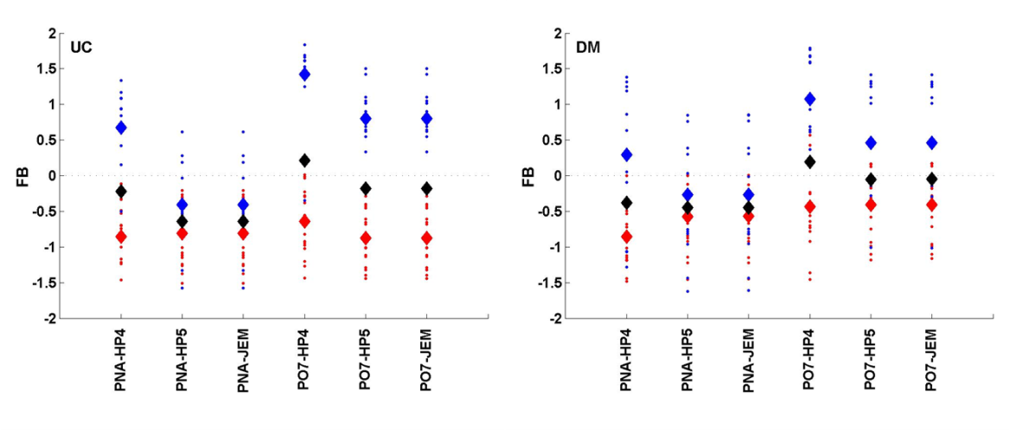
JU03 Results (2)
The JEM 1.1B4 UDM mode outperformed UC for nighttime releases using the Post Office MET. Similarly HPAC 5.0 SP1 Build 84 UDM outperformed UC for the same set of releases and samplers.
Statistically significant improvements in dosage based MOEs seen in both JEM and HPAC 5 UDM over HPAC 4 UDM for nighttime releases using the PO7 MET.
Principal difference in model performance was seen for UC predictions of nighttime releases using the PO7 MET. For these releases, JEM showed less bias, less scatter, and more predictions within a factor of two of the measurements than HPAC 4.0 SP3.
The changes to SWIFT appear in our comparison of urban modes in JEM 1.1B4 and HPAC 4.04 SP3. Observed model improvements are due to changes in SWIFT rather than a result of substantial improvements to the UC and UDM algorithms.
PO7 Night
JEM
UC
JEM
HPAC4
UDM
HPAC4
  Fractional bias for HPAC4, HPAC5, and JEM JU03 Predictions. Night releases shown in blue, day in red, and overall in black.
Plot of 250 ppt Threshold-Based MOE Values for Predictions from HPAC 4.04 SP3 and JEM 1.1B4.

Slide 11
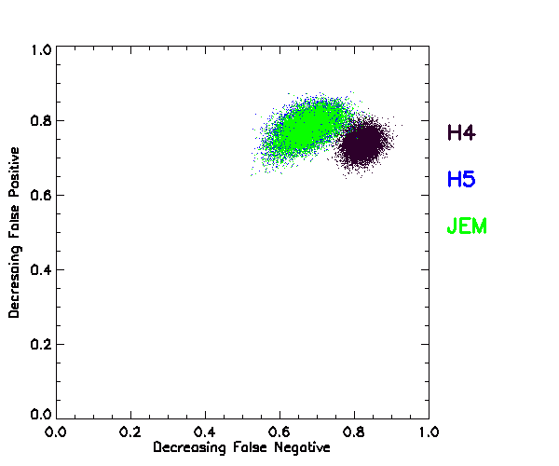
Urban 2000 Preliminary Results
HPAC 5.0 SP1 and JEM 1.1B4P2 UC modes produce identical outputs.
Neither model can complete calculations in UDM mode for IOP 7 in the ‘ALL’ MET, IOPs 2,4,5, 7, and 10 of the Raging Waters MET, and IOP 7 of the SLC airport MET. Can get IOP 7 in the All met and IOP 10 of RGW by “resuming” calculation, but this does not work for the others. This is a memory usage issue.
JEM UDM and HPAC 5 UDM produce similar results for averaged concentrations.
  Preliminary 2-D MOE for HPAC5, JEM, and HPAC4 for Urban 2000 Using UDM with the LDS MET.

Slide 12
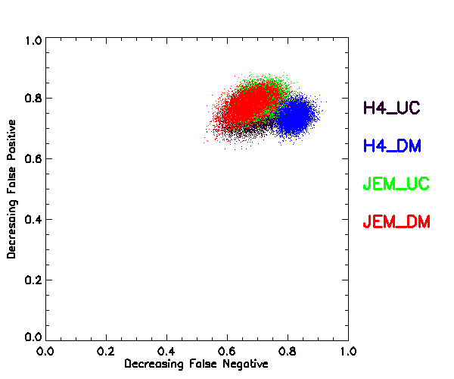
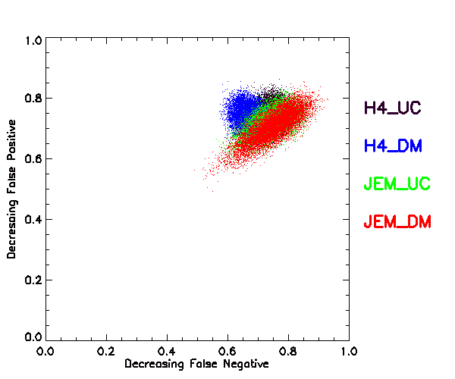
Urban 2000 Preliminary Results (2)
2-D MOEs may indicate that JEM UDM predictions (for the OMG and LDS METs) differ from UDM predictions from HPAC4.
  Preliminary 2-D MOE for HPAC4 and JEM for Urban 2000 Using the LDS MET.
  Preliminary 2-D MOE for HPAC4 and JEM for Urban 2000 Using the OMG MET.

Slide 13
Conclusions
UC results are identical between HPAC 5.0 and JEM 1.1 versions.
UDM results differ, but such differences thus far do not seem to be statistically different for averaged concentrations.
Comparisons of HPAC 5.0 and JEM 1.1 urban modes have been completed for JU03.
  Changes to SWIFT have been reflected by improvements in the predictions for JU03 from both UC and UDM modes.
  JEM UDM mode performed better than HPAC 4.04 SP3 UDM for JU03 Post Office MET.
Comparisons are underway for Urban 2000.
  Only OMG and LDS MET have been completed for all IOPs due to memory-related bug in JEM UDM.
  JEM predictions for Urban 2000 may differ from those from HPAC 4.
Future work
  Continue UC and UDM comparisons with Urban 2000 (other METs and more statistics)
  Compare performance of UC and UDM with that of Micro-SWIFT SPRAY (MSS).

