Slide 1

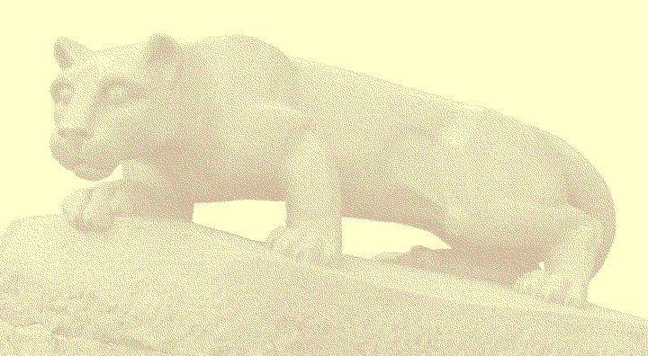
A Combined Computational Fluid Dynamics and Mesoscale Model Approach to Wind Turbine Siting Using Data Assimilation
13th Annual George Mason University Conference on
Atmospheric Transport and Dispersion Modeling
F.J. Zajaczkowski, S.E. Haupt,
K.J. Long
July 14, 2009

Slide 2
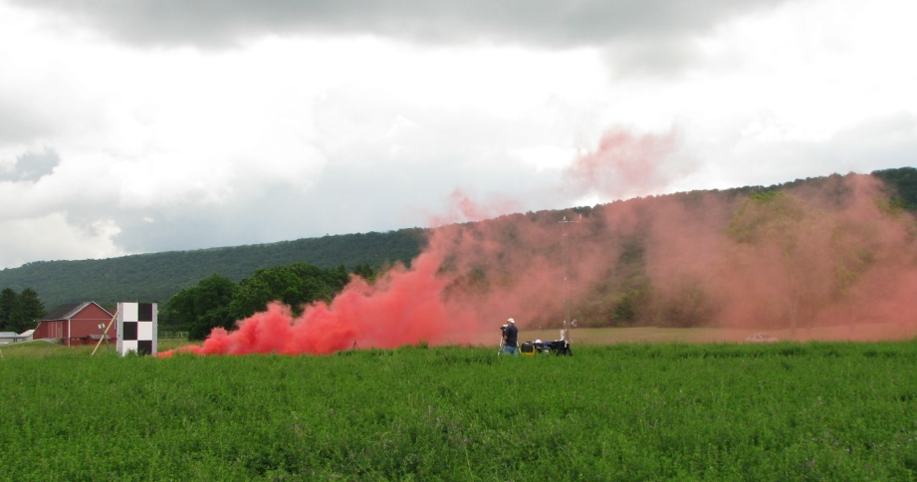
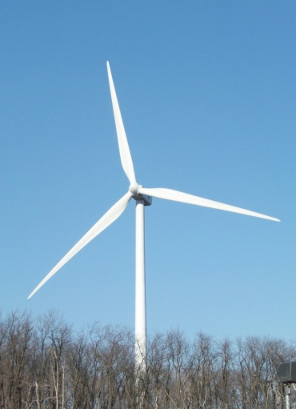
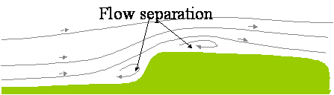
Motivation
Accurate prediction of atmospheric dispersion can be difficult – many factors play a role
Details of local flow are critical
If local wind variability can be determined (velocity, direction and variances) we can make better predictions
There is overlap between dispersion modeling and turbine siting.
Notes:
Mention factors such as terrain (complicated) surface roughness,

Slide 3
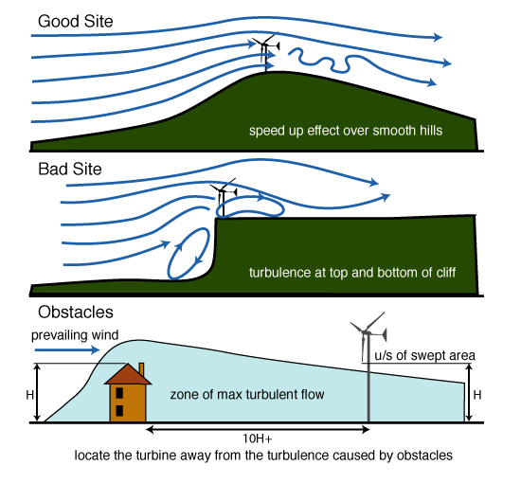
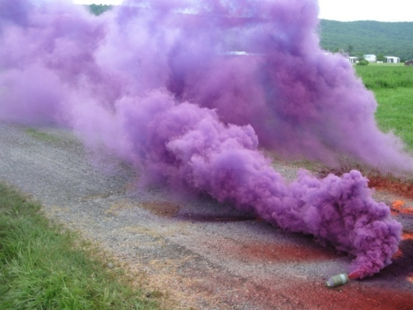
Problem Overview
Goal:
To enhance predictive capabilities for atmospheric dispersion.
Issues:
Terrain, wind uncertainty, local wind variability and surface heating.
Approach:
Combine state-of-the-art Computational Fluid Dynamics (CFD) coupled with Mesoscale NWP model to obtain more accurate predictions.
www.greenspec.co.uk
Notes:
NWP –Numerical Weather Prediction Model

Slide 4
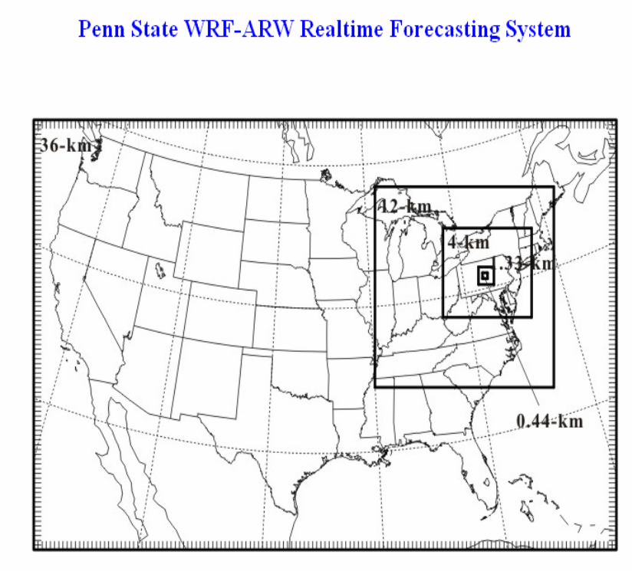
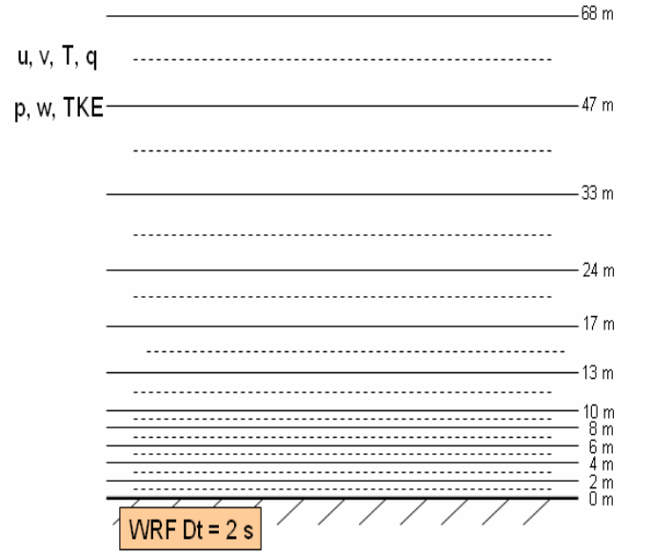
Mesoscale Model
The Mesoscale Numerical Weather Prediction (NWP) model runs are based on the Advanced Research version of WRF (WRF-ARW) version 2.2.1
Nested grid configuration for model runs of the WRF-ARW model for studying atmospheric boundary layers in central PA.
Vertical grid configuration for the lowest 70 m above ground level for the finest nest of the WRF-ARW runs.
Notes:
-Worked with Dave Stauffer’s group to get wrf run. 43 vertical levels packed toward the surface, 444 m resolution.
We used WRF data from new years eve to drive CFD model. This was a cold, windy day.
WRF is going to be used to provide both inflow data and to move the solution

Slide 5
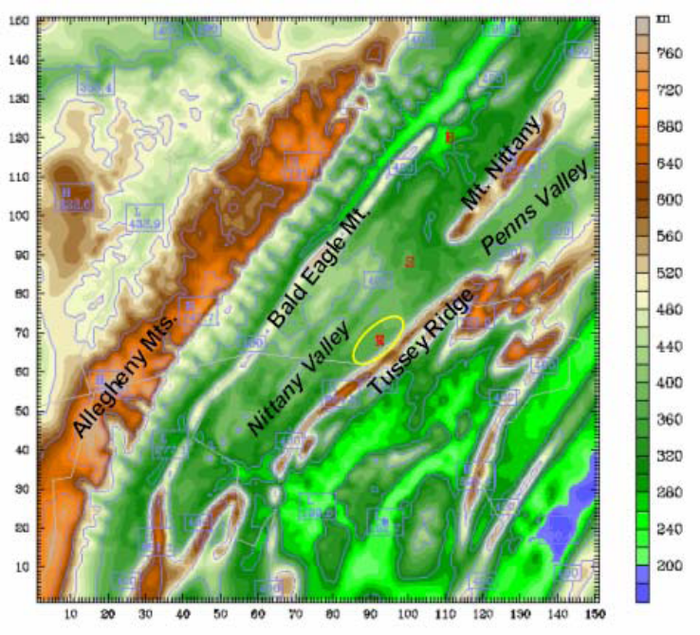
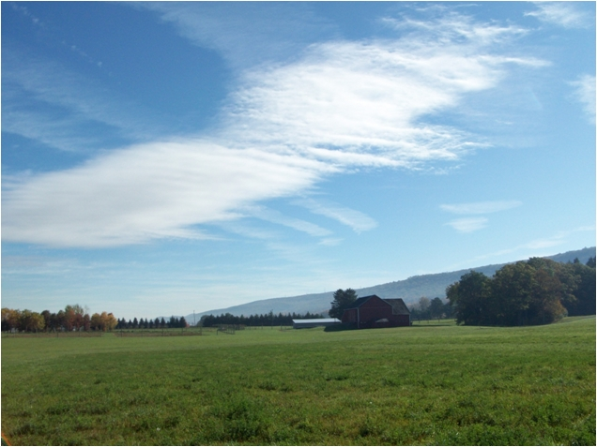
Site Description
Rock Springs Pennsylvania
The site chosen for the test case presented
here is the Rock Springs test site in central
Pennsylvania nearby State College and
owned by The Pennsylvania State
University.
Topography of the region surrounding the Rock Springs site. The oval indicates the local observation network.
Notes:
-We chose this site because we have high-resolution terrain data.
-Access to WRF for this site
-Access to met data
Example of wave clouds – terrain effect

Slide 6
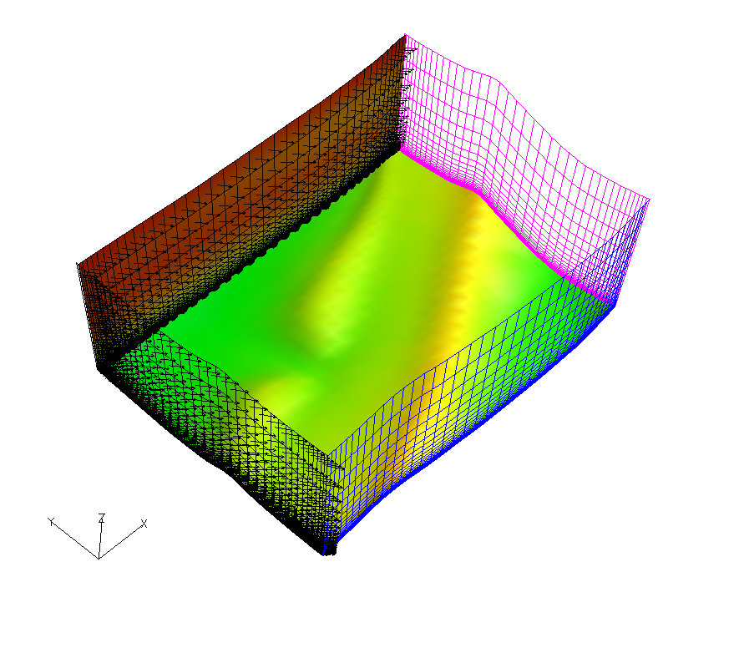
Modeling-CFD
Computational Domain and Boundary Conditions
Outflow boundaries
AcuSolve is a commercial CFD Code
The computational domain
is roughly 2.0 km x 2.6 km
Mesh:
114,000 nodes
106,000 elements
Near wall vertical resolution 1e-4 m
Horizontal resolution
30 to 40 m
Specified WRF inflow
1 km
2.6 km
2.0 km
Notes:
-This is our ‘coarse’ mesh resolution, well be doing higher soon
-multiple inflow
-used acuSolve commercial CFD code

Slide 7
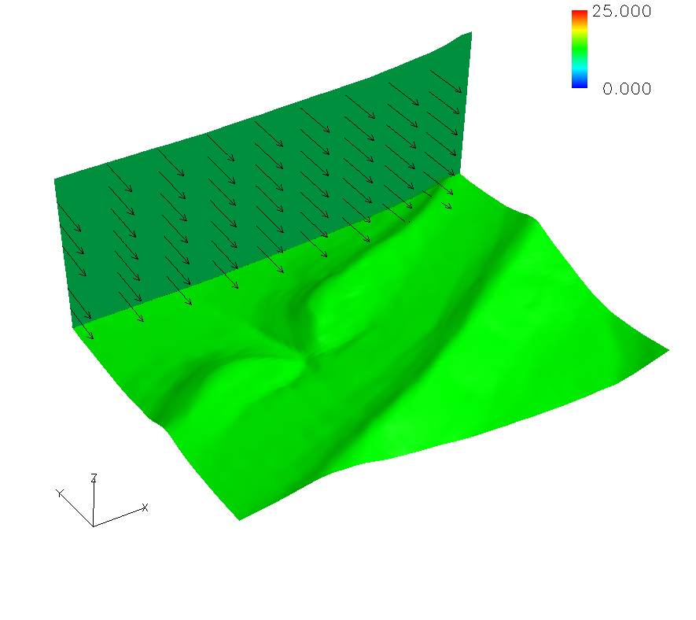
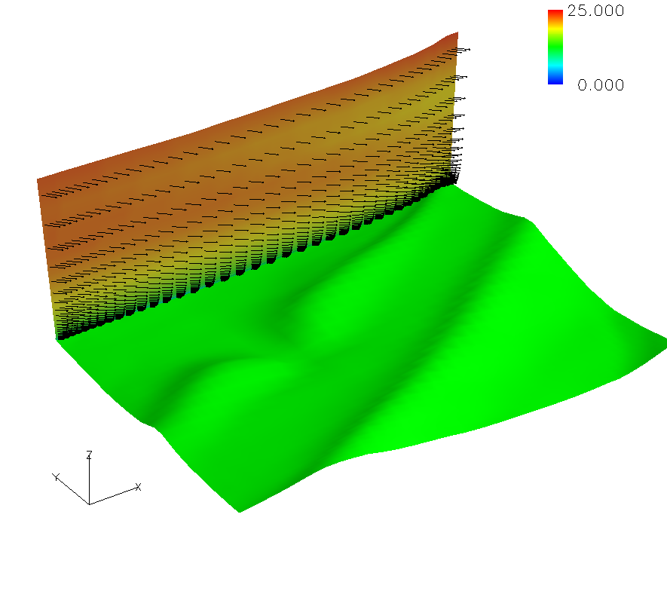
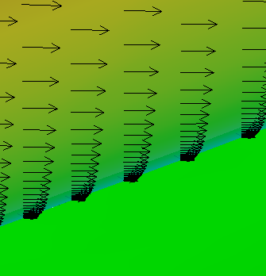
Modeling-CFD
Inflow Profile Comparisons
Inflow Location
Inflow Location
Constant Inflow
WRF inflow
Notes:
Inflow profiles.
-The left has no spatial variation, the one on the right has spatial variation.
-Velocity contours and vectors are shown
Note boundary layer formation
Can be made to be time-accurate.

Slide 8
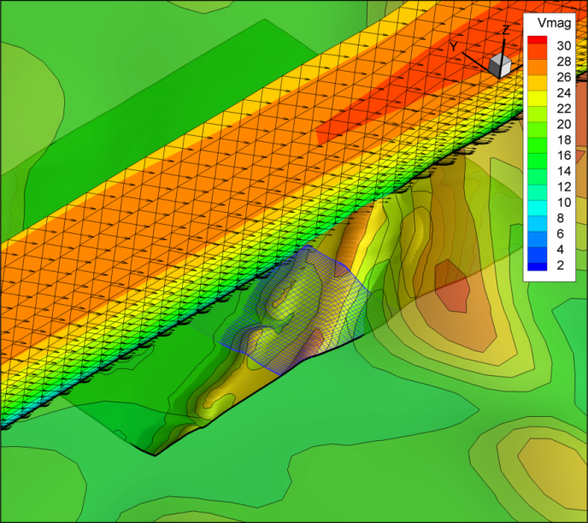
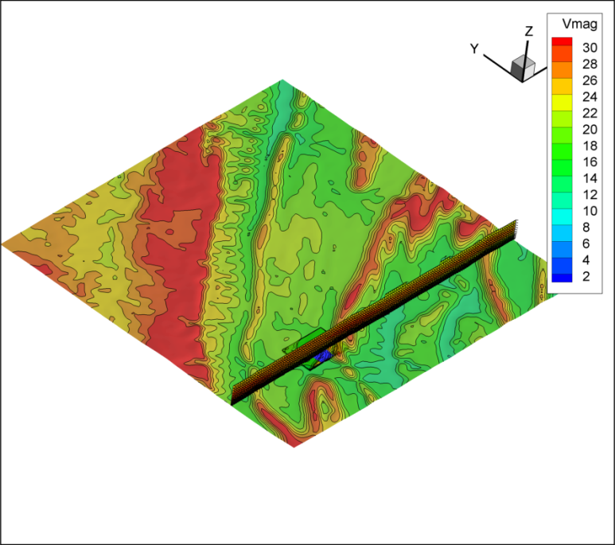
WRF and CFD Overlay
We overlay the domains.
WRF domain
CFD domain
WRF domain with the CFD mesh.
CFD domain
Notes:
-Ground plane is colored by height
-Cut plane is colored by vel. magnitude

Slide 9
Data Assimilation
Known data is used to guide the flow solution.
Assimilation is available in WRF
Our goal is to use Four Dimensional Data nudging
The CFD model will follow a solution path that may not agree with measured data or WRF solution.
CFD domain
Mast with known data
Notes:
-Assimilation is a borrowed technique
-Even though the inflow is specified, an unsteady simulation can choose many realizable paths. Assimilation guides the flow solution to the realization that was observed.
-nudging is new

Slide 10
Data Assimilation
Our approach uses the difference between the known velocity field and the current flow to guide the solution.
Stress Term
Body Force
Time rate of change of velocity
Convective Term
Pressure term
Notes:
-Typically known as 4D assimilation, steady results are shown here.
-talk about each term…

Slide 11
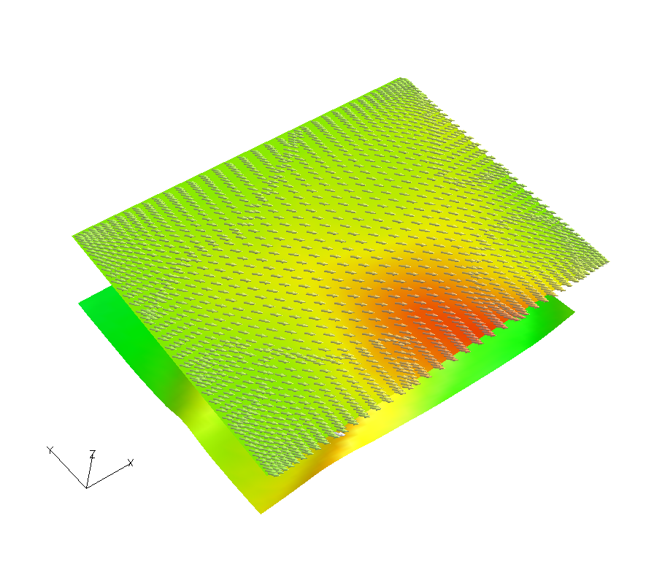
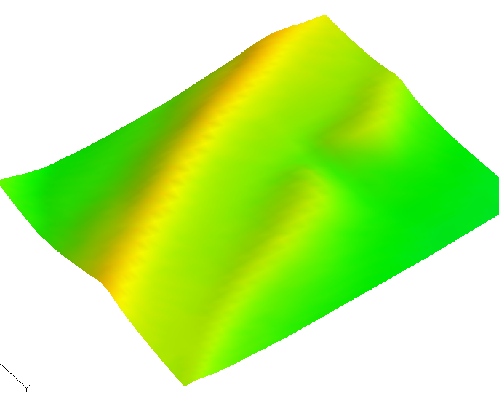
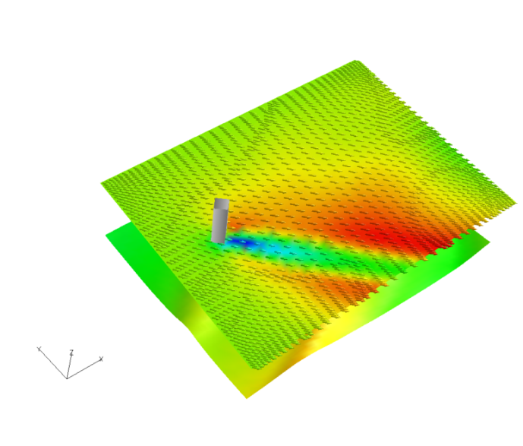
Assimilation Results
Flow field has been modified by a notional body force.
The line represents known data; body forces are applied here.
Baseline with no data assimilation
Mast with known data
Data assimilation applied to the solution
Notes:
Assume known data
Notional wind field chosen
Top figure is a slice with no velocity modification
Bottom is modified with notional body force
Red is high speed, blue is low speed

Slide 12
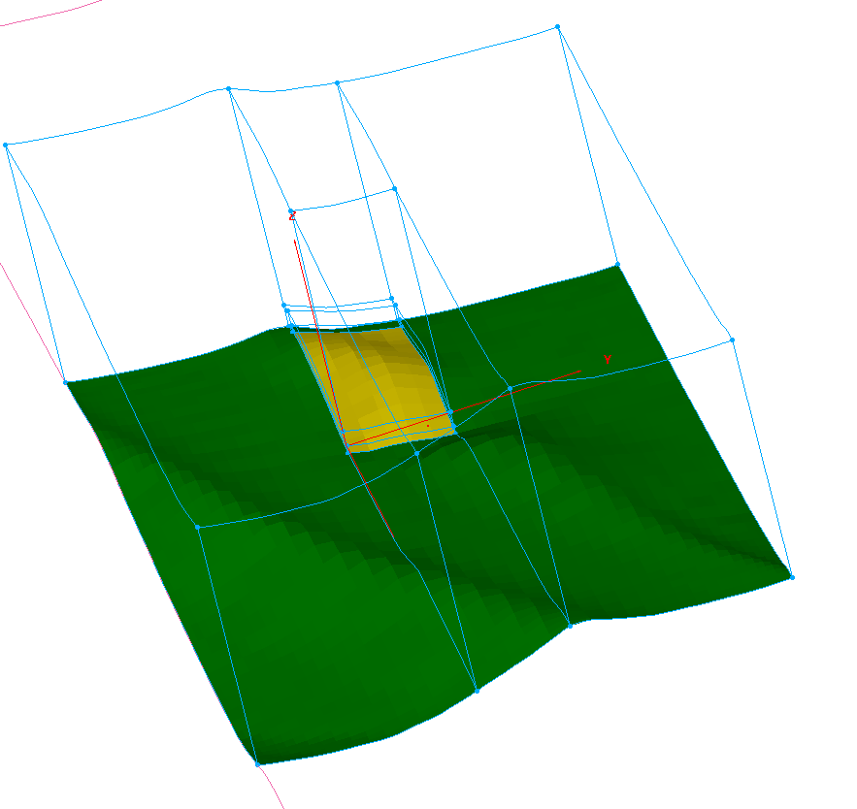
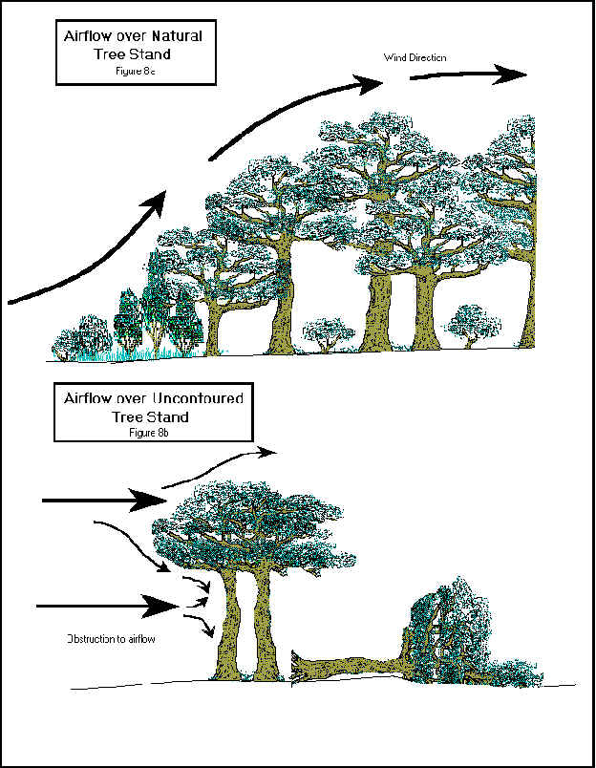
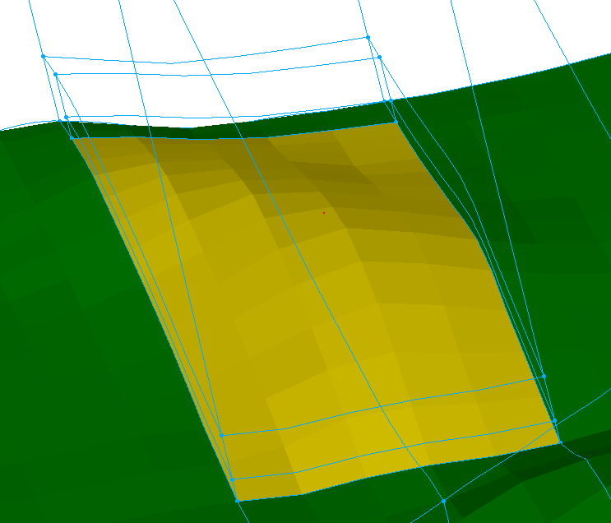
Surface Roughness
There is a need to account for surface usage such as trees.
The model can be applied over arbitrary specified regions.
We’ve applied the model to tree height or about 30m
Notes:
Typically used for ground porosity
Fi -> Linear and quadratic pieces, quadratic for high speed flow -

Slide 13
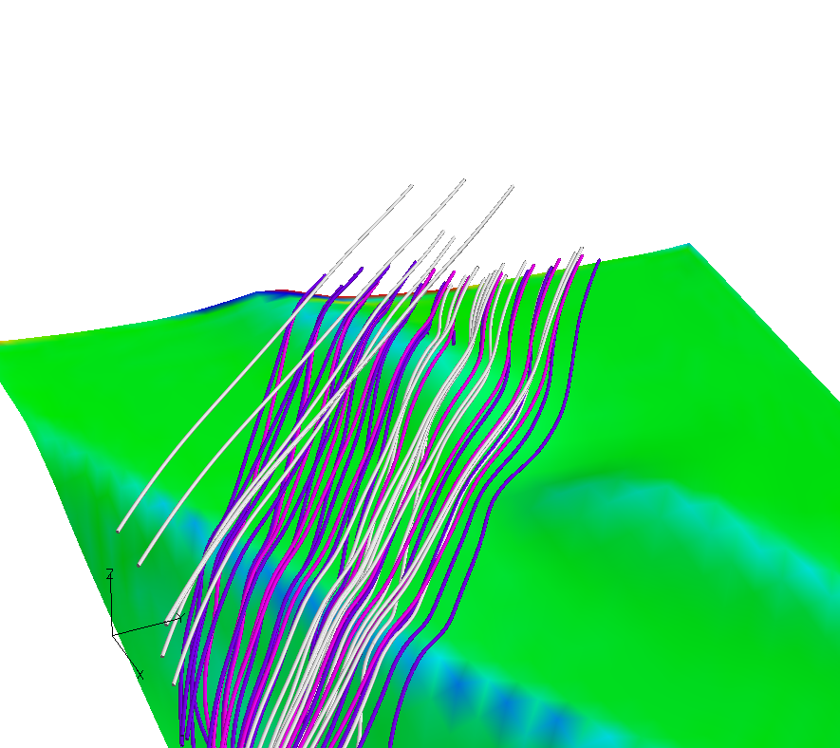
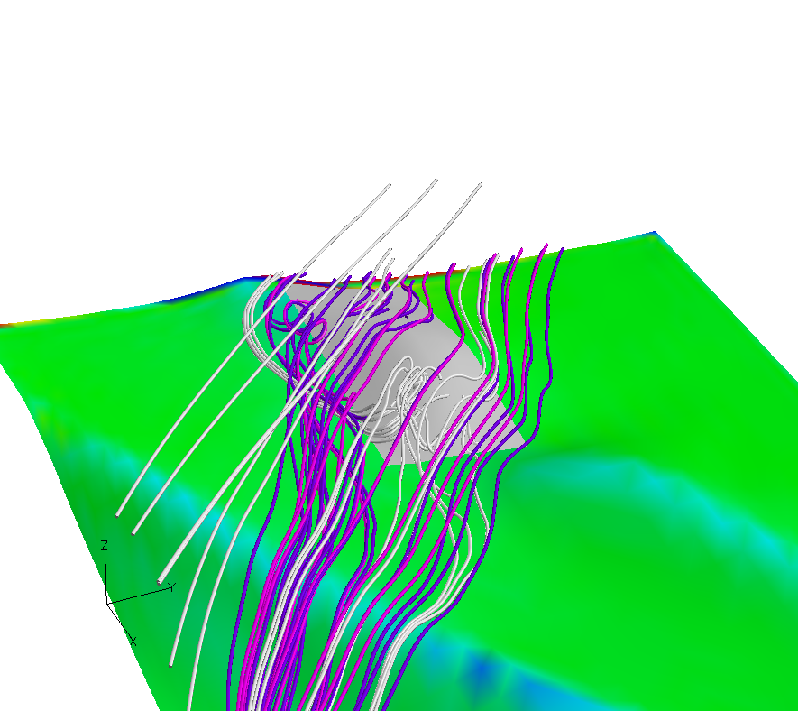
Surface Roughness
Flow separations on the lee-side of the hills
Specified inflow with no roughness modeling
Specified inflow with roughness modeling added

Slide 14
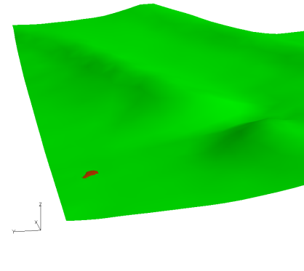
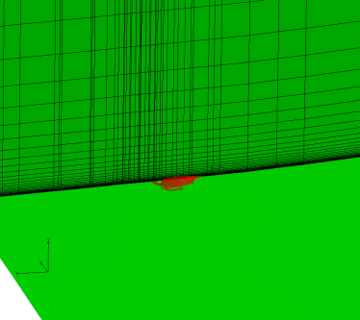
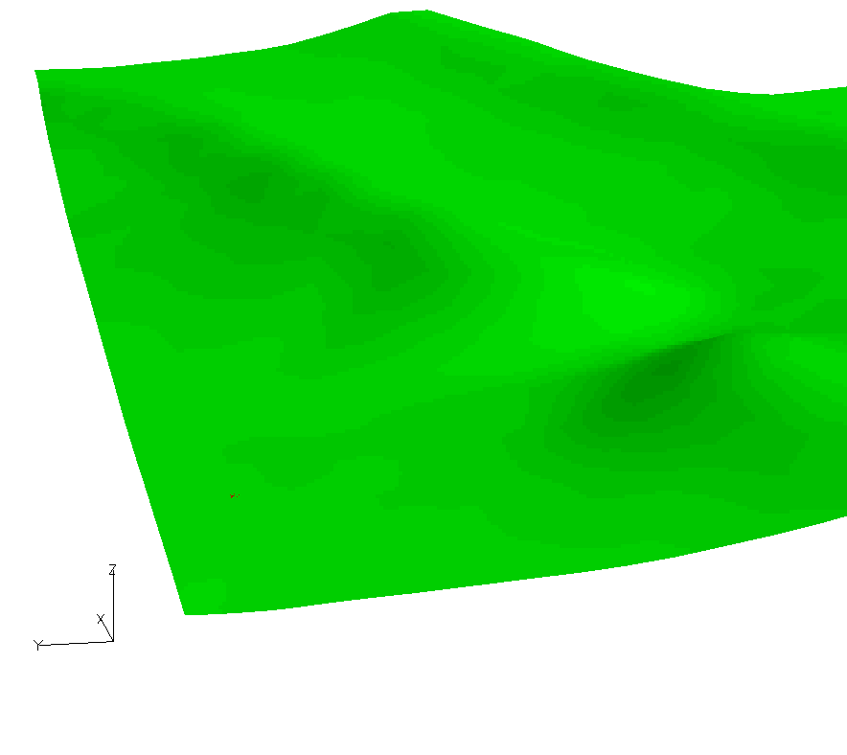
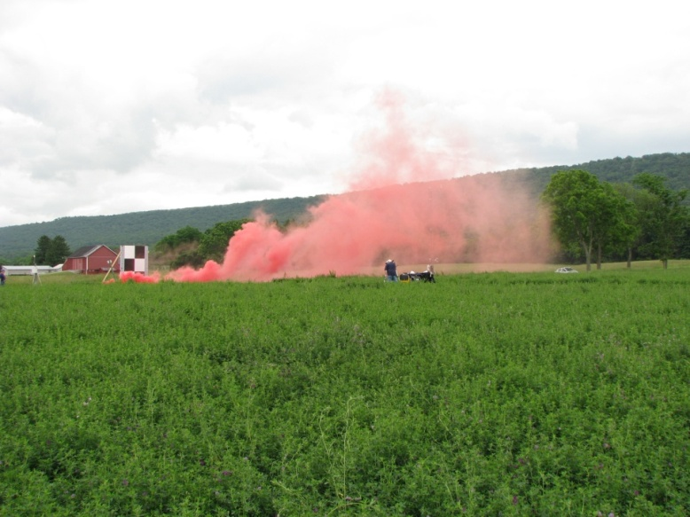
Plume Release
We are showing a plume release at the Rock Springs site.
Unsteady RANS simulation representing about a 20 second release.

Slide 15
Summary
We are developing a comprehensive modeling capability which will include surface heating, surface usage and high-resolution terrain data.
We believe that we can provide more detailed dispersion information than with other techniques
Two main enhancements are the Mesoscale Modeling (WRF/MM5) downscaling capability and data assimilation.
We need more detailed data for further case studies.
A radial distribution model will be added to the assimilation model.

Slide 16

Backup
Local flow fields depend on boundary conditions but also are influenced by terrain and ground usage.
Surface heating also influences local wind conditions..
Source: Garrad Hassan
Notes:
Lots of interest in this topic….
Re-work red …

